Slide 1

Texas Demographic Trends, Characteristics, and Projections
Leadership Mid-Valley Class XIII
Austin, TX
May 2, 2018
@TexasDemography

Slide 2
Demographic Trends
Texas is growing fast and by a lot, 50% from natural increase.
Urban core growing the most and suburban ring counties growing the fastest; many rural counties continue to lose population.
Texas continues to racially/ethnically diversify.
  Population growth driven by younger Latinos.
  Recent international migration trends increasingly from Asian countries.
Texas is relatively young, but also aging.

Slide 3
Other Key Points
Children in poverty most substantial in the urban core counties and in the lower RGV.
  Percent children in poverty greatest in lower RGV.
Children who do not speak English at home most substantial in urban core counties and lower RGV.
  Percent children who do not speak English at home greatest in lower RGV.
Substantial divide between Hispanics and other race/ethnic groups in educational attainment and income.
Trends in educational attainment suggest increasing percent of labor force aged population has post-secondary education.

Slide 4
Population Growth, 2010-2017
Area | 2010 | 2017 | Numeric Change | Percent Change
United States | 308,745,538 | 325,719,178 | 16,961,073 | 5.49%
Texas | 25,145,561 | 28,304,596 | 3,158,496 | 12.56%
Cameron County | 406,220 | 423,725 | 17,506 | 4.31%
Hidalgo County | 774,769 | 860,661 | 85,891 | 13.48%
Starr County | 60,968 | 64,454 | 3,486 | 11.09%
Willacy County | 22,134 | 21,584 | -553 | -2.50%
Between 2016 and 2017, Texas added 399,734 to its population.
This yields approximately 1000 new people added to our population each day,
through birth or migration.
Over 3000 people move to Texas everyday.
Daily net migration to Texas is a little over 500 per day.
Source: U.S. Census Bureau. 2000 and 2010 Census Count, 2017 Population Estimates; 2016 State-to-State Migration Flows.

Slide 5

Total Estimated Population by County, Texas, 2016
Approximately 86% of the population is along I-35 and east.
The Texas population triangle includes the four major metro areas in the state.
The counties of Harris, Dallas, Tarrant, Bexar, and Travis make up the points of the “population triangle” in Texas and are the most populated in the State.
Many counties west of Interstate 35 are more sparsely populated.
Source: U.S. Census Bureau, 2016 Vintage Population Estimates
Notes:
When we look at the geographic distribution of the population of Texas over time we see continually increasing population in the counties along the I-35 corridor, the Houston area, and the lower Rio Grand Valley. Urbanized areas out west have grown but most counties west have experienced limited growth and some population decline. Approximately 86% of the population is along I-35 and east. This area with the 3 major metropolitan areas at the points is often described as the Texas population triangle.
The counties of Harris, Dallas, Tarrant, Bexar, and Travis make up the points of the “population triangle” in Texas and are the most populated in the State. Collin, Denton, Fort Bend, Hidalgo, and El Paso counties also have significant population concentrations. Many counties west of Interstate 35 are more sparsely populated.

Slide 6
Estimated Population Change, Texas Counties, 2010 to 2016
96 counties lost population over the 6 year period.
Source: U.S. Census Bureau, 2016 Vintage Population Estimates
Notes:
Population change over the decade has been greatest in the urban and suburban population triangle counties. Counties in the lower Rio Grande Valley also had significant growth as did El Paso. Overall, 158 counties gained population while 96 (38%) lost population over the decade.

Slide 7
Estimated Percent Change of the Total Population by County, Texas, 2010 to 2016
Source: U.S. Census Bureau, 2016 Vintage Population Estimates
Notes:
Percent change is an indicator of the speed of population change void of information about the volume of population change. Percent change in the population over the past few years has been greatest in the suburban population triangle counties, notably among counties between San Antonio and Austin. In the early part of the decade, counties in the Eagle Ford Shale area (south east of San Antonio) and the Cline Shale area (Midland and Odessa area), had been growing quickly. This is no longer the case.

Slide 8
Percent Urban-Rural, Texas,
1910-2010

Slide 9
Components of Population Change
by Percent in Texas, 1950-2010
Source: U.S. Census Bureau, Population Estimates
Notes:
It is important to understand a couple of very basic element of population change to think about how growing population may impact our transportation system. Population changes from two factors, one is natural increase which is simply births minus deaths over time. Essentially population added from natural increase are babies who are unlikely to be driving their own vehicle on our roads before age 16. Combine this with the fact that as people die, there are fewer drivers on the road. So the effect of population growth from natural increase on our transportation infrastructure is both lightening, from people dying, and delayed until babies reach the age where they can drive. The second way population changes is from net-migration, which is simply in-minus out migrants. In Texas, the balance has been for us to have more in than out migrants. Migrants, are usually adults who are drivers (though yes, some do have non-driving children) and the may be compounded by the fact that many of the in-migrants may also take a job that requires them to drive. Essentially, migrants immediately contribute to adding stress to the transportation infrastructure.
When we look at population change in Texas, from 1950 to present we can see that before 1970, most of our growth was from natural increase. Starting in the 1970s a much larger percent of our growth is attributed to net migration and this continues to today where approaching half of our population change is from migration.

Slide 10
Components of Population Change,
Rio Grande Valley, 2010-2017
 | Population Change | Natural Increase (Births-Deaths) | International In-Migration | Net Domestic Migration
Cameron County | 17,506 | 34,686 | 5,303 | -22,536
Hidalgo County | 85,891 | 87,171 | 15,468 | -16,446
Starr County | 3,486 | 6,869 | 1,068 | -4,485
Willacy County | -553 | 1,029 | 151 | -1,743
Source: U.S. Census Bureau, 2017 Vintage Population Estimates.

Slide 11
Texas Racial and Ethnic Composition,
2000, 2010, and 2016
11
Source: U.S. Census Bureau. 2000, 2010 Decennial Census and 2016 Population Estimates
Notes:
As of the 2000 Census, about 53% of Texas’ population was non-Hispanic Anglo, about 32% where of Hispanic descent, about 11% where non-Hispanic African American, and about 4% were non-Hispanic Other.
In 2010, it is estimated that about 45% of the Texas population was non-Hispanic Anglo, 38% of Hispanic descent, 11% were non-Hispanic African American, and about 6% were non-Hispanic Other (largely of Asian descent).

Slide 12
Race/Ethnicity Composition, 2016
 | United States | Texas | Hidalgo County
Total | 323,127,513 | 27,862,596 | 828,334
NH White | 197,969,608 (61.3%) | 11,872,926 (42.6%) | 57,238 (6.9%)
NH Black | 40,229,236 (12.4%) | 3,298,870 (11.8%) | 3,454 (0.4% )
NH Asian | 17,741,457 (5.5%) | 1,301,143 (4.7%) | 7,851 (0.9%)
NH Other | 2,954,629 (0.9%) | 113,744 (0.4%) | 809 (0.001%)
NH Two or More Races | 6,762,296 (2.1%) | 394,789 (1.4%) | 1,257 (0.1%)
Hispanic | 57,470,287 (17.8%) | 10,881,124 (39.1%) | 757,725 (91.5%)
Source: U.S. Census Bureau, 2016 American Community Survey 5-Year Estimates
Notes:
The fastest growing (2010 to 2016) race/ethnic group in the U.S. is Asian, followed by Two or More Races. In Texas, there is a similar trend. In Tarrant County, the fastest growing race/ethnic groups are Two or More Races, followed by Asian.

Slide 13
Texas White (non-Hispanic) and Hispanic Populations by Age, 2014
Source: U.S. Census Bureau 2010 Decennial Census, SF1
Notes:
The age distribution of the non-Hispanic white population in Texas is weighted heavily with the “baby boom” generation. Largely the result of lower fertility and less net in-migration, the non-Hispanic white population has relatively fewer young persons relative to those in the middle-age years. In 2010, at ages 37 and younger, the Hispanic population exceeds the non-Hispanic white population.

Slide 14
Annual Shares of Recent Non-Citizen Immigrants to Texas by World Area of Birth, 2005-2015
Source: U.S. Census Bureau, American Community Survey, 1-Year PUMS

Slide 15
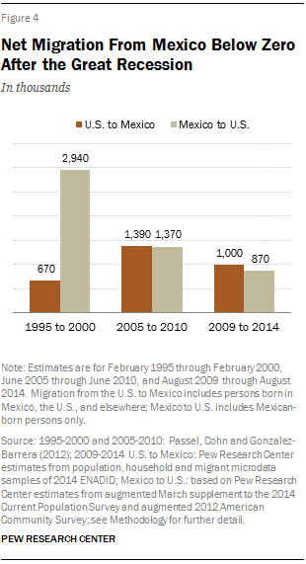
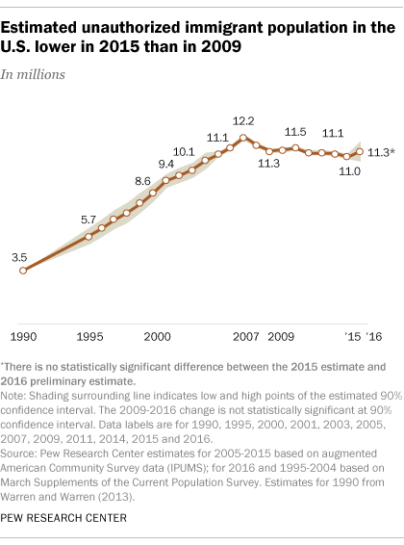
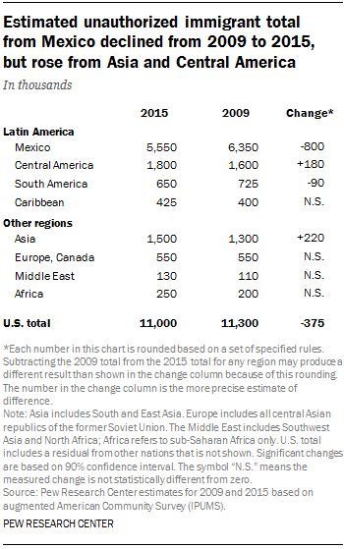
Unauthorized and Mexican Immigration, 2015
Notes:
Texas is estimated to be home to 1.65 million undocumented immigrants, making up about 6% of the total state population but nearly 9% of the state’s work force. The decreasing number of undocumented immigrants could have implications for the growth of the state, its labor force, and the racial make up of Texas immigrants.

Slide 16
States with the Oldest Median Ages, 2000, 2010, 2014
2000 |  |  | 2010 |  |  | 2014
Rank | State | Med Age | Rank | State | Median Age | Rank | State | Median Age
1 | West Virginia | 38.9 | 1 | Maine | 42.7 | 1 | Maine | 44.2
2 | Florida | 38.7 | 2 | Vermont | 41.5 | 2 | New Hampshire | 42.6
3 | Maine | 38.6 | 3 | West Virginia | 41.3 | 3 | Vermont | 42.6
4 | Pennsylvania | 38 | 4 | New Hampshire | 41.1 | 4 | West Virginia | 42.0
5… | Vermont | 37.7 | 5… | Florida | 40.7 | 5… | Florida | 41.8
…46 | California | 33.3 | …46 | California | 35.2 | …46 | Idaho | 35.7
47 | Idaho | 33.2 | 47 | Idaho | 34.6 | 47 | North Dakota | 34.9
48 | Alaska | 32.4 | 48 | Alaska | 33.8 | 48 | Texas | 34.2
49 | Texas | 32.3 | 49 | Texas | 33.6 | 49 | Alaska | 33.3
50 | Utah | 27.1 | 50 | Utah | 29.2 | 50 | Utah | 30.5
- | United States | 35.3 | - | United States | 37.2 | - | United States | 37.7
Source: US Census Bureau, 2000 and 2010 Decennial Censuses US Census Bureau, 2014 Population Estimate by State

Slide 17
Median Age, Texas Counties, 2012-2016
Source: U.S. Census Bureau, 2016 American Community Survey 5-Year Estimates

Slide 18
Percent of Population 65 Years Plus, Texas Counties, 2011-2015
Source: U.S. Census Bureau, 2015 American Community Survey 5-Year Estimates
30

Slide 19
Economic Indicators, Texas and U.S., 2016
 | Median Household Income | Change, 2015-2016
Texas | $56,565 | +
Asian | $82,081 | +
NH White | $70,131 | +
Hispanic | $44,579 | +
Black | $42,582 | +
Unemployment rate
  Texas = 5.6%
  U.S. = 5.8%
Median Household Income
  Texas = $56,565
  U.S. = $57,617
Median Family Income
  Texas = $67,025
  U.S. = 71,062
Median earnings for males working full time
  Texas = $47,351
  U.S. = $50,586
Median earnings for females working full time
  Texas = $37,576
  U.S. = $40,626
Poverty rate
  Texas = 15.6%
  U.S. = 14.0%
Source: U.S. Census Bureau, 2016 American Community Survey 1-Year Estimates

Slide 20
Economic Indicators, RGV Counties, 2016
 | Hidalgo | Cameron | Starr | Willacy
Unemployment Rate | 9.0% | 9.4% | 14.2% | 13.4%
Median Household Income | $36,094 | $34,578 | $26,682 | $28,817
Median Family Income | $39,087 | $38,551 | $29,341 | $30,612
Median Earnings, Male | $23,532 | $24,499 | $19,780 | $19,759
Median Earnings, Female | $17,077 | $18,289 | $12,772 | $17,923
Poverty Rate | 32.8% | 33.0% | 37.6% | 37.2%
Source: U.S. Census Bureau, American Community Survey, 5-Year Sample, 2012-2016

Slide 21
Educational Attainment, Texas and RGV Counties, 2016
 | Texas | Hidalgo | Cameron | Starr | Willacy
% with HS Diploma + | 82.3% | 63.3% | 65.6% | 48.5% | 63.1%
Hispanic | 63.2% | 59.5% | 61.0% | 48.2% | 58.5%
NH White | 93.2% | 91.8% | 92.0% | 64.6% | 89.6%
% with Bachelor’s + | 28.1% | 17.4% | 16.4% | 9.3% | 8.6%
Hispanic | 13.3% | 15.2% | 13.7% | 9.1% | 6.5%
NH White | 36.6% | 31.0% | 33.4% | 24.4% | 21.5%
Source: U.S. Census Bureau, American Community Survey, 5-Year Sample, 2012-2016
Notes:
Poverty among Hispanics is more than twice as high as that of NH Whites. Poverty among those with a BA is 1/6 of poverty among those with less than a high school education.

Slide 22
Trends in Educational Attainment of Persons in the Labor Force (25-64 Years of Age) in Texas by Race/Ethnicity – High School Graduates and Above
Source: U.S. Census Bureau, American Community Survey, Public Use Micro Sample, 2001-2011
Notes:
Educational attainment by race/ethnicity in Texas suggests that adults of Hispanic descent are much less likely to have completed high school compared to other race/ethnic groups. Over time, the percent of persons of Hispanic descent who have completed high school has been increasing more rapidly than for other groups but even at this pace of change it will take numerous decades for Hispanics to achieve parity with non-Hispanics in the percent with a high school degree or greater.

Slide 23
Trends in Latino Education in the U.S.
Over the past decade, Hispanic high school dropout rates have dropped.
College enrollment among Hispanics is increased.
There is still a large disparity between Hispanics and other groups in obtaining a bachelor’s degree.
Hispanic college students attend public 2-year schools at higher rates than other groups.
Hispanics are less likely than other groups to have student debt.
Nearly all Latino youths (89%) believe a college degree is important for getting ahead in life.
Source: Pew Research Center, 2016, 5 Facts about Latinos and Education and Between Two Worlds: How Young Latinos Come of Age in America, 2009

Slide 24
Projected Population Growth in Texas,
2010-2050
Source: Texas State Data Center, 2016 Preliminary Population Projections

Slide 25
Projected Racial and Ethnic Percent, Texas, 2010-2050
Source: Texas State Data Center 2012 Population Projections , 2000-2010 Migration Scenario
Notes:
The projected population of Texas by race/ethnicity suggests that the Hispanic population will be a major driver in the population growth of the state. The non-Hispanic white population will grow very slowly and then start to decline as the Baby-Boom generation ages into high mortality years. The non-Hispanic other group is largely composed of persons of Asian descent and this group is projected to exceed the non-Hispanic black population by 2038. This graph assumes migration patterns observed between 2000 and 2010.

Slide 26
Population Projections by Race/Ethnicity, 2010 to 2050, Region One Counties
 | Cameron | Hidalgo | Jim Hogg | Starr | Webb | Willacy | Zapata
2010
Total | 406,220 | 774,769 | 5,300 | 60,968 | 250,304 | 22,134 | 14,018
Anglo | 43,427 | 60,553 | 334 | 2,449 | 8,345 | 2,235 | 861
Black | 1,192 | 2,777 | 18 | 15 | 487 | 389 | 11
Hispanic | 357,747 | 702,206 | 4,907 | 58,337 | 239,653 | 19,297 | 13,084
Other | 3,854 | 9,233 | 41 | 167 | 1,819 | 213 | 62
2050
Total | 728,518 | 1,553,142 | 7,114 | 98,953 | 494,081 | 37,733 | 27,215
Anglo | 26,709 | 50,015 | 275 | 2,894 | 9,536 | 1,742 | 529
Black | 1,398 | 3,885 | 16 | 14 | 728 | 349 | 9
Hispanic | 691,109 | 1,475,202 | 6,787 | 95,845 | 481,102 | 35,379 | 26,608
Other | 9,302 | 24,040 | 36 | 200 | 2,715 | 263 | 69
Source: Texas State Data Center 2016 Population Projections, 0.5 Migration Scenario

Slide 27
Population Change, 2010-2050, Region One Counties
 | Numeric Change, 2010-2050 |  |  |  |  | Percent Change, 2010-2050
 | Total | NH White | Black | Hispanic | Other | Total | NH White | Black | Hispanic | Other
Hidalgo | 778,373 | -10,538 | 1,108 | 772,996 | 14,807 | 100.5% | -17.4% | 39.9% | 110.1% | 160.4%
Cameron | 322,298 | -16,718 | 206 | 333,362 | 5,448 | 79.3% | -38.5% | 17.3% | 93.2% | 141.4%
Webb | 243,777 | 1,191 | 241 | 241,449 | 896 | 97.4% | 14.3% | 49.5% | 100.7% | 49.3%
Starr | 37,985 | 445 | -1 | 37,508 | 33 | 62.3% | 18.2% | -6.7% | 64.3% | 19.8%
Willacy | 15,599 | -493 | -40 | 16,082 | 50 | 70.5% | -22.1% | -10.3% | 83.3% | 23.5%
Jim Hogg | 1,814 | -59 | -2 | 1,880 | -5 | 34.2% | -17.7% | -11.1% | 38.3% | -12.2%
Source: Texas State Data Center 2016 Population Projections, 0.5 Migration Scenario

Slide 28
Demographic Overview
Texas is experiencing significant growth.
Population growth is not geographically evenly distributed.
Texas continues to racially/ethnically diversify.
The population of Texas, while relatively young, is also aging.
The components of population change have varying implications for infrastructure in Texas.
A young and growing workforce could be a competitive edge for Texas and its growing metro areas.
Demographic shifts may have serious implications for maintaining inclusive and equitable economic growth in the state.

Slide 29
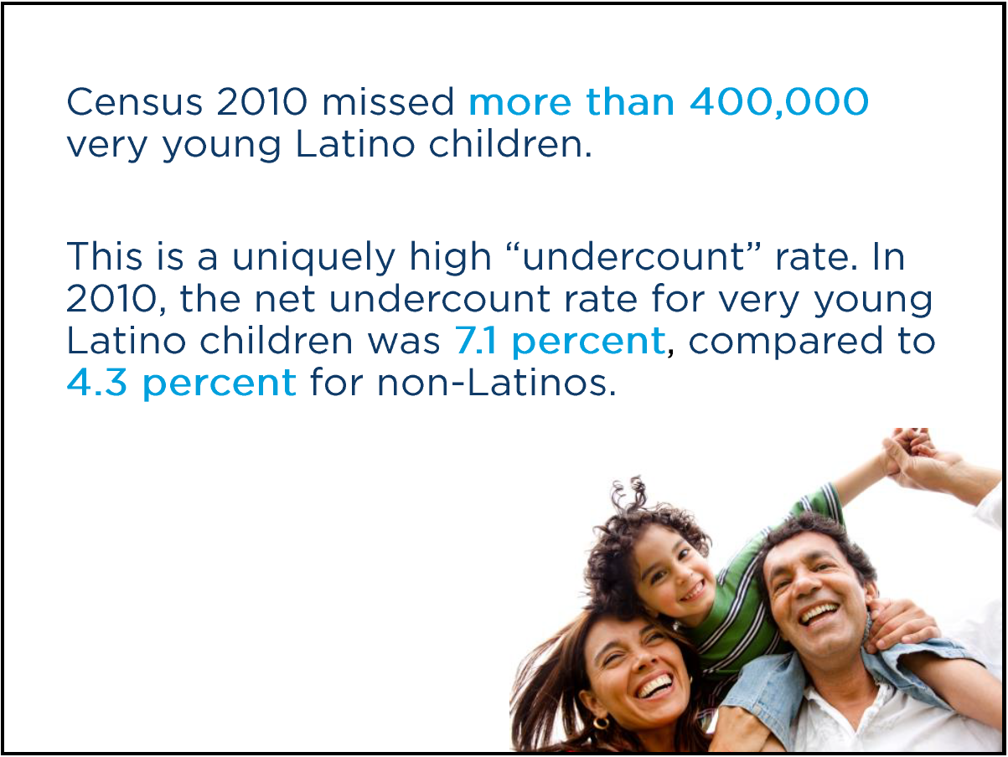

Slide 30

May 23-24, 2018
Austin, TX
Registration open now.

Slide 31


  Office: (512) 936-3542
  Lila.Valencia@utsa.edu
  demographics.texas.gov
Lila Valencia, Ph.D.
@TexasDemography
Notes:
The Office of the State Demographer and the Texas State Data Center are committed to supporting your work through providing you with the best, most accurate, and objective information we can identify about our greatest asset, the people of Texas.

