Slide 1

Demographic Trends, Characteristics, and Projections for Texas and the DFW Metro
Leadership North Texas
Dallas, TX
January 18, 2019
@TexasDemography

Slide 2
Demographic Overview
Texas is experiencing significant growth.
Migration is the primary source of growth for metropolitan areas in Texas.
For the second year in a row, the Dallas-Fort Worth-Arlington metro area added more people between 2016 and 2017 than any other metro in the country.
About 60% of population change in the DFW metro area can be attributed to net migration.
Internally, the DFW metro has significant population reallocation, impacting the principal core counties of Dallas and Tarrant in very different ways.
International migration plays a key role in population growth in the DFW metro area.
A young and growing workforce could be a competitive edge for Texas and its growing metro areas.
Demographic shifts may have serious implications for maintaining inclusive and equitable economic growth in the state.

Slide 3
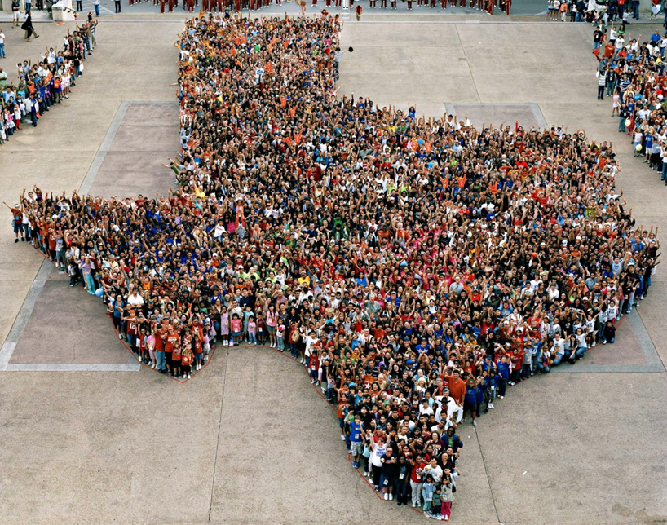
Texas is experiencing significant growth.

Slide 4
Population Growth of Select States, 2000-2018
 | 2000 Population | 2010 Population | 2018 Population | Numeric Change 2010-2018 | Percent Change 2010-2018
United States | 281,421,906 | 308,745,538 | 327,167,434 | 18,409,329 | 6%
Texas | 20,851,820 | 25,145,561 | 28,701,845 | 3,555,731 | 14%
California | 33,871,648 | 37,253,956 | 39,557,045 | 2,302,522 | 6%
Florida | 15,982,378 | 18,801,310 | 21,299,325 | 2,494,745 | 13%
Georgia | 8,186,453 | 9,687,653 | 10,519,475 | 830,766 | 9%
North Carolina | 8,049,313 | 9,535,483 | 10,383,620 | 847,884 | 9%
Washington | 5,894,121 | 6,724,540 | 7,535,591 | 811,051 | 12%
Arizona | 5,130,632 | 6,392,017 | 7,171,646 | 779,358 | 12%
Colorado | 5,029,196 | 5,029,196 | 5,695,564 | 666,248 | 13%
Source: U.S. Census Bureau. 2000 and 2010 Census Count, 2018 Population Estimates.
Notes:
Texas is the second largest state in terms of population (2nd to CA) and area (2nd to AK). In terms of number of people, Texas’ growth exceeds that of all other states between 2010 and 2018.

Slide 5
Texas added 379,128 people between July 1, 2017 and July 1, 2018.
About 1,039 people per day added to our population.
  About 524 persons per day from natural increase (more births than deaths)
  About 515 per day from net migration (288 international and 227 domestic migrants per day).
Source: U.S. Census Bureau, 2018 Population Estimates.

Slide 6

Total Estimated Population by County, Texas, 2017
Source: U.S. Census Bureau, 2017 Vintage Population Estimates
Notes:
When we look at the geographic distribution of the population of Texas over time we see continually increasing population in the counties along the I-35 corridor, the Houston area, and the lower Rio Grand Valley. Urbanized areas out west have grown but most counties in the west have experienced limited growth and some population decline. Approximately 86% of the population is along I-35 and east. This area with the 3 major metropolitan areas at the points is often described as the Texas population triangle.

Slide 7
Estimated Population Change, Texas Counties,
2010 to 2017
91 counties lost population over the 7 year period.
Source: U.S. Census Bureau, 2016 Vintage Population Estimates
Notes:
Population change over the decade has been greatest in the urban and suburban population triangle counties. Counties in the lower Rio Grande Valley also had significant growth as did El Paso. Overall, 163 counties gained population while 91 (36%) lost population over the decade.

Slide 8
Estimated Percent Change of the Total Population by County, Texas, 2010 to 2017
Source: U.S. Census Bureau, 2017 Vintage Population Estimates
Notes:
Percent change is an indicator of the speed of population change void of information about the volume of population change. Percent change in the population over the past few years has been greatest in the suburban population triangle counties, notably among counties between San Antonio and Austin. In the early part of the decade, counties in the Eagle Ford Shale area (south east of San Antonio) had been growing quickly. This is less so the case today. The Cline Shale area (Midland and Odessa area) continues to grow and in some cases even growing faster than the State.

Slide 9
Components of Population Change
by Percent in Texas, 1950-2010
Source: U.S. Census Bureau, Population Estimates
Notes:
It is important to understand a couple of very basic element of population change to think about how growing population may impact our state infrastructure and demand for services. Population changes from two factors, one is natural increase which is simply births minus deaths over time. Essentially population added from natural increase are babies who are usually added to an already existing household. They won’t be attending school for at least the next 4 years and they won’t be driving their own vehicle on our roads for another 16 years. So the effect of population growth from natural increase on our state infrastructure is both lightening, from people dying, and somewhat lagged, until babies start attending school and driving on our roads.
The second way population changes is from net-migration, which is simply in-minus out migrants. In Texas, the balance has been for us to have more in than out migrants. Migrants, are usually adults who are looking for a place to live, adding a vehicle to the road, and for those with children enrolling in our schools. Essentially, migrants make a more immediate demand for goods and services and instantly contribute to adding stress to our state’s infrastructure.
When we look at population change in Texas, from 1950 to present we can see that before 1970, most of our growth was from natural increase. Starting in the 1970s a much larger percent of our growth is attributed to net migration and this continues to today where nearly half of our population change is from migration.

Slide 10
Estimates of Percent Components of Population Change, Texas, 2011-2018
Source: U.S. Census Bureau, 2018 Vintage population estimates
Notes:
Natural increase has been in the range of half of population change since the last Census in Texas. Thus Texas is growing quickly and substantially from having more births than deaths over time. In recent years the number and percent of new Texans from other states has declined and the number and percent of international migrants has increased.

Slide 11
Top Counties for Numeric Growth in Texas,
2016-2017
County | U.S. Rank Population Change | Population Change | Percent of Change from Natural Increase | Percent Change from Domestic Migration | Percent Change from International Migration
Harris* | 4 | 35,939 | 128.8% | -126.0% | 97.2%
Tarrant | 5 | 32,729 | 47.9% | 29.0% | 23.1%
Bexar | 7 | 30,831 | 47.8% | 33.4% | 18.8%
Dallas | 8 | 30,686 | 78.0% | -25.5% | 47.6%
Denton | 9 | 27,911 | 23.3% | 67.0% | 9.7%
Collin | 10 | 27,150 | 24.4% | 56.5% | 19.0%
Fort Bend | 14 | 22,870 | 29.4% | 48.1% | 22.6%
Travis | 15 | 22,116 | 47.9% | 22.1% | 30.0%
Williamson | 19 | 19,776 | 20.1% | 73.5% | 6.3%
Montgomery | 28 | 16,412 | 22.7% | 68.5% | 8.8%
Hidalgo* | 49 | 10,474 | 105.9% | -34.5% | 28.5%
*Hidalgo and Harris Counties had negative net migration (Harris -10,322 and Hidalgo -621).
Source: U.S. Census Bureau, 2017 Vintage Population Estimates
Notes:
Nearly a quarter of the top counties adding the most population between 2016 and 2017 are Texas counties. Four of the top 10 were in the Dallas Fort Worth metro area.

Slide 12
Top Counties for Percent Growth* in Texas,
2016-2017
County | U.S. Rank | 2016-2017 Percent Population Change | Percent Change from Domestic Migration | Percent Change from International Migration
Comal | 2 | 5.1% | 90.7% | 1.9%
Hays | 4 | 5.0% | 81.6% | 2.8%
Kendall | 5 | 4.9% | 96.3% | 3.3%
Kaufman | 11 | 4.1% | 83.0% | 2.2%
Rains | 13 | 4.0% | 103.1% | 2.9%
Williamson | 16 | 3.7% | 73.5% | 6.3%
Rockwall | 22 | 3.6% | 81.8% | 2.4%
Parker | 26 | 3.6% | 89.7% | 1.3%
Denton | 32 | 3.5% | 67.0% | 9.7%
Guadalupe | 36 | 3.3% | 81.4% | 2.7%
Ellis | 44 | 3.1% | 78.2% | 3.0%
Llano | 45 | 3.1% | 119.8% | 0.5%
Fort Bend | 48 | 3.1% | 48.1% | 22.6%
*Among Counties with 10,000 or more population in 2017
Source: U.S. Census Bureau, 2017 Vintage Population Estimates
Notes:
More than 1 in four of the top 50 fastest growing counties between 2016 and 2017 are Texas counties.

Slide 13
Largest U.S. Cities, 2017
Rank | Place | Census 2010 | 2011 | 2012 | 2013 | 2014 | 2015 | 2016 | 2017
1 | New York, NY | 8,175,133 | 8,292,688 | 8,383,504 | 8,458,642 | 8,521,135 | 8,582,459 | 8,615,426 | 8,622,698
2 | Los Angeles, CA | 3,792,621 | 3,824,592 | 3,859,267 | 3,891,783 | 3,922,668 | 3,953,459 | 3,981,116 | 3,999,759
3 | Chicago, IL | 2,695,598 | 2,706,670 | 2,717,989 | 2,724,482 | 2,726,533 | 2,725,154 | 2,720,275 | 2,716,450
4 | Houston, TX | 2,099,451 | 2,125,450 | 2,159,824 | 2,198,244 | 2,238,795 | 2,282,235 | 2,304,482 | 2,312,717
5 | Phoenix, AZ | 1,445,632 | 1,467,519 | 1,495,880 | 1,521,182 | 1,547,729 | 1,575,039 | 1,602,042 | 1,626,078
6 | Philadelphia, PA | 1,526,006 | 1,539,649 | 1,551,944 | 1,558,109 | 1,564,042 | 1,570,507 | 1,574,765 | 1,580,863
7 | San Antonio, TX | 1,327,407 | 1,357,900 | 1,383,505 | 1,408,910 | 1,435,554 | 1,464,147 | 1,487,738 | 1,511,946
8 | San Diego, CA | 1,307,402 | 1,320,638 | 1,338,975 | 1,358,207 | 1,379,123 | 1,391,040 | 1,406,682 | 1,419,516
9 | Dallas, TX | 1,197,816 | 1,218,631 | 1,242,035 | 1,258,932 | 1,278,504 | 1,299,793 | 1,322,140 | 1,341,075
10 | San Jose, CA | 945,942 | 971,352 | 985,722 | 1,003,735 | 1,016,708 | 1,027,560 | 1,031,942 | 1,035,317
11 | Austin, TX | 790,390 | 828,700 | 854,350 | 874,910 | 900,621 | 919,974 | 938,200 | 950,715
Source: U.S. Census Bureau, 2017 Vintage Population Estimates

Slide 14
15 Fastest-Growing Large Cities and Towns Between July 1, 2016, and July 1, 2017 (Populations of 50,000 or more in 2016)
Rank | City | State | Percent increase | 2017 total population
1 | Frisco | TX | 8.2 | 177,286
2 | New Braunfels | TX | 8.0 | 79,152
3 | Pflugerville | TX | 6.5 | 63,359
4 | Ankeny | IA | 6.4 | 62,416
5 | Buckeye | AZ | 5.9 | 68,453
6 | Georgetown | TX | 5.4 | 70,685
7 | Castle Rock town | CO | 5.1 | 62,276
8 | Franklin | TN | 4.9 | 78,321
9 | McKinney | TX | 4.8 | 181,330
10 | Meridian | ID | 4.7 | 99,926
11 | Flower Mound town | TX | 4.3 | 76,681
12 | Bend | OR | 4.3 | 94,520
13 | Cedar Park | TX | 4.2 | 75,704
14 | Doral | FL | 4.2 | 61,130
15 | Fort Myers | FL | 4.2 | 79,94
Source: U.S. Census Bureau, 2017 Vintage Population Estimates
Notes:
Nearly half of the top 15 fastest growing cities between 2016 and 2017 are in Texas. The fastest growing city in the country is located in the Dallas Fort Worth metro area.

Slide 15
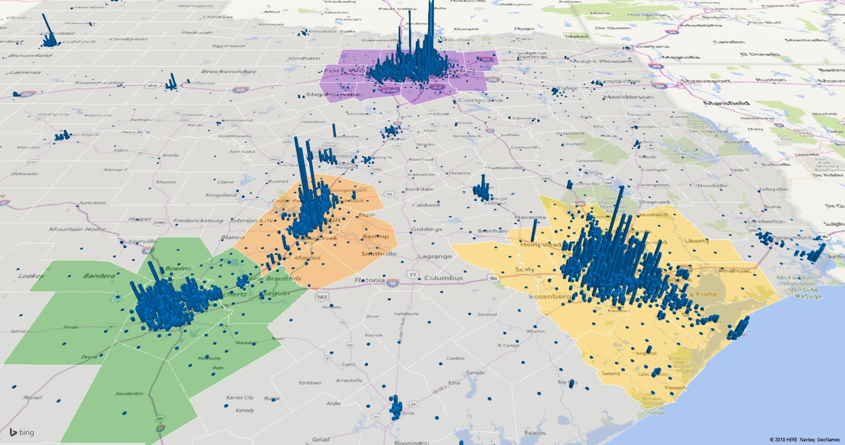
Increases in Population Density, Census Tracts, Texas Population Triangle, 2011-2016
Source: U.S. Census Bureau, American Community Survey, 2007-2011 and 2012-2016 5-Year Estimates

Slide 16
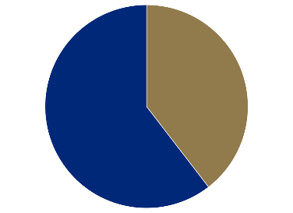
Population Growth and Components of Change for the DFW Metro Area, 2017
Source: U.S. Census Bureau, 2017 Population Estimates

Slide 17
Estimated Percent of Total Net-Migrant Flows to and From Texas and Other States, 2016
Source: U.S. Census Bureau, 2018. ACS Migration Flows, 2016

Slide 18


Domestic and Internal Migration Flows to and from the DFW Metro
Highest Sending
States:
California
Oklahoma
Florida
Louisiana
Illinois
Highest Receiving
States:
Oklahoma
California
Florida
Colorado
Louisiana
Source: U.S. Census Bureau, 2016. ACS County to County Migration Flows, 2010-2014

Slide 19
County to County Migration Flows, Dallas and Tarrant Counties, 2010-2014
Dallas County
Tarrant County
 | In-Flows | Net Migration
Tarrant County | 14,501 | -5,333
Collin County | 13,637 | -1,803
Denton County | 9,576 | -8,105
Harris County | 3,771 | -1,013
Ellis County | 2,746 | -1,201
Kaufman County | 2,436 | -1,829
Travis County | 2,186 | -1,226
Bexar County | 2,070 | 113
 | In-Flows | Net Migration
Dallas County | 19,834 | 5,333
Denton County | 5,752 | -1,780
Harris County | 3,403 | 1,279
Johnson County | 3,208 | -528
Parker County | 2,620 | -45
Collin County | 2,612 | -191
Brazos County | 465 | -1,192

Slide 20

Texas continues to diversify.

Slide 21
Texas Racial and Ethnic Composition,
2000, 2010, and 2017
11
Source: U.S. Census Bureau. 2000, 2010 Decennial Census and 2017 Population Estimates
Notes:
As of the 2000 Census, about 53% of Texas’ population was non-Hispanic Anglo, about 32% where of Hispanic descent, about 11% where non-Hispanic African American, and about 4% were non-Hispanic Other.
In 2010, it is estimated that about 45% of the Texas population was non-Hispanic Anglo, 38% of Hispanic descent, 11% were non-Hispanic African American, and about 6% were non-Hispanic Other (largely of Asian descent). In 2017, Texas continues to diversify with increases in proportion of population identifying as Hispanic and NH Asian and a decrease in the proportion identifying as White, NH.

Slide 22
Race/Ethnicity Composition, Dallas Metro Area and DFW Counties, 2017
Dallas-Fort Worth-Arlington Metro Area
 | Hispanic | NH White | NH Black | NH Asian | NH Two or More Races
Collin | 15.3% | 57.3% | 9.7% | 14.9% | 2.3%
Dallas | 40.2% | 29.2% | 22.5% | 6.3% | 1.4%
Delta | 7.6% | 81.0% | 6.2% | 0.7% | 2.7%
Denton | 19.4% | 59.3% | 9.8% | 8.9% | 2.1%
Ellis | 26.3% | 60.8% | 10.3% | 0.7% | 1.4%
Hunt | 16.4% | 71.7% | 7.9% | 1.4% | 1.7%
Johnson | 21.3% | 72.2% | 3.2% | 0.8% | 1.6%
Kaufman | 21.4% | 64.1% | 11.1% | 1.2% | 1.6%
Parker | 12.2% | 83.6% | 1.4% | 0.6% | 1.5%
Rockwall | 17.7% | 71.2% | 6.2% | 2.7% | 1.7%
Tarrant | 28.9% | 46.8% | 16.3% | 5.5% | 1.9%
Wise | 19.5% | 76.5% | 1.4% | 0.5% | 1.4%
Source: U.S. Census Bureau, 2017 American Community Survey 1-Year Estimates
Source: U.S. Census Bureau, 2017 Population Estimates

Slide 23
Numeric and Percent Change by Race/Ethnicity, 2010 to 2016
 |  | Total | NH White | NH Black | Hispanic | NH Asian | NH Other
Dallas County | NumChg | 206,845 | -20,159 | 60,442 | 120,316 | 38,678 | 7,568
 | PerChg | 8.73% | -2.56% | 11.61% | 13.28% | 32.39% | 21.62%
Tarrant County | NumChg | 207,838 | 25,809 | 58,268 | 90,228 | 23,467 | 10,066
 | PerChg | 11.49% | 2.75% | 22.10% | 18.68% | 27.88% | 25.89%
Collin County | NumChg | 157,244 | 55,202 | 24,560 | 26,855 | 43,954 | 6,673
 | PerChg | 20.10% | 11.16% | 37.71% | 23.28% | 49.78% | 35.48%
Denton County | NumChg | 143,566 | 57,762 | 22,422 | 33,964 | 24,126 | 5,292
 | PerChg | 21.67% | 13.50% | 41.23% | 28.11% | 55.17% | 33.75%
Johnson County | NumChg | 12,340 | 3,716 | 1,035 | 6,384 | 310 | 895
 | PerChg | 8.18% | 3.21% | 27.04% | 23.37% | 32.16% | 29.11%
Source: U.S. Census Bureau, 2016 Population Estimates

Slide 24
Annual Shares of Recent Non-Citizen Immigrants to Texas by World Area of Birth, 2005-2015
Estimated number of international migrants to Texas
101,588
77,702
98,194
Source: U.S. Census Bureau, American Community Survey, 1-Year PUMS

Slide 25
Population Pyramid for White Non-Hispanics in Texas, 2017
Source: U.S. Census Bureau, 2017 Population Estimates
Notes:
The age distribution of the non-Hispanic white population in Texas is weighted heavily with the “baby boom” generation. Largely the result of lower fertility and less net in-migration, the non-Hispanic white population has relatively fewer young persons relative to those in the middle-age years. In 2010, at ages 37 and younger, the Hispanic population exceeds the non-Hispanic white population. In 2017, median age of NH White women is 43.5 years of age, compared to 29.3 years of age for Hispanic women.

Slide 26
Population Pyramid for Hispanics in Texas, 2017
Source: U.S. Census Bureau, 2017 Population Estimates

Slide 27
Texas Population Pyramid by Race/Ethnicity, 2017
Source: U.S. Census Bureau, 2017 Population Estimates
Notes:
This population pyramid represents the age, sex, race and ethnic composition of the Texas population. Blue represents males, red females, rows are single years of age, and shades represent specified race/ethnic groups as indicated in the legend.

Slide 28

Texas economic indicators

Slide 29
Economic Indicators, Texas and U.S., 2017
 | Median Household Income | Change, 2016-2017
Texas | $59,206 | +
Asian | $84,100 | +
NH White | $72,361 | +
Hispanic | $46,855 | +
Black | $45,092 | +
Unemployment rate
  Texas = 5.1%
  U.S. = 5.3%
Median Household Income
  Texas = $59,206
  U.S. = $60,336
Median Family Income
  Texas = $70,136
  U.S. = $73,891
Poverty rate
  Texas = 14.7%
  U.S. = 13.4%
Source: U.S. Census Bureau, 2017 American Community Survey 1-Year Estimates

Slide 30
Gender Pay Gap, Texas and Big Four Metros, 2017
 | Median Earnings, Male | Median Earnings, Female | Pay Gap
Texas | $49,414 | $40,236 | .81
Austin Metro | $55,162 | $47,075 | .85
DFW Metro | $51,498 | $44,207 | .86
Houston Metro | $51,634 | $42,274 | .82
San Antonio Metro | $43,515 | $37,535 | .86
 | Pay Gap for Hispanic Women
Texas | .60
Austin Metro | .64
DFW Metro | .59
Houston Metro | .56
San Antonio Metro | .74
Source: U.S. Census Bureau, 2017 American Community Survey 1-Year Estimates

Slide 31
Educational Attainment by Race/Ethnicity,
Texas and Big Four Metro Areas, 2017
High School Degree and above
Educational attainment in the Dallas metro is higher or similar to that of the state with the exception of Hispanic educational attainment, where it is lower.
Bachelor’s Degree and above
Source: U.S. Census Bureau, 2017 American Community Survey 1-Year Estimates

Slide 32
Percent Population 25 Years and Older with BA Degree and Above, DFW Metro Area Census Tracts, 2012-2016
Source: U.S. Census Bureau, 2016 ACS 5-Year Estimates

Slide 33
Median Household Income by Race/Ethnicity,
Texas and Big Four Metro Areas, 2017
Median household incomes in the Dallas metro tend to be higher than the state for all race/ethnic groups, but especially for Asians.
Source: U.S. Census Bureau, 2017 American Community Survey 1-Year Estimates

Slide 34
Median Household Income, DFW Metro Area Census Tracts, 2012-2016
Source: U.S. Census Bureau, 2016 ACS 5-Year Estimates

Slide 35
Unemployment and Poverty Rates by Race/Ethnicity,
Texas and Big Four Metro Areas, 2017
The unemployment and poverty rates in the Dallas metro tend to be lower than the state rates for all race/ethnicity groups.
Poverty Rate
Unemployment Rate
Source: U.S. Census Bureau, 2017 American Community Survey 1-Year Estimates

Slide 36
Percent Population Below Poverty Level,
DFW Metro Area Census Tracts, 2012-2016
Source: U.S. Census Bureau, 2016 ACS 5-Year Estimates

Slide 37
Housing Affordability in Select Texas Metros,
2007-2017
Notes: Data are through fourth quarter 2017. The Housing Opportunity Index represents the share of homes sold in a given area that
Would have been affordable to a family earning the local median income.
Source: National Association of Home Builders/Wells Fargo.
Notes:
Housing affordability—the share of homes sold that were affordable to a median-income family in the area—has fallen in most major Texas metros. Additionally, apartment demand and occupancy rates generally remain high.

Slide 38
Percent of Housing Units Built before 1960 and after 2000, DFW Metro, 2012-2016
Source: U.S. Census Bureau, 2016 ACS 5-Year Estimates

Slide 39

Population Projections

Slide 40
Projected Population, 2010-2050, Texas

Slide 41
Projected Population by Race and Ethnicity,
Texas 2010-2050
Source: Texas Demographic Center 2018 Population Projections
Notes:
Population projections by race and ethnicity suggest that Latino’s are and will increasingly be the largest race/ethnic group. The number and percent who are non-Hispanic white are likely to decline. Non-Hispanic other are largely of Asian descent and they appear to be increasing rapidly, although the base number is small.

Slide 42
Population Projections, DFW Metro Largest Counties, 2010-2050
Source: Texas Demographic Center, 2018 Population Projections

Slide 43
Population Projections, DFW Metro Smaller Counties, 2010-2050
Source: Texas Demographic Center, 2018 Population Projections

Slide 44
 |  | NH White | NH Black | Hispanic | NH Asian | NH Other
Collin | 2010 | 63.1% | 8.3% | 14.7% | 11.2% | 2.7%
 | 2030 | 47.6% | 12.0% | 16.6% | 19.9% | 3.9%
Dallas | 2010 | 33.1% | 21.9% | 38.3% | 5.0% | 1.7%
 | 2030 | 24.3% | 23.0% | 40.9% | 9.3% | 2.5%
Delta | 2010 | 83.2% | 7.2% | 5.5% | 0.6% | 3.6%
 | 2030 | 76.5% | 9.2% | 9.2% | 0.6% | 4.6%
Denton | 2010 | 64.4% | 8.2% | 18.2% | 6.5% | 2.7%
 | 2030 | 48.3% | 14.6% | 20.9% | 12.9% | 3.3%
Ellis | 2010 | 65.5% | 8.8% | 23.5% | 0.5% | 1.7%
 | 2030 | 54.4% | 11.6% | 31.1% | 0.5% | 2.5%
Hunt | 2010 | 74.8% | 8.1% | 13.6% | 1.0% | 2.5%
 | 2030 | 62.9% | 9.2% | 20.7% | 5.0% | 2.2%
Johnson | 2010 | 76.6% | 2.5% | 18.1% | 0.6% | 2.2%
 | 2030 | 64.1% | 4.2% | 27.4% | 0.7% | 3.6%
Kaufman | 2010 | 70.0% | 10.2% | 17.0% | 0.8% | 2.0%
 | 2030 | 56.4% | 10.7% | 29.6% | 0.8% | 2.5%
Parker | 2010 | 85.3% | 1.6% | 10.6% | 0.5% | 2.0%
 | 2030 | 79.2% | 1.4% | 16.1% | 0.5% | 2.8%
Rockwall | 2010 | 74.1% | 5.6% | 15.9% | 2.4% | 2.0%
 | 2030 | 65.8% | 6.7% | 21.1% | 4.1% | 2.3%
Tarrant | 2010 | 51.8% | 14.5% | 26.7% | 4.6% | 2.4%
 | 2030 | 39.8% | 18.1% | 31.4% | 7.5% | 3.3%
Wise | 2010 | 79.7% | 1.0% | 17.1% | 0.4% | 1.8%
 | 2030 | 72.3% | 1.1% | 23.8% | 0.5% | 2.4%

Slide 45
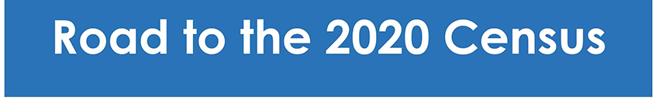
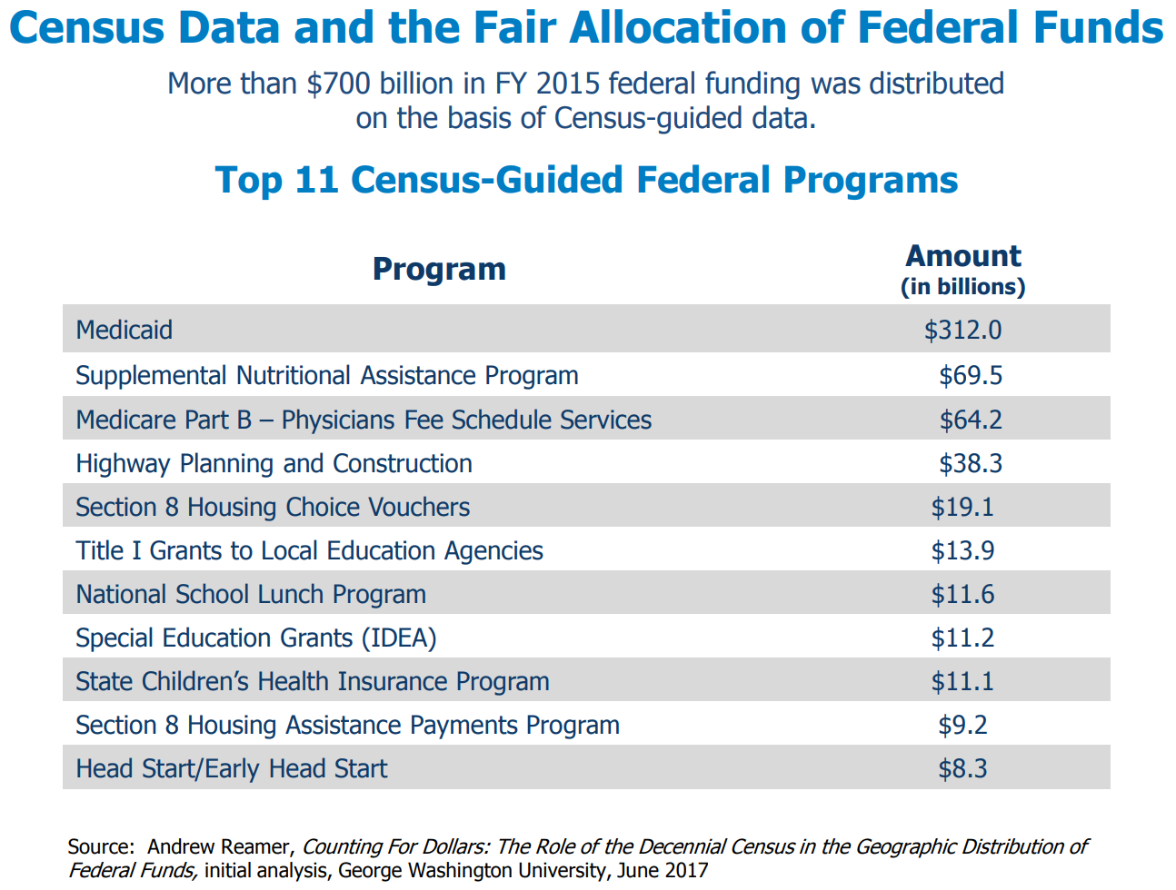

Slide 46
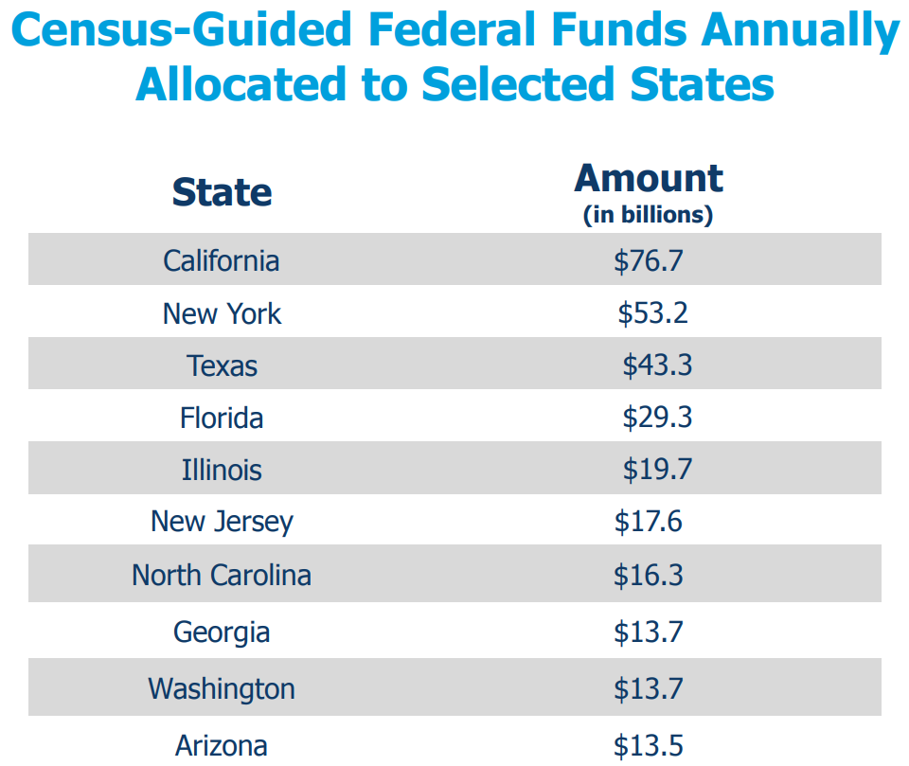

Slide 47
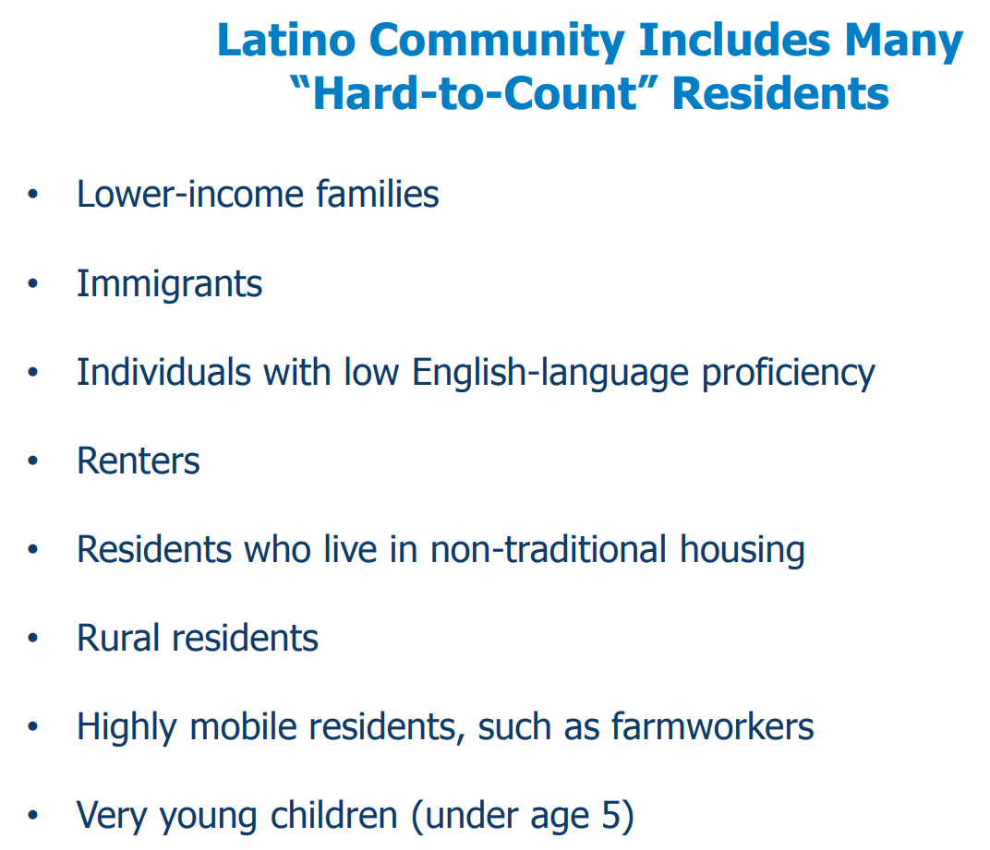

Slide 48
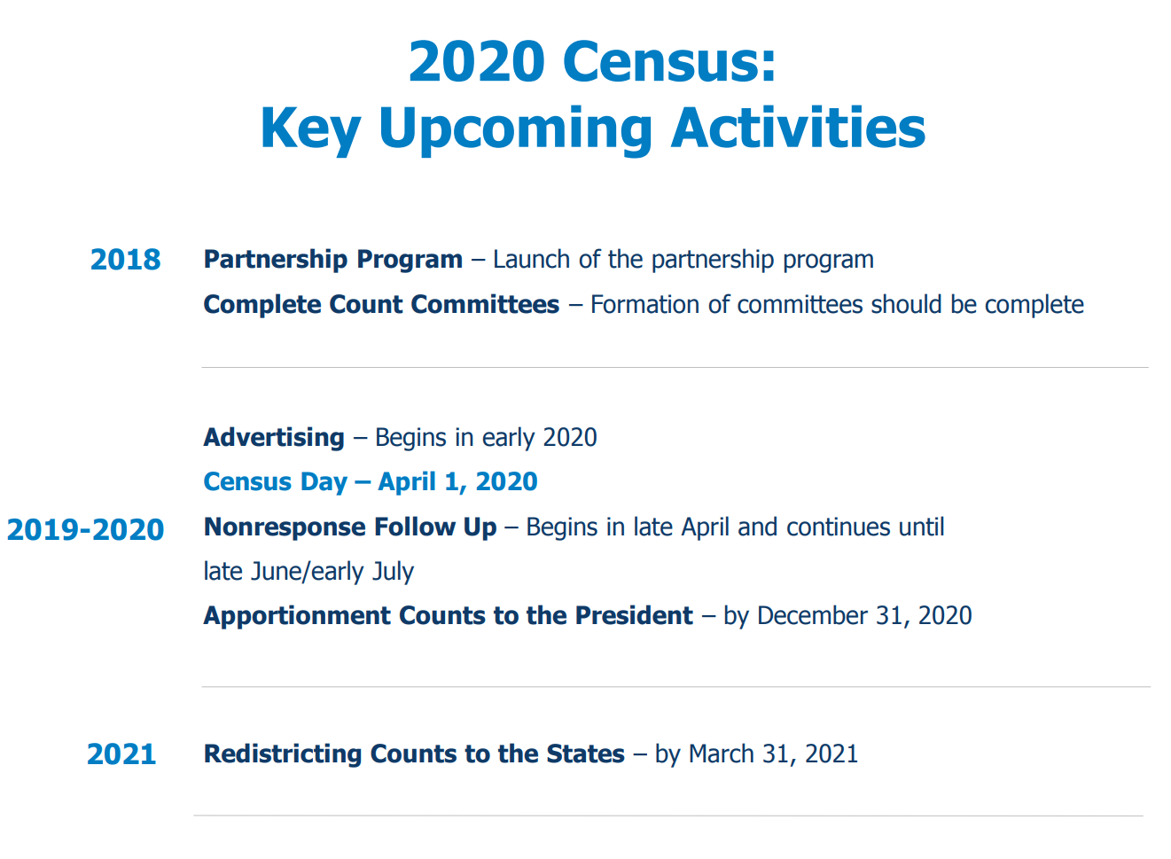

Slide 49


  Office: (512) 936-3542
  Lila.Valencia@utsa.edu
  demographics.texas.gov
Lila Valencia, Ph.D.
@TexasDemography
Notes:
The Office of the State Demographer and the Texas State Data Center are committed to supporting your work through providing you with the best, most accurate, and objective information we can identify about our greatest asset, the people of Texas.

