Slide 1
Rural Texas
Jennifer Zanoni
Geography Division
U.S. Census Bureau
Texas State Data Center Annual Meeting
Austin, Texas
May 23, 2018

Slide 2
Agenda
Census Geography
Urban/Rural Definitions
County-based Demographics
2020 Census
Questions
Notes:
We’ll start this presentation with two observations:
The history of urban and rural classifications since the late-19th century has been one of response to improvements in spatial resolution of data, increased amounts and variety of data, and improved technology. We’ll provide a few examples in this presentation.
Applying more data at lower levels of geography more frequently does not necessarily produce a better definition of rural or urban. We can now measure and define the urban landscape with greater precision than ever before. But, to what avail? We now quibble over small differences in measurements, or over whether the boundary line runs down the middle of a road or along one side or the other. We can now calculate block-level densities and measure changing commuting patterns at the tract-level on an annual basis, but we would ask: does that give us a better definition? Do we really need to do so?

Slide 3
Notes:
Standard Census Bureau geographic hierarchy. The geographic areas along the central axis all nest within the entities higher on the axis. For example, blocks nest or “add up to” block groups, which in turn nest within tracts. Put another way, tracts will never cross county boundaries; counties never cross state boundaries. Entities to either side of the central axis will nest within some of the entities on the central axis, but can cross boundaries of others. For example, places will never cross state boundaries (Texarkana, TX and Texarkana, AR are two separate cities), but can cross county, tract, and block group boundaries. Urban areas can cross boundaries of all other census geographic areas except the nation.

Slide 4
1950: urbanized areas of 50,000+ adopted.
2000: urban clusters of 2,500-49,999 adopted.
Notes:
Over the course of over 200 years, the United States has changed from a predominantly rural to a predominantly urban nation (recognizing, of course, that the way in which one defines urban and rural affects the speed and magnitude of the shift).
As we look at the changing percentage of population that is urban over time, we can see three distinct eras: 1) a period (1790 to 1840) in which the population was predominantly rural and the percentage that was urban increased slowly; 2) a period (1840 to 1970) in which the percentage that is urban increased steadily as the nation industrialized, the nature of our economy changed, agriculture mechanized, and cities and suburbs grew; and 3) a period (1970 to present) in which the population is predominantly urban, with the percentage urban continuing to increase, but at a slower rate.
In the first era, when rural was the norm, cities– or perhaps more appropriately, densely settled populations– were more closely interconnected with the surrounding rural areas, and “urban” was perhaps more difficult to define. In the second era, as the industrial economy grows and cities expand both out and up, “urban” and “rural” became very distinct and easier to separate. We defined “urban” because it occupied the smaller footprint and required less time, but there was a clear distinction between urban and rural. In the third era, urban is the norm, less densely settled areas are closely connected to urban life, with the result that rural is now harder to define.

Slide 5
Census Bureau designated Urban Areas
Delineated decennially
Two types of urban areas:
Urbanized Areas (UAs) of 50,000 or more people
Urban Clusters (UCs) of at least 2,500 and less than 50,000 people

Slide 6
Urban and Rural Population in the United States: 2010 and 2000
 | 2000 Population | 2000 Percent | 2010 Population | 2010 Percent
Urban | 222,360,539 | 79.0 | 249,253,271 | 80.7
Urbanized Area | 192,323,824 | 68.3 | 219,922,123 | 71.2
Urban Cluster | 30,036,715 | 10.7 | 29,331,148 | 9.5
Rural | 59,061,367 | 21.0 | 59,492,267 | 19.3
Notes:
Percentage of population in urban and rural areas, 2000 and 2010. As a nation, we are becoming more urban. It is important, though, that the rural population increased from 2000 to 2010, but fell as a percentage of the total population.

Slide 7
Urban/Rural Population: Texas
Percent Rural
2000: 17.5%
2010: 15.3%

Slide 8
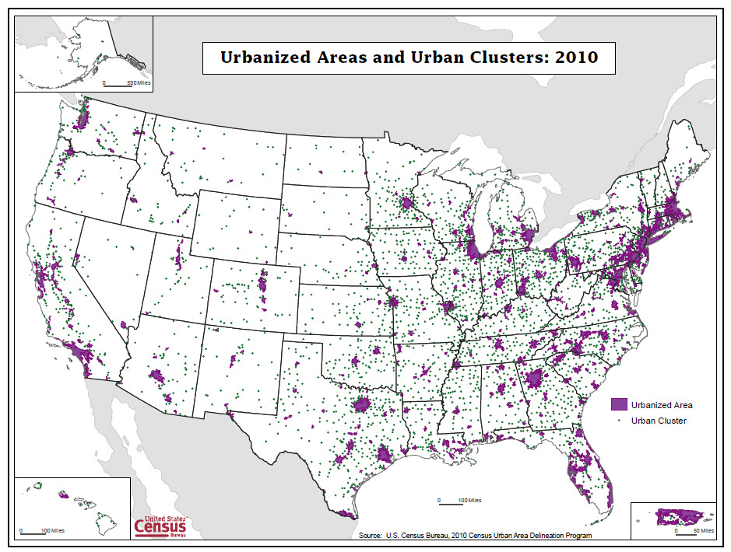

Slide 9
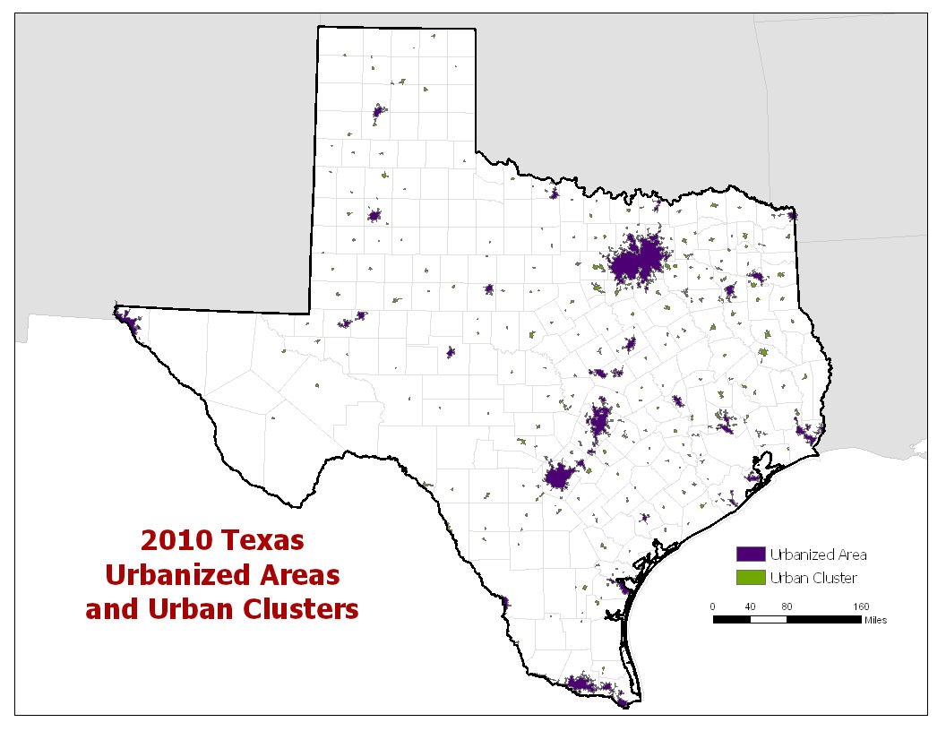

Slide 10
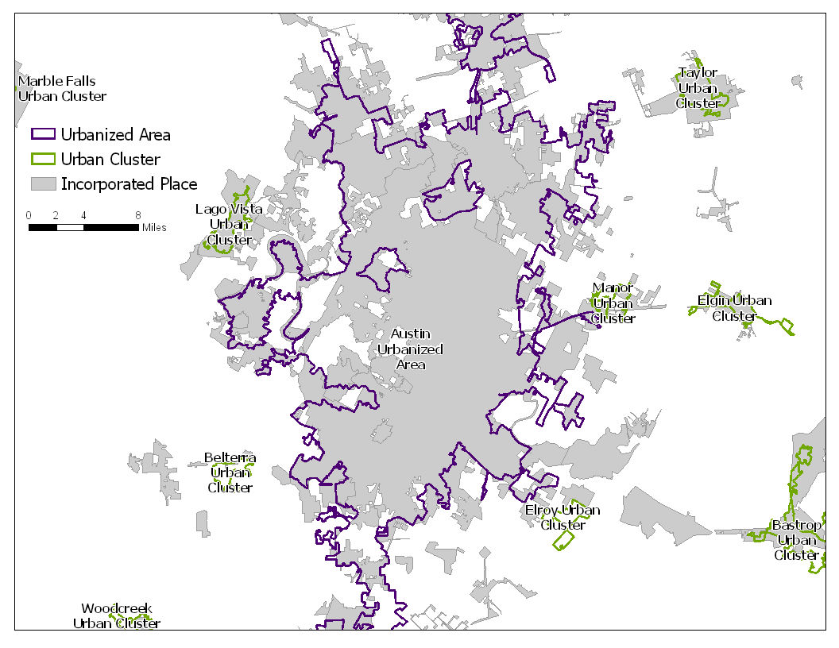

Slide 11
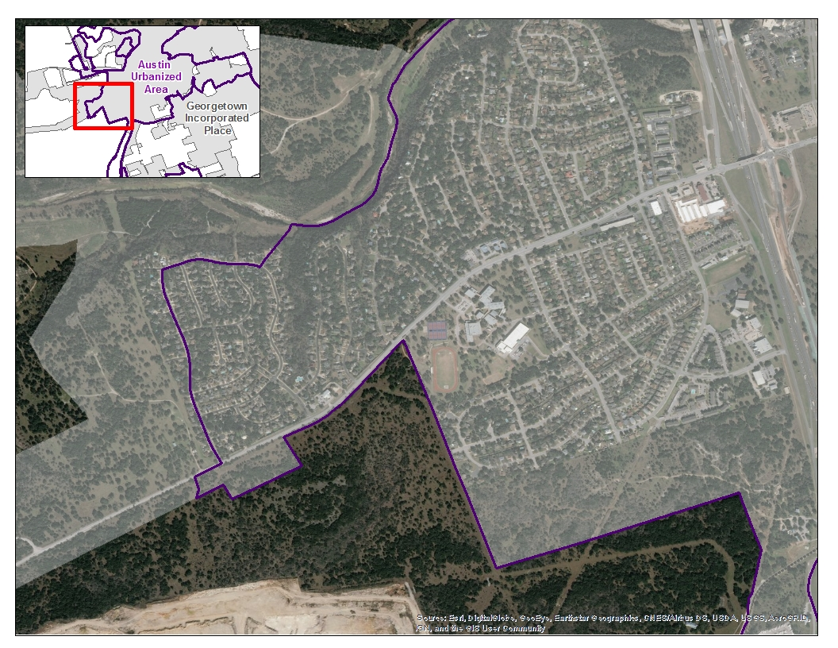

Slide 12
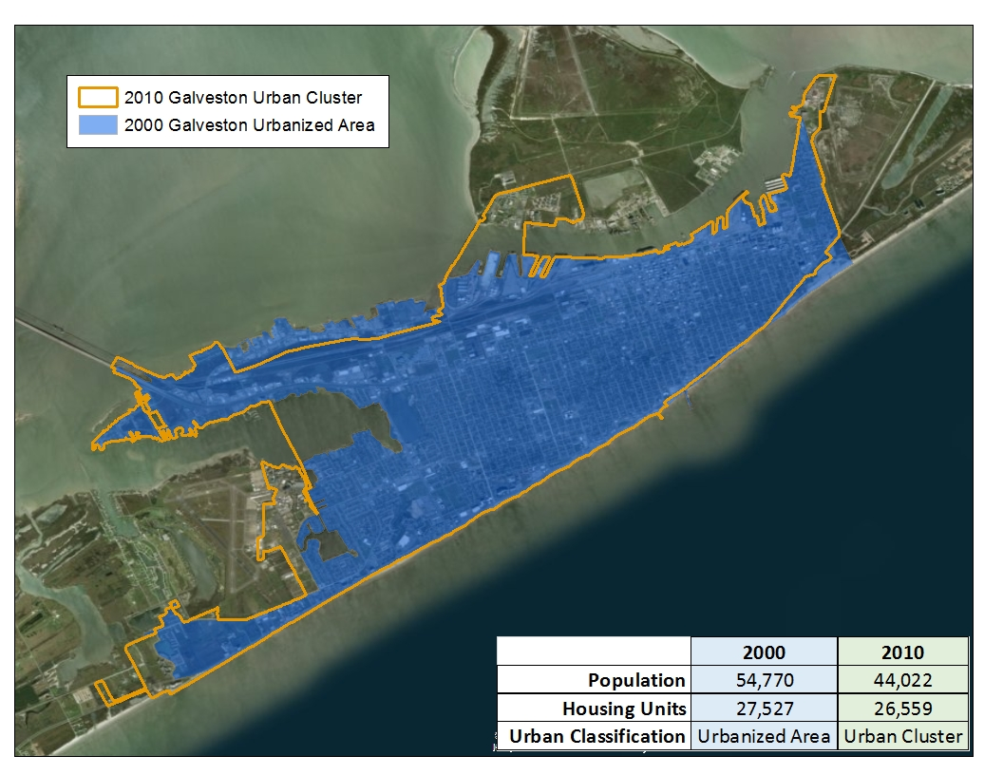

Slide 13
Metropolitan and Micropolitan Statistical Areas
Defined by U.S. Office of Management and Budget (OMB)
County Level
Metropolitan Statistical Areas
associated with at least 1 urbanized area with 50,000 population
adjacent counties having a high degree of social and economic integration with the core as measured through commuting ties
Micropolitan Statistical Areas
associated with at least one urban cluster of at least 10,000 but less than 50,000 population
adjacent counties having a high degree of social and economic integration with the core as measured through commuting ties

Slide 15
USDA Rural Classifications
County Level
Rural-Urban Continuum Codes
Sub-County Level
Frontier and Remote Area Codes
https://www.ers.usda.gov/topics/rural-economy-population/rural-classifications/data-for-rural-analysis/

Slide 16
Rural-Urban Continuum Codes
2013 (update planned for mid-2023)
Based on OMB Metropolitan and Micropolitan categories
Metropolitan counties by the population size of their metro area
Nonmetropolitan counties by degree of urbanization and adjacency to a metro area
Subdivided into three metro and six nonmetro categories
Every county assigned one of the 9 codes

Slide 17
Rural-Urban Continuum Codes
 | Code | Description
Metro | 1 | Counties in metro areas of 1 million population or more
 | 2 | Counties in metro areas of 250,000 to 1 million population
 | 3 | Counties in metro areas of fewer than 250,000 population
Micro | 4 | Urban population of 20,000 or more, adjacent to a metro area
 | 5 | Urban population of 20,000 or more, not adjacent to a metro area
 | 6 | Urban population of 2,500 to 19,999, adjacent to a metro area
 | 7 | Urban population of 2,500 to 19,999, not adjacent to a metro area
 | 8 | Completely rural or less than 2,500 urban population, adjacent to a metro area
 | 9 | Completely rural or less than 2,500 urban population, not adjacent to a metro area

Slide 19
Frontier and Remote Area Codes
ESRI zip code area level
Based on different population thresholds
Meant to reflect likely access to high order services (level one), low order services (level four), and intermediate order services (levels two and three)
Level | Description
1 | Rural areas and urban areas up to 50,000 people that are 60 minutes or more from an urban area of 50,000 or more people
2 | Rural areas and urban areas up to 25,000 people that are: 45 minutes or more from an urban area of 25,000-49,999 people; and 60 minutes or more from an urban area of 50,000 or more people
3 | Rural areas and urban areas up to 10,000 people that are: 30 minutes or more from an urban area of 10,000-24,999; 45 minutes or more from an urban area of 25,000-49,999 people; and 60 minutes or more from an urban area of 50,000 or more people
4 | Rural areas that are: 15 minutes or more from an urban area of 2,500-9,999 people; 30 minutes or more from an urban area of 10,000-24,999 people; 45 minutes or more from an urban area of 25,000-49,999 people; and 60 minutes or more from an urban area of 50,000 or more people

Slide 22
Refined Degree of Urbanisation
 |  |  | Areas outside settlements |  | Settlements by population size
 |  |  |  |  | Small | Medium | Large
 |  |  |  |  | 500 – 5,000 | 5,000 – 50,000 | >50,000
Cell level criteria Residents per sq km | High Density | >1,500 |  |  |  | Town | Urban Centre
 | Medium Density | 300 – 1,500 | Not Applicable |  | Village | Suburb & Urban Edge
 | Low Density | 50 – 300 |  | Rural Dispersed Areas
 | Very Low Density | <50 | Mostly Uninhabited Areas

Slide 24
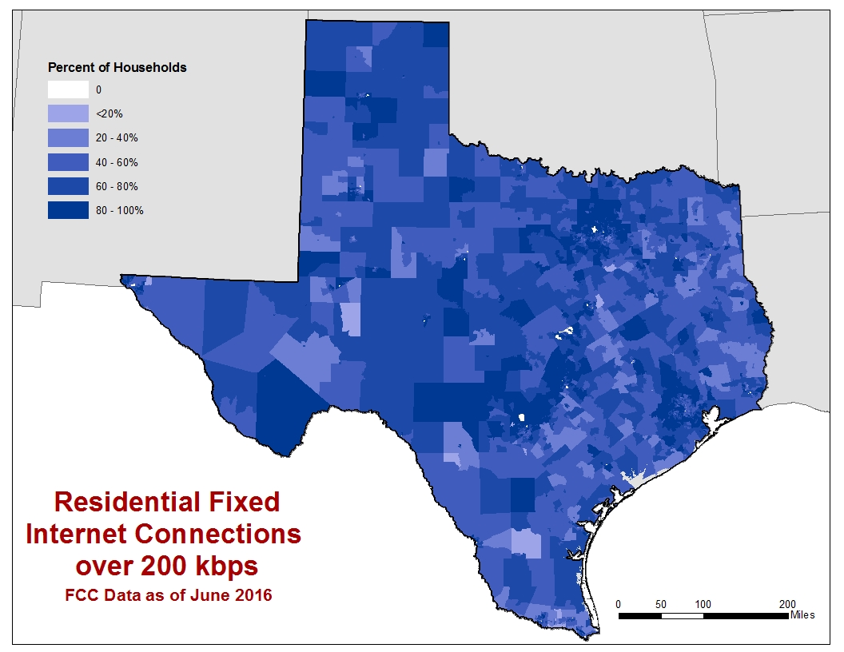

Slide 25
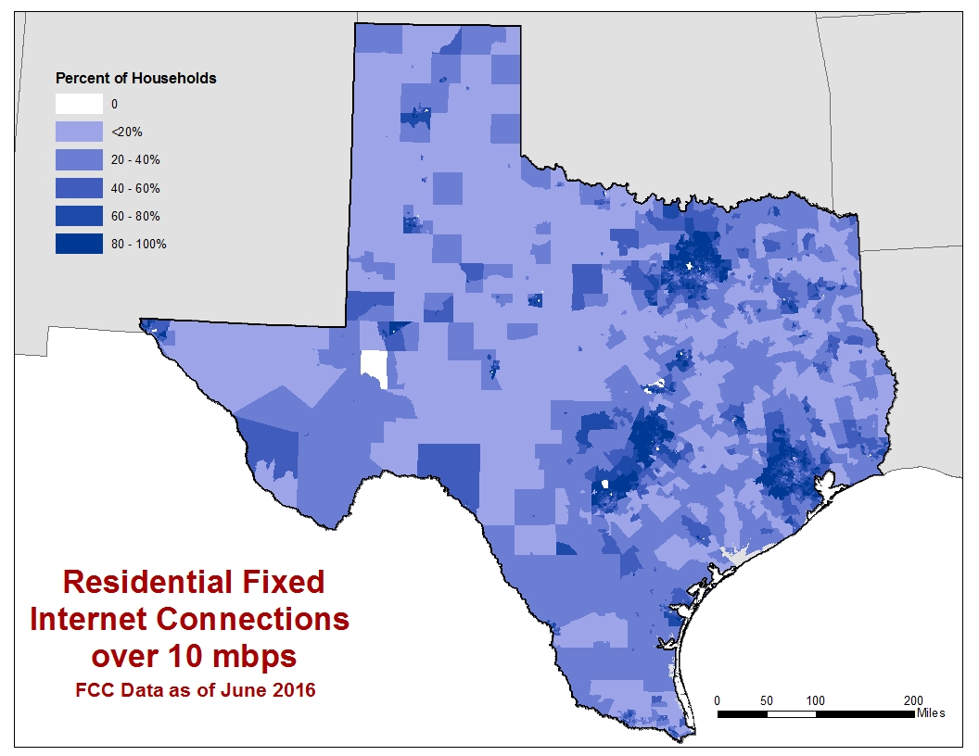

Slide 27
What is “rural?” What characterizes “rurality?”
Low population density
Small numbers of people
Low levels of urbanization/urban population
Distance from/proximity to [larger] urban centers
Isolation and remoteness
Rural often is defined as the residual. This could be “not urban” or “not metropolitan” in a dichotomous classification, or what remains after all other categories in a multi-category classification have been defined.

Slide 28
Rural Texas
Completely Rural: 100% of population lives in areas that have lower population density with <1,000 people per square mile (Stonewall County)
Mostly Rural: 50.1% to 99.9% of the population lives in areas with lower population density (Henderson County)
Rural/Urban: Counties with populations < 50,000 people that have >50% of people in higher population density (Kimble County)
Mostly Urban: Counties with Populations > 50,000 people that have >50% of people in higher population density (Harris County)

Slide 40
2020 Urban Areas and Future
2020 Urban Areas Delineation Criteria
How to define a Rural Statistical Area?
40

Slide 41
Rural Statistical Areas
Each statistical area:
Must have a population of 65,000 or more (to tabulate and disseminate ACS 1-year data)
Should encompass one or more contiguous counties (or other geographic unit)
Should, to the extent possible, encompass areas with similar levels of rurality
Statistical areas should be comparable from one state to another.

Slide 42
Questions? Comments?
Contact information:
Jennifer Zanoni
301-763-5647
Jennifer.zanoni@census.gov
42

