Slide 1
Migration and Mobility in Texas
Texas Demographic Conference
May 24, 2018
Austin, Texas

Slide 2
Migration estimates
Indicators
Residual method
Surveys
IRS data

Slide 3
Growing States, 2010-2017
 | 2010 Census Population | 2017 Population | Numeric Change 2010-2017 | Percent Change 2010-2017
United States | 308,745,538 | 325,719,178 | 16,973,640 | 5.5%
Texas | 25,145,561 | 28,304,596 | 3,159,035 | 12.6%
California | 37,253,956 | 39,536,653 | 2,282,697 | 6.1%
Florida | 18,801,310 | 20,984,400 | 2,183,090 | 11.6%
Georgia | 9,687,653 | 10,429,379 | 741,726 | 7.7%
North Carolina | 9,535,483 | 10,273,419 | 737,936 | 7.7%
Washington | 6,724,540 | 7,405,743 | 681,203 | 10.1%
Arizona | 6,392,017 | 7,016,270 | 624,253 | 9.8%
Colorado | 5,029,196 | 5,607,154 | 577,958 | 11.5%
Source: U.S. Census Bureau. 2000 and 2010 Census Count, 2017 Population Estimates.
Notes:
Texas is the second largest state in term s of population (2nd to CA) and area (2nd to AK). In terms of number of people, Texas’ growth exceeds that of all other states between 2010 and 2017. The pace of (percent) change of Texas exceeds that of other large states.

Slide 4
Estimates of percent components of population change, Texas, 2015-2017
Source: U.S. Census Bureau, 2017 Vintage population estimates
Notes:
Natural increase has been in the range of half of population change since the last Census in Texas. Thus Texas is growing quickly and substantially from having more births than deaths over time. In recent years the number and percent of new Texas from other states has decline and the number and percent of international migrants has increased.

Slide 5
Top Counties for Numeric Growth in Texas, 2016-2017
County | U.S. Rank Population Change | Population Change | Percent of Change from Natural Increase | Percent Change from Domestic Migration | Percent Change from International Migration
Harris* | 4 | 35,939 | 128.8% | -126.0% | 97.2%
Tarrant | 5 | 32,729 | 47.9% | 29.0% | 23.1%
Bexar | 7 | 30,831 | 47.8% | 33.4% | 18.8%
Dallas | 8 | 30,686 | 78.0% | -25.5% | 47.6%
Denton | 9 | 27,911 | 23.3% | 67.0% | 9.7%
Collin | 10 | 27,150 | 24.4% | 56.5% | 19.0%
Fort Bend | 14 | 22,870 | 29.4% | 48.1% | 22.6%
Travis | 15 | 22,116 | 47.9% | 22.1% | 30.0%
Williamson | 19 | 19,776 | 20.1% | 73.5% | 6.3%
Montgomery | 28 | 16,412 | 22.7% | 68.5% | 8.8%
Hidalgo* | 49 | 10,474 | 105.9% | -34.5% | 28.5%
* Hidalgo and Harris Counties had negative net migration (Harris -10,322 and Hidalgo -621).
Source: U.S. Census Bureau, 2017 Vintage Population Estimates

Slide 6
Top Counties for Percent Growth* in Texas, 2015-2016
County | U.S. Rank | 2015-2016 Percent Population Change | Percent Change from Domestic Migration | Percent Change from International Migration
Kendall | 2 | 5.2% | 95.9% | 4.0%
Hays | 3 | 5.1% | 82.2% | 1.8%
Comal | 6 | 4.4% | 88.5% | 2.0%
Williamson | 14 | 4.1% | 74.1% | 5.6%
Fort Bend | 18 | 3.8% | 59.4% | 15.8%
Montgomery | 24 | 3.7% | 73.5% | 8.0%
Rockwall | 25 | 3.6% | 82.2% | 2.5%
Denton | 28 | 3.6% | 67.1% | 9.0%
Kaufman | 36 | 3.4% | 81.3% | 2.2%
Bastrop | 42 | 3.1% | 83.5% | 0.7%
Ellis | 50 | 3.1% | 78.1% | 2.6%
*Among Counties with 10,000 or more population in 2016
Source: U.S. Census Bureau, 2016 Vintage Population Estimates

Slide 7
Texas Percentage of the U.S. Population by Nativity, 1850-2010
Sources: Gibson and Jung 2006; ACS 1-Year Summary Data, 2010

Slide 8
Estimated Numeric Change from Domestic Migration by County, Texas, 2010 to 2017
Source: U.S. Census Bureau, 2017 Vintage Population Estimates

Slide 9
Population change, Texas, Florida, and California, 2011-2017
Source: U.S. Census Bureau, 2017 Vintage Population Estimates

Slide 10
Natural increase, Texas, Florida, California, 2011-2017
Source: U.S. Census Bureau, 2017 Vintage Population Estimates

Slide 11
International net-migration, Texas, Florida, California, 2011-2017
Source: U.S. Census Bureau, 2017 Vintage Population Estimates

Slide 12
Domestic net-migration, Texas, Florida, California, 2011-2017
Source: U.S. Census Bureau, 2017 Vintage Population Estimates

Slide 13
Percent of Housing Units Built Before 1960, Census Tracts, Metroplex Area, Texas, 2012-2016
Source: U.S. Census Bureau, American Community Survey, 2012-2016 5-Year Sample

Slide 14
Percent of Housing Units Built Between 1960 and 1979, Census Tracts, Metroplex Area, Texas, 2012-2016
Source: U.S. Census Bureau, American Community Survey, 2012-2016 5-Year Sample

Slide 15
Percent of Housing Units Built Between 1980 and 1999, Census Tracts, Metroplex Area, Texas, 2012-2016
Source: U.S. Census Bureau, American Community Survey, 2012-2016 5-Year Sample

Slide 16
Percent of Housing Units Built Between 2000 and later, Census Tracts, Metroplex Area, Texas, 2012-2016
Source: U.S. Census Bureau, American Community Survey, 2012-2016 5-Year Sample

Slide 17
Mean Age Percent Distribution for Domestic Migrants and the Total Population in Texas, 2005-2013
Source: U.S. Census Bureau ACS 1-Year PUMS 2005-2013

Slide 18
Net Domestic Migration to Texas by Age and Sex, 2013
Source: U.S. Census Bureau ACS 1-Year PUMS 2013

Slide 19
Mean Race/Ethnicity Percent Distribution for Domestic Migrants and the Total Population in Texas, 2005-2013
Source: U.S. Census Bureau ACS 1-Year PUMS 2005-2013

Slide 20
Number of Texas Domestic Migration by Race/Ethnicity, 2013
Source: U.S. Census Bureau ACS 1-Year PUMS 2013

Slide 21
Highest Net Internal Migration County Pairs for the Big Four MSAs in Texas, 2010-2014
U.S. Census Bureau. 2016. County-to-County Migration Flows: 2010-2014 ACS

Slide 22
Migration In-Flows for the Big Four MSAs in Texas*, 2011-2015
Source: U.S. Census Bureau, 2016, ACS County-to-County Migration Flows, 2010-2014
Note: *The Big Four are the 4 metros with populations of 1,000,000 or more in 2010.

Slide 23
Annual Shares of Recent Non-Citizen Immigrants to Texas by World Area of Birth, 2005-2015
Source: U.S. Census Bureau, American Community Survey, 1-Year PUMS

Slide 24
Origins of Recent Immigrants to Texas by Metropolitan Status, 2010-2014
Source: U.S. Census Bureau, 2016. ACS County-to-County Migration Flows, 2010-2014

Slide 25
Origins of Recent Immigrants to the Four Largest MSAs in Texas, 2010-2014
Source: U.S. Census Bureau, 2016. ACS County-to-County Migration Flows, 2010-2014

Slide 26
Comparison of 2005 and 2013 Foreign-Born Migrants to Texas by World Area of Birth and Migration Type
Source: ACS 1-Year PUMS Data, 2005 and 2013

Slide 27
Numerical Change in the Size of the 2005 and 2013 Foreign-Born Migrant Streams to Texas by World Area of Birth and Migration Type
Source: ACS 1-Year PUMS Data, 2005 and 2013

Slide 28
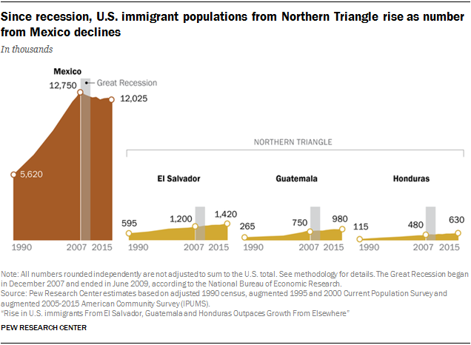

Slide 29
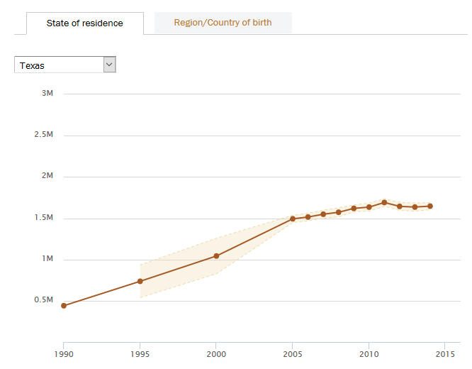
Estimated unauthorized immigrants in Texas, 1990-2015
Source: Pew Research Center

Slide 30
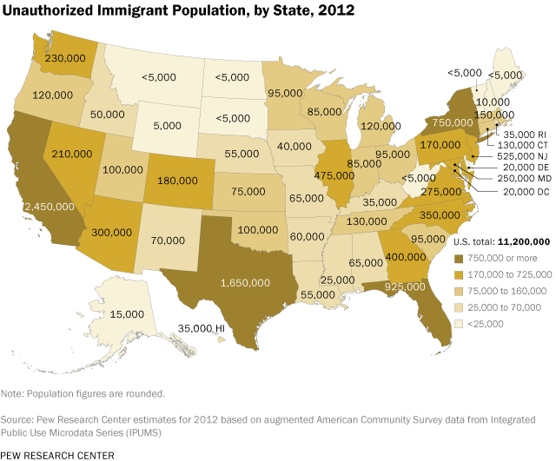
~5.8% of Texas’ population

Slide 31
Projected Population Growth in Texas,
2010-2050
Source: Texas State Data Center 2016 Population Projections

Slide 32
Projected Population Growth in Texas,
2010-2020
Source: Texas State Data Center 2016 Population Projections

Slide 33

Contact
  State Demographer
  Office: (210) 458-6530
  Email: Lloyd.Potter@utsa.edu
  Internet: demographics.texas.gov
Lloyd Potter, Ph.D.
@TexasDemography
Notes:
The Texas Demographic Data Center are committed to supporting your work through providing you with the best, most accurate, and objective information we can identify about our greatest asset, the people of Texas.

