Slide 1
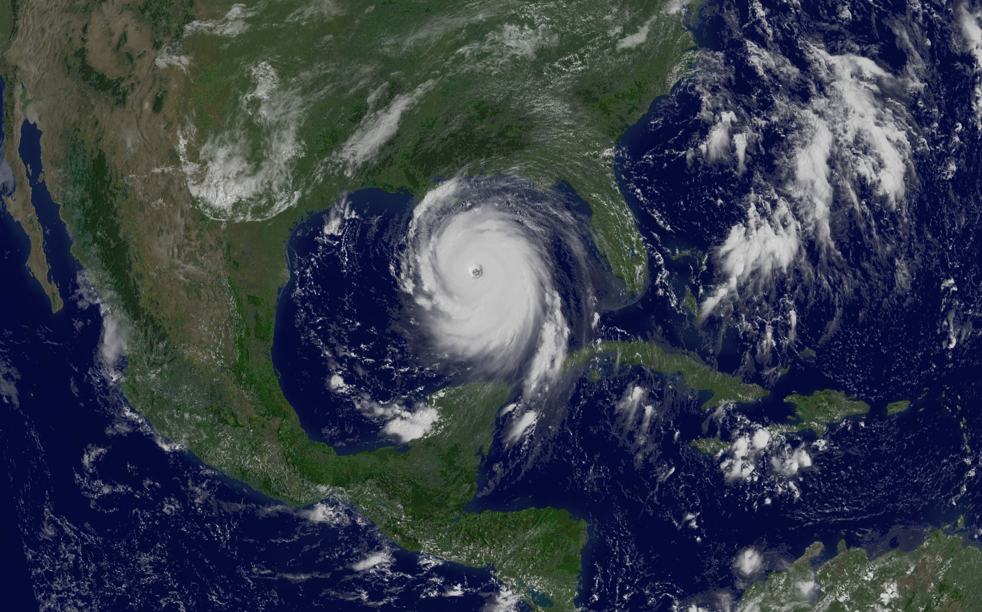
Social Vulnerability to Hurricane Disasters: Exploring the Effect of Place as a Mediating Factor
Lorenzo D. Sanchez, PhD, CEM
The University of Texas at san Antonio
Notes:
Welcome
Thank everyone for supporting me along the journey
About me:
Current position
Past work experience with MDFR and SAOEM

Slide 2
Background
Annual threat of hurricanes (June 1 – November 30)
Changing demographic composition of Gulf & Atlantic states influence social vulnerability (SV)
SV is the relationship between social, economic, and demographic characteristics that influence resiliency
Population growth in environmentally high-risk areas
Place is understudied as a risk factor of SV
Examples: Hurricane(s) Andrew (1992), Katrina (2005), Rita (2005), Ike (2008), Harvey (2017), Maria (2017)
Notes:
Annual threat of hurricanes and tropical systems
Growth in populations along the coastal states, cities, and adjacent areas
With growth into at-risk areas increases place-based vulnerability
Place is understudied as a condition of social vulnerability
It’s important to understand how place may serve as a mediating factor of SV, and if considerations of place influence disaster risk beyond sociodemographic characteristics
Identifying types of place for consideration is important and also understudied
Previous research in other disciplines struggle with this concept, and have used the RUCC to further stratify place
Katrina is the most stark example of catastrophe relative to socially vulnerable populations and hurricane disasters
Important to identify who are most at-risk, develop targeted approaches to helping them, and mitigating future crisis

Slide 3
Why is This Research Important?
Examine components of social vulnerability across time and by type of place
Does place serve in a mediating capacity of SV?
Does SV operate differently by type of place?
How has SV changed over time?
Does SV interact with place to influence disaster casualty risk?
Policy implications for disaster management
Hazard mitigation planning
Federal and state funds to counties and local jurisdictions
UASI, SHSGP, EMPG
Notes:
As mentioned, it is important to identify key sociodemographic characteristics that comprise social vulnerability
More so, does place mediate these risk factors?
SV is not a static construct, and is dynamic based on place and over time – further reiterating the importance of policymakers and EM professionals to keep up with the pulse of changing communities

Slide 4
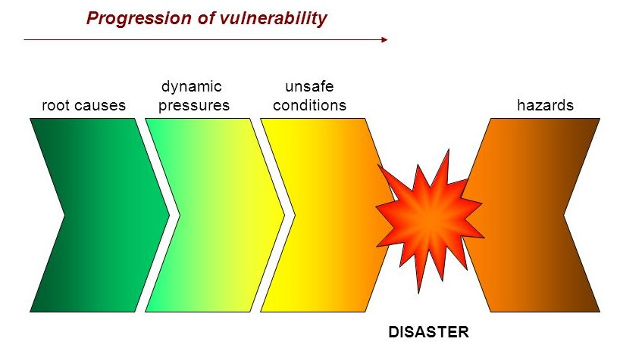
Risk & Vulnerability Theory
Progression of Vulnerability
Pressure and Release Model (PAR)
Intersection of SV and disaster risk
Catastrophe results when pierced
Risk = Hazard + Vulnerability
Dynamic Pressures
Unsafe Conditions
Root Causes
Hazard
Access to Basic Resources:
Lack of Training
Institutional
Support, Skills,
Markets
Fragile Physical Environment, Local Economies
Power, Safe Structures, Resources
Hurricanes,
Tropical Storms,
Tropical Depressions
Risk
External Influences:
Political & Economic
Population Growth, & Change, Urbanization
Risky Livelihoods,
Low Income, Vulnerable Populations
Image Source: University of Alberta, Canada
Notes:
PAR model is like a balloon – each contributing factor elevates risk
When disaster ensues, this balloon pierces and exposes the most vulnerable to risk of casualty or negative impact on their livelihood
Root Causes: Low access to basic resources, such as power, safe structures, resources, as well as external influences in the political economy
Dynamic Pressures: Lack of training, institutional support, skills, investment, markets, as well as forces of population growth, urbanization, degradation
Unsafe Conditions: Fragile physical environment, and fragile local economies, risky livelihoods, vulnerable populations, low income
Hazards: natural hazards, manmade hazards, in this case hurricanes and tropical systems

Slide 5
Data & Methods
Research Goals
SV by Type of Place
Temporal Change in SV by Place
SV & Disaster Casualty Risk
Methods
Multi-Group Principal Component Analysis (mgPCA)
Generalized Estimating Equation Model
Zero-Inflated Negative Binomial Mixture Model
Type of Place
Large Metropolitan
Urban Adjacent (Suburban)
Urban Non-Adjacent (Isolated Urban Area)
Rural
DATA 1: IPUMS National Historical Geographic Information System (NHGIS - 1990–2010)
VARIABLES: Sociodemographic Variables, Housing, SES
DATA 2: Area Health Resource Files (AHRF – 2015)
VARIABLES: Rural-Urban Continuum Codes, Elevation
DATA 3: Spatial Hazard Events and Losses Database for the U.S. (SHELDUS – 2017)
VARIABLES: Injury & Fatality Rates
Notes:
Chapter three provides the foundation for the exploration of place as a mediating factor.
mgPCA allows for variable reduction within the SV index, as well as within groups (RUCC), based on the premise that SV variables are measuring the underlying dimensions of vulnerability.
Chapter four builds on chapter three, and examines temporal change in SV by place.
Generalized estimating equation (GEE) model, which provided an analytical technique to examine the relationship of social vulnerability over time and by type of place.
Chapter five brings three and four together, and looks at the relationship between disaster casualty risk (injury/fatality) and SV by place and time.
Based on the high number of zero counts for injury and mortalities within the data, the zero-inflated models allow for an analysis to be conducted using the research supported indicator variables of social vulnerability, place-based contexts, as well as an offset factor (population rate) in the analysis.
The zero-inflated mixture models account for this data through a component mixture function, which splits the model effectively in two, the first of which models the density of zero’s as a mixture of a binomial outcome and the count data’s distribution of zero’s respectively, and the second model component that models the non-zero counts.

Slide 6
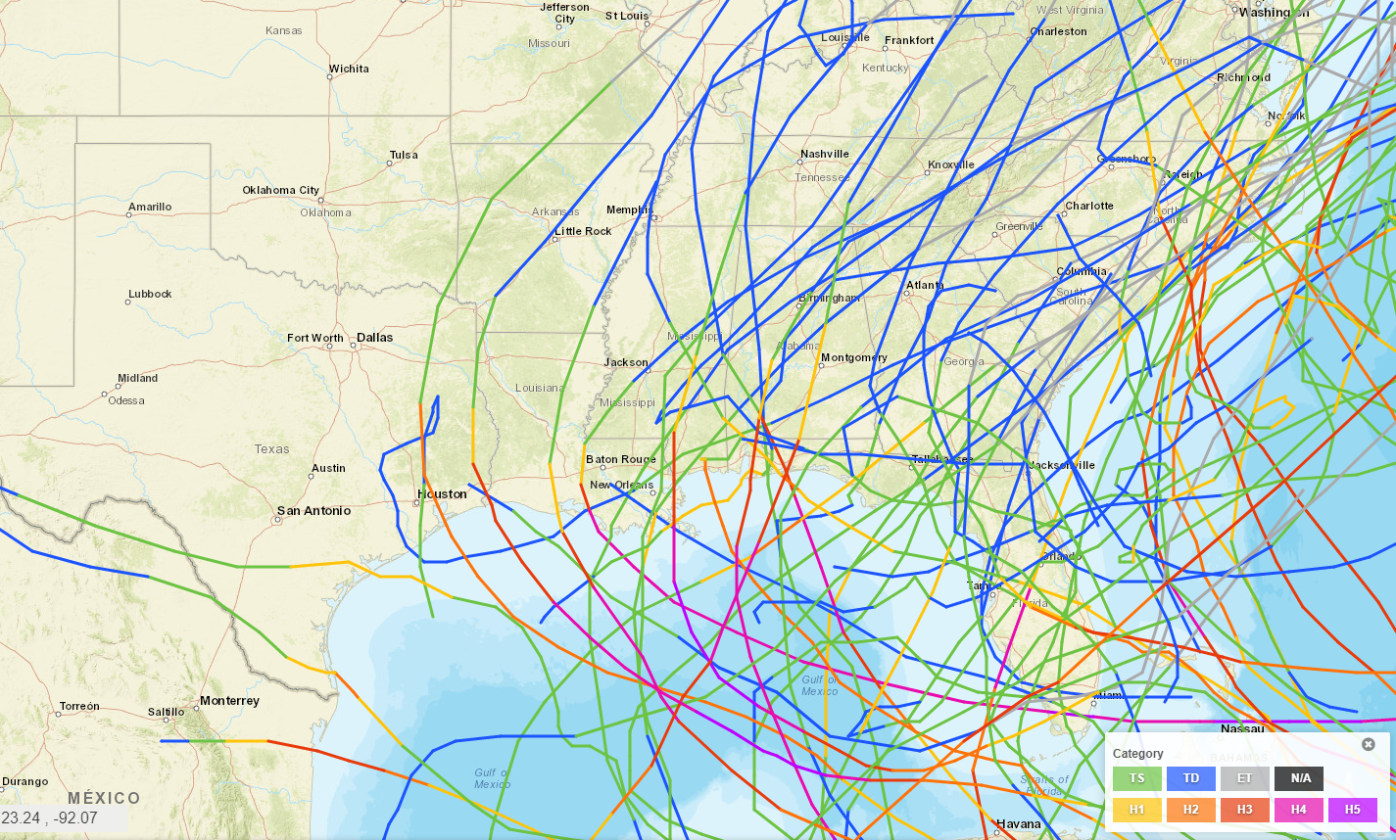
Area of Analysis
71/330 Tropical Systems to Landfall Between 1990 - 2010
9 States in Analytical Area:
Texas
Louisiana
Mississippi
Alabama
Georgia
Florida
South Carolina
North Carolina
Virginia
Source: U.S. Department of Commerce – National Oceanic and Atmospheric Administration
Notes:
To establish the area of analysis:
Utilized NOAA National Ocean Service – Office of Coastal Management – Historical Hurricane Tracking Tool
71 storms to make landfall of 330 across the Gulf and Atlantic basins
Established cut-off for east coast through Virginia because states northward may skew results due to limited Presidential Disaster Declarations and availability of data

Slide 7
Research Goal One:
Research Aim:
Seeks to identify factors relative to social vulnerability with place-based considerations, which may predispose populations to higher or lower risks to hurricane-related disasters given spatial variations of place.
Research Questions:
What factors are influential in measuring social vulnerability?
Does social vulnerability operate in the same way across type of place?
Methodology:
Multi-Group Principal Component Analysis
Exploring the Relationship Between Social Vulnerability and Place
Notes:
mgPCA allows for variable reduction within the SV index, as well as within groups (RUCC), based on the premise that SV variables are measuring the underlying dimensions of vulnerability.
SV cannot be measured directly, and an SoVI helps to explain this latent construct within the variables collectively

Slide 8
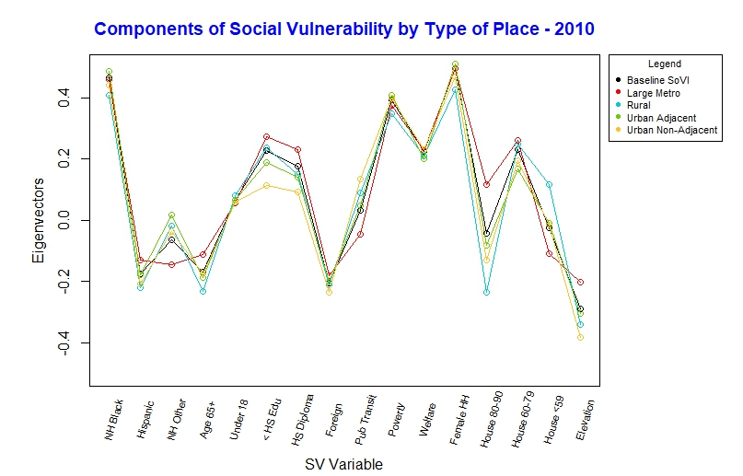
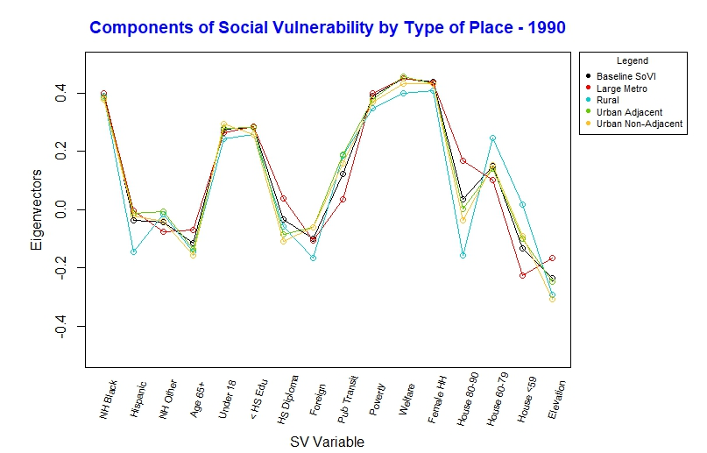
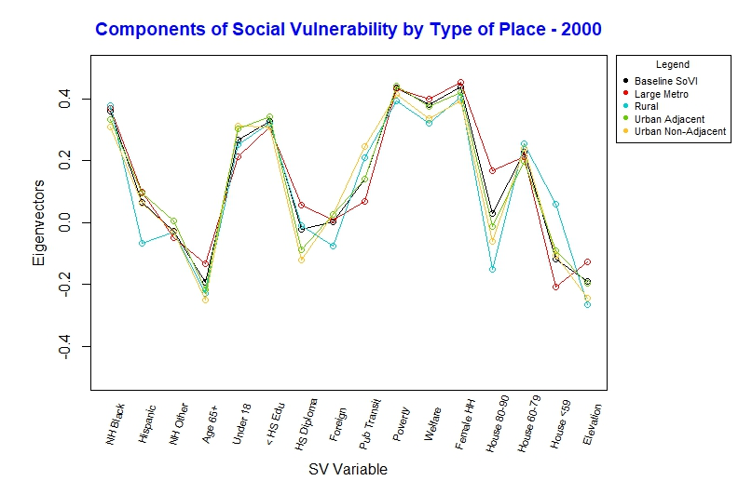
Notes:
Important key points:
Strength of eigenvectors for each type of place indicates variable loadings operate differently
Eigenvectors above 0 load positively on SV, and are risk factors that contribute to the SV index loadings

Slide 9
Research Goal Two:
Research Aim:
Builds upon place-based social vulnerability, and seeks to identify how dynamic the concept is, and will attempt to identify areas with significant change via increasing or decreasing social vulnerability measurements over time.
Research Questions:
Does social vulnerability risk change over time and across place, and what areas consistently experience high risk values?
Does the level of vulnerability correlate with certain characteristics of place, and do certain types of place increase or decrease risk?
Methodology:
Standard Principal Component Analysis
Generalized Estimating Equation Model
Examining Temporal Change in Social Vulnerability

Slide 10
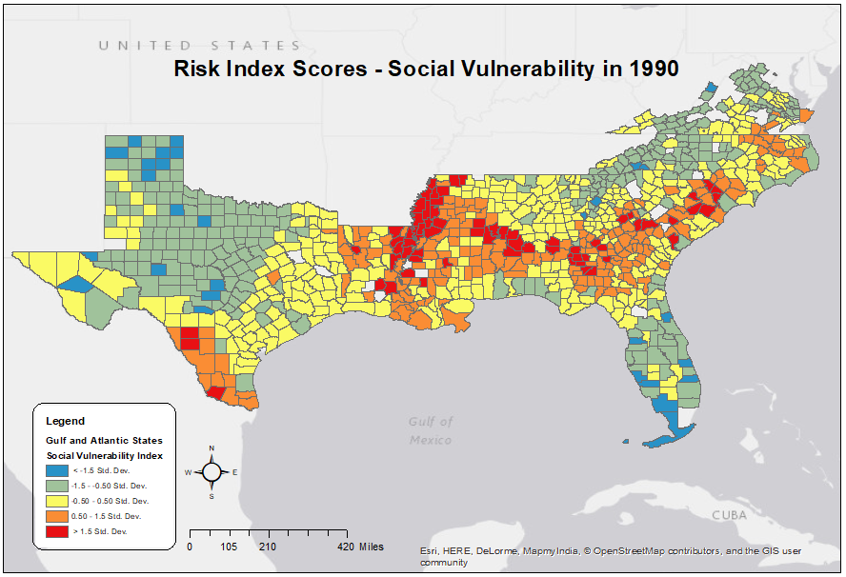
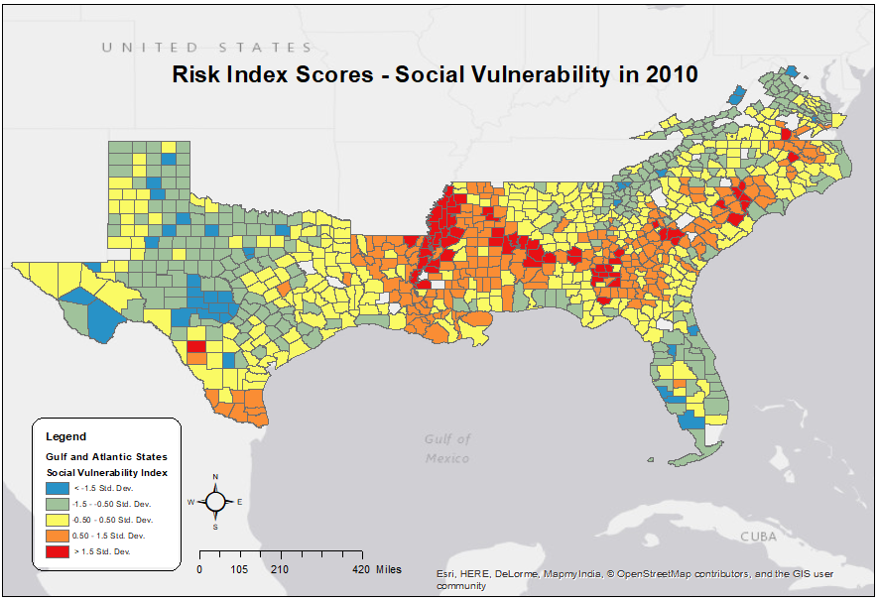
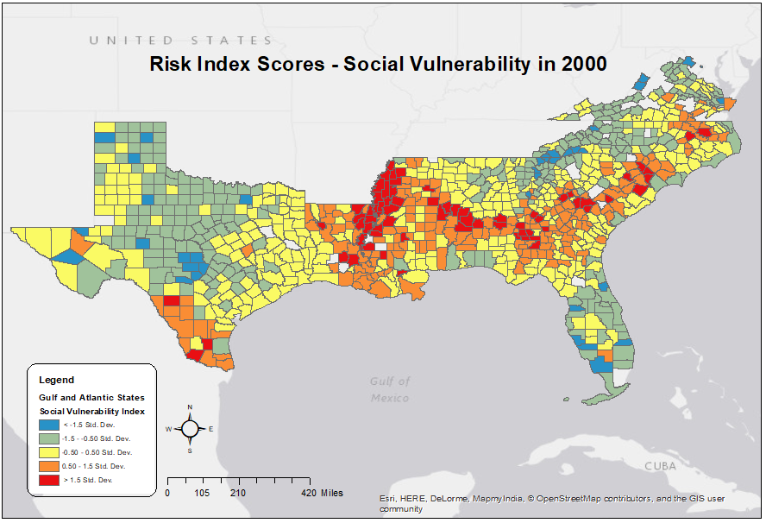
Notes:
Illustrates average SV across the Gulf and Atlantic states
Red high risk – yellow average risk – blue low risk
Yellow becomes more prevalent with each time interval

Slide 11
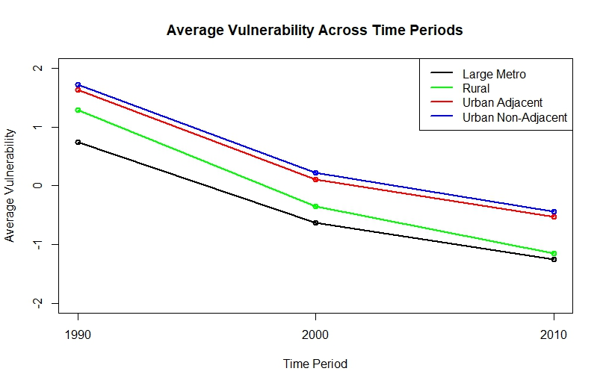
Time Interval
Notes:
As average risk became evident in maps, this graph illustrates the average risk decrease by type of place
Suburban and isolated urban areas (i.e. midland) are highest risk over time
Rural has sharpest decline
Large metro lowest average risk over time

Slide 12
Research Goal Three:
Research Aim:
Seeks to determine if a relationship exists between disaster casualty risk and place-based dimensions of social vulnerability over time and across space.
Research Questions:
Are there differentials in casualty risk relative to social vulnerability, and do certain environmental factors increase casualty risk more than others?
Does type of place moderate the effects of social vulnerability on disaster casualty risk, and does this operate the same over time?
Methodology:
Zero-Inflated Negative Binomial Mixture Model
An Exploration of Disaster Casualty Risk and Social Vulnerability Across Time and Place
Notes:
Based on the high number of zero counts for injury and mortalities within the data, the zero-inflated models allow for an analysis to be conducted using the research supported indicator variables of social vulnerability, place-based contexts, as well as an offset factor (population rate) in the analysis.
The zero-inflated mixture models account for this data through a component mixture function, which splits the model effectively in two, the first of which models the density of zero’s as a mixture of a binomial outcome and the count data’s distribution of zero’s respectively, and the second model component that models the non-zero counts.

Slide 13
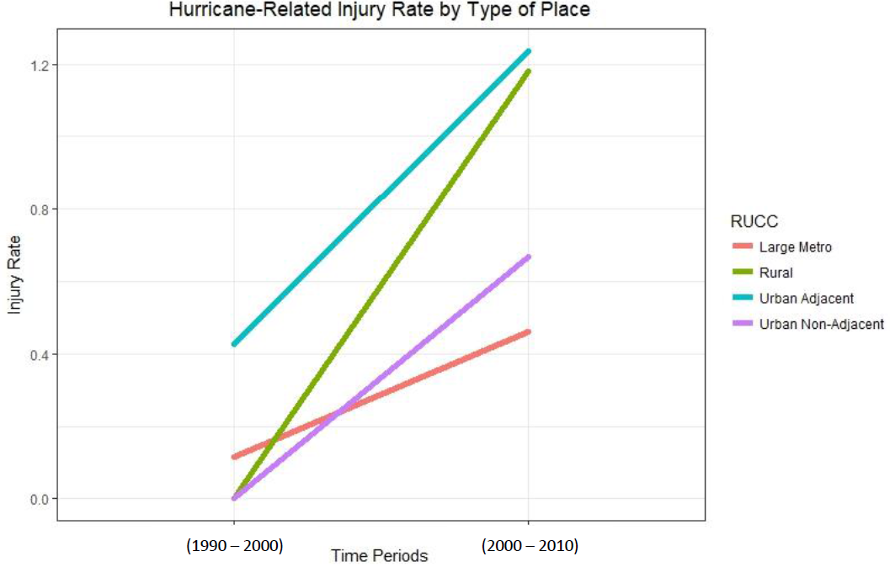
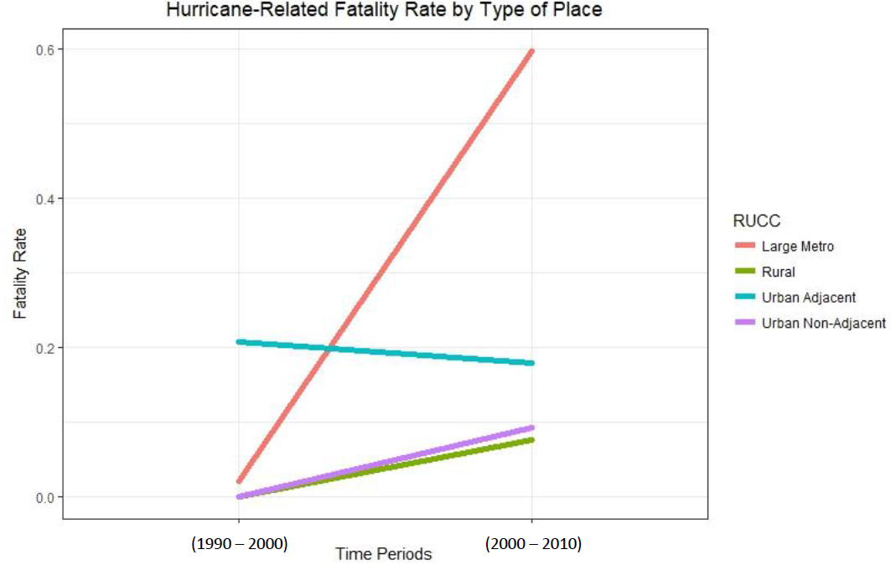
Notes:
Key points
Injury –
Fatality

Slide 14
Key Takeaways
Social vulnerability is not a static construct, and variation is evident by type of place and over time
Consistent highest risk components for all 3 time intervals:
NH Black, <18 years, <HS education, public transit, poverty status, welfare, female headed-households, housing (1960-1979)
Urban non-adjacent counties have the highest average SV risk across time; Large metropolitan counties have the lowest average SV risk
Injury Model: Higher risk of injuries in TP2 compared to TP1, large metropolitan had lowest risk – urban adjacent had highest risk
Fatality Model: Slightly higher risk of fatalities in TP2, large metropolitan had highest risk between time periods, rural lowest risk

Slide 15
Policy Implications
Target at-risk populations with tailored preparedness programs and services
Identify specific needs within the population, and address those through targeted approaches (i.e. special needs evacuation programs, etc.)
Implement mitigation programs that increase community resiliency
Many programs focus on the county level – SV is a useful barometer for risk and conversely resiliency
“One size-fits-all” planning may not be the best strategy – doesn’t account for sociodemographic and place-based variation of risk

Slide 16
Limitations
Data consistency over time, consistent measures of place
Type of place (county level) doesn’t account for variation of smaller community units
Direct/Indirect casualty measurements may not fully be captured in data (i.e. enumeration of count data by Presidential Disaster Declarations)
Numerous counties with no values for casualty risk

Slide 17
Future Research & Conclusion
Further identification of place-based factors that influence social vulnerability
Examine if social vulnerability manifests differently for other hazards/threats and by type of place
Identify other variables, such as damage to homes, infrastructure, agriculture, etc., and impact on SV
Exploring the dimensions of SV through research can increase resiliency within our communities

Slide 18
Questions? Thank You!
Lorenzo D. Sanchez, Ph.D.
UTSA Director of Emergency Management
(210) 458-6756, lorenzo.sanchez@utsa.edu

