Slide 1
The 2016 TDC Population Estimates
Helen You
Texas Demographic Conference
May 2018
Austin, Texas

Slide 2
Status of the 2016 population estimates
Total populations of counties
Total populations of places
County populations by age, sex and race/ethnicity
Done!
Internal Review!
In Progress

Slide 3
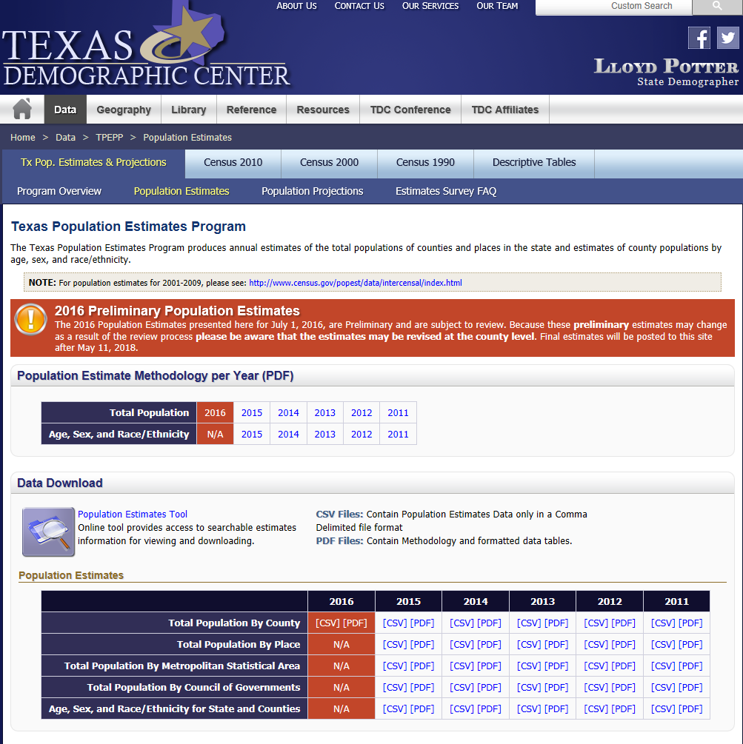
You can access the data from our website
(http://demographics.texas.gov)

Slide 4
The TDC Population Estimates and the Census Bureau Estimates
We are on a collaborative relationship with the CB estimates team;
We help CB to collect some the data they use;
We use Census Bureau state estimates as the control for our county estimates;
We utilize different data and methodology;
And due to the timing of data collection and production cycle, our data are usually one year recent than the CB.
In most cases, the two estimates are within the range of each other.

Slide 5
We collect …
SURVEY data – private schools, annexation and boundary changes, and building permits …
ADMINISTRATIVE data – vital statistics, voter registration, vehicle registration, nursing homes, medicare, prison and correctional facilities …
Public data – decennial census, ACS …

Slide 6
The methodology we used …
Top down
  -- County population estimates are controlled to the state estimates and place estimates are controlled to the county estimates
Three methods for the county and place totals
  Housing Unit
  Cohort component II
  Ratio Correlation
“Projected” age-sex-race distribution applied to county total to obtain estimates with demographic details.

Slide 7
10 Most Populous Texas Counties, 2016
 | 2016 Population Estimate | 2010 Population | Numeric Change 2010-2016
Harris County | 4,565,394 | 4,092,459 | 472,935
Dallas County | 2,591,002 | 2,368,139 | 222,863
Tarrant County | 1,984,677 | 1,809,034 | 175,643
Bexar County | 1,918,444 | 1,714,773 | 203,671
Travis County | 1,194,552 | 1,024,266 | 170,286
Collin County | 959,054 | 782,341 | 176,713
Hidalgo County | 855,229 | 774,773 | 80,456
El Paso County | 841,570 | 800,647 | 40,923
Denton County | 805,292 | 662,614 | 142,678
Fort Bend County | 744,199 | 585,375 | 158,824
Source: Texas Demographic Center 2016 Population Estimates.

Slide 8
Total Estimated Population by County, Texas, 2016
Source: Texas Demographic Center 2016 Population Estimates.
Notes:
When we look at the geographic distribution of the population of Texas over time we see continually increasing population in the counties along the I-35 corridor, the Houston area, and the lower Rio Grand Valley. Urbanized areas out west have grown but most counties west have experienced limited growth and some population decline. Approximately 86% of the population is along I-35 and east. This area with the 3 major metropolitan areas at the points is often described as the Texas population triangle.
The counties of Harris, Dallas, Tarrant, Bexar, and Travis make up the points of the “population triangle” in Texas and are the most populated in the State. Collin, Denton, Fort Bend, Hidalgo, and El Paso counties also have significant population concentrations. Many counties west of Interstate 35 are more sparsely populated.

Slide 9
Top 10 Counties with Greatest Numeric Change,
2010-2016
 | 2016 Population Estimate | 2010 Population | Numeric Change 2010-2016
Harris County | 4,565,394 | 4,092,459 | 472,935
Dallas County | 2,591,002 | 2,368,139 | 222,863
Bexar County | 1,918,444 | 1,714,773 | 203,671
Collin County | 959,054 | 782,341 | 176,713
Tarrant County | 1,984,677 | 1,809,034 | 175,643
Travis County | 1,194,552 | 1,024,266 | 170,286
Fort Bend County | 744,199 | 585,375 | 158,824
Denton County | 805,292 | 662,614 | 142,678
Montgomery County | 557,340 | 455,746 | 101,594
Williamson County | 514,534 | 422,679 | 91,855
Source: Texas Demographic Center 2016 Population Estimates.

Slide 10
Estimated Population Change, Texas Counties, 2010 to 2016
75 counties lost population over the 6 year period.
Source: Texas Demographic Center 2016 Population Estimates.
Notes:
Population change over the decade has been greatest in the urban and suburban population triangle counties. Counties in the lower Rio Grande Valley also had significant growth as did El Paso. Overall, 158 counties gained population while 96 (38%) lost population over the decade.

Slide 11
Top 10 Fastest Growing Counties,
2010-2016
 | 2016 Population Estimate | 2010 Population | Percent Change 2010-2016
Hays County | 201,588 | 157,107 | 28.3
Fort Bend County | 744,199 | 585,375 | 27.1
Kendall County | 42,324 | 33,410 | 26.7
Comal County | 134,668 | 108,472 | 24.2
Collin County | 959,054 | 782,341 | 22.6
McMullen County | 866 | 707 | 22.5
Montgomery County | 557,340 | 455,746 | 22.3
Williamson County | 514,534 | 422,679 | 21.7
Denton County | 805,292 | 662,614 | 21.5
Andrews County | 17,829 | 14,786 | 20.6
Source: Texas Demographic Center 2016 Population Estimates.

Slide 12
Estimated Percent Change of the Total Population by County, Texas, 2010 to 2016
Source: Texas Demographic Center 2016 Population Estimates.
Notes:
Percent change is an indicator of the speed of population change void of information about the volume of population change. Percent change in the population over the past few years has been greatest in the suburban population triangle counties, notably among counties between San Antonio and Austin. In the early part of the decade, counties in the Eagle Ford Shale area (south east of San Antonio) and the Cline Shale area (Midland and Odessa area), had been growing quickly. This is no longer the case.

Slide 13
Looking into the future
Our estimates will be more timely and on schedule!
  The 2017 estimates will be available in October, 2018
We are exploring ways to include more local experts in our reviewers group.
Making year-to-year estimates more comparable

Slide 14



  Office: (210) 458-3179
  Helen.You@utsa.edu
  demographics.texas.gov
Helen You, Ph.D.
@TexasDemography
Notes:
The Texas Demographic Center is committed to supporting your work through providing you with the best, most accurate, and objective information we can identify about our greatest asset, the people of Texas.

