Slide 1
2020 Census Barriers, Attitudes, and Motivators Study (CBAMS)
Survey and Focus Groups Report Findings Presentation
Monica Vines
US Census Bureau
June 6, 2019
Authorized Use Only

Slide 2
Outline
1
CBAMS Overview
2
Study Design
3
Key Findings
A
Intent to Respond
B
Knowledge Gaps
C
Potential Concerns & Attitudinal Barriers
D
Potential Motivators & Facilitators
4
2020 CBAMS Conclusions & Recommendations
5
2020 CBAMS Mindsets
Authorized Use Only

Slide 3
1
CBAMS Overview
Authorized Use Only

Slide 4
CBAMS Overview
Purpose
Understand attitudes, barriers, & motivators toward the census
Increase
self-response to the 2020 Census
Inform & inspire
creative strategy
Research Questions
Who intends to respond to the census?
Where do gaps in knowledge about the census exist?
What barriers would prevent people from completing the census?
What would motivate people to complete the census?
Methodology
Quantitative Survey
Qualitative Focus Groups
Authorized Use Only

Slide 5
2
Study Design
Authorized Use Only

Slide 6
Study Design: CBAMS Survey
The 2020 CBAMS Survey was administered from February to April 2018 to 50,000 addresses in all 50 states and Washington, D.C.
Questionnaire consisted of 61 questions
Adults 18+ were eligible to participate via mail or web
Households in the sample received a prepaid incentive and up to five mailings inviting them to participate
Oversampled Asians, Blacks, Hispanics, and other small-sample races.
Roughly 17,500 people responded to the survey
Authorized Use Only

Slide 7
Study Design: CBAMS Focus Groups
2020 CBAMS Focus Groups held in March and April 2018.
42 focus groups conducted with 11 audiences across 14 locations
16 focus groups were non-English
Focus group transcripts went through a rigorous process to ensure intercoder reliability
Transcripts were analyzed to identify themes among response barriers and motivators
Authorized Use Only

Slide 8
Study Design: CBAMS Focus Groups
2020 CBAMS Focus Groups conducted among the 11 audiences.
American Indian and Alaska Native
Black or African American
Chinese – Cantonese and Mandarin
Low Internet Proficiency
Middle Eastern and North African
Native Hawaiian and Pacific Islander (NHPI)
Rural
Spanish (Puerto Rico)
Spanish (U.S. Mainland)
Vietnamese
Young and Mobile
Authorized Use Only

Slide 9
3
Key Findings
Authorized Use Only

Slide 10
Key Findings Areas
Intent to Respond
Knowledge Gaps
Potential Concerns & Attitudinal Barriers
Potential Motivators & Facilitators
Authorized Use Only

Slide 11
Intent to Respond
Authorized Use Only

Slide 12
Two out of three said they were likely to respond
CBAMS Survey and Decennial Census
Measured vs Observed Response Rate
The mail return rate to the 2010 Census was 10 pts lower than measured in the 2008 CBAMS Survey
CBAMS measures those who are “extremely” or “very” likely to fill out the census form if the census were held today.
Note: Due to methodological differences, direct statistical comparisons between 2008 and 2018 survey are not appropriate.
Authorized Use Only

Slide 13
Knowledge Gaps
Authorized Use Only

Slide 14
Many know the census basics but not much more
How familiar are you with the U.S. census?
Not at all familiar
In their own words
Not too familiar
[What comes to mind when I hear ‘census’?] I don’t know. Isn’t that like the people that want to know like everything? They send you letters to your house.”
— American Indian and Alaska Native
Somewhat familiar
79%
Very familiar
Extremely familiar
Authorized Use Only

Slide 15
Overview of knowledge gaps
Authorized Use Only

Slide 16
Knowledge about funding from census data varies little by race and ethnicity
% Correct by Race/Ethnicity
Black/AA, NH: 40%
Small sample race, NH: 41%
Asian, NH: 43%
Hispanic, any-race: 43%
White, NH: 47%
Authorized Use Only

Slide 17
Hispanics & Asians more likely to know census counts citizens and non-citizens than others
% Correct by Race/Ethnicity:
Hispanic, any-race: 68%
Asian, NH: 64%
Small sample race, NH: 57%
White, NH: 54%
Black/AA, NH: 48%
Authorized Use Only
Notes:
Alternately, this is an example where there is substantial variability across race/ethnicity, which is important for the development of targeted advertising for particular race or ethnic groups. Knowledge differences will be most important for the education phase of advertising.
We asked respondents whether it was true or false that the Census counts both citizens and non-citizens, which is true. 55% of respondents overall answered correctly. This time however, 68% of Hispanic respondents answered correctly, while only 48% of NH Black or African American respondents answered correctly. These are the exact type of nuances that will assist us in presenting the best messages to the groups they most resonate with.
Another note about this question – it is one of only two related, in any way, to citizenship. Because the survey was already in the field and we had collected the majority of our survey responses, we could not change the instrument after the announcement of the addition of a citizenship question. However, we did add questions and probes to our focus group discussion guide after the announcement on March 26. We’ll see some more about this later, but note we were able to address the issue in 30 out of 42 focus groups including all Spanish language groups.

Slide 18
Some misperceive the census’ purpose
37% are unsure if it used this way
10% mistakenly think that the census is used to locate people living in the country without documentation
Authorized Use Only

Slide 19
Potential Concerns & Attitudinal Barriers
Authorized Use Only

Slide 20
Potential barriers to participation in the 2020 Census
Apathy & Efficacy
Concerns about data confidentiality & privacy
Fear of Repercussions
Distrust in Government
Few Perceived Personal Benefits
Authorized Use Only

Slide 21
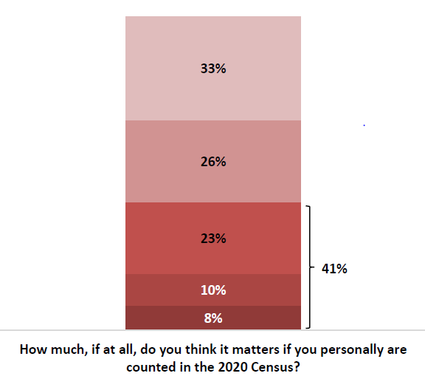
Does it matter if I’m personally counted?
A great deal
A lot
A moderate amount
A little
Not at all
Authorized Use Only

Slide 22
Does it matter if I’m personally counted?
Lack of Efficacy
They won’t ever come into the hood, give us stuff that we need, or give us anything. You go out where she at [a suburb] and you see parks and they get cleaned up, you see areas and centers and everything. Well, we have none of that. That’s why I see a thousand kids on the block every day…So many high schools been closed. [It’s connected to the census] because they not helping. They not giving us no money. Then they up there counting, taking counts for everybody for what?”
— Black or African American
Authorized Use Only

Slide 23
Does it matter if I’m personally counted?
Apathy
[I would not fill it out] just for not wanting to do it. Just not feeling like it… it kind of seems like taking a survey or something. Almost kind of pointless, like it doesn’t mean anything. It’s not going to help anyways or do anything. It’s more bothersome or more of a nuisance than anything, I guess.”
— Low Internet Proficiency
[I would not fill out the census because] I just don’t care.” — Chinese
Authorized Use Only

Slide 24
About one-quarter of respondents worry about confidentiality
28%
were “extremely concerned” or “very concerned” that the Census Bureau would not keep their answers confidential.
Authorized Use Only

Slide 25
About one-quarter of respondents are concerned the census shares data
24%
were “extremely concerned” or “very concerned” that the Census Bureau would share their answers with other government agencies.
Authorized Use Only

Slide 26
Privacy and confidentiality concerns in focus groups
Privacy Concerns
Privacy [is a reason why people would not fill out the census]. I think there’s a lot of people that are out there – I work in health and we have to keep things private – they probably think, ‘Why do I have to give you this?’”
— American Indian and Alaska Native
Authorized Use Only

Slide 27
Privacy and confidentiality concerns in focus groups
Confidentiality Concerns
Every single scrap of information that the government gets goes to every single intelligence agency, that’s how it works…individual level data. Like, the city government gets information and then the FBI and then the CIA and then ICE and military…”
— Middle Eastern and North African
Authorized Use Only

Slide 28
Nearly 1 in 4 respondents fear that their answers to the 2020 Census will be used against them
22%
were “extremely concerned” or “very concerned” that their answers would be used against them.
Authorized Use Only

Slide 29
Some focus group participants felt the government would use their data against their community
Harm to the Community
They could say, ‘Look, this community has, like, X amount of race or something; let’s avoid them, or let’s define that area’… you can see it sometimes where they don’t fund certain schools because it’s in certain ‘bad areas.’”
— Middle Eastern and North African
Authorized Use Only

Slide 30
…or them personally
Harm to them Personally
[Someone might choose not to participate because] it can come back and haunt them...Like if you get food stamps, ...and they will be afraid that it's going to affect their food stamps if they report somebody else is there.”
— Native Hawaiian and Pacific Islander
Authorized Use Only

Slide 31
The citizenship question may be a major barrier
Its purpose is to find undocumented immigrants
The political discourse is targeting their ethnic group – residents and citizens may also feel endangered
ICE is working with different groups on deportation sweeps, and it would make me feel like I’m aiding in that. They’re doing a lot of illegal stuff, and so I wouldn’t fill out any of the questions.”
— Middle Eastern and North African
[The purpose is] to make people panic… Some people will panic because they are afraid that they might be deported.”
— Vietnamese
For this census, a lot of people are afraid. It doesn’t matter if they ask you whether or not you’re a citizen. The first question they ask you, are you Hispanic or Latino? And that’s enough. That’s all they need. And people are scared.”
— Spanish (U.S. Mainland)
[Latinos will not participate] out of fear…[there] is practically a hunt [for us] …Latinos are going to be afraid to be counted because of the retaliation that could happen - it's like giving the government information, saying, ‘Oh, there are more here.’” — Spanish (U.S. Mainland)
Authorized Use Only

Slide 32
Distrust is highest for the federal government
59%
55%
47%
said they did not trust
the federal government
said they did not trust
their state government
said they did not trust
their local government
Authorized Use Only

Slide 33
Focus group participants who distrust the government do so strongly
[The government will sell personal information] in a heartbeat.”
— Rural
The U.S. Census Bureau is connected to the U.S. government. I don’t trust the government not one bit, so I wouldn’t even if they told me this is what we’re going to do I wouldn’t.”
— Black or African American
The government has always been intrusive as it is, and it’s probably a level of intrusion. That’s why people are like, ‘Hold on, what you want to know what’s in my bed, at my house, and who’s using my toilet? You should go mind your business.’”
— Native Hawaiian and Pacific Islander
Authorized Use Only

Slide 34
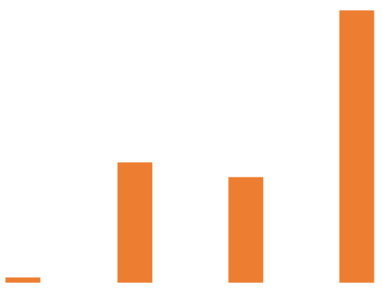
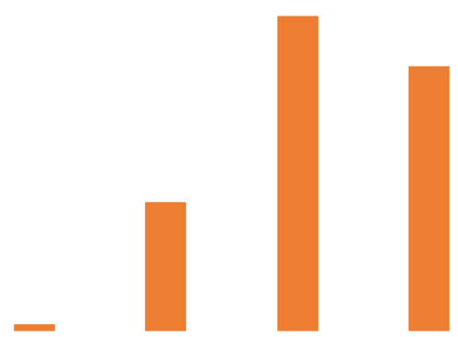
More feel the 2020 Census benefits the community than them personally
Do you believe answering your 2020 Census form could benefit or harm [your community/you] in any way?
Your Community
You
54%
Benefit
37%
Neither benefit
nor harm
21%
44%
Both benefit
and harm
24%
18%
1%
Harm
1%
Authorized Use Only

Slide 35
Potential Motivators & Facilitators
Authorized Use Only

Slide 36
Survey respondents chose funding for public services as the single most important reason to respond
What is the one most important reason to fill out the census?
Helps determine funding for
public services in my community
It is my civic duty
Contributes to a better
future for my community
Provides information for my
local government to plan for changes
Determines my state’s number
of elected representatives
Authorized Use Only

Slide 37
Public services are important to nearly all respondents
Most Important Motivators
94%
Hospitals and healthcare
Fire departments
Police departments
Roads and highways
Enforcement of civil rights laws
Schools and education system
Civic duty
Contributing to a better future
for community
94%
92%
92%
86%
85%
82%
81%
Authorized Use Only

Slide 38
According to the focus groups, what would motivate people to participate?
Schools & Education System
Conditions that need to be met to be most compelling
Our schools need help. The schools here do need help. It hasn’t been that long since the school system was shook up pretty bad, so it does need help, and I don’t know about the fire departments.” — Low Internet Proficiency
1
Information about the census and its impact
2
Tangible evidence
Better Future for Community
[I would fill it out] because that data is going to impact my community. And if it’s not my community, because I die, then my grandchildren and my children.”
— Spanish (U.S. Mainland)
3
Connection to a better future
Authorized Use Only

Slide 39
Focus group results imply community can assuage skepticism
According to many focus group participants, trusted voices and organizations with deep community roots may facilitate participation among the most skeptical by:
Providing information about the community funding and the general census process
Assuring people that participation is safe
Authorized Use Only

Slide 40
Trusted voices and organizations
Most definitely [my church would assure me if I had concerns about filling out the census form].” — Rural
Those who are representing and helping the Hispanic communities [would assure me my information is safe]…Those who are independent, who support all the Hispanics. Those who are now helping [with] DACA and all those young people.”
— Spanish (U.S. Mainland)
Somebody raised in the city, knows the hardships, and something like that, not somebody that just got elected to be somebody.”
— Black or African American
Authorized Use Only

Slide 41
4
2020 CBAMS
Conclusions & Recommendations
Authorized Use Only

Slide 42
Connecting Census & Community Funding
Helps determine funding for
public services in my community
Although people identified “helps determine funding for public services in my community” as the most important reason to fill out the census…
It is my civic duty
…only 45% of people know that the census is used to determine community funding.
Contributes to a better
future for my community
Provides information for my
local government to plan for changes
Determines my state’s number
of elected representatives
Authorized Use Only

Slide 43
Big Picture Conclusions
Knowledge Gaps
There is a general lack of knowledge about the census’ scope, purpose, and constitutional foundation
Connecting census participation to support for local communities may address apathy and lack of efficacy
Barriers
Apathy and lack of efficacy
Privacy concerns
Fear of repercussions
Distrust of government
Few Perceived Personal Benefits
Informing the public on the census’ scope, purpose, and process may address privacy and confidentiality concerns and fear of repercussions
Engaging trusted voices may address trust-based concerns, especially among the most skeptical and disaffected
Motivators
Funding for community needs is the most influential motivator across audiences
Services such as hospitals, fire departments, and schools are important to many respondents
Authorized Use Only

Slide 44
5
2020 CBAMS Mindsets
Authorized Use Only

Slide 45
Creating Candidate Mindsets
For the 2020 mindsets, we used a mathematical approach to balance two goals:
Cluster individuals into cohesive groups with similar attitudes/behaviors.
Have mindset groupings that are distinct from each other.
Creating the candidate mindsets involved five steps:
Step 1: Use principal component analysis (PCA) to distill 50+ CBAMS questions into a smaller number of factors.
Step 2: Cluster algorithms to group into candidate mindsets.
Step 3: Select a final mindset solution.
Step 4: Name the mindsets and develop easy-to-understand personas.
Step 5: Use mindsets to inform the communications program.
Authorized Use Only

Slide 46
Big Picture: Mindsets
Eager Engagers
Fence Sitters
Confidentiality Minded
19% of U.S. Population
32% of U.S. Population
15% of U.S. Population
82%
Intent to Respond
71%
Intent to Respond
63%
Intent to Respond
Head Nodders
Wary Skeptics
Disconnected Doubters
9% of U.S. Population
14% of U.S. Population
10% of U.S. Population
60%
Intent to Respond
Intent to Respond
51%
Intent to Respond
59%
Note: U.S. population percentages do not add to 100% due to rounding error.

Slide 47
Questions?
monica.j.vines@census.gov
Authorized Use Only

