Slide 1
Texas Demographic Conference
Cathy L. Lacy , Regional Director
U.S. Census Bureau – Denver Region

Slide 2
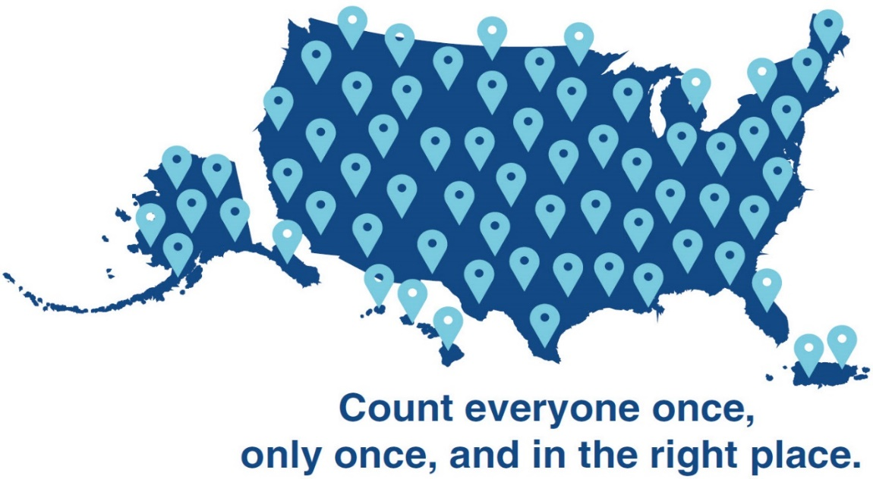
Road to the 2020 Census
SELF-RESPONSE
GROUP QUARTERS
MOTIVATE PEOPLE TO RESPOND
NONRESPONSE FOLLOWUP
ESTABLISH WHERE TO COUNT
TABULATE DATA AND RELEASE CENSUS RESULTS

Slide 3
Self Responding Has Never Been Easier!

Slide 4
Confidentiality Is Key
Title 13 of the Code of Federal Regulations requires us to keep everyone’s information confidential
We cannot share responses with immigration, law enforcement, or allow information to be used to determine eligibility for benefits
We can only use the information we collect for statistical purposes.
All people living in Texas will be counted –
Once, Only Once, and In The Right Place
Notes:
Those you serve should feel comfortable responding. The law requires the Census Bureau to keep everyone’s information confidential. By law, your responses cannot be used against you by any government agency or court in any way. The Census Bureau will not share an individual’s responses with immigration enforcement agencies, law enforcement agencies, or allow that information to be used to determine eligibility for government benefits. Title 13 makes it very clear that the data we collect can only be used for statistical purposes—we cannot allow it to be used for anything else, including law enforcement.

Slide 5
Responding Is More Important Than Ever
Results of the census impact funding for:
Schools and education
Healthcare facilities
Public transportation
Housing assistance
Child and food assistance programs
Career and technical education grants

Slide 6
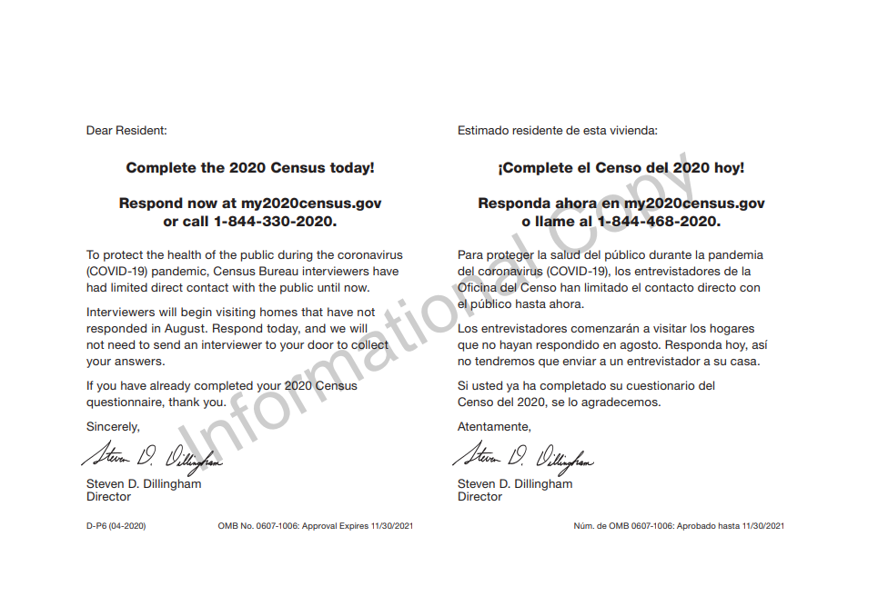
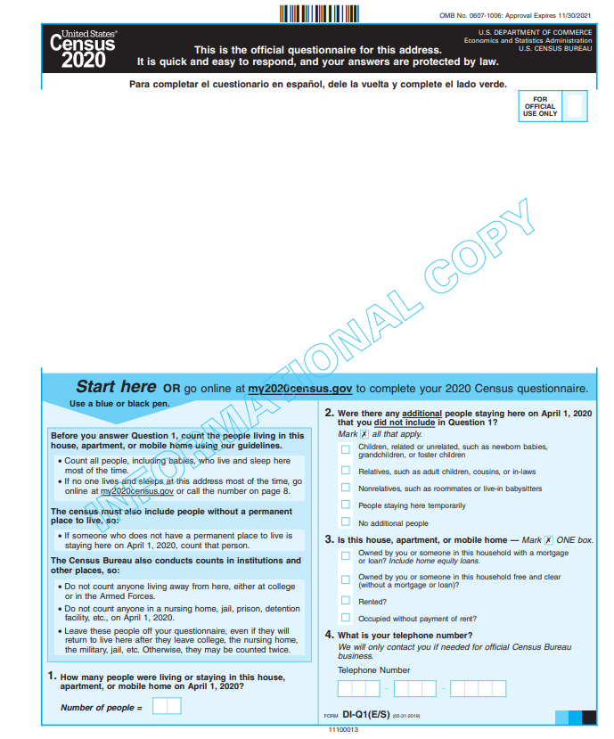
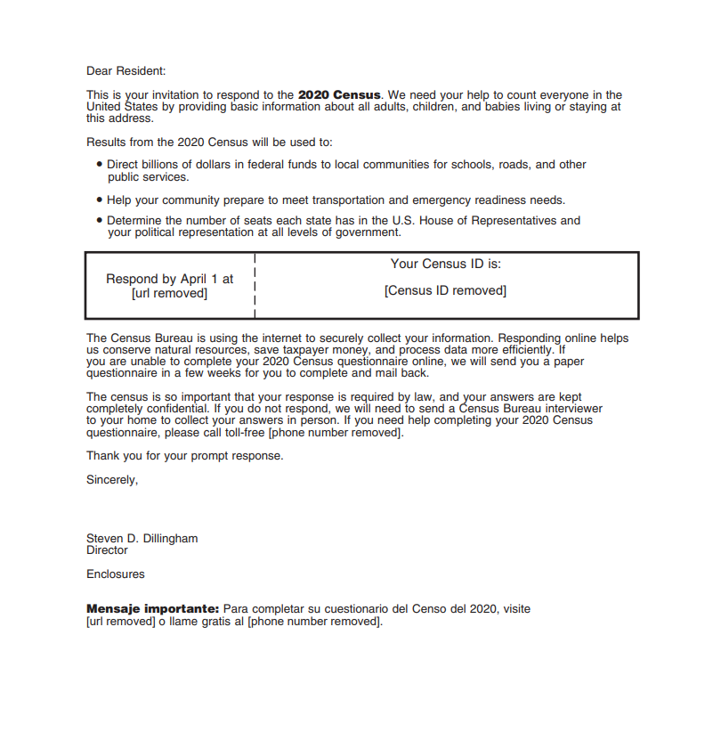
2020 Census Mailouts
Initial Invitation
Reminder Letter
Reminder Postcard
Reminder letter and Paper Questionnaire
Final Reminder Postcards – Last week

Slide 7
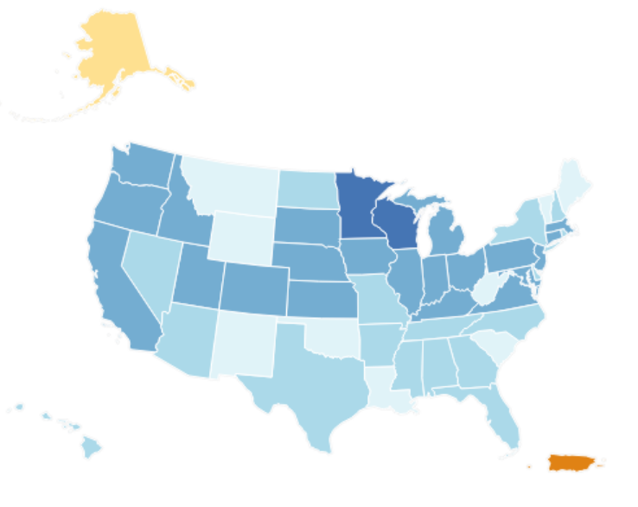
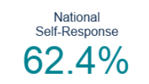
2020 Census Response Rates
www.2020census.gov/response-rates

Slide 8
Self Response Rate in Texas 57.2%

Slide 9
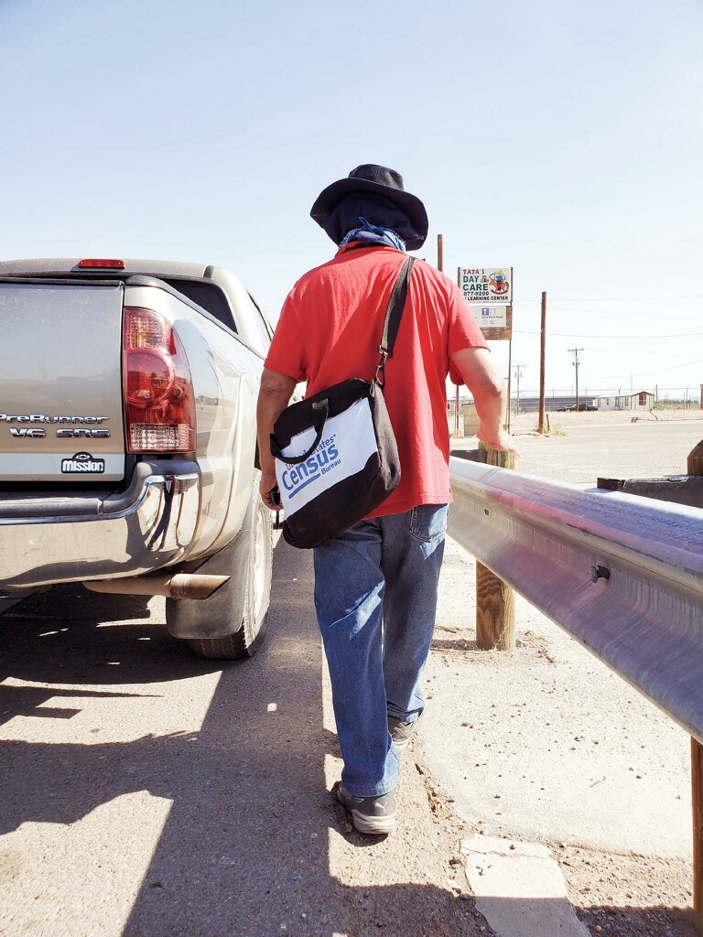
2020 Census
Operational Update

Slide 10
Adjusted Operational Timeline
Operation | Original Schedule: | New Schedule
Self Response Phase | 3/12-7/31 | 3/12-10/31
Group Quarters (E-response and Paper Enumeration) | 4/2-6/5 | 4/2-9/3
Update Leave | 3/15-4/17 | 5/4 – 7/10
Nonresponse Follow-up | 5/13-7/31 | 8/11-10/30
In-Person Group Quarters Enumeration | 4/2-6/5 | 7/1-9/3
Services Based Enumeration | 3/30-4/1 | 9/22-9/24
Mobile Questionnaire Assistance | 3/30-7/31 | Varies
Count of People experiencing Homelessness | 4/1 | 9/22-9/24
Enumeration of Transitory Locations | 4/9-5/4 | 9/3-9/28
Deliver Apportionment Counts to the President | 12/31 | By 4/30/21
Deliver Redistricting Counts to the States | By 4/1/21 | By 7/31/21

Slide 11
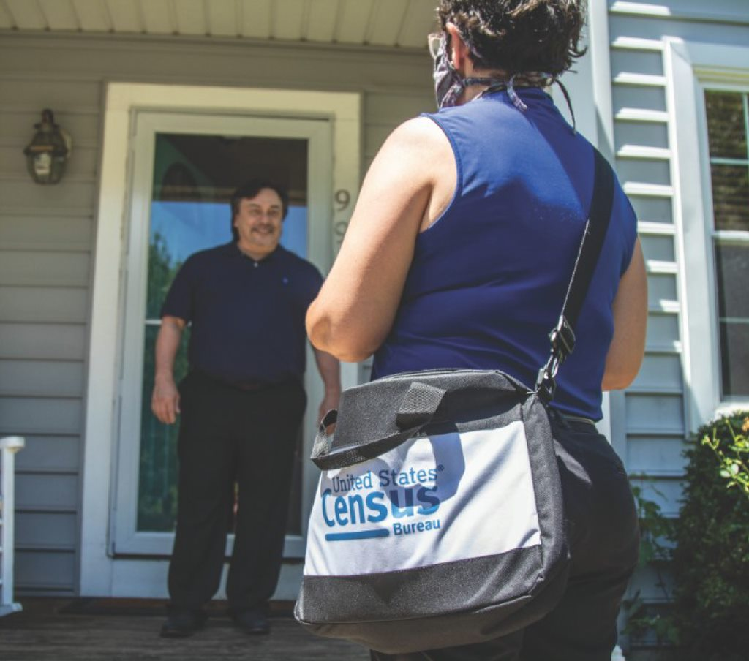
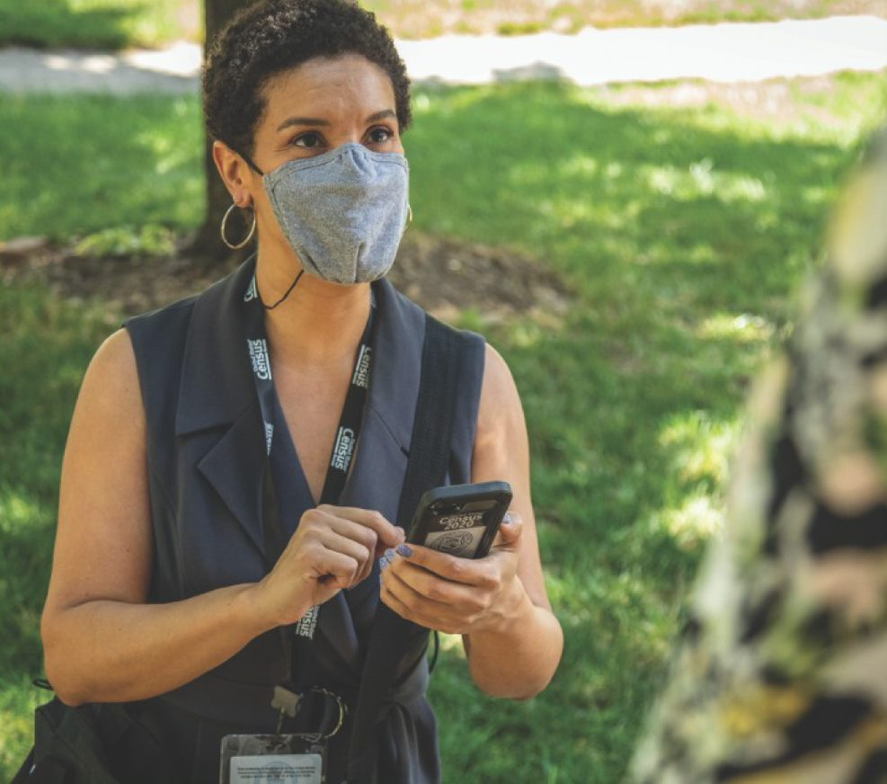
Nonresponse Follow-up
Start 8/11 – 10/31
Personal Visit to Non-responding Households to complete the Census questionnaire
Hand-held device
Mask
6-foot distancing from Respondents
KEY MESSAGE: It’s not too late to respond to the 2020 Census while being safe and practicing social distancing at home. Once you have responded, please encourage your family, friends and loved ones to complete the census too.

Slide 12
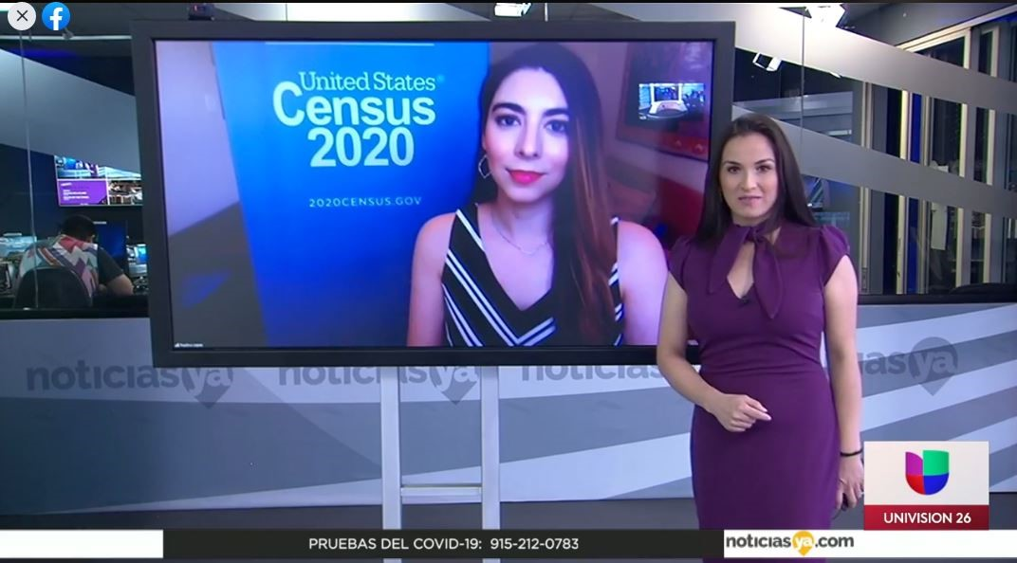
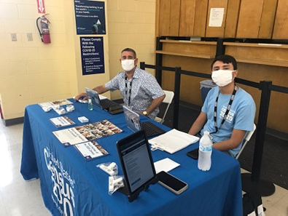
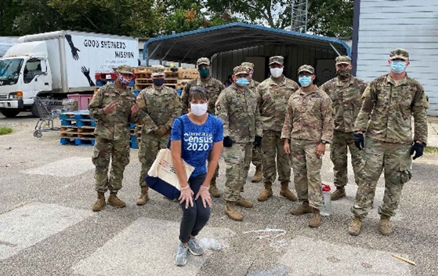
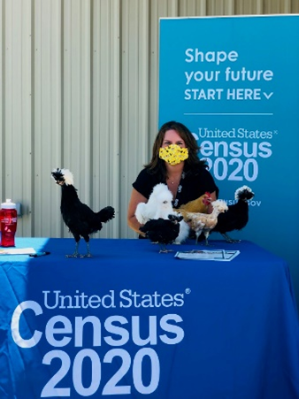
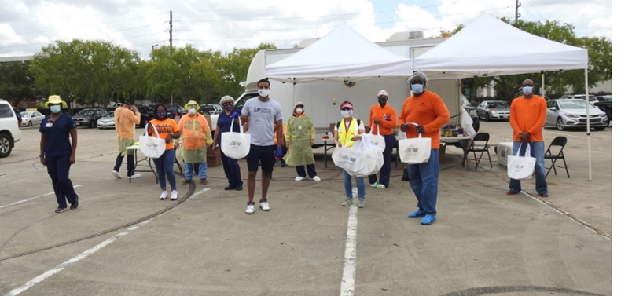
Outreach During A Pandemic

Slide 13
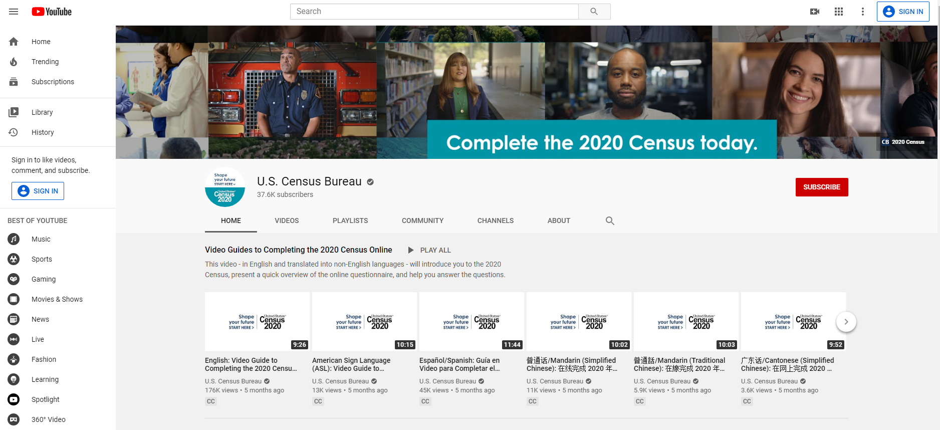
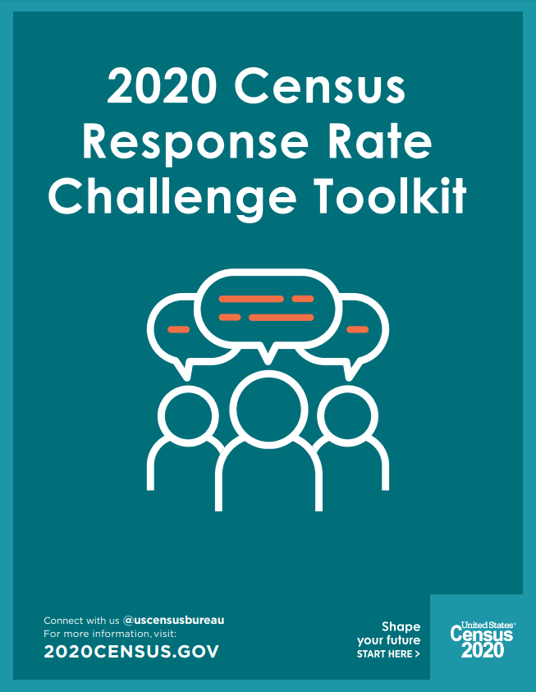
Resources Available – www.2020census.gov/partners

