Slide 1
Census Has Business Data?
An Update on the
2017 Economic Census Data Released for Texas (plus other updates…)
Economic Census webinar
July 27th, 2020
Presented by: Andrew W. Hait
U.S. Census Bureau
TX SDC - 2017 EC webinar | July 2020| 1
Notes:
Good afternoon, Introduce self.
States covered in today’s Economic Census webinar are: Iowa, Nebraska, and South Dakota

Slide 2
About the Census Bureau
The U.S. Census Bureau is the federal government’s largest statistical agency.
We conduct more than 130 censuses and surveys each year, including
The Decennial Census – the once-a-decade population and housing count of the United States
The American Community Survey – the ongoing annual survey of the nation’s population
The Census of Governments – identifies the scope and nature of the nation's state and local government sector
The Economic Census – the official five-year measure of American business
Our mission is to serve as the leading source of quality data about America’s people, places, and economy.
https://www.census.gov/
TX SDC - 2017 EC webinar | July 2020 | 2
Notes:
Go through each bullet point.

Slide 3
Monthly
and Quarterly
Surveys
Annual Surveys
Economic Census – Every 5 years
Census Economic Surveys
Census Bureau Economic Surveys are a key source for official statistics companies can use:
Monthly and Quarterly are small sample surveys that provide the most TIMELY data available
Annual surveys have larger samples and provide the most up-to-date TREND data available
Every 5 years, the Economic Census measures all businesses and provides the most COMPREHENSIVE data available
These surveys set the standard for U.S. economic statistics, and are fueled by the data provided by individual businesses
TX SDC - 2017 EC webinar | July 2020 | 3
Notes:
Go through the pyramid and points below.

Slide 4
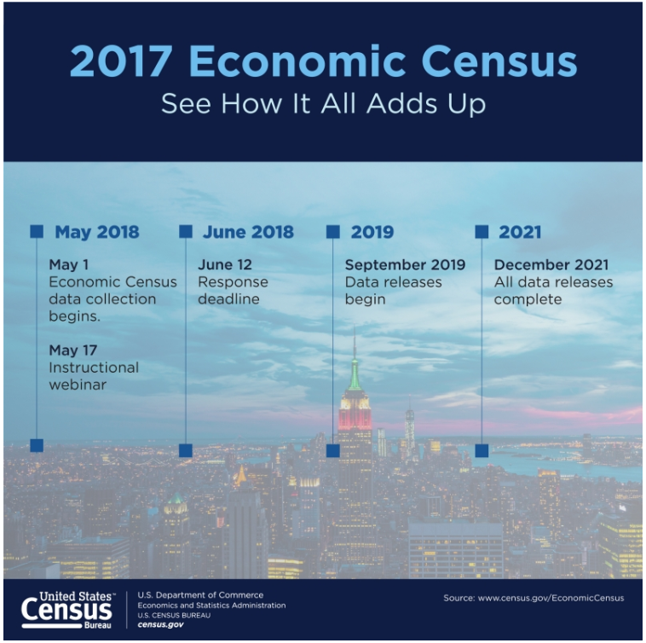
The Economic Census (EC)
NAICS: Every 2- thru 6-digit code covered by the Census Bureau
Excludes Agriculture (NAICS 11) and other selected types of business (see https://www.census.gov/programs-surveys/economic-census/guidance/understanding-naics.html#par_textimage for full list of exclusions)
Geography: Provides data at the national, state, metro area, county, and place levels
Other Dimensions: Data by business size, Franchise status, etc.
Over 200 data variables shown, including variables like the number of establishments, employment, payroll, and sales plus sector-specific variables (inventories, assets, expenses, etc.)
Product Lines data
Released on data.census.gov, Census Business Builder, and other Census tools
TX SDC - 2017 EC webinar | July 2020 | 4
Notes:
Go thru each bullet point.
Banners on the right include an example of a ECON Census promotion advertisement, and the tentative schedule of releases.

Slide 5
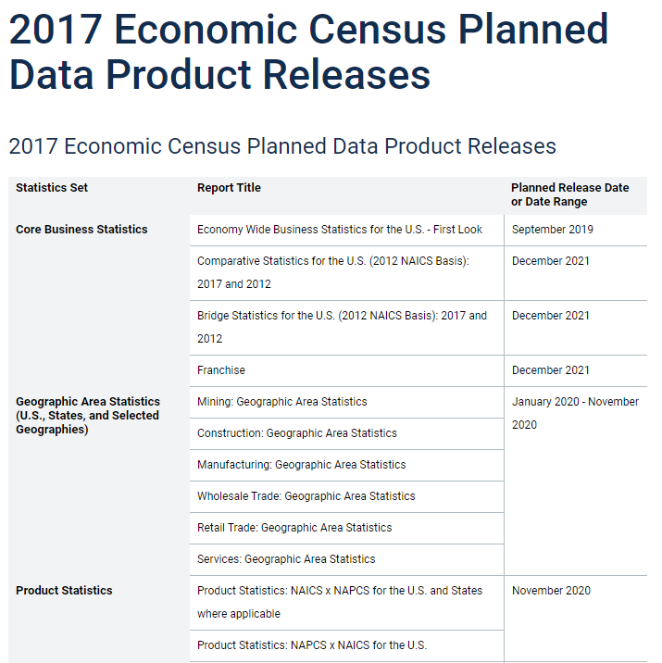
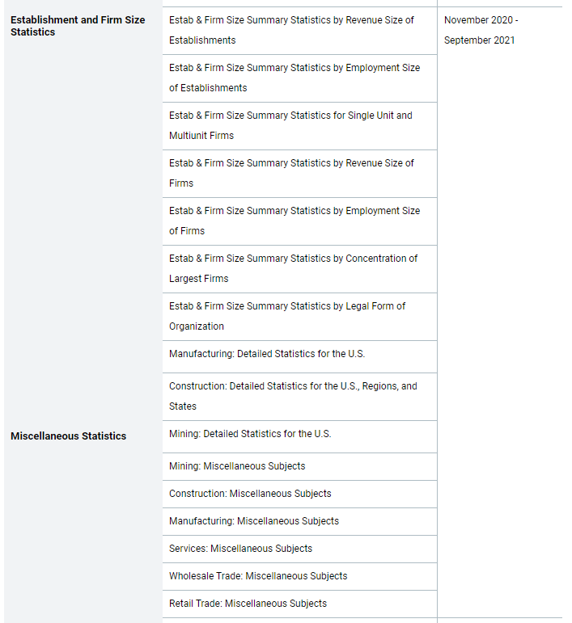
https://www.census.gov/programs-surveys/economic-census/about/release-schedules.html
TX SDC - 2017 EC webinar | July 2020 | 5
Notes:
This is the schedule of when 2017 ECON Census data releases are planned for. GAS data releases are expected by November 2020. The entire set of data will be completed by December 2021.
In the red box is a link that takes you directly to this updated release schedule.

Slide 6
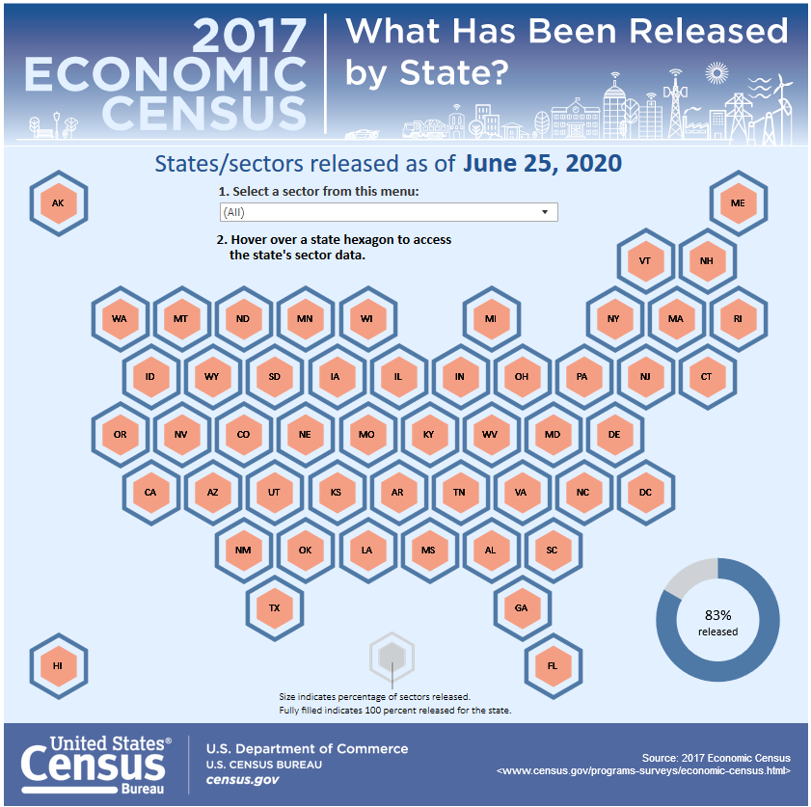
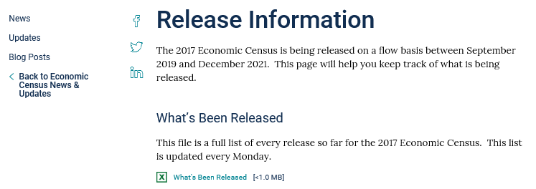
2017 Economic Census GAS Release Resources
https://www.census.gov/programs-surveys/economic-census/news-updates/releases.html
TX SDC - 2017 EC webinar | July 2020 | 6
Notes:
The infographic on the right displays the states that have released data from the 2017 Economic Census. By clicking on each individual state, you can get a better idea of which NAICS sectors have been released for that state, and it also includes a direct link to the data source.
You can also sort at the top of the infographic the NAICS sectors, to see what percentage of the sectors have been released thus far. The percentage marker on the bottom right will automatically refresh based on your selections.
The infographic can be found at this link in the top red box (Click on link)
After going through the infographic, back to slide to explain that the states were are covering today were released on April 23rd

Slide 7
Key Changes in the 2017 Economic Census
Geographic area changes (counties, places, metros)
No ZIP Code data (see ZIP Code Business Patterns)
No Place data for Manufacturing
North American Industry Classification System (NAICS) changes
The New North American Product Classification System (NAPCS) (replaces old “Product Lines” tables)
Other changes, including:
New Disclosure Rules (and their impacts)
New Data.census.gov dissemination platform
For a summary of the key changes, view our recorded webinar at https://www.census.gov/data/academy/webinars/2019/2017-econ-census.html
TX SDC - 2017 EC webinar | July 2020 | 7
Notes:
Go through each bullet point
Be sure to point out red box at the bottom includes a link to our previously recorded webinar that explains key changes to the 2017 Economic Census.

Slide 8
Geographic Area Changes for
Texas
Visit https://www.census.gov/programs-surveys/economic-census/geographies.html for more information
Dallas-Fort Worth TX-OK CSA now includes a new Micro Area (Bonham)
694 economic place changes
377 Places with Area Gain
251 Places with Area Loss
7 Places with a name change
40 New Places
6 Dropped Places
Dropped Places
COUNTY Code | TITLE | PLACE Code | TITLE
000 | Cross-Over Place Total | 37936 | Jollyville CDP
 |  | 54432 | Overton city
023 | Baylor County | 66968 | Seymour city
095 | Concho County | 22552 | Eden city
187 | Guadalupe County | 45948 | McQueeney CDP
323 | Maverick County | 41583 | Las Quintas Fronterizas CDP
401 | Rusk County | 54432 | Overton city
423 | Smith County | 54432 | Overton city
453 | Travis County | 37936 | Jollyville CDP
491 | Williamson County | 37936 | Jollyville CDP
Visit https://tigerweb.geo.census.gov/tigerwebecon/ for online map resources to better understand the changes
TX SDC - 2017 EC webinar | July 2020 | 8
Notes:
Examples:
Arlington city – Area Gain
Dallas city – Area Loss

Slide 9
NAICS
The standard used by US Federal statistical agencies to classify businesses
Developed by OMB, Statistics Canada, and Mexico’s stat agency (INEGI)
Helps ensure statistical comparability across North American countries
Adopted in 1997 and updated every 5 years (see the 2017 NAICS Manual)
Types of Changes
One-to-One (Recodes), Many-to-One (Combos), and Many-to-Many
One-to-Many (Splitters) (none for 2017, few in 2012)
TX SDC - 2017 EC webinar | July 2020 | 9
Notes:
Go thru the bullet points.

Slide 10
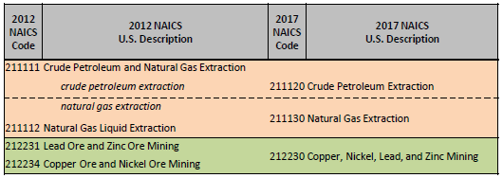
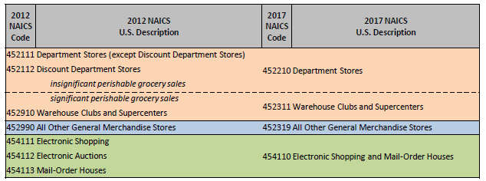
NAICS Changes for 2017
Mining
Manufacturing
Retail Trade
Visit the NAICS website for more information (https://www.census.gov/eos/www/naics/)
TX SDC - 2017 EC webinar | July 2020 | 10
Notes:
Explain an example of changes for each: (Salmon color = name change/NAICS change; Blue = NAICS change only; Green= Merged NAICS change)
Mining: Crude petroleum and natural gas extraction (211111) has changed to Crude Petroleum Extraction (211120) (Natural gas part split off and combined with Natural Gas Liquid Extraction)
Manufacturing: Pump and pumping equipment MFG and Measuring and Dispensing pump MFG has merged to become Measuring, Dispensing, and Other Pumping Equipment Manufacturing.
Retail Trade: Warehouse Clubs and Supercenters has a NAICS code change of 452910 to 452311 but now includes businesses with significant perishable goods sales that used to be classified in 452112 (name is the same but content is NOT)

Slide 11
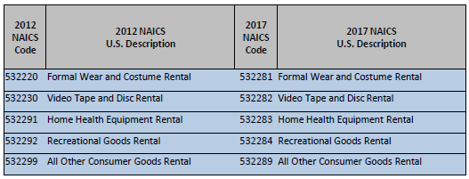
NAICS Changes for 2017 (cont.)
Information
Real Estate & Rental & Leasing
Professional, Scientific, and Technical Services
TX SDC - 2017 EC webinar | July 2020 | 11
Notes:
Explain an example of changes for each: (Salmon color = name change/NAICS change; Blue = NAICS change only; Green= Merged NAICS change)
Info: one combo and 2 recodes
RE: 5 recodes
Prof: Only sector with a truly new industry (R&D in Nanotechnology)

Slide 12
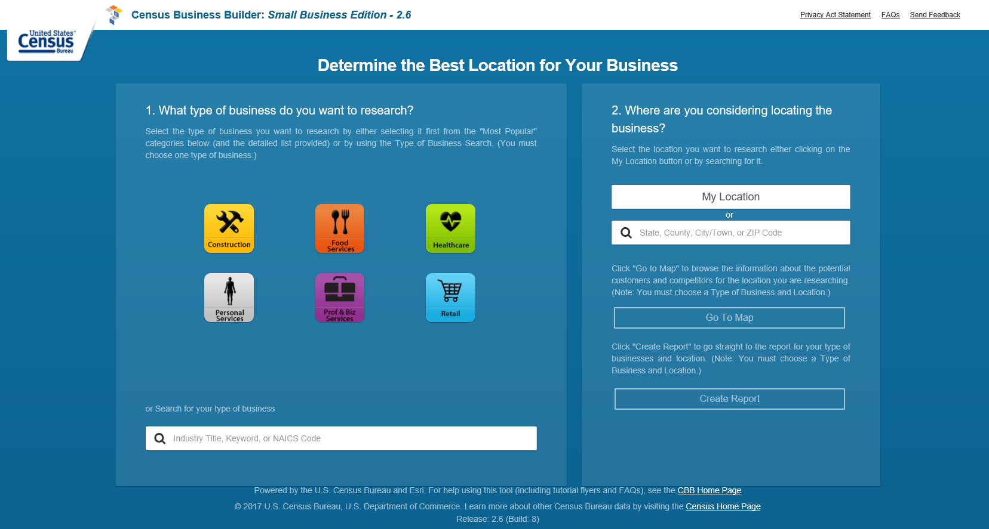
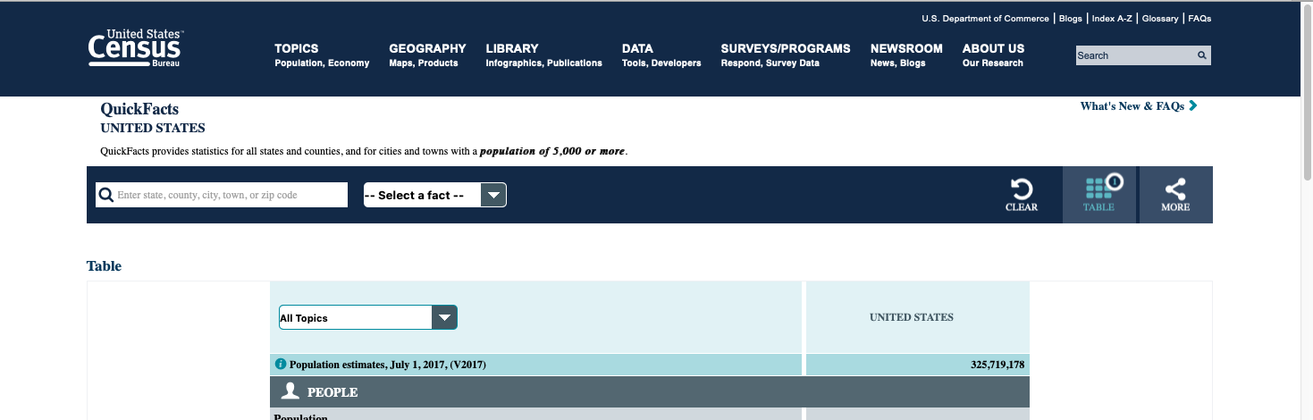
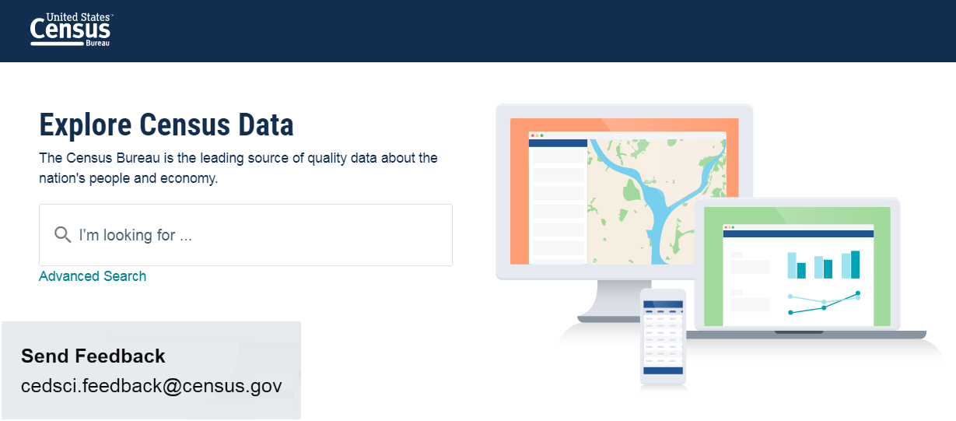
Where to Access the 2017 Economic Census Data
Census Business Builder 3.1
QuickFacts
Data for cities and towns with population 5,000 or more
Data.census.gov
TX SDC - 2017 EC webinar | July 2020 | 12
Notes:
These are the three data tools you can use to obtain Economic Census data: Quickfacts, Census Business Builder (coming in Aug in release 3.1) and the new data dissemination platform that has replaced American FactFinder (Data.census.gov)

Slide 13
Selected Findings for Texas
NA
NA
NA
NA
NA
NA
Note: Revenue data not available at the state level for the Utilities, Information, and Finance and Insurance sectors.
TX SDC - 2017 EC webinar | July 2020 | 13
Notes:
Wholesale – top sector in 2017 (of published sectors): $1.2 trillion (we’ll see where this ranks once Manufacturing is released)
Wholesale also saw the largest increase in revenue between 2012 and 2017 (of published sectors): up $77.4 billion (Retail was # 2) No sectors were DOWN

Slide 14
TX SDC - 2017 EC webinar | July 2020 | 14

Slide 15
TX SDC - 2017 EC webinar | July 2020 | 15

Slide 16
TX SDC - 2017 EC webinar | July 2020 | 16

Slide 17
TX SDC - 2017 EC webinar | July 2020 | 17

Slide 18
TX SDC - 2017 EC webinar | July 2020 | 18

Slide 19
TX SDC - 2017 EC webinar | July 2020 | 19

Slide 20
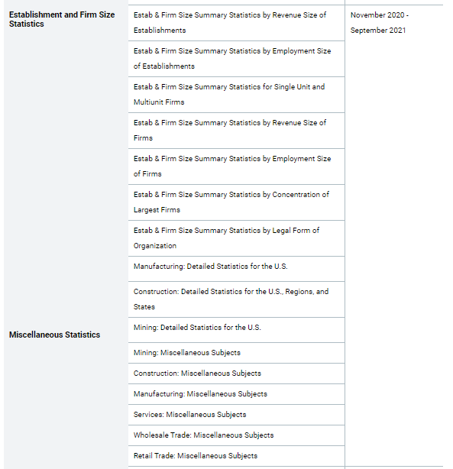
What’s Coming Next
North American Product Classification System (Nov 2020)
Product Lines provide a breakout of the products made and sold and services provided by businesses
In 2012 EC, data for Mining & Manufacturing, Construction, and Other Sectors released separately
Establishment & Firm Size releases (Nov 2020 – Sept 2021)
Consolidated into 7 tables (separate tables in 2012); Size categories standardized
Miscellaneous Subjects tables
38 tables dropped and 7 tables added
Consolidation of Class of Customer, Enterprise Support, and Exported Services releases
Visit the NAPCS website and Concordance Tables for more information (https://www.census.gov/programs-surveys/economic-census/guidance/understanding-napcs.html)
TX SDC - 2017 EC webinar | July 2020 | 20
Notes:
Go thru each bullet point.

Slide 21
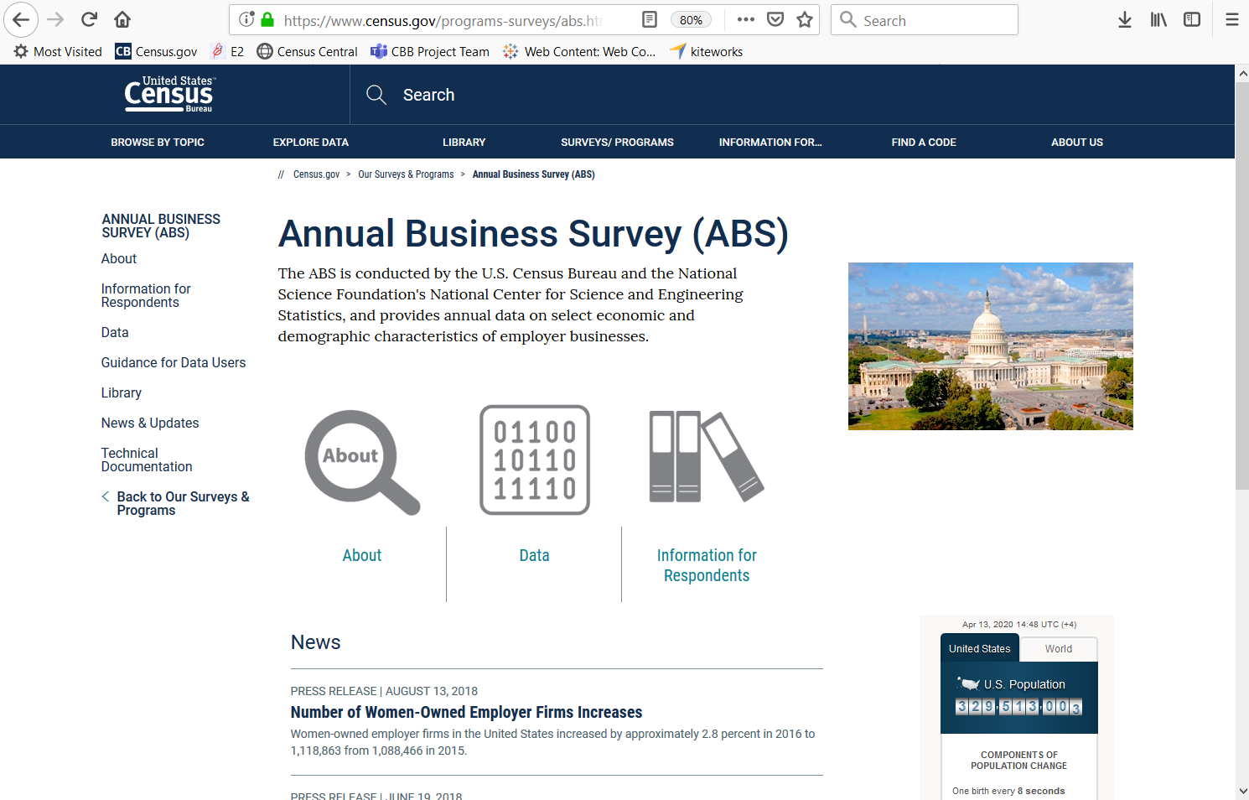
The NEW Annual Business Survey
Provides similar data as the SBO and ASE
Data on business ownership by race, ethnicity, gender, and veteran status for employer businesses
Geographies
Nation and State by 2- thru 6-digit NAICS
County, Metro, and Place by 2-digit NAICS
Released May 19th
https://www.census.gov/programs-surveys/abs.html
TX SDC - 2017 EC webinar | July 2020 | 21

Slide 22
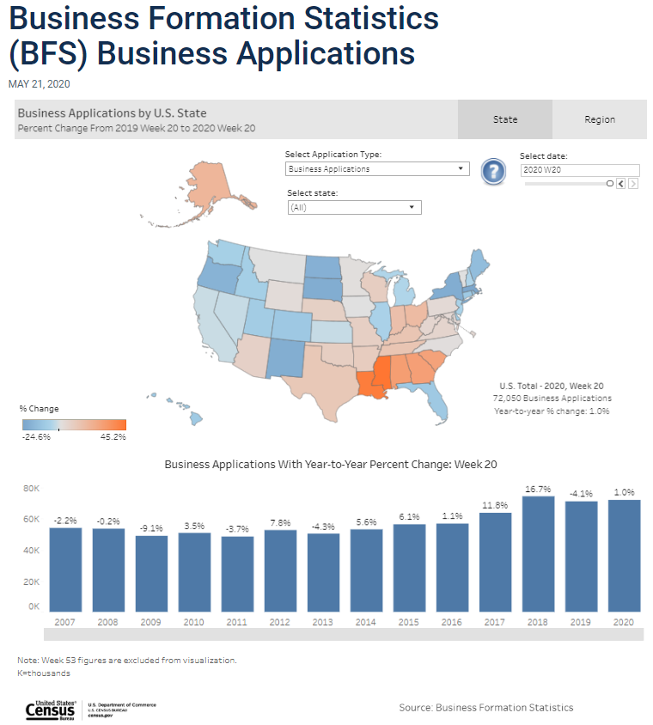
The UPDATED Business Formation Statistics
Provides weekly data on Business Applications and Formations
Data on Total Business Applications, plus breakout for
BAs from Corporations
High Propensity Bas
BAs with Planned Wages
Estimate and Year-to-Year % change
Geographies
Nation, Region, and State (no NAICS detail)
Released May 21st
https://www.census.gov/econ/bfs/index.html?#
https://www.census.gov/library/visualizations/interactive/bfs-weekly-business-applications.html
TX SDC - 2017 EC webinar | July 2020 | 22

Slide 23
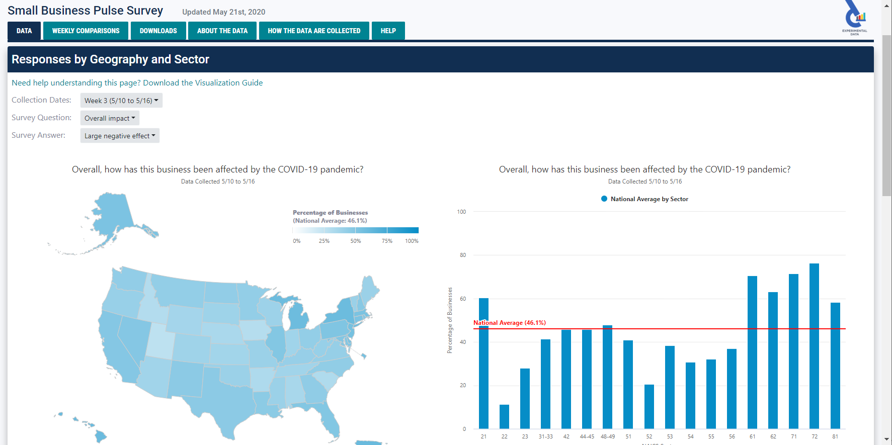
The NEW Small Business Pulse Survey
Measures the changes in business conditions on small businesses during the COVID-19 pandemic
Data on the overall impacts to small businesses of coronavirus as well as specific impacts
Geographies
Nation and State by 2- thru 6-digit NAICS
Released May 14th
https://www.census.gov/data/experimental-data-products/small-business-pulse-survey.html
TX SDC - 2017 EC webinar | July 2020 | 23

Slide 24
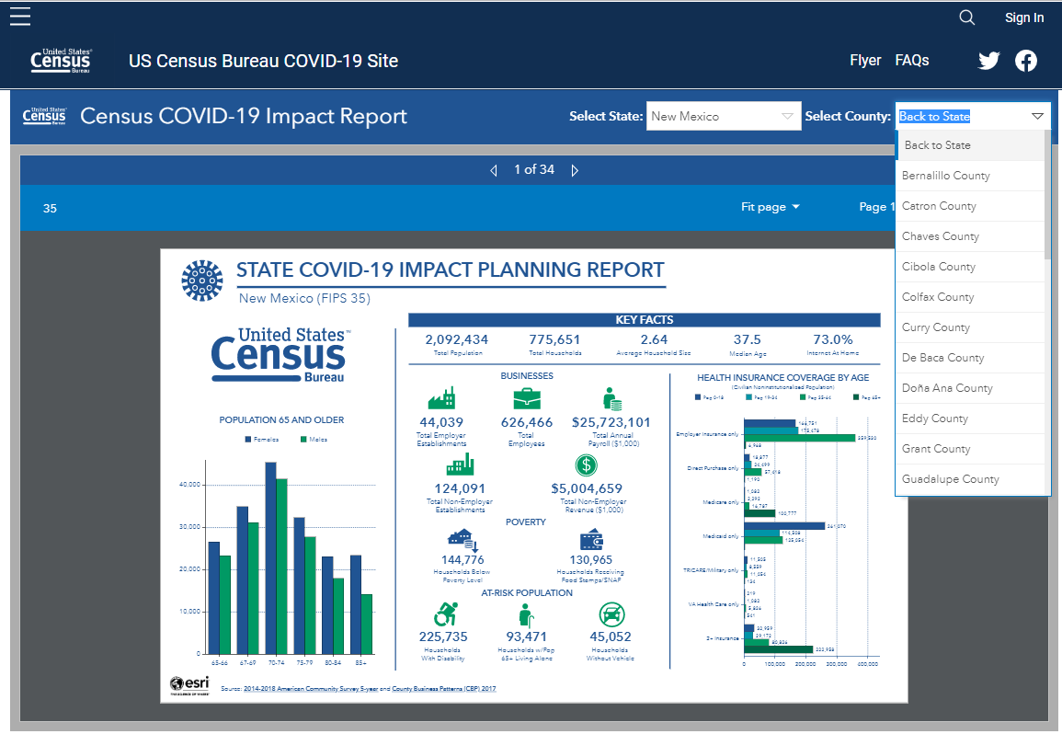
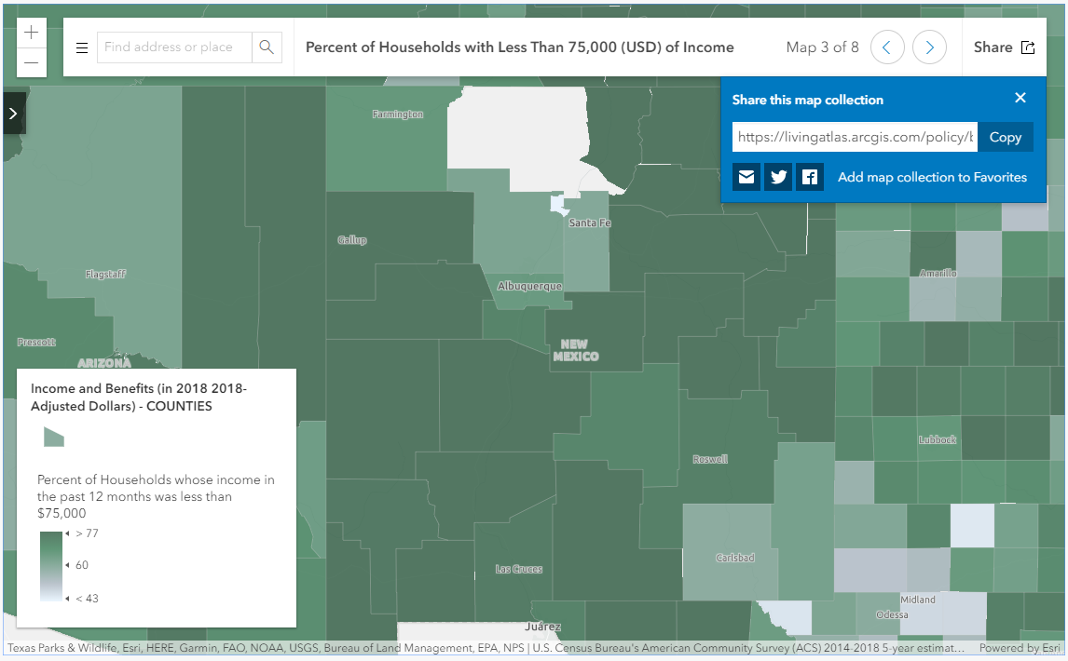
New COVID-19 Hub
https://covid19.census.gov/
https://www.census.gov/topics/preparedness/events/pandemics/covid-19.html
TX SDC - 2017 EC webinar | July 2020 | 24

Slide 25
Summary
The Economic Census provides a wealth of business data
Learn more at https://www.census.gov/programs-surveys/economic-census.html
The data are released on a flow basis (all states/sectors will be complete in August 2020) and more data is coming
Learn more at https://www.census.gov/programs-surveys/economic-census/news-updates/releases.html
Geography and NAICS changes… make sure data are comparable
Learn more at https://www.census.gov/programs-surveys/economic-census/geographies.html and https://www.census.gov/eos/www/naics/
The 3 new COVID-related programs and Hub provide timely data that can help in the recovery from the COVID-19 Pandemic
TX SDC - 2017 EC webinar | July 2020 | 25
Notes:
Go thru each bullet point and explain links.

Slide 26
Q & A and Thank You!
Contact me at:
Andrew.W.Hait@census.gov
(301)763-6747
TX SDC - 2017 EC webinar | July 2020 | 26
Notes:
Thank attendees and open up the phones for questions.

