Slide 1





Earnings and Employment Outcomes Data Using LEHD’s New and Enhanced Explorer Tools
Texas State Data Center
July 29, 2020
Presenter: Earlene Dowell

Slide 2
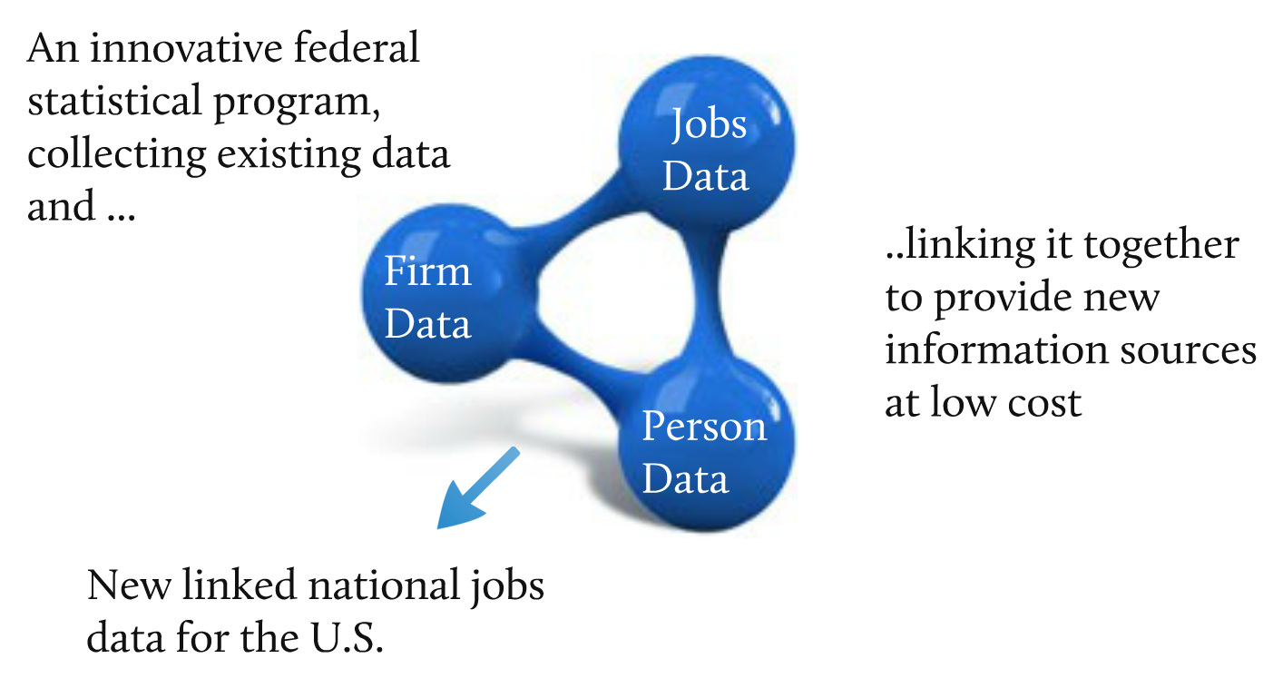
What is LEHD?
The LEHD Program at Census
Notes:
Unlike ACS and the economic census the Longitudinal Employer-Household Dynamics Program or the LEHD Program at the US Census Bureau has constructed unique linked employer-employee data for the United States.
It connects administrative records with census and survey data to produce new public-use data products as well as microdata for research.
The Local Employment Dynamics Partnership or LED is a voluntary federal-state partnership developed in the 1990 with just a few states. Currently we have 52 states and territories in the partnership including DC, the Virgin Islands, and Puerto Rico. In 2019 LED celebrated it’s 20th Anniversary.
Its main purpose is to merge employee data and employer data to produce a collection of enhanced labor market statistics with state-of-the-art confidentiality protection.
Under the partnership, states send their Unemployment Insurance Wage (UI) Records and their Quarterly Census of Employment Wage (QCEW) data, which the LEHD Program combines with Censuses and surveys to create new dynamic information on workers.
The UI gives us jobs data, the QCEW gives us firm data, and our person data comes from the Censuses and surveys
In addition to the public-use data, LEHD microdata is available for research use in approved projects. Researchers interested in using restricted-use LEHD data must submit a proposal to conduct research at a secure Census Research Data Center.

Slide 3
Longitudinal Employer-Household Dynamics (LEHD)
Where Data is Published:
Data Product | Explore the data, answer questions, or get visualizations | Bulk data for use in analysis process/software | Live queries for building web applications
QWI | QWI Explorer | LED Extraction Tool and Raw data download | Census Bureau API
LODES | OnTheMap OnTheMap for Emergency Management | Raw data download | Future development
J2J | J2J Explorer | Raw data download | Future Development
PSEO | PSEO Explorer | Raw data download | Future Development
VEO | VEO Explorer | Raw data download | Future Development

Slide 4

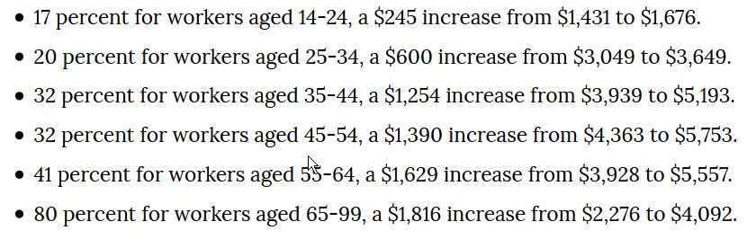
Notes:
Based on an article published on Census’s America Counts, my colleague Jim Spletzer found that older people working longer, earn more.
His findings are the following. From 1994 – 2015, the growth of average monthly earnings of older workers is greater than those of any age group.
Jim used the LED Extraction Tool, which enables streamlined access to the raw public-use data . This easy to use tool provides CSV files for the exact variables and characteristics requested by the users.

Slide 5
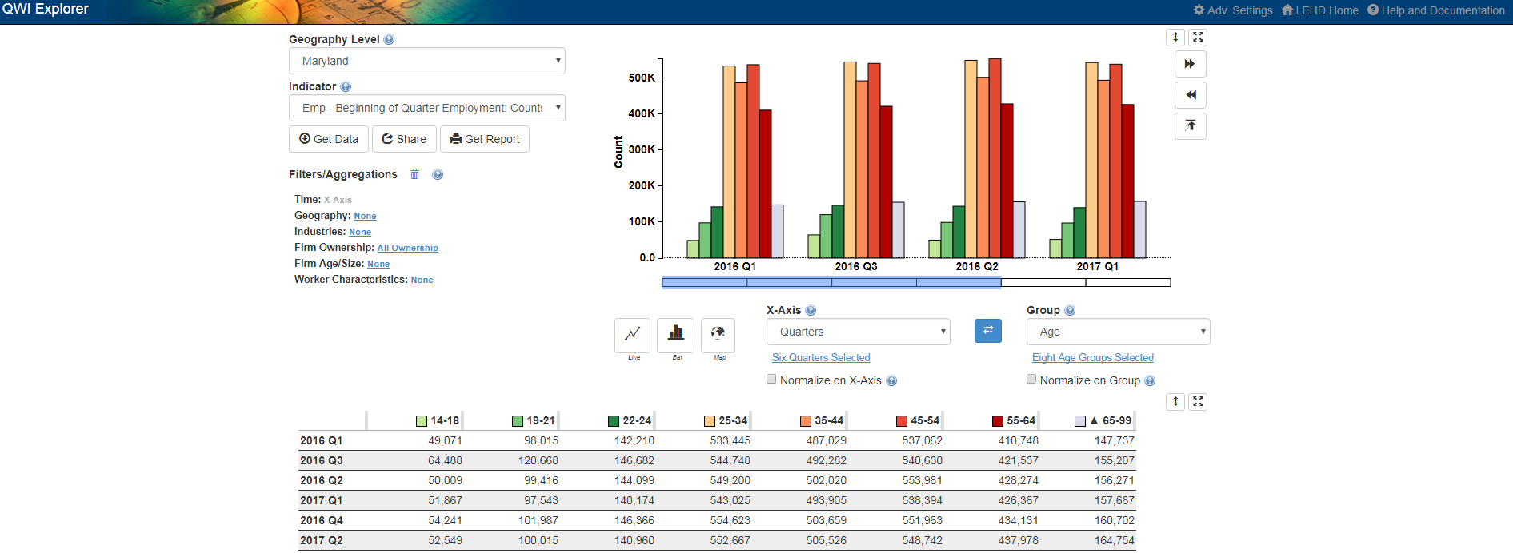
QWI Explorer
32 Quarterly Workforce Indicators
Flexible Pivot Table and Map/Chart interface
Data on detailed interactions between firms and workers include employment, employment change (individual and firm), and earnings
Analyze/report by worker demographics: age, earnings, race, ethnicity, educational attainment, and sex
Analyze/report by firm
characteristics: NAICS
classification (sector, 3, 4), firm
age, and firm size
Quarterly data very current
(9-12 months old)
National and 50 states available
(plus DC)
Notes:
However, we’re able to recreate this table using the QWI Explorer.
The QWI Explorer makes the entire QWI dataset available for visualization in line charts, bar charts, and thematic maps.
The application's intuitive dashboard allows for the construction of pivot tables to compare and rank labor-force indicators such as employment, job creation and destruction, wages, and hires across a wide range of firm and worker characteristics.
Potential analyses include a longitudinal look at wages by worker sex and age across counties, ranking job creation rates of young firms across NAICS industry groups, and comparing hiring levels by worker race and education levels across a selection of Metropolitan.

Slide 6
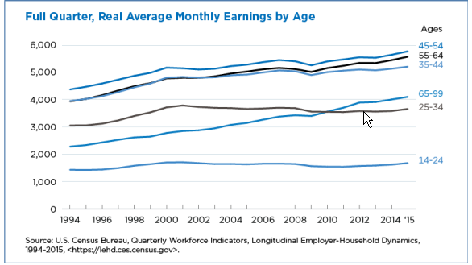
Average Monthly Earnings by Age
Notes:
Let’s drill into QWI Explorer and recreate the numbers shown here.

Slide 7
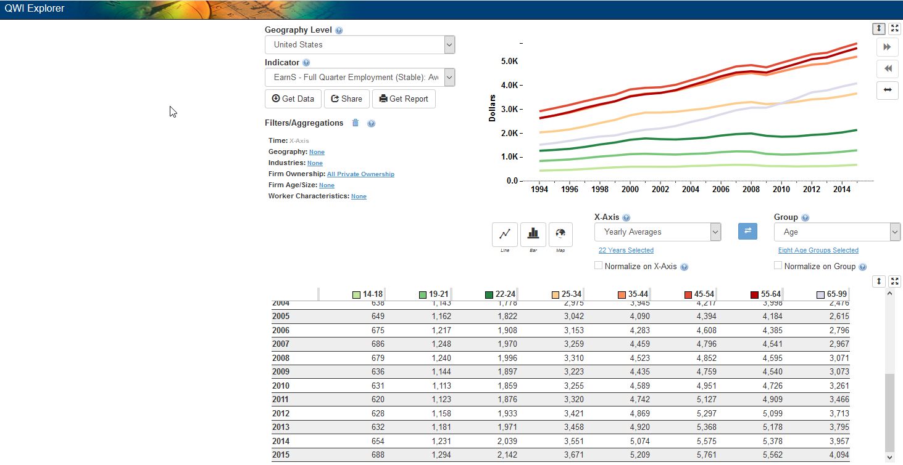
National Yearly Earnings
Notes:
Here we can replicate the graph from the previous slide using the national earnings.
Lets go live and duplicate this graph and I can show you some of the features.
From Census.gov, to explore data, to data tools and aps, to local employment dynamics
Qwi explorer
Go over all the features
Then choose United States, earnS, change quarters
Then click on x-axis and choose yearly average click on 1994-2015

Slide 8

Notes:
Showing the divide between low income families and job opportunities.

Slide 9
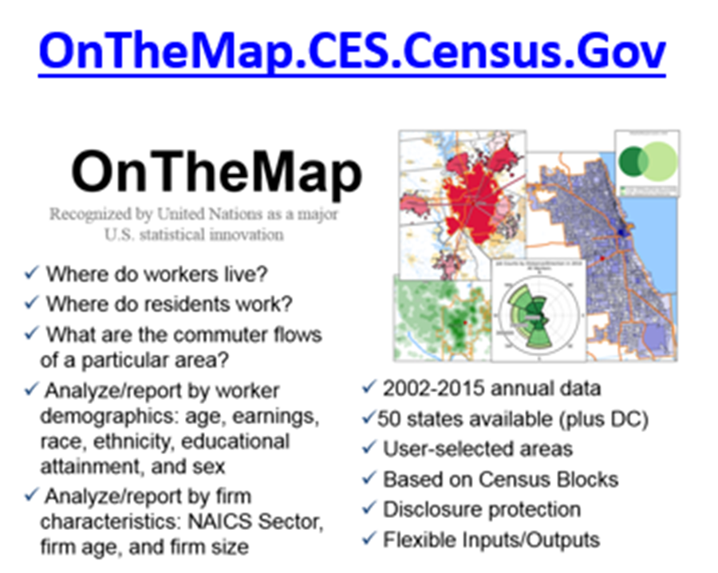
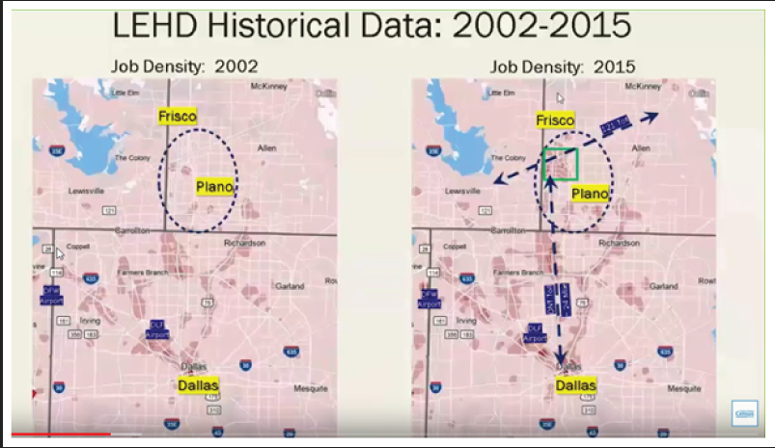
Notes:
In 1990, the population in the Dallas-Fort Worth area was about 3 million with employment at 2 million. More than 25 years later, the population had more than doubled to 7.4 million and employment was 3.6 million.
By 2018, Dallas-Fort Worth’s population had increased the most of any metro area, according to Census Bureau estimates.
job growth in the Dallas metro area over the past 13 years
The 2015 map shows growth in low-wage jobs about 25 miles away from downtown Dallas, to the north of the city. Many corporate headquarters, such as Toyota and Ikea, have relocated or expanded their operations there.
The main access between north and south for commuters is the Dallas North Tollway. Average travel time during peak rush hours is two hours by public transit or 45 minutes by car, with estimated yearly toll fees ranging from $175-$3,289.

Slide 10
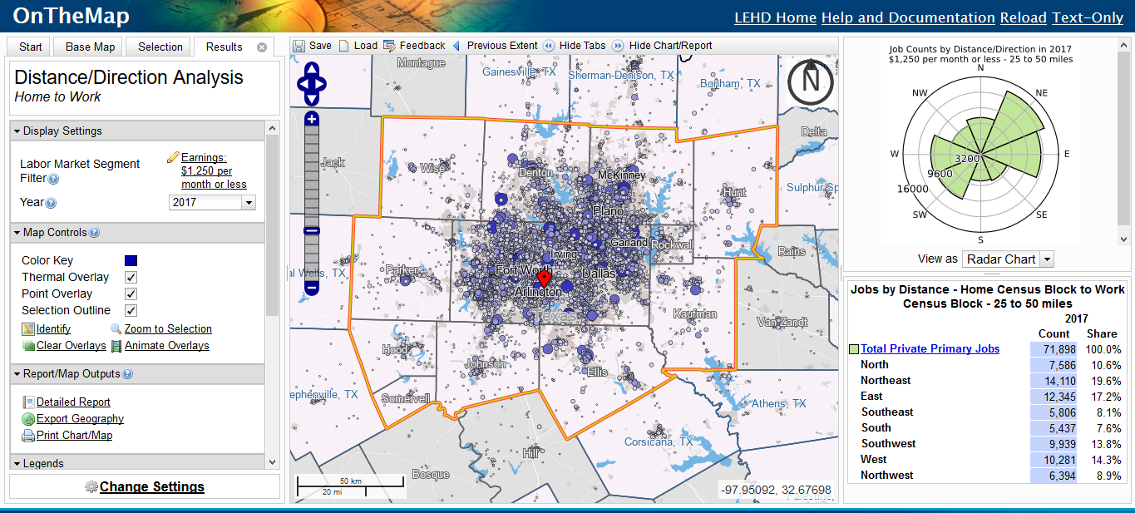
Distance-Direction Analysis

Slide 11
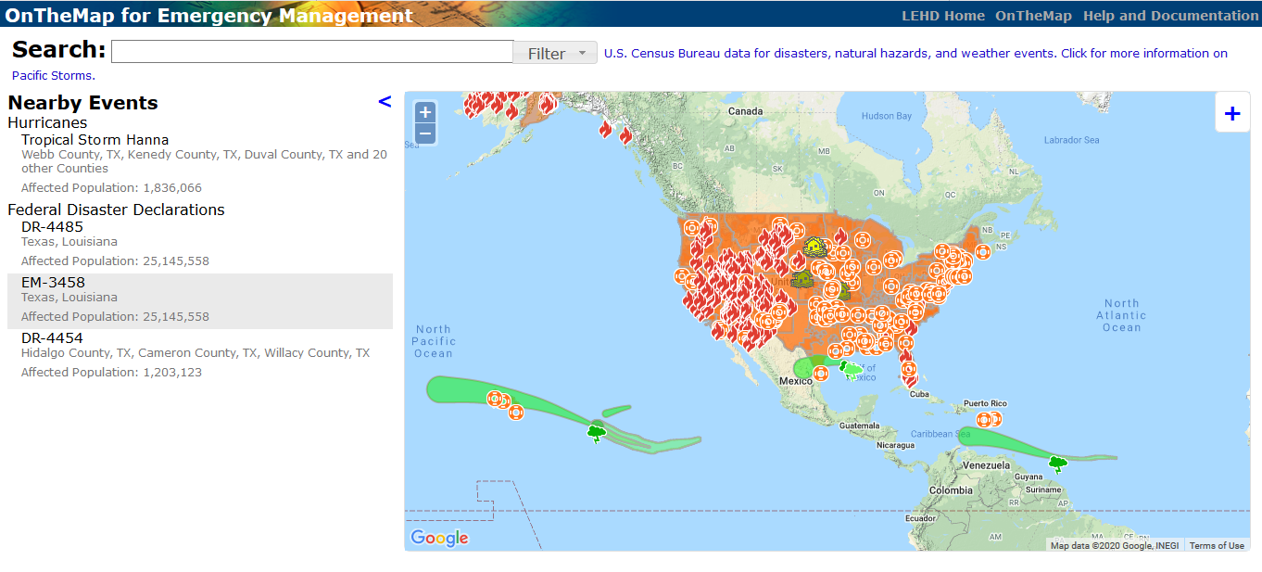
https://onthemap.ces.census.gov/em/
Notes:
http://em.treehorn2.excensus-online.com/em/

Slide 12

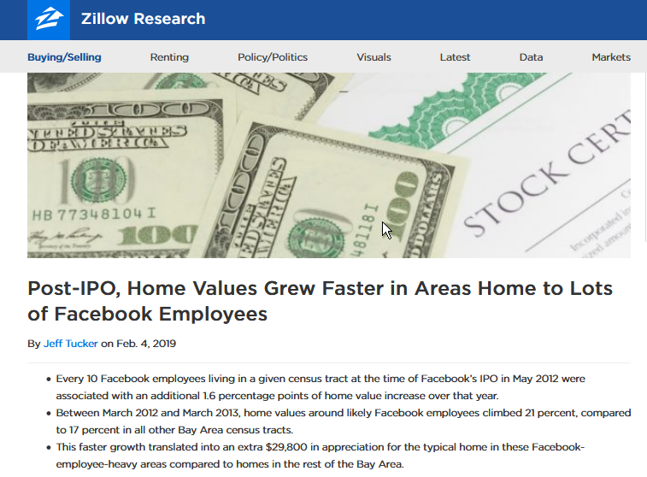
Facebook Headquarters - Menlo Park
Notes:
In another example regarding post Facebooks IPO in 2012, Zillow researchers used the same method in finding out home values in Menlo Park, home to Facebook Headquarters. By combining weighted index of home values and the LODES data set.
The results show that home values have increased nearly $30,000 in that area. Another thing to think about in the forecast is that Uber, Lyft, Airbnb, and Pinterest are all soon to be going public in the San Francisco Bay area.

Slide 13
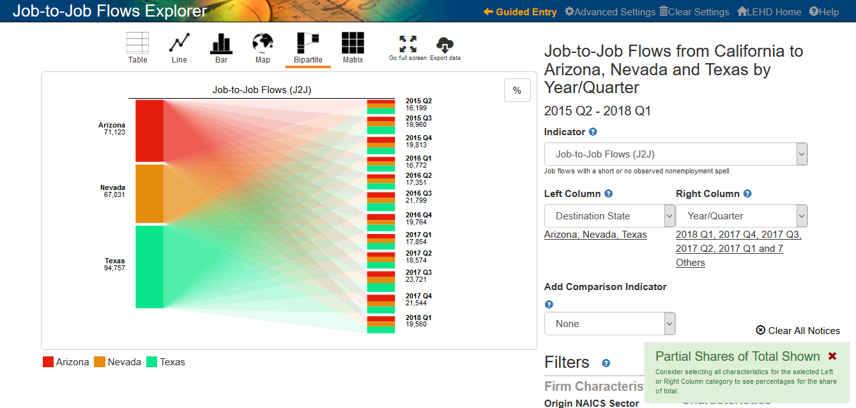

Slide 14
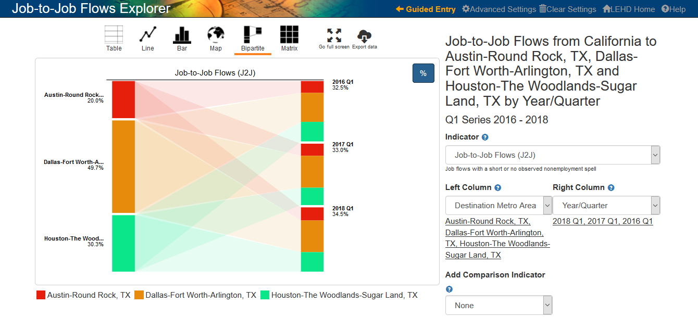
J2J Explorer 1.0

Slide 15
Post Secondary Employment Outcomes - PSEO
Current PSEO partners:
  The University of Texas system (2017)
  Colorado Department of Higher Education (2017)
  University of Michigan, Ann Arbor (2018)
  University of Wisconsin, Madison (2018)
Future Partners
  Ohio
  New York
A joint pilot project between university systems, state higher education systems, and the Census Bureau, the Post-Secondary Employment Outcomes (PSEO)are experimental tabulations providing national earnings statistics for graduates of post-secondary institutions.
  PSEO Provides
    25th, 50th, and 75th percentiles of annual earnings for college and university graduates.
    Employment by industry and region of the country.
    By degree level, degree major, and post-secondary institution.
    One year, five years, and 10 years after graduation.
Notes:
Current PSEO partners:
•
The University of Texas system (2017),
•
Colorado Department of Higher Education (2017),
•
University of Michigan, Ann Arbor; University of Wisconsin, Madison (2018).
Negotiating MOUs with:
•
Ohio Department of Higher Education,
•
State Council of Higher Education for Virginia,
•
Texas Higher Education Coordinating Board,
•
Arizona Board of Regents,
•
New York SUNY and CUNY systems,
•
Indiana Commission of Higher Education,
•
Utah System of Higher Education.

Slide 16


Statistics are generated by matching university transcript data with a national database of jobs, using state-of-the-art confidentiality protection mechanisms to protect the underlying data.

Slide 17
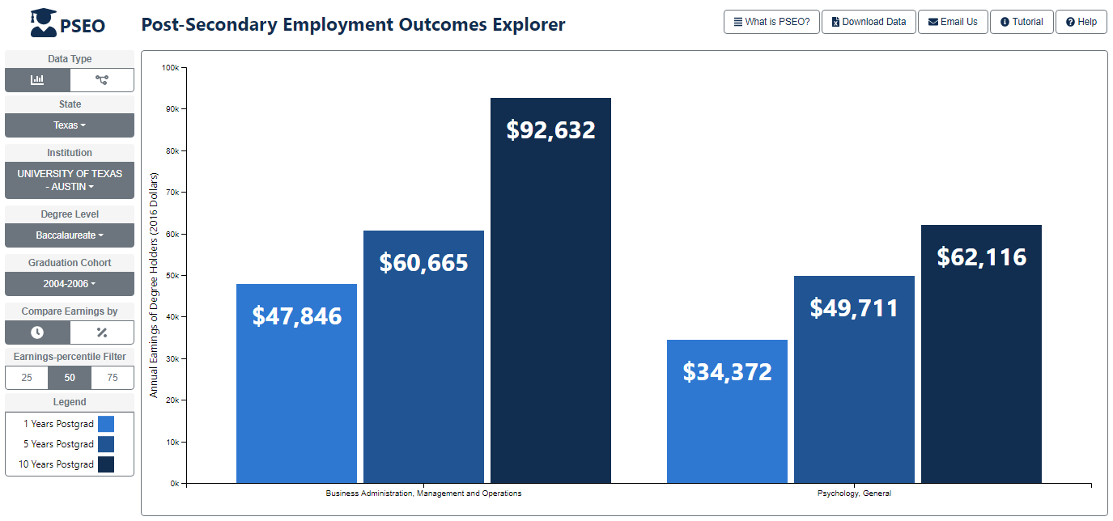
How Much are UT Austin Graduates Earning?
1-, 5-, 10-Years Post-Graduation

Slide 18
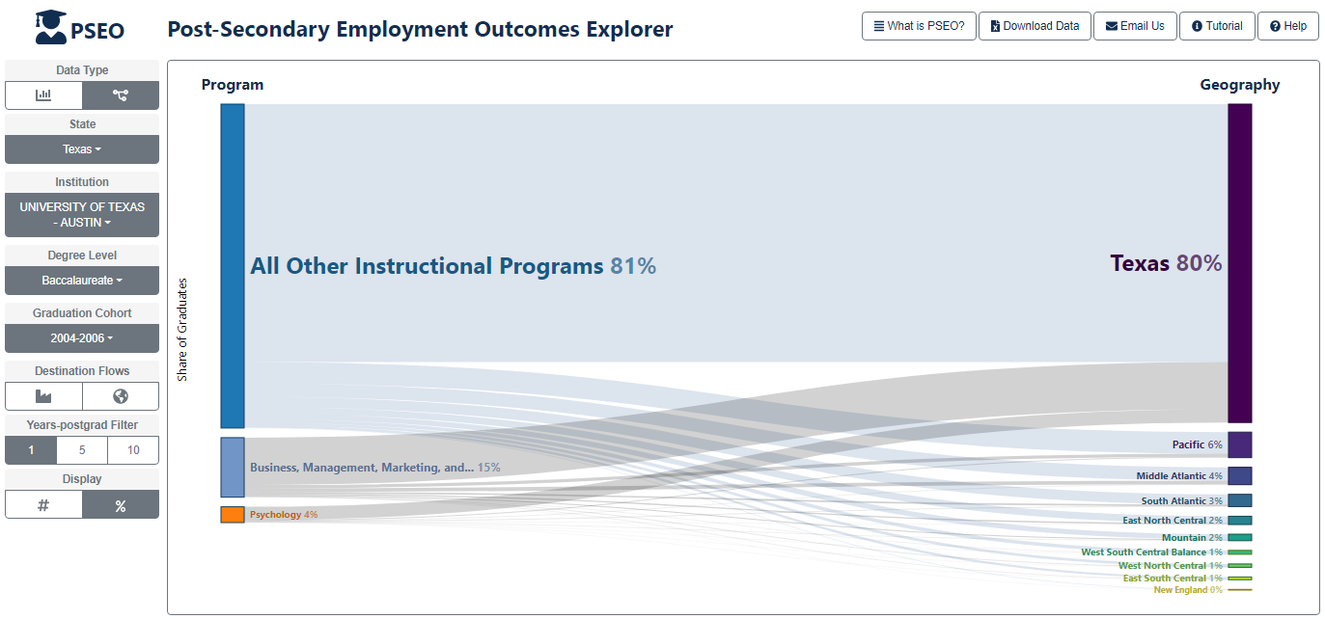
Where are UT Austin Graduates Working?
1-Year Post-Graduation
Notes:
To get to the visualizations on this and the next two slides:
Change Data Type to ‘Flows’
Add ‘All Other Instructional Programs’
Under Destination Flows, unclick ‘Flows to NAICS Industry Sector’ and click on ‘Flows to State/Census Division’
Change the Years-postgrad Filter to the year of interest

Slide 19
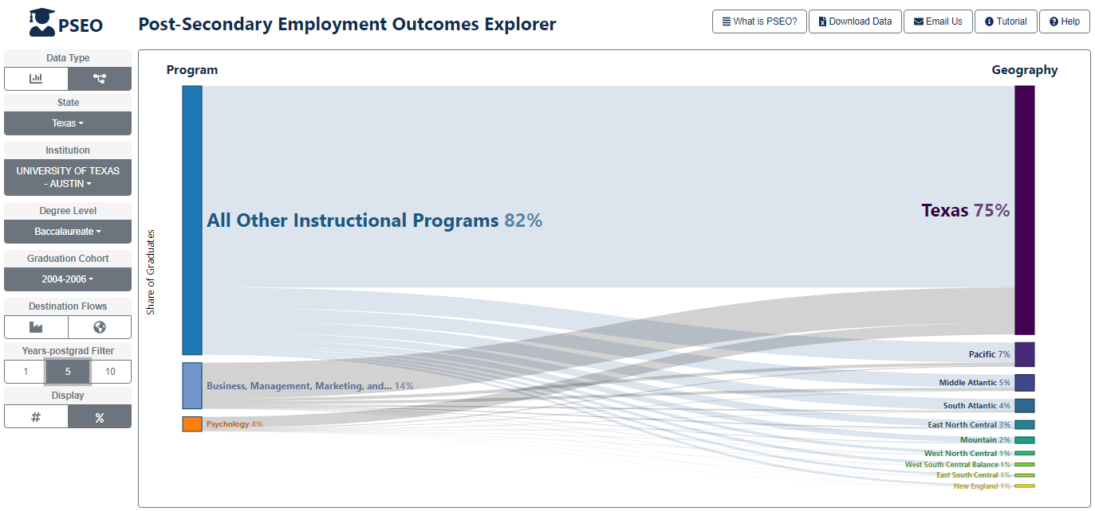
Where are UT Austin Graduates Working?
5-Years Post-Graduation

Slide 20
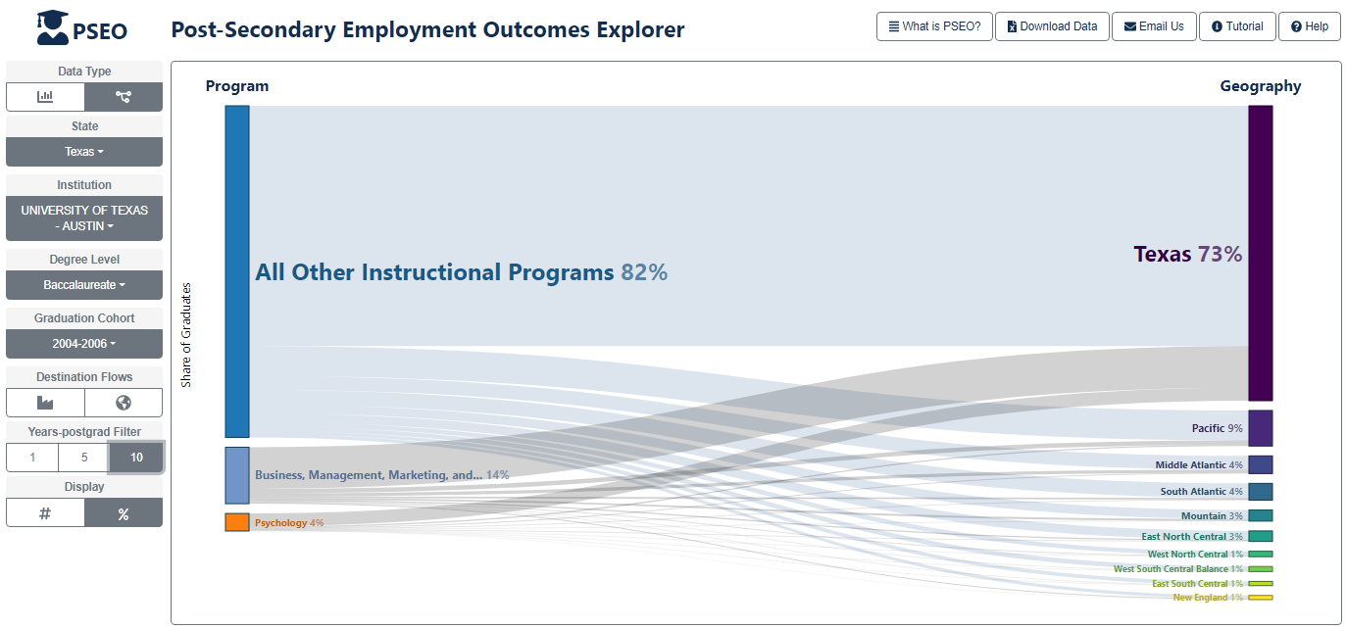
Where are UT Austin Graduates Working?
10-Years Post-Graduation

Slide 21
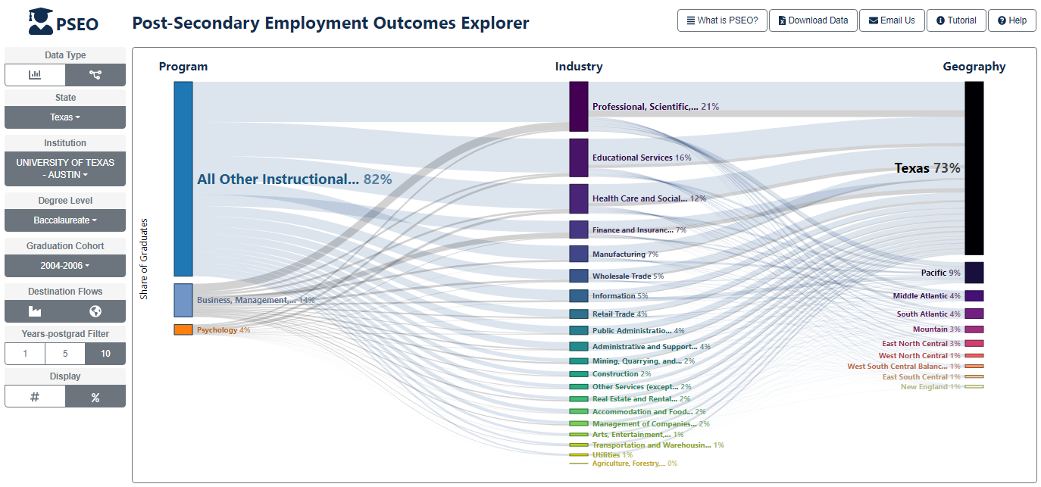
Where are UT Austin Graduates Working?
10-Years Post-Graduation
Notes:
To get to the visualization on this slide:
Under Destination Flows, click on ‘Flows to NAICS Industry Sector’

Slide 22
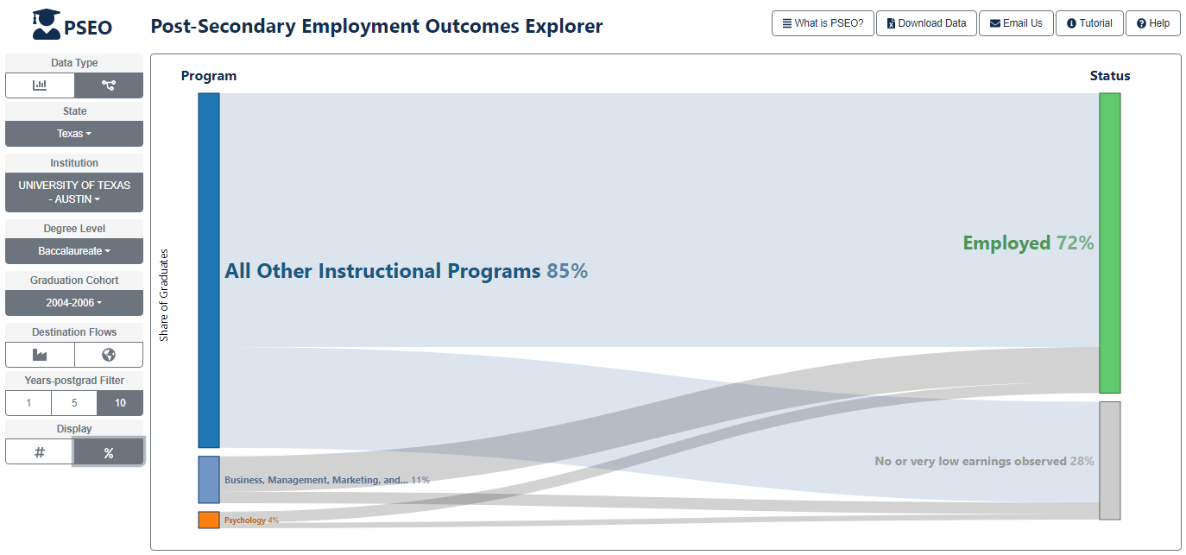
Where are UT Austin Graduates Working?
10-Years Post-Graduation
Notes:
To get to the visualization on this slide:
Under Destination Flows, unclick ‘Flows to NAICS Industry Sector’ and ‘Flows to State/Census Division’

Slide 23

Veteran’s Employment Outcomes

Slide 24
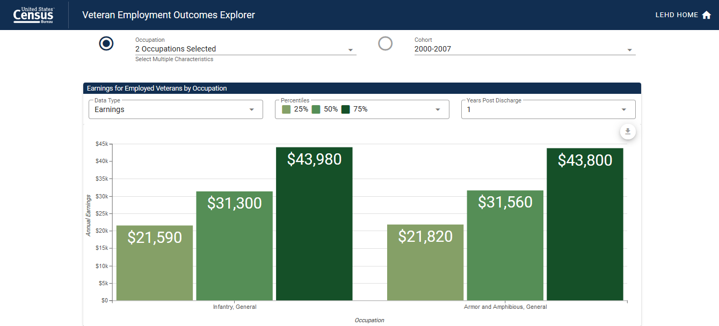
Veteran’s Employment Outcome
Notes:
PSEO’-like statistics for Army veterans, 1, 5, and 10 years after exit.

Slide 25
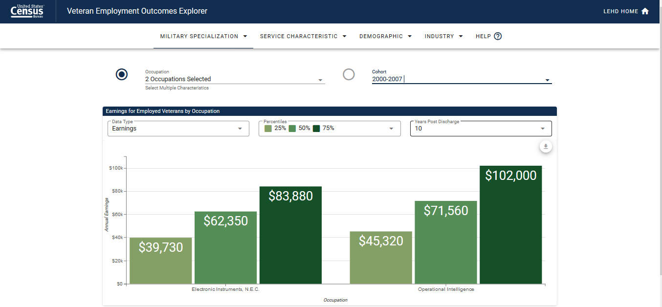
Earnings

Slide 26
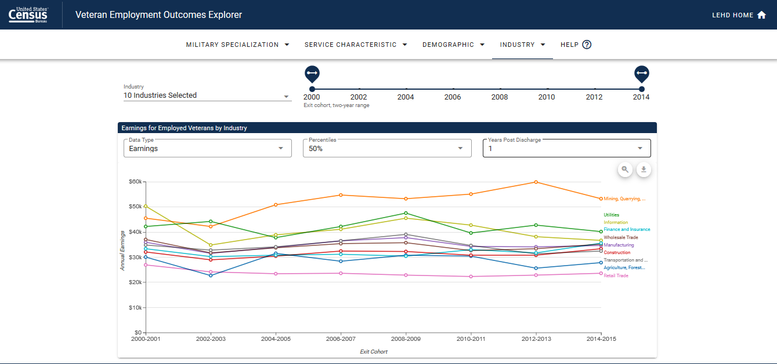
Industry

Slide 27
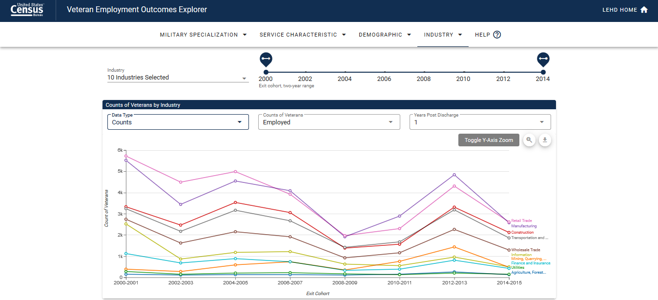
Employment Rates

Slide 28
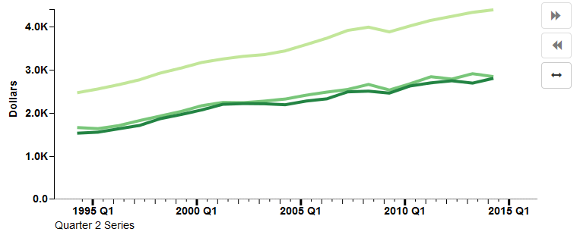
Takeaways: Why Are LED Data Tools Important?
Accessibility
“Explorability”
Provide context
Visualizations lead to insight
Promote/market the data
Provide “value-add” for our state partners

Slide 29
Q & A and Thank You!
Contact:
Earlene.KP.Dowell@census.gov
301-763-9628

