Slide 1
The TDC Population Estimates and Projections Program Update
Helen You
Texas Demographic Center
San Antonio, Texas
July 2020

Slide 2
The TDC Population Estimates Program
Established in the mid-1980s
Annual estimates:
a. county total;
b. place total;
c. county population by age, sex and race/ethnicity
Biennial Projections;
a. state by ASR
b. county by ASR
Special Projections priodically
Free to the public!

Slide 3
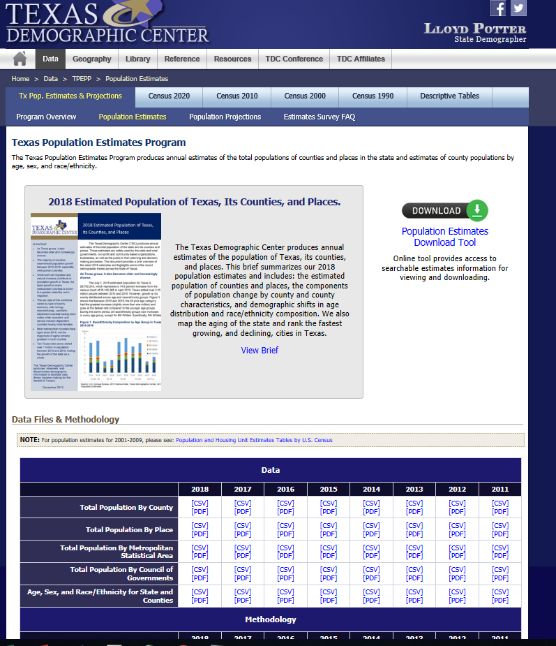
Access the TDC Population Estimates
https://demographics.texas.gov/Data/TPEPP/Estimates/
Notes:
testing

Slide 4
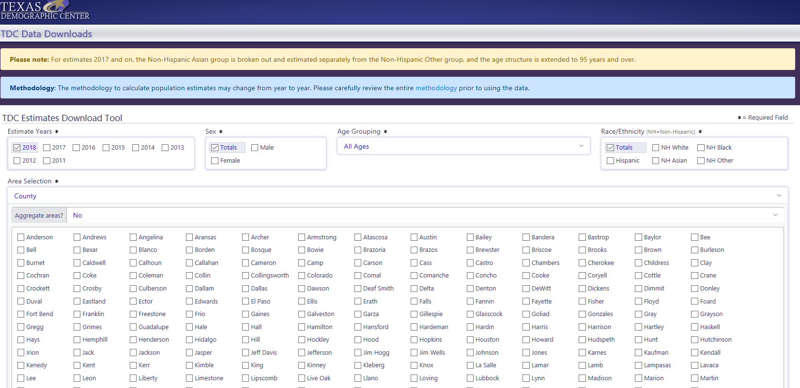
Customized tables – Population Estimates Download Tool for the COUNTIES

Slide 5
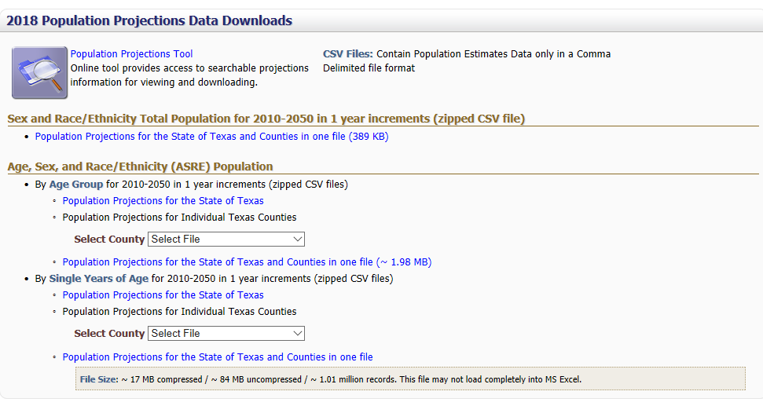
Access the TDC Population Projections
https://demographics.texas.gov/Data/TPEPP/Projections/
Customized Tables

Slide 6
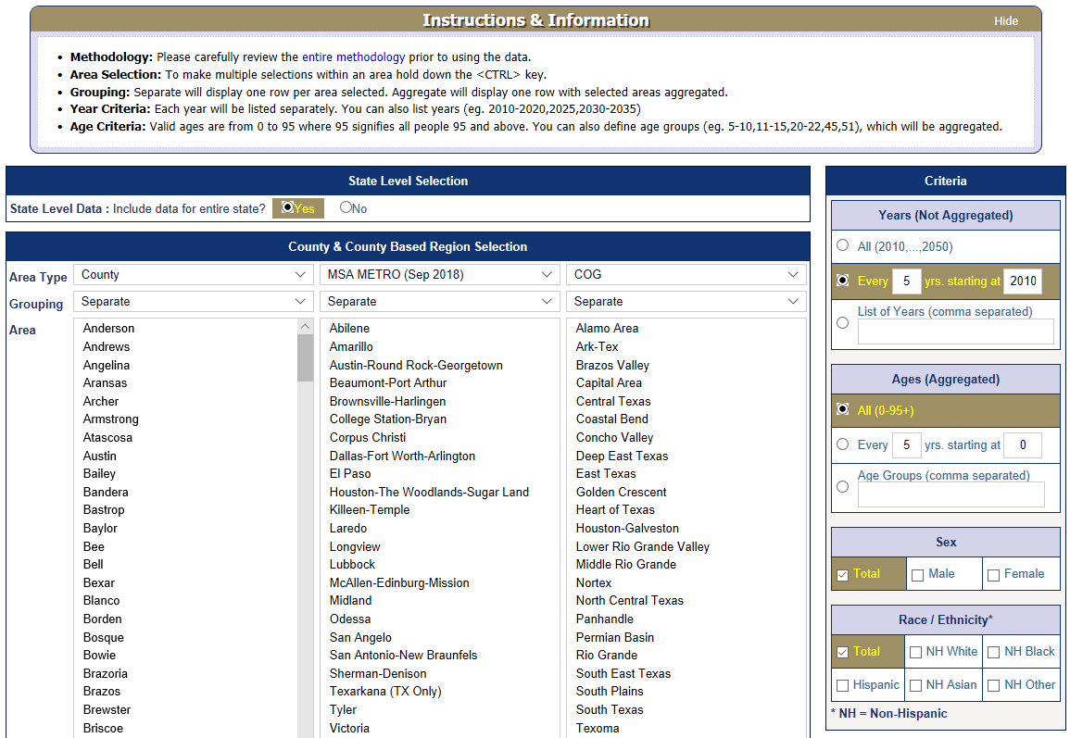
Customized tables – Population Projections Download Tool for the COUNTIES

Slide 7
The TDC Population Estimates Updates
Completed data collection for the 2019 estimates
Administrative data
Vital statistics, voter registration, vehicle registration, nursing homes, Medicare, prison and correctional facilities, public school enrollment, public higher education enrollment and dorm count.
Public Data
Decennial Census, American Community Survey, Census Bureau Building Permits Survey
TDC Survey
The PRELIMINARY 2019 estimates will be sent out for external review in SEPTEMBER
The FINAL estimates will be published in OCTOBER

Slide 8
The TDC Estimates Program Surveys

Slide 9
Answers to questions frequently asked about the TDC Estimates
We publish estimates for “whole” places;
We do not publish place estimates broken down by county;
-- “part” place: sumlev 155
We do not publish population for unincorporated areas;
Starting from 2018, we have 5 exclusive race/ethnicity breakouts, with two or more races in the residual “other” category;

Slide 10
Comparison of CB and TDC Estimates
CB vs. TDC ?

Slide 11
Comparison of CB and TDC Estimates
Collaborative relationship
The Federal-State Cooperative for Population Estimates (FSCPE)
TDC provides annual Group Quarter and Vital Statistics report to CB
But we produce population estimates INDEPENDENTLY using DIFFERENT methods
Both estimate for Texas on the July population of
County and place total
County breakdown by age, race and sex

Slide 12
Comparison of CB and TDC Estimates
Available only in Census Bureau Estimates:
Components of change (birth, death, migration)
“Part” place, or the breakdown of place estimates by county and the “residual”, or the unincorporated areas for each county
Estimates of housing units
Available only in TDC Estimates:
Estimates for Census Designated Places (CDPs), though available in ACS
Estimates for January, next year
Some newly incorporated places

Slide 13
Comparison of CB and TDC Estimates
Other differences
Publishing schedule:
CB 2019: Dec. 2019 – July. 2020
TDC 2019: Oct. 2020
Vintage
CB: each vintage includes estimates for all the years since the base year (decennial)
TDC 2019: only estimate for current year
Categories used:
Race/ethnicity
Age

Slide 14
The TDC Estimates and Projections: Made IN and FOR Texas
We closely observe local trends.
We include important local indicators.
We respond to local needs.
Please use and provide feedback to our estimates and projections to make our program better.

Slide 15
The TDC Population Projection Updates
Last projection completed in 2018
Working on special projections through the TxDOT One-Stop program:
Household
Household income distribution/median income
Family in poverty
Vehicle Ownership
Labor force
Disability
Redesign the projection page and make the special projections available in fall

Slide 16
Beyond 2020
First estimates 2021
First projection 2022
Census 2020 counts being the base population, estimates and projections may be impacted in terms of schedule and content availability.
Opportunity to implement changes to the estimates and projections.
Feedback greatly appreciated!

Slide 17
Contact
Texas Demographic Center
(210) 458-6543
tdc@utsa.edu
demographics.texas.gov

