Slide 1
Count Question Resolution Resources
2021 Texas Demographic Conference
June 10, 2021
@TexasDemography

Slide 2
Count Question Resolution Program
The CQR operation accepts requests for review of the 2020 census housing & population counts based on two types of cases: boundary and/or living quarters count.
Boundary — Correct inaccurate reporting or recording of boundaries legally in effect on January 1, 2020.
Living Quarters
Geocoding — Correct the placement of living quarters and associated population within the correct governmental unit boundaries and 2020 census tabulation blocks.
Coverage — Add or delete specific living quarters and people associated with them, identified during the census process, but erroneously included as duplicates or excluded due to processing errors.

Slide 3
Count Question Resolution Program (cont’d)

Slide 4
Count Question Resolution Program (cont’d)

Slide 5
Count Question Resolution Program (cont’d)

Slide 6
Census Bureau Data
Census Block Housing Units
Used to compare to non-Census data counts (i.e., local CAD data, etc.)
Census TIGER GIS Data
Determine if administrative boundaries match boundaries legally in effect on January 1, 2020
Determine if Housing Units were tabulated in the incorrect Census Block

Slide 7
Local Data
CAD Parcel and GIS Data
Codes for residential parcels
Fields indicating Year Built and Improvement Value (essential)
Focus on parcels and not structures
Situs Address vs. Physical/Mailing Address has implications for multiple units on one parcel
Certificate of Occupancy Permits
Provides proof that a Housing Unit was able to be occupied
Utility Connection Data
May be able to provide proof of occupancy at an address

Slide 8
Texas Natural Resources Information System (TNRIS) Resources
Statewide Layers
Address Points
https://tnris.org/stratmap/address-points/
Commission on State Emergency Communications (CSEC)
911 Addressing Coordinators
Land Parcels
https://www.tnris.org/stratmap/land-parcels/
Multiple appraisal districts and private vendors
Building Footprints (in progress)
Improving 3D Buildings into Realistic Objects (2019 Texas GIS Forum)
https://speakerdeck.com/texasnaturalresourcesinformationsytem/improving-3-d-buildings-into-realistic-objects
Aerial Imagery
NAIP Imagery
Notes:
NAIP = National Agriculture Imagery Program

Slide 9
Commercial Data*
Data Axle (formerly InfoUSA/Infogroup) Consumer Data
Data is primarily aimed at direct marketing to reach consumers via mail
Data obtained through “scraping” multiple public and private data sources including credit applications, utility connection data, USPS deliverable data, etc.
Address data is mailing address and not necessarily physical address which results in many PO Box addresses in more rural areas.
Lat/Long coordinates of geocoded addresses
First American Data Tree Address Data
Data obtained primarily from real estate titles, deeds, mortgage, etc.
Master address file for all properties including commercial and residential and can even identify individual unit numbers
Lat/Long coordinates of geocoded addresses
Aerial Imagery
Google Imagery, Bing Imagery, etc.
Privately contracted imagery
Geocoding Applications
Esri StreetMap Premium, Centrus, and others
*not an endorsement of any specific products

Slide 10
Hidalgo County (2010 CQR Example)
Response from the Census Bureau:
We reviewed the documentation that Hidalgo County provided in conjunction with the official 2010 Census records as part of our research to resolve their inquiry.
Our research found errors in the geographic placement of housing units/group quarters related to the legal boundary of Hidalgo County.
We also found a coverage error that resulted from a 2010 Census processing error.

Slide 11
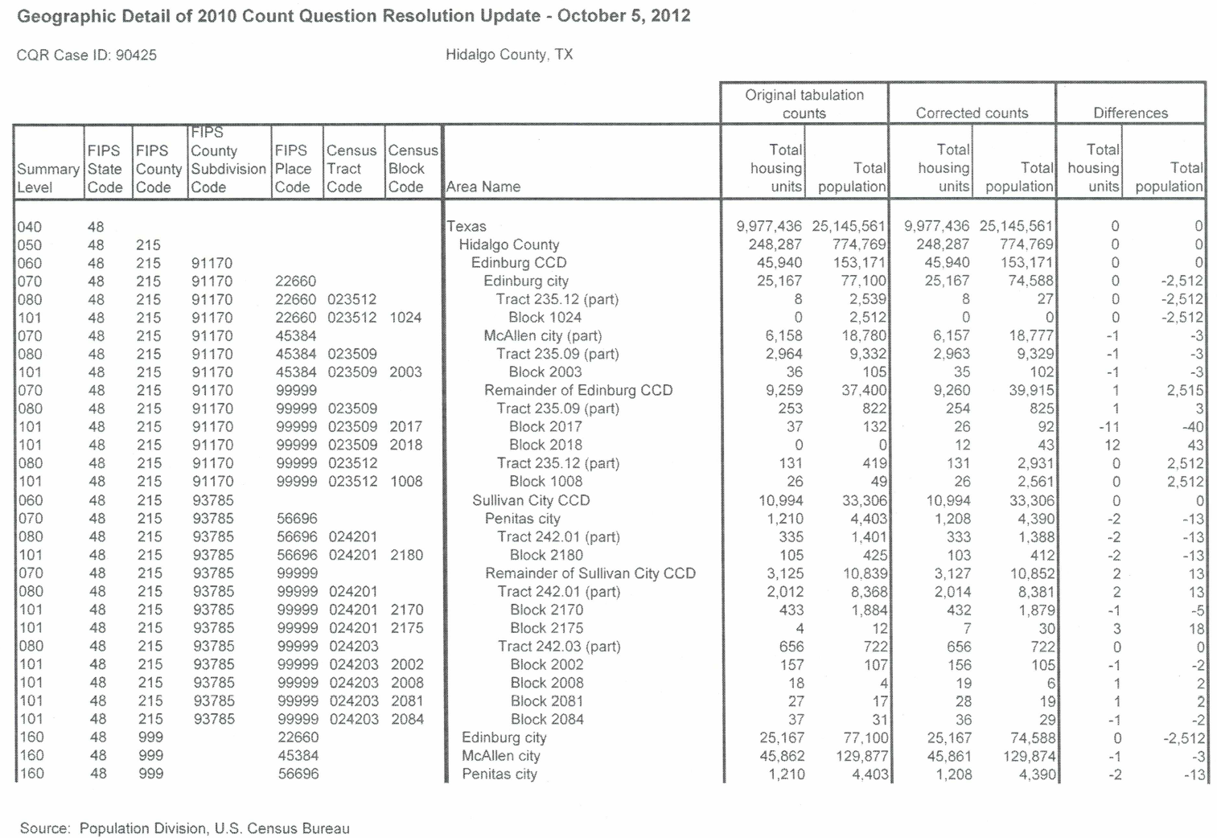
Hidalgo County (2010 CQR Example) (cont’d)

Slide 12
Jeff Jordan
(210) 458-6530
Jeff.Jordan@utsa.edu
demographics.texas.gov
@TexasDemography

