Slide 1
Defining Urban and Rural at the U.S. Census Bureau:
A Look at Demographic Trends
Michael Ratcliffe
Geography Division
U.S. Census Bureau
Texas Demographic Conference
May 26, 2022
The views expressed in this presentation are those of the author and not necessarily those of the U.S. Census Bureau.

Slide 2
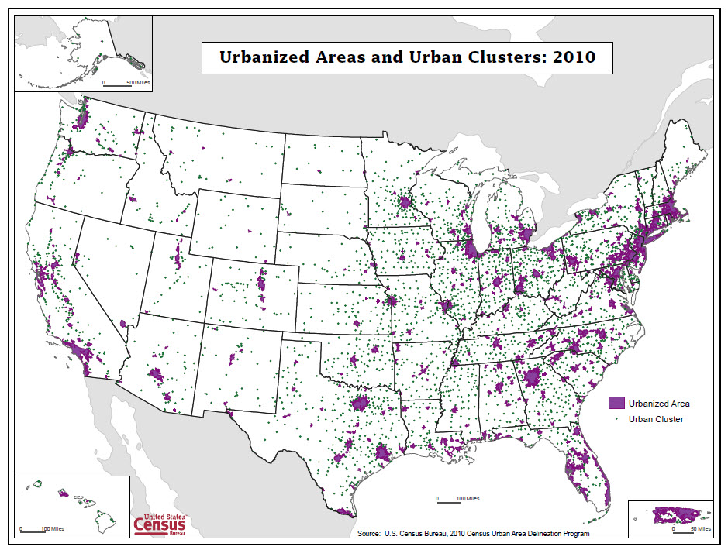
Census Bureau Urban Areas: 2010 Definition
Urbanized areas: 50,000 or more population.
Urban clusters: at least 2,500 and less than 50,000 population.
Defined primarily based on population density measured at the census tract and census block levels.
  Initial urban core: at least 1,000 per square mile
  Remainder of urban area: at least 500 per square mile
 | 2010 Census Population | 2010 Percent | 2020 ACS 5-year Population Estimates* | 2020 Percent
Total | 308,745,538 | 100.0 | 326,569,308 | 100.00
Urban | 249,253,271 | 80.7 | 263,366,402 | 80.7
Urbanized Area | 219,922,123 | 71.2 | 233,777,857 | 71.6
Urban Cluster | 29,331,148 | 9.5 | 29,588,545 | 9.1
Rural | 59,492,267 | 19.3 | 63,202,906 | 19.3
*2020 ACS estimates for urban areas are based on urban area boundaries defined in 2010 and do not account for new urbanization that occurred outside those boundaries between 2010 and 2020.
Sources: 2010 Census; 2016-2020 ACS 5-year data.
2

Slide 3
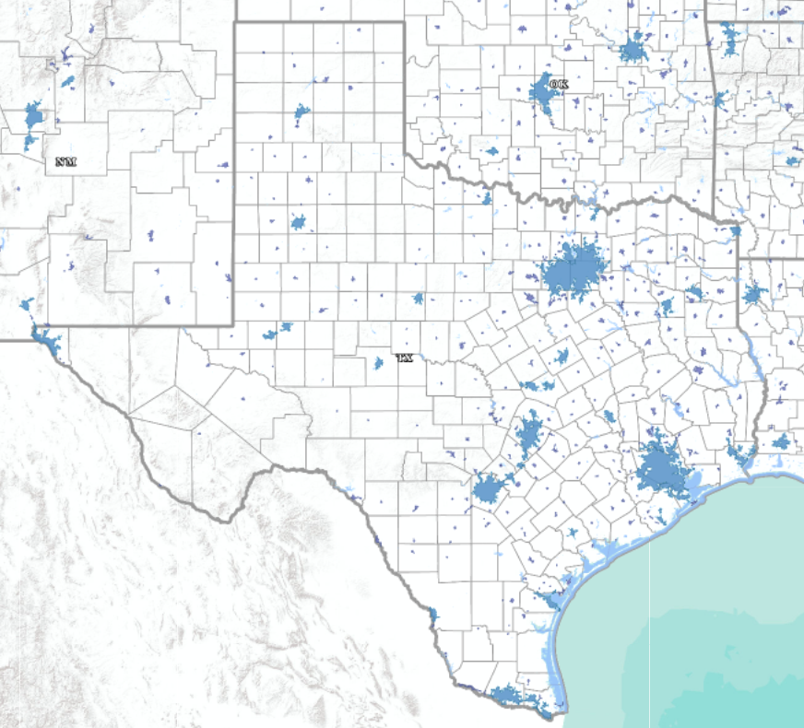
Texas Urban Areas: 2010 Definition
 | 2010 Census Population | 2010 Percent | 2020 ACS 5-year Population Estimates* | 2020 Percent
Total | 25,145,561 | 100.0 | 28,635,442 | 100.0
Urban | 21,298,039 | 84.7 | 23,885,740 | 83.4
Urbanized Area | 18,947,957 | 75.4 | 21,446,574 | 74.9
Urban Cluster | 2,350,082 | 9.3 | 2,439,166 | 8.5
Rural | 3,847,522 | 15.3 | 4,749,702 | 16.6
Sources: 2010 Census; 2016-2020 ACS 5-year data.
*2020 ACS estimates for urban areas are based on urban area boundaries defined in 2010 and do not account for new urbanization that occurred outside those boundaries between 2010 and 2020.
3

Slide 4
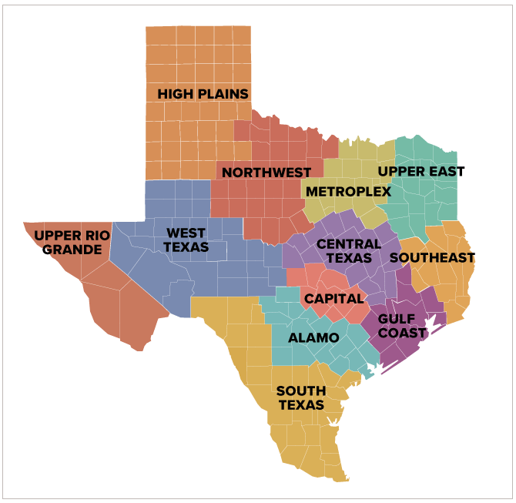
Texas Regions
Region | 2016-2020 Estimated Population | 2016-2020 Estimated Urban Population | Number of Urban Areas | Number of Urban Areas with Less Than 5,000 Persons (2016-2020)
Alamo | 2,821,665 | 2,292,857 | 25 | 7
Capital | 2,296,958 | 1,866,042 | 23 | 6
Central Texas | 1,222,588 | 831,814 | 24 | 10
Gulf Coast | 7,151,728 | 6,439,399 | 34 | 13
High Plains | 870,094 | 669,394 | 30 | 14
Metroplex | 7,850,335 | 7,008,079 | 39 | 11
Northwest Texas | 550,070 | 352,235 | 26 | 15
South Texas | 2,431,844 | 2,149,270 | 35 | 11
Southeast Texas | 777,694 | 430,053 | 13 | 4
Upper East Texas | 1,150,363 | 562,012 | 35 | 16
Upper Rio Grande | 862,069 | 787,803 | 5 | 3
West Texas | 650,034 | 496,782 | 17 | 5

Slide 5
Urban areas that had 2010 Census populations of 2,500 up to 9,999, as a category, lost population between 2010 and 2020. All other size categories experienced population increases.
Sources: 2010 Census; 2016-2020 ACS 5-year data.

Slide 6
All size categories of urban areas in Texas experienced population increases between 2010 and 2020. Urban areas of 1 million or more population in 2010 experienced the highest rate of growth.
Sources: 2010 Census; 2016-2020 ACS 5-year data.

Slide 7
Percent Urban by Texas Region, 2010 and 2020 (2010 Criteria)
Sources: 2010 Census; 2016-2020 ACS 5-year data.

Slide 8
The regions containing Texas’ four largest urban areas experienced the highest rates of growth between 2010 and 2020.
Sources: 2010 Census; 2016-2020 ACS 5-year data.

Slide 9
The Gulf Coast and Metroplex regions, together, account for over 50 percent of Texas’ urban population.
Sources: 2010 Census; 2016-2020 ACS 5-year data.

Slide 10
Percent change in population, 2010-2020, for the 25 largest urban areas (based on 2010 population)
Sources: 2010 Census; 2016-2020 ACS 5-year data.

Slide 11
Census Bureau Urban Areas (2020 Census criteria)
Urban Areas of at least 2,000 housing units or at least 5,000 people.
Defined primarily based on housing unit density measured at the census block level.
  Initial urban core: at least 425 housing units per square mile
  Remainder of urban area: at least 200 housing units per square mile
  At least one high density nucleus of at least 1,275 housing units per square mile required for qualification.
Notes:
Distribution of urbanized areas and urban clusters in the United States: urbanized areas in purple (full extent shown); urban clusters in green (point locations only). Map included only to provide quick reference.

Slide 12
Key Changes to Urban Area Criteria
Minimum threshold for qualification as urban: at least 2,000 housing units or at least 5,000 population. Increased from a minimum of 2,500 persons.
Use of housing unit density at the census block level instead of population density.
No longer distinguish between urbanized areas of 50,000 or more population and urban clusters of less than 50,000 persons.
Maximum distance for “jumping” across low-density intervening territory reduced from 2.5 miles to 1.5 miles (return to the jump distance that was in effect from 1950 through 1990).
Will not include the intervening low-density “hop” and “jump” corridors in the urban area. This results in noncontiguous urban areas.
Splitting continuous urban agglomerations based on commuting patterns (using Longitudinal Employer-Household Dynamics [LEHD] data).

Slide 13
Housing Unit Density
More direct measure of developed landscape
Census block-level housing unit counts are invariant
Ability to update extent of Urban Areas between censuses
425 housing units per square mile (HPSM) for initial cores
200 HPSM to fill in extent of urban areas
1,275 HPSM to ensure each urban area has a high-density nucleus
200 HPSM = 500 persons per square mile (PPSM), based on national average of 2.5 persons per housing unit
425 HPSM = 1,062 PPSM
1,275 HPSM = 3,188 PPSM

Slide 14
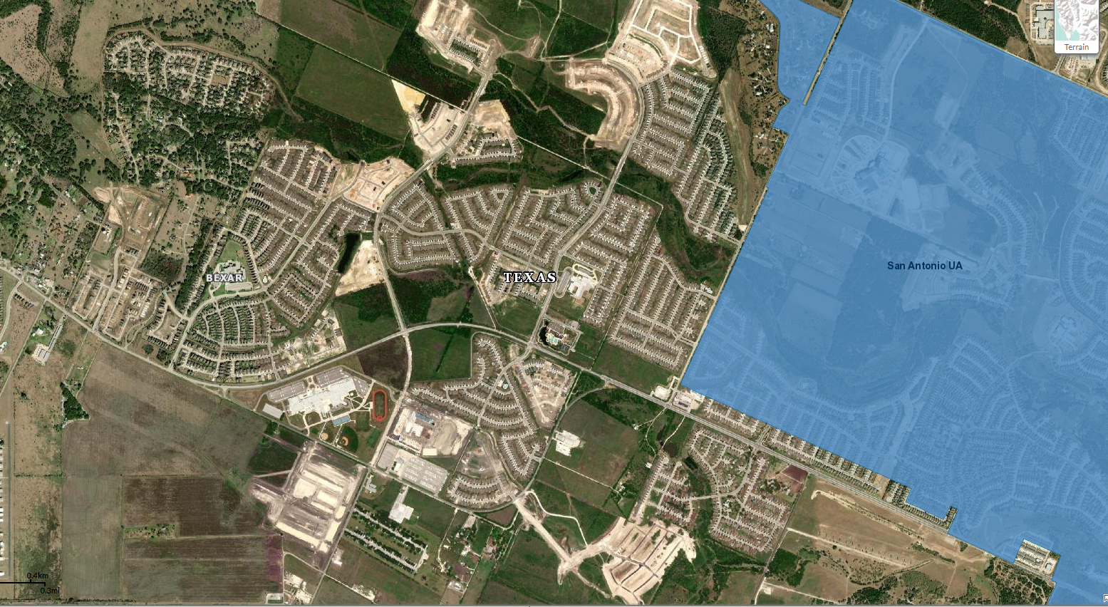
Use of housing unit density at the census block-level provides the ability to update urban area boundaries between censuses.
Post-2010 development on the west side of the San Antonio urban area. Because urban areas are not updated between censuses, the population and housing in this and similar areas was treated as rural in American Community Survey and other statistical data products.

Slide 15
No Longer Distinguish Between Types of Urban Areas
No longer distinguish between urbanized areas of 50,000 or more population and urban clusters of less than 50,000 persons.
  No clear scientific basis for use of 50,000 as a threshold distinguishing different types of urban areas.
  The decision to adopt 50,000 as a threshold for urbanized areas starting in 1950 seems to have been based more on operational concerns and data availability than rooted in economic data or central place theory.
  Urban areas between 40,000 and 51,000 population are similar in terms of economic activity.
  Still possible for data users and agencies to identify areas based on various sizes of population.
Impact: The term “Census Bureau-defined urbanized areas” is used in legislation and program documentation without specific reference to population size since urbanized areas, by definition, had a minimum population of 50,000. These references will have to be revised to “… urban areas of 50,000 or more…” or interpreted to mean areas of 50,000 or more persons.

Slide 16
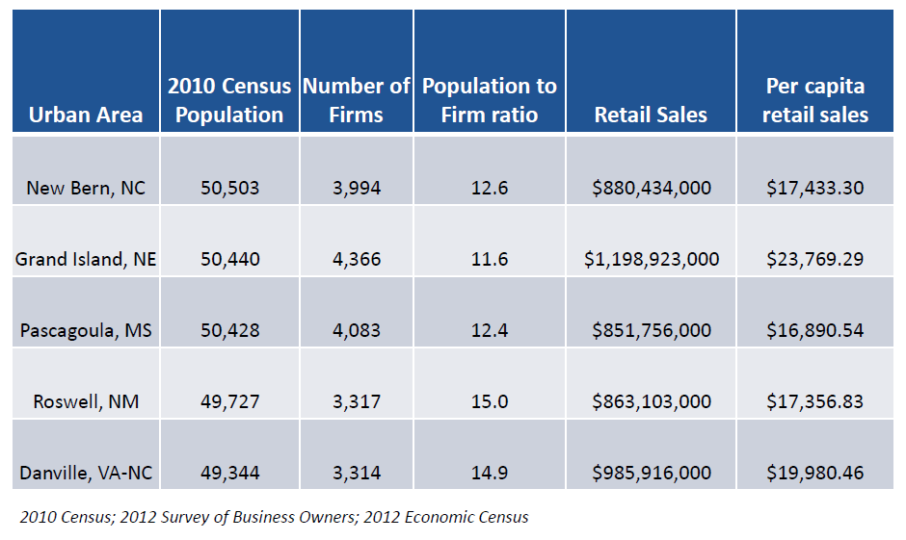
Urban areas with populations just above or just below the 50,000-person threshold do not differ substantially in terms of economic activity, as measured by numbers of firms and retail sales.
Data for each urban area are based on the aggregation of data for places located within the urban area (Economic Census data are not tabulated for urban areas).

Slide 17
Change to Jump Distance and Inclusion of Intervening Low-Density Territory
Maximum distance for “jumping” across low-density intervening territory reduced from 2.5 miles to 1.5 miles (return to the jump distance that was in effect from 1950 through 1990).
Will not include the intervening low-density “hop” and “jump” corridors in the urban area. This results in noncontiguous urban areas.
Impact:
Will reduce the amount of land area within individual urban areas. This will have a positive impact on the measurement of the extent of urbanization and urban sprawl.
Will affect the total population of individual urban areas. A small number of areas might drop below 50,000 persons as a result.
Creation of noncontiguous areas adds complexity when using our areas.
  Use of geographic information systems mitigates the complexity of working with complicated boundaries.

Slide 18
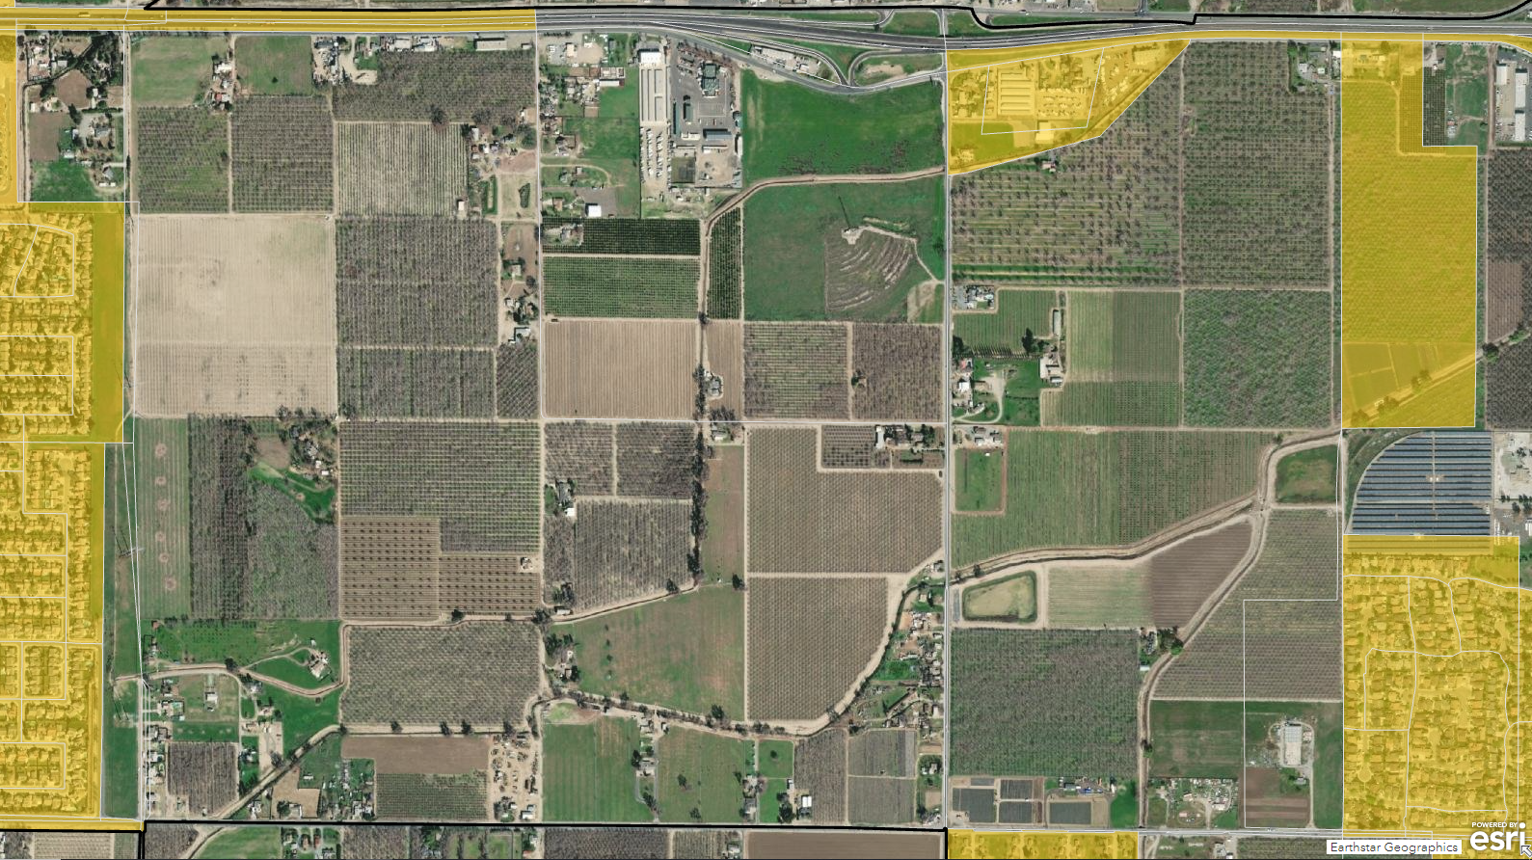
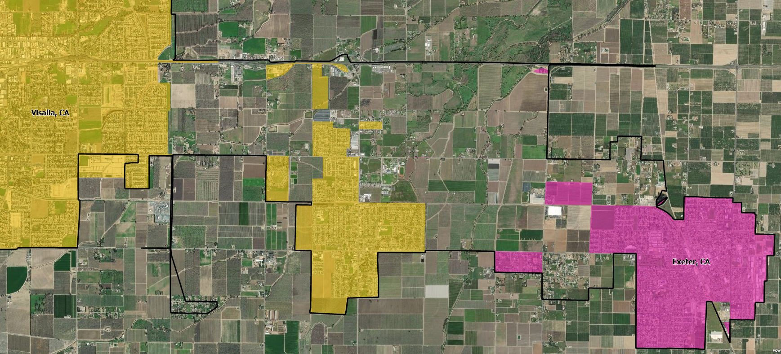
By not including hop and jump corridors, low-density areas with typically rural land uses will not be included in the urban area, resulting in a more accurate delineation.

Slide 19
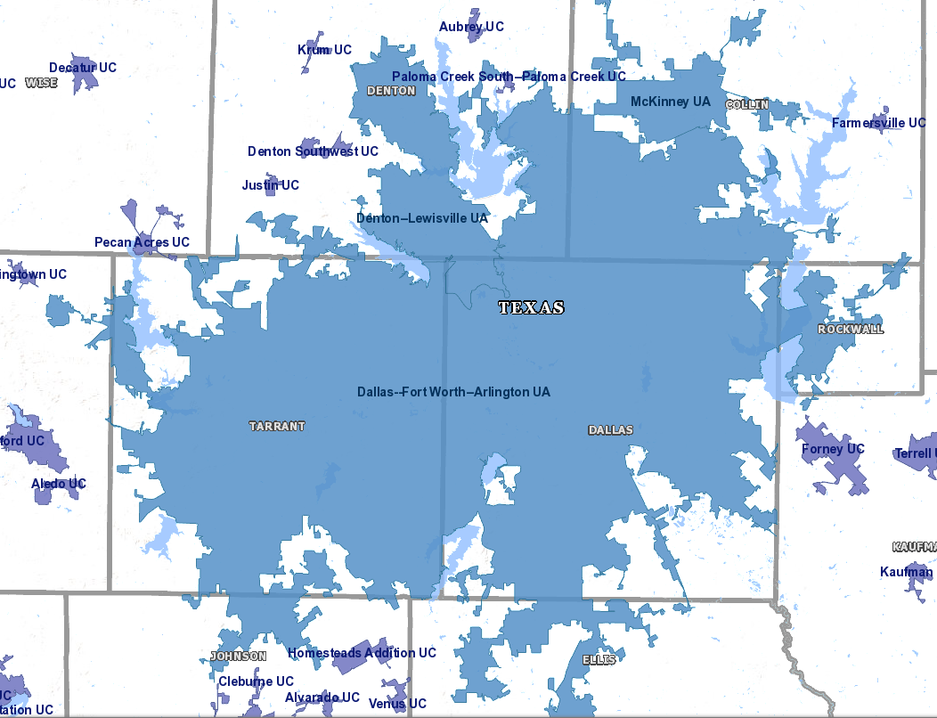
Splitting Urban Agglomerations
The delineation process results in large agglomerations encompassing multiple, individual urban areas. The question each decade is how, and where, to split these large agglomerations to define more recognizable and meaningful areas for analysis.
  Previous decades’ delineations relied on metropolitan area definitions (which had been based on the previous decade’s urban area boundaries) or where the connecting corridor was narrowest. None of these approaches were data driven.
For 2020, we will use the Longitudinal Employer-Household Dynamic (LEHD) Origin-Destination (LODES) dataset to analyze commuting patterns and determine whether to split agglomerations and, if so, where to draw the boundary.
Contiguous urban areas in the Metroplex Region: Dallas-Fort Worth-Arlington, Denton-Lewisville, and McKinney.

Slide 20
Change to Thresholds for Qualifying as an Urban Area
Minimum threshold for qualification as urban: at least 2,000 housing units or at least 5,000 population. Increased from a minimum of 2,500 persons.
  2,500-person threshold had been in use since 1910.
  Census Bureau’s threshold was the lowest in use in various agencies’ urban/rural definitions.
  Rural stakeholders and analysts have questioned the continued validity of the 2,500-person threshold and have routinely asked if we would consider an increase. Most recently, the Western Governors’ Association asked us to consider raising the threshold to 10,000 persons.
Impact:
    Approximately 1,000 areas in the US would shift from urban to rural status (based on 2020 ACS 5-year data). These areas contained an estimated 3.5 million people in 2020 (ACS 2016-2020 5-year estimates).
    Approximately 100 areas in Texas would shift from urban to rural status (based on 2020 ACS 5-year data). These areas contained an estimated 351,000 people in 2020 (ACS 2016-2020 5-year estimates).

Slide 21
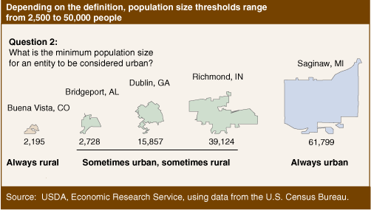
What is the minimum population size for an entity to be considered urban? Different federal agencies use different thresholds.
Source: Cromartie and Bucholtz (2008), “Defining the ‘Rural’ in Rural America.”
USDA ERS - Defining the “Rural” in Rural America
Notes:
This example is for places; could apply the same question to urban clusters, metro-micro areas.

Slide 22
Why 2,500 persons?
The Census Bureau officially adopted the 2,500-person threshold as the minimum population for an urban place in 1910.
  Truesdell, 1949: “For the census of 1910 the definition of urban population [2,500 persons] presented in the [1906] Statistical Analysis was adopted, again without any discussion of its merits as compared with those which had been used earlier; and this definition has been used, with minor modifications, in later censuses down to and including 1940.”
From 1874 to 1900:
  1874: 8,000-person threshold was used to identify urban cities and towns.
  1880: 4,000-person threshold. “It seemed to be the opinion of the officials in charge of the census in 1880 that the 8,000 limit was too high to include all of the population that was really urban in character.” (Truesdell, 1949).
  1890: back to 8,000 persons.
  1900: 4,000-person threshold used in reports.
Source: Leon Truesdell, 1949. “The Development of the Urban-Rural Classification in the United States: 1874 to 1949.” Current Population Reports, P-23, Number 1.

Slide 23
All other changes to criteria and population distribution aside, the change to the minimum threshold will result in an increase in rural population.
Urban and Rural Population
Based on 2010 Threshold
Urban and Rural Populations
Based on 2020 Thresholds
Applied to Current Urban Areas
 | 2020 ACS 5-year Population Estimates | 2020 Percent
United States | 326,569,308 | 100.0
Urban | 263,366,402 | 80.7
Rural | 63,202,906 | 19.3
 | 2020 ACS 5-year Population Estimates | 2020 Percent
United States | 326,569,308 | 100.0
Urban | 259,850,930 | 79.6
Rural | 66,718,378 | 20.4
Source: 2016-2020 ACS 5-year data.

Slide 24
All other changes to criteria and population distribution aside, the change to the minimum threshold will result in an increase in rural population.
Urban and Rural Population
Based on 2010 Threshold
Urban and Rural Populations
Based on 2020 Thresholds
Applied to Current Urban Areas
 | 2020 ACS 5-year Population Estimates | 2020 Percent
Texas | 28,635,442 | 100.00
Urban | 21,446,574 | 83.4
Rural | 4,749,702 | 16.6
 | 2020 ACS 5-year Population Estimates | 2020 Percent
Texas | 28,635,442 | 100.00
Urban | 23,534,227 | 82.2
Rural | 5,101,215 | 17.8
Source: 2016-2020 ACS 5-year data.

Slide 25
Percent Urban by Texas Region, 2010 and 2020 (2020 Criteria)
Sources: 2010 Census; 2016-2020 ACS 5-year data.

Slide 26
Regional Urban Population as a Proportion of Total Texas Urban Population, 2010 and 2020, based on 2020 Thresholds Applied to 2010 Urban Areas
Sources: 2010 Census; 2016-2020 ACS 5-year data.

Slide 27
All other changes to criteria and population distribution aside, the percentage point increase in rural population is greatest in Northwest Texas (7.6), High Plains (4.6), and Upper East Texas (4.2).
Sources: 2010 Census; 2016-2020 ACS 5-year data.

Slide 28
Thank You. Questions?
Michael Ratcliffe
Senior Advisor
Geography Division
michael.r.ratcliffe@census.gov

