Slide 1
Texas KIDS COUNT
Health Equity for Every Child
Presentation by Kaitlan Wong, wong@everytexan.org

Slide 2
Notes:
We are a public policy, social justice nonprofit based in Austin, TX. We work to strengthen public policy to expand opportunities and equity for Texans of all backgrounds.
We firmly believe that social justice requires public policy.

Slide 3
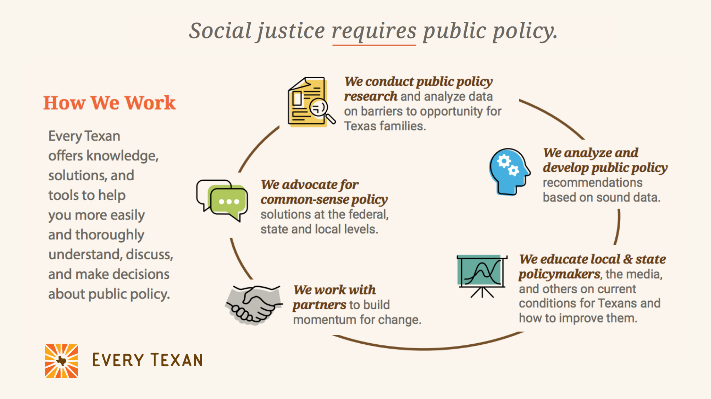
Notes:
Here is a chart showing how we work as an organization.

Slide 4
Learn more about Every Texan at everytexan.org
Notes:
Here are our main policy focus areas. We look at health care, food security, education, jobs & financial security, budget & taxes, and equity & inequality.
If you are interested in learning more about our work in these areas, please check out our website at everytexan.org
Access to quality, affordable health care for every Texan: health insurance coverage, family planning and women’s health, immigrant access, affordability & medical debt
We are dedicated to achieving food security for every Texan: food assistance, SNAP, school meals
Education: Early Childhood & Pre-K, K-12 Public Education, Higher Education
Job and financial security: Fair Wages, Paid Sick Days, Kids Living with Relatives, Cash Assistance
Budget and Taxes: Federal Budget & Taxes, Where the Money Comes From, Where the Money Goes
Equity and Inequality: Focus on issues that impact People of Color & Race Equity, Immigrants, Women & Gender Equality, Children, Low-Income Texans

Slide 5
What is KIDS COUNT?
Explore the Texas Kids Count Data Center at datacenter.kidscount.org
Notes:
Project funded by the Annie E. Casey Foundation. The Annie E. Casey Foundation funds a nationwide network of state-level KIDS COUNT® grantees to track the well-being of children in the United States.
By providing high-quality data and trend analysis through its KIDS COUNT Data Center, the Foundation seeks to enrich local, state and national discussions concerning ways to secure better futures for all children — and to raise the visibility of children's issues through a nonpartisan, evidence-based lens.
In addition to including data from the most trusted national resources, the KIDS COUNT Data Center draws from more than 50 KIDS COUNT state organizations that provide state and local data, as well as publications providing insights into trends affecting child and family well-being.
Through KIDS COUNT, the Foundation develops and distributes reports on important well-being issues. Much of the data from these nationally recognized publications, including the KIDS COUNT Data Book, are featured on the KIDS COUNT Data Center.
You can explore the Kids Count Data Center at datacenter.kidscount.org. We’ll actually get to explore it a bit together a little later in the presentation.

Slide 6
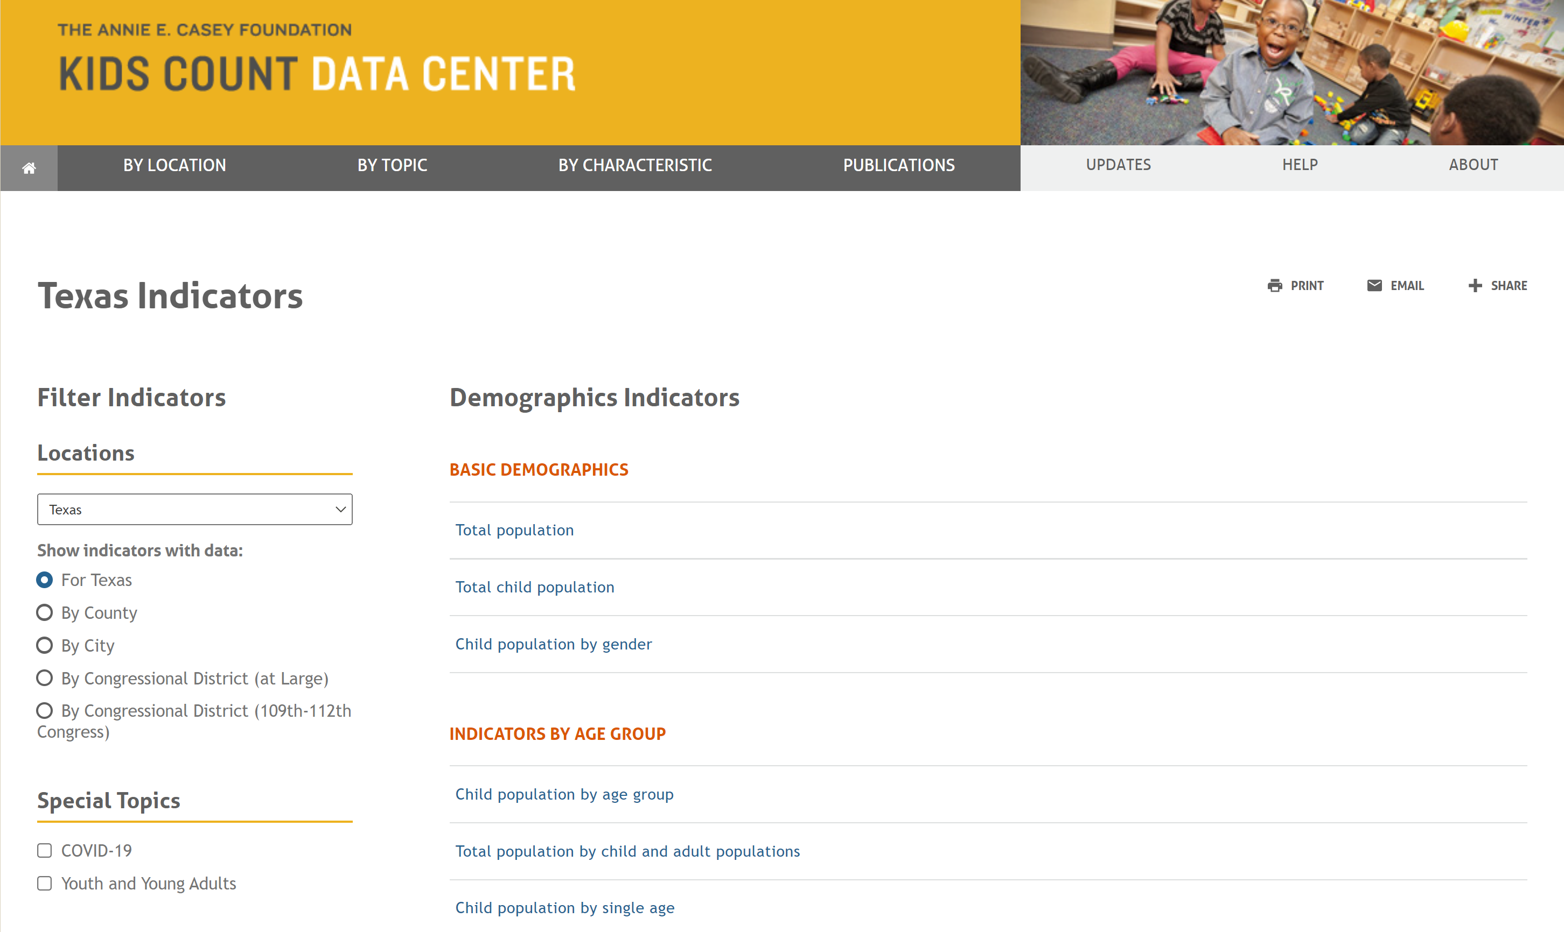
KIDS COUNT Data Center
Notes:
I’m here to talk specifically about Texas Kids Count.
Right here you’ll see a screenshot of the home page of the TX Kids Count Data Center, we’ll get into that more in a few minutes. First, I want to talk about how Kids Count data can be used.

Slide 7
How can KIDS COUNT data be used?
Observe changes over time
Create maps and graphs
Compare your location to others
Obtain data for grant proposals or projects from trusted data sources
Notes:
Texas KIDS COUNT® collects and reports credible data that is featured on the Texas KIDS COUNT Data Center. With these data, Every Texan provides policy analysis based on evidence and shines a spotlight on pressing issues in order to improve programs and policies for children and families.
The Texas KIDS COUNT Data Center shows how children in Texas are faring on over 70 different measures of child well-being. So, how can Kids Count data be used? With this data, you can observe changes over time, create maps and graphs, compare your location to others, and obtain data for grant proposals or projects from trusted data sources.

Slide 8
KIDS COUNT Indicators
Economic Well-being
Education
Family & Community
Health & Nutrition
Safety & Risky Behaviors
Demographics
And more!
Notes:
I want to talk a little bit about the indicators available. Like I said, there are over 70 measures of child well being, and they can fit into a few main focus areas.
Economic wellbeing
- Employment and income: median income of households, unemployment, children with parents in the labor force
- Public assistance: such as TANF, SSI, WIC, SNAP
- Housing: children living in households that are owned, children living in households with a high housing cost burden, children living in crowded housing, household’s confidence in ability to pay rent or mortgage payments
Poverty
Education
- Early childhood: subsidized childcare, public pre-K, Head Start
- School-age: public school enrollment, high school graduation and dropout
- Young adults: college completion, educational attainment
- Test scores
Family & Community
- Community environment: children living in areas of concentrated poverty, children who speak a language other than English at home
- Family structure: household type, children living in single-parent households, children living with other relatives,
Health & Nutrition
- Birth outcomes: low birthweight, preterm births, infant mortality, teen births
- Health insurance: Medicaid enrollment, Children’s Health Insurance program, uninsured children
- Vital statistics: total live births, child deaths, teen deaths
- Dental health: Children who have received preventive dental care in the past year, Children whose teeth are in excellent or very good condition
- Mental health: Children who have emotional, behavioral, or developmental conditions, anxiety, depression
Nutrition: school meals, nutrition programs, food insecurity
Safety & risky behaviors
- Juvenile justice: juvenile violent crime arrests, youth residing in juvenile detention, correctional, or residential facilities
- Out of home placement: foster care
Demographics
- Of course we look at demographics. Many of the indicators I mentioned already are disaggregated by demographics data such as race and ethnicity.

Slide 9
Let’s Explore the Data!
datacenter.kidscount.org
Notes:
Now that you’ve listened to me talk all about the data available, let’s explore the data center!

Slide 10
2021 Texas Kids Count Data Book
Read the full interactive report at everytexan.org/kids-count-2021/
Notes:
I also wanted to talk a little bit about our Kids Count data products available. As a Kids Count grantee, Every Texan releases a Kids Count Data Book every other year. We released our 2021 data book last year and plan on releasing a 2023 data book early next year.
The 2021 Texas Kids Count data book is a report that looks at how public policy can improve health equity for all Texas children.

Slide 11
Texas Kids Count 2021 Data Book
Read the full interactive report at everytexan.org/kids-count-2021/
Notes:
The report focuses on three main areas related to health equity for Texas children: food insecurity, health insurance, and economic opportunity.

Slide 12
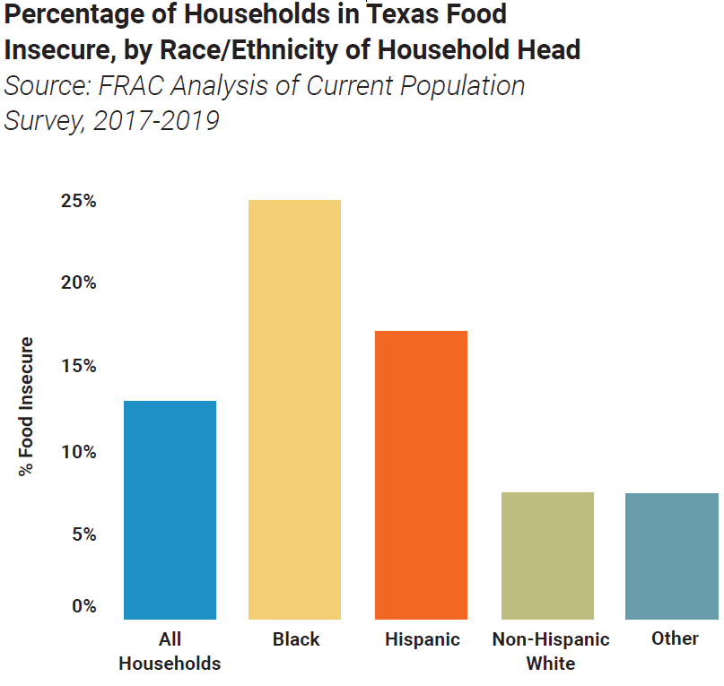
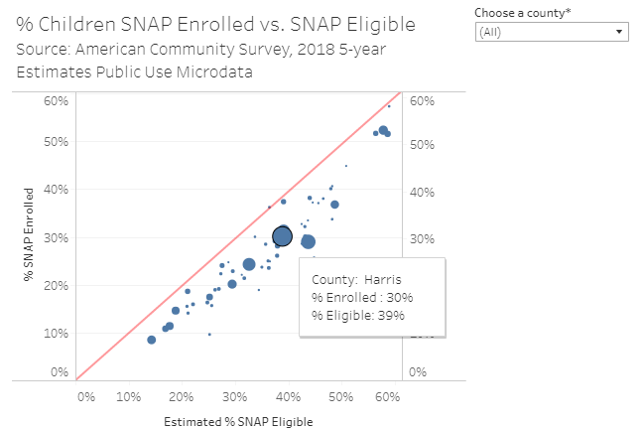
Texas Kids Count 2021 Data Book
Read the full interactive report at everytexan.org/kids-count-2021/

Slide 13
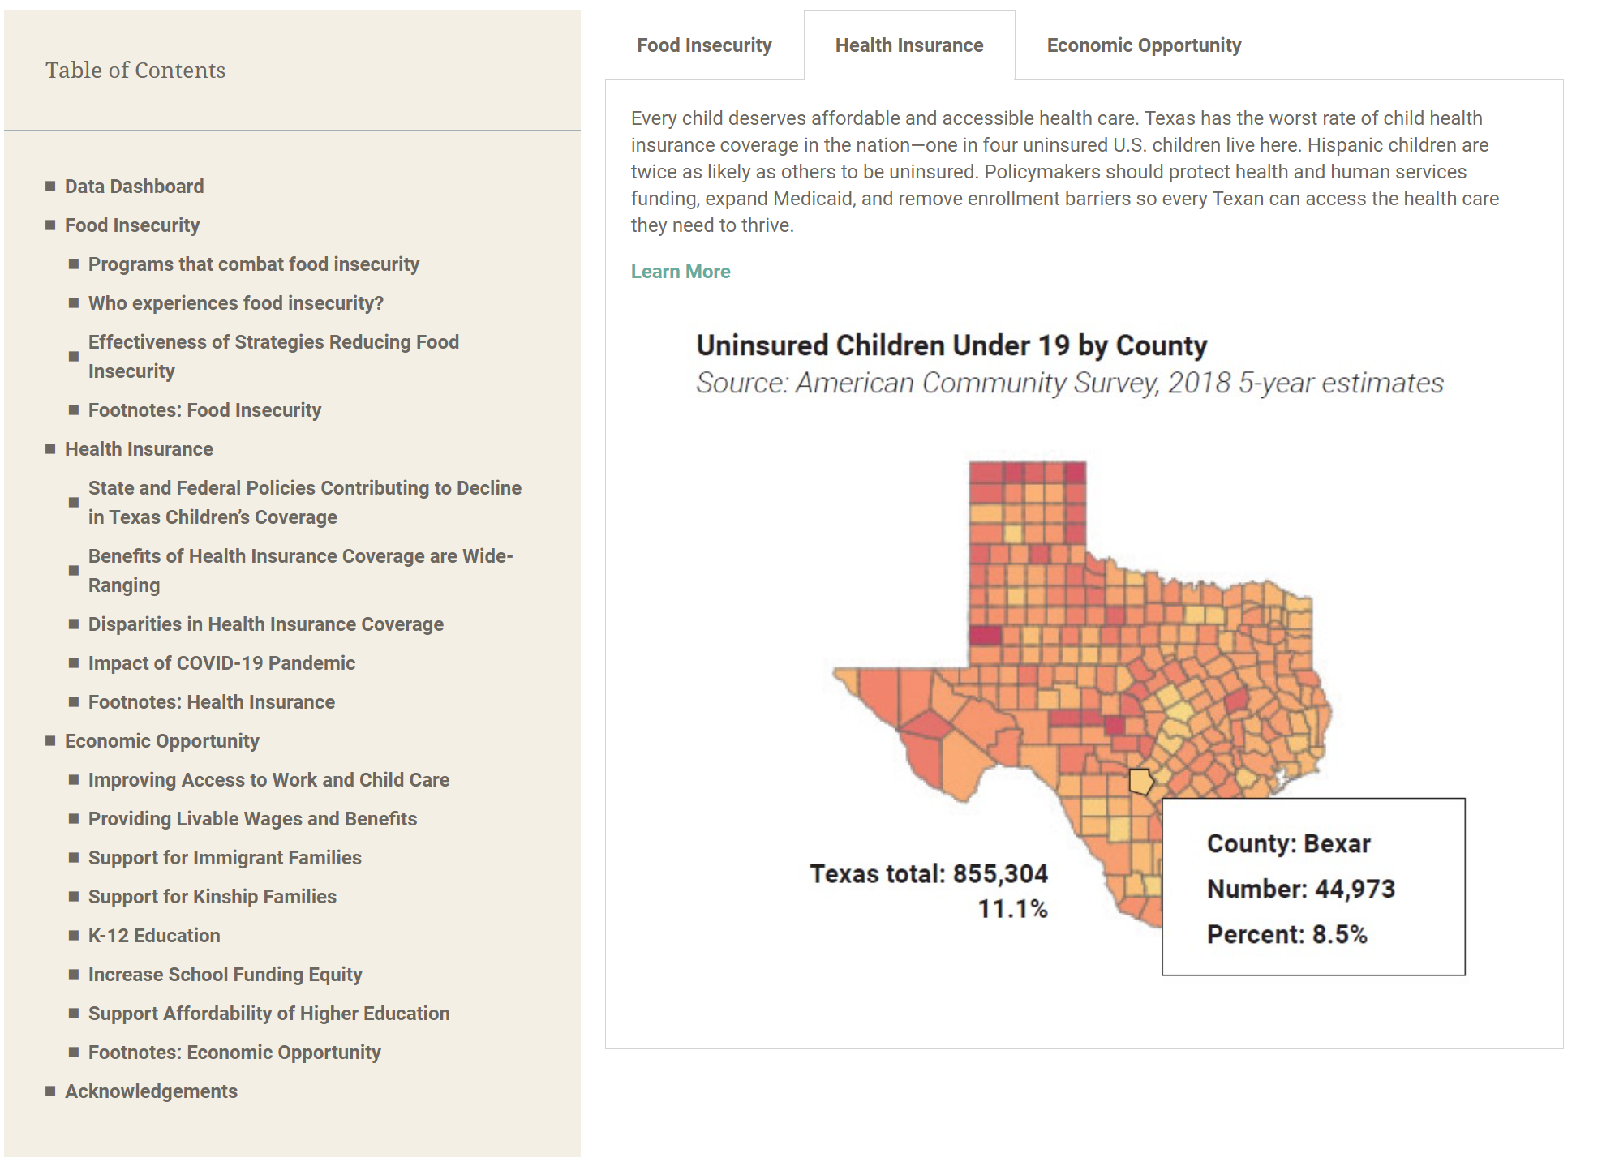
Texas Kids Count 2021 Data Book
Read the full interactive report at everytexan.org/kids-count-2021/

Slide 14
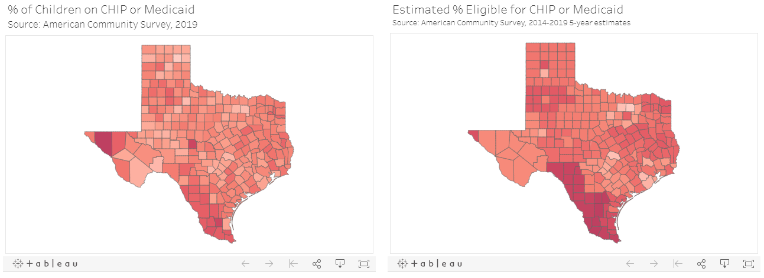
Texas Kids Count 2021 Data Book
Read the full interactive report at everytexan.org/kids-count-2021/

Slide 15
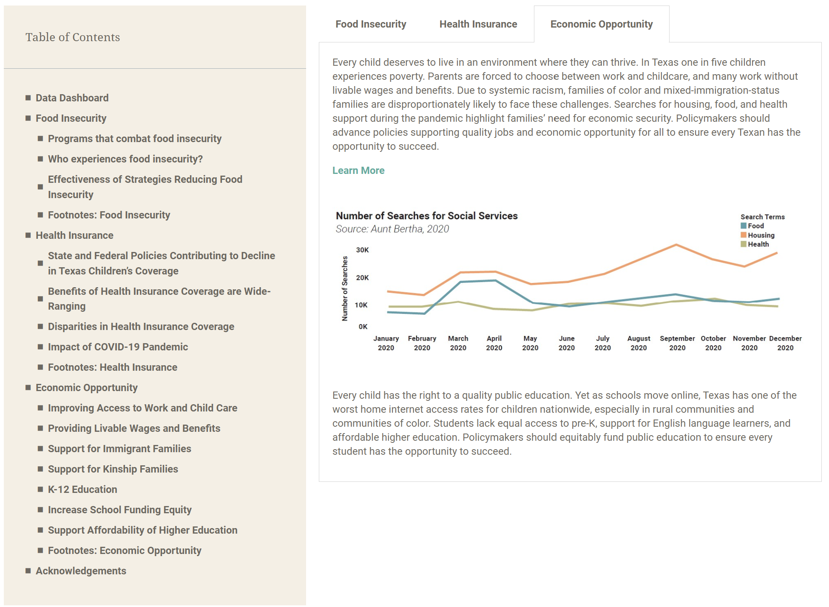
Texas Kids Count 2021 Data Book
Read the full interactive report at everytexan.org/kids-count-2021/

Slide 16
Texas Kids Count 2021 Data Book
Read the full interactive report at everytexan.org/kids-count-2021/

Slide 17
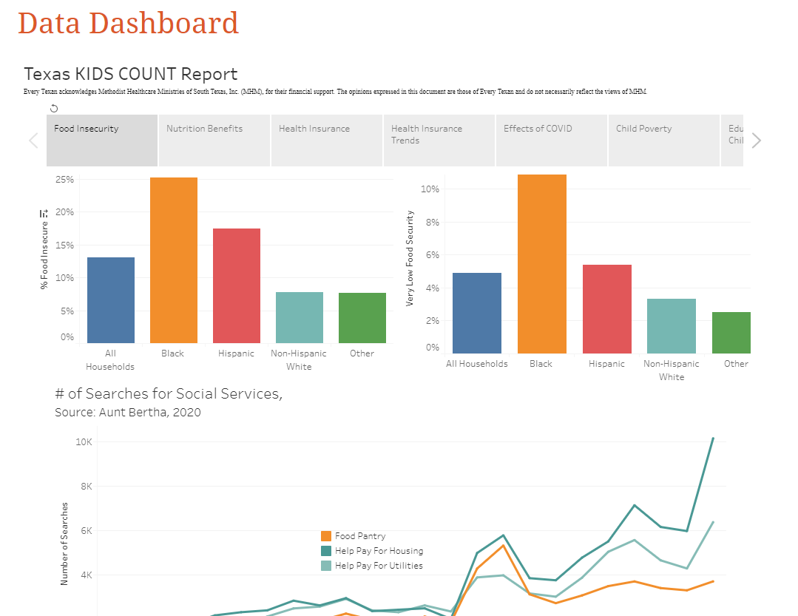
Notes:
On our dashboard, you can find interactive data for your county, disaggregated by race and ethnicity

Slide 18
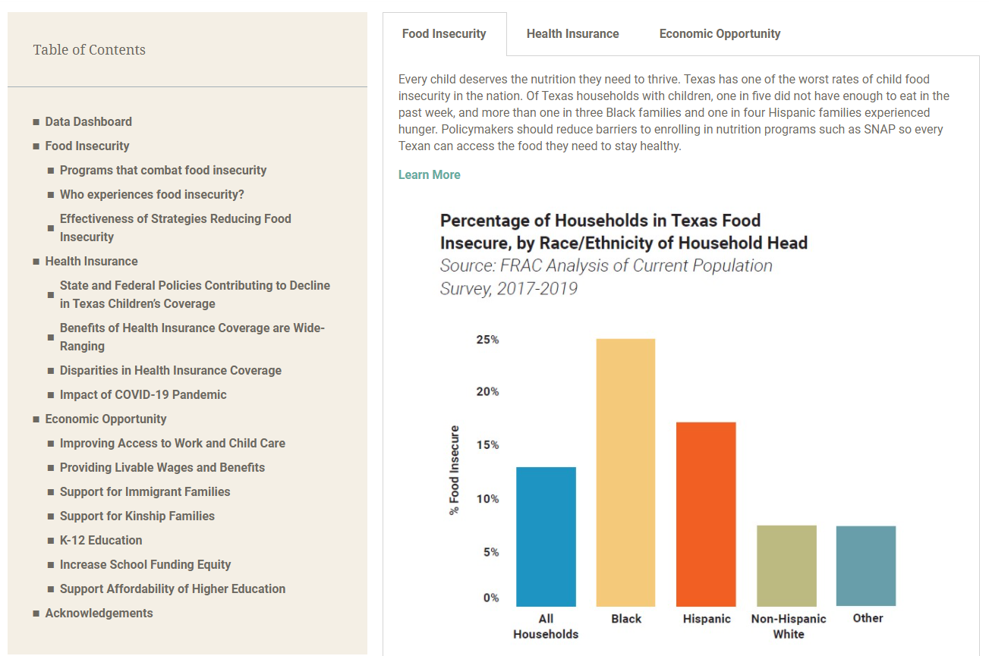
https://everytexan.org/kids-count-2021
Notes:
All this information and more can be found on our interactive data report online.

Slide 19
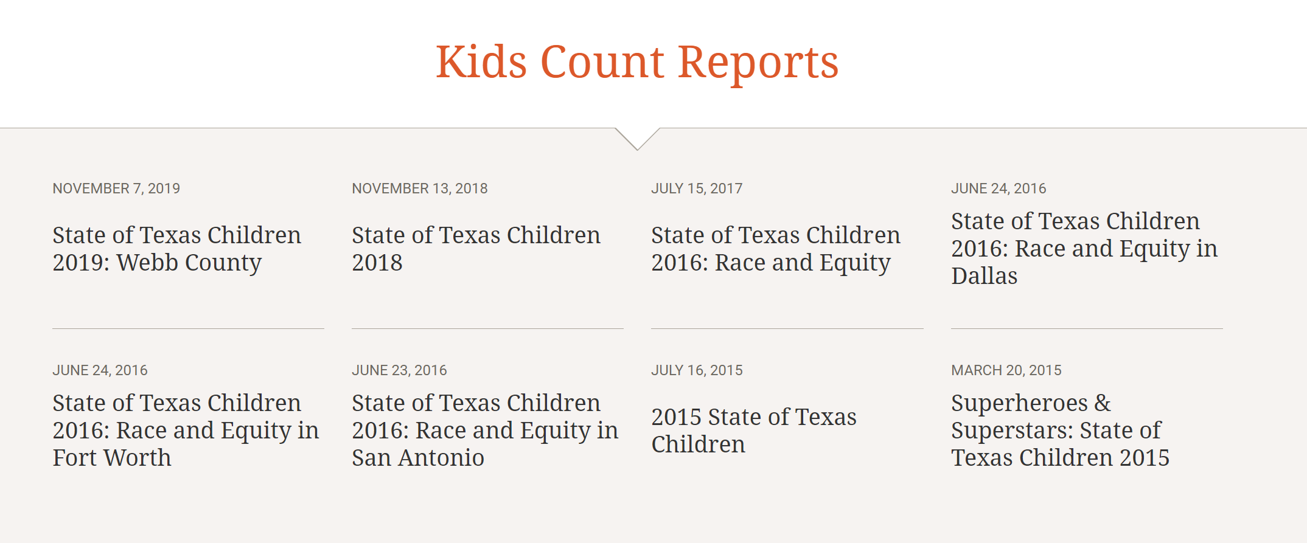
Check out our past reports!
See our past reports at everytexan.org/data-center/kids-count/

Slide 20
Learn more about Every Texan at everytexan.org
Questions about the data? Email wong@everytexan.org

