Slide 1
University of Texas at Austin
Department of Statistics
and Data Sciences
Statistics in Action Series
March 1, 2016
Austin, TX
Notes:
Lila Valencia is Legislative Liaison and Research Associate at the Office of the State Demographer.

Slide 2

Demography – the study of the size, distribution, and composition of populations; the processes determining these – namely, fertility, mortality, and migration; and the determinants and consequences of all of the above.
~ Bogue, 1968; Murdock & Ellis, 1991
Notes:
Generally, demography is the study of populations. More specifically, demography is the study of the size, distribution, and composition of populations; the processes determining these – namely, fertility, mortality, and migration; and the determinants and consequences of all of the above.
~ Bogue, 1968; Murdock & Ellis, 1991
Socioeconomic characteristics that are commonly studied in conjunction with or in relation to the demographic processes include: marital status, living arrangements, race/ethnic composition, education, economic status, and more frequently health status.

Slide 3
The Population Research Institute,
2.1 Kids: Stable Population
http://youtu.be/zBS6f-JVvTY
Notes:
Here is a short piece on two of the main processes in demography.
Population Research Institute’s 2.1 Kids: Stable Population
The total fertility rate (TFR) can be thought of as the average number of children that would be born per woman.
In 2009, the U.S. Total Fertility Rate was 2.007. This is down from 2.085 in 2008, which represents the largest single year decline since 1973. However, the TFR was above replacement levels as recently as 2006 and 2007. Non-Hispanic White TFR = 1.78; Hispanic TFR = 2.733
During this same period, the Texas Total Fertility Rate was 2.2995, well above replacement levels.

Slide 4
Mission
The Office of the State Demographer disseminates demographic and related socioeconomic data to the State of Texas and the general public. The State Demographer’s Office monitors demographic and socioeconomic changes in the State in order to better inform the executive and legislative branches of Texas government. Special emphasis is placed on data that may be useful to policy makers in dealing with issues regarding the demand for state services.
Notes:
At the State Demographer’s Office, we describe the three demographic processes and their determinants and consequences for the State of Texas. We make this information available to policy makers, state and local governments, community organizations, businesses, and the general public.
So how do we do this?

Slide 5
Meeting the Mission
Data Portal, Publications, and Reports
http://osd.texas.gov/
Population Estimates and Projections Program http://osd.texas.gov/Data/TPEPP/
Public Presentations http://osd.texas.gov/Presentations
Resource Witness at Legislative Hearings
Data Requests
Custom Research Projects
Annual Conference for Data Users and Applied Demography Conference
Notes:
So how do we do this?
The Texas State Data Center, a sister agency of the State Demographer’s Office, provides simplified and ready-to-use Census data products specific to Texas. We are also in the process of producing research briefs that tell us what the data mean.
Another of our main products is mandated by the State Legislature. We produce annual population estimates (for between Census years) and biennial population projections (for long-term planning). Estimates are produced for the total State, counties, and places by age, sex, and race/ethnicity. Projections are produced for the State and counties by age, sex, and race/ethnicity.
Our estimates and projections are used by the Governor’s office, the legislative budget board (for budget planning), the legislative council (for redistricting planning), the Comptroller’s office (for defining regions), TxDOT (for facility, route, and highway construction planning), Texas National Guard (for recruiting and to estimate future manpower needs), Dept. of Human Services, and other state agencies.
We post all of our presentations on our website to be used by the general public.

Slide 6
Demographic Overview
Texas is experiencing significant growth.
Population continues to grow at a steady pace though growth is not geographically evenly distributed.
Growth is not racially/ethnically evenly distributed. Population growth is being driven largely by the Hispanic population.
The population of Texas, while relatively young, is also aging.
The components of population change have varying implications for infrastructure in Texas.
Demographic and infrastructure challenges may have serious implications for the future Texas economy.

Slide 7
Components of Population Change by Percent in Texas, 1950-2010
Source: U.S. Census Bureau, Population Estimates
Notes:
Population changes from two factors, one is natural increase which is simply births minus deaths over time and the other is net migration which is in-migrants minus out-migrants over time. Population added from natural increase are babies joining an already existing household. So the effect of population growth from natural increase on infrastructure demands is both lightening, from people dying, and delayed until babies reach the age where they have infrastructure requirements. Net-migration, in Texas, has been positive for most of our history. Migrants, are usually adults in a household, thus migrants immediately add new households and have instant infrastructure needs, such as housing, transportation, etc.
When we look at population change in Texas, from 1950 to present we can see that before 1970, most of our growth was from natural increase. Starting in the 1970s a much larger percent of our growth is attributed to net migration and this continues to today where approaching half of our population change is from migration.

Slide 8
Population Projections,
Texas, 2010 - 2050
Source: Texas State Data Center Population Estimates and Projections Program, 2014 Projections

Slide 9
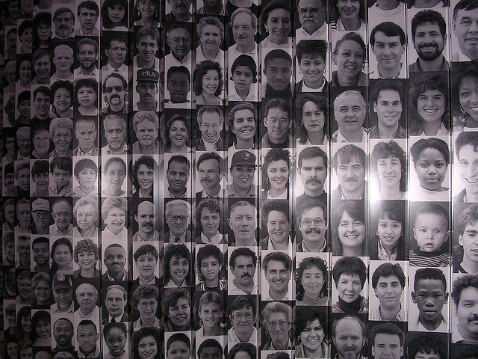
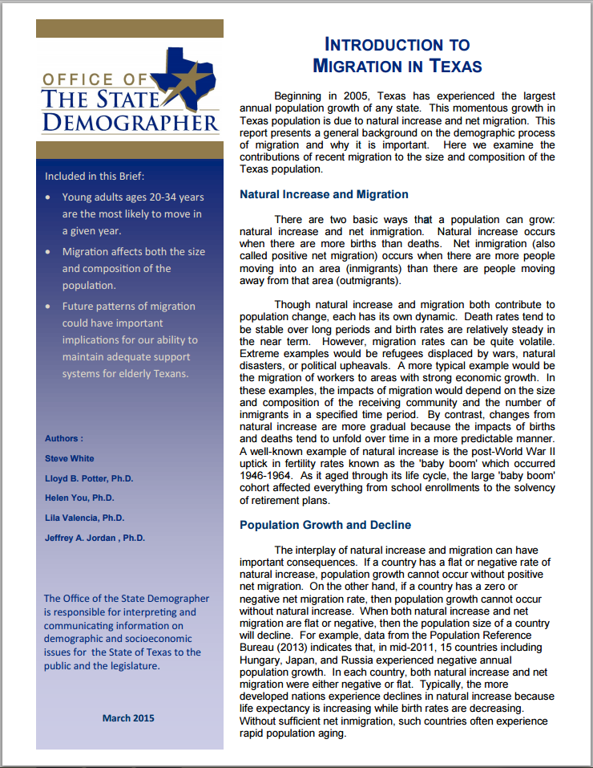
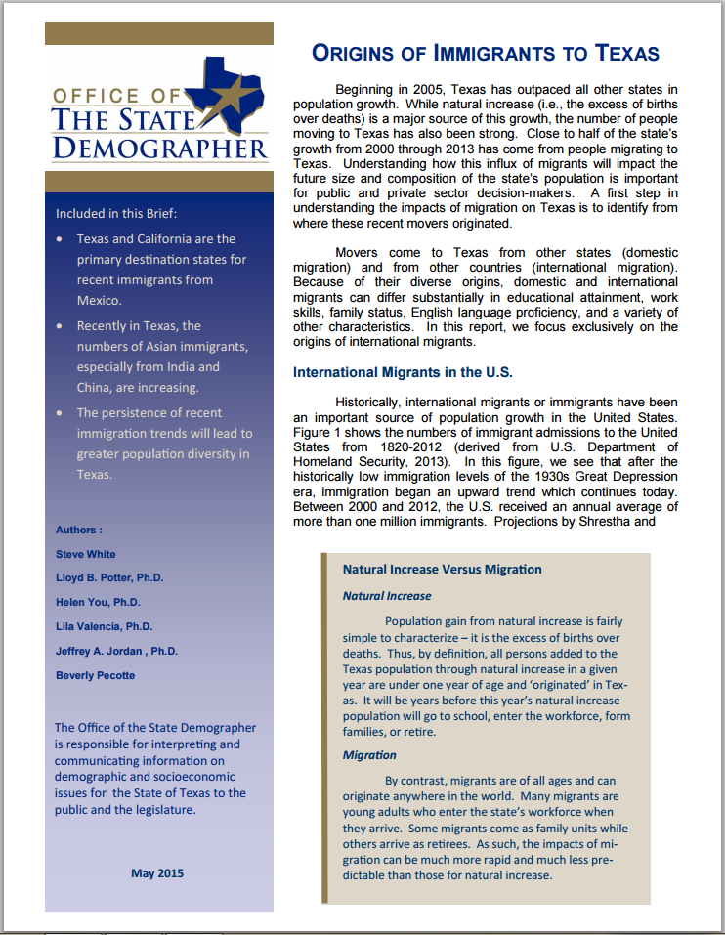
A Profile of International Migrants
in Texas

Slide 10
Immigrants have been an important source of population growth in the U.S.
Migration can alter a population’s age structure. Young adults ages 20-34 years most likely to move in a given year.
Migration can also alter a population’s race/ethnic composition.
Historically, Texas immigrants have been more homogeneous compared to other states.
More recently, Texas has increasingly been a destination for immigrants of more diverse backgrounds.
These trends, if they persist, would yield a more diverse population in Texas.
Notes:
In 8 short years, share of Texas immigrants from Asia more than doubled, while the share of immigrants from Latin America decreased by 38%.

Slide 11
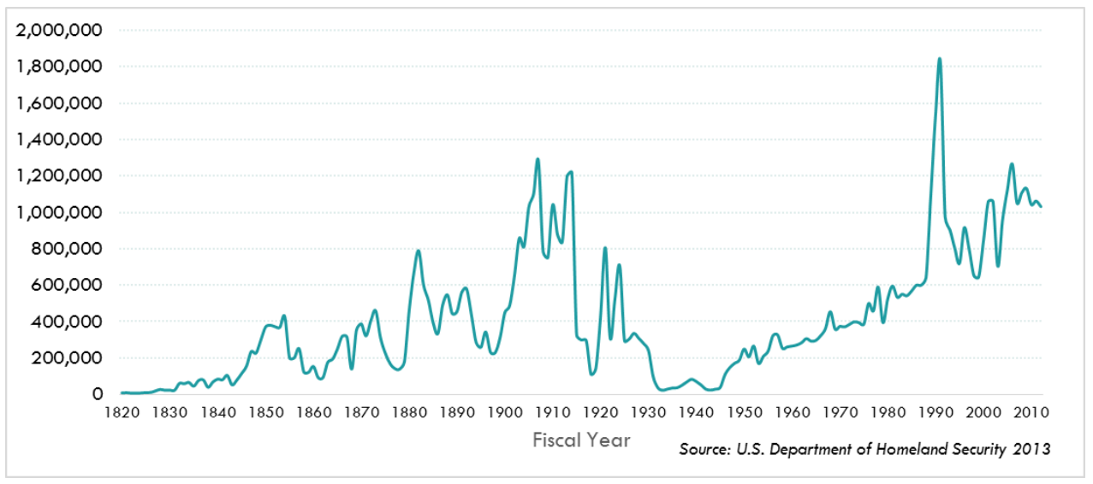
Number of Annual Immigrants Admitted to the U.S., 1820-2012

Slide 12
Percent of Non-Citizen Immigrants by World Area of Birth in the Top 10 Immigrant States, 2007-2011

Slide 13
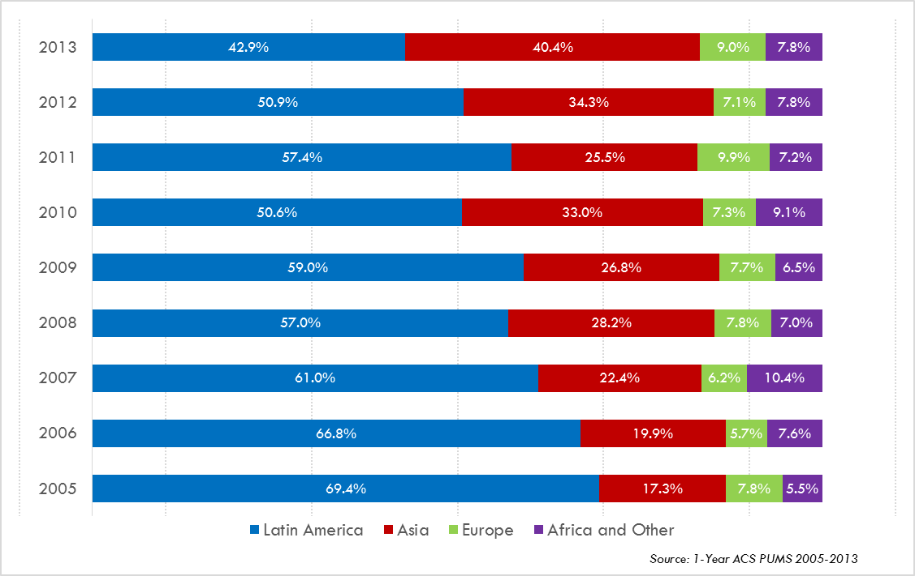
Annual Shares of Recent Non-Citizen Immigrants to Texas by World Area of Birth, 2005-2013

Slide 14


Projecting the educational attainment of the Texas labor force

Slide 15
Employment Status of the Labor Force by Educational Attainment, Texas
Source: U.S. Census Bureau. 2001 to 2011 American Community Survey 1-Year PUMS data
Notes:
Education and employment are positively related. Individuals with higher educational attainment are more likely to be employed. The trend over the past decade suggest this employment gap may be widening. In general, employment rates have decreased between 2001 and 2011, likely due to the economic downturn toward the end of the decade.

Slide 17
Educational Attainment in Texas, 2011
Level of Educational Attainment | Percent of persons aged 25 years and older | State Ranking
High school diploma or equivalency or greater | 81.1% | 48/49/50 (tied with CA and MS)
Bachelors or greater | 26.4% | 29
Source: U.S. Census Bureau, American Community Survey, One-year Sample, 2011.

Slide 18
Percent of persons aged 25 years and older with a high school degree or higher, Texas, 2006-2011

Slide 19
Trends in Educational Attainment of Persons in the Labor Force (25-64 Years of Age) in Texas by Race/Ethnicity – High School Graduates and Above
Source: U.S. Census Bureau, American Community Survey, Public Use Micro Sample, 2001-2011
Notes:
Educational attainment by race/ethnicity in Texas suggests that adults of Hispanic descent are much less likely to have completed high school compared to other race/ethnic groups. Over time, the percent of persons of Hispanic descent who have completed high school has been increasing more rapidly than for other groups but even at this pace of change it will take numerous decades for Hispanics to achieve parity with non-Hispanics in the percent with a high school degree or greater.

Slide 20
Percent of the Civilian Labor Force (ages 25-64) by Educational Attainment for 2011, 2030 Using Constant Rates, Texas
These should be going DOWN
These should be going UP
Sources: U.S. Census Bureau, American Community Survey, 1-Year PUMS.
Texas State Data Center, 2012 Vintage Population Projections, 0.5 Migration Scenario
(http://osd.state.tx.us/Publications/2014-04-08_EducationAttainment.pdf)
Notes:
The first assumption (represented by the red columns) is that educational attainment by race/ethnicity and sex would remain the same as it was in 2011. Thus the changes we see in educational attainment in this projection are due only to changes in the racial/ethnic composition of the population (driven by increasing Hispanic population and a leveling of growth among the non-Hispanic white population). Under this scenario, we would see increases of the percent of the labor force with lower levels of education and declines in the percent of the labor force with higher levels.

Slide 21
Percent of the Civilian Labor Force (ages 25-64) by Educational Attainment for 2011, and 2030 Using Trended Rates, Texas
These should be going DOWN
These should be going UP
Sources: U.S. Census Bureau, American Community Survey, 1-Year PUMS.
Texas State Data Center, 2012 Vintage Population Projections, 0.5 Migration Scenario
(http://osd.state.tx.us/Publications/2014-04-08_EducationAttainment.pdf)
Notes:
Under the second assumption (green columns) the trends observed in improving educational attainment are projected forward and applied to the projected population by race/ethnicity and sex. Thus the generally positive trends we have noted in improving educational attainment are assumed to continue into the future. The result of this projection suggests that we will see declines in the percent of the labor force with lower levels of education and increases in the percent of the labor force with higher levels of education.

Slide 22

America's Electoral Future: How changing demographics could impact future presidential elections, 2016 to 2032
Notes:
Source: States of Change: Demographics and Democracy project, Brookings Institute interactive

Slide 23

Demographics & Destiny

Slide 24
Contact
  Office: (512) 936-3542
  Email: Lila.Valencia@osd.state.tx.us
  Internet: www.osd.texas.gov
  Twitter: @TexasDemography
Lila Valencia, Ph.D.
Notes:
The Office of the State Demographer and the Texas State Data Center are committed to supporting your work through providing you with the best, most accurate, and objective information we can identify about our greatest asset, the people of Texas.

Slide 25
Hans Rosling’s The Joy of Stats BBC Four
http://youtu.be/jbkSRLYSojo
Notes:
No one better than Hans Rosling, professor of global health at the Karolinksa Institute, to demonstrate how statistics can help us make sense of data and better understand our world.
Here he helps us to visualize the association between life expectancy and wealth. Life expectancy is the average number of years a person is expected to live when they are born. If it is low, this generally indicates a higher infant mortality rate, or increased deaths among very young children.
This demonstration gave us a wealth of information. However, it still does not answer the more applied question of “How much of this progress in wealth and health was associated with improvements in human rights?”

