Slide 1

Demographics of Aging, Disabilities, and Veteran and Associated Needs in the Houston Metropolitan Area
2016 Bridges Conference
May 13, 2016
Houston, Texas
Lloyd B. Potter
State Demographer
@TexasDemography
Notes:
Lloyd Potter is the Texas State Demographer and the Director of the Texas State Data Center based at the University of Texas at San Antonio.

Slide 2

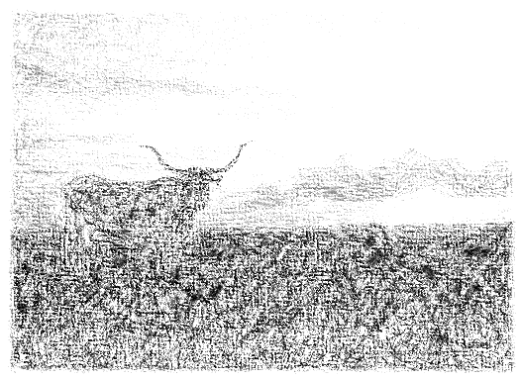
Overview
Texas demographics
Aging of our population
Veterans
Disability
Health trends
Labor force

Slide 3
Total Population and Components of Population Change in Texas, 1950-2014
All values for the decennial dates are for April 1st of the indicated census year. Values for 2012-2014 are for July 1 as estimated by the U.S. Census Bureau.
Source: U.S. Census Bureau, Census Counts and Population Estimates

Slide 4
Population Growth, Texas, 1950-2010
Source: U.S. Census Bureau, Decennial Censuses
Notes:
In 2014 we estimate that Texas had just under 27 million residents, while in the 2010 Census we had just over 25 million residents.
Population growth in Texas has been geometric or compounding in nature. Over the past two decades there have been three 20 year periods where the numeric growth has increased. We have no indication that the population growth in Texas will slow dramatically in coming years.

Slide 5
Total Estimated Population by County, Texas, 2015
Source: U.S. Census Bureau, 2015 Vintage Population Estimates
Notes:
When we look at the geographic distribution of the population of Texas over time we see continually increasing population in the counties along the I-35 corridor, the Houston area, and the lower Rio Grand Valley. Urbanized areas out west have grown but most counties west have experienced limited growth and some population decline. Approximately 86% of the population is along I-35 and east. This area with the 3 major metropolitan areas at the points is often described as the Texas population triangle.
The counties of Harris, Dallas, Tarrant, Bexar, and Travis make up the points of the “population triangle” in Texas and are the most populated in the State. Collin, Denton, Fort Bend, Hidalgo, and El Paso counties also have significant population concentrations. Many counties west of Interstate 35 are more sparsely populated.

Slide 6
Estimated Population Change, Texas Counties, 2010 to 2015
99 counties lost population over the five year period.
Source: U.S. Census Bureau Population Estimates, 2015 Vintage.
Notes:
Population change over the decade has been greatest in the urban and suburban population triangle counties. Counties in the lower Rio Grande Valley also had significant growth as did El Paso . Overall, 155 counties gained population while 99 (39%) lost population over the decade.

Slide 7
Estimated Percent Change of the Total Population by County, Texas, 2010 to 2015
Source: U.S. Census Bureau Population Estimates, 2015 Vintage.
Notes:
Percent change is an indicator of the speed of population change void of information about the volume of population change. Percent change in the population over the past few years has been greatest in the urban and suburban population triangle counties. Notably counties in the Eagle Ford Shale area (south east of San Antonio) and the Cline Shale area (Midland and Odessa area), have been growing quickly.

Slide 8
Top Counties for Numeric Growth in Texas, 2013-2014
 | U.S. Rank Population Change | Population Change | Percent of Change from Natural Increase | Percent Change from Migration | Percent of Migration that is international
Harris | 1 | 88,618 | 48.6% | 51.4% | 54.0%
Bexar | 6 | 33,712 | 42.8% | 57.2% | 23.2%
Dallas | 8 | 32,555 | 69.6% | 30.4% | 116.3%*
Tarrant | 10 | 31,417 | 50.8% | 49.2% | 38.5%
Fort Bend | 11 | 30,784 | 19.4% | 80.6% | 17.3%
Travis | 12 | 28,397 | 38.2% | 61.8% | 29.7%
Collin | 14 | 26,530 | 26.1% | 73.8% | 20.1%
Denton | 16 | 24,211 | 27.2% | 72.8% | 14.0%
Montgomery | 27 | 19,129 | 17.9% | 82.1% | 10.4%
Williamson | 31 | 18,025 | 23.2% | 76.8% | 7.8%
*Dallas had net out domestic migration over this period.
Source: U.S. Census Bureau, 2014 Vintage Population Estimates

Slide 9
Top Counties for Percent Growth* in Texas, 2013-2014
 | U.S. Rank | 2013-2014 Percent Population Change | Percent Change from Migration | Percent of Migration that is International
Hays | 5 | 4.8% | 83.89% | 2.6%
Fort Bend | 6 | 4.7% | 80.6% | 17.37%
Comal | 9 | 4.0% | 90.1% | 3.0%
Andrews | 12 | 4.0% | 62.8% | 3.7%
Montgomery | 13 | 3.8% | 82.1% | 10.4%
Williamson | 14 | 3.8% | 76.8% | 7.8%
Kendall | 15 | 3.8% | 98.0% | 5.0%
Ward | 21 | 3.4% | 72.0% | 1.5%
Denton | 23 | 3.3% | 72.8% | 14.2%
Collin | 31 | 3.1% | 73.9% | 20.1%
Aransas | 32 | 3.1% | 110.8% | 4.3%
Rockwall | 35 | 3.0% | 78.3% | 7.8%
Waller | 36 | 2.9% | 77.2% | 5.3%
Ector | 37 | 2.9% | 59.9% | 2.0%
Guadalupe | 42 | 2.8% | 78.6% | 4.9%
Source: U.S. Census Bureau, 2014 Vintage Population Estimates
*Among Counties with 10,000 or more population in 2013

Slide 10
Percent Population by Race and Ethnicity, Texas, 2000 and 2010
2000
2010
Source: U.S. Census Bureau 2000 and 2010 Decennial Census, SF1

Slide 11
Texas White (non-Hispanic) and Hispanic Populations by Age, 2010
Source: U.S. Census Bureau 2010 Decennial Census, SF1
Notes:
The age distribution of the non-Hispanic white population in Texas is weighted heavily with the “baby boom” generation. Largely the result of lower fertility and less net in-migration, the non-Hispanic white population has relatively fewer young persons relative to those in the middle-age years. In 2010, at ages 37 and younger, the Hispanic population exceeds the non-Hispanic white population.

Slide 12
Texas Population Pyramid by Race/Ethnicity, 2010
Source: U.S. Census Bureau 2010 Decennial Census, SF1
Notes:
This population pyramid represents the age and sex composition of the Texas non-Hispanic white population. Blue represents males, red females, rows are single years of age.

Slide 13
Texas Population Pyramid by Race/Ethnicity, 2010
Source: U.S. Census Bureau 2010 Decennial Census, SF1
Notes:
This population pyramid represents the age, and sex composition of the minority population in Texas. Blue represents males, red females, rows are single years of age, and shades represent specified race/ethnic groups as indicated in the legend.

Slide 14
Texas Population Pyramid by Race/Ethnicity, 2010
Source: U.S. Census Bureau 2010 Decennial Census, SF1
Notes:
This population pyramid represents the age, sex, race and ethnic composition of the Texas population. Blue represents males, red females, rows are single years of age, and shades represent specified race/ethnic groups as indicated in the legend.

Slide 15
Estimated number of persons aged 65 years and older, Texas Counties, 2010-2014
Source: U.S. Census Bureau, American Community Survey, 2010-2014 5 Year Sample

Slide 16
Estimated Population Aged 65 Years and Older, Census Tracts, Houston area, Texas, 2010-2014
Source: U.S. Census Bureau, American Community Survey, 2010-2014 5 Year Sample

Slide 17
Median Age by State, 2008-2013
Source: U.S. Census Bureau, American Community Survey, 5 Year Sample 2009-2013.
Notes:
The median age of Texas’ population is young compared to most states.

Slide 18
Median Age, Texas Counties, 2010-2014
Source: U.S. Census Bureau, American Community Survey, 2010-2014 5 Year Sample

Slide 19
Median age, Census Tracts, Houston area, Texas, 2010-2014
Source: U.S. Census Bureau, American Community Survey, 2010-2014 5 Year Sample

Slide 20
Change in Median Age, Texas Counties, 2000-2014
Source: US Census Bureau US Census Bureau, 2000
Decennial Census, SF-1, Population Estimates 2014 Vintage.

Slide 21
Percent of the Population Aged 65 Years and Older by State, 2010-2014
Source: U.S. Census Bureau, American Community Survey, 5 Year Sample 2010-2014

Slide 22
Percent of the population aged 75 years and older, Texas Counties, 2009-2013
Source: U.S. Census Bureau, American Community Survey, 2009-2013 5 Year Sample

Slide 23
Projected Population Growth in Texas,
2010-2050
Source: Texas State Data Center 2014 Population Projections
Notes:
The projected population of Texas is produced using three different migration scenarios. The blue line represents the assumption that there is no in or out migration for Texas. The result is a population that is growing only from natural increase (births-deaths). Under this unlikely scenario, Texas will maintain a health pace of population growth. The other two scenarios assume that 1) the migration rate will be the same as we observed between 2000 and 2010 and 2) the migration rate will be half of what we observed between 2000 and 2010. Under the first assumption Texas will add another 5 million persons this decade, another 7 million the following, 8 or 9 million between 2030 and 2040 and almost 10 million between 2040 and 2050. The half migration scenario also projects significant growth but more modest than the assumption of full migration.

Slide 24
Projected and Estimated Population Growth in Texas, 2010-2015
Source: Texas State Data Center 2014 Population Projections and U.S. Census Bureau Population Estimates

Slide 25
Projected Growth of Population Aged 65 Years and Older in Texas, 2010-2050
Source: Texas State Data Center 2014 Population Projections
Notes:
The projected population of Texas is produced using three different migration scenarios. The blue line represents the assumption that there is no in or out migration for Texas. The result is a population that is growing only from natural increase (births-deaths). Under this unlikely scenario, Texas will maintain a health pace of population growth. The other two scenarios assume that 1) the migration rate will be the same as we observed between 2000 and 2010 and 2) the migration rate will be half of what we observed between 2000 and 2010. Under the first assumption Texas will add another 5 million persons this decade, another 7 million the following, 8 or 9 million between 2030 and 2040 and almost 10 million between 2040 and 2050. The half migration scenario also projects significant growth but more modest than the assumption of full migration.

Slide 26
Population Change by Age Group, Texas, 1950-2050
Source: US Census Bureau, 1950-2010 Censuses
US Census Bureau, State Population Estimates
Texas State Data Center, 2014 Population Projections, 1.0 Migration Scenario

Slide 27
Projected Population Change by Age Group, Harris County, Texas, 1950-2050
Source: Texas State Data Center, 2014 Population Projections, 1.0 Migration Scenario

Slide 28
Population Projections 65 Years and Over by Race/Ethnicity, Texas, 2010-2050
Source: Texas State Data Center 2014 Population Projections , Half 2000-2010 Migration Scenario

Slide 29
Population Projections 65 Years and Over by Race/Ethnicity, Harris County, Texas, 2010-2050
Source: Texas State Data Center 2014 Population Projections , Half 2000-2010 Migration Scenario

Slide 30
Veteran Population in Texas and Houston Area Counties, 2010-2014
 | Texas | Harris | Montgomery | Fort Bend | Galveston
Total Civilian population 18 years and over | 19,004,447 | 3,092,972 | 451,491 | 354,454 | 226,207
Veteran Civilian population 18 years and over | 1,564,501 | 175,509 | 26,865 | 32,052 | 21,217
Veterans Percent of Civilian Population | 8.2% | 5.7% | 6.0% | 9.0% | 9.4%
Source: U.S. Census Bureau, American Community Survey, 2010-2014 5 Year Sample

Slide 31
Veteran Era of Service in Texas and Houston Area Counties, 2010-2014
 | Texas | Harris | Montgomery | Fort Bend | Galveston
Percent Veterans in Gulf War (9/2001 or later) | 16.8 | 15.9 | 14.6 | 12.2 | 14.8
Percent of Veterans in Gulf War (8/1990 to 8/2001) | 22.1 | 20.5 | 23.8 | 17.8 | 18.9
Percent of Veterans of Vietnam era | 34.8 | 32.7 | 34.0 | 37.9 | 36.3
Percent of Veterans of Korean War | 9.1 | 8.5 | 6.6 | 8.2 | 8.8
Percent of Veterans of World War II | 5.8 | 5.9 | 4.4 | 5.1 | 5.7
Source: U.S. Census Bureau, American Community Survey, 2010-2014 5 Year Sample

Slide 32
Percent of the Total Population and Percent of Veterans by
Age Groups, Texas and Houston Area Counties, 2010-2014
 | Texas | Harris | Montgomery | Fort Bend | Galveston
Percent of Total Population Aged 65 to 74 years | 6.3 | 4.2 | 6.6 | 4.8 | 5.9
Percent of Veterans Aged 65 to 74 years | 18.3 | 14.0 | 18.3 | 17.6 | 17.1
Percent of Total Population Aged 75 and Older | 8.7 | 7.6 | 9.5 | 7.2 | 9.7
Percent of Veterans Aged 75 and Older | 20.6 | 20.6 | 20.8 | 20.6 | 24.3
Source: U.S. Census Bureau, American Community Survey, 2010-2014 5 Year Sample

Slide 33
Percent of the Total Population and Veterans Living Below Poverty and with Any Disability, Texas and Houston Area Counties, 2010-2014
 | Texas | Harris | Montgomery | Fort Bend | Galveston
Percent of the Total Population Below Poverty | 14.9 | 7.3 | 11.5 | 15.1 | 10.4
Percent of Veterans Below Poverty | 6.8 | 4.4 | 6.0 | 7.5 | 4.5
Percent of Total Population with any disability | 14.5 | 9.0 | 15.3 | 11.5 | 13.5
Percent of Veterans with any disability | 27.0 | 20.3 | 26.1 | 23.6 | 25.7
Source: U.S. Census Bureau, American Community Survey, 2010-2014 5 Year Sample

Slide 34
Percent of the population aged 65 years and older who are Veterans, Census Tracts, Houston area, Texas, 2010-2014
Source: U.S. Census Bureau, American Community Survey, 2010-2014 5 Year Sample

Slide 35
Percent of the Population Aged 65 Years and Older without Health Insurance, Texas Counties, 2010-2014

Slide 36
Estimated number and percent of persons with a disability for Texas and Houston Area Counties, 2010-2014
 | Texas | Harris | Montgomery | Fort Bend | Galveston
Total Population with a disability | 2,969,042 | 392,304 | 51,831 | 47,553 | 37,136
Percent with a disability | 11.6 | 9.2 | 10.7 | 7.6 | 12.5
Population 65 years and over with a disability | 1,103,018 | 134,996 | 19,757 | 16,405 | 13,491
Percent of population 65 years and over with a disability | 39.9 | 37.0 | 36.5 | 31.2 | 38.1
Source: U.S. Census Bureau, American Community Survey, 2010-2014 5 Year Sample

Slide 37
Percent of the population aged 65 years and older with an independent living disability, Texas Counties, 2010-2014
Source: U.S. Census Bureau, American Community Survey, 2010-2014 5 Year Sample

Slide 38
Percent of the population aged 65 years and older with an independent living disability, Texas Counties, 2010-2014
Source: U.S. Census Bureau, American Community Survey, 2010-2014 5 Year Sample

Slide 39
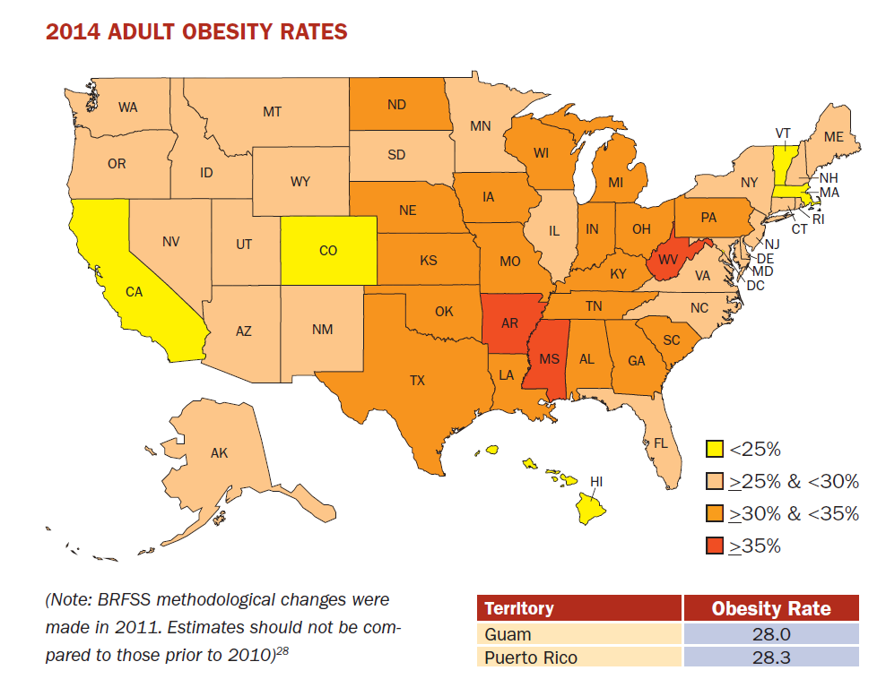
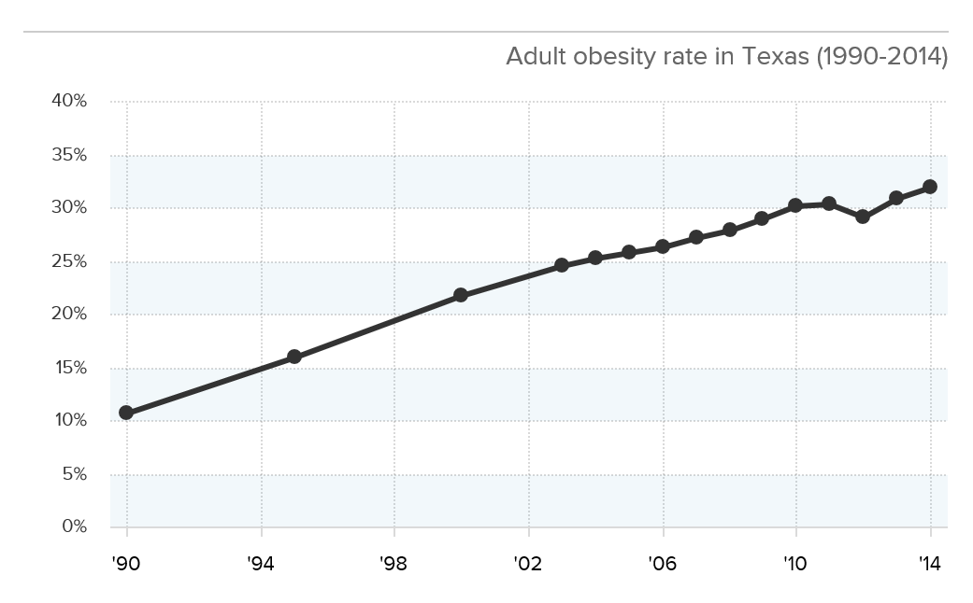
Adult Obesity
Source: http://stateofobesity.org/files/stateofobesity2015.pdf

Slide 40
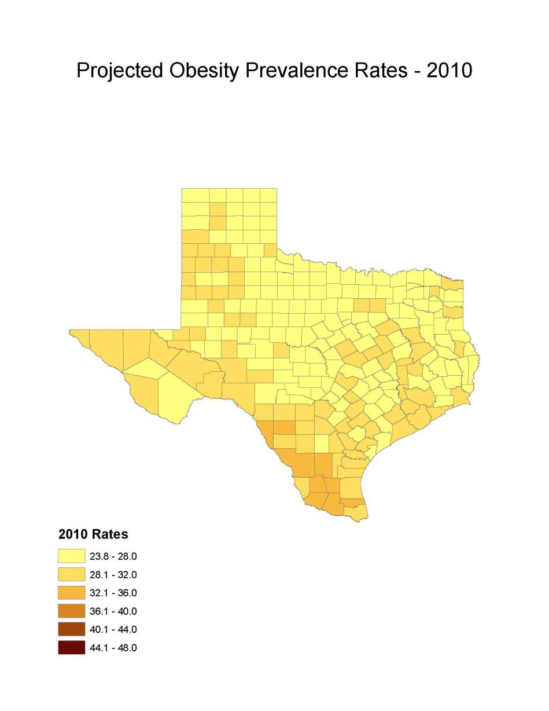
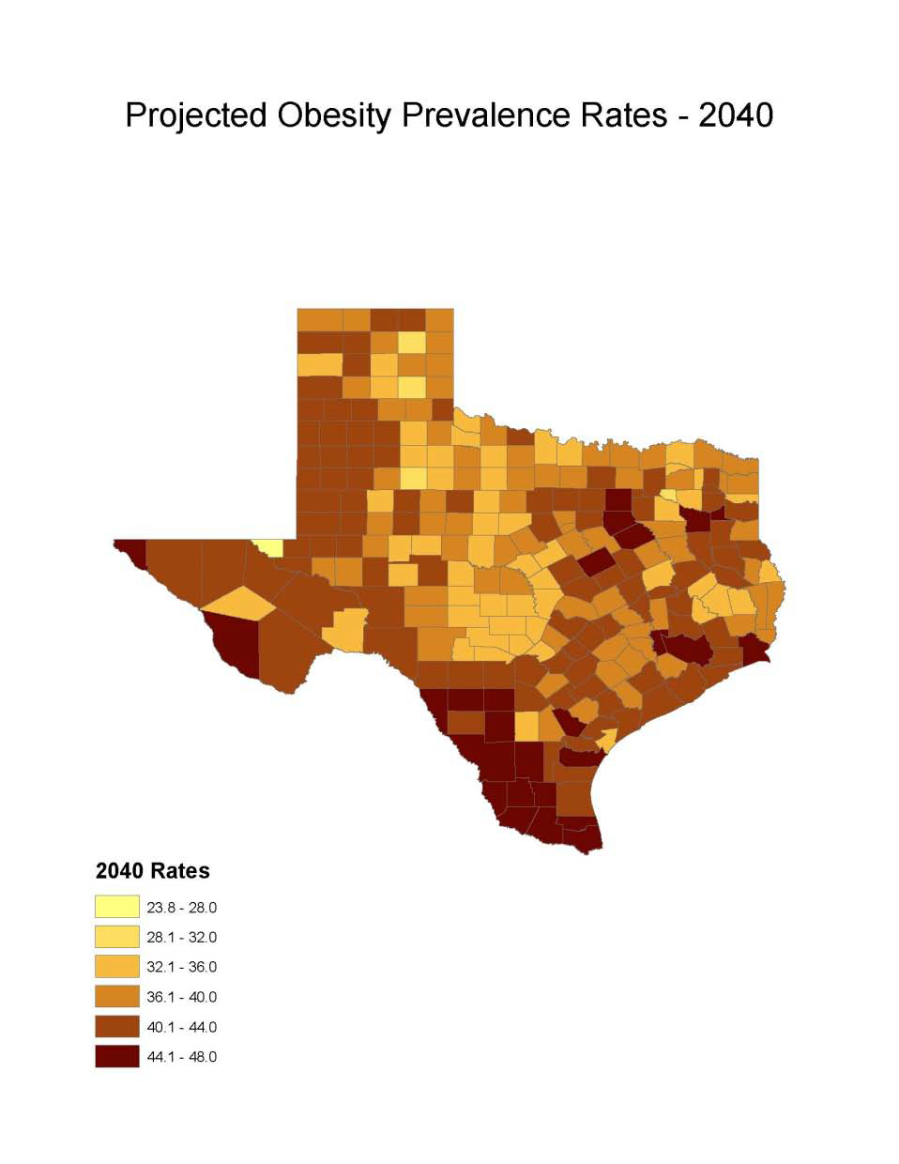
Obesity Prevalence
% adults with obesity: Office of the State Demographer, 2000-2004 Projection

Slide 41
Projected Number of Adults with Diabetes by Race and Ethnicity, Texas, 2010-2040

Slide 42
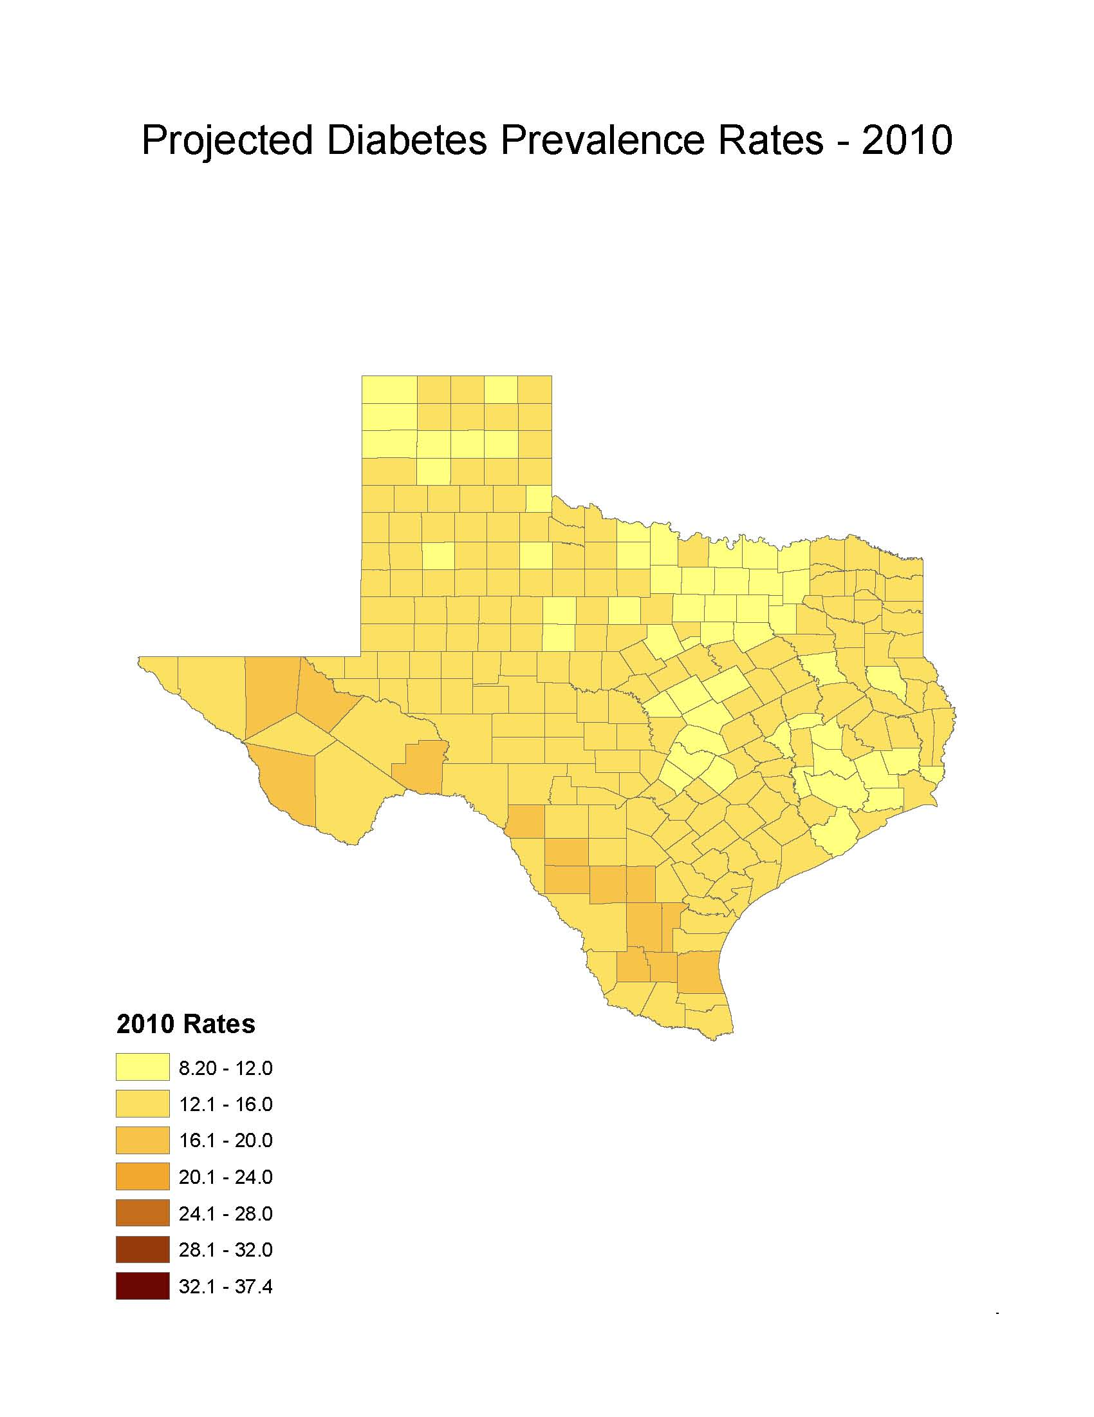
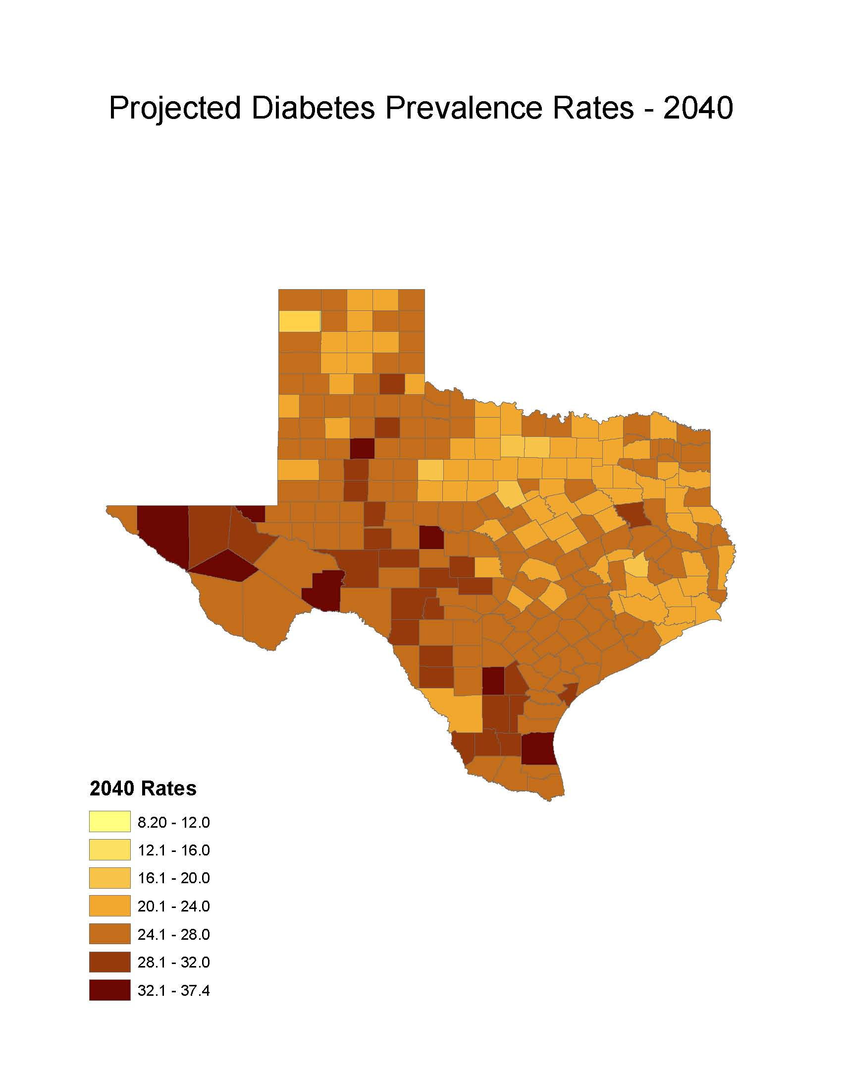
Diabetes Prevalence
% adults with diabetes: Office of the State Demographer, 2000-2004 Projection

Slide 43
RNs and LVNs Working in Nursing Homes and Extended Care Facilities per 1,000 Persons Aged 65 Years and Older, Texas Counties, 2015
Sources: Texas Board of Nursing, 2016 and U.S. Census Bureau, American Community Survey, 2010-2014 5 Year Sample

Slide 44
Physicians per 1,000 Population Aged 65 Years and Older by County, 2011
Source: U.S. Census Bureau. 2010 Census and Texas Medical Board (2011 physicians).
Notes:
Data on this map about physicians licensed to practice in Texas are from the Texas Medical Board. Some rural counties do not have any practicing physicians. The more urban counties appear to have relatively high ratios of physicians to population aged 65+. This map does not provide information about the type/specialty of physicians.

Slide 45


Review
Growth and diversity
“Young” aging rapidly
Aging Veteran’s
Disability numbers
Health issues
Labor force

Slide 46
  Office: (210) 458-6530
  Lloyd.Potter@UTSA.edu
  Demographics.Texas.gov
Lloyd B. Potter, Ph.D.
State Demographer
@TexasDemography
Notes:
The Office of the State Demographer and the Texas State Data Center are committed to supporting your work through providing you with the best, most accurate, and objective information we can identify about our greatest asset, the people of Texas.

