Slide 1
Texas Population Trends, Characteristics, &Projections
Texas State Agency Business Administrators Association
Annual Summer Conference
Corpus Christi, TX
July 21, 2016

Slide 2

Overview
Texas demographics
Population growth
Race and Ethnicity trends
Migration
Population Projections
@TexasDemography

Slide 3
Texas is experiencing fast and high growth.

Slide 4
Total Population and Components of Change in Texas, 1950-2014
Notes:
Between 2000 and 2010 Texas added over 4 million residents. In 5 short years, it is estimated Texas has added over 2 million more, placing Texas population at 27.5 million, on pace to meet or surpass our gains since the last census. Population growth in Texas has been geometric or compounding in nature. Over the past six decades there have been three periods where the numeric growth has increased relative to previous years. We have no indication that the population growth in Texas will slow dramatically in coming years.

Slide 5
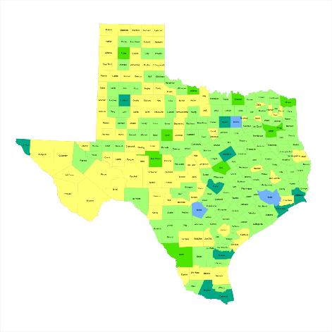
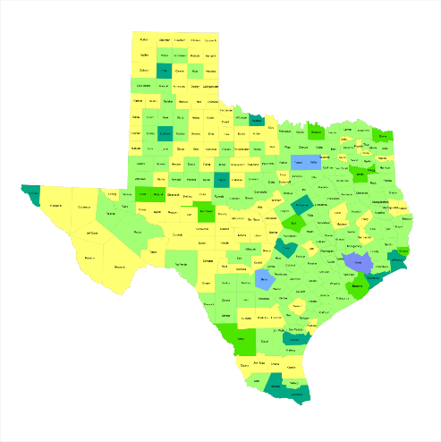
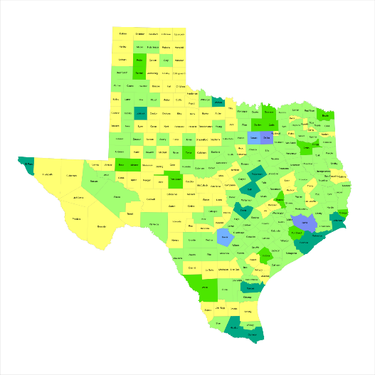

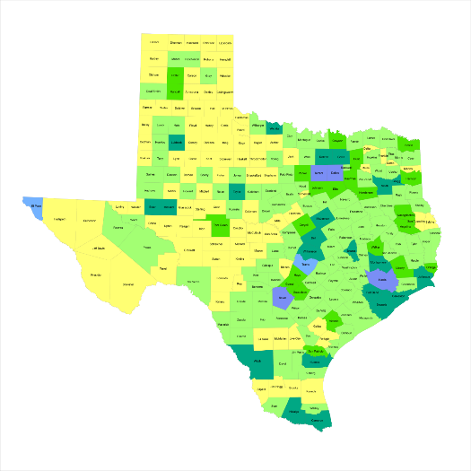
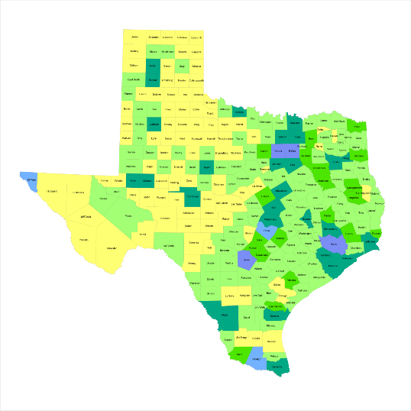
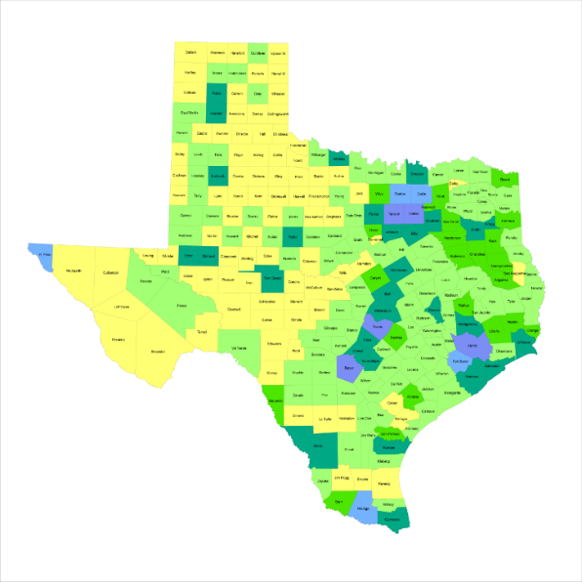
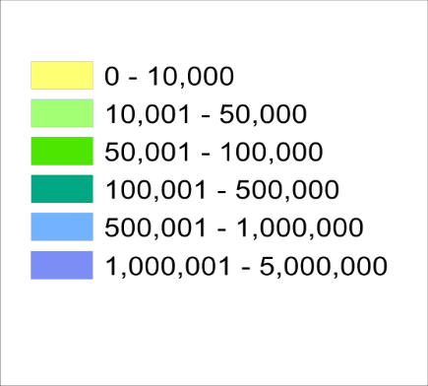
Historic County Population, Texas
1950
1960
1970
1980
1990
2000
2010
3
Source: U.S. Census Bureau, decennial censuses
Notes:
Texas growth has been steady but not geographically even over the past seven decades. As the population in the major urban areas and surrounding suburban areas has grown dramatically, areas the more rural western part of the state that were populated earlier have become less populated in recent decades.

Slide 6
Total Estimated Population by County, Texas, 2015
Source: U.S. Census Bureau, 2015 Vintage Population Estimates
Notes:
When we look at the geographic distribution of the population of Texas over time we see continually increasing population in the counties along the I-35 corridor, the Houston area, and the lower Rio Grand Valley. Urbanized areas out west have grown but most counties west have experienced limited growth and some population decline. Approximately 86% of the population is along I-35 and east. This area with the 3 major metropolitan areas at the points is often described as the Texas population triangle.
The counties of Harris, Dallas, Tarrant, Bexar, and Travis make up the points of the “population triangle” in Texas and are the most populated in the State. Collin, Denton, Fort Bend, Hidalgo, and El Paso counties also have significant population concentrations. Many counties west of Interstate 35 are more sparsely populated.

Slide 7
Estimated Population Change, Texas Counties, 2010 to 2015
99 counties lost population over the five year period.
Source: U.S. Census Bureau Population Estimates, 2015 Vintage.
Notes:
Population change over the decade has been greatest in the urban and suburban population triangle counties. Counties in the lower Rio Grande Valley also had significant growth as did El Paso . Overall, 155 counties gained population while 99 (39%) lost population over the decade.

Slide 8
Estimated Percent Change of the Total Population by County, Texas, 2010 to 2015
Source: U.S. Census Bureau Population Estimates, 2015 Vintage.
Notes:
Percent change is an indicator of the speed of population change void of information about the volume of population change. Percent change in the population over the past few years has been greatest in the urban and suburban population triangle counties. Notably counties in the Eagle Ford Shale area (south east of San Antonio) and the Cline Shale area (Midland and Odessa area), have been growing quickly.

Slide 9
Top Counties for Percent Growth* in Texas, 2014-2015
 | U.S. Rank | 2014-2015 Percent Population Change | Percent Change from Migration | Percent of Migration that is International
Hays County | 4 | 5.2% | 86.4% | 2.2%
Comal County | 7 | 4.5% | 90.5% | 2.3%
Fort Bend County | 9 | 4.3% | 79.3% | 20.8%
Kendall County | 12 | 4.2% | 102.9% | 3.6%
Gaines County | 13 | 4.0% | 62.8% | 7.8%
Waller County | 14 | 4.0% | 79.2% | 2.7%
Williamson County | 16 | 3.9% | 79.9% | 8.5%
Andrews County | 19 | 3.7% | 61.1% | 4.8%
Rockwall County | 20 | 3.7% | 85.3% | 5.0%
Montgomery County | 23 | 3.6% | 79.2% | 12.2%
Denton County | 25 | 3.4% | 74.1% | 15.7%
Ector County | 36 | 3.3% | 63.7% | 5.0%
Midland County | 37 | 3.3% | 69.2% | 4.8%
Collin County | 42 | 3.2% | 74.3% | 21.0%
Kaufman County | 46 | 3.1% | 78.3% | 3.9%
Bastrop County | 48 | 3.0% | 79.4% | 3.0%
*Among counties with 10,000 or more population in 2014
8
Source: U.S. Census Bureau, 2015 Vintage Population Estimates.
Notes:
Over thirty percent of the 50 fastest growing counties in the United States from 2014 to 2015 were in Texas. Some of the fastest growing counties in the country continue to be suburban ring counties, such as Hays, Comal, and Fort Bend counties. Growth among the fastest growing counties in the country stems more from migration than natural increase.

Slide 10
Top Counties for Numeric Growth in Texas, 2014-2015
 | U.S. Rank Population Change | Population Change | Percent of Change from Natural Increase | Percent Change from Migration | Percent of Migration that is international
Harris County | 1 | 90,451 | 48.8% | 51.2% | 63.2%
Bexar County | 5 | 37,479 | 42.8% | 57.2% | 29.0%
Tarrant County | 6 | 36,152 | 47.6% | 52.4% | 37.5%
Dallas County | 9 | 33,760 | 67.0% | 33.0% | 122.3%*
Fort Bend County | 13 | 29,437 | 20.7% | 79.3% | 20.8%
Collin County | 14 | 28,075 | 25.7% | 74.3% | 21.0%
Denton County | 16 | 25,820 | 25.9% | 74.1% | 15.7%
Travis County | 17 | 25,562 | 42.3% | 57.7% | 39.8%
Williamson County | 27 | 19,086 | 20.1% | 79.9% | 8.5%
Montgomery County | 29 | 18,505 | 20.8% | 79.2% | 12.2%
*Dallas had net out domestic migration over this period.
9
Source: U.S. Census Bureau, 2015 Vintage Population Estimates.
Notes:
One-fifth of the top 50 counties in the United States that were growing the most numerically between 2014 and 2015 were in Texas. These counties are the larger ones in the State and are all counties that have experienced continued growth. However, the components attributing to their population change varies. For instance, natural increase and international migration are playing a key role in population growth in Dallas County. Harris and Tarrant counties are growing about evenly from migration and natural increase. Whereas in the suburban ring counties migration (mostly domestic) is driving population growth.

Slide 11
Components of Population Change by Percent in Texas, 1950-2010
Source: U.S. Census Bureau, Population Estimates
5
Notes:
Population changes from two factors, one is natural increase which is simply births minus deaths over time and the other is net migration which is in-migrants minus out-migrants over time. Population added from natural increase are babies joining an already existing household. So the effect of population growth from natural increase on infrastructure demands is both lightening, from people dying, and delayed until babies reach the age where they have infrastructure requirements. Net-migration, in Texas, has been positive for most of our history. Migrants, are usually adults in a household, thus migrants immediately add new households and have instant infrastructure needs, such as housing, transportation, etc.
When we look at population change in Texas, from 1950 to present we can see that before 1970, most of our growth was from natural increase. Starting in the 1970s a much larger percent of our growth is attributed to net migration and this continues to today where approaching half of our population change is from migration.

Slide 12
The 10 U.S. States with the Largest Average Annual Net Domestic Migration by Rank, 2005-2013
Source: U.S. Census Bureau, American Community Survey 1-Year PUMS 2005-2013

Slide 13
Components of Population Change for the Top Five Growth States, 2013-14
Source: U.S. Census Bureau, Population Estimates, 2013

Slide 14
Domestic and International Net Migration for the Top Five Growth States, 2013-14
Source: U.S. Census Bureau, Population Estimates, 2013

Slide 15
Top 10 Destination Counties for Interstate Domestic Migration to Texas, 2009-2013
U.S. Census Bureau American Community Survey 5-Year Summary Data, 2009-2013

Slide 16
Texas is racially/ethnically diversifying.

Slide 17
Texas Racial and Ethnic Composition,
2000, 2010, and 2015
11
Source: U.S. Census Bureau. 2000, 2010 Decennial Census and 2015 Population Estimates
Notes:
As of the 2000 Census, about 53% of Texas’ population was non-Hispanic Anglo, about 32% where of Hispanic descent, about 11% where non-Hispanic African American, and about 4% were non-Hispanic Other.
In 2010, it is estimated that about 45% of the Texas population was non-Hispanic Anglo, 38% of Hispanic descent, 11% were non-Hispanic African American, and about 6% were non-Hispanic Other (largely of Asian descent).

Slide 18
Racial and Ethnic Composition of Texas and Top 10 Most Populous Counties, 2014
 | NH White | Hispanic | NH Black | NH Asian | NH Other
TEXAS | 43.5% | 38.6% | 11.7% | 4.4% | 1.7%
Denton County | 61.7% | 19.0% | 9.1% | 7.6% | 2.5%
Collin County | 60.4% | 15.1% | 9.2% | 12.8% | 2.6%
Travis County | 49.7% | 33.9% | 8.1% | 6.2% | 2.1%
Tarrant County | 49.3% | 27.8% | 15.4% | 5.1% | 2.3%
Fort Bend County | 35.1% | 24.0% | 20.3% | 18.7% | 1.8%
Harris County | 31.4% | 41.8% | 18.5% | 6.8% | 1.5%
Dallas County | 31.1% | 39.3% | 22.3% | 5.8% | 1.6%
Bexar County | 29.2% | 59.3% | 7.2% | 2.6% | 1.7%
El Paso County | 13.3% | 81.2% | 3.1% | 1.1% | 1.2%
Hidalgo County | 7.1% | 91.2% | 0.4% | 1.0% | 0.2%
12
Source: U.S. Census Bureau, 2014 Vintage Population Estimates

Slide 19
Texas White (non-Hispanic) and Hispanic Populations by Age, 2010
Source: U.S. Census Bureau, 2010 Decennial Census, Summary File 1
Notes:
The age distribution of the non-Hispanic white population in Texas is weighted heavily with the “baby boom” generation. Largely the result of lower fertility and less net in-migration, the non-Hispanic white population has relatively fewer young persons relative to those in the middle-age years. In 2010, at ages 37 and younger, the Hispanic population exceeds the non-Hispanic white population.

Slide 20
Texas Population Pyramid by Race/Ethnicity, 2010
Source: U.S. Census Bureau, 2010 Decennial Census, Summary File 1
Notes:
This population pyramid represents the age and sex composition of the Texas non-Hispanic white population. Blue represents males, red females, rows are single years of age. In 2013, median age among non-Hispanic white females was 43 years of age.

Slide 21
Texas Population Pyramid by Race/Ethnicity, 2010
Source: U.S. Census Bureau, 2010 Decennial Census, Summary File 1
Notes:
This population pyramid represents the age, sex, race and ethnic composition of the Texas population. Blue represents males, red females, rows are single years of age, and shades represent specified race/ethnic groups as indicated in the legend.

Slide 22
Texas Population Pyramid by Race/Ethnicity, 2010
Source: U.S. Census Bureau, 2010 Decennial Census, Summary File 1
Notes:
This population pyramid represents the age, and sex composition of the minority population in Texas. Blue represents males, red females, rows are single years of age, and shades represent specified race/ethnic groups as indicated in the legend.

Slide 23
Texas Population Pyramid by Race/Ethnicity, 2010
Source: U.S. Census Bureau, 2010 Decennial Census, Summary File 1
Notes:
This population pyramid represents the age, sex, race and ethnic composition of the Texas population. Blue represents males, red females, rows are single years of age, and shades represent specified race/ethnic groups as indicated in the legend.

Slide 24
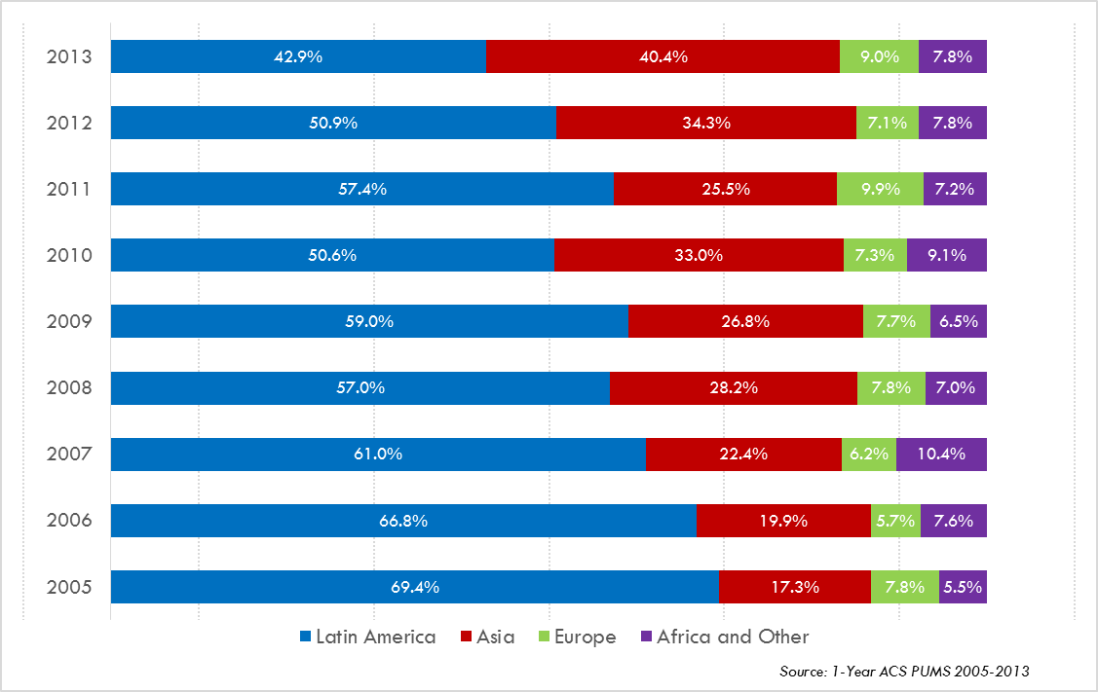
Annual Shares of Recent Non-Citizen Immigrants to Texas by World Area of Birth, 2005-2013

Slide 25
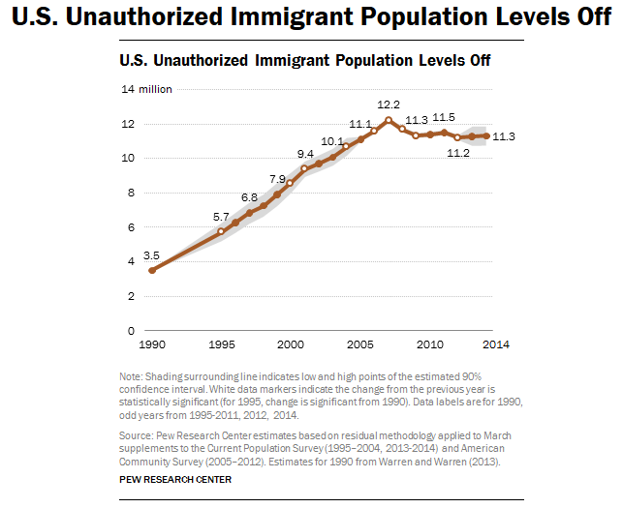
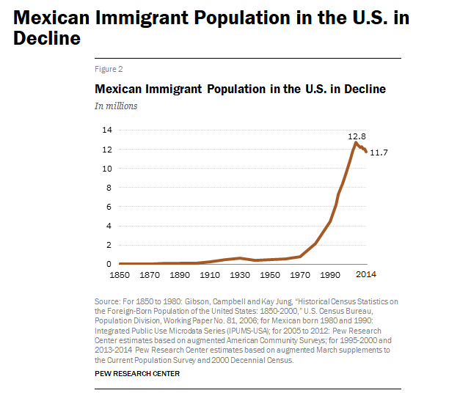
Unauthorized and Mexican Immigration, 2014

Slide 26
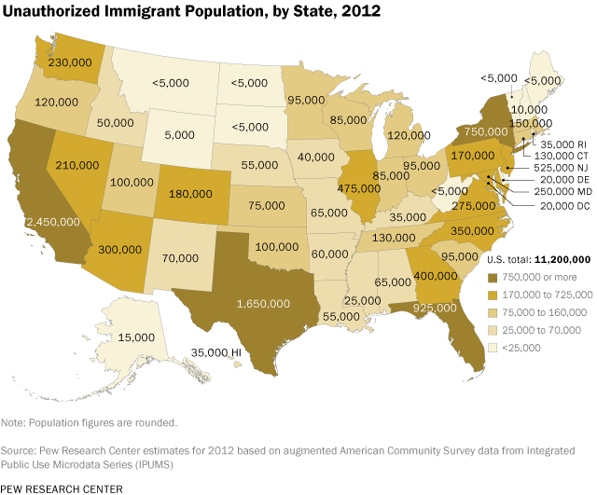

Slide 27


Slide 28
Texas is aging.

Slide 29
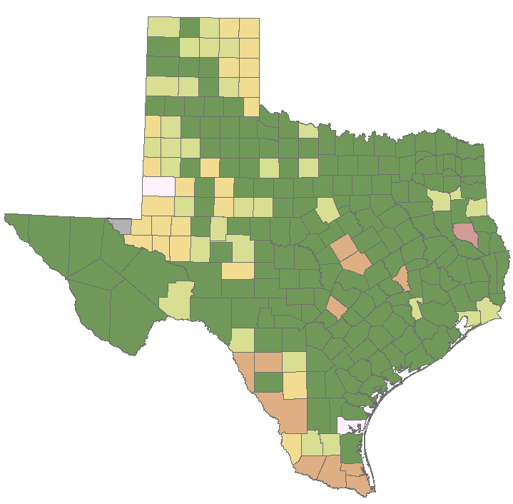
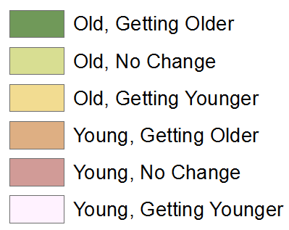
Median Age by Change in Median Age in Texas Counties, 2000-2014
Source: U.S. Census Bureau, 2000, 2010 Decennial Censuses and 2014 Population Estimates
Note: Old=Median Age>30 years; no data available for counties in gray.
30

Slide 30
Percent of Households with at Least One Person 65 Years Plus, Texas Counties, 2008-2012
Source: U.S. Census Bureau, American Community Survey, 5-year sample, 2008-2012
30

Slide 31
Population Projections

Slide 32
Projected Population Growth in Texas,
2010-2050
Source: Texas State Data Center 2014 Population Projections
Notes:
The projected population of Texas is produced using three different migration scenarios. The blue line represents the assumption that there is no in or out migration for Texas. The result is a population that is growing only from natural increase (births-deaths). Under this unlikely scenario, Texas will maintain a health pace of population growth. The other two scenarios assume that 1) the migration rate will be the same as we observed between 2000 and 2010 and 2) the migration rate will be half of what we observed between 2000 and 2010. Under the first assumption Texas will add another 5 million persons this decade, another 7 million the following, 8 or 9 million between 2030 and 2040 and almost 10 million between 2040 and 2050. The half migration scenario also projects significant growth but more modest than the assumption of full migration.

Slide 33
Projected and Estimated Population Growth in Texas, 2010-2015
Source: Texas State Data Center 2014 Population Projections and U.S. Census Bureau Population Estimates

Slide 34
Population Change by Age Group, Texas, 1950-2050
Source: US Census Bureau, 1950-2010 Censuses
US Census Bureau, State Population Estimates
Texas State Data Center, 2014 Population Projections, 1.0 Migration Scenario

Slide 35
Projected Racial and Ethnic Percent, Texas, 2010-2050
Source: Texas State Data Center 2012 Population Projections , 2000-2010 Migration Scenario
Notes:
The projected population of Texas by race/ethnicity suggests that the Hispanic population will be a major driver in the population growth of the state. The non-Hispanic white population will grow very slowly and then start to decline as the Baby-Boom generation ages into high mortality years. The non-Hispanic other group is largely composed of persons of Asian descent and this group is projected to exceed the non-Hispanic black population by 2038. This graph assumes migration patterns observed between 2000 and 2010.

Slide 36
Trends in Educational Attainment of Persons in the Labor Force (25-64 Years of Age) in Texas by Race/Ethnicity – High School Graduates and Above
Source: U.S. Census Bureau, American Community Survey, Public Use Micro Sample, 2001-2011
Notes:
Educational attainment by race/ethnicity in Texas suggests that adults of Hispanic descent are much less likely to have completed high school compared to other race/ethnic groups. Over time, the percent of persons of Hispanic descent who have completed high school has been increasing more rapidly than for other groups but even at this pace of change it will take numerous decades for Hispanics to achieve parity with non-Hispanics in the percent with a high school degree or greater.

Slide 37
Percent of the Civilian Labor Force (ages 25-64) by Educational Attainment for 2011, 2030 Using Constant Rates, Texas
These should be going DOWN
These should be going UP
Sources: U.S. Census Bureau, American Community Survey, 1-Year PUMS.
Texas State Data Center, 2012 Vintage Population Projections, 0.5 Migration Scenario
Notes:
The first assumption (represented by the red columns) is that educational attainment by race/ethnicity and sex would remain the same as it was in 2011. Thus the changes we see in educational attainment in this projection are due only to changes in the racial/ethnic composition of the population (driven by increasing Hispanic population and a leveling of growth among the non-Hispanic white population). Under this scenario, we would see increases of the percent of the labor force with lower levels of education and declines in the percent of the labor force with higher levels.

Slide 38
Percent of the Civilian Labor Force (ages 25-64) by Educational Attainment for 2011, and 2030 Using Trended Rates, Texas
These should be going DOWN
These should be going UP
Sources: U.S. Census Bureau, American Community Survey, 1-Year PUMS.
Texas State Data Center, 2012 Vintage Population Projections, 0.5 Migration Scenario
Notes:
Under the second assumption (green columns) the trends observed in improving educational attainment are projected forward and applied to the projected population by race/ethnicity and sex. Thus the generally positive trends we have noted in improving educational attainment are assumed to continue into the future. The result of this projection suggests that we will see declines in the percent of the labor force with lower levels of education and increases in the percent of the labor force with higher levels of education.

Slide 39

Notes:
Growth in Texas is significant, fast, yet uneven. The Hispanic population is driving growth. Migration patterns are dynamic. Projections indicate continued growth. An educated labor force continues to be a challenge for Texas.

Slide 40
  Office: (512) 936-3542
  Email: Lila.Valencia@UTSA.edu
  Internet: demographics.texas.gov
Lila Valencia, Ph.D.
@TexasDemography

