Slide 1
Changing Demographics of Texas: Population Characteristics and Housing
Texas House of Representatives
Urban Affairs Committee
Dallas, Texas
August 31, 2016

Slide 2
Growing States, 2000-2015
 | 2000 Population | 2010 Population | 2015 Population | Numeric Change 2010-2015 | Percent Change 2000-2010
United States | 281,421,906 | 308,745,538 | 321,418,820 | 12,673,282 | 4.1%
Texas | 20,851,820 | 25,145,561 | 27,469,114 | 2,323,553 | 9.2%
California | 33,871,648 | 37,253,956 | 39,144,818 | 1,890,862 | 5.1%
Florida | 15,982,378 | 18,801,310 | 20,271,272 | 1,469,962 | 7.8%
Georgia | 8,186,453 | 9,687,653 | 10,214,860 | 527,207 | 5.4%
North Carolina | 8,049,313 | 9,535,483 | 10,042,802 | 507,319 | 5.3%
Arizona | 5,130,632 | 6,392,017 | 6,828,065 | 436,048 | 6.8%
Source: U.S. Census Bureau. 2000 and 2010 Census Count, 2015 Population Estimates.
Notes:
Texas is the second largest state in terms of population (2nd to CA) and area (2nd to AK). In terms of number of people, Texas’ growth exceeds that of all other states between 2010 and 2015.

Slide 3
Total Population and Components of Population Change in Texas, 1950-2014
All values for the decennial dates are for April 1st of the indicated census year. Values for 2012-2014 are for July 1 as estimated by the U.S. Census Bureau.
Source: U.S. Census Bureau, Census Counts and Population Estimates

Slide 4
Total Estimated Population by County, Texas, 2015
Source: U.S. Census Bureau, 2015 Vintage Population Estimates
Notes:
When we look at the geographic distribution of the population of Texas over time we see continually increasing population in the counties along the I-35 corridor, the Houston area, and the lower Rio Grand Valley. Urbanized areas out west have grown but most counties west have experienced limited growth and some population decline. Approximately 86% of the population is along I-35 and east. This area with the 3 major metropolitan areas at the points is often described as the Texas population triangle.
The counties of Harris, Dallas, Tarrant, Bexar, and Travis make up the points of the “population triangle” in Texas and are the most populated in the State. Collin, Denton, Fort Bend, Hidalgo, and El Paso counties also have significant population concentrations. Many counties west of Interstate 35 are more sparsely populated.

Slide 5
Estimated Population Change, Texas Counties, 2010 to 2015
99 counties lost population over the five year period.
Source: U.S. Census Bureau Population Estimates, 2015 Vintage.
Notes:
Population change over the decade has been greatest in the urban and suburban population triangle counties. Counties in the lower Rio Grande Valley also had significant growth as did El Paso . Overall, 155 counties gained population while 99 (39%) lost population over the decade.

Slide 6
Estimated Percent Change of the Total Population by County, Texas, 2010 to 2015
Source: U.S. Census Bureau Population Estimates, 2015 Vintage.
Notes:
Percent change is an indicator of the speed of population change void of information about the volume of population change. Percent change in the population over the past few years has been greatest in the urban and suburban population triangle counties. Notably counties in the Eagle Ford Shale area (south east of San Antonio) and the Cline Shale area (Midland and Odessa area), have been growing quickly.

Slide 7
Top Counties for Numeric Growth in Texas, 2014-2015
County | U.S. Rank Population Change | Population Change | Percent of Change from Natural Increase | Percent Change from Migration | Percent Change from International Migration
Harris | 1 | 90,451 | 49.3% | 50.7% | 32.0%
Bexar | 5 | 37,479 | 41.2% | 58.8% | 17.0%
Tarrant | 6 | 36,152 | 46.3% | 53.7% | 20.2%
Dallas | 9 | 33,760 | 68.1% | 31.9% | 39.0%
Fort Bend | 13 | 29,437 | 20.7% | 79.3% | 16.5%
Collin | 14 | 28,075 | 24.8% | 75.2% | 15.8%
Denton | 16 | 25,820 | 25.5% | 74.5% | 11.7%
Travis | 17 | 25,562 | 42.5% | 57.5% | 22.9%
Williamson | 27 | 19,086 | 20.9% | 79.1% | 6.7%
Montgomery | 29 | 18,505 | 19.2% | 80.8% | 9.9%
*Dallas had net out domestic migration over this period.
Source: U.S. Census Bureau, 2015 Vintage Population Estimates

Slide 8
Top Counties for Percent Growth* in Texas, 2014-2015
County | U.S. Rank | 2014-2015 Percent Population Change | Percent Change from Migration | Percent Change from International Migration
Hays | 1 | 5.2% | 85.5% | 1.9%
Comal | 2 | 4.5% | 90.7% | 2.1%
Fort Bend | 4 | 4.3% | 79.3% | 16.5%
Williamson | 7 | 3.9% | 79.1% | 6.7%
Montgomery | 10 | 3.6% | 80.8% | 9.9%
Denton | 12 | 3.4% | 74.5% | 11.7%
Ector | 18 | 3.3% | 63.1% | 3.1%
Midland | 19 | 3.3% | 66.2% | 3.2%
Collin | 23 | 3.2% | 75.2% | 15.8%
Kaufman | 25 | 3.1% | 79.8% | 3.2%
Parker | 29 | 2.8% | 89.8% | 2.2%
Brazos | 32 | 2.8% | 69.2% | 27.4%
Guadalupe | 38 | 2.7% | 78.8% | 4.6%
Ellis | 39 | 2.7% | 77.2% | 2.7%
*Among Counties with 10,000 or more population in 2014
Source: U.S. Census Bureau, 2015 Vintage Population Estimates

Slide 9
Density by Census Tract, Metroplex Area, 1970-2010
1970
1980
1990
2000
2010
Persons per Square Mile
0 – 10
11 – 50
51 – 500
501 – 4,000
4,001 – 56,000
Source: U.S. Census Bureau, decennial censuses. Geolytics, Neighborhood Change Database Tract Data from 1970-2010
Notes:
As more and more people move into our counties and communities, there are more and more persons per square mile. The sequence of images here show how from 1970 to 2010 the urban areas of San Antonio and Austin have become very dense in terms of population and how the are in-between these two cities has become more and more dense. This increasing density is happening in other urban areas of the State and the stress put on the transportation infrastructure from this increasing density creates challenges for our commuting residents and for businesses who are providing services and moving goods.

Slide 10
Percent of Housing Units Built Before 1960, Census Tracts, Metroplex Area, Texas, 2009-2013
Source: U.S. Census Bureau, American Community Survey, 2009-2013 5-Year Sample

Slide 11
Percent of Housing Units Built Between 1960 and 1999, Census Tracts, Metroplex Area, Texas, 2009-2013
Source: U.S. Census Bureau, American Community Survey, 2009-2013 5-Year Sample

Slide 12
Percent of Housing Units Built After 1999, Census Tracts, Metroplex Area, Texas, 2009-2013
Source: U.S. Census Bureau, American Community Survey, 2009-2013 5-Year Sample

Slide 13
Percent of the population living below poverty, DFW area, 2009-2013
Source: U.S. Census Bureau, American Community Survey, 2009-2013 5-Year Sample

Slide 14
Percent of the population that is Hispanic,
Census Tracts, Metroplex Area, Texas, 2009-2013
Source: U.S. Census Bureau, American Community Survey, 5 Year Sample 2009-2013.

Slide 15
Percent of the population that is Black/African American,
Census Tracts, Metroplex Area, Texas, 2009-2013
Source: U.S. Census Bureau, American Community Survey, 5 Year Sample 2009-2013.

Slide 16
Percent of the population that is Asian, Census Tracts, Metroplex Area, Texas, 2009-2013
Source: U.S. Census Bureau, American Community Survey, 5 Year Sample 2009-2013.

Slide 17
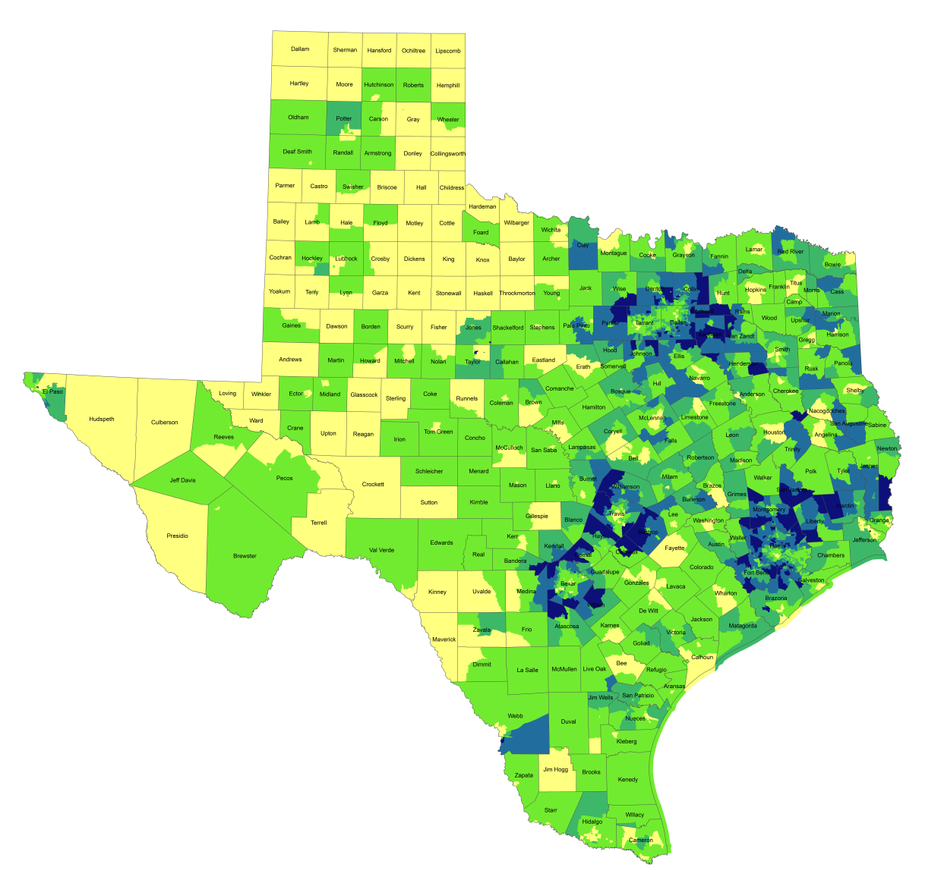
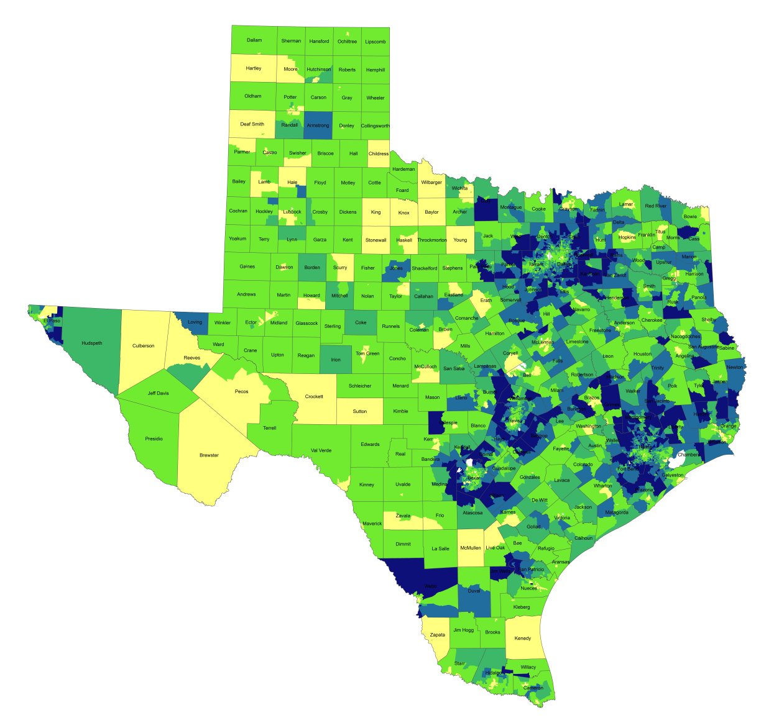
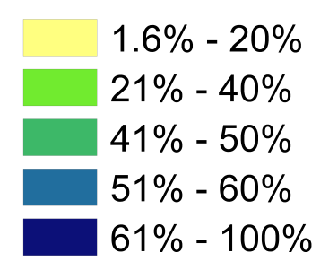
Percentage of Population with Drive Times Longer than 25 Minutes, Texas Census Tracts, 1990 and 2010*
1990
2010*
Source: U.S. Census Bureau, 1990 decennial census and *American Community Survey, 2008-2012 5 Year Sample.
Notes:
One indicator of quality of life is how much time spent commuting to and from work. Commuting takes away time from family and leisure activities and may have an impact on work productivity as well. When we look at the percent of workers who commute longer than 25 minutes by census tract, you can see how increasing population and resulting density, perhaps combined with lagging infrastructure has resulted in increasing commuting times for suburban residents in the more densely populated parts of the state. Commuting time is a factor that some potential business will examine when considering moving operations to a place and one that most can agree is something we want to be as small as possible within reason.

Slide 18
Mean Commute Time (minutes) of workers, Census Tracts, Metroplex Area, Texas, 2009-2013
Source: U.S. Census Bureau, American Community Survey, 5 Year Sample 2009-2013.

Slide 19
Percent of housing units valued at $200,000 or more, Census Tracts, MetroPlex area, 2010-2014
Source: U.S. Census Bureau, American Community Survey, 2010-2014 5-Year Samples

Slide 20
Median Value of Owner Occupied Housing, Census Tracts, MetroPlex, 2010-2014
Source: U.S. Census Bureau, American Community Survey, 2010-2014 5-Year Samples

Slide 21
Percent Change Black Population, Census Tracts, South Dallas, TX, 2010-2014
Source: U.S. Census Bureau, American Community Survey, 2006-2010 and 2010-2014 5-Year Samples

Slide 22
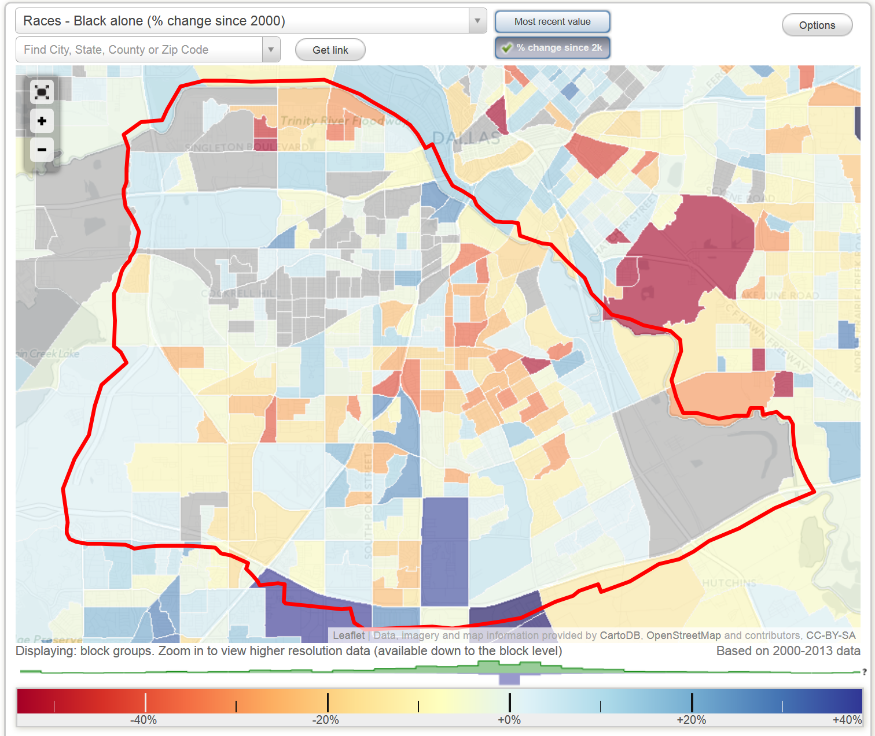
Percent Change Black Population, Block Groups, South Dallas, TX (2000-2013)
http://www.city-data.com/neighborhood/South-Dallas-Dallas-TX.html

Slide 23
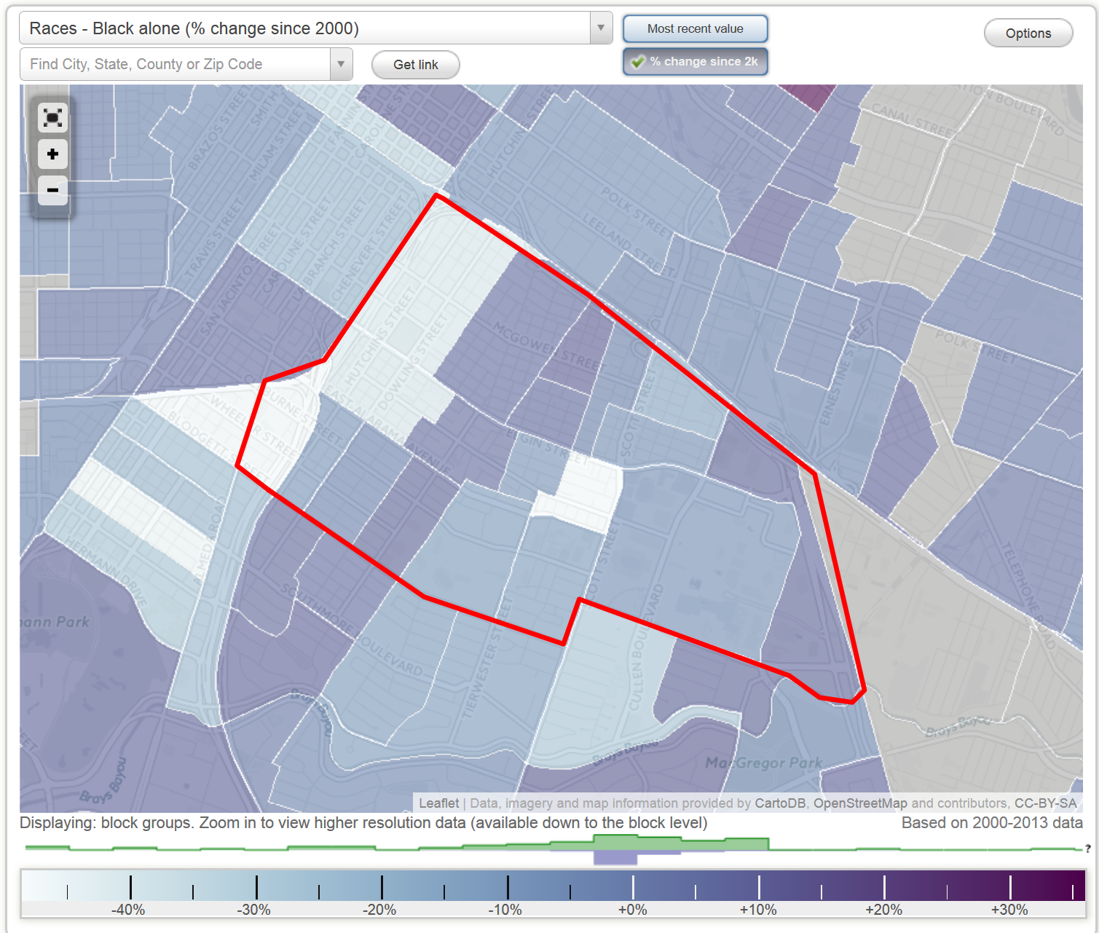
Percent Change Black Population, Block Groups, Third Ward, Houston, TX (2000-2103)
http://www.city-data.com/neighborhood/Third-Ward-Houston-TX.html

Slide 24
Texas Population Pyramid by Race/Ethnicity, 2014
Source: Texas Demographic Center, 2014 Population Estimates
Notes:
This population pyramid represents the age, sex, race and ethnic composition of the Texas population. Blue represents males, red females, rows are single years of age, and shades represent specified race/ethnic groups as indicated in the legend.

Slide 25
Estimated number of persons aged 65 years and older, Texas Counties, 2010-2014
Source: U.S. Census Bureau, American Community Survey, 2010-2014 5 Year Sample

Slide 26
Median Age, Texas Counties, 2010-2014
Source: U.S. Census Bureau, American Community Survey, 2010-2014 5 Year Sample

Slide 27
Change in Median Age, Texas Counties, 2000-2014
Source: US Census Bureau US Census Bureau, 2000
Decennial Census, SF-1, Population Estimates 2014 Vintage.

Slide 28
Projected Population Growth in Texas,
2010-2050
Source: Texas State Data Center 2014 Population Projections
Notes:
The projected population of Texas is produced using three different migration scenarios. The blue line represents the assumption that there is no in or out migration for Texas. The result is a population that is growing only from natural increase (births-deaths). Under this unlikely scenario, Texas will maintain a health pace of population growth. The other two scenarios assume that 1) the migration rate will be the same as we observed between 2000 and 2010 and 2) the migration rate will be half of what we observed between 2000 and 2010. Under the first assumption Texas will add another 5 million persons this decade, another 7 million the following, 8 or 9 million between 2030 and 2040 and almost 10 million between 2040 and 2050. The half migration scenario also projects significant growth but more modest than the assumption of full migration.

Slide 29
Projected and Estimated Population Growth in Texas, 2010-2015
Source: Texas State Data Center 2014 Population Projections and U.S. Census Bureau Population Estimates

Slide 30
Projected Growth of Population Aged 65 Years and Older in Texas, 2010-2050
Source: Texas State Data Center 2014 Population Projections
Notes:
The projected population of Texas is produced using three different migration scenarios. The blue line represents the assumption that there is no in or out migration for Texas. The result is a population that is growing only from natural increase (births-deaths). Under this unlikely scenario, Texas will maintain a health pace of population growth. The other two scenarios assume that 1) the migration rate will be the same as we observed between 2000 and 2010 and 2) the migration rate will be half of what we observed between 2000 and 2010. Under the first assumption Texas will add another 5 million persons this decade, another 7 million the following, 8 or 9 million between 2030 and 2040 and almost 10 million between 2040 and 2050. The half migration scenario also projects significant growth but more modest than the assumption of full migration.

Slide 31
Population Change by Age Group, Texas, 1950-2050
Source: US Census Bureau, 1950-2010 Censuses
US Census Bureau, State Population Estimates
Texas State Data Center, 2014 Population Projections, 1.0 Migration Scenario

Slide 32
Population Projections 65 Years and Over by Race/Ethnicity, Texas, 2010-2050
Source: Texas State Data Center 2014 Population Projections , Half 2000-2010 Migration Scenario

Slide 33

Contact
  Office: (210) 458-6530
  Email: Lloyd.Potter@utsa.edu
  Internet: demographics.texas.gov
Lloyd Potter, Ph.D.
@TexasDemography
Notes:
The Office of the State Demographer and the Texas State Data Center are committed to supporting your work through providing you with the best, most accurate, and objective information we can identify about our greatest asset, the people of Texas.

