Slide 1
The Increasing Hispanic Population in Texas:
Health Care and Access to Care Issues

Slide 2
Growing States, 2000-2015
 | 2000 Population | 2010 Population | 2015 Population | Numeric Change 2010-2015 | Percent Change 2000-2010
United States | 281,421,906 | 308,745,538 | 321,418,820 | 12,673,282 | 4.1%
Texas | 20,851,820 | 25,145,561 | 27,469,114 | 2,323,553 | 9.2%
California | 33,871,648 | 37,253,956 | 39,144,818 | 1,890,862 | 5.1%
Florida | 15,982,378 | 18,801,310 | 20,271,272 | 1,469,962 | 7.8%
Georgia | 8,186,453 | 9,687,653 | 10,214,860 | 527,207 | 5.4%
North Carolina | 8,049,313 | 9,535,483 | 10,042,802 | 507,319 | 5.3%
Arizona | 5,130,632 | 6,392,017 | 6,828,065 | 436,048 | 6.8%
Source: U.S. Census Bureau. 2000 and 2010 Census Count, 2015 Population Estimates.
Notes:
Texas is the second largest state in terms of population (2nd to CA) and area (2nd to AK). In terms of number of people, Texas’ growth exceeds that of all other states between 2010 and 2015.

Slide 3
Total Population and Population Change in Texas, 1950-2014
All values for the decennial dates are for April 1st of the indicated census year. Values for 2012-2014 are for July 1 as estimated by the U.S. Census Bureau.
Source: U.S. Census Bureau, Census Counts and Population Estimates

Slide 4
Components of Population Change by Percent in Texas, 1950-2010
Source: U.S. Census Bureau, Population Estimates
Notes:
It is important to understand a couple of very basic element of population change to think about how growing population may impact our transportation system. Population changes from two factors, one is natural increase which is simply births minus deaths over time. Essentially population added from natural increase are babies who are unlikely to be driving their own vehicle on our roads before age 16. Combine this with the fact that as people die, there are fewer drivers on the road. So the effect of population growth from natural increase on our transportation infrastructure is both lightening, from people dying, and delayed until babies reach the age where they can drive. The second way population changes is from net-migration, which is simply in-minus out migrants. In Texas, the balance has been for us to have more in than out migrants. Migrants, are usually adults who are drivers (though yes, some do have non-driving children) and the may be compounded by the fact that many of the in-migrants may also take a job that requires them to drive. Essentially, migrants immediately contribute to adding stress to the transportation infrastructure.
When we look at population change in Texas, from 1950 to present we can see that before 1970, most of our growth was from natural increase. Starting in the 1970s a much larger percent of our growth is attributed to net migration and this continues to today where approaching half of our population change is from migration.

Slide 5
Total Estimated Population by County, Texas, 2015
Source: U.S. Census Bureau, 2015 Vintage Population Estimates
Notes:
When we look at the geographic distribution of the population of Texas over time we see continually increasing population in the counties along the I-35 corridor, the Houston area, and the lower Rio Grand Valley. Urbanized areas out west have grown but most counties west have experienced limited growth and some population decline. Approximately 86% of the population is along I-35 and east. This area with the 3 major metropolitan areas at the points is often described as the Texas population triangle.
The counties of Harris, Dallas, Tarrant, Bexar, and Travis make up the points of the “population triangle” in Texas and are the most populated in the State. Collin, Denton, Fort Bend, Hidalgo, and El Paso counties also have significant population concentrations. Many counties west of Interstate 35 are more sparsely populated.

Slide 6
Estimated Population Change, Texas Counties, 2010 to 2015
99 counties lost population over the five year period.
Source: U.S. Census Bureau Population Estimates, 2015 Vintage.
Notes:
Population change over the decade has been greatest in the urban and suburban population triangle counties. Counties in the lower Rio Grande Valley also had significant growth as did El Paso . Overall, 155 counties gained population while 99 (39%) lost population over the decade.

Slide 7
Estimated Percent Change of the Total Population by County, Texas, 2010 to 2015
Source: U.S. Census Bureau Population Estimates, 2015 Vintage.
Notes:
Percent change is an indicator of the speed of population change void of information about the volume of population change. Percent change in the population over the past few years has been greatest in the urban and suburban population triangle counties. Notably counties in the Eagle Ford Shale area (south east of San Antonio) and the Cline Shale area (Midland and Odessa area), have been growing quickly.

Slide 8
Estimated Net-Domestic Migrants by County, Texas, 2014-2015
Source: U.S. Census Bureau Population Estimates, 2015 Vintage.

Slide 9
Estimated Net-International Migrants by County, Texas, 2014-2015
Source: U.S. Census Bureau Population Estimates, 2015 Vintage.

Slide 10
Estimated Net-Migrants by County, Texas, 2014-2015
Source: U.S. Census Bureau Population Estimates, 2015 Vintage.

Slide 11
Top Counties for Numeric Growth in Texas, 2014-2015
County | U.S. Rank Population Change | Population Change | Percent of Change from Natural Increase | Percent Change from Migration | Percent Change from International Migration
Harris | 1 | 90,451 | 49.3% | 50.7% | 32.0%
Bexar | 5 | 37,479 | 41.2% | 58.8% | 17.0%
Tarrant | 6 | 36,152 | 46.3% | 53.7% | 20.2%
Dallas | 9 | 33,760 | 68.1% | 31.9% | 39.0%
Fort Bend | 13 | 29,437 | 20.7% | 79.3% | 16.5%
Collin | 14 | 28,075 | 24.8% | 75.2% | 15.8%
Denton | 16 | 25,820 | 25.5% | 74.5% | 11.7%
Travis | 17 | 25,562 | 42.5% | 57.5% | 22.9%
Williamson | 27 | 19,086 | 20.9% | 79.1% | 6.7%
Montgomery | 29 | 18,505 | 19.2% | 80.8% | 9.9%
*Dallas had net out domestic migration over this period.
Source: U.S. Census Bureau, 2015 Vintage Population Estimates

Slide 12
Top Counties for Percent Growth* in Texas, 2014-2015
County | U.S. Rank | 2014-2015 Percent Population Change | Percent Change from Migration | Percent Change from International Migration
Hays | 1 | 5.2% | 85.5% | 1.9%
Comal | 2 | 4.5% | 90.7% | 2.1%
Fort Bend | 4 | 4.3% | 79.3% | 16.5%
Williamson | 7 | 3.9% | 79.1% | 6.7%
Montgomery | 10 | 3.6% | 80.8% | 9.9%
Denton | 12 | 3.4% | 74.5% | 11.7%
Ector | 18 | 3.3% | 63.1% | 3.1%
Midland | 19 | 3.3% | 66.2% | 3.2%
Collin | 23 | 3.2% | 75.2% | 15.8%
Kaufman | 25 | 3.1% | 79.8% | 3.2%
Parker | 29 | 2.8% | 89.8% | 2.2%
Brazos | 32 | 2.8% | 69.2% | 27.4%
Guadalupe | 38 | 2.7% | 78.8% | 4.6%
Ellis | 39 | 2.7% | 77.2% | 2.7%
*Among Counties with 10,000 or more population in 2014
Source: U.S. Census Bureau, 2015 Vintage Population Estimates

Slide 13
Texas Racial and Ethnic Composition,
2000, 2010, and 2015
11
Source: U.S. Census Bureau. 2000, 2010 Decennial Census and 2015 Population Estimates
Notes:
As of the 2000 Census, about 53% of Texas’ population was non-Hispanic Anglo, about 32% where of Hispanic descent, about 11% where non-Hispanic African American, and about 4% were non-Hispanic Other.
In 2010, it is estimated that about 45% of the Texas population was non-Hispanic Anglo, 38% of Hispanic descent, 11% were non-Hispanic African American, and about 6% were non-Hispanic Other (largely of Asian descent).

Slide 14
Percent of the Population that is Hispanic, Texas Counties, 2009-2013
Source: U.S. Census Bureau, American Community Survey, 2009-2013 5 Year Sample

Slide 15
Percent of the Population that is Non-Hispanic Black, Texas Counties, 2009-2013
Source: U.S. Census Bureau, American Community Survey, 2009-2013 5 Year Sample

Slide 16
Percent of the Population that is Asian, Texas Counties, 2009-2013
Source: U.S. Census Bureau, American Community Survey, 2009-2013 5 Year Sample

Slide 17
Texas White (non-Hispanic) and Hispanic Populations by Age, 2014
Source: U.S. Census Bureau 2010 Decennial Census, SF1
Notes:
The age distribution of the non-Hispanic white population in Texas is weighted heavily with the “baby boom” generation. Largely the result of lower fertility and less net in-migration, the non-Hispanic white population has relatively fewer young persons relative to those in the middle-age years. In 2010, at ages 37 and younger, the Hispanic population exceeds the non-Hispanic white population.

Slide 18
Texas Population Pyramid by Race/Ethnicity, 2014
Source: Texas Demographic Center, 2014 Population Estimates
Notes:
This population pyramid represents the age, sex, race and ethnic composition of the Texas population. Blue represents males, red females, rows are single years of age, and shades represent specified race/ethnic groups as indicated in the legend.

Slide 19
Texas Population Pyramid by Race/Ethnicity, 2014
Source: Texas Demographic Center, 2014 Population Estimates
Notes:
This population pyramid represents the age, sex, race and ethnic composition of the Texas population. Blue represents males, red females, rows are single years of age, and shades represent specified race/ethnic groups as indicated in the legend.

Slide 20
Texas Population Pyramid by Race/Ethnicity, 2014
Source: Texas Demographic Center, 2014 Population Estimates
Notes:
This population pyramid represents the age, sex, race and ethnic composition of the Texas population. Blue represents males, red females, rows are single years of age, and shades represent specified race/ethnic groups as indicated in the legend.

Slide 21
Top 10 Gross Migration States for Domestic Migration to Texas, 2013
U.S. Census Bureau ACS 1-Year PUMS,2013

Slide 22
Top 10 Destination Counties for Interstate Domestic Migration to Texas, 2009-2013
U.S. Census Bureau ACS 5-Year Summary Data, 2009-2013

Slide 23
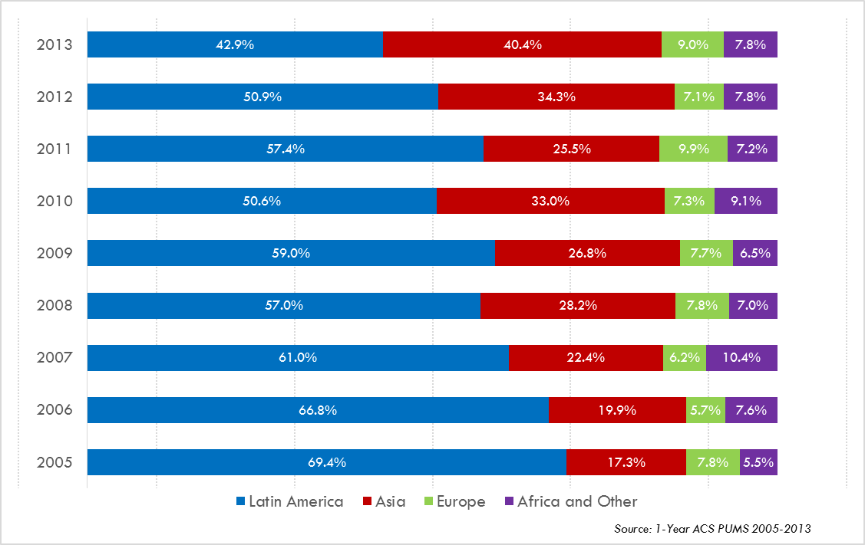
Annual Shares of Recent Non-Citizen Immigrants to Texas by World Area of Birth, 2005-2013

Slide 24
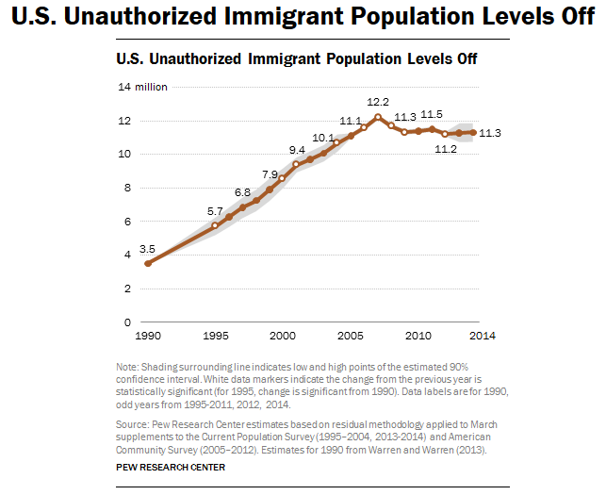

Slide 25
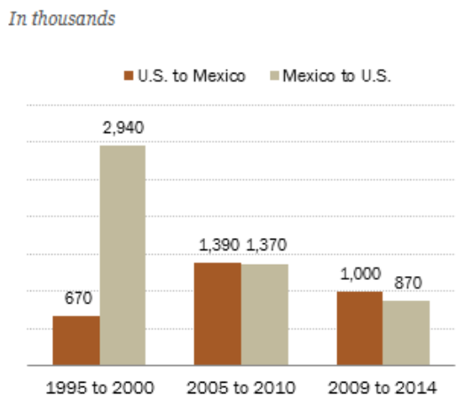
Net Migration from Mexico Below Zero After the Great Recession
Source: Pew Research Center
http://www.pewhispanic.org/2015/11/19/more-mexicans-leaving-than-coming-to-the-u-s/ph_2015-11-19_mexican-immigration-04/

Slide 26
Projected Population Growth in Texas,
2010-2050
Source: Texas State Data Center 2014 Population Projections
Notes:
The projected population of Texas is produced using three different migration scenarios. The blue line represents the assumption that there is no in or out migration for Texas. The result is a population that is growing only from natural increase (births-deaths). Under this unlikely scenario, Texas will maintain a health pace of population growth. The other two scenarios assume that 1) the migration rate will be the same as we observed between 2000 and 2010 and 2) the migration rate will be half of what we observed between 2000 and 2010. Under the first assumption Texas will add another 5 million persons this decade, another 7 million the following, 8 or 9 million between 2030 and 2040 and almost 10 million between 2040 and 2050. The half migration scenario also projects significant growth but more modest than the assumption of full migration.

Slide 27
Projected and Estimated Population Growth in Texas, 2010-2015
Source: Texas State Data Center 2014 Population Projections and U.S. Census Bureau Population Estimates

Slide 28
Population Change by Age Group, Texas, 1950-2050
Sources: US Census Bureau, 1950-2010 Censuses
US Census Bureau, State Population Estimates
Texas State Data Center, 2014 Population Projections, 1.0 Migration Scenario

Slide 29
Estimated number of persons aged 65 years and older, Texas Counties, 2010-2014
Source: U.S. Census Bureau, American Community Survey, 2010-2014 5 Year Sample

Slide 30
Population Projections, Texas, 2010-2050,
Percent Over and Under 65
Source: Texas State Data Center 2014 Population Projections , Half 2000-2010 Migration Scenario

Slide 31
Projected Racial and Ethnic Population, Texas, 2010-2050
Source: Texas State Data Center 2012 Population Projections , 2000-2010 Migration Scenario
Notes:
The projected population of Texas by race/ethnicity suggests that the Hispanic population will be a major driver in the population growth of the state. The non-Hispanic white population will grow very slowly and then start to decline as the Baby-Boom generation ages into high mortality years. The non-Hispanic other group is largely composed of persons of Asian descent and this group is projected to exceed the non-Hispanic black population by 2038. This graph assumes migration patterns observed between 2000 and 2010.

Slide 32
Population Projections 65 Years and Over by Race/Ethnicity, Texas, 2010-2050
Source: Texas State Data Center 2014 Population Projections , Half 2000-2010 Migration Scenario

Slide 33
Percent of Population by Race/Ethnicity for Age Groups, 2010 and 2050
2010 2050
Source: US Census Bureau, State Population Estimates, 2014
Source: Texas State Data Center, 2014 Projections, 1.0 Migration Scenario

Slide 34
Educational Attainment of Persons Aged 25 Years and Older, NH White and Hispanic, Texas, 2014
Source: U.S. Census Bureau, American Community Survey, 2014 1-Year Sample

Slide 35
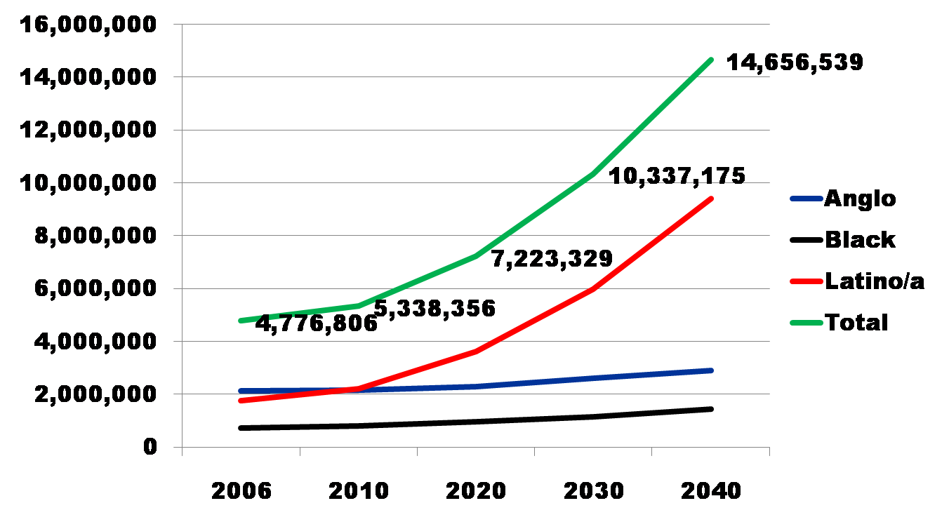
Projected Increase in Obesity in Texas by Ethnicity, 2006 to 2040
Source: Office of the State Demographer projections, using 2000-2004 migration scenario population projections

Slide 36
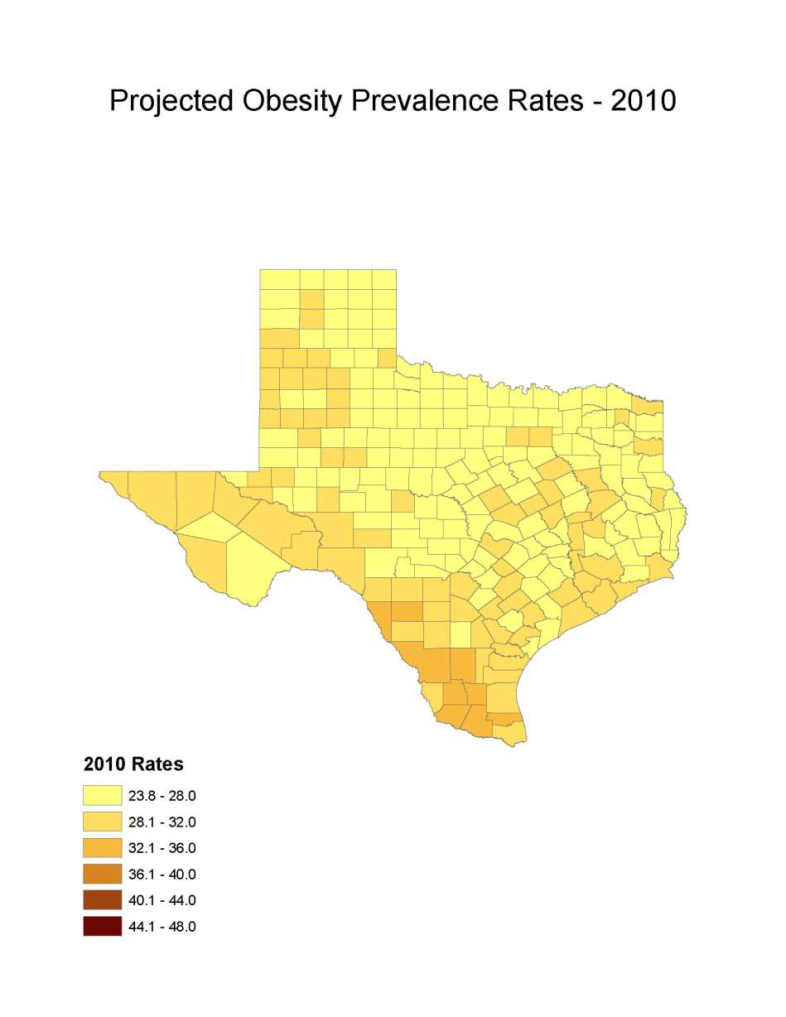
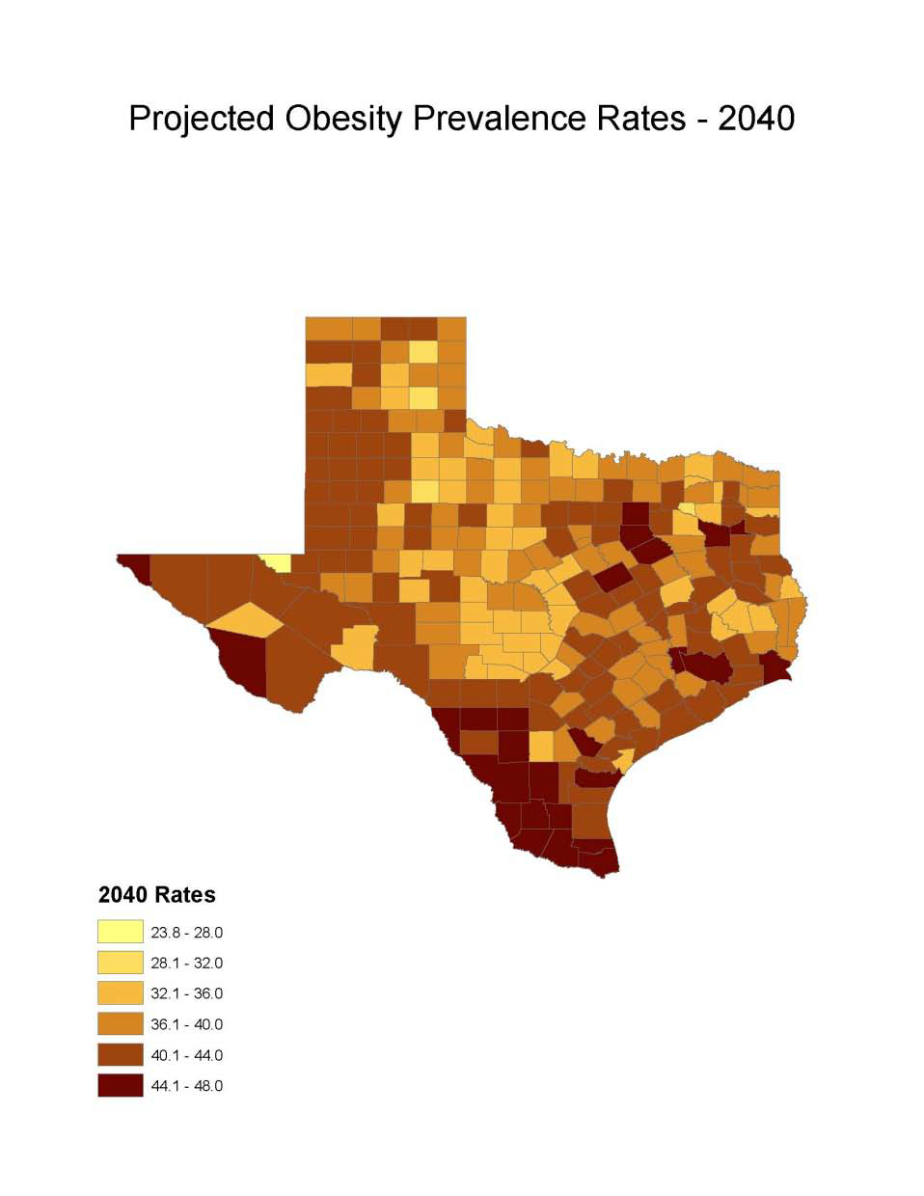
Obesity Prevalence
% adults with obesity: Office of the State Demographer, 2000-2004 Projection

Slide 37
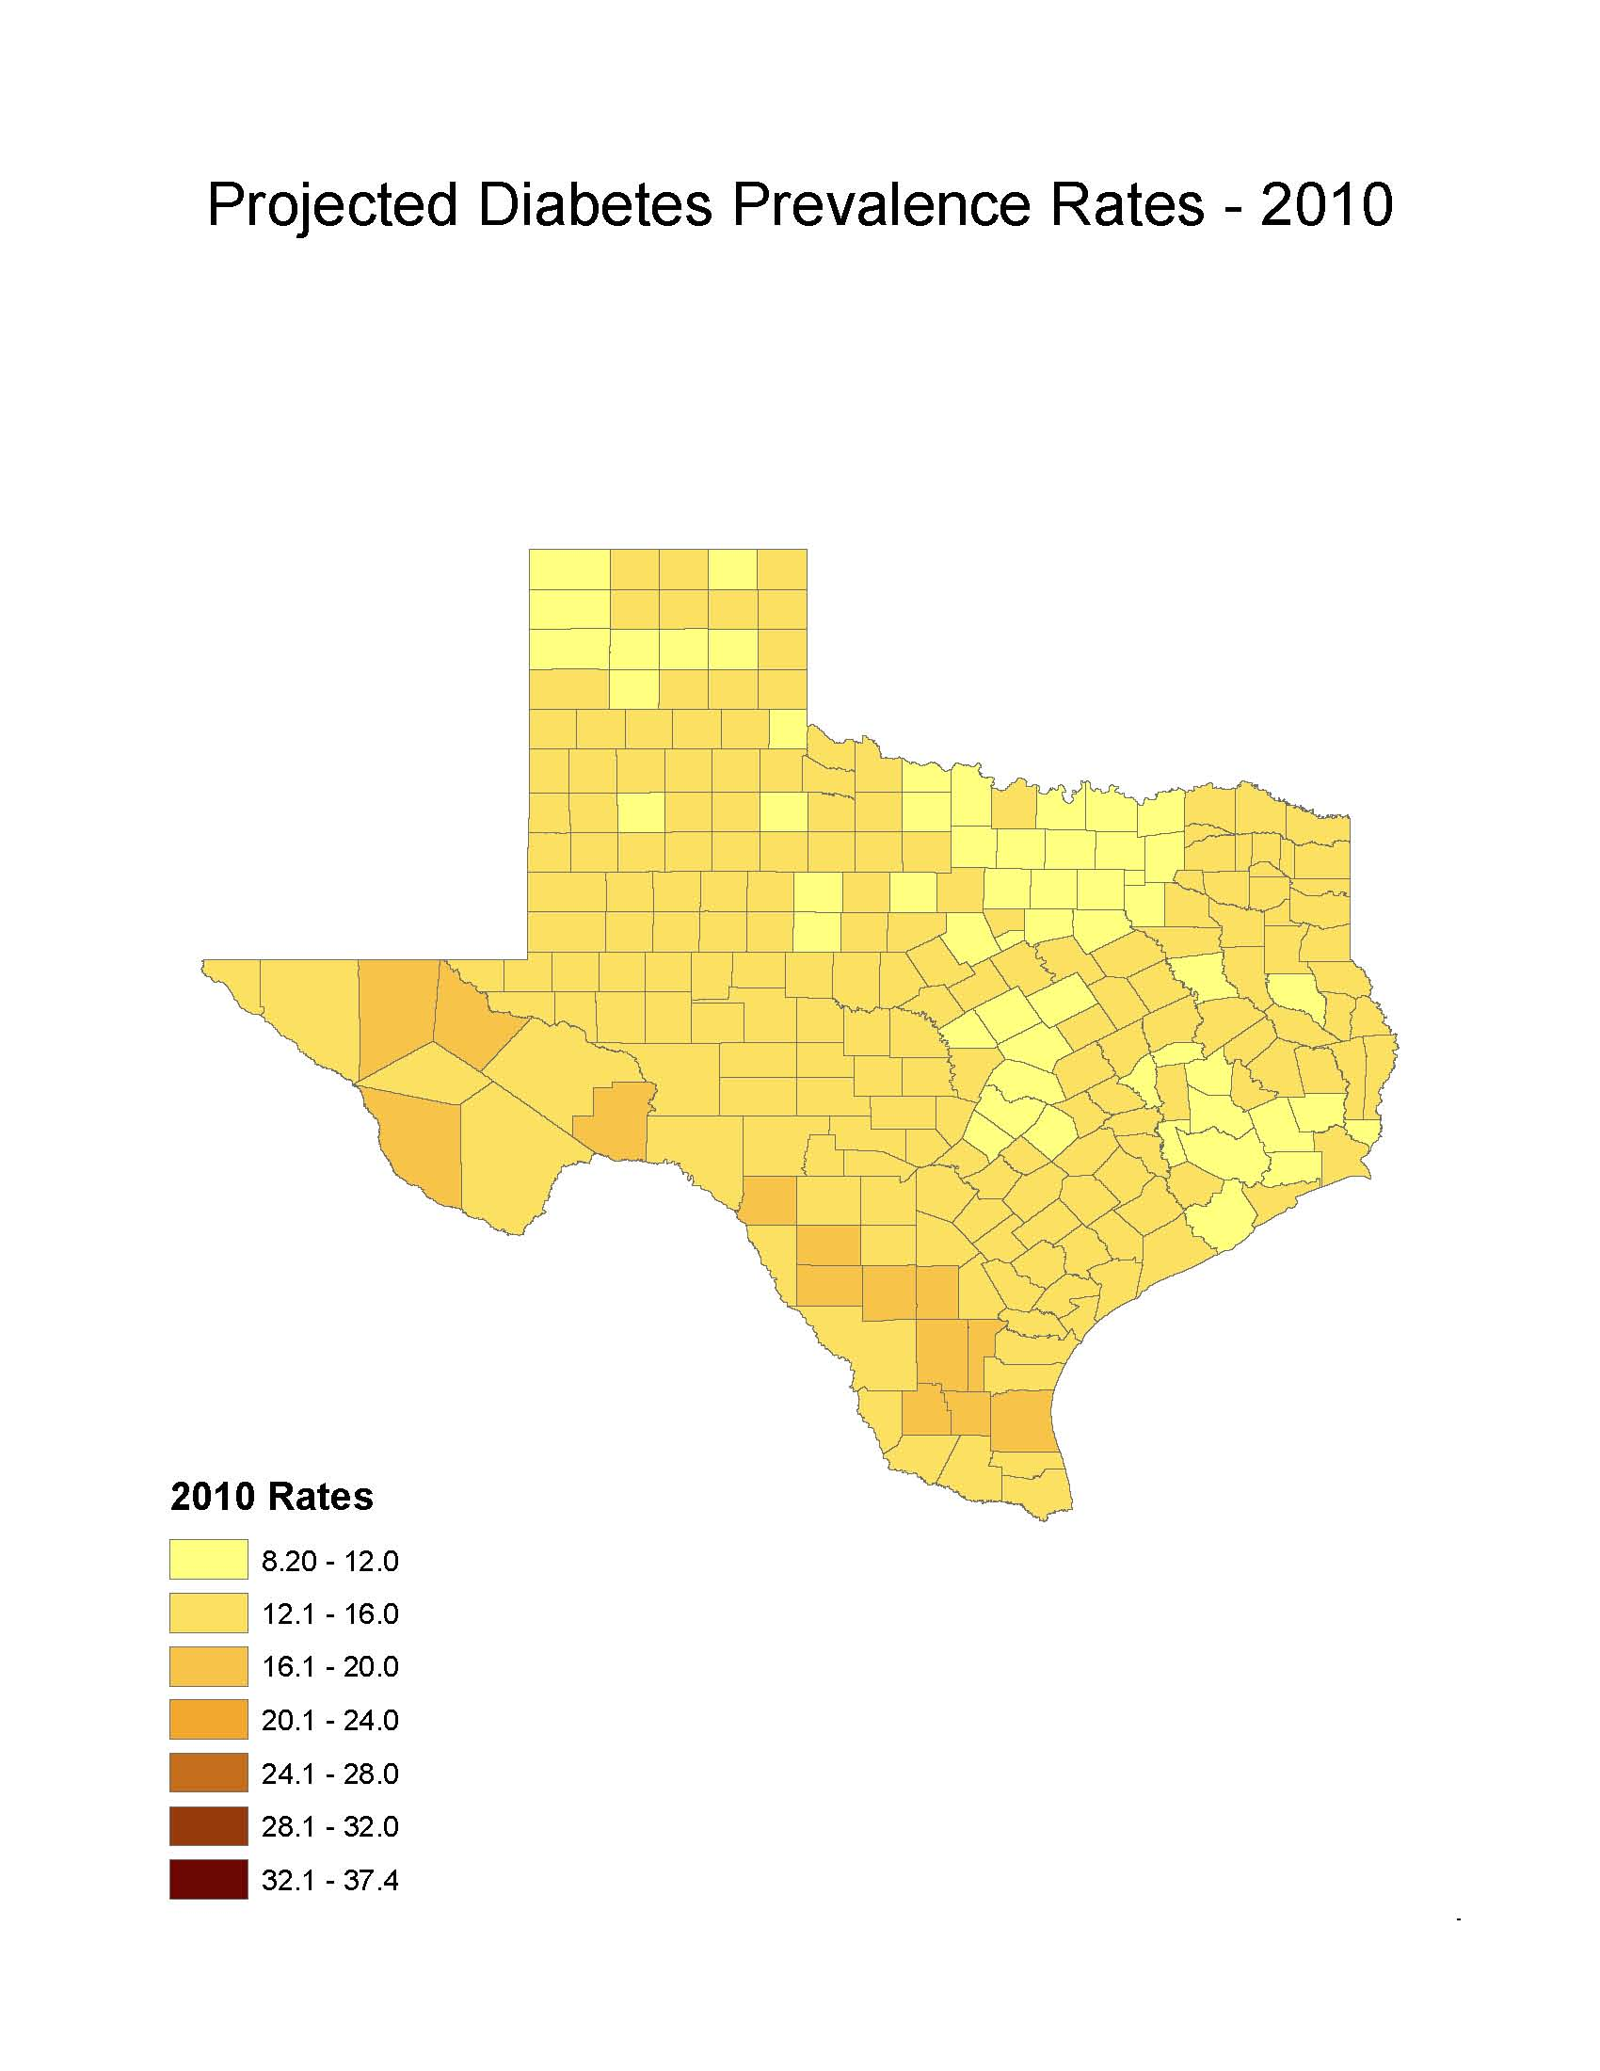
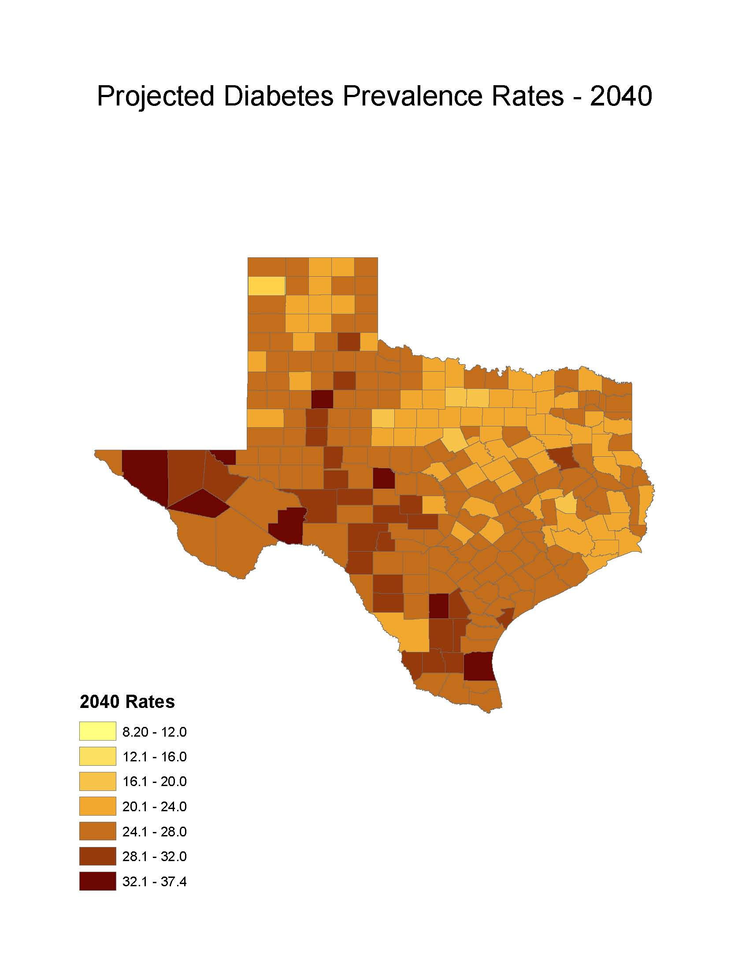
Diabetes Prevalence
% adults with diabetes: Office of the State Demographer, 2000-2004 Projection

Slide 38
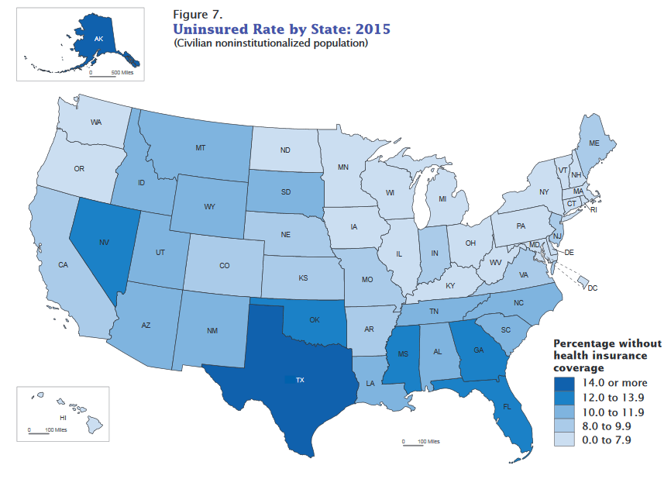
Uninsured Rates by State, 2015
Source: U.S. Census Bureau, 2015 1-Year American Community Survey.
https://www2.census.gov/programs-surveys/demo/visualizations/p60/257/figure7.pdf

Slide 39
Estimated percent of persons who do not have health insurance, Texas Counties, 2010-2014
Source: U.S. Census Bureau, American Community Survey, 2010-2014 5 Year Sample

Slide 40
Estimated percent of Hispanic persons who do not have health insurance, Texas Counties, 2010-2014
Source: U.S. Census Bureau, American Community Survey, 2010-2014 5 Year Sample

Slide 41

Contact
  Office: (210) 458-6530
  Email: Lloyd.Potter@utsa.edu
  Internet: Demographics.Texas.gov
Lloyd Potter, Ph.D., M.P.H.
@TexasDemography
Notes:
The Office of the State Demographer and the Texas State Data Center are committed to supporting your work through providing you with the best, most accurate, and objective information we can identify about our greatest asset, the people of Texas.

