Slide 1

Population Trends and Projections for Texas
Texas Farm Bureau
AgLead XIII and FarmLead VI Leadership Classes
Austin, TX
April 24, 2017
@TexasDemography

Slide 2
Demographic Overview
Texas is experiencing significant growth.
Population continues to grow at a steady pace though growth is not geographically evenly distributed.
Growth is not racially/ethnically evenly distributed. Population growth is being driven largely by the Hispanic population.
The population of Texas, while relatively young, is also aging.
The components of population change have varying implications for infrastructure in Texas.
Demographic shifts may have serious implications for maintaining inclusive and equitable economic growth in the state.

Slide 3
Texas is experiencing fast and high growth.

Slide 4
Growing States, 2000-2016
 | 2000 Population | 2010 Population | 2016 Population | Numeric Change 2010-2016 | Percent Change 2000-2010
United States | 281,421,906 | 308,745,538 | 323,127,513 | 14,369,408 | 4.1%
Texas | 20,851,820 | 25,145,561 | 27,862,596 | 2,716,496 | 9.2%
California | 33,871,648 | 37,253,956 | 39,250,017 | 1,995,495 | 5.1%
Florida | 15,982,378 | 18,801,310 | 20,612,439 | 1,807,847 | 7.8%
Georgia | 8,186,453 | 9,687,653 | 10,310,371 | 621,691 | 5.4%
North Carolina | 8,049,313 | 9,535,483 | 10,146,788 | 611,100 | 5.3%
Arizona | 5,130,632 | 6,392,017 | 6,931,071 | 538,770 | 6.8%
Source: U.S. Census Bureau. 2000 and 2010 Census Count, 2016 Population Estimates.
Notes:
Texas is the second largest state in terms of population (2nd to CA) and area (2nd to AK). In terms of number of people, Texas’ growth exceeds that of all other states between 2010 and 2016.

Slide 5
Total Population and Components of Change in Texas, 1950-2016
Notes:
Between 2000 and 2010 Texas added over 4 million residents. In 6 short years, it is estimated Texas has added over 2 million more, placing Texas population at 27.9 million, on pace to meet or surpass our gains since the last census. Population growth in Texas has been geometric or compounding in nature. Over the past six decades there have been three periods where the numeric growth has increased relative to previous years. We have no indication that the population growth in Texas will slow dramatically in coming years.

Slide 6
Total Estimated Population by County, Texas, 2016
Source: U.S. Census Bureau, 2016 Vintage Population Estimates
Notes:
When we look at the geographic distribution of the population of Texas over time we see continually increasing population in the counties along the I-35 corridor, the Houston area, and the lower Rio Grand Valley. Urbanized areas out west have grown but most counties west have experienced limited growth and some population decline. Approximately 86% of the population is along I-35 and east. This area with the 3 major metropolitan areas at the points is often described as the Texas population triangle.
The counties of Harris, Dallas, Tarrant, Bexar, and Travis make up the points of the “population triangle” in Texas and are the most populated in the State. Collin, Denton, Fort Bend, Hidalgo, and El Paso counties also have significant population concentrations. Many counties west of Interstate 35 are more sparsely populated.

Slide 7
Estimated Population Change, Texas Counties, 2010 to 2016
96 counties lost population over the 6 year period.
Source: U.S. Census Bureau, 2016 Vintage Population Estimates
Notes:
Population change over the decade has been greatest in the urban and suburban population triangle counties. Counties in the lower Rio Grande Valley also had significant growth as did El Paso. Overall, 158 counties gained population while 96 (38%) lost population over the decade.

Slide 8
Estimated Percent Change of the Total Population by County, Texas, 2010 to 2016
Source: U.S. Census Bureau, 2016 Vintage Population Estimates
Notes:
Percent change is an indicator of the speed of population change void of information about the volume of population change. Percent change in the population over the past few years has been greatest in the suburban population triangle counties, notably among counties between San Antonio and Austin. In the early part of the decade, counties in the Eagle Ford Shale area (south east of San Antonio) and the Cline Shale area (Midland and Odessa area), had been growing quickly. This is no longer the case.

Slide 9
Top Counties for Percent Growth* in Texas,
2015-2016
 | U.S. Rank | 2015-2016 Percent Population Change | Percent Change from Migration | Percent of Migration that is International
Kendall County | 2 | 5.2% | 92.0% | 4.0%
Hays County | 3 | 5.1% | 81.9% | 2.1%
Comal County | 6 | 4.4% | 85.8% | 2.2%
Williamson County | 14 | 4.1% | 76.4% | 7.1%
Fort Bend County | 18 | 3.8% | 72.7% | 21.0%
Montgomery County | 24 | 3.7% | 79.2% | 9.9%
Rockwall County | 25 | 3.6% | 81.5% | 2.9%
Denton County | 28 | 3.6% | 74.3% | 11.9%
Kaufman County | 36 | 3.4% | 81.8% | 2.6%
Bastrop County | 43 | 3.1% | 83.6% | 0.9%
*Among counties with 10,000 or more population in 2016
8
Source: U.S. Census Bureau, 2016 Vintage Population Estimates.
Notes:
Ten percent of the 50 fastest growing counties in the United States from 2015 to 2016 were in Texas. Some of the fastest growing counties in the country continue to be suburban ring counties, such as Kendall, Hays, and Comal counties. Growth among the fastest growing counties in the country stems more from migration than natural increase.

Slide 10
Top Counties for Numeric Growth in Texas,
2015-2016
 | U.S. Rank Population Change | Population Change | Percent of Change from Natural Increase | Percent Change from Migration | Percent of Migration that is international
Harris County | 2 | 56,587 | 82.0% | 20.7% | 238.7%*
Tarrant County | 5 | 35,462 | 44.5% | 55.7% | 32.1%
Bexar County | 7 | 33,198 | 44.7% | 55.5% | 29.1%
Dallas County | 9 | 29,209 | 81.0% | 20.3% | 204.3%*
Denton County | 11 | 27,689 | 23.3% | 74.3% | 11.9%
Fort Bend County | 13 | 27,388 | 23.9% | 72.7% | 21.0%
Collin County | 14 | 26,506 | 25.3% | 72.9% | 20.9%
Travis County | 17 | 24,505 | 44.5% | 56.3% | 40.3%
Williamson County | 22 | 20,659 | 19.4% | 76.4% | 7.1%
Montgomery County | 24 | 19,769 | 18.0% | 79.2% | 9.9%
*Harris and Dallas counties had net out domestic migration over this period.
9
Source: U.S. Census Bureau, 2016 Vintage Population Estimates.
Notes:
Ten of the top 25 counties in the United States that were growing the most numerically between 2015 and 2016 were in Texas. These counties are the larger ones in the State and are all counties that have experienced continued growth. However, the components attributing to their population change varies. For instance, natural increase and international migration are playing a key role in population growth in Dallas County. Harris and Tarrant counties are growing about evenly from migration and natural increase. Whereas in the suburban ring counties migration (mostly domestic) is driving population growth. 2016 marked the first year in a few years that Harris County did not add the most people of any other county in the U.S. This drop can most likely be attributed to a decline in oil and gas industry in this region.

Slide 11
Texas continues to racially/ethnically diversify.

Slide 12
Texas Racial and Ethnic Composition,
2000, 2010, and 2015
11
Source: U.S. Census Bureau. 2000, 2010 Decennial Census and 2015 Population Estimates
Notes:
As of the 2000 Census, about 53% of Texas’ population was non-Hispanic Anglo, about 32% where of Hispanic descent, about 11% where non-Hispanic African American, and about 4% were non-Hispanic Other.
In 2010, it is estimated that about 45% of the Texas population was non-Hispanic Anglo, 38% of Hispanic descent, 11% were non-Hispanic African American, and about 6% were non-Hispanic Other (largely of Asian descent).

Slide 13
Racial and Ethnic Composition of Texas and Top 10 Most Populous Counties, 2015
 | NH White | NH Black | Hispanic | NH Asian | NH Other
TEXAS | 43.0% | 11.8% | 38.8% | 4.6% | 1.8%
Denton County | 60.9% | 9.3% | 19.2% | 8.0% | 2.6%
Collin County | 59.4% | 9.4% | 15.2% | 13.4% | 2.7%
Travis County | 49.5% | 8.0% | 33.9% | 6.4% | 2.1%
Tarrant County | 48.6% | 15.6% | 28.2% | 5.3% | 2.4%
Fort Bend County | 34.6% | 20.1% | 24.1% | 19.2% | 1.9%
Harris County | 31.0% | 18.5% | 42.0% | 7.0% | 1.6%
Dallas County | 30.6% | 22.3% | 39.5% | 6.0% | 1.6%
Bexar County | 28.7% | 7.3% | 59.5% | 2.7% | 1.7%
El Paso County | 13.1% | 3.2% | 81.3% | 1.2% | 1.2%
Hidalgo County | 7.0% | 0.5% | 91.3% | 1.0% | 0.2%
12
Source: U.S. Census Bureau, 2015 Vintage Population Estimates

Slide 14
Annual Shares of Recent Non-Citizen Immigrants to Texas by World Area of Birth, 2005-2015
Source: U.S. Census Bureau, American Community Survey, 1-Year PUMS

Slide 15
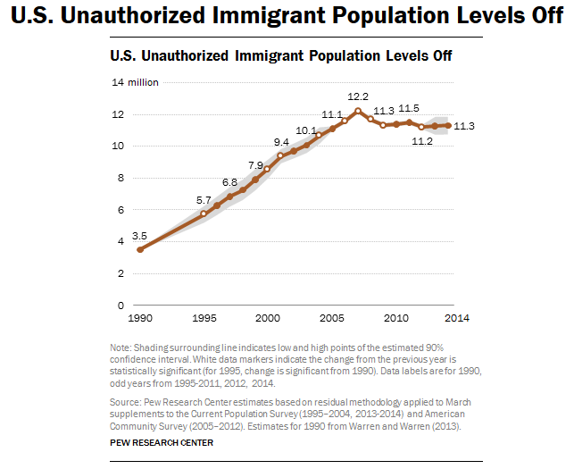
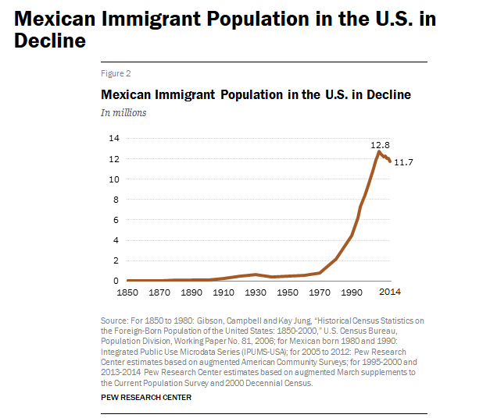
Unauthorized and Mexican Immigration, 2014

Slide 16
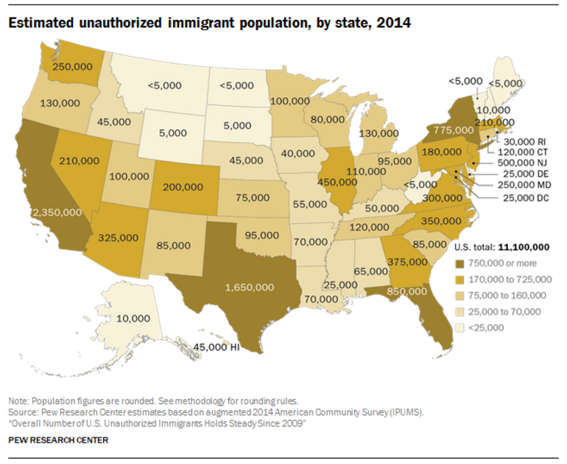

Slide 17


Slide 18
Texas is young, but aging.

Slide 19
States with the Oldest Median Ages, 2000, 2010, 2014
2000 |  |  | 2010 |  |  | 2014
Rank | State | Med Age | Rank | State | Median Age | Rank | State | Median Age
1 | West Virginia | 38.9 | 1 | Maine | 42.7 | 1 | Maine | 44.2
2 | Florida | 38.7 | 2 | Vermont | 41.5 | 2 | New Hampshire | 42.6
3 | Maine | 38.6 | 3 | West Virginia | 41.3 | 3 | Vermont | 42.6
4 | Pennsylvania | 38 | 4 | New Hampshire | 41.1 | 4 | West Virginia | 42.0
5… | Vermont | 37.7 | 5 | Florida | 40.7 | 5 | Florida | 41.8
…46 | California | 33.3 | 46 | California | 35.2 | 46 | Idaho | 35.7
47 | Idaho | 33.2 | 47 | Idaho | 34.6 | 47 | North Dakota | 34.9
48 | Alaska | 32.4 | 48 | Alaska | 33.8 | 48 | Texas | 34.2
49 | Texas | 32.3 | 49 | Texas | 33.6 | 49 | Alaska | 33.3
50 | Utah | 27.1 | 50 | Utah | 29.2 | 50 | Utah | 30.5
- | United States | 35.3 | - | United States | 37.2 | - | United States | 37.7
Source: US Census Bureau, 2000 and 2010 Decennial Censuses US Census Bureau, 2014 Population Estimate by State

Slide 20
Texas Population by Age Group, 2000 to 2014
 | 2000 |  | 2010 |  | 2014 |  | 2000-2014
 | Population | Percent | Population | Percent | Estimate | Percent | Absolute Change | Percent Change
Under 18 | 5,886,759 | 28.2 | 6,865,824 | 27.3 | 7,115,614 | 26.4 | 1,228,855 | 20.9
18 to 64 | 12,892,529 | 61.8 | 15,677,851 | 62.3 | 16,742,263 | 62.1 | 3,849,734 | 29.9
65 and Older | 2,072,532 | 9.9 | 2,601,886 | 10.3 | 3,099,081 | 11.5 | 1,026,549 | 49.5
Total | 20,851,820 | 100 | 25,145,561 | 100 | 26,956,958 | 100 | 6,105,138 | 29.3
Source: US Census Bureau, 2000 and 2010 Censuses, QT-P1 and derived from QT-P1

Slide 21
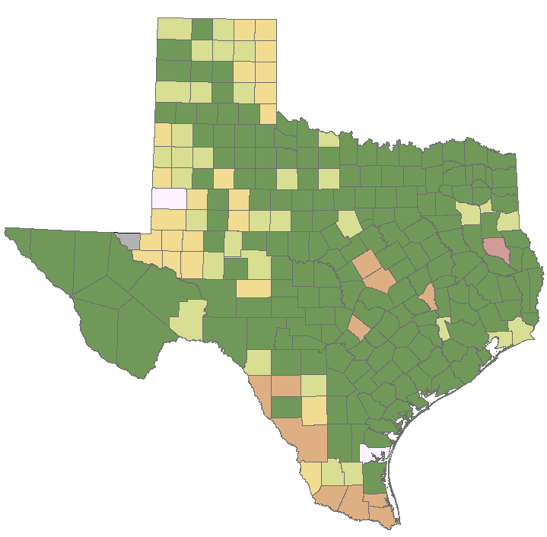
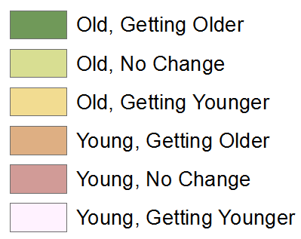
Median Age by Change in Median Age in Texas Counties, 2000-2014
Source: U.S. Census Bureau, 2000, 2010 Decennial Censuses and 2014 Population Estimates
Note: Old=Median Age>30 years; no data available for counties in gray.
30

Slide 22
Percent of Population 65 Years Plus, Texas Counties, 2011-2015
Source: U.S. Census Bureau, 2015 American Community Survey 5-Year Estimates
30

Slide 23
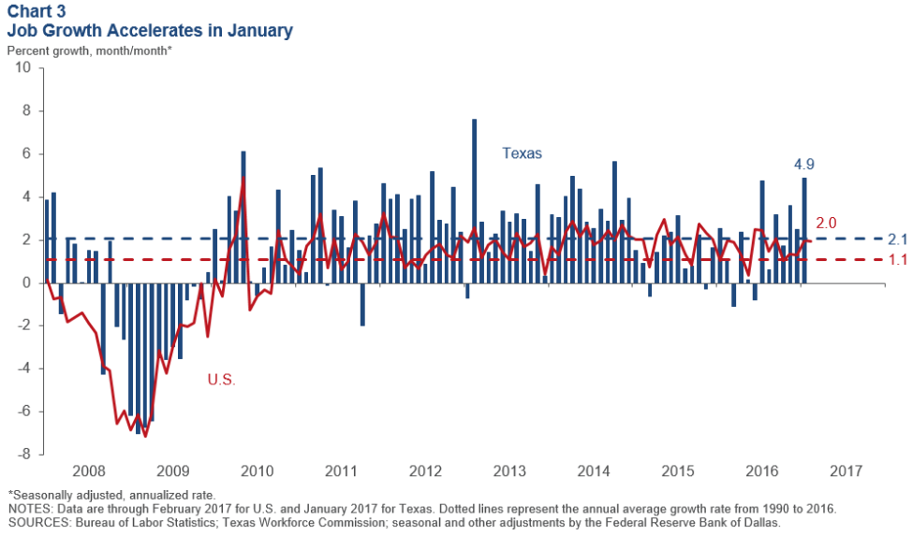
Job Growth, U.S. and Texas, 2008 to 2017
Notes:
According to the Dallas Fed, Texas’ employment growth rate of 4.9 percent in January was the highest since October 2014. The expansion was broad based, covering every sector except information.

Slide 24
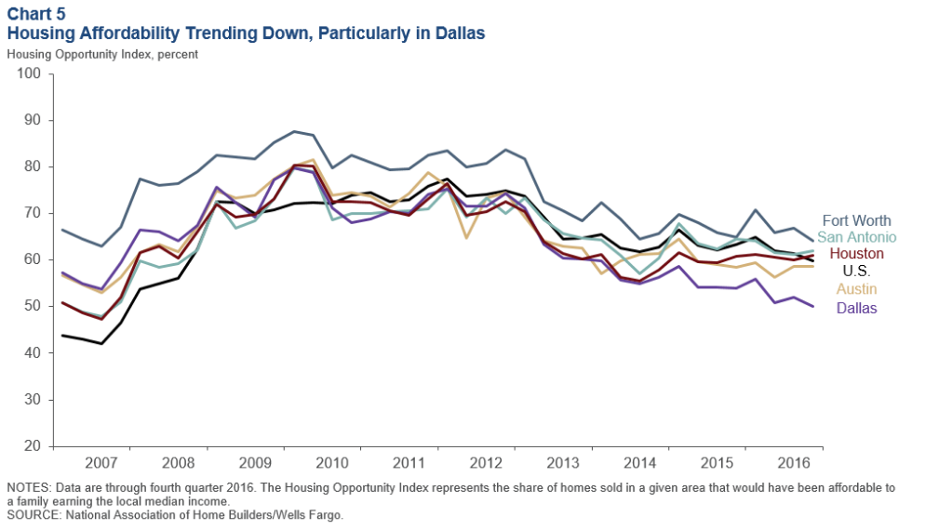
Housing Affordability in Select Texas Metros,
2007-2016
Notes:
Housing affordability—the share of homes sold that were affordable to a median-income family in the area—has fallen in most major Texas metros. Houston is an exception, the result of the oil bust slowing home appreciation. Apartment demand and occupancy rates generally remain high.

Slide 25
Farming and Agriculture in Texas

Slide 26
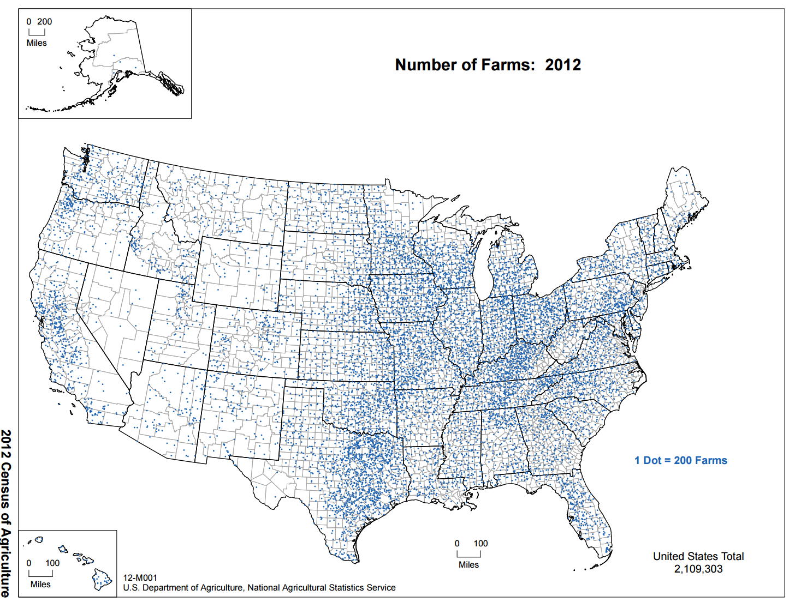
Notes:
The 2012 estimate for the number of farms in the U.S. was 2.1 million. The eastern half of the U.S. has the greatest concentration of farms. In 2016, Texas is estimated to have around 241k farm operations. Texas farms are most concentrated in parts of East Texas. We also see a high concentration of farms in parts of the Panhandle and along the southern border.

Slide 27
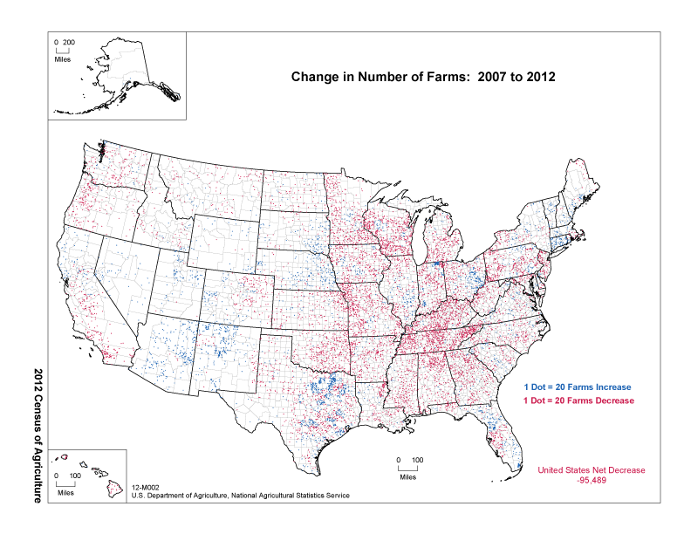
Notes:
Dot distribution map showing the change in the number of farms from 2007 to 2012. Each dot represents 20 farms. Red dots indicate a decrease in farms. Blue dots indicate an increase in farms. There was an overall decrease of 95,489 farms from 2007 to 2012. In Texas, there was an overall increase of 1,372 farms between 2007 and 2012.

Slide 28
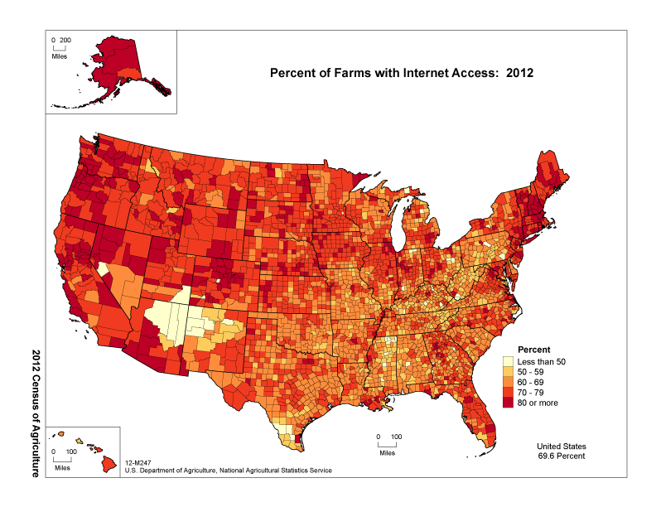
Notes:
Texas is on par with other US farmers in terms of internet access, with 68% reporting internet access in Texas. Darker colors indicate a higher percentage of farms with internet access. Internet access is higher in the northern and western regions of the US. We see lower rates of internet access along the southern border of Texas.

Slide 29
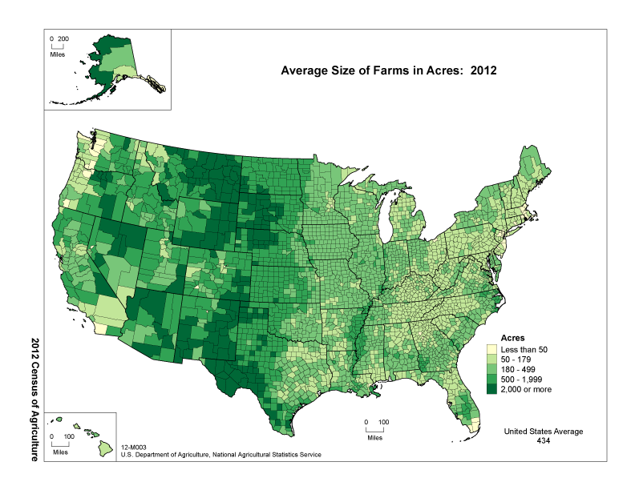
Notes:
Average size of farms in Texas is 523 acres, larger than the size for the U.S., at 434 acres. Darker colors indicate larger farms. Larger farms are more common in the west central regions of the US. The same is true for Texas.

Slide 30
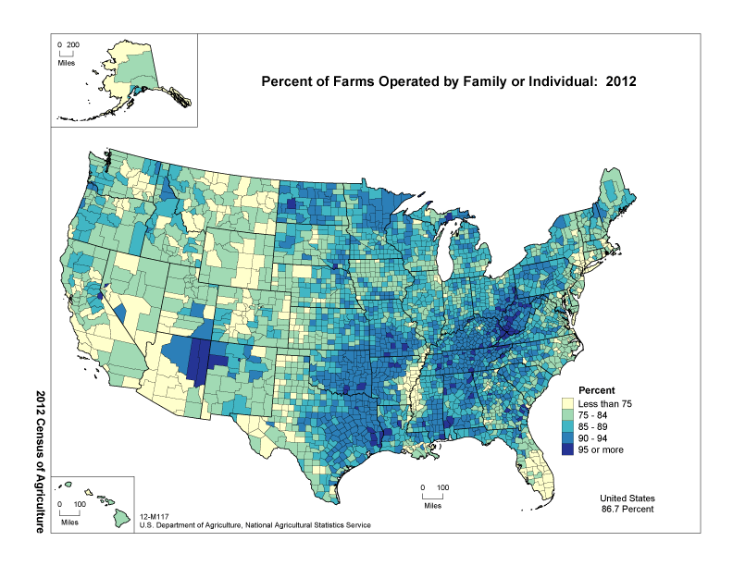
Notes:
Texas has a higher percentage (89.5%) of family operated farms than the U.S. Darker colors indicate a greater percentage of family or individual operating arrangement. We find higher rates in parts of East Texas.

Slide 31
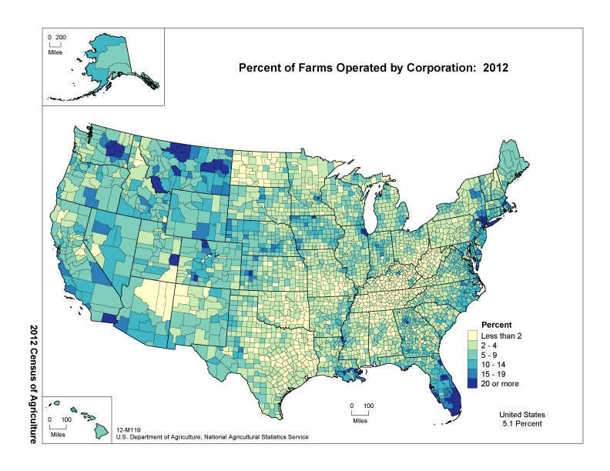
Notes:
Just under 3 percent of Texas farms are corporation operated. Darker colors indicate a greater percentage of corporations. Areas with the greatest concentration are in Florida and Montana. Texas has a relatively higher rate of corporate owned farms in parts of West Texas.

Slide 32
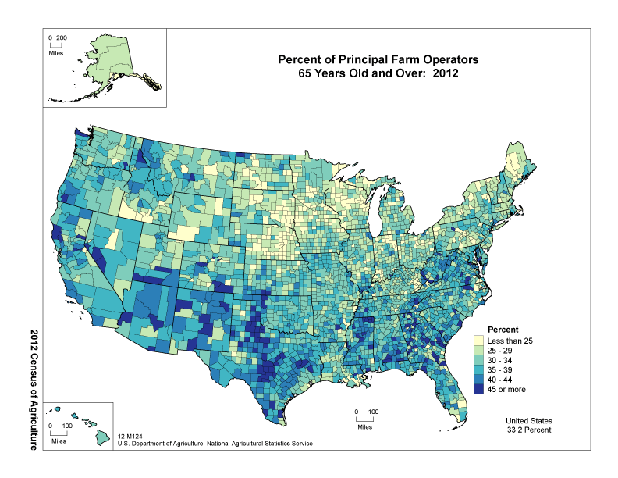
Notes:
Counties with higher percentages of principal operators 65 years and older are in the South. In Texas, the average age of principal operators is 60.1 years of age. Higher percentages of older farm operators can be found in parts of the Panhandle, the Hill Country, and south Texas.

Slide 33
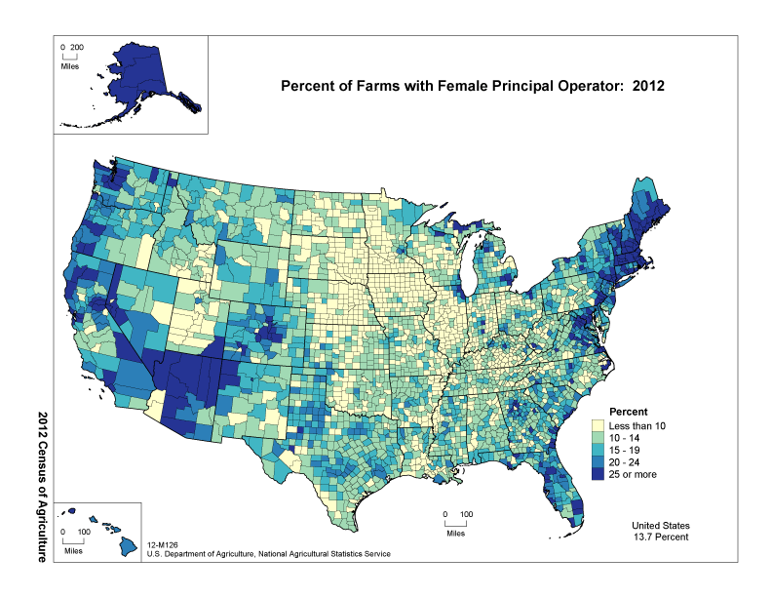
Notes:
Counties with higher percentages of female principal operators are in New England and Arizona. In Texas, there are 120,758 female operators (32.5%) and 38,452 principal operators (15.5%). Higher percentages of female principal operators can be found in the Panhandle, parts of West Texas, and areas of the population triangle. Female operators have a younger average age when compared to male operators. However, female principal operators have an average age of 62.2 years.

Slide 34
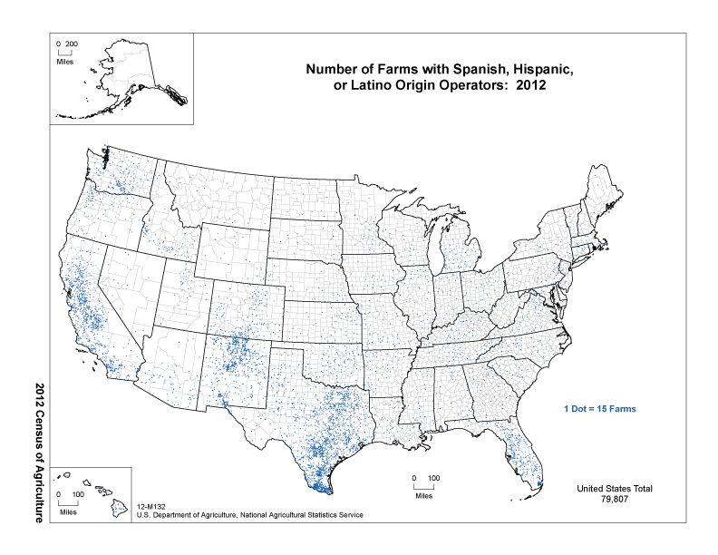
Notes:
The largest concentrations of dots are in the California, New Mexico and Texas. In Texas, there are 34,264 Hispanic farm operators (9.2%) and 23,689 Hispanic principal operators (9.5%). Average age of Hispanic operators is much younger than Texas average, at 54.8 years of age. Average age for principal operators is slightly higher, at 56.9 years of age.

Slide 35
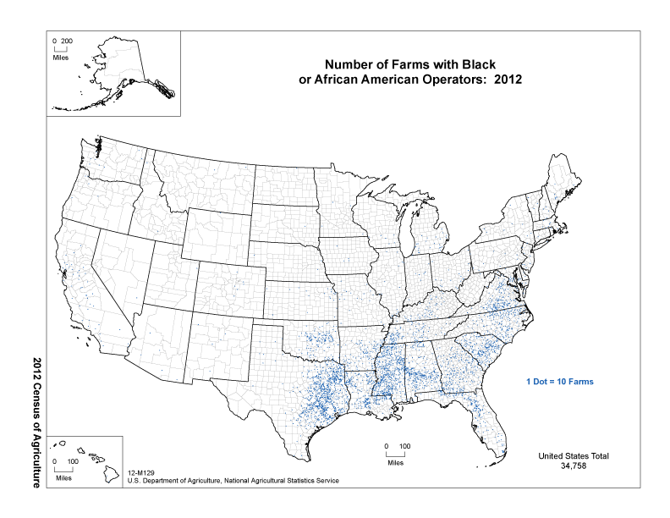
Notes:
In Texas, there are 8,551 African American principal operators, or 3.4%. The largest concentrations of African American farm operators can be found in East Texas.

Slide 36
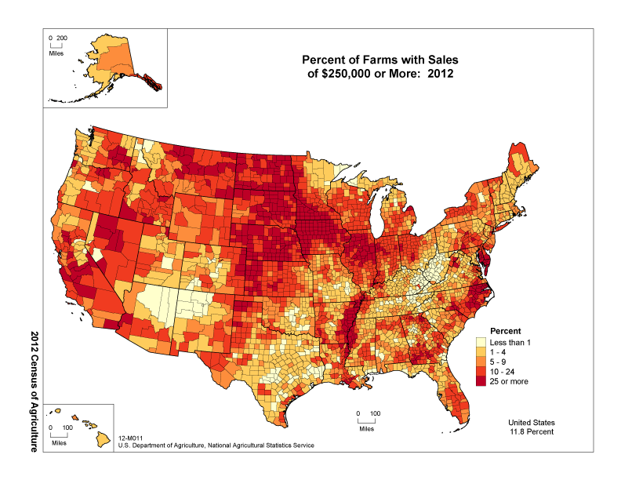
Notes:
Average per farm sales in Texas was $101,988, yielding a total of $25.4 billion in sales in 2012.

Slide 37
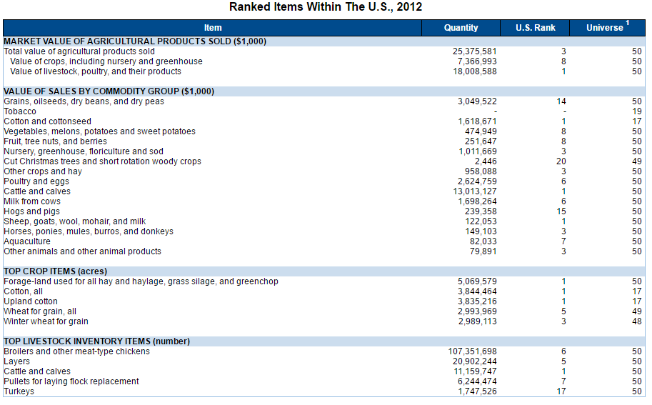
Texas Agriculture Overview, 2016
Source: US Department of Agriculture, National Agricultural Statistics Service, 2012 Census of Agriculture

Slide 38
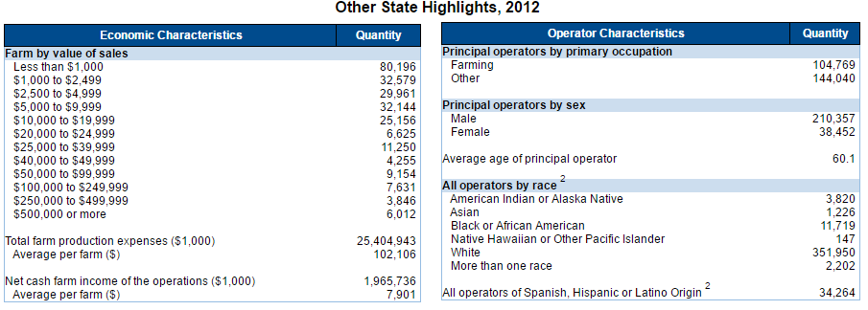
Texas Agriculture Overview, 2016
Source: US Department of Agriculture, National Agricultural Statistics Service, 2012 Census of Agriculture

Slide 39
Population Projections, Texas, 2010 - 2050
Source: Texas State Data Center, 2014 Population Projections, 0.5 Migration Scenario

Slide 40
Population and Projected Share of Population by Age Group,
Texas, 1950 to 2050
Source: U.S. Census Bureau, Decennial Censuses and 2015 Population Estimates; Texas Demographic Center, 2014 Vintage Population Projections, 0.5 Migration Scenario
Notes:
The older population of Texas is growing at an even faster rate than the state as a whole. Over 1 million of the people added to the Texas population between 2000 and 2015 were people aged 65 years and older. This significant increase is driven by the aging of the Baby Boom generation. In 2011, the oldest Baby Boomers turned 65. The older population in Texas is projected to continue its rapid growth, peaking in 2030 when the bulk of the Baby Boomers age into the elder population and leveling off as they age into higher mortality years. By 2050, the elder population and the youth population are projected to make up similar proportions of the state population, projected to be over 40 million.

Slide 41


  Office: (512) 936-3542
  Lila.Valencia@utsa.edu
  www.texasdemographics.gov
Lila Valencia, Ph.D.
@TexasDemography
Notes:
The Office of the State Demographer and the Texas State Data Center are committed to supporting your work through providing you with the best, most accurate, and objective information we can identify about our greatest asset, the people of Texas.

