Slide 1
Population and Water in Texas
Texas Municipal Utilities Association
Georgetown, Texas
June 23, 2017

Slide 2
Growing States, 2000-2016
 | 2000 Population (millions) | 2010 Population (millions) | 2016 Population (millions) | Numeric Change 2010-2016 (millions) | Percent Change 2010-2016
United States | 281.4 | 308.7 | 323.1 | 14.3 | 4.7%
Texas | 20.8 | 25.1 | 27.8 | 2.7 | 10.8%
California | 33.8 | 37.2 | 39.2 | 1.9 | 5.4%
Florida | 15.9 | 18.8 | 20.6 | 1.8 | 9.6%
Georgia | 8.2 | 9.7 | 10.3 | .6 | 6.4%
North Carolina | 8.0 | 9.5 | 10.1 | .6 | 6.4%
Washington | 5.8 | 6.7 | 7.3 | .6 | 8.4%
Arizona | 5.1 | 6.4 | 6.9 | .5 | 8.4%
Source: U.S. Census Bureau. 2000 and 2010 Census Count, 2016 Population Estimates.
Notes:
Texas is the second largest state in terms of population (2nd to CA) and area (2nd to AK). In terms of number of people, Texas’ growth exceeds that of all other states between 2010 and 205.

Slide 3

Total Estimated Population by County, Texas, 2016
Source: U.S. Census Bureau, 2016 Vintage Population Estimates
Notes:
When we look at the geographic distribution of the population of Texas over time we see continually increasing population in the counties along the I-35 corridor, the Houston area, and the lower Rio Grand Valley. Urbanized areas out west have grown but most counties west have experienced limited growth and some population decline. Approximately 86% of the population is along I-35 and east. This area with the 3 major metropolitan areas at the points is often described as the Texas population triangle.
The counties of Harris, Dallas, Tarrant, Bexar, and Travis make up the points of the “population triangle” in Texas and are the most populated in the State. Collin, Denton, Fort Bend, Hidalgo, and El Paso counties also have significant population concentrations. Many counties west of Interstate 35 are more sparsely populated.

Slide 4
Estimated Population Change, Texas Counties, 2010 to 2016
96 counties lost population over the 6 year period.
Source: U.S. Census Bureau, 2016 Vintage Population Estimates
Notes:
Population change over the decade has been greatest in the urban and suburban population triangle counties. Counties in the lower Rio Grande Valley also had significant growth as did El Paso. Overall, 158 counties gained population while 96 (38%) lost population over the decade.

Slide 5
Estimated Percent Change of the Total Population by County, Texas, 2010 to 2016
Source: U.S. Census Bureau, 2016 Vintage Population Estimates
Notes:
Percent change is an indicator of the speed of population change void of information about the volume of population change. Percent change in the population over the past few years has been greatest in the suburban population triangle counties, notably among counties between San Antonio and Austin. In the early part of the decade, counties in the Eagle Ford Shale area (south east of San Antonio) and the Cline Shale area (Midland and Odessa area), had been growing quickly. This is no longer the case.

Slide 6
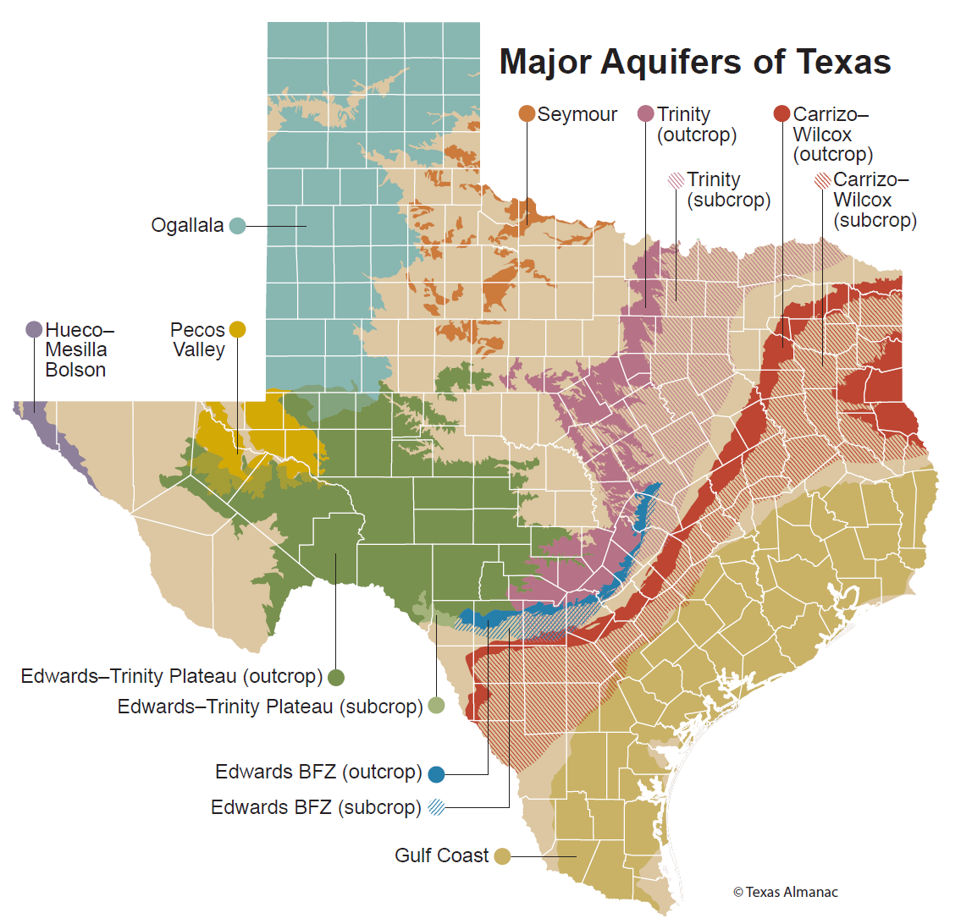
Major Texas Aquifers

Slide 7
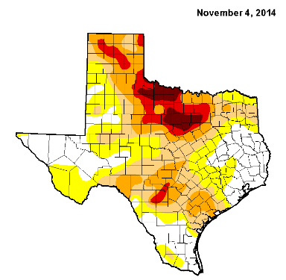
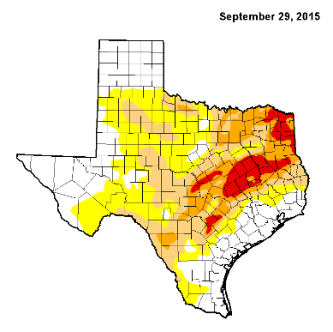
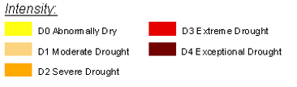
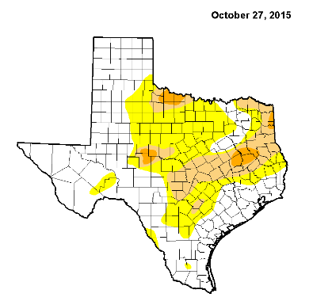
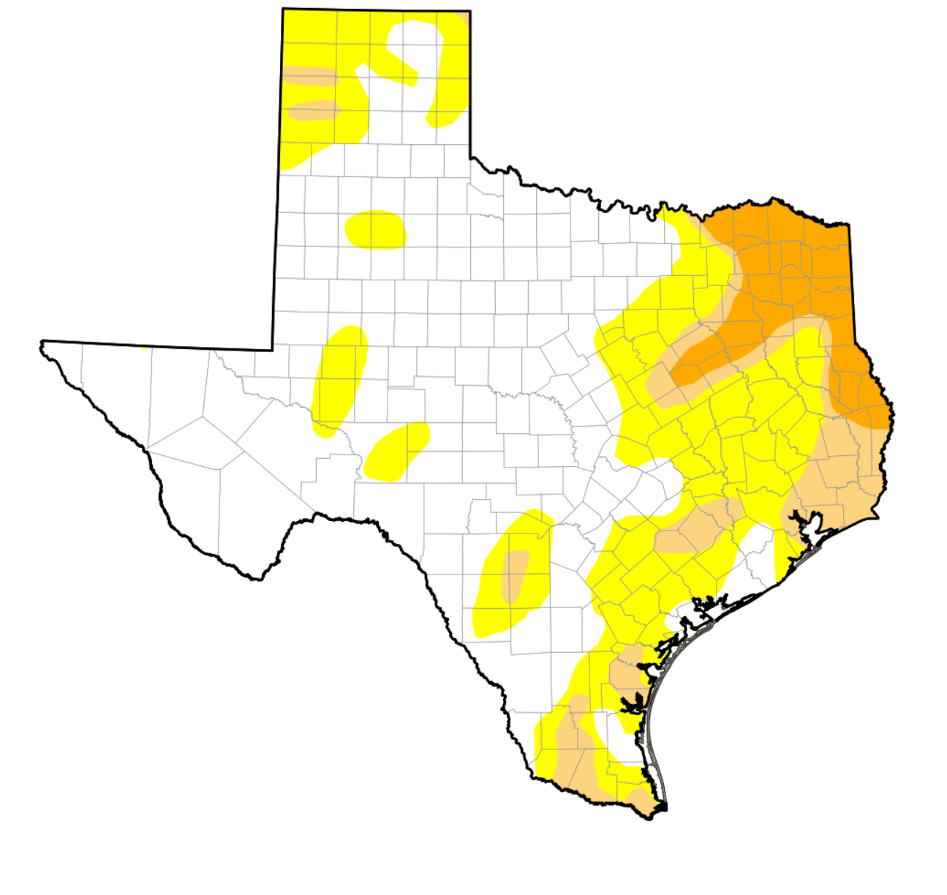
Drought Conditions in Texas
November 1, 2016
  https://waterdatafortexas.org/drought/drought-monitor

Slide 8
Top Counties for Numeric Growth in Texas, 2015-2016
County | U.S. Rank Population Change | Population Change | Percent of Change from Natural Increase | Percent Change from Domestic Migration | Percent Change from International Migration
Harris | 2 | 56,587 | 79.9% | -27.9% | 48.1%
Tarrant | 5 | 35,462 | 44.4% | 37.7% | 17.9%
Bexar | 7 | 33,198 | 44.6% | 39.3% | 16.1%
Dallas | 9 | 29,209 | 79.9% | -20.9% | 41.0%
Denton | 11 | 27,689 | 23.9% | 67.1% | 9.0%
Fort Bend | 13 | 27,388 | 24.8% | 59.4% | 15.8%
Collin | 14 | 26,506 | 25.8% | 58.7% | 15.5%
Travis | 17 | 24,505 | 44.2% | 33.3% | 22.5%
Williamson | 22 | 20,659 | 20.3% | 74.1% | 5.6%
Montgomery | 24 | 19,769 | 18.5% | 73.5% | 8.0%
Hidalgo* | 54 | 10,529 | 113.5% | -33.4% | 19.9%
Hidalgo County had negative net migration (-13.5% of total population growth).
Source: U.S. Census Bureau, 2016 Vintage Population Estimates

Slide 9
Top Counties for Percent Growth* in Texas, 2015-2016
County | U.S. Rank | 2015-2016 Percent Population Change | Percent Change from Domestic Migration | Percent Change from International Migration
Kendall | 2 | 5.2% | 95.9% | 4.0%
Hays | 3 | 5.1% | 82.2% | 1.8%
Comal | 6 | 4.4% | 88.5% | 2.0%
Williamson | 14 | 4.1% | 74.1% | 5.6%
Fort Bend | 18 | 3.8% | 59.4% | 15.8%
Montgomery | 24 | 3.7% | 73.5% | 8.0%
Rockwall | 25 | 3.6% | 82.2% | 2.5%
Denton | 28 | 3.6% | 67.1% | 9.0%
Kaufman | 36 | 3.4% | 81.3% | 2.2%
Bastrop | 42 | 3.1% | 83.5% | 0.7%
Ellis | 50 | 3.1% | 78.1% | 2.6%
*Among Counties with 10,000 or more population in 2016
Source: U.S. Census Bureau, 2016 Vintage Population Estimates

Slide 10
Density by Census Tract, San Antonio-Austin Area, 1970-2010
1970
1980
1990
2000
2010
Persons per Square Mile
0 – 10
11 – 50
51 – 500
501 – 4,000
4,001 – 56,000
Source: U.S. Census Bureau, decennial censuses. Geolytics, Neighborhood Change Database Tract Data from 1970-2010
Notes:
As more and more people move into our counties and communities, there are more and more persons per square mile. The sequence of images here show how from 1970 to 2010 the urban areas of San Antonio and Austin have become very dense in terms of population and how the are in-between these two cities has become more and more dense. This increasing density is happening in other urban areas of the State and the stress put on the transportation infrastructure from this increasing density creates challenges for our commuting residents and for businesses who are providing services and moving goods.

Slide 11
Population for San Antonio/Austin area by Census Tract, 1970-2010
1970
1980
1990
2000
2010
Source: U.S. Census Bureau, decennial censuses. Geolytics, Neighborhood Change Database Tract Data from 1970-2010

Slide 12
Percent of Housing Units Built by Period, Census Tracts, Metroplex Area, Texas, 2009-2013
2000 and Later
1960-1999
Before 1960

Slide 13
Projected Population Growth in Texas,
2010-2050
Source: Texas State Data Center 2014 Population Projections
Notes:
The projected population of Texas is produced using three different migration scenarios. The blue line represents the assumption that there is no in or out migration for Texas. The result is a population that is growing only from natural increase (births-deaths). Under this unlikely scenario, Texas will maintain a health pace of population growth. The other two scenarios assume that 1) the migration rate will be the same as we observed between 2000 and 2010 and 2) the migration rate will be half of what we observed between 2000 and 2010. Under the first assumption Texas will add another 5 million persons this decade, another 7 million the following, 8 or 9 million between 2030 and 2040 and almost 10 million between 2040 and 2050. The half migration scenario also projects significant growth but more modest than the assumption of full migration.

Slide 14
Projected and Estimated Population Growth in Texas, 2010-2015
Source: Texas State Data Center 2014 Population Projections and U.S. Census Bureau Population Estimates

Slide 15
Projected Population Change, Texas Counties, 2010-2050
Source: Texas State Data Center 2012 Population Projections . 2000-2010 Migration Scenario
Notes:
Projected population growth suggests increased numbers and density in the points of Texas’ population triangle, the lower Rio Grande valley with continued growth of El Paso and the urbanized areas in the west of the State. Many rural counties will continue to lose population.

Slide 16
Projected Percent Change in Population 2010-2050
Source: Texas State Data Center 2014 Population Projections, 1.0 Scenario

Slide 17

Contact
  State Demographer
  Office: (210) 458-6530
  Email: Lloyd.Potter@utsa.edu
  Internet: demographics.texas.gov
Lloyd Potter, Ph.D.
@TexasDemography
Notes:
The Texas Demgraphic Data Center are committed to supporting your work through providing you with the best, most accurate, and objective information we can identify about our greatest asset, the people of Texas.

