Slide 1

Demographic Trends, Characteristics, and Projections for Texas and the Dallas Metroplex
Leadership North Texas
Dallas, TX
September 22, 2017
@TexasDemography

Slide 2
Demographic Overview
Texas is experiencing significant growth.
Population continues to grow at a steady pace though growth is not geographically evenly distributed.
Growth is not racially/ethnically evenly distributed. Population growth is being driven largely by the Hispanic population.
The population of Texas, while relatively young, is also aging.
The components of population change have varying implications for infrastructure in Texas.
Demographic shifts may have serious implications for maintaining inclusive and equitable economic growth in the state.

Slide 3
Texas is experiencing fast and high growth.

Slide 4
Growing States, 2000-2016
 | 2000 Population | 2010 Population | 2016 Population | Numeric Change 2010-2016 | Percent Change 2010-2016
United States | 281,421,906 | 308,745,538 | 323,127,513 | 14,369,408 | 4.7%
Texas | 20,851,820 | 25,145,561 | 27,862,596 | 2,716,496 | 10.8%
California | 33,871,648 | 37,253,956 | 39,250,017 | 1,995,495 | 5.4%
Florida | 15,982,378 | 18,801,310 | 20,612,439 | 1,807,847 | 9.6%
Georgia | 8,186,453 | 9,687,653 | 10,310,371 | 621,691 | 6.4%
North Carolina | 8,049,313 | 9,535,483 | 10,146,788 | 611,100 | 6.4%
Washington | 5,894,121 | 6,724,540 | 7,288,000 | 563,455 | 8.4%
Arizona | 5,130,632 | 6,392,017 | 6,931,071 | 538,770 | 8.4%
Source: U.S. Census Bureau. 2000 and 2010 Census Count, 2016 Population Estimates.
Notes:
Texas is the second largest state in terms of population (2nd to CA) and area (2nd to AK). In terms of number of people, Texas’ growth exceeds that of all other states between 2010 and 2016.

Slide 5
Total Population in Texas, 1950-2016 (in millions)
Source: U.S. Census Bureau. 2000 and 2010 Census Counts and Population Estimates.
All values for decennial dates are for April 1st of the indicated census year. Values for 2011-2016 are for July 1 as estimated by the U.S. Census Bureau.
Notes:
Between 2000 and 2010 Texas added over 4 million residents. In 6 short years, it is estimated Texas has added over 2 million more, placing Texas population at 27.9 million, on pace to meet or surpass our gains since the last census. Population growth in Texas has been geometric or compounding in nature. Over the past six decades there have been three periods where the numeric growth has increased relative to previous years. We have no indication that the population growth in Texas will slow dramatically in coming years.

Slide 6

Total Estimated Population by County, Texas, 2016
Source: U.S. Census Bureau, 2016 Vintage Population Estimates
Notes:
When we look at the geographic distribution of the population of Texas over time we see continually increasing population in the counties along the I-35 corridor, the Houston area, and the lower Rio Grand Valley. Urbanized areas out west have grown but most counties west have experienced limited growth and some population decline. Approximately 86% of the population is along I-35 and east. This area with the 3 major metropolitan areas at the points is often described as the Texas population triangle.
The counties of Harris, Dallas, Tarrant, Bexar, and Travis make up the points of the “population triangle” in Texas and are the most populated in the State. Collin, Denton, Fort Bend, Hidalgo, and El Paso counties also have significant population concentrations. Many counties west of Interstate 35 are more sparsely populated.

Slide 7
Estimated Population Change, Texas Counties, 2010 to 2016
96 counties lost population over the 6 year period.
Source: U.S. Census Bureau, 2016 Vintage Population Estimates
Notes:
Population change over the decade has been greatest in the urban and suburban population triangle counties. Counties in the lower Rio Grande Valley also had significant growth as did El Paso. Overall, 158 counties gained population while 96 (38%) lost population over the decade.

Slide 8
Estimated Percent Change of the Total Population by County, Texas, 2010 to 2016
Source: U.S. Census Bureau, 2016 Vintage Population Estimates
Notes:
Percent change is an indicator of the speed of population change void of information about the volume of population change. Percent change in the population over the past few years has been greatest in the suburban population triangle counties, notably among counties between San Antonio and Austin. In the early part of the decade, counties in the Eagle Ford Shale area (south east of San Antonio) and the Cline Shale area (Midland and Odessa area), had been growing quickly. This is no longer the case.

Slide 9
Components of Population Change
by Percent in Texas, 1950-2010
Source: U.S. Census Bureau, Population Estimates
Notes:
It is important to understand a couple of very basic element of population change to think about how growing population may impact our transportation system. Population changes from two factors, one is natural increase which is simply births minus deaths over time. Essentially population added from natural increase are babies who are unlikely to be driving their own vehicle on our roads before age 16. Combine this with the fact that as people die, there are fewer drivers on the road. So the effect of population growth from natural increase on our transportation infrastructure is both lightening, from people dying, and delayed until babies reach the age where they can drive. The second way population changes is from net-migration, which is simply in-minus out migrants. In Texas, the balance has been for us to have more in than out migrants. Migrants, are usually adults who are drivers (though yes, some do have non-driving children) and the may be compounded by the fact that many of the in-migrants may also take a job that requires them to drive. Essentially, migrants immediately contribute to adding stress to the transportation infrastructure.
When we look at population change in Texas, from 1950 to present we can see that before 1970, most of our growth was from natural increase. Starting in the 1970s a much larger percent of our growth is attributed to net migration and this continues to today where approaching half of our population change is from migration.

Slide 10
Top Counties for Percent Growth* in Texas,
2015-2016
County | U.S. Rank | 2015-2016 Percent Population Change | Percent Change from Domestic Migration | Percent Change from International Migration
Kendall | 2 | 5.2% | 95.9% | 4.0%
Hays | 3 | 5.1% | 82.2% | 1.8%
Comal | 6 | 4.4% | 88.5% | 2.0%
Williamson | 14 | 4.1% | 74.1% | 5.6%
Fort Bend | 18 | 3.8% | 59.4% | 15.8%
Montgomery | 24 | 3.7% | 73.5% | 8.0%
Rockwall | 25 | 3.6% | 82.2% | 2.5%
Denton | 28 | 3.6% | 67.1% | 9.0%
Kaufman | 36 | 3.4% | 81.3% | 2.2%
Bastrop | 42 | 3.1% | 83.5% | 0.7%
Ellis | 50 | 3.1% | 78.1% | 2.6%
8
Source: U.S. Census Bureau, 2016 Vintage Population Estimates.
Notes:
Ten percent of the 50 fastest growing counties in the United States from 2015 to 2016 were in Texas. Some of the fastest growing counties in the country continue to be suburban ring counties, such as Kendall, Hays, and Comal counties. Growth among the fastest growing counties in the country stems more from migration than natural increase.

Slide 11
Top Counties for Numeric Growth in Texas,
2015-2016
County | U.S. Rank Population Change | Population Change | Percent of Change from Natural Increase | Percent Change from Domestic Migration | Percent Change from International Migration
Harris | 2 | 56,587 | 79.9% | -27.9% | 48.1%
Tarrant | 5 | 35,462 | 44.4% | 37.7% | 17.9%
Bexar | 7 | 33,198 | 44.6% | 39.3% | 16.1%
Dallas | 9 | 29,209 | 79.9% | -20.9% | 41.0%
Denton | 11 | 27,689 | 23.9% | 67.1% | 9.0%
Fort Bend | 13 | 27,388 | 24.8% | 59.4% | 15.8%
Collin | 14 | 26,506 | 25.8% | 58.7% | 15.5%
Travis | 17 | 24,505 | 44.2% | 33.3% | 22.5%
Williamson | 22 | 20,659 | 20.3% | 74.1% | 5.6%
Montgomery | 24 | 19,769 | 18.5% | 73.5% | 8.0%
Hidalgo* | 54 | 10,529 | 113.5% | -33.4% | 19.9%
Hidalgo County had negative net migration (-13.5% of total population growth).
Source: U.S. Census Bureau, 2016 Vintage Population Estimates
9
Source: U.S. Census Bureau, 2016 Vintage Population Estimates.
Notes:
Ten of the top 25 counties in the United States that were growing the most numerically between 2015 and 2016 were in Texas. These counties are the larger ones in the State and are all counties that have experienced continued growth. However, the components attributing to their population change varies. For instance, natural increase and international migration are playing a key role in population growth in Dallas County. Harris and Tarrant counties are growing about evenly from migration and natural increase. Whereas in the suburban ring counties migration (mostly domestic) is driving population growth. 2016 marked the first year in a few years that Harris County did not add the most people of any other county in the U.S. This drop can most likely be attributed to a decline in oil and gas industry in this region.

Slide 12
Estimated Percent of Total Net-Migrant Flows to and From Texas and Other States, 2015
Source: U.S. Census Bureau, 2016. ACS Migration Flows, 2015

Slide 13
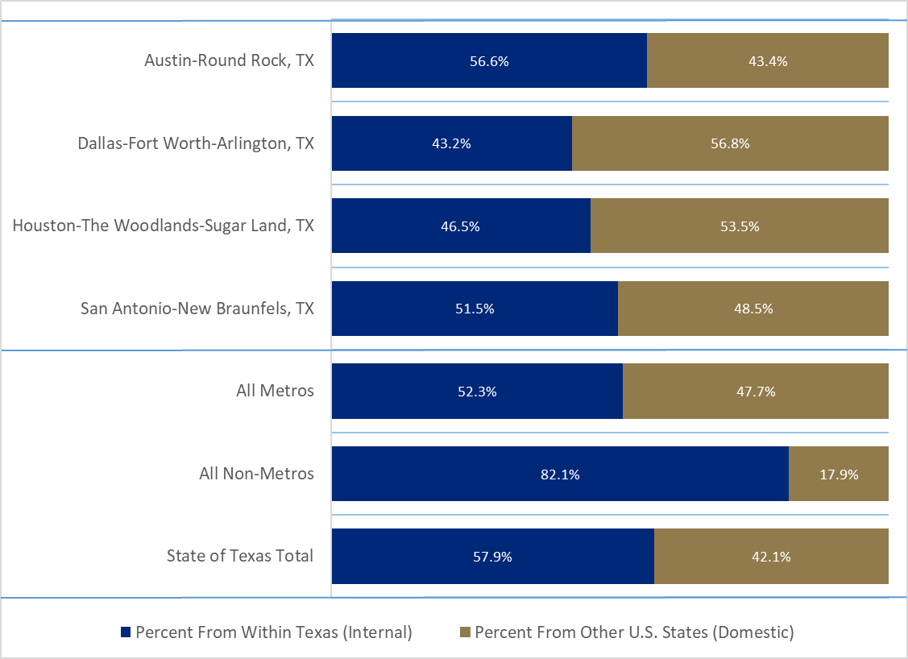
Shares of Internal and Domestic Gross Migration, Texas MSAs, 2010-2014

Slide 14
County to County Migration Flows, Dallas and Tarrant Counties, 2010-2014
 | Biggest Senders |  | Losing to
Dallas County | In-Flow | Net Migration | Net Migration
 | CA | CA | CO
 | IL | IL | OK
 | OK | NY | UT
 | FL | GA | OR
 | NY | NJ | NC
 | TX |  | TX
Tarrant County | CA | CA | CO
 | FL | AZ | WA
 | LA | MD | OK
 | OK | LA | GA
 | AZ | IL | NE
 | TX

Slide 15
County to County Migration Flows, Dallas and Tarrant Counties, 2010-2014
Dallas County
Tarrant County
 | In-Flows | Net Migration
Denton County | 8,852 | -7,365
Tarrant County | 13,443 | -6,406
Travis County | 2,010 | -1,426
Harris County | 3,375 | -1,356
Kaufman County | 2,501 | -1,201
 | In-Flows | Net Migration
Dallas County | 19,849 | 6,406
Harris County | 3,218 | 1,181
Denton County | 5,895 | -1,405
Brazos County | 458 | -1,153
Lubbock County | 1,177 | -1,073
Collin County | 2,622 | -321
Ellis County | 914 | -47

Slide 16
Texas continues to racially/ethnically diversify.

Slide 17
Texas Racial and Ethnic Composition,
2000, 2010, and 2016
11
Source: U.S. Census Bureau. 2000, 2010 Decennial Census and 2016 Population Estimates
Notes:
As of the 2000 Census, about 53% of Texas’ population was non-Hispanic Anglo, about 32% where of Hispanic descent, about 11% where non-Hispanic African American, and about 4% were non-Hispanic Other.
In 2010, it is estimated that about 45% of the Texas population was non-Hispanic Anglo, 38% of Hispanic descent, 11% were non-Hispanic African American, and about 6% were non-Hispanic Other (largely of Asian descent).

Slide 18
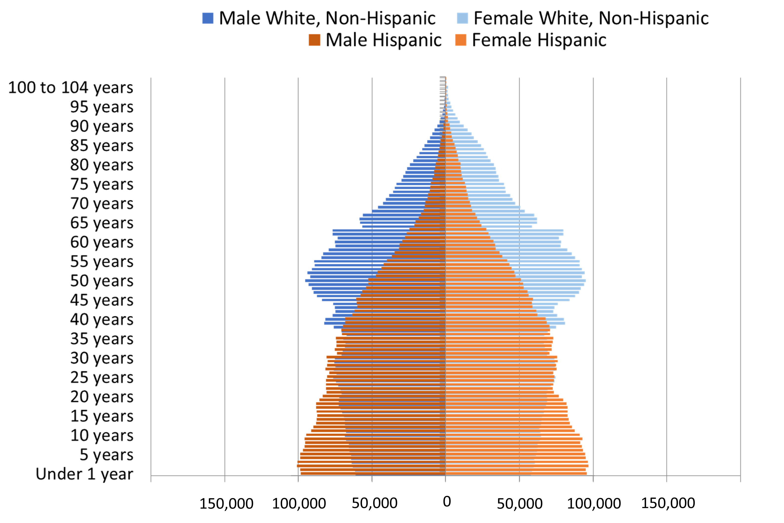
Population Pyramids for Hispanics and Non-Hispanic Whites in Texas, 2010
Notes:
The age distribution of the non-Hispanic white population in Texas is weighted heavily with the “baby boom” generation. Largely the result of lower fertility and less net in-migration, the non-Hispanic white population has relatively fewer young persons relative to those in the middle-age years. In 2010, at ages 37 and younger, the Hispanic population exceeds the non-Hispanic white population. Median age of NH White women is 43.4 years of age, compared to 29.0 years of age for Hispanic women.

Slide 19
Annual Shares of Recent Non-Citizen Immigrants to Texas by World Area of Birth, 2005-2015
Source: U.S. Census Bureau, American Community Survey, 1-Year PUMS

Slide 20
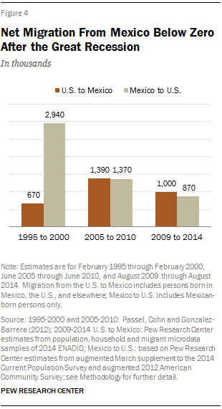
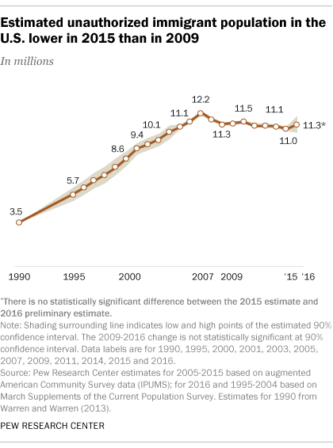
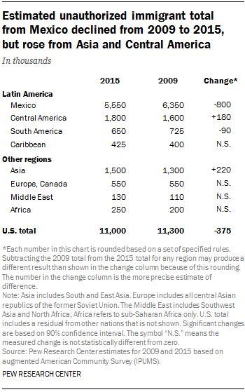
Unauthorized and Mexican Immigration, 2015
Notes:
Texas is estimated to be home to 1.65 million undocumented immigrants, making up about 6% of the total state population but nearly 9% of the state’s work force. The decreasing number of undocumented immigrants could have implications for the growth of the state, its labor force, and the racial make up of Texas immigrants.

Slide 21
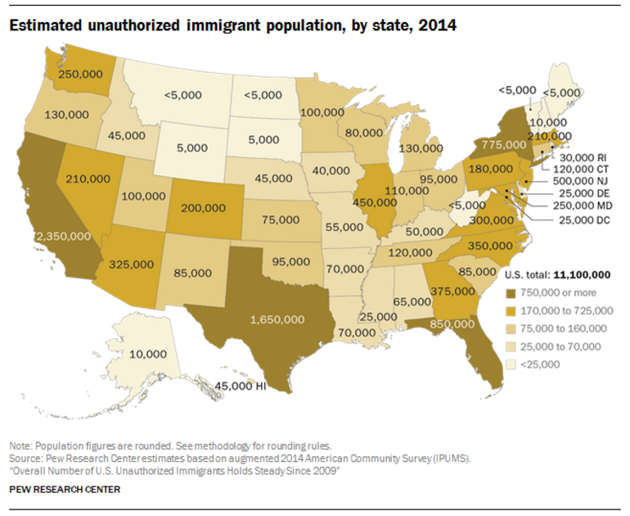

Slide 22


Slide 23
Texas is young, but aging.

Slide 24
States with the Oldest Median Ages, 2000, 2010, 2014
2000 |  |  | 2010 |  |  | 2014
Rank | State | Med Age | Rank | State | Median Age | Rank | State | Median Age
1 | West Virginia | 38.9 | 1 | Maine | 42.7 | 1 | Maine | 44.2
2 | Florida | 38.7 | 2 | Vermont | 41.5 | 2 | New Hampshire | 42.6
3 | Maine | 38.6 | 3 | West Virginia | 41.3 | 3 | Vermont | 42.6
4 | Pennsylvania | 38 | 4 | New Hampshire | 41.1 | 4 | West Virginia | 42.0
5… | Vermont | 37.7 | 5 | Florida | 40.7 | 5 | Florida | 41.8
…46 | California | 33.3 | 46 | California | 35.2 | 46 | Idaho | 35.7
47 | Idaho | 33.2 | 47 | Idaho | 34.6 | 47 | North Dakota | 34.9
48 | Alaska | 32.4 | 48 | Alaska | 33.8 | 48 | Texas | 34.2
49 | Texas | 32.3 | 49 | Texas | 33.6 | 49 | Alaska | 33.3
50 | Utah | 27.1 | 50 | Utah | 29.2 | 50 | Utah | 30.5
- | United States | 35.3 | - | United States | 37.2 | - | United States | 37.7
Source: US Census Bureau, 2000 and 2010 Decennial Censuses US Census Bureau, 2014 Population Estimate by State

Slide 25
Texas Population by Age Group, 2000 to 2014
 | 2000 |  | 2010 |  | 2014 |  | 2000-2014
 | Population | Percent | Population | Percent | Estimate | Percent | Absolute Change | Percent Change
Under 18 | 5,886,759 | 28.2 | 6,865,824 | 27.3 | 7,115,614 | 26.4 | 1,228,855 | 20.9
18 to 64 | 12,892,529 | 61.8 | 15,677,851 | 62.3 | 16,742,263 | 62.1 | 3,849,734 | 29.9
65 and Older | 2,072,532 | 9.9 | 2,601,886 | 10.3 | 3,099,081 | 11.5 | 1,026,549 | 49.5
Total | 20,851,820 | 100 | 25,145,561 | 100 | 26,956,958 | 100 | 6,105,138 | 29.3
Source: US Census Bureau, 2000 and 2010 Censuses, QT-P1 and derived from QT-P1

Slide 26
Population Projections by Age Group,
2010 to 2050
Age Group | 2010 | 2020 | 2030 | 2040 | 2050 | 2010-2050 Percent Change
65 and Older | 2,601,886 | 4,014,083 | 5,929,471 | 7,583,385 | 9,442,865 | 262.9
65-69 | 853,100 | 1,375,699 | 1,779,930 | 2,019,401 | 2,519,575 | 195.3
70-74 | 619,156 | 1,081,697 | 1,569,556 | 1,747,404 | 2,136,439 | 245.1
75-79 | 477,245 | 714,641 | 1,181,376 | 1,568,513 | 1,830,330 | 283.5
80-84 | 347,206 | 440,399 | 794,965 | 1,186,724 | 1,365,653 | 293.3
85+ | 205,501 | 401,647 | 603,644 | 1,061,343 | 1,590,868 | 421.3
Total Population | 25,145,561 | 30,541,978 | 37,155,084 | 44,955,896 | 54,369,297 | 116.2
Source: US Census Bureau, 2010 Census Texas State Data Center, 2014 Projections, 1.0 Migration Scenario

Slide 27
Percent of Population 65 Years Plus, Texas Counties, 2011-2015
Source: U.S. Census Bureau, 2015 American Community Survey 5-Year Estimates
30

Slide 28
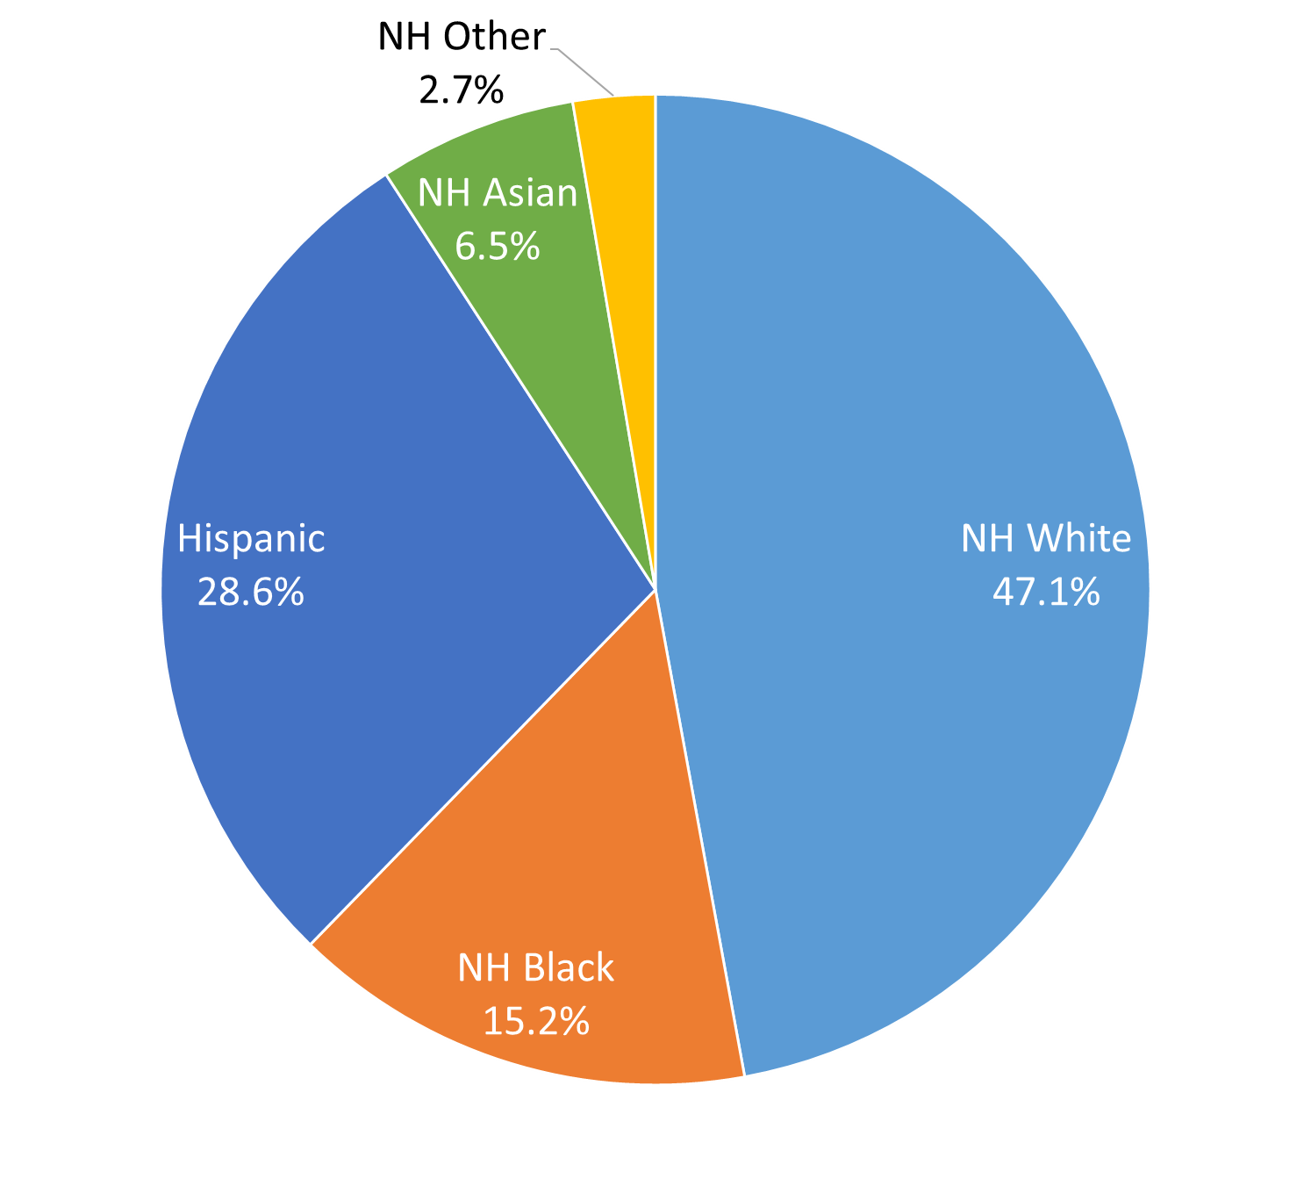
Race/Ethnicity Composition, Dallas Metro Area and DFW Counties
Dallas-Fort Worth-Arlington Metro Area
 | NH White | NH Black | Hispanic or Latino | NH Asian | NH Other
Parker County | 84.5% | 1.7% | 11.2% | 0.6% | 1.9%
Delta County | 81.2% | 8.2% | 6.8% | 0.7% | 3.0%
Wise County | 78.2% | 1.2% | 18.2% | 0.4% | 2.1%
Johnson County | 74.6% | 2.5% | 19.5% | 0.8% | 2.6%
Hunt County | 73.5% | 8.4% | 14.6% | 1.2% | 2.3%
Rockwall County | 72.8% | 5.3% | 16.7% | 2.3% | 2.8%
Kaufman County | 68.1% | 9.3% | 18.8% | 0.8% | 2.9%
Ellis County | 63.9% | 8.8% | 24.7% | 0.6% | 2.0%
Denton County | 62.1% | 8.7% | 18.8% | 7.3% | 3.1%
Collin County | 60.8% | 8.9% | 15.0% | 12.4% | 2.9%
Tarrant County | 49.8% | 15.1% | 27.6% | 4.9% | 2.6%
Dallas County | 31.5% | 21.8% | 39.0% | 5.6% | 2.1%
Source: U.S. Census Bureau, 2016 American Community Survey 1-Year Estimates
Source: U.S. Census Bureau, 2015 American Community Survey 5-Year Estimates

Slide 29
Economic Outlook

Slide 30
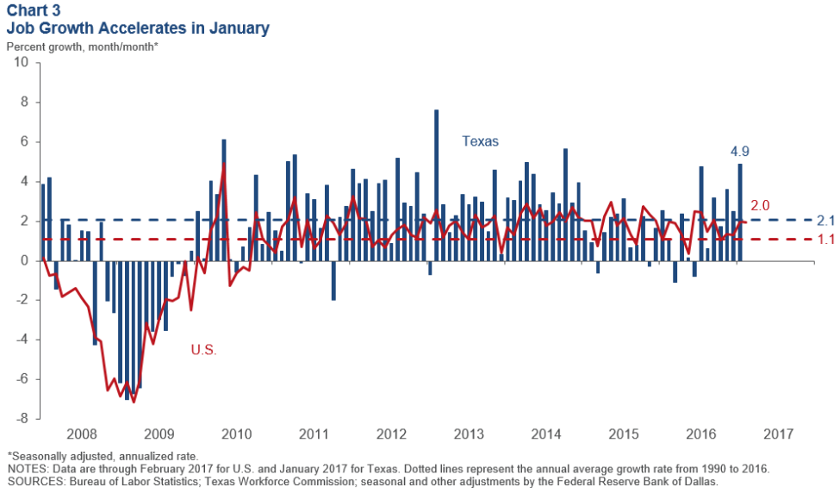
Job Growth, U.S. and Texas, 2008 to 2017
Notes:
According to the Dallas Fed, Texas’ employment growth rate of 4.9 percent in January was the highest since October 2014. The expansion was broad based, covering every sector except information.

Slide 31
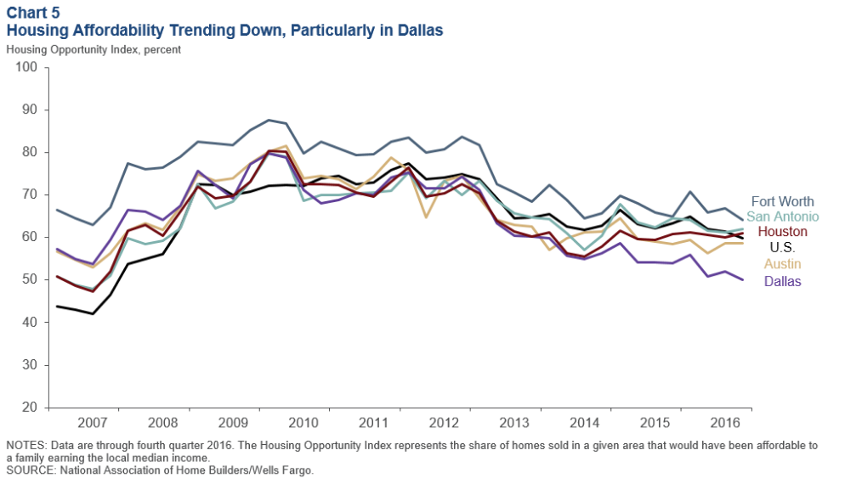
Housing Affordability in Select Texas Metros,
2007-2016
Notes:
Housing affordability—the share of homes sold that were affordable to a median-income family in the area—has fallen in most major Texas metros. Houston is an exception, the result of the oil bust slowing home appreciation. Apartment demand and occupancy rates generally remain high.

Slide 32
Economic Indicators, Texas and U.S., 2016
 | Median Household Income | Change, 2015-2016
Texas | $56,565 | +
Asian | $82,081 | +
NH White | $70,131 | +
Hispanic | $44,579 | +
Black | $42,582 | +
Unemployment rate
  Texas = 5.6%
  U.S. = 5.8%
Median Household Income
  Texas = $56,565
  U.S. = $57,617
Median Family Income
  Texas = $67,025
  U.S. = 71,062
Median earnings for males working full time
  Texas = $47,351
  U.S. = $50,586
Median earnings for females working full time
  Texas = $37,576
  U.S. = $40,626
Poverty rate
  Texas = 15.6% 12.7%
  U.S. = 14.0%
Source: U.S. Census Bureau, 2016 American Community Survey 1-Year Estimates

Slide 33
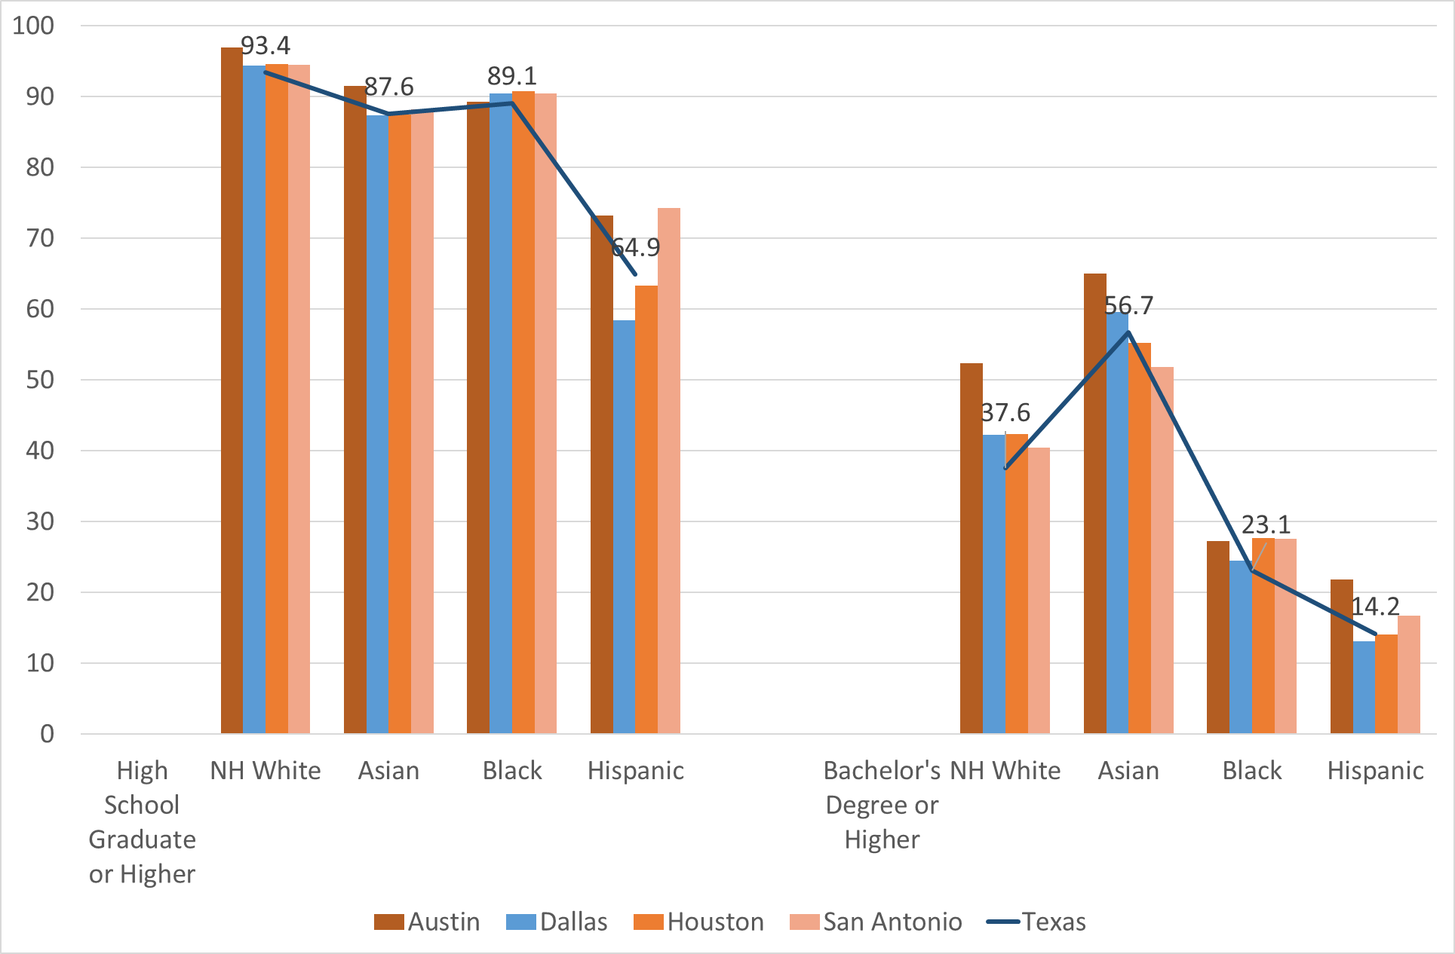
Educational Attainment by Race/Ethnicity, Texas and Big Four Metro Areas, 2016

Slide 34
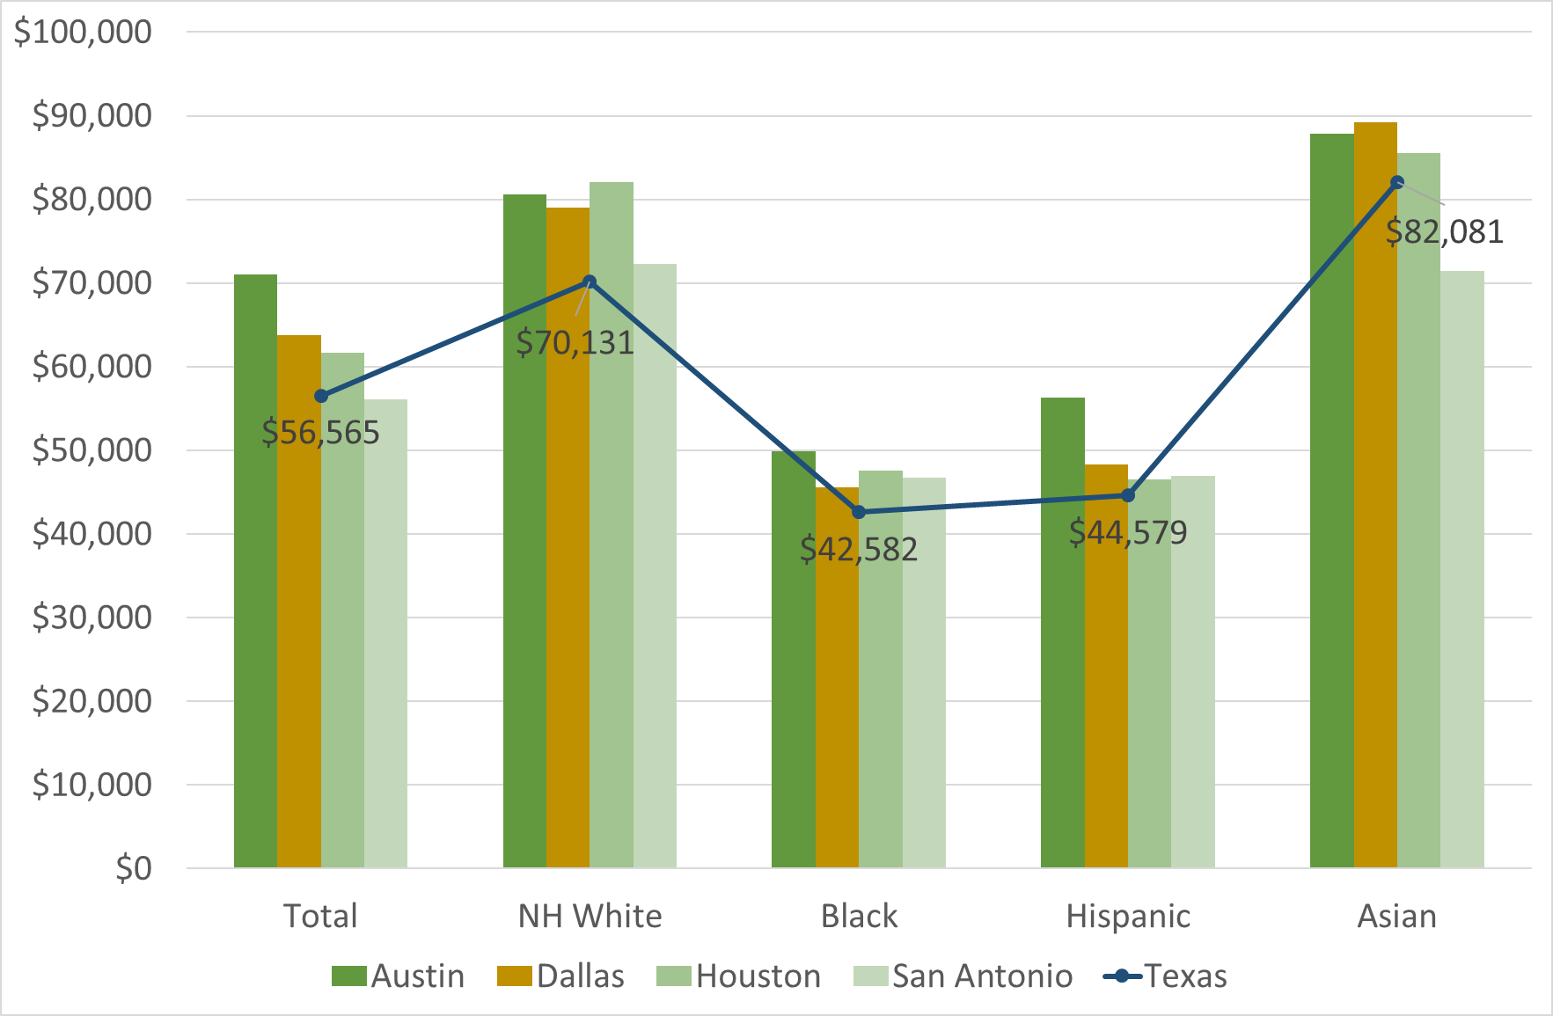
Median Household Income by Race/Ethnicity, Texas and Big Four Metro Areas, 2016

Slide 35
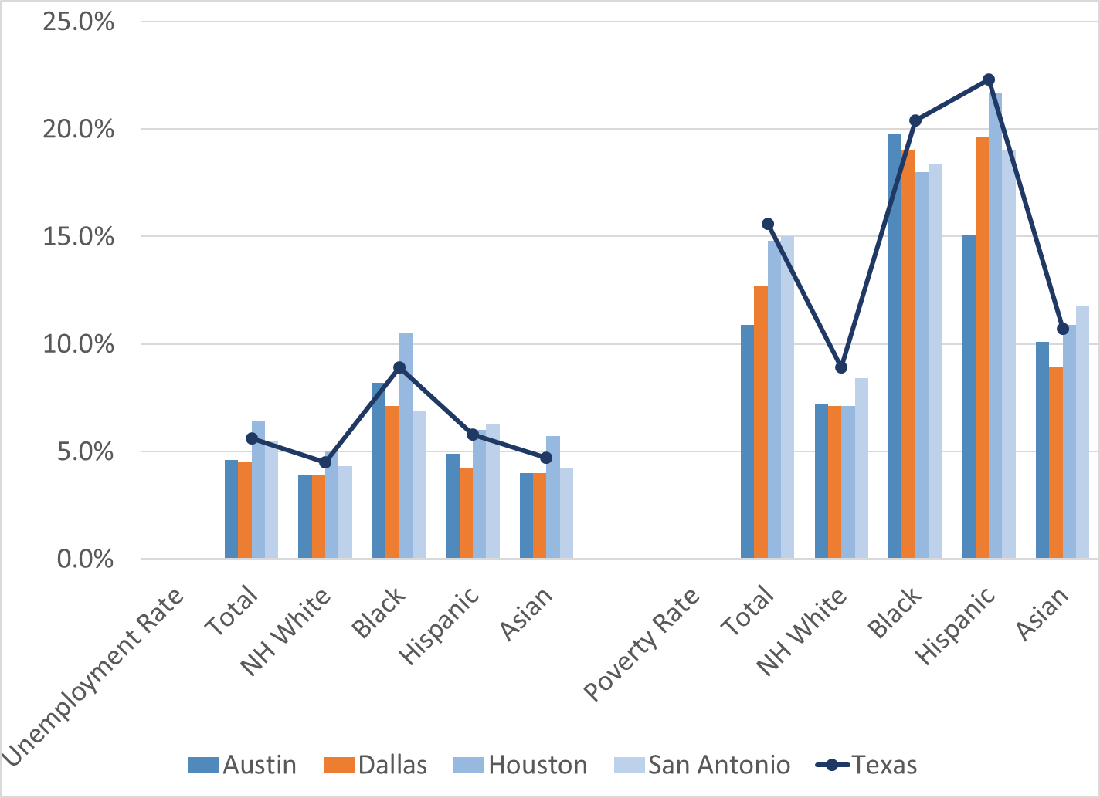
Unemployment and Poverty Rates by Race/Ethnicity, Texas and Big Four Metro Areas, 2016

Slide 36
Population Projections

Slide 37
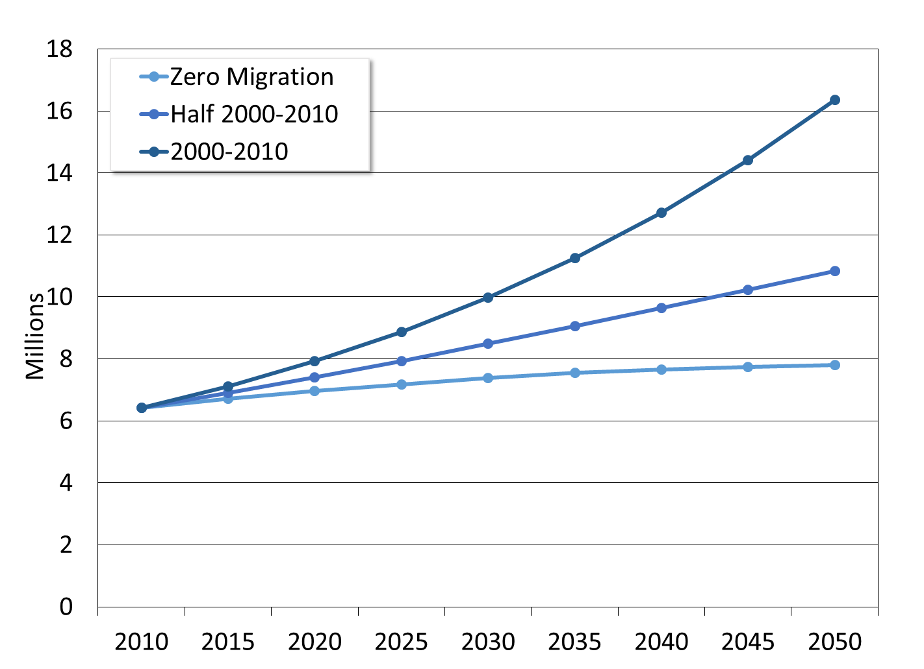
Population Projections, Dallas-Fort Worth Metro Area, 2010-2050
Source: Texas Demographic Center, 2014 Population Projections

Slide 38
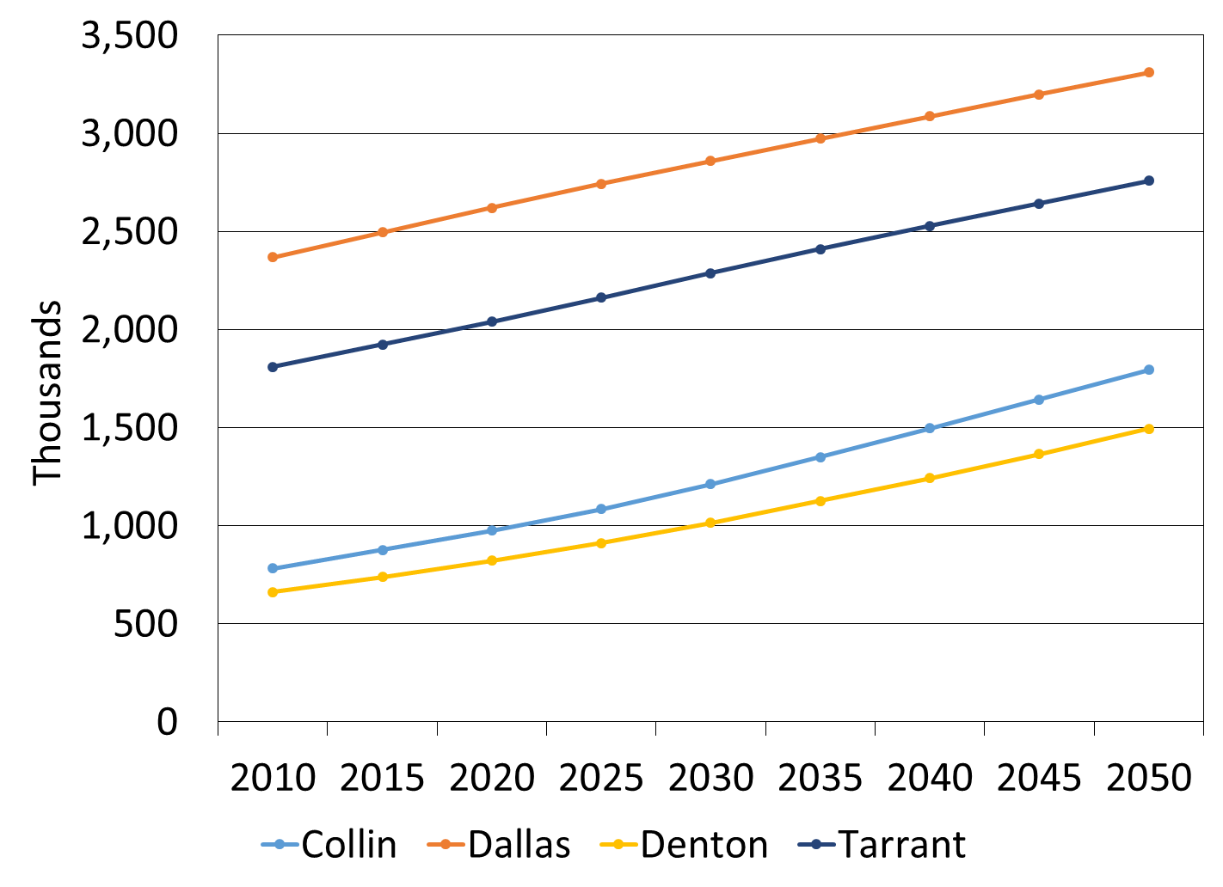
Population Projections, DFW Metro Largest Counties, 2010-2050
Source: Texas Demographic Center, 2014 Population Projections, Half Migration Scenario

Slide 39
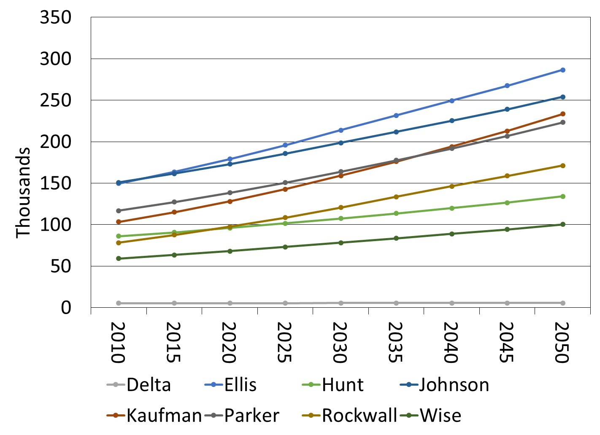
Population Projections, DFW Metro Smaller Counties, 2010-2050
Source: Texas Demographic Center, 2014 Population Projections, Half Migration Scenario

Slide 40


  Office: (512) 936-3542
  Lila.Valencia@utsa.edu
  www.texasdemographics.gov
Lila Valencia, Ph.D.
@TexasDemography
Notes:
The Office of the State Demographer and the Texas State Data Center are committed to supporting your work through providing you with the best, most accurate, and objective information we can identify about our greatest asset, the people of Texas.

