Slide 1
Education and Texas Demographic Characteristics and Trends
Texas Association of School Boards
Odessa, Texas
November 16, 2017

Slide 2

Total Estimated Population by County, Texas, 2016
86%
Source: U.S. Census Bureau, 2016 Vintage Population Estimates
Notes:
When we look at the geographic distribution of the population of Texas over time we see continually increasing population in the counties along the I-35 corridor, the Houston area, and the lower Rio Grand Valley. Urbanized areas out west have grown but most counties west have experienced limited growth and some population decline. Approximately 86% of the population is along I-35 and east. This area with the 3 major metropolitan areas at the points is often described as the Texas population triangle.
The counties of Harris, Dallas, Tarrant, Bexar, and Travis make up the points of the “population triangle” in Texas and are the most populated in the State. Collin, Denton, Fort Bend, Hidalgo, and El Paso counties also have significant population concentrations. Many counties west of Interstate 35 are more sparsely populated.

Slide 3
Estimated Population Change, Texas Counties, 2010 to 2016
96 counties lost population over the 6 year period.
Source: U.S. Census Bureau, 2016 Vintage Population Estimates
Notes:
Population change over the decade has been greatest in the urban and suburban population triangle counties. Counties in the lower Rio Grande Valley also had significant growth as did El Paso. Overall, 158 counties gained population while 96 (38%) lost population over the decade.

Slide 4
Estimated Percent Change of the Total Population by County, Texas, 2010 to 2016
Source: U.S. Census Bureau, 2016 Vintage Population Estimates
Notes:
Percent change is an indicator of the speed of population change void of information about the volume of population change. Percent change in the population over the past few years has been greatest in the suburban population triangle counties, notably among counties between San Antonio and Austin. In the early part of the decade, counties in the Eagle Ford Shale area (south east of San Antonio) and the Cline Shale area (Midland and Odessa area), had been growing quickly. This is no longer the case.

Slide 5
Top Counties for Numeric Growth in Texas, 2015-2016
County | U.S. Rank Population Change | Population Change | Percent of Change from Natural Increase | Percent Change from Domestic Migration | Percent Change from International Migration
Harris | 2 | 56,587 | 79.9% | -27.9% | 48.1%
Tarrant | 5 | 35,462 | 44.4% | 37.7% | 17.9%
Bexar | 7 | 33,198 | 44.6% | 39.3% | 16.1%
Dallas | 9 | 29,209 | 79.9% | -20.9% | 41.0%
Denton | 11 | 27,689 | 23.9% | 67.1% | 9.0%
Fort Bend | 13 | 27,388 | 24.8% | 59.4% | 15.8%
Collin | 14 | 26,506 | 25.8% | 58.7% | 15.5%
Travis | 17 | 24,505 | 44.2% | 33.3% | 22.5%
Williamson | 22 | 20,659 | 20.3% | 74.1% | 5.6%
Montgomery | 24 | 19,769 | 18.5% | 73.5% | 8.0%
Hidalgo* | 54 | 10,529 | 113.5% | -33.4% | 19.9%
Hidalgo County had negative net migration (-13.5% of total population growth).
Source: U.S. Census Bureau, 2016 Vintage Population Estimates

Slide 6
Top Counties for Percent Growth* in Texas, 2015-2016
County | U.S. Rank | 2015-2016 Percent Population Change | Percent Change from Domestic Migration | Percent Change from International Migration
Kendall | 2 | 5.2% | 95.9% | 4.0%
Hays | 3 | 5.1% | 82.2% | 1.8%
Comal | 6 | 4.4% | 88.5% | 2.0%
Williamson | 14 | 4.1% | 74.1% | 5.6%
Fort Bend | 18 | 3.8% | 59.4% | 15.8%
Montgomery | 24 | 3.7% | 73.5% | 8.0%
Rockwall | 25 | 3.6% | 82.2% | 2.5%
Denton | 28 | 3.6% | 67.1% | 9.0%
Kaufman | 36 | 3.4% | 81.3% | 2.2%
Bastrop | 42 | 3.1% | 83.5% | 0.7%
Ellis | 50 | 3.1% | 78.1% | 2.6%
*Among Counties with 10,000 or more population in 2016
Source: U.S. Census Bureau, 2016 Vintage Population Estimates

Slide 7
Estimated Percent Population Change, Texas Places, 2015-2016
Source: U.S. Census Bureau, 2016 Vintage Population Estimates

Slide 8
Estimated Percent Population Change, Texas Places, 2015-2016
Source: U.S. Census Bureau, 2016 Vintage Population Estimates

Slide 9
Estimated Percent Population Change, Texas Places, 2015-2016
Source: U.S. Census Bureau, 2016 Vintage Population Estimates

Slide 10
Estimated Percent Population Change, Texas Places, 2015-2016
Source: U.S. Census Bureau, 2016 Vintage Population Estimates

Slide 11
Estimated Percent Population Change, Texas Places, 2015-2016
Source: U.S. Census Bureau, 2016 Vintage Population Estimates

Slide 12
Estimated Percent of Total Net-Migrant Flows to and From Texas and Other States, 2015
Source: U.S. Census Bureau, 2016. ACS Migration Flows, 2015

Slide 13
Texas Racial and Ethnic Composition,
2000 and 2015
11
Source: U.S. Census Bureau. 2000, 2010 Decennial Census and 2015 Population Estimates
Notes:
As of the 2000 Census, about 53% of Texas’ population was non-Hispanic Anglo, about 32% where of Hispanic descent, about 11% where non-Hispanic African American, and about 4% were non-Hispanic Other.
In 2010, it is estimated that about 45% of the Texas population was non-Hispanic Anglo, 38% of Hispanic descent, 11% were non-Hispanic African American, and about 6% were non-Hispanic Other (largely of Asian descent).

Slide 14
Texas White (non-Hispanic) and Hispanic Populations by Age, 2014
Source: U.S. Census Bureau 2010 Decennial Census, SF1
Notes:
The age distribution of the non-Hispanic white population in Texas is weighted heavily with the “baby boom” generation. Largely the result of lower fertility and less net in-migration, the non-Hispanic white population has relatively fewer young persons relative to those in the middle-age years. In 2010, at ages 37 and younger, the Hispanic population exceeds the non-Hispanic white population.

Slide 15
Texas Population Pyramid by Race/Ethnicity, 2014
Source: Texas Demographic Center, 2014 Population Estimates
Notes:
This population pyramid represents the age, sex, race and ethnic composition of the Texas population. Blue represents males, red females, rows are single years of age, and shades represent specified race/ethnic groups as indicated in the legend.

Slide 16
Texas Population Pyramid by Race/Ethnicity, 2014
Source: Texas Demographic Center, 2014 Population Estimates
Notes:
This population pyramid represents the age, sex, race and ethnic composition of the Texas population. Blue represents males, red females, rows are single years of age, and shades represent specified race/ethnic groups as indicated in the legend.

Slide 17
Texas Population Pyramid by Race/Ethnicity, 2014
Source: Texas Demographic Center, 2014 Population Estimates
Notes:
This population pyramid represents the age, sex, race and ethnic composition of the Texas population. Blue represents males, red females, rows are single years of age, and shades represent specified race/ethnic groups as indicated in the legend.

Slide 18
Estimated Population by Age Group, Texas, 2010 through 2016
Source: U.S. Census Bureau, 2016 Vintage Population Estimates

Slide 19
Estimated Population by Age Group, Texas, 2010 through 2016
Source: U.S. Census Bureau, 2016 Vintage Population Estimates

Slide 20
Estimated Percent of Total Population by Age Group, Texas, 2010 through 2016
Source: U.S. Census Bureau, 2016 Vintage Population Estimates

Slide 21
Estimated Percent of Total Population by Age Group, Texas, 2010 through 2016
Source: U.S. Census Bureau, 2016 Vintage Population Estimates

Slide 22
Projected Population Growth in Texas,
2010-2050
Source: Texas State Data Center 2016 Population Projections

Slide 23
Projected Population Growth in Texas,
2010-2020
Source: Texas State Data Center 2016 Population Projections

Slide 24
Projected Population of Persons Aged 0-18 Years by Race and Ethnicity, Texas 2010-2050
Source: Texas State Data Center 2016 Population Projections

Slide 25
Projected Population of Persons Aged 0-18 Years by Race and Ethnicity, Texas 2010-2050
Source: Texas State Data Center 2016 Population Projections

Slide 26
Projected Population of Persons Aged 0-18 Years by Race and Ethnicity, Texas 2010-2050
Source: Texas State Data Center 2016 Population Projections

Slide 27
Projected Percent of Population of Persons Aged 0-18 Years by Race and Ethnicity, Texas 2010-2050
Source: Texas State Data Center 2016 Population Projections

Slide 28
Projected population and population change for persons aged 0-18 years, 2010-2030 for Texas counties by metro status
 |  | Total | Metro | Metro 1 million or more | Metro less than 1 million | Nonmetro | Nonmetro adjacent to metro | Nonmetro not adjacent to metro
Projected Numeric Change 2010-2030 | Total | 2,184,778 | 2,066,849 | 1,599,918 | 466,931 | 117,929 | 91,145 | 26,784
 | NH White | (24,243) | (13,261) | (5,787) | (7,474) | (10,982) | (11,006) | 24
 | Black | 95,170 | 100,349 | 95,110 | 5,239 | (5,179) | (3,632) | (1,547)
 | Hispanic | 1,745,883 | 1,624,210 | 1,201,130 | 423,080 | 121,673 | 95,098 | 26,575
 | Other | 367,968 | 355,551 | 309,465 | 46,086 | 12,417 | 10,685 | 1,732
Projected Percent Change 2010-2030 | Total | 30.2% | 32.0% | 34.1% | 26.4% | 14.9% | 15.1% | 14.3%
 | NH White | -1.0% | -0.6% | -0.4% | -1.5% | -3.0% | -4.0% | 0.0%
 | Black | 11.1% | 12.5% | 14.3% | 3.8% | -8.7% | -7.5% | -14.2%
 | Hispanic | 50.1% | 51.7% | 58.3% | 39.1% | 35.3% | 36.0% | 32.9%
 | Other | 84.6% | 86.0% | 87.2% | 79.1% | 57.6% | 63.8% | 35.9%
 | Number of Counties | 254 | 82 | 35 | 47 | 172 | 84 | 88
Source: Texas Demographic Center 2016 Population Projections, 2000-2010 migration scenario. U.S. Department of Agriculture 2013 Rural Urban Continuum Codes

Slide 29
Projected change in total population aged 0-18 years, Texas counties, 2010-2030
Source: Texas Demographic Center 2016 Population Projections, 2000-2010 migration scenario.

Slide 30
Projected percent change in total population aged 0-18 years, Texas counties, 2010-2030
Source: Texas Demographic Center 2016 Population Projections, 2000-2010 migration scenario.

Slide 31
Projected percent change in the non-Hispanic white population aged 0-18, Texas counties, 2010-2030
Source: Texas Demographic Center 2016 Population Projections, 2000-2010 migration scenario.

Slide 32
Projected percent change in non-Hispanic black population aged 0-18 years, Texas counties, 2010-2030
Source: Texas Demographic Center 2016 Population Projections, 2000-2010 migration scenario.

Slide 33
Projected percent change in Hispanic population aged 0-18 years, Texas counties, 2010-2030
Source: Texas Demographic Center 2016 Population Projections, 2000-2010 migration scenario.

Slide 34
Percent of children living in poverty and enrolled in Pre-K through 12, Texas Counties, 2011-2015
Source: U.S. Census Bureau, American Community Survey, 5-Year Sample, 2011-2015

Slide 35
Place of Birth, Texas, 2011 and 2015
 | 2011 | 2015
Native | 83.6% | 83.0% | *
Born in United States | 82.4% | 81.6% | *
State of residence | 60.6% | 59.7% | *
Different state | 21.8% | 21.9%
Born in Puerto Rico, U.S. Island areas, or born abroad to American parent(s) | 1.2% | 1.4% | *
Foreign born | 16.4% | 17.0% | *
U.S. Census Bureau American Community Survey, 5-Year Samples, 2006-2010 and 2011-2015
* Estimates for time periods are significantly different (p<.05)

Slide 36
Language Spoken at Home and English Proficiency, Texas, 2006-2010 and 2011-2015
 | 2006-2010 | 2011-2015
Speak a language other than English at home | 34.2% | 35.0%
Spanish | 29.2% | 29.5%
Asian and Pacific Islands languages | 2.5% | 2.7%
Language other than English at home
 | English Less than Very Well
Spanish | 43.4% | 41.3%
5-17 Years | 28.6% | 26.1%
18-64 Years | 46.5% | 44.2%
65 plus | 60.5% | 57.8%
Asian and Pacific Islands languages | 46.2% | 45.3%
5-17 Years | 26.4% | 25.6%
18-64 Years | 47.2% | 45.6%
65 plus | 73.6% | 71.8%
U.S. Census Bureau American Community Survey, 5-Year Samples, 2006-2010 and 2011-2015

Slide 37
Percent of Population Below Poverty Threshold, Texas, 2010-2015
 | Percent below poverty level
 | 2010 | 2015 | Difference
AGE
Under 18 years | 25.7% | 23.0% | -2.7%
18 to 64 years | 15.6% | 13.8% | -1.8%
65 years and over | 10.7% | 10.3% | -0.4%
Source: U.S. Census Bureau, American Community Survey, 2010 and 2015 1 Year Samples

Slide 38
Percent of Population Below Poverty Threshold by Race/Ethnicity, Texas, 2010-2015
 | Percent below poverty level
 | 2010 | 2015 | Difference
Race Alone
Black or African American | 24.8% | 21.4% | -3.4%
Asian | 12.6% | 10.6% | -2.0%
Hispanic or Latino origin (of any race) | 26.8% | 22.8% | -4.0%
White alone, not Hispanic or Latino | 9.3% | 8.6% | -0.7%
Source: U.S. Census Bureau, American Community Survey, 2010 and 2015 1 Year Samples

Slide 39
Percent of Population Below Poverty Threshold by Educational Attainment (age 25 and older), Texas, 2010-2015
 | Percent below poverty level
 | 2010 | 2015 | Difference
EDUCATIONAL ATTAINMENT
Less than high school graduate | 29.1% | 26.2% | -2.9%
High school graduate (includes equivalency) | 14.7% | 14.2% | -0.5%
Some college, associate's degree | 9.5% | 9.4% | -0.1%
Bachelor's degree or higher | 3.9% | 4.1% | 0.2%
Source: U.S. Census Bureau, American Community Survey, 2010 and 2015 1 Year Samples

Slide 40
Percent of Civilian Labor Force by Occupation, Texas, 2008, 2014 and 2014-2008 Difference
Source: U.S. Census Bureau, American Community Survey, 1-Year Sample, 2008, 2010, 2014`

Slide 41
Earnings and Education
Source: US Census Bureau, American Community Survey, 5-Year, 2015, B20004.

Slide 42
Educational Attainment, Persons Aged 25 Years and Older, Texas, 2011 and 2015
 | 2011 | 2015
Percent high school graduate or higher | 81.1% | 82.4% | *
Percent bachelor's degree or higher | 26.4% | 28.4% | *
U.S. Census Bureau American Community Survey, 1-Year Samples, 2011 and 2015
* Years significantly different p<.05

Slide 43
Percent Distribution of Educational Attainment of Persons Aged 25 Years and Older, Texas, 2008, 2011, and 2015
Source: U.S. Census Bureau, American Community Survey, 1-Year Samples, 2008-2015

Slide 44
Educational Attainment of Persons Age 25 Years and Older by Race/Ethnicity, Texas, 2015
Source: U.S. Census Bureau, American Community Survey, 1-Year Sample, 2015

Slide 45
Trends in Educational Attainment of Persons in the Labor Force (25-64 Years of Age) in Texas by Race/Ethnicity – High School Graduates and Above
Source: U.S. Census Bureau, American Community Survey, Public Use Micro Sample, 2001-2011
Notes:
Educational attainment by race/ethnicity in Texas suggests that adults of Hispanic descent are much less likely to have completed high school compared to other race/ethnic groups. Over time, the percent of persons of Hispanic descent who have completed high school has been increasing more rapidly than for other groups but even at this pace of change it will take numerous decades for Hispanics to achieve parity with non-Hispanics in the percent with a high school degree or greater.

Slide 46
Percent of the Civilian Labor Force (ages 25-64) by Educational Attainment for 2011, 2030 Using Constant Rates, Texas
These should be going DOWN
These should be going UP
Sources: U.S. Census Bureau, American Community Survey, 1-Year PUMS.
Texas State Data Center, 2012 Vintage Population Projections, 0.5 Migration Scenario
Notes:
The first assumption (represented by the red columns) is that educational attainment by race/ethnicity and sex would remain the same as it was in 2011. Thus the changes we see in educational attainment in this projection are due only to changes in the racial/ethnic composition of the population (driven by increasing Hispanic population and a leveling of growth among the non-Hispanic white population). Under this scenario, we would see increases of the percent of the labor force with lower levels of education and declines in the percent of the labor force with higher levels.

Slide 47
Percent of the Civilian Labor Force (ages 25-64) by Educational Attainment for 2011, and 2030 Using Trended Rates, Texas
These should be going DOWN
These should be going UP
Sources: U.S. Census Bureau, American Community Survey, 1-Year PUMS.
Texas State Data Center, 2012 Vintage Population Projections, 0.5 Migration Scenario
Notes:
Under the second assumption (green columns) the trends observed in improving educational attainment are projected forward and applied to the projected population by race/ethnicity and sex. Thus the generally positive trends we have noted in improving educational attainment are assumed to continue into the future. The result of this projection suggests that we will see declines in the percent of the labor force with lower levels of education and increases in the percent of the labor force with higher levels of education.

Slide 48
Teen (ages 15-19 years) birth rates, the U.S. and select states, 2014
Area | Rank | Birth Rate Per 1,000 Women
UnitedStates |  | 24.2
Arkansas | 1 | 39.5
Oklahoma | 2 | 38.5
Mississippi | 3 | 38.0
New Mexico | 4 | 37.8
Texas | 5 | 37.8
West Virginia | 6 | 36.6
Louisiana | 7 | 35.8
Kentucky | 8 | 35.3
Tennessee | 9 | 33.0
Alabama | 10 | 32.0
Wyoming | 11 | 30.1
Arizona | 12 | 29.9
South Carolina | 13 | 28.5
Nevada | 14 | 28.5
District of Columbia | 15 | 28.4
Source: National Center for Health Statistics at the Centers for Disease Control and Prevention

Slide 49
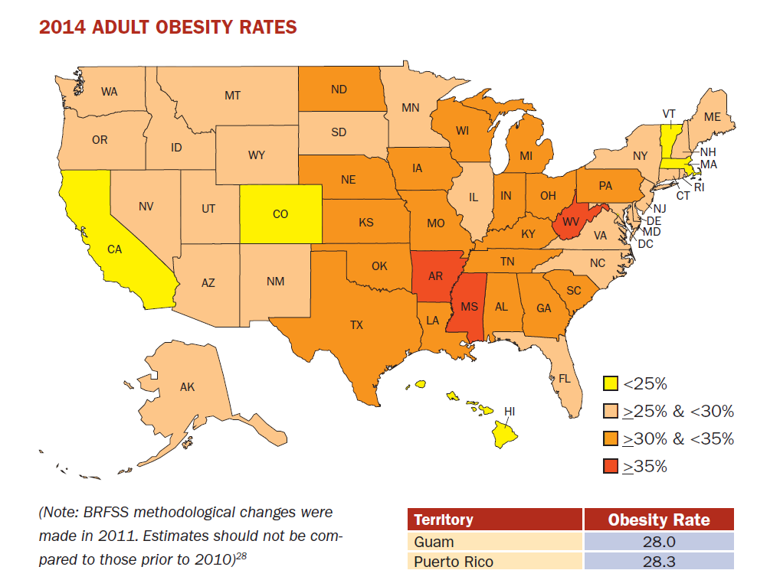
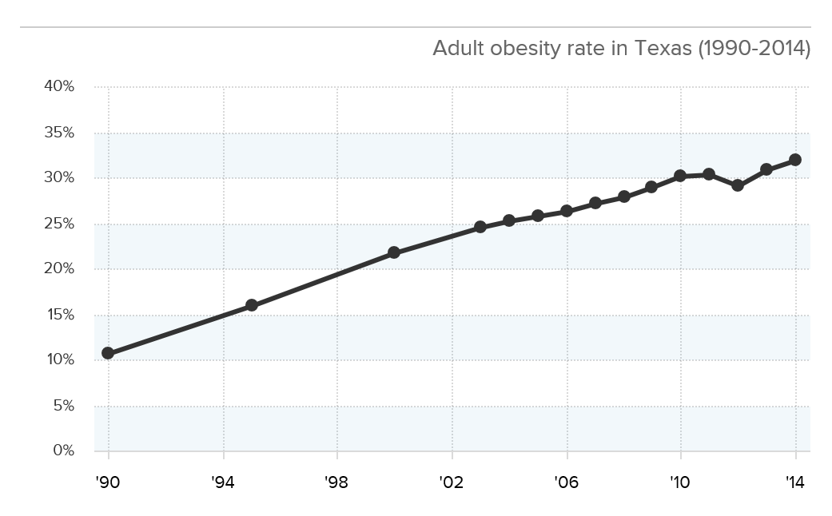
Adult Obesity
Source: http://stateofobesity.org/files/stateofobesity2015.pdf

Slide 50

Contact
  State Demographer
  Office: (210) 458-6530
  Email: Lloyd.Potter@utsa.edu
  Internet: demographics.texas.gov
Lloyd Potter, Ph.D.
@TexasDemography
Notes:
The Texas Demgraphic Data Center are committed to supporting your work through providing you with the best, most accurate, and objective information we can identify about our greatest asset, the people of Texas.

