Slide 1
Economic Development and Demographic Characteristics and Trends in Texas
Texas Economic Development Council
February 22, 2018
San Antonio, Texas

Slide 2
Growing States, 2010-2017
 | 2010 Census Population | 2017 Population | Numeric Change 2010-2017 | Percent Change 2010-2017
United States | 308,745,538 | 325,719,178 | 16,973,640 | 5.5%
Texas | 25,145,561 | 28,304,596 | 3,159,035 | 12.6%
California | 37,253,956 | 39,536,653 | 2,282,697 | 6.1%
Florida | 18,801,310 | 20,984,400 | 2,183,090 | 11.6%
Georgia | 9,687,653 | 10,429,379 | 741,726 | 7.7%
North Carolina | 9,535,483 | 10,273,419 | 737,936 | 7.7%
Washington | 6,724,540 | 7,405,743 | 681,203 | 10.1%
Arizona | 6,392,017 | 7,016,270 | 624,253 | 9.8%
Colorado | 5,029,196 | 5,607,154 | 577,958 | 11.5%
Source: U.S. Census Bureau. 2000 and 2010 Census Count, 2017 Population Estimates.
Notes:
Texas is the second largest state in term s of population (2nd to CA) and area (2nd to AK). In terms of number of people, Texas’ growth exceeds that of all other states between 2010 and 2017. The pace of (percent) change of Texas exceeds that of other large states.

Slide 3

Total Estimated Population by County, Texas, 2016
86%
Source: U.S. Census Bureau, 2016 Vintage Population Estimates
Notes:
When we look at the geographic distribution of the population of Texas over time we see continually increasing population in the counties along the I-35 corridor, the Houston area, and the lower Rio Grand Valley. Urbanized areas out west have grown but most counties west have experienced limited growth and some population decline. Approximately 86% of the population is along I-35 and east. This area with the 3 major metropolitan areas at the points is often described as the Texas population triangle.
The counties of Harris, Dallas, Tarrant, Bexar, and Travis make up the points of the “population triangle” in Texas and are the most populated in the State. Collin, Denton, Fort Bend, Hidalgo, and El Paso counties also have significant population concentrations. Many counties west of Interstate 35 are more sparsely populated.

Slide 4
Estimated Population Change, Texas Counties, 2010 to 2016
96 counties lost population over the 6 year period.
Source: U.S. Census Bureau, 2016 Vintage Population Estimates
Notes:
Population change over the decade has been greatest in the urban and suburban population triangle counties. Counties in the lower Rio Grande Valley also had significant growth as did El Paso. Overall, 158 counties gained population while 96 (38%) lost population over the decade.

Slide 5
Estimated Percent Change of the Total Population by County, Texas, 2010 to 2016
Source: U.S. Census Bureau, 2016 Vintage Population Estimates
Notes:
Percent change is an indicator of the speed of population change void of information about the volume of population change. Percent change in the population over the past few years has been greatest in the suburban population triangle counties, notably among counties between San Antonio and Austin. In the early part of the decade, counties in the Eagle Ford Shale area (south east of San Antonio) and the Cline Shale area (Midland and Odessa area), had been growing quickly. This is no longer the case.

Slide 6
Top Counties for Numeric Growth in Texas, 2015-2016
County | U.S. Rank Population Change | Population Change | Percent of Change from Natural Increase | Percent Change from Domestic Migration | Percent Change from International Migration
Harris | 2 | 56,587 | 79.9% | -27.9% | 48.1%
Tarrant | 5 | 35,462 | 44.4% | 37.7% | 17.9%
Bexar | 7 | 33,198 | 44.6% | 39.3% | 16.1%
Dallas | 9 | 29,209 | 79.9% | -20.9% | 41.0%
Denton | 11 | 27,689 | 23.9% | 67.1% | 9.0%
Fort Bend | 13 | 27,388 | 24.8% | 59.4% | 15.8%
Collin | 14 | 26,506 | 25.8% | 58.7% | 15.5%
Travis | 17 | 24,505 | 44.2% | 33.3% | 22.5%
Williamson | 22 | 20,659 | 20.3% | 74.1% | 5.6%
Montgomery | 24 | 19,769 | 18.5% | 73.5% | 8.0%
Hidalgo* | 54 | 10,529 | 113.5% | -33.4% | 19.9%
Hidalgo County had negative net migration (-13.5% of total population growth).
Source: U.S. Census Bureau, 2016 Vintage Population Estimates

Slide 7
Top Counties for Percent Growth* in Texas, 2015-2016
County | U.S. Rank | 2015-2016 Percent Population Change | Percent Change from Domestic Migration | Percent Change from International Migration
Kendall | 2 | 5.2% | 95.9% | 4.0%
Hays | 3 | 5.1% | 82.2% | 1.8%
Comal | 6 | 4.4% | 88.5% | 2.0%
Williamson | 14 | 4.1% | 74.1% | 5.6%
Fort Bend | 18 | 3.8% | 59.4% | 15.8%
Montgomery | 24 | 3.7% | 73.5% | 8.0%
Rockwall | 25 | 3.6% | 82.2% | 2.5%
Denton | 28 | 3.6% | 67.1% | 9.0%
Kaufman | 36 | 3.4% | 81.3% | 2.2%
Bastrop | 42 | 3.1% | 83.5% | 0.7%
Ellis | 50 | 3.1% | 78.1% | 2.6%
*Among Counties with 10,000 or more population in 2016
Source: U.S. Census Bureau, 2016 Vintage Population Estimates

Slide 8
Estimates of percent components of population change, Texas, 2015-2017
Source: U.S. Census Bureau, 2017 Vintage population estimates
Notes:
Natural increase has been in the range of half of population change since the last Census in Texas. Thus Texas is growing quickly and substantially from having more births than deaths over time. In recent years the number and percent of new Texas from other states has decline and the number and percent of international migrants has increased.

Slide 9
Population change, Texas, Florida, and California, 2011-2017
Source: U.S. Census Bureau, 2017 Vintage Population Estimates

Slide 10
Natural increase, Texas, Florida, California, 2011-2017
Source: U.S. Census Bureau, 2017 Vintage Population Estimates

Slide 11
International net-migration, Texas, Florida, California, 2011-2017
Source: U.S. Census Bureau, 2017 Vintage Population Estimates

Slide 12
Domestic net-migration, Texas, Florida, California, 2011-2017
Source: U.S. Census Bureau, 2017 Vintage Population Estimates

Slide 13
Annual Shares of Recent Non-Citizen Immigrants to Texas by World Area of Birth, 2005-2015
Source: U.S. Census Bureau, American Community Survey, 1-Year PUMS

Slide 14
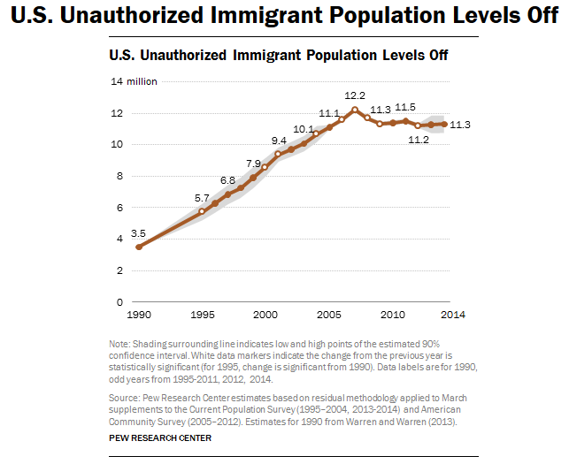

Slide 15
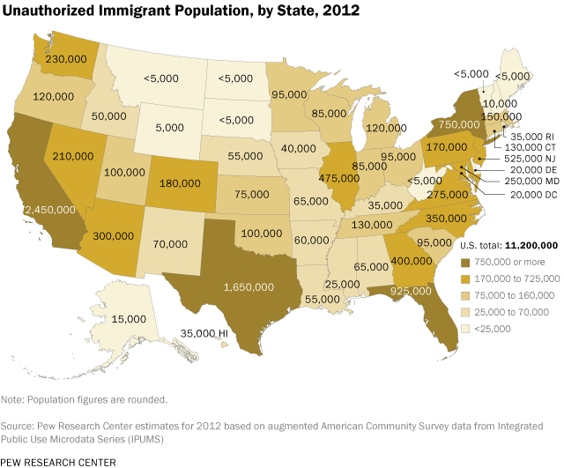
~5.8% of Texas’ population

Slide 16
Texas White (non-Hispanic) and Hispanic Populations by Age, 2014
Source: U.S. Census Bureau 2010 Decennial Census, SF1
Notes:
The age distribution of the non-Hispanic white population in Texas is weighted heavily with the “baby boom” generation. Largely the result of lower fertility and less net in-migration, the non-Hispanic white population has relatively fewer young persons relative to those in the middle-age years. In 2010, at ages 37 and younger, the Hispanic population exceeds the non-Hispanic white population.

Slide 17
Texas Population Pyramid by Race/Ethnicity, 2014
Source: Texas Demographic Center, 2014 Population Estimates
Notes:
This population pyramid represents the age, sex, race and ethnic composition of the Texas population. Blue represents males, red females, rows are single years of age, and shades represent specified race/ethnic groups as indicated in the legend.

Slide 18
Texas Population Pyramid by Race/Ethnicity, 2014
Source: Texas Demographic Center, 2014 Population Estimates
Notes:
This population pyramid represents the age, sex, race and ethnic composition of the Texas population. Blue represents males, red females, rows are single years of age, and shades represent specified race/ethnic groups as indicated in the legend.

Slide 19
Texas Population Pyramid by Race/Ethnicity, 2014
Source: Texas Demographic Center, 2014 Population Estimates
Notes:
This population pyramid represents the age, sex, race and ethnic composition of the Texas population. Blue represents males, red females, rows are single years of age, and shades represent specified race/ethnic groups as indicated in the legend.

Slide 20
Texas Population Pyramid by Race/Ethnicity, 2014
Source: Texas Demographic Center, 2014 Population Estimates
Notes:
This population pyramid represents the age, sex, race and ethnic composition of the Texas population. Blue represents males, red females, rows are single years of age, and shades represent specified race/ethnic groups as indicated in the legend.

Slide 21
Texas Population Pyramid by Race/Ethnicity, 2014
Source: Texas Demographic Center, 2014 Population Estimates
Notes:
This population pyramid represents the age, sex, race and ethnic composition of the Texas population. Blue represents males, red females, rows are single years of age, and shades represent specified race/ethnic groups as indicated in the legend.

Slide 22
Texas Population Pyramid by Race/Ethnicity, 2014
Source: Texas Demographic Center, 2014 Population Estimates
Notes:
This population pyramid represents the age, sex, race and ethnic composition of the Texas population. Blue represents males, red females, rows are single years of age, and shades represent specified race/ethnic groups as indicated in the legend.

Slide 23
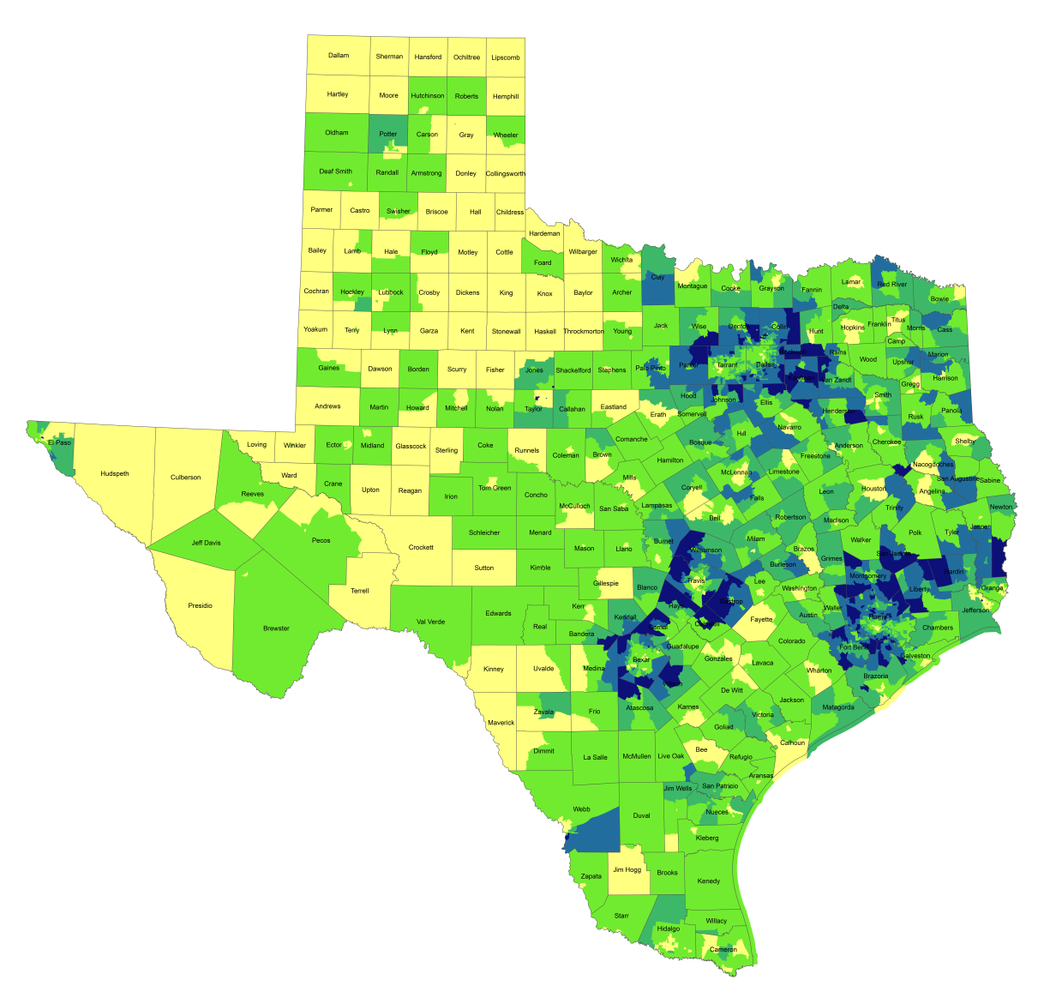
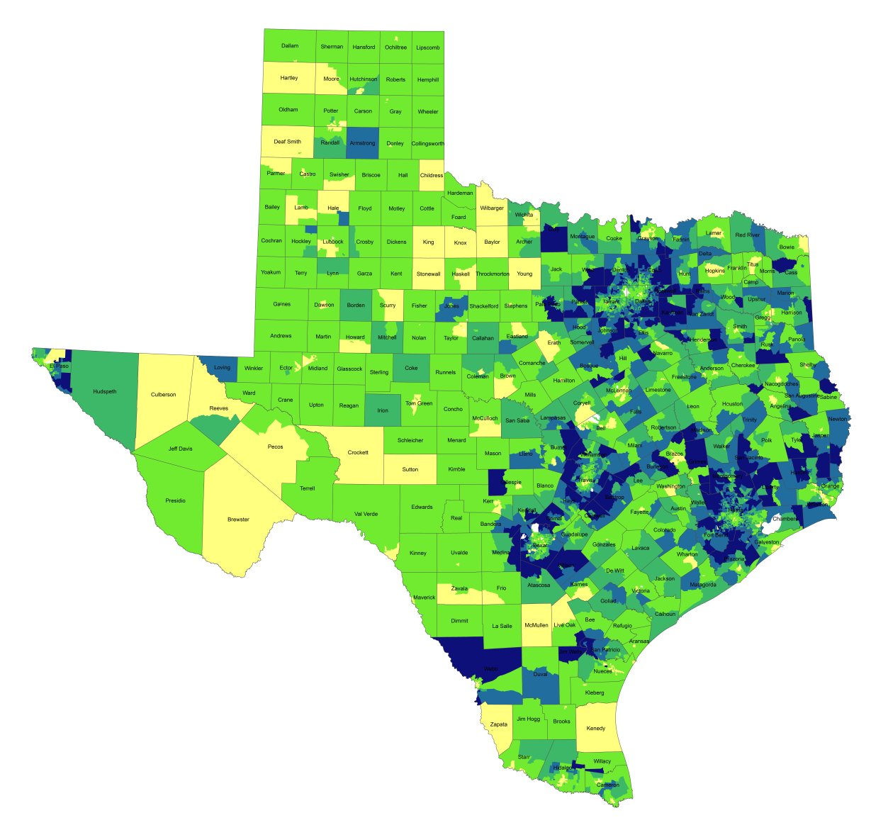
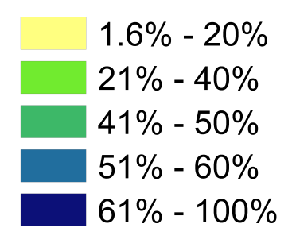
Percentage of Population with Drive Times Longer than 25 Minutes, Texas Census Tracts, 1990 and 2010*
1990
2010*
Source: U.S. Census Bureau, 1990 decennial census and *American Community Survey, 2008-2012 5 Year Sample.
Notes:
One indicator of quality of life is how much time spent commuting to and from work. Commuting takes away time from family and leisure activities and may have an impact on work productivity as well. When we look at the percent of workers who commute longer than 25 minutes by census tract, you can see how increasing population and resulting density, perhaps combined with lagging infrastructure has resulted in increasing commuting times for suburban residents in the more densely populated parts of the state. Commuting time is a factor that some potential business will examine when considering moving operations to a place and one that most can agree is something we want to be as small as possible within reason.

Slide 24
Mean Commute Time (minutes) of workers, Census Tracts, Metroplex Area, Texas, 2009-2013
Source: U.S. Census Bureau, American Community Survey, 5 Year Sample 2009-2013.

Slide 25
Density by Census Tract, Metroplex Area, 1970-2010
1970
1980
1990
2000
2010
Persons per Square Mile
0 – 10
11 – 50
51 – 500
501 – 4,000
4,001 – 56,000
Source: U.S. Census Bureau, decennial censuses. Geolytics, Neighborhood Change Database Tract Data from 1970-2010
Notes:
As more and more people move into our counties and communities, there are more and more persons per square mile. The sequence of images here show how from 1970 to 2010 the urban areas of San Antonio and Austin have become very dense in terms of population and how the are in-between these two cities has become more and more dense. This increasing density is happening in other urban areas of the State and the stress put on the transportation infrastructure from this increasing density creates challenges for our commuting residents and for businesses who are providing services and moving goods.

Slide 26
Percent of Housing Units Built Before 1960, Census Tracts, Metroplex Area, Texas, 2009-2013
Source: U.S. Census Bureau, American Community Survey, 2009-2013 5-Year Sample

Slide 27
Percent of Housing Units Built Between 1960 and 1999, Census Tracts, Metroplex Area, Texas, 2009-2013
Source: U.S. Census Bureau, American Community Survey, 2009-2013 5-Year Sample

Slide 28
Percent of Housing Units Built After 1999, Census Tracts, Metroplex Area, Texas, 2009-2013
Source: U.S. Census Bureau, American Community Survey, 2009-2013 5-Year Sample

Slide 29
Projected Population Growth in Texas,
2010-2050
Source: Texas State Data Center 2016 Population Projections

Slide 30
Projected Population Growth in Texas,
2010-2020
Source: Texas State Data Center 2016 Population Projections

Slide 31
Projected Racial and Ethnic Percent, Texas, 2010-2050
Source: Texas State Data Center 2012 Population Projections , 2000-2010 Migration Scenario
Notes:
The projected population of Texas by race/ethnicity suggests that the Hispanic population will be a major driver in the population growth of the state. The non-Hispanic white population will grow very slowly and then start to decline as the Baby-Boom generation ages into high mortality years. The non-Hispanic other group is largely composed of persons of Asian descent and this group is projected to exceed the non-Hispanic black population by 2038. This graph assumes migration patterns observed between 2000 and 2010.

Slide 32
Percent distribution of employed persons by industry, Texas, 2005 and 2017
Source: Texas Workforce Commission, Tracer, Employment Estimates. http://www.tracer2.com/cgi/dataanalysis/AreaSelection.asp?tableName=Ces

Slide 33
Percent of Civilian Labor Force by Occupation, Texas, 2008, 2014 and 2014-2008 Difference
Source: U.S. Census Bureau, American Community Survey, 1-Year Sample, 2008, 2010, 2014`

Slide 34
Educational Attainment, Persons Aged 25 Years and Older, Texas, 2011 and 2015
 | 2011 | 2015
Percent high school graduate or higher | 81.1% | 82.4% | *
Percent bachelor's degree or higher | 26.4% | 28.4% | *
U.S. Census Bureau American Community Survey, 1-Year Samples, 2011 and 2015
* Years significantly different p<.05

Slide 35
Percent Distribution of Educational Attainment of Persons Aged 25 Years and Older, Texas, 2008, 2011, and 2015
Source: U.S. Census Bureau, American Community Survey, 1-Year Samples, 2008-2015

Slide 36
Educational Attainment of Persons Age 25 Years and Older by Race/Ethnicity, Texas, 2015
Source: U.S. Census Bureau, American Community Survey, 1-Year Sample, 2015

Slide 37
Trends in Educational Attainment of Persons in the Labor Force (25-64 Years of Age) in Texas by Race/Ethnicity – High School Graduates and Above
Source: U.S. Census Bureau, American Community Survey, Public Use Micro Sample, 2001-2011
Notes:
Educational attainment by race/ethnicity in Texas suggests that adults of Hispanic descent are much less likely to have completed high school compared to other race/ethnic groups. Over time, the percent of persons of Hispanic descent who have completed high school has been increasing more rapidly than for other groups but even at this pace of change it will take numerous decades for Hispanics to achieve parity with non-Hispanics in the percent with a high school degree or greater.

Slide 38
Percent of the Civilian Labor Force (ages 25-64) by Educational Attainment for 2011, 2030 Using Constant Rates, Texas
These should be going DOWN
These should be going UP
Sources: U.S. Census Bureau, American Community Survey, 1-Year PUMS.
Texas State Data Center, 2012 Vintage Population Projections, 0.5 Migration Scenario
Notes:
The first assumption (represented by the red columns) is that educational attainment by race/ethnicity and sex would remain the same as it was in 2011. Thus the changes we see in educational attainment in this projection are due only to changes in the racial/ethnic composition of the population (driven by increasing Hispanic population and a leveling of growth among the non-Hispanic white population). Under this scenario, we would see increases of the percent of the labor force with lower levels of education and declines in the percent of the labor force with higher levels.

Slide 39
Percent of the Civilian Labor Force (ages 25-64) by Educational Attainment for 2011, and 2030 Using Trended Rates, Texas
These should be going DOWN
These should be going UP
Sources: U.S. Census Bureau, American Community Survey, 1-Year PUMS.
Texas State Data Center, 2012 Vintage Population Projections, 0.5 Migration Scenario
Notes:
Under the second assumption (green columns) the trends observed in improving educational attainment are projected forward and applied to the projected population by race/ethnicity and sex. Thus the generally positive trends we have noted in improving educational attainment are assumed to continue into the future. The result of this projection suggests that we will see declines in the percent of the labor force with lower levels of education and increases in the percent of the labor force with higher levels of education.

Slide 40
Teen (ages 15-19 years) birth rates, the U.S. and select states, 2015
Area | Rank | Birth Rate Per 1,000 Women
United States |  | 23.3
Arkansas | 1 | 38.0
Mississippi | 2 | 34.8
Oklahoma | 3 | 34.8
New Mexico | 4 | 34.6
Texas | 5 | 34.6
Louisiana | 6 | 34.1
Kentucky | 7 | 32.4
West Virginia | 8 | 31.9
Tennessee | 9 | 30.5
Alabama | 10 | 30.1
Alaska | 11 | 29.3
Wyoming | 12 | 29.2
Nevada | 13 | 27.6
South Dakota | 14 | 26.4
Arizona | 15 | 26.3
Source: National Center for Health Statistics at the Centers for Disease Control and Prevention

Slide 41
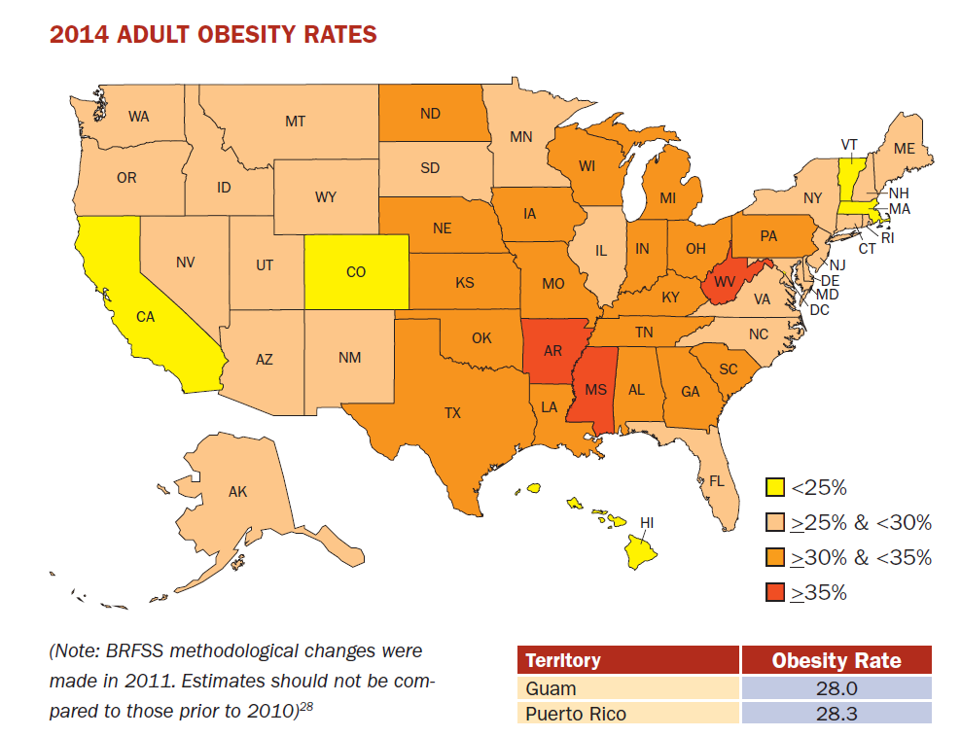
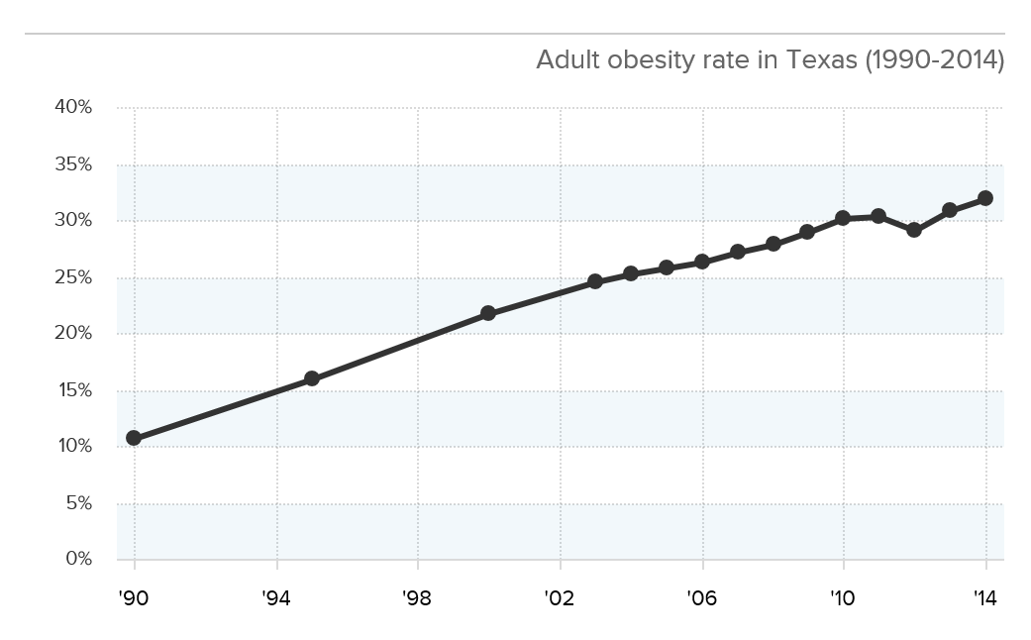
Adult Obesity
Source: http://stateofobesity.org/files/stateofobesity2015.pdf

Slide 42
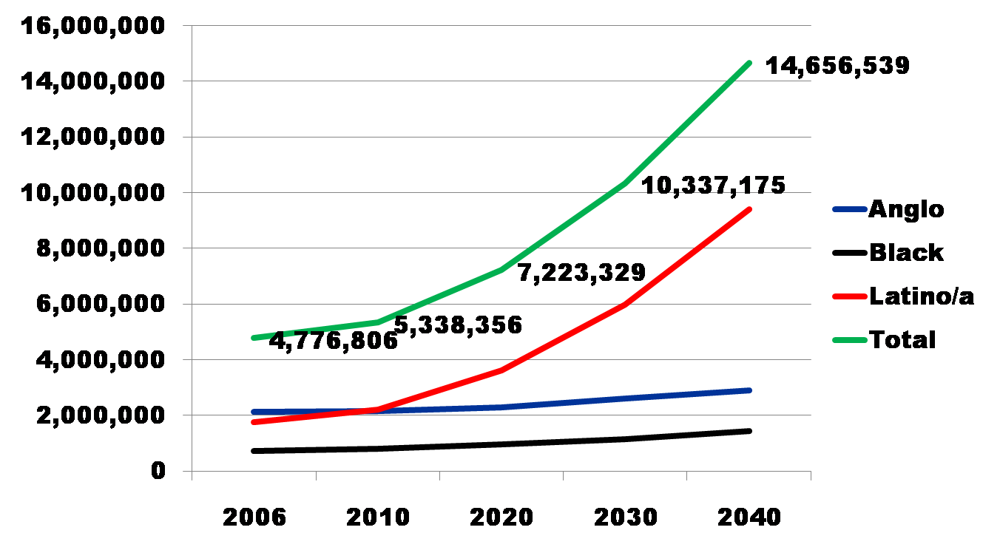
Projected Increase in Obesity in Texas by Ethnicity, 2006 to 2040
Source: Office of the State Demographer projections, using 2000-2004 migration scenario population projections

Slide 43

Contact
  State Demographer
  Office: (210) 458-6530
  Email: Lloyd.Potter@utsa.edu
  Internet: demographics.texas.gov
Lloyd Potter, Ph.D.
@TexasDemography
Notes:
The Texas Demgraphic Data Center are committed to supporting your work through providing you with the best, most accurate, and objective information we can identify about our greatest asset, the people of Texas.

