Slide 1
Future Demographics of Texas
Urban Leadership Agriculture Academy
Robstown, Texas
April 19, 2018

Slide 2

Total Estimated Population by County, Texas, 2017
87%
Source: U.S. Census Bureau, 2017 Vintage Population Estimates

Slide 3
Estimated Population Change, Texas Counties, 2010 to 2017
Source: U.S. Census Bureau, 2017 Vintage Population Estimates

Slide 4
Estimated Percent Change of the Total Population by County, Texas, 2016 to 2017
Source: U.S. Census Bureau, 2017 Vintage Population Estimates

Slide 5
Estimated Percent Change of the Total Population by County, Texas, 2010 to 2017
Source: U.S. Census Bureau, 2017 Vintage Population Estimates

Slide 6
Estimated Numeric Change from Domestic Migration by County, Texas, 2010 to 2017
Source: U.S. Census Bureau, 2017 Vintage Population Estimates

Slide 7
Top Counties for Numeric Growth in Texas, 2016-2017
County | U.S. Rank Population Change | Population Change | Percent of Change from Natural Increase | Percent Change from Domestic Migration | Percent Change from International Migration
Harris* | 4 | 35,939 | 97.2% | -126.0% | 97.2%
Tarrant | 5 | 32,729 | 23.1% | 29.0% | 23.1%
Bexar | 7 | 30,831 | 18.8% | 33.4% | 18.8%
Dallas | 8 | 30,686 | 47.6% | -25.5% | 47.6%
Denton | 9 | 27,911 | 9.7% | 67.0% | 9.7%
Collin | 10 | 27,150 | 19.0% | 56.5% | 19.0%
Fort Bend | 14 | 22,870 | 22.6% | 48.1% | 22.6%
Travis | 15 | 22,116 | 30.0% | 22.1% | 30.0%
Williamson | 19 | 19,776 | 6.3% | 73.5% | 6.3%
Montgomery | 28 | 16,412 | 8.8% | 68.5% | 8.8%
Hidalgo* | 49 | 10,474 | 28.5% | -34.5% | 28.5%
* Hidalgo and Harris Counties had negative net migration (Harris -10,322 and Hidalgo -621).
Source: U.S. Census Bureau, 2017 Vintage Population Estimates

Slide 8
Top Counties for Percent Growth* in Texas, 2016-2017
County | U.S. Rank | 2015-2016 Percent Population Change | Percent Change from Domestic Migration | Percent Change from International Migration
Comal | 2 | 5.1% | 90.7% | 1.9%
Hays | 4 | 5.0% | 81.6% | 2.8%
Kendall | 5 | 4.9% | 96.3% | 3.3%
Kaufman | 11 | 4.1% | 83.0% | 2.2%
Rains | 13 | 4.0% | 103.1% | 2.9%
Williamson | 16 | 3.7% | 73.5% | 6.3%
Rockwall | 22 | 3.6% | 81.8% | 2.4%
Parker | 26 | 3.6% | 89.7% | 1.3%
Denton | 32 | 3.5% | 67.0% | 9.7%
Guadalupe | 36 | 3.3% | 81.4% | 2.7%
Ellis | 44 | 3.1% | 78.2% | 3.0%
Llano | 45 | 3.1% | 119.8% | 0.5%
Fort Bend | 48 | 3.1% | 48.1% | 22.6%
*Among Counties with 10,000 or more population in 2017
Source: U.S. Census Bureau, 2017 Vintage Population Estimates

Slide 9
Population Change and Components of Change, Nueces County, Texas, 2010-2017 and 2016-2017
Total Population Change | Natural Increase | Vital Events |  | Net Migration
April 1, 2010 to July 1, 2017 |  | Births | Deaths | Total | International | Domestic
20,998 | 15,144 | 35,414 | 20,270 | 5,937 | 4,769 | 1,168
July 1, 2016 to July 1, 2017
-308 | 1,963 | 4,887 | 2,924 | -2,277 | 716 | -2,993
Source: U.S. Census Bureau, 2017 Vintage Population Estimates

Slide 10
Population change for places in Texas, 2015-2016
Source: U.S. Census Bureau, 2016 Vintage Population Estimates

Slide 11
Texas Racial and Ethnic Composition,
2000, 2010, and 2016
11
Source: U.S. Census Bureau. 2000, 2010 Decennial Census and 2016 Population Estimates

Slide 12
Percent Racial and Ethnic Composition, Texas and Nueces County, 2012-2016
 | Texas | Nueces County
NH White | 42.6% | 29.9%
Hispanic or Latino | 39.1% | 63.4%
Black or African American | 12.6% | 4.4%
Asian | 4.8% | 2.2%
Source: U.S. Census Bureau, American Community Survey, 5-year Sample, 2012-2016

Slide 13
Percent Hispanic, Census Tracts, Nueces County Area, Texas, 2012-2016
Source: U.S. Census Bureau, American Community Survey, 2012-2016 5-Year Sample

Slide 14
Texas White (non-Hispanic) and Hispanic Populations by Age, 2014
Source: U.S. Census Bureau 2010 Decennial Census, SF1
Notes:
The age distribution of the non-Hispanic white population in Texas is weighted heavily with the “baby boom” generation. Largely the result of lower fertility and less net in-migration, the non-Hispanic white population has relatively fewer young persons relative to those in the middle-age years. In 2010, at ages 37 and younger, the Hispanic population exceeds the non-Hispanic white population.

Slide 15
Texas Population Pyramid by Race/Ethnicity, 2014
Source: Texas Demographic Center, 2014 Population Estimates
Notes:
This population pyramid represents the age, sex, race and ethnic composition of the Texas population. Blue represents males, red females, rows are single years of age, and shades represent specified race/ethnic groups as indicated in the legend.

Slide 16
Texas Population Pyramid by Race/Ethnicity, 2014
Source: Texas Demographic Center, 2014 Population Estimates
Notes:
This population pyramid represents the age, sex, race and ethnic composition of the Texas population. Blue represents males, red females, rows are single years of age, and shades represent specified race/ethnic groups as indicated in the legend.

Slide 17
Texas Population Pyramid by Race/Ethnicity, 2014
Source: Texas Demographic Center, 2014 Population Estimates
Notes:
This population pyramid represents the age, sex, race and ethnic composition of the Texas population. Blue represents males, red females, rows are single years of age, and shades represent specified race/ethnic groups as indicated in the legend.

Slide 18
Housing characteristics, Texas and Nueces County, 2012-2016
 | Texas | Nueces County
Owner-occupied housing unit rate, 2012-2016 | 61.90% | 57.40%
Median value of owner-occupied housing units, 2012-2016 | $142,700 | $116,600
Median gross rent, 2012-2016 | $911 | $912
Living in same house 1 year ago | 83.50% | 80.70%
Source: U.S. Census Bureau, American Community Survey, 5-year Sample, 2012-2016

Slide 19
Percent of Housing Units Built Before 1960, Census Tracts, Nueces County area, Texas, 2012-2016
Source: U.S. Census Bureau, American Community Survey, 2012-2016 5-Year Sample

Slide 20
Percent of Housing Units Built Between 1959 and 1970, Census Tracts, Nueces County area, Texas, 2012-2016
Source: U.S. Census Bureau, American Community Survey, 2012-2016 5-Year Sample

Slide 21
Percent of Housing Units Built Between 1979 and 2000, Nueces County area, Texas, 2012-2016
Source: U.S. Census Bureau, American Community Survey, 2012-2016 5-Year Sample

Slide 22
Percent of Housing Units Built After 1999, Census Tracts, Nueces County area, Texas, 2012-2016
Source: U.S. Census Bureau, American Community Survey, 2012-2016 5-Year Sample

Slide 23
Percent of owner occupied housing units valued at $500k and more, Census Tracts, Nueces County area, Texas, 2012-2016
Source: U.S. Census Bureau, American Community Survey, 2012-2016 5-Year Sample

Slide 24
Mean commute time (minutes), Census Tracts, Nueces County area, 2012-2016
Source: U.S. Census Bureau, American Community Survey, 2012-2016 5-Year Sample

Slide 25
Percent educational attainment for persons 25 years and older, Texas and Nueces County, 2012-2016
 | Texas | Nueces County
High school graduate or higher | 82.3% | 81.3%
Bachelor's degree or higher | 28.1% | 20.5%
Source: U.S. Census Bureau, American Community Survey, 2012-2016 5-Year Sample

Slide 26
Percent of the population (25 and older) with less than high school degree, Census Tracts, Nueces County Area, Texas, 2012-2016
Source: U.S. Census Bureau, American Community Survey, 2012-2016 5-Year Sample

Slide 27
Percent distribution of the labor force by industry, Texas and Nueces County, 2012-2016
 | Texas | Nueces County, Texas
 | Percent | Percent
INDUSTRY
Agriculture, forestry, fishing and hunting, and mining | 3.30% | 3.60%
Construction | 8.00% | 8.50%
Manufacturing | 8.90% | 6.40%
Wholesale trade | 3.00% | 2.40%
Retail trade | 11.50% | 11.70%
Transportation and warehousing, and utilities | 5.50% | 4.80%
Information | 1.80% | 1.60%
Finance and insurance, and real estate and rental and leasing | 6.60% | 5.30%
Professional, scientific, and management, and administrative and waste management services | 11.20% | 8.60%
Educational services, and health care and social assistance | 21.60% | 23.60%
Arts, entertainment, and recreation, and accommodation and food services | 9.00% | 11.60%
Other services, except public administration | 5.30% | 5.50%
Public administration | 4.20% | 6.40%
Source: U.S. Census Bureau, American Community Survey, 2012-2016 5-Year Sample

Slide 28
Percent of labor force working in management, business, science, and arts occupations, Census Tracts, Nueces County area, Texas, 2012-2016
Source: U.S. Census Bureau, American Community Survey, 2012-2016 5-Year Sample

Slide 29
Percent of labor force working in agriculture, forestry, fishing, hunting and mining, Census Tracts, Nueces County area, Texas, 2012-2016
Source: U.S. Census Bureau, American Community Survey, 2012-2016 5-Year Sample

Slide 30
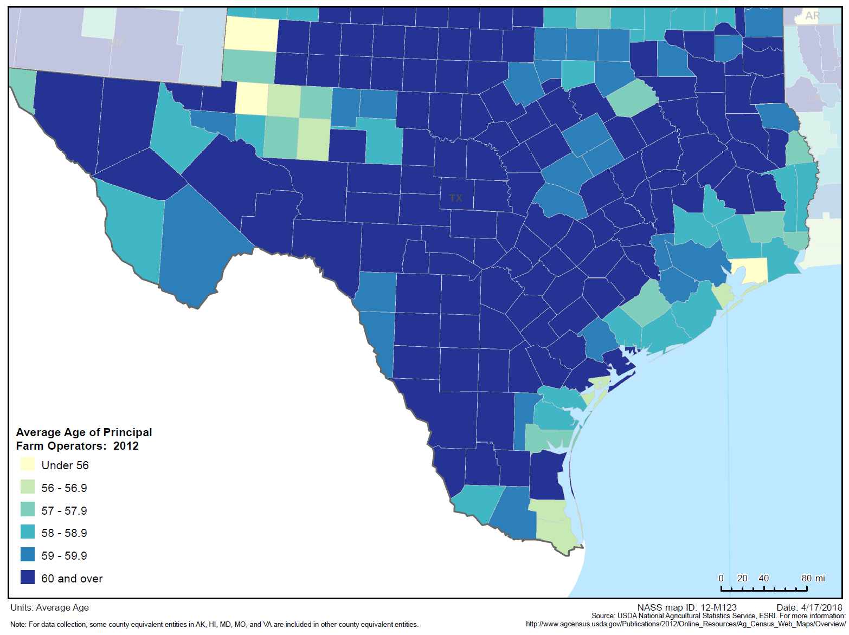
Average age of farm operators, Texas Counties, 2012

Slide 31
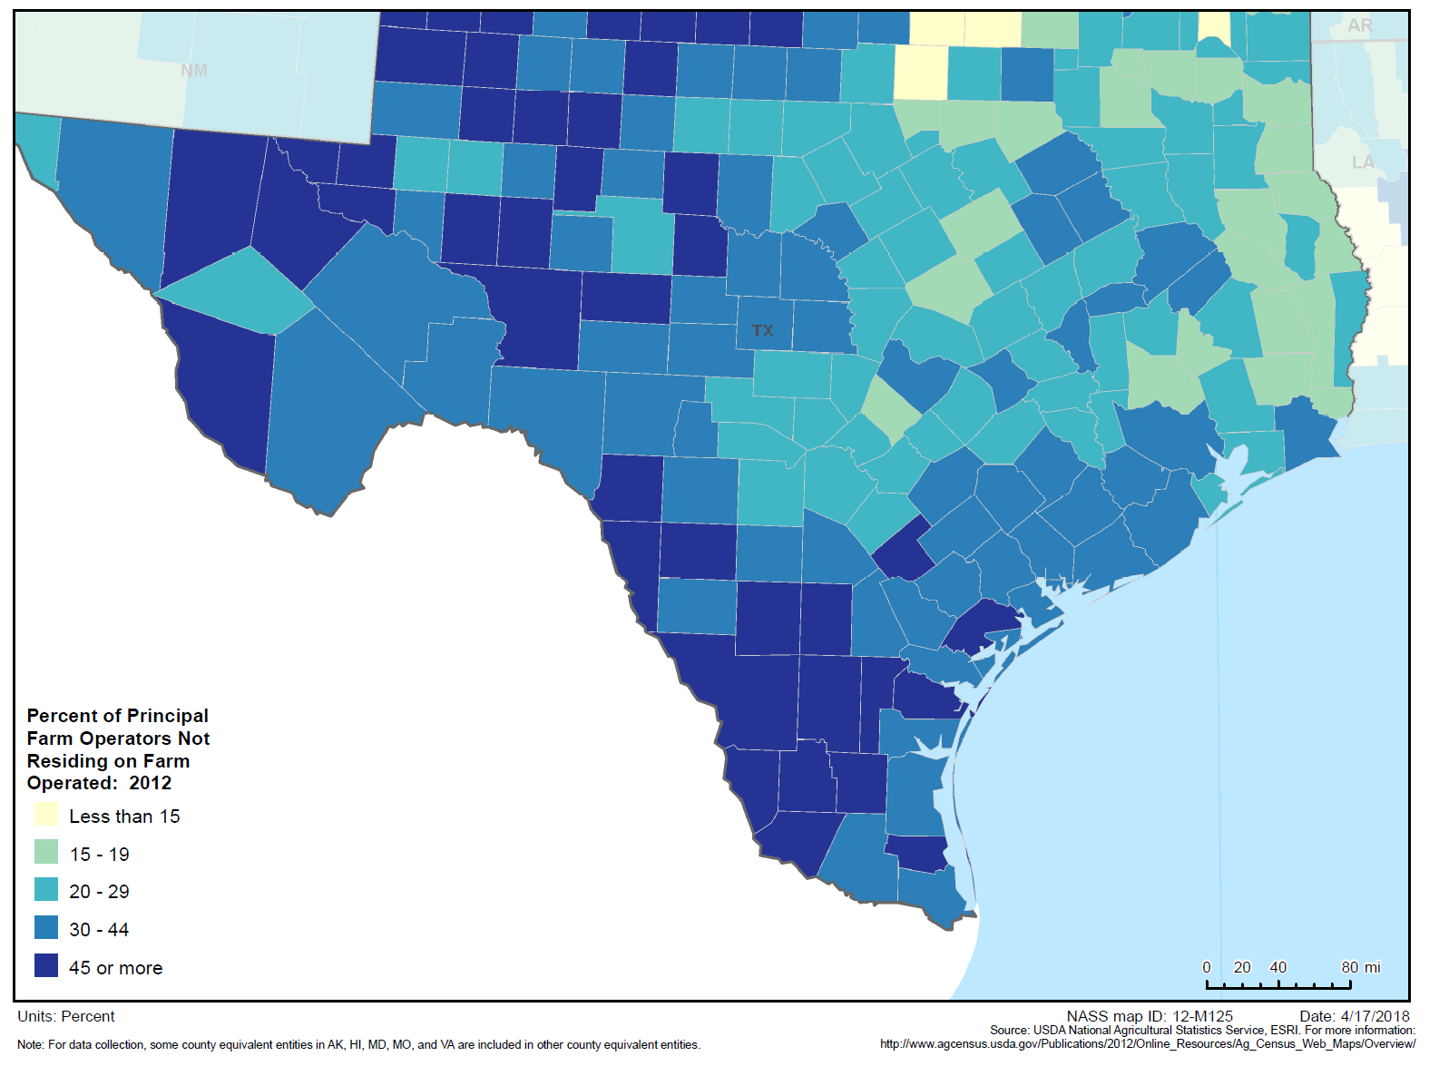
Percent of Principal Operators Not Residing on Farm Operated, Texas Counties, 2012

Slide 32
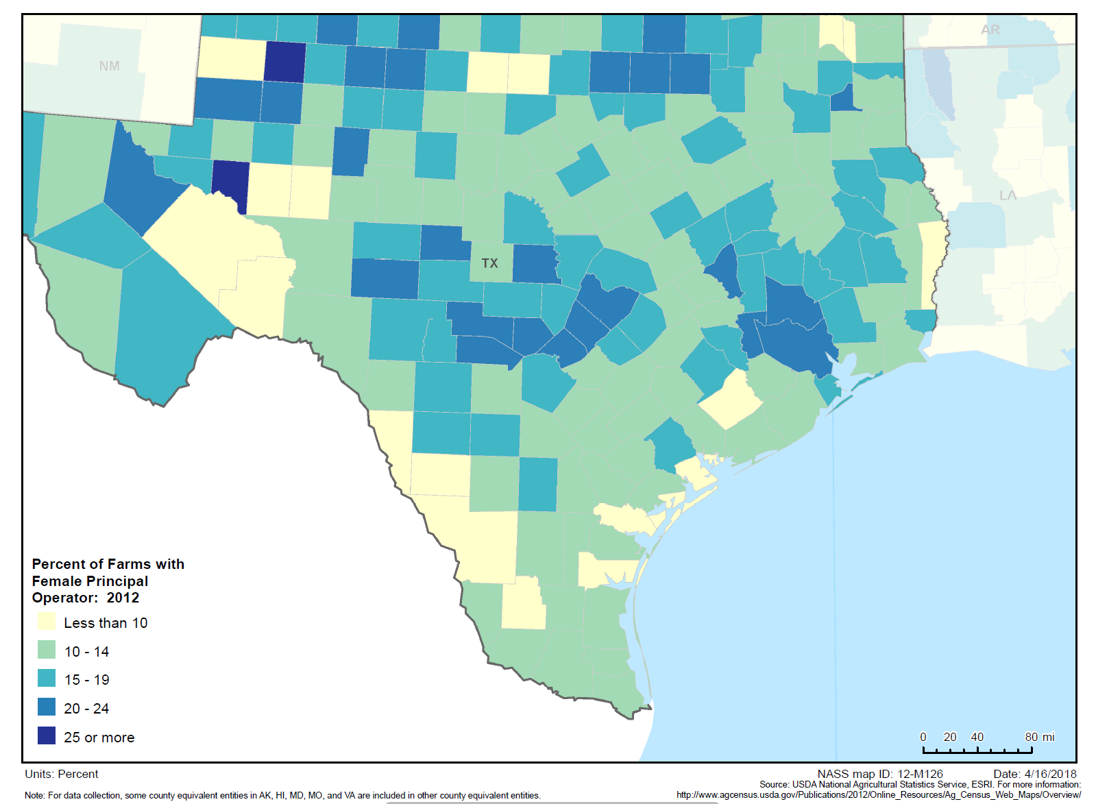
Percent of Farms with Female Principal Operator, 2012

Slide 33
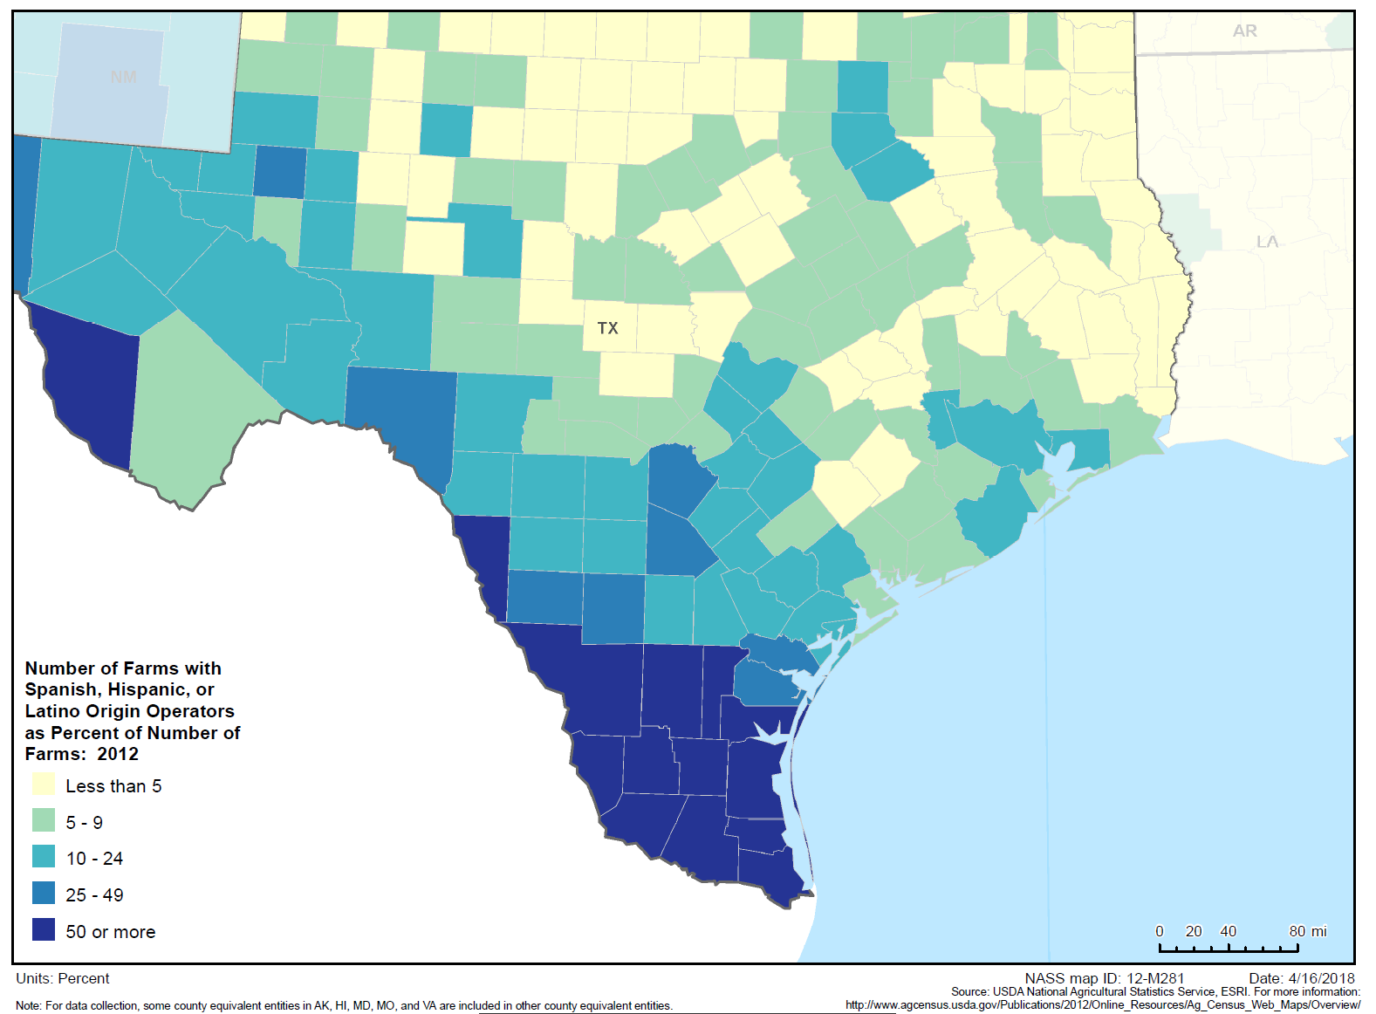
Percent of farms with Hispanic Operators, Texas Counties, 2012

Slide 34
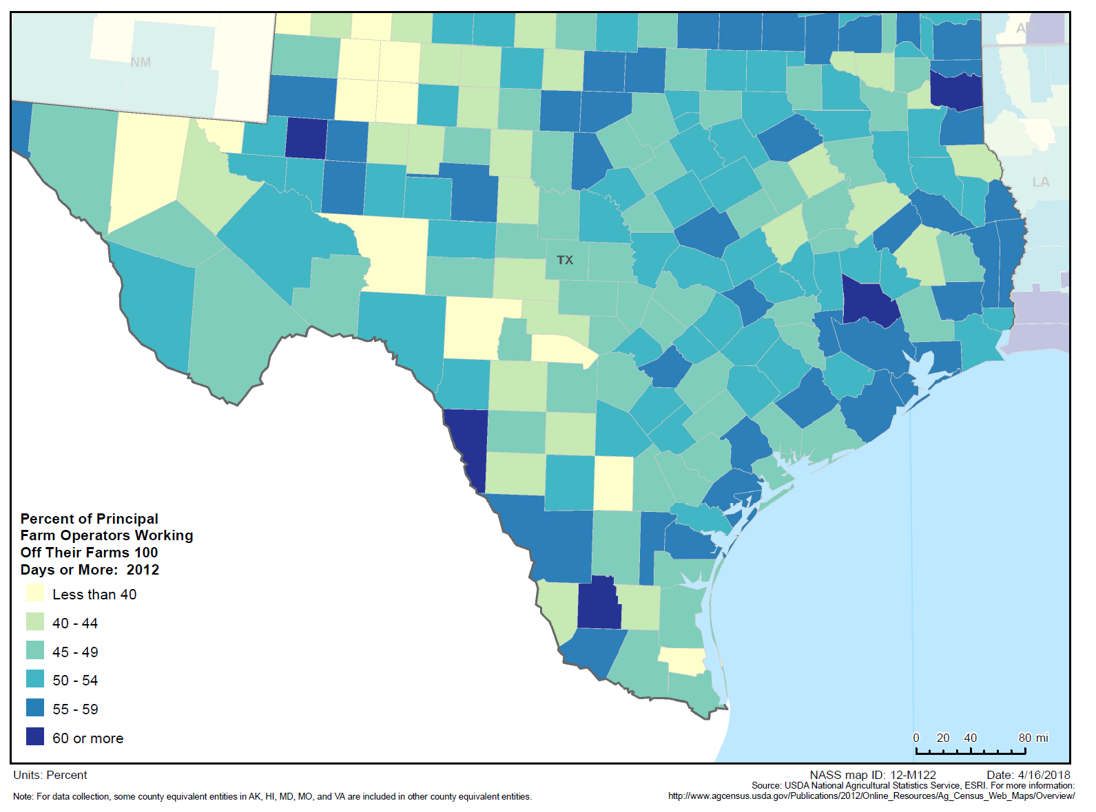

Slide 35
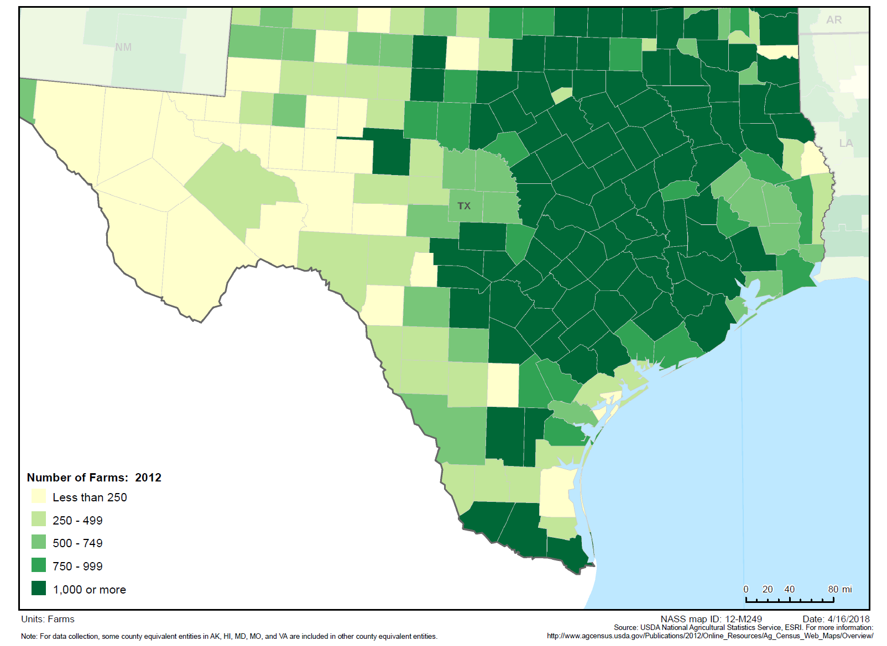

Slide 36
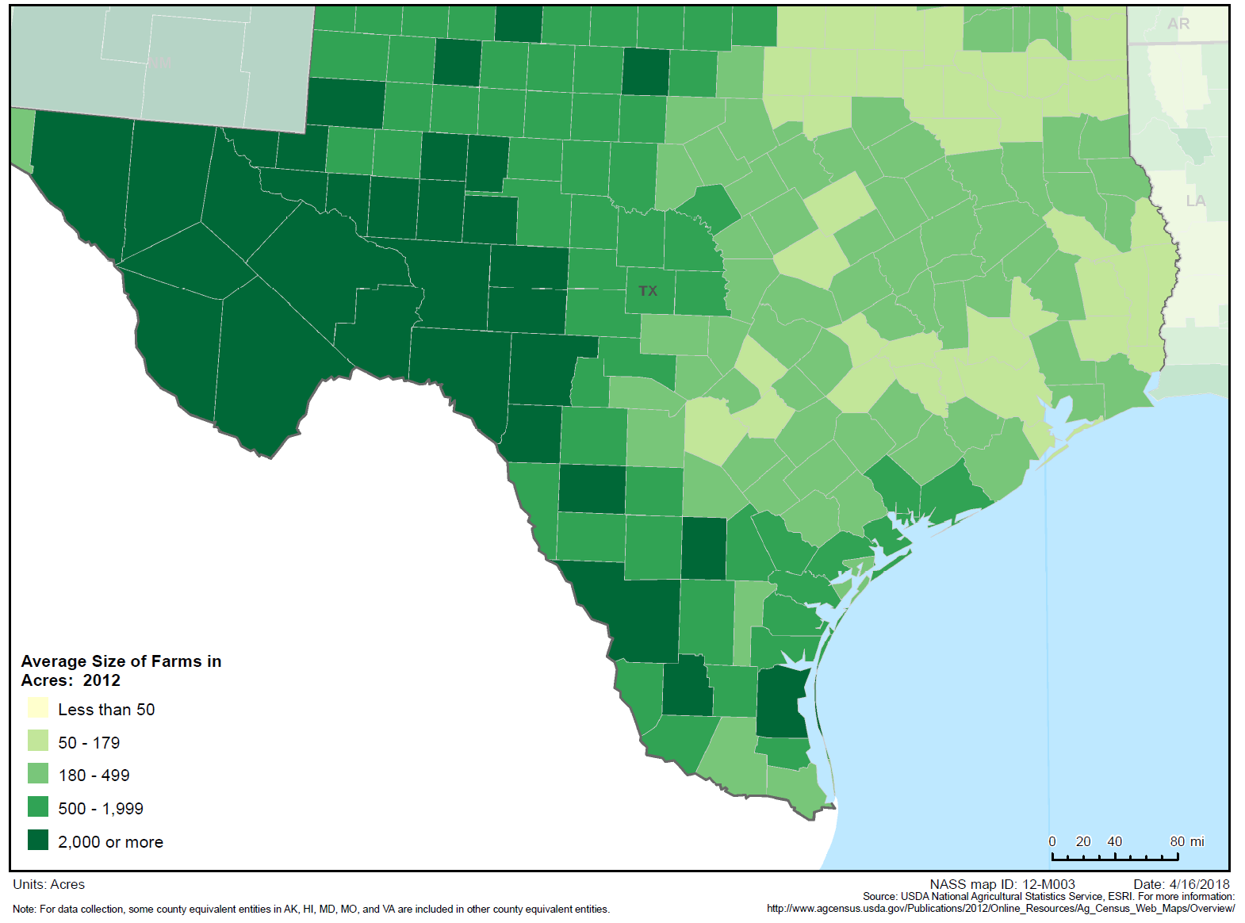

Slide 37
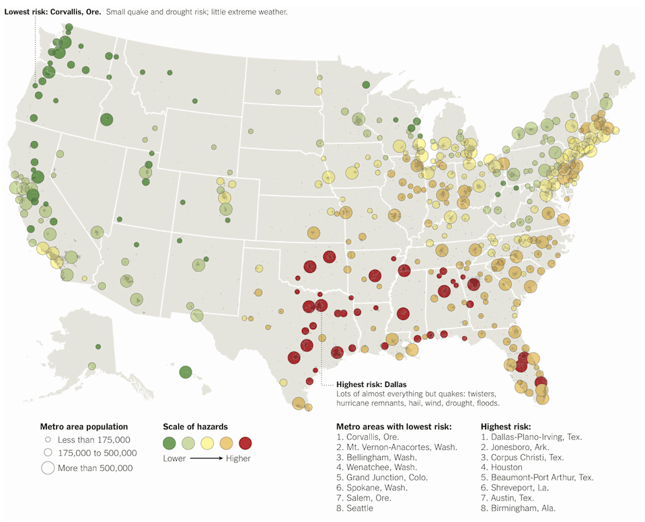
Sources: Sperling’s Best Places

Slide 38
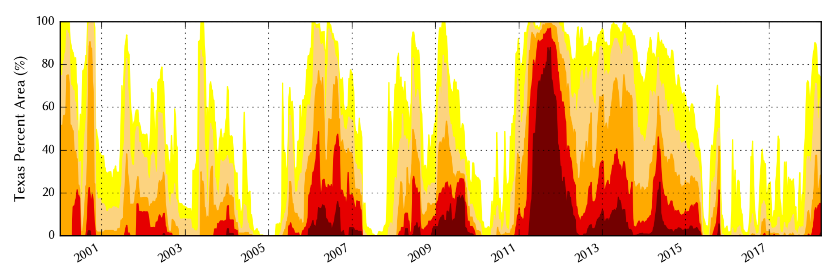
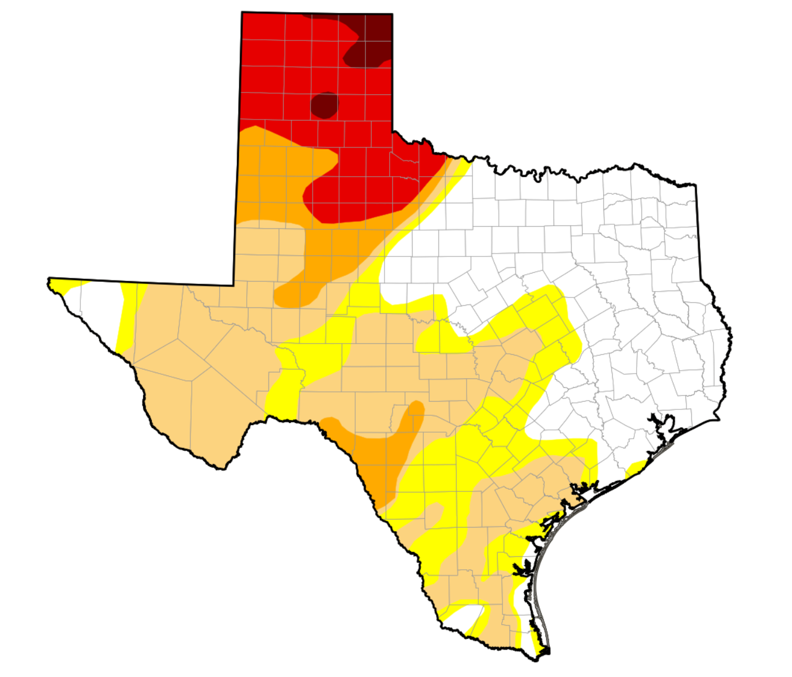
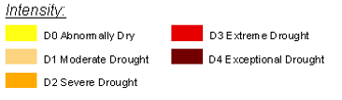
Drought Conditions in Texas
April, 3, 2018
  https://waterdatafortexas.org/drought/drought-monitor

Slide 39
Projected and Estimated Population Growth in Texas, 2010-2050
Source: Texas Demographic Center 2017 Population Projections. U.S. Census Bureau, 2017 Vintage Estimates

Slide 40
Population projections and estimates, Nueces County, Texas, 2010-2050
Source: Texas State Data Center 2014 Population Projections . 2000-2010 Migration Scenario

Slide 41
Population projections and estimates, Nueces County, Texas, 2010-2020
Source: Texas State Data Center 2014 Population Projections . 2000-2010 and .5 of 2000-2010 Migration Scenario

Slide 42
Projected Population Change, Texas Counties, 2010-2050
Source: Texas State Data Center 2014 Population Projections . 2000-2010 Migration Scenario
Notes:
Projected population growth suggests increased numbers and density in the points of Texas’ population triangle, the lower Rio Grande valley with continued growth of El Paso and the urbanized areas in the west of the State. Many rural counties will continue to lose population.

Slide 43
Projected Percent Change in Population 2010-2050
Source: Texas State Data Center 2014 Population Projections, 1.0 Scenario

Slide 44

Contact
  State Demographer
  Office: (210) 458-6530
  Email: Lloyd.Potter@utsa.edu
  Internet: demographics.texas.gov
Lloyd Potter, Ph.D.
@TexasDemography
Notes:
The Texas Demographic Data Center are committed to supporting your work through providing you with the best, most accurate, and objective information we can identify about our greatest asset, the people of Texas.

