Slide 1
Texas Demographic Characteristics and Trends
Texas Association of Regional Councils
Austin, Texas
June 21, 2018

Slide 2
Growing States, 2010-2017
 | 2010 Census Population | 2017 Population | Numeric Change 2010-2017 | Percent Change 2010-2017
United States | 308,745,538 | 325,719,178 | 16,973,640 | 5.5%
Texas | 25,145,561 | 28,304,596 | 3,159,035 | 12.6%
California | 37,253,956 | 39,536,653 | 2,282,697 | 6.1%
Florida | 18,801,310 | 20,984,400 | 2,183,090 | 11.6%
Georgia | 9,687,653 | 10,429,379 | 741,726 | 7.7%
North Carolina | 9,535,483 | 10,273,419 | 737,936 | 7.7%
Washington | 6,724,540 | 7,405,743 | 681,203 | 10.1%
Arizona | 6,392,017 | 7,016,270 | 624,253 | 9.8%
Colorado | 5,029,196 | 5,607,154 | 577,958 | 11.5%
Source: U.S. Census Bureau. 2000 and 2010 Census Count, 2017 Population Estimates.
Notes:
Texas is the second largest state in term s of population (2nd to CA) and area (2nd to AK). In terms of number of people, Texas’ growth exceeds that of all other states between 2010 and 2017. The pace of (percent) change of Texas exceeds that of other large states.

Slide 3
Estimates of percent components of population change, Texas, 2011-2017
Source: U.S. Census Bureau, 2017 Vintage population estimates
Notes:
Natural increase has been in the range of half of population change since the last Census in Texas. Thus Texas is growing quickly and substantially from having more births than deaths over time. In recent years the number and percent of new Texas from other states has decline and the number and percent of international migrants has increased.

Slide 4

Total Estimated Population by County, Texas, 2017
87%
Source: U.S. Census Bureau, 2017 Vintage Population Estimates

Slide 5
Estimated Population Change, Texas Counties, 2010 to 2017
Source: U.S. Census Bureau, 2017 Vintage Population Estimates

Slide 6
Estimated Percent Change of the Total Population by County, Texas, 2016 to 2017
Source: U.S. Census Bureau, 2017 Vintage Population Estimates

Slide 7
Estimated Percent Change of the Total Population by County, Texas, 2010 to 2017
Source: U.S. Census Bureau, 2017 Vintage Population Estimates

Slide 8
Top Counties for Numeric Growth in Texas, 2016-2017
County | U.S. Rank Population Change | Population Change | Percent of Change from Natural Increase | Percent Change from Domestic Migration | Percent Change from International Migration
Harris* | 4 | 35,939 | 128.8% | -126.0% | 97.2%
Tarrant | 5 | 32,729 | 47.9% | 29.0% | 23.1%
Bexar | 7 | 30,831 | 47.8% | 33.4% | 18.8%
Dallas | 8 | 30,686 | 78.0% | -25.5% | 47.6%
Denton | 9 | 27,911 | 23.3% | 67.0% | 9.7%
Collin | 10 | 27,150 | 24.4% | 56.5% | 19.0%
Fort Bend | 14 | 22,870 | 29.4% | 48.1% | 22.6%
Travis | 15 | 22,116 | 47.9% | 22.1% | 30.0%
Williamson | 19 | 19,776 | 20.1% | 73.5% | 6.3%
Montgomery | 28 | 16,412 | 22.7% | 68.5% | 8.8%
Hidalgo* | 49 | 10,474 | 105.9% | -34.5% | 28.5%
* Hidalgo and Harris Counties had negative net migration (Harris -10,322 and Hidalgo -621).
Source: U.S. Census Bureau, 2017 Vintage Population Estimates

Slide 9
Top Counties for Percent Growth* in Texas, 2016-2017
County | U.S. Rank | 2015-2016 Percent Population Change | Percent Change from Domestic Migration | Percent Change from International Migration
Comal | 2 | 5.1% | 90.7% | 1.9%
Hays | 4 | 5.0% | 81.6% | 2.8%
Kendall | 5 | 4.9% | 96.3% | 3.3%
Kaufman | 11 | 4.1% | 83.0% | 2.2%
Rains | 13 | 4.0% | 103.1% | 2.9%
Williamson | 16 | 3.7% | 73.5% | 6.3%
Rockwall | 22 | 3.6% | 81.8% | 2.4%
Parker | 26 | 3.6% | 89.7% | 1.3%
Denton | 32 | 3.5% | 67.0% | 9.7%
Guadalupe | 36 | 3.3% | 81.4% | 2.7%
Ellis | 44 | 3.1% | 78.2% | 3.0%
Llano | 45 | 3.1% | 119.8% | 0.5%
Fort Bend | 48 | 3.1% | 48.1% | 22.6%
*Among Counties with 10,000 or more population in 2017
Source: U.S. Census Bureau, 2017 Vintage Population Estimates

Slide 10
The 15 Cities With the Largest Numeric Increase Between July 1, 2016, and July 1, 2017 (Populations of 50,000 or more in 2016)
Rank | City | State | Numeric increase | 2017 total population
1 | San Antonio | Texas | 24,208 | 1,511,946
2 | Phoenix | Arizona | 24,036 | 1,626,078
3 | Dallas | Texas | 18,935 | 1,341,075
4 | Fort Worth | Texas | 18,664 | 874,168
5 | Los Angeles | California | 18,643 | 3,999,759
6 | Seattle | Washington | 17,490 | 724,745
7 | Charlotte | North Carolina | 15,551 | 859,035
8 | Columbus | Ohio | 15,429 | 879,170
9 | Frisco | Texas | 13,470 | 177,286
10 | Atlanta | Georgia | 13,323 | 486,290
11 | San Diego | California | 12,834 | 1,419,516
12 | Austin | Texas | 12,515 | 950,715
13 | Jacksonville | Florida | 11,169 | 892,062
14 | Irvine | California | 11,068 | 277,453
15 | Henderson | Nevada | 10,534 | 302,539
Source: U.S. Census Bureau, 2017 Vintage Population Estimates

Slide 11
The 15 Most Populous Cities as of July 1, 2017
Rank | City | State | 2017 total population
1 | New York | New York | 8,622,698
2 | Los Angeles | California | 3,999,759
3 | Chicago | Illinois | 2,716,450
4 | Houston | Texas | 2,312,717
5 | Phoenix | Arizona | 1,626,078
6 | Philadelphia | Pennsylvania | 1,580,863
7 | San Antonio | Texas | 1,511,946
8 | San Diego | California | 1,419,516
9 | Dallas | Texas | 1,341,075
10 | San Jose | California | 1,035,317
11 | Austin | Texas | 950,715
12 | Jacksonville | Florida | 892,062
13 | San Francisco | California | 884,363
14 | Columbus | Ohio | 879,170
15 | Fort Worth | Texas | 874,168
Source: U.S. Census Bureau, 2017 Vintage Population Estimates

Slide 12
The 15 Fastest-Growing Large Cities and Towns Between July 1, 2016, and July 1, 2017 (Populations of 50,000 or more in 2016)
Rank | City | State | Percent increase | 2017 total population
1 | Frisco | Texas | 8.2 | 177,286
2 | New Braunfels | Texas | 8.0 | 79,152
3 | Pflugerville | Texas | 6.5 | 63,359
4 | Ankeny | Iowa | 6.4 | 62,416
5 | Buckeye | Arizona | 5.9 | 68,453
6 | Georgetown | Texas | 5.4 | 70,685
7 | Castle Rock town | Colorado | 5.1 | 62,276
8 | Franklin | Tennessee | 4.9 | 78,321
9 | McKinney | Texas | 4.8 | 181,330
10 | Meridian | Idaho | 4.7 | 99,926
11 | Flower Mound town | Texas | 4.3 | 76,681
12 | Bend | Oregon | 4.3 | 94,520
13 | Cedar Park | Texas | 4.2 | 75,704
14 | Doral | Florida | 4.2 | 61,130
15 | Fort Myers | Florida | 4.2 | 79,94
Source: U.S. Census Bureau, 2017 Vintage Population Estimates

Slide 13
Texas Population Pyramid by Race/Ethnicity, 2014
Source: Texas Demographic Center, 2014 Population Estimates
Notes:
This population pyramid represents the age, sex, race and ethnic composition of the Texas population. Blue represents males, red females, rows are single years of age, and shades represent specified race/ethnic groups as indicated in the legend.

Slide 14
Texas Population Pyramid by Race/Ethnicity, 2014
Source: Texas Demographic Center, 2014 Population Estimates
Notes:
This population pyramid represents the age, sex, race and ethnic composition of the Texas population. Blue represents males, red females, rows are single years of age, and shades represent specified race/ethnic groups as indicated in the legend.

Slide 15
Texas Population Pyramid by Race/Ethnicity, 2014
Source: Texas Demographic Center, 2014 Population Estimates
Notes:
This population pyramid represents the age, sex, race and ethnic composition of the Texas population. Blue represents males, red females, rows are single years of age, and shades represent specified race/ethnic groups as indicated in the legend.

Slide 16
Estimated Percent of Total Net-Migrant Flows to and From Texas and Other States, 2015
Source: U.S. Census Bureau, 2016. ACS Migration Flows, 2015

Slide 17
Annual Shares of Recent Non-Citizen Immigrants to Texas by World Area of Birth, 2005-2015
Source: U.S. Census Bureau, American Community Survey, 1-Year PUMS

Slide 18
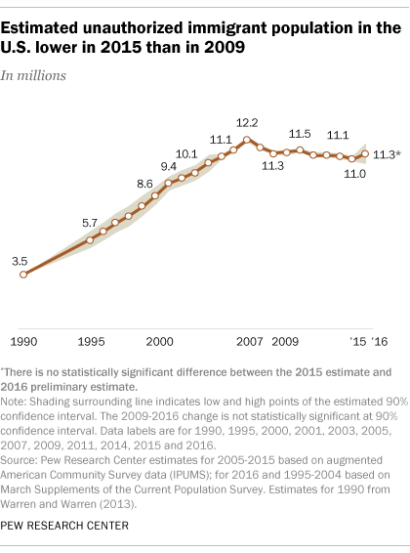
Unauthorized and Mexican Immigration, 2015

Slide 19
Percent of Housing Units Built Before 1960, Census Tracts, Metroplex Area, Texas, 2012-2016
Source: U.S. Census Bureau, American Community Survey, 2012-2016 5-Year Sample

Slide 20
Percent of Housing Units Built Between 1960 and 1979, Census Tracts, Metroplex Area, Texas, 2012-2016
Source: U.S. Census Bureau, American Community Survey, 2012-2016 5-Year Sample

Slide 21
Percent of Housing Units Built Between 1980 and 1999, Census Tracts, Metroplex Area, Texas, 2012-2016
Source: U.S. Census Bureau, American Community Survey, 2012-2016 5-Year Sample

Slide 22
Percent of Housing Units Built Between 2000 and later, Census Tracts, Metroplex Area, Texas, 2012-2016
Source: U.S. Census Bureau, American Community Survey, 2012-2016 5-Year Sample

Slide 23
Projected Population Growth in Texas,
2010-2050
Source: Texas State Data Center 2016 Population Projections
Notes:
According to the most recent projection (2010-2015) Texas will add 10 million new residents over the 2010 census by 2030. The bulk of these new residents will be children and from Hispanic families.

Slide 24
Projected and Estimated Population Growth in Texas, 2010-2050
Source: Texas Demographic Center 2017 Population Projections. U.S. Census Bureau, 2017 Vintage Estimates

Slide 25
Projected Population Growth in Texas,
2010-2020
Source: Texas State Data Center 2016 Population Projections
Notes:
According to the most recent projection (2010-2015) Texas will add 10 million new residents over the 2010 census by 2030. The bulk of these new residents will be children and from Hispanic families.

Slide 26
Projected population for Texas Councils of Government, 2010-2050
Source: Texas State Data Center 2016 Population Projections 1.0 Scenario

Slide 27
Projected population for Texas Councils of Government, 2010-2050
Source: Texas State Data Center 2016 Population Projections 1.0 Scenario

Slide 28
Projected population for Texas Councils of Government, 2010-2050
Source: Texas State Data Center 2016 Population Projections 1.0 Scenario

Slide 29
Projected population for Texas Councils of Government, 2010-2050
Source: Texas State Data Center 2016 Population Projections 1.0 Scenario

Slide 30
Projected population and population change for persons aged 0-18 years, 2010-2030 for Texas counties by metro status
 |  | Total | Metro | Metro 1 million or more | Metro less than 1 million | Nonmetro | Nonmetro adjacent to metro | Nonmetro not adjacent to metro
Projected Numeric Change 2010-2030 | Total | 2,184,778 | 2,066,849 | 1,599,918 | 466,931 | 117,929 | 91,145 | 26,784
 | NH White | (24,243) | (13,261) | (5,787) | (7,474) | (10,982) | (11,006) | 24
 | Black | 95,170 | 100,349 | 95,110 | 5,239 | (5,179) | (3,632) | (1,547)
 | Hispanic | 1,745,883 | 1,624,210 | 1,201,130 | 423,080 | 121,673 | 95,098 | 26,575
 | Other | 367,968 | 355,551 | 309,465 | 46,086 | 12,417 | 10,685 | 1,732
Projected Percent Change 2010-2030 | Total | 30.2% | 32.0% | 34.1% | 26.4% | 14.9% | 15.1% | 14.3%
 | NH White | -1.0% | -0.6% | -0.4% | -1.5% | -3.0% | -4.0% | 0.0%
 | Black | 11.1% | 12.5% | 14.3% | 3.8% | -8.7% | -7.5% | -14.2%
 | Hispanic | 50.1% | 51.7% | 58.3% | 39.1% | 35.3% | 36.0% | 32.9%
 | Other | 84.6% | 86.0% | 87.2% | 79.1% | 57.6% | 63.8% | 35.9%
 | Number of Counties | 254 | 82 | 35 | 47 | 172 | 84 | 88
Source: Texas Demographic Center 2016 Population Projections, 2000-2010 migration scenario. U.S. Department of Agriculture 2013 Rural Urban Continuum Codes
Notes:
This table demonstrates that most of the population change (95%) in Texas’s population of persons aged 0-18 will in metro areas by 2030.
About 80% of the population change of persons aged 0-18 will be from Hispanic descent in 2030 and 93% of Hispanic children will live in metro areas.

Slide 31
Projected Population of Persons Aged 0-18 Years by Race and Ethnicity, Texas 2010-2050
Source: Texas Demographic Center, 2016 Population Projections, 2000-2010 Migration Scenario
Notes:
The projected number of children by race and ethnicity suggests that Hispanics are and will continue to drive increases in population among youth in Texas.

Slide 32
Projected Percent of Population of Persons Aged 0-18 Years by Race and Ethnicity, Texas 2010-2050
Source: Texas Demographic Center, 2016 Population Projections, 2000-2010 Migration Scenario
Notes:
The child aged population in Texas will increasingly be Hispanic and the percent that are non-Hispanic white will decrease over time.

Slide 33
Percent of Civilian Labor Force by Occupation, Texas, 2008, 2014 and 2014-2008 Difference
Source: U.S. Census Bureau, American Community Survey, 1-Year Sample, 2008, 2010, 2014`

Slide 34
Percent Distribution of Educational Attainment of Persons Aged 25 Years and Older, Texas, 2008, 2011, and 2015
Source: U.S. Census Bureau, American Community Survey, 1-Year Samples, 2008-2015

Slide 35
Educational Attainment of Persons Age 25 Years and Older by Race/Ethnicity, Texas, 2015
Source: U.S. Census Bureau, American Community Survey, 1-Year Sample, 2015

Slide 36
Projected Growth of Population Aged 65 Years and Older in Texas, 2010-2050
Source: Texas State Data Center 2014 Population Projections
Notes:
The projected population of Texas is produced using three different migration scenarios. The blue line represents the assumption that there is no in or out migration for Texas. The result is a population that is growing only from natural increase (births-deaths). Under this unlikely scenario, Texas will maintain a health pace of population growth. The other two scenarios assume that 1) the migration rate will be the same as we observed between 2000 and 2010 and 2) the migration rate will be half of what we observed between 2000 and 2010. Under the first assumption Texas will add another 5 million persons this decade, another 7 million the following, 8 or 9 million between 2030 and 2040 and almost 10 million between 2040 and 2050. The half migration scenario also projects significant growth but more modest than the assumption of full migration.

Slide 37
Population Change by Age Group, Texas, 1950-2050
Source: US Census Bureau, 1950-2010 Censuses
US Census Bureau, State Population Estimates
Texas State Data Center, 2014 Population Projections, 1.0 Migration Scenario

Slide 38
Population Projections, Texas, 2010-2050,
Percent Over and Under 65
Source: Texas State Data Center 2014 Population Projections , Half 2000-2010 Migration Scenario

Slide 39
Texas Population Change by Age Group, 2010-2030
Source: Texas State Data Center 2012 Population Projections
Notes:
This image represents population pyramids for Texas in 2010 and then our projected population in 2030. Population pyramids provide a visual representation of the age structure of a population. In comparing 2010 and 2030 in terms of the impact on our education system, look at the lighter shaded areas from 15 years and above to 25-29. Some proportion of this increased population in these ages will be going to college in Texas. The lighter shaded areas below 15 suggest what’s coming in the future.

Slide 40
Projected Racial and Ethnic Percent, Texas, 2010-2050
Source: Texas State Data Center 2012 Population Projections , 2000-2010 Migration Scenario
Notes:
The projected population of Texas by race/ethnicity suggests that the Hispanic population will be a major driver in the population growth of the state. The non-Hispanic white population will grow very slowly and then start to decline as the Baby-Boom generation ages into high mortality years. The non-Hispanic other group is largely composed of persons of Asian descent and this group is projected to exceed the non-Hispanic black population by 2038. This graph assumes migration patterns observed between 2000 and 2010.

Slide 41
Population Projections 65 Years and Over by Race/Ethnicity, Texas, 2010-2050
Source: Texas State Data Center 2014 Population Projections , Half 2000-2010 Migration Scenario

Slide 42
Percent of Population by Race/Ethnicity for Age Groups, 2010 and 2050
2010 2050
Source: US Census Bureau, State Population Estimates, 2014
Source: Texas State Data Center, 2014 Projections, 1.0 Migration Scenario

Slide 43
Percent of Housing Units Built by Period, Census Tracts, Gulf Coast Area, Texas, 2012-2016
Before 1960
1960-79
2000 and later
1980-99
Source: U.S. Census Bureau, American Community Survey, 2012-2016 5-Year Sample

Slide 44
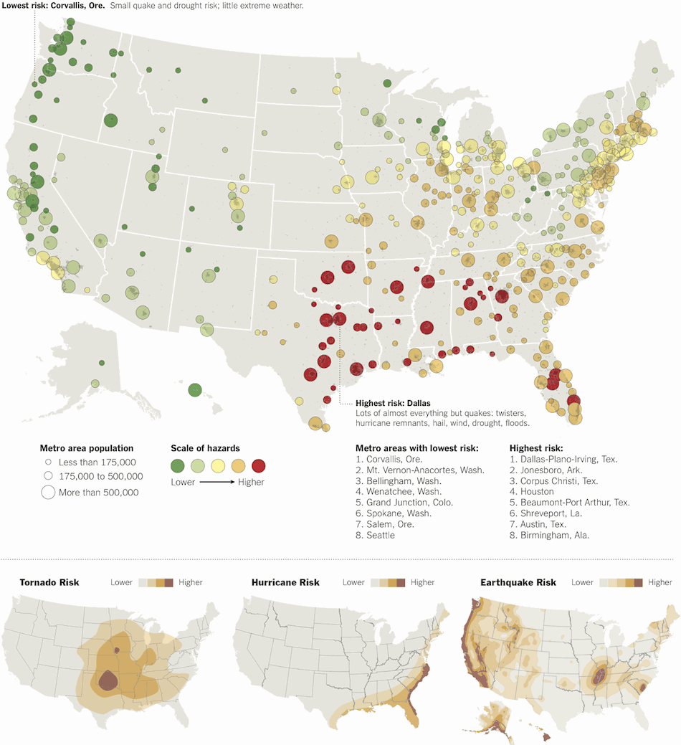
Disaster Risk
Source:http://www.nytimes.com/interactive/2011/05/01/weekinreview/01safe.html?_r=0

Slide 45

Contact
  State Demographer
  Office: (210) 458-6530
  Email: Lloyd.Potter@utsa.edu
  Internet: demographics.texas.gov
Lloyd Potter, Ph.D.
@TexasDemography
Notes:
The Texas Demographic Data Center are committed to supporting your work through providing you with the best, most accurate, and objective information we can identify about our greatest asset, the people of Texas.

