Slide 1

Demographic Trends, Characteristics, and Projections for Texas and the Austin Metro
Hispanic Austin Leadership
Austin, TX
October 9, 2018
@TexasDemography

Slide 2

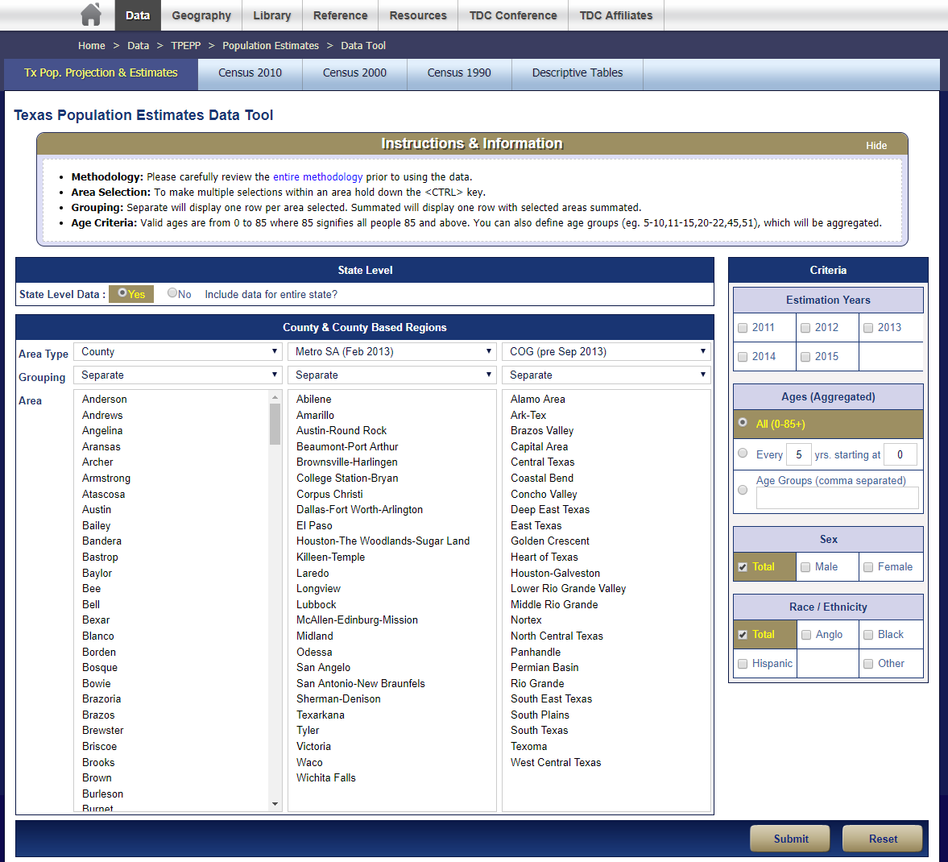

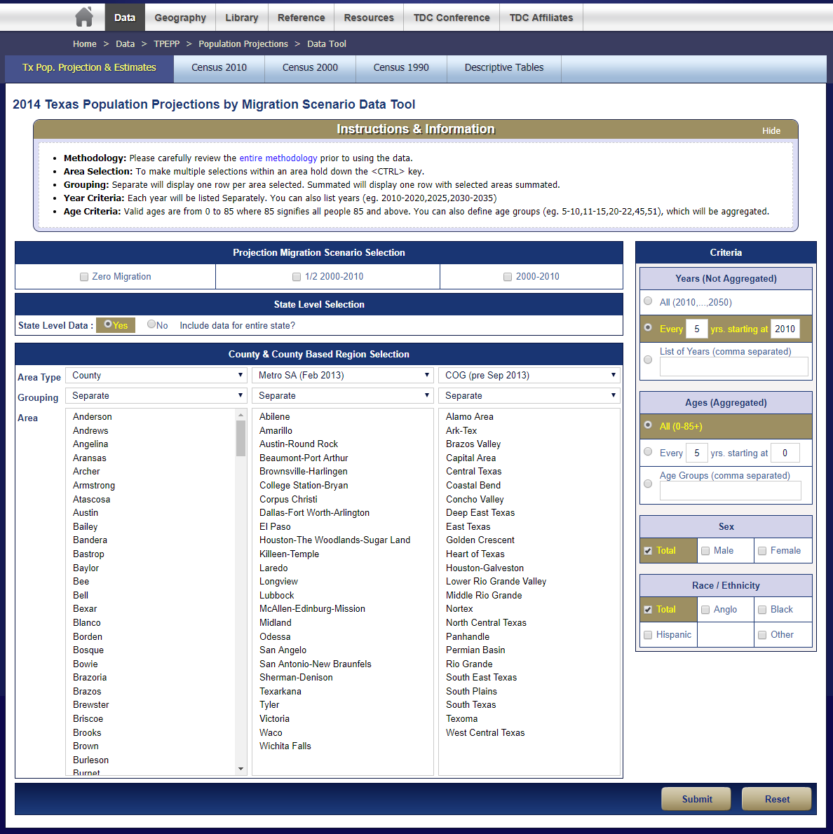
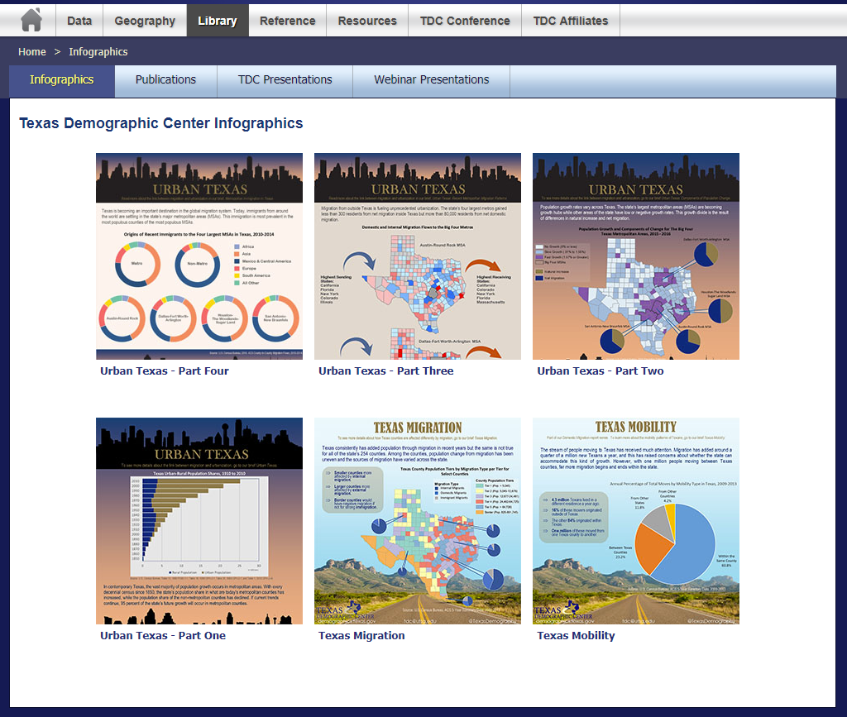

Slide 3

Texas is experiencing significant growth.

Slide 4
Growing States, 2000-2017
 | 2000 Population | 2010 Population | 2017 Population | Numeric Change 2010-2017 | Percent Change 2010-2017
United States | 281,421,906 | 308,745,538 | 325,719,178 | 16,961,073 | 5.49%
Texas | 20,851,820 | 25,145,561 | 28,304,596 | 3,158,496 | 12.56%
California | 33,871,648 | 37,253,956 | 39,536,653 | 2,282,135 | 6.13%
Florida | 15,982,378 | 18,801,310 | 20,984,400 | 2,179,806 | 11.59%
Georgia | 8,186,453 | 9,687,653 | 10,429,379 | 740,689 | 7.65%
North Carolina | 8,049,313 | 9,535,483 | 10,273,419 | 737,698 | 7.74%
Washington | 5,894,121 | 6,724,540 | 7,405,743 | 681,198 | 10.13%
Arizona | 5,130,632 | 6,392,017 | 7,016,270 | 623,961 | 9.76%
Source: U.S. Census Bureau. 2000 and 2010 Census Count, 2017 Population Estimates.
Notes:
Texas is the second largest state in terms of population (2nd to CA) and area (2nd to AK). In terms of number of people, Texas’ growth exceeds that of all other states between 2010 and 2017.

Slide 5

Total Estimated Population by County, Texas, 2017
Source: U.S. Census Bureau, 2017 Vintage Population Estimates
Notes:
When we look at the geographic distribution of the population of Texas over time we see continually increasing population in the counties along the I-35 corridor, the Houston area, and the lower Rio Grand Valley. Urbanized areas out west have grown but most counties in the west have experienced limited growth and some population decline. Approximately 86% of the population is along I-35 and east. This area with the 3 major metropolitan areas at the points is often described as the Texas population triangle.

Slide 6
Estimated Population Change, Texas Counties,
2010 to 2017
91 counties lost population over the 7 year period.
Source: U.S. Census Bureau, 2016 Vintage Population Estimates
Notes:
Population change over the decade has been greatest in the urban and suburban population triangle counties. Counties in the lower Rio Grande Valley also had significant growth as did El Paso. Overall, 163 counties gained population while 91 (36%) lost population over the decade.

Slide 7
Estimated Percent Change of the Total Population by County, Texas, 2010 to 2017
Source: U.S. Census Bureau, 2017 Vintage Population Estimates
Notes:
Percent change is an indicator of the speed of population change void of information about the volume of population change. Percent change in the population over the past few years has been greatest in the suburban population triangle counties, notably among counties between San Antonio and Austin. In the early part of the decade, counties in the Eagle Ford Shale area (south east of San Antonio) had been growing quickly. This is less so the case today. The Cline Shale area (Midland and Odessa area) continues to grow and in some cases even growing faster than the State.

Slide 8
Components of Population Change
by Percent in Texas, 1950-2010
Source: U.S. Census Bureau, Population Estimates
Notes:
It is important to understand a couple of very basic element of population change to think about how growing population may impact our state infrastructure and demand for services. Population changes from two factors, one is natural increase which is simply births minus deaths over time. Essentially population added from natural increase are babies who are usually added to an already existing household. They won’t be attending school for at least the next 4 years and they won’t be driving their own vehicle on our roads for another 16 years. So the effect of population growth from natural increase on our state infrastructure is both lightening, from people dying, and somewhat lagged, until babies start attending school and driving on our roads.
The second way population changes is from net-migration, which is simply in-minus out migrants. In Texas, the balance has been for us to have more in than out migrants. Migrants, are usually adults who are looking for a place to live, adding a vehicle to the road, and for those with children enrolling in our schools. Essentially, migrants make a more immediate demand for goods and services and instantly contribute to adding stress to our state’s infrastructure.
When we look at population change in Texas, from 1950 to present we can see that before 1970, most of our growth was from natural increase. Starting in the 1970s a much larger percent of our growth is attributed to net migration and this continues to today where nearly half of our population change is from migration.

Slide 9
Estimates of percent components of population change, Texas, 2011-2017
Source: U.S. Census Bureau, 2017 Vintage population estimates
Notes:
Natural increase has been in the range of half of population change since the last Census in Texas. Thus Texas is growing quickly and substantially from having more births than deaths over time. In recent years the number and percent of new Texans from other states has declined and the number and percent of international migrants has increased.

Slide 10
Top Counties for Numeric Growth in Texas,
2016-2017
County | U.S. Rank Population Change | Population Change | Percent of Change from Natural Increase | Percent Change from Domestic Migration | Percent Change from International Migration
Harris* | 4 | 35,939 | 128.8% | -126.0% | 97.2%
Tarrant | 5 | 32,729 | 47.9% | 29.0% | 23.1%
Bexar | 7 | 30,831 | 47.8% | 33.4% | 18.8%
Dallas | 8 | 30,686 | 78.0% | -25.5% | 47.6%
Denton | 9 | 27,911 | 23.3% | 67.0% | 9.7%
Collin | 10 | 27,150 | 24.4% | 56.5% | 19.0%
Fort Bend | 14 | 22,870 | 29.4% | 48.1% | 22.6%
Travis | 15 | 22,116 | 47.9% | 22.1% | 30.0%
Williamson | 19 | 19,776 | 20.1% | 73.5% | 6.3%
Montgomery | 28 | 16,412 | 22.7% | 68.5% | 8.8%
Hidalgo* | 49 | 10,474 | 105.9% | -34.5% | 28.5%
*Hidalgo and Harris Counties had negative net migration (Harris -10,322 and Hidalgo -621).
Source: U.S. Census Bureau, 2017 Vintage Population Estimates
Notes:
Nearly a quarter of the top counties adding the most population between 2016 and 2017 are Texas counties. Four of the top 10 were in the Dallas Fort Worth metro area.

Slide 11
Top Counties for Percent Growth* in Texas,
2016-2017
County | U.S. Rank | 2016-2017 Percent Population Change | Percent Change from Domestic Migration | Percent Change from International Migration
Comal | 2 | 5.1% | 90.7% | 1.9%
Hays | 4 | 5.0% | 81.6% | 2.8%
Kendall | 5 | 4.9% | 96.3% | 3.3%
Kaufman | 11 | 4.1% | 83.0% | 2.2%
Rains | 13 | 4.0% | 103.1% | 2.9%
Williamson | 16 | 3.7% | 73.5% | 6.3%
Rockwall | 22 | 3.6% | 81.8% | 2.4%
Parker | 26 | 3.6% | 89.7% | 1.3%
Denton | 32 | 3.5% | 67.0% | 9.7%
Guadalupe | 36 | 3.3% | 81.4% | 2.7%
Ellis | 44 | 3.1% | 78.2% | 3.0%
Llano | 45 | 3.1% | 119.8% | 0.5%
Fort Bend | 48 | 3.1% | 48.1% | 22.6%
*Among Counties with 10,000 or more population in 2017
Source: U.S. Census Bureau, 2017 Vintage Population Estimates
Notes:
More than 1 in four of the top 50 fastest growing counties between 2016 and 2017 are Texas counties.

Slide 12
The 15 Fastest-Growing Large Cities and Towns Between July 1, 2016, and July 1, 2017 (Populations of 50,000 or more in 2016)
Rank | City | State | Percent increase | 2017 total population
1 | Frisco | Texas | 8.2 | 177,286
2 | New Braunfels | Texas | 8.0 | 79,152
3 | Pflugerville | Texas | 6.5 | 63,359
4 | Ankeny | Iowa | 6.4 | 62,416
5 | Buckeye | Arizona | 5.9 | 68,453
6 | Georgetown | Texas | 5.4 | 70,685
7 | Castle Rock town | Colorado | 5.1 | 62,276
8 | Franklin | Tennessee | 4.9 | 78,321
9 | McKinney | Texas | 4.8 | 181,330
10 | Meridian | Idaho | 4.7 | 99,926
11 | Flower Mound town | Texas | 4.3 | 76,681
12 | Bend | Oregon | 4.3 | 94,520
13 | Cedar Park | Texas | 4.2 | 75,704
14 | Doral | Florida | 4.2 | 61,130
15 | Fort Myers | Florida | 4.2 | 79,94
Source: U.S. Census Bureau, 2017 Vintage Population Estimates
Notes:
Nearly half of the top 15 fastest growing cities between 2016 and 2017 are in Texas. The fastest growing city in the country is located in the Dallas Fort Worth metro area.

Slide 13
Population Growth and Components of Change for the Austin Metro Area, 2017
Source: U.S. Census Bureau, 2017 Population Estimates

Slide 14
Estimated Percent of Total Net-Migrant Flows to and From Texas and Other States, 2015
Source: U.S. Census Bureau, 2016. ACS Migration Flows, 2015

Slide 15


Domestic and Internal Migration Flows to and from the Austin Metro
Highest Sending
States:
California
Florida
New York
Colorado
Illinois
Highest Receiving
States:
California
Colorado
New York
Florida
Massachusetts
Source: U.S. Census Bureau, 2016. ACS County to County Migration Flows, 2010-2014

Slide 16
County to County Migration Flows, Austin Metro Counties, 2011-2015
Travis County
 | In-Flows | Net Migration
Williamson County | 10,951 | -6,674
Harris County | 5,835 | 1,741
Bexar County | 3,811 | 674
Hays County | 3,530 | -3,466
Dallas County | 3,436 | 1,426
Tarrant County | 2,042 | 319
Bastrop County | 1,484 | -748
Collin County | 1,305 | 782
Caldwell County | 333 | -359

Slide 17

Texas continues to diversify.

Slide 18
Texas Racial and Ethnic Composition,
2000, 2010, and 2017
11
Source: U.S. Census Bureau. 2000, 2010 Decennial Census and 2017 Population Estimates
Notes:
As of the 2000 Census, about 53% of Texas’ population was non-Hispanic Anglo, about 32% where of Hispanic descent, about 11% where non-Hispanic African American, and about 4% were non-Hispanic Other.
In 2010, it is estimated that about 45% of the Texas population was non-Hispanic Anglo, 38% of Hispanic descent, 11% were non-Hispanic African American, and about 6% were non-Hispanic Other (largely of Asian descent). In 2017, Texas continues to diversify with increases in proportion of population identifying as Hispanic and NH Asian and a decrease in the proportion identifying as White, NH.

Slide 19
Race/Ethnicity Composition, Austin Metro Area and Its Counties, 2017
Austin Metro Area
 | Hispanic | NH White | NH Black | NH Asian | NH Two or More Races
Travis County | 33.9% | 49.0% | 8.0% | 6.8% | 1.9%
Williamson County | 24.5% | 59.6% | 6.4% | 6.9% | 2.1%
Hays County | 39.0% | 53.8% | 3.7% | 1.5% | 1.6%
Bastrop County | 37.8% | 52.6% | 6.8% | 0.8% | 1.4%
Caldwell County | 52.3% | 39.7% | 5.8% | 0.9% | 1.0%
Source: U.S. Census Bureau, 2017 Population Estimates
Source: U.S. Census Bureau, 2017 American Community Survey 1-Year Estimates

Slide 20
Numeric and Percent Change by Race/Ethnicity, 2010 to 2017
 | Total |  | Hispanic |  | NH White |  | NH Black |  | NH Asian |  | NH Other
 | Num Change | % Change | Num Change | % Change | Num Change | % Change | Num Change | % Change | Num Change | % Change | Num Change | % Change
Bastrop | 10,602 | 14.3% | 7,884 | 32.6% | 2,036 | 4.8% | 233 | 4.2% | 182 | 40.0% | 255 | 18.4%
Caldwell | 4,281 | 11.2% | 4,206 | 23.5% | -76 | -0.4% | -38 | -1.5% | 39 | 11.3% | 141 | 33.3%
Hays | 57,396 | 36.5% | 28,311 | 51.1% | 23,024 | 24.9% | 2,857 | 57.1% | 1,537 | 89.1% | 1,649 | 62.7%
Travis | 202,219 | 19.7% | 73,390 | 21.4% | 82,086 | 15.8% | 14,923 | 17.9% | 24,703 | 41.8% | 7,330 | 37.1%
Williamson | 125,009 | 29.6% | 36,218 | 36.9% | 56,237 | 20.8% | 9,920 | 39.8% | 17,714 | 87.3% | 4,777 | 51.5%
Austin Metro | 399,507 | 23.2% | 150,007 | 27.9% | 162,392 | 17.3% | 23,309 | 19.3% | 40,942 | 50.6% | 22,888 | 60.2%
Source: U.S. Census Bureau, 2017 Population Estimates; 2017 American Community Survey 1-Year Estimates

Slide 21
Annual Shares of Recent Non-Citizen Immigrants to Texas by World Area of Birth, 2005-2015
Source: U.S. Census Bureau, American Community Survey, 1-Year PUMS

Slide 22
Population Pyramid for White Non-Hispanics in Texas, 2017
Source: U.S. Census Bureau, 2017 Population Estimates
Notes:
The age distribution of the non-Hispanic white population in Texas is weighted heavily with the “baby boom” generation. Largely the result of lower fertility and less net in-migration, the non-Hispanic white population has relatively fewer young persons relative to those in the middle-age years. In 2010, at ages 37 and younger, the Hispanic population exceeds the non-Hispanic white population. In 2017, median age of NH White women is 43.5 years of age, compared to 29.3 years of age for Hispanic women.

Slide 23
Population Pyramid for Hispanics in Texas, 2017
Source: U.S. Census Bureau, 2017 Population Estimates

Slide 24
Texas Population Pyramid by Race/Ethnicity, 2017
Source: U.S. Census Bureau, 2017 Population Estimates
Notes:
This population pyramid represents the age, sex, race and ethnic composition of the Texas population. Blue represents males, red females, rows are single years of age, and shades represent specified race/ethnic groups as indicated in the legend.

Slide 25

Texas economic indicators

Slide 26
Economic Indicators, Texas and U.S., 2017
 | Median Household Income | Change, 2016-2017
Texas | $59,206 | +
Asian | $84,100 | +
NH White | $72,361 | +
Hispanic | $46,855 | +
Black | $45,092 | +
Unemployment rate
  Texas = 5.1%
  U.S. = 5.3%
Median Household Income
  Texas = $59,206
  U.S. = $60,336
Median Family Income
  Texas = $70,136
  U.S. = $73,891
Poverty rate
  Texas = 14.7%
  U.S. = 13.4%
Source: U.S. Census Bureau, 2017 American Community Survey 1-Year Estimates

Slide 27
Gender Pay Gap, Texas and Big Four Metros, 2017
 | Median Earnings, Male | Median Earnings, Female | Pay Gap
Texas | $49,414 | $40,236 | .81
Austin Metro | $55,162 | $47,075 | .85
DFW Metro | $51,498 | $44,207 | .86
Houston Metro | $51,634 | $42,274 | .82
San Antonio Metro | $43,515 | $37,535 | .86
 | Pay Gap for Hispanic Women
Texas | .60
Austin Metro | .64
DFW Metro | .59
Houston Metro | .56
San Antonio Metro | .74
Source: U.S. Census Bureau, 2017 American Community Survey 1-Year Estimates

Slide 28
Educational Attainment by Race/Ethnicity,
Texas and Big Four Metro Areas, 2017
High School Degree and above
Educational attainment in the Austin metro is significantly higher than that of the state as well as compared to other metros. However, educational disparities are still evident.
Bachelor’s Degree and above
Source: U.S. Census Bureau, 2017 American Community Survey 1-Year Estimates

Slide 29
Median Household Income by Race/Ethnicity,
Texas and Big Four Metro Areas, 2017
Median household incomes in the Austin metro tend to be higher than the state for all race/ethnic groups, but especially for Asians.
Source: U.S. Census Bureau, 2017 American Community Survey 1-Year Estimates

Slide 30
Unemployment and Poverty Rates by Race/Ethnicity,
Texas and Big Four Metro Areas, 2017
The unemployment and poverty rates in the Austin metro tend to be lower than the state rates for all race/ethnicity groups.
Poverty Rate
Unemployment Rate
Source: U.S. Census Bureau, 2017 American Community Survey 1-Year Estimates

Slide 31
Housing Affordability in Select Texas Metros,
2007-2017
Notes: Data are through fourth quarter 2017. The Housing Opportunity Index represents the share of homes sold in a given area that
Would have been affordable to a family earning the local median income.
Source: National Association of Home Builders/Wells Fargo.
Notes:
Housing affordability—the share of homes sold that were affordable to a median-income family in the area—has fallen in most major Texas metros. Additionally, apartment demand and occupancy rates generally remain high.

Slide 32

Education in Texas

Slide 33
Trends in Latino Education in the U.S.
Over the past decade, Hispanic high school dropout rates have dropped.
College enrollment among Hispanics is increased.
There is still a large disparity between Hispanics and other groups in obtaining a bachelor’s degree.
Hispanic college students attend public 2-year schools at higher rates than other groups.
Hispanics are less likely than other groups to have student debt.
Nearly all Latino youths (89%) believe a college degree is important for getting ahead in life.
Source: Pew Research Center, 2016, 5 Facts about Latinos and Education and Between Two Worlds: How Young Latinos Come of Age in America, 2009

Slide 34
College and Graduate Enrollment, Texas, 2007-2017
Source: U.S. Census Bureau, American Community Survey 1-Year Estimates, 2007-2017

Slide 35
College and Graduate Enrollment by Race/Ethnicity, Texas, 2008-2017
Source: U.S. Census Bureau, American Community Survey 1-Year Estimates, 2008-2017

Slide 36
Percent Distribution of Educational Attainment of Persons Aged 25 Years and Older, Texas, 2007 and 2017
 | 2007 | 2017
Percent high school graduate or higher | 79.1% | 83.6% | *
Percent bachelor's degree or higher | 25.2% | 29.6% | *
Source: U.S. Census Bureau, American Community Survey, 1-Year Samples, 2007-2017. * Years significantly different p<.05
Notes:
Texas continues to make strides in educational attainment. In 2007 about half (48.5%) of Texans 25 years and older had a high school diploma or GED or even less education and the other half had some college and up to a professional degree. By 2017, closer to 60% of Texans 25 years and older now have some college, a college degree, or a professional degree. Similarly our percent of the population with at least a HS diploma has increased from 79% in 2007 to over 83% in 2017 and the percent of population with a bachelor’s degree has increased from 25% to over 29% during the same time period.

Slide 37
Educational Attainment, Texas,
2007 and 2017
Source: U.S. Census Bureau, ACS 1-Year Estimates, 2007, 2017

Slide 38
Percent of Civilian Labor Force by Occupation, Texas, 2007, 2017 and 2017-2017 Change
Source: U.S. Census Bureau, American Community Survey, 1-Year Sample, 2007, 2017

Slide 39
Select Social Characteristics of Young Texans, 2017
1.85 million Texans are enrolled in college or graduate school.
  20.7% of undergrads live below the poverty level.
  14.6% of graduate students live below the poverty level.
  20.9% of 19 to 25 year-olds enrolled in school have no insurance.
 | Total | Male | Female
Population 18 to 24 | 2,790,087 | 1,441,775 | 1,348,312
Enrolled in college or graduate school | 37.9% | 34.1% | 41.9%
Enrolled in public school | 85.5% | 86.3% | 84.7%
Enrolled in private school | 14.5% | 13.7% | 15.3%
Percent below Poverty | 50.0% | 43.3% | 56.8%
Percent without Health Insurance* | 29.3% | 30.7% | 27.8%
Source: U.S. Census Bureau, 2017 American Community Survey 1-Year Estimates
Notes:
Over one-third of 18 to 24 year-olds are enrolled college or graduate school. Enrollment is higher among women of this age group. A large majority of young Texans enrolled in college or graduate school are enrolled in a public college or university. Of those, enrolled in private schools, there is a larger share who are women compared to men.
One in two 18 to 24 year-olds in Texas live below the poverty level, with young women more likely to live below poverty level.
18 to 24 year-old Texans have the highest uninsured rate of all other age groups, with young men being more likely to be uninsured.

Slide 40

Population Projections

Slide 41
Projected Population Growth in Texas,
2010-2020
Source: Texas Demographic Center 2014 Population Projections
Notes:
According to the most recent projection (2010-2015) Texas will add 10 million new residents over the 2010 census by 2030. The bulk of these new residents will be children and from Hispanic families.

Slide 42
Projected Population by Race and Ethnicity,
Texas 2010-2050
Source: Texas Demographic Center 2014 Population Projections
Notes:
Population projections by race and ethnicity suggest that Latino’s are and will increasingly be the largest race/ethnic group. The number and percent who are non-Hispanic white are likely to decline. Non-Hispanic other are largely of Asian descent and they appear to be increasing rapidly, although the base number is small.

Slide 43
Population Projections, Austin-Round Rock Metro Area, 2010-2050
Source: Texas Demographic Center, 2014 Population Projections

Slide 44
Population Projections, Austin-Round Rock Metro Counties, 2010-2050
Source: Texas Demographic Center, 2014 Population Projections, Half Migration Scenario

Slide 45
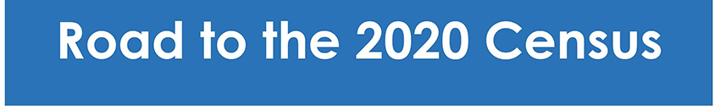
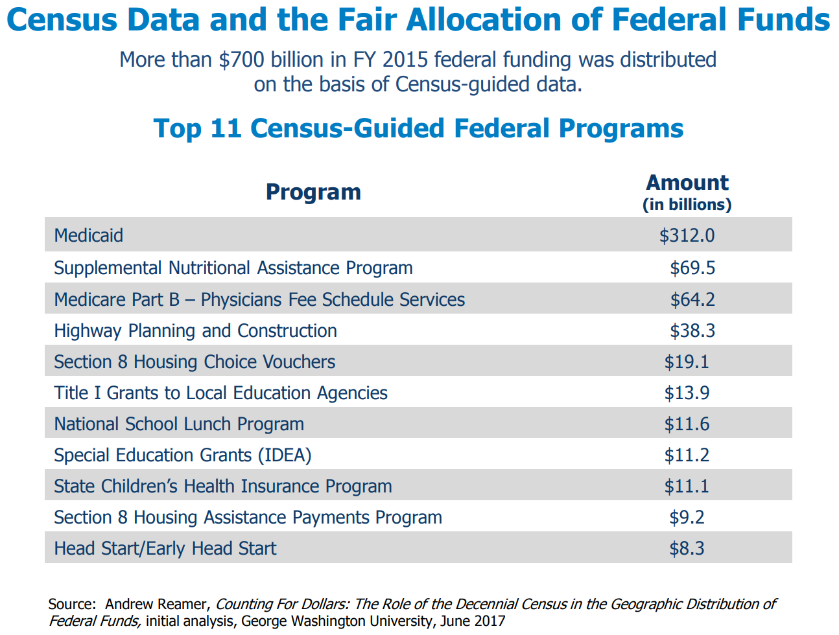

Slide 46
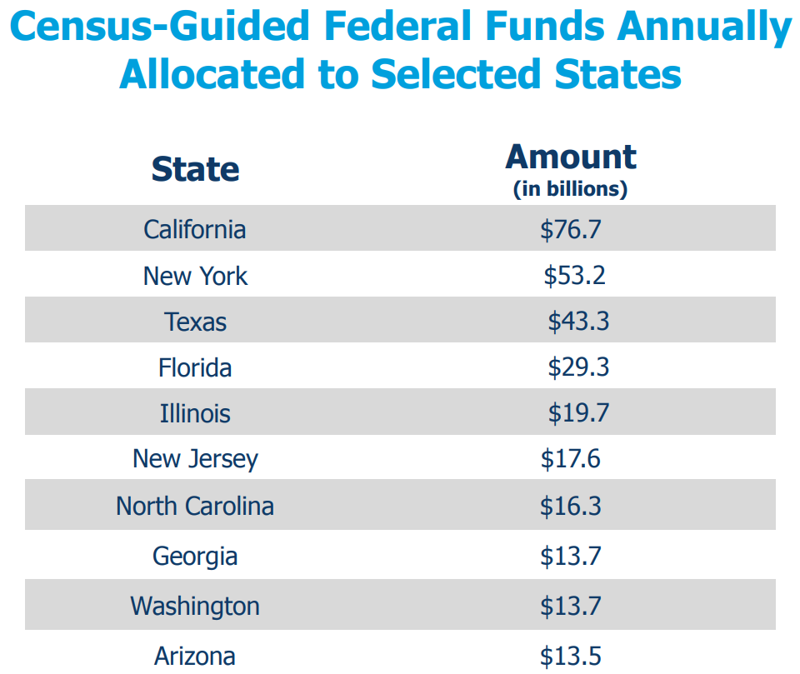

Slide 47
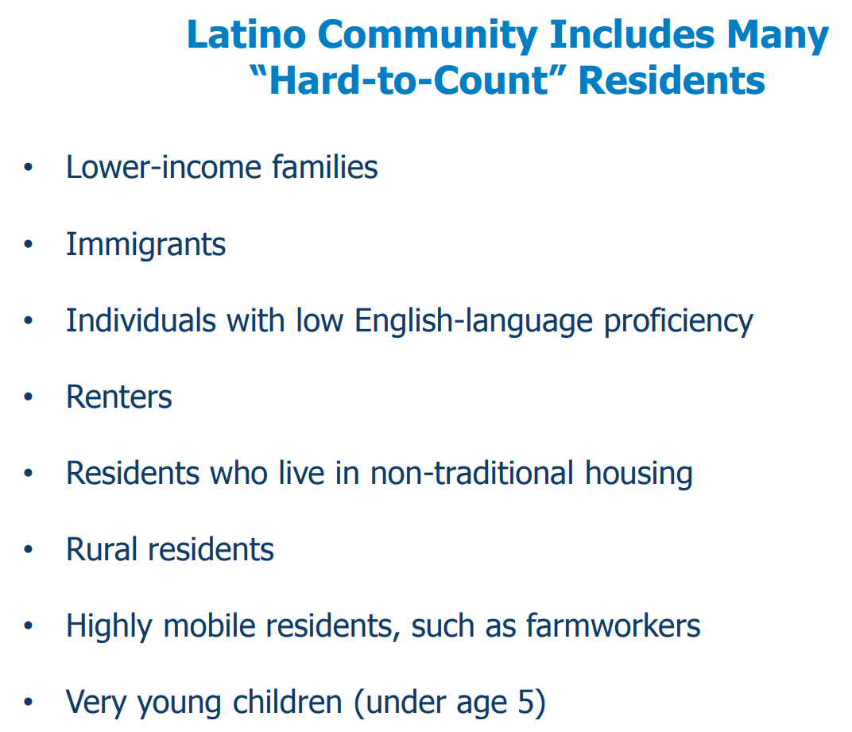

Slide 48
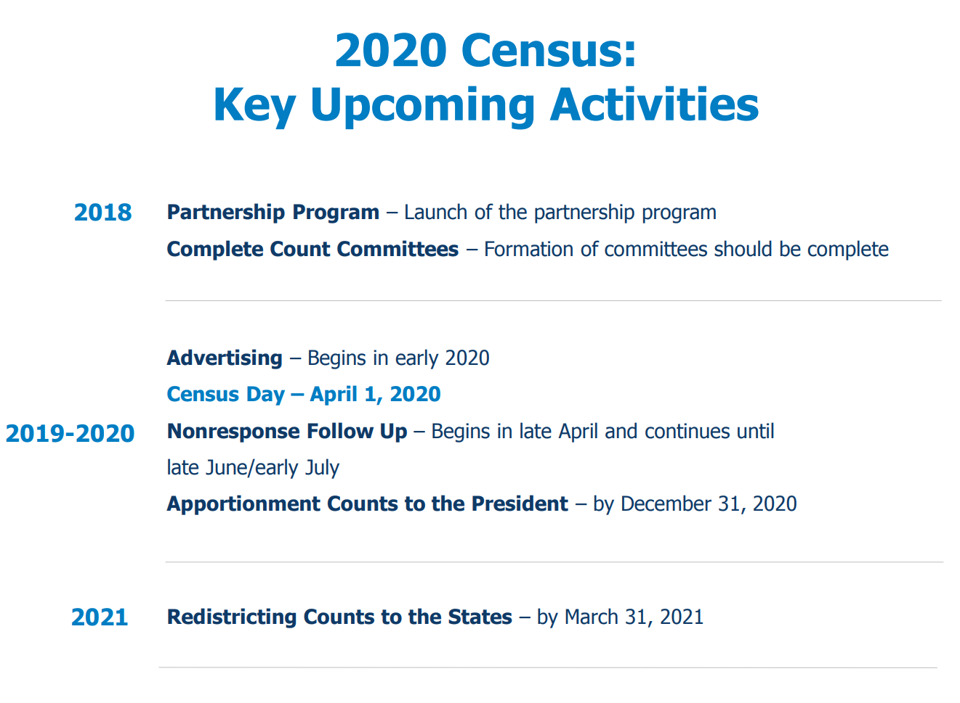

Slide 49


  Office: (512) 936-3542
  Lila.Valencia@utsa.edu
  demographics.texas.gov
Lila Valencia, Ph.D.
@TexasDemography
Notes:
The Office of the State Demographer and the Texas State Data Center are committed to supporting your work through providing you with the best, most accurate, and objective information we can identify about our greatest asset, the people of Texas.

