Slide 1
Demographic Characteristics and Trends in Texas and the Fort Worth Area
JPS Health Network
Hurst, Texas
March 1, 2019

Slide 2

Growing States, 2010-2018
Rank | State | 2010 | 2017 | 2018 | Numeric growth 2017-2018 | Percent Growth 2017-2018 | Percent Growth 2010-2018
1 | Texas | 25,146,114 | 28,322,717 | 28,701,845 | 379,128 | 1.3% | 14.1%
2 | Florida | 18,804,580 | 20,976,812 | 21,299,325 | 322,513 | 1.5% | 13.3%
3 | California | 37,254,523 | 39,399,349 | 39,557,045 | 157,696 | 0.4% | 6.2%
4 | Arizona | 6,392,288 | 7,048,876 | 7,171,646 | 122,770 | 1.7% | 12.2%
5 | North Carolina | 9,535,736 | 10,270,800 | 10,383,620 | 112,820 | 1.1% | 8.9%
Source: U.S. Census Bureau. 2000 and 2010 Census Count, 2018 Population Estimates.

Slide 3
Texas added 379,128 people between July 1, 2017 and July 1, 2018.
About 1,039 people per day added to our population.
  About 524 persons per day from natural increase (more births than deaths)
  About 515 per day from net migration (288 international and 227 domestic migrants per day).
Source: U.S. Census Bureau, 2018 Population Estimates.

Slide 4

Total Estimated Population by County, Texas, 2017
87%
Source: U.S. Census Bureau, 2017 Vintage Population Estimates

Slide 5
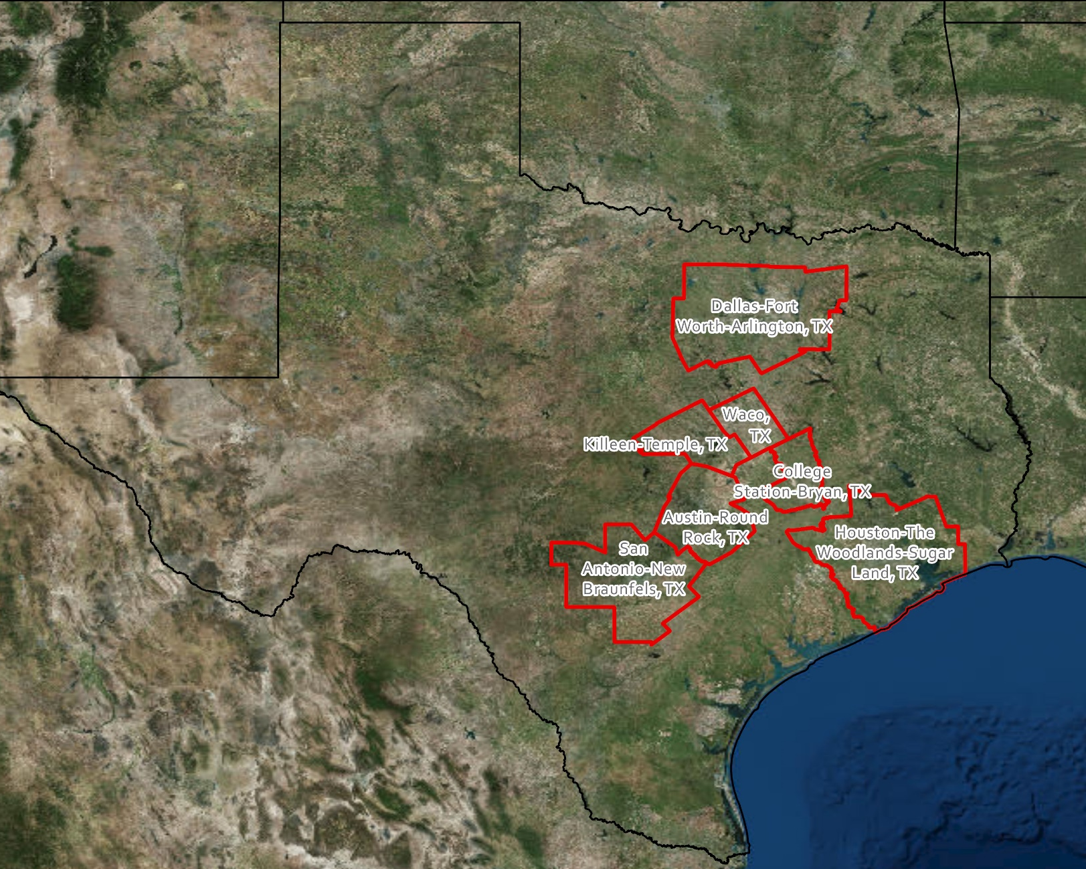
Seven Metropolitan Statistical Areas Accounted for 70% of Texas’ Population in 2017
Source: U.S. Census Bureau, 2017 Vintage Population Estimates

Slide 6
Estimated Population Change, Texas Counties, 2010 to 2017
Source: U.S. Census Bureau, 2017 Vintage Population Estimates

Slide 7
Estimated Percent Population Change by County, Texas, 2010 to 2017
Source: U.S. Census Bureau, 2017 Vintage Population Estimates

Slide 8
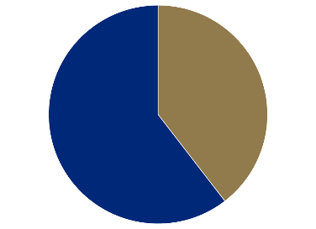
Population Growth and Components of Change for the DFW Metro Area, 2017
Source: U.S. Census Bureau, 2017 Population Estimates

Slide 9


Domestic and Internal Migration Flows to and from the DFW Metro
Highest Sending
States:
California
Oklahoma
Florida
Louisiana
Illinois
Highest Receiving
States:
Oklahoma
California
Florida
Colorado
Louisiana
Source: U.S. Census Bureau, 2016. ACS County to County Migration Flows, 2010-2014

Slide 10
County to County Migration Flows, Dallas and Tarrant Counties, 2010-2014
Dallas County
Tarrant County
 | In-Flows | Net Migration
Tarrant County | 14,501 | -5,333
Collin County | 13,637 | -1,803
Denton County | 9,576 | -8,105
Harris County | 3,771 | -1,013
Ellis County | 2,746 | -1,201
Kaufman County | 2,436 | -1,829
Travis County | 2,186 | -1,226
Bexar County | 2,070 | 113
 | In-Flows | Net Migration
Dallas County | 19,834 | 5,333
Denton County | 5,752 | -1,780
Harris County | 3,403 | 1,279
Johnson County | 3,208 | -528
Parker County | 2,620 | -45
Collin County | 2,612 | -191
Brazos County | 465 | -1,192

Slide 11
Top Counties for Numeric Growth in Texas, 2016-2017
County | U.S. Rank Population Change | Population Change | Percent of Change from Natural Increase | Percent of Change from Domestic Migration | Percent of Change from International Migration
Harris* | 4 | 35,939 | 128.8% | -126.0% | 97.2%
Tarrant | 5 | 32,729 | 47.9% | 29.0% | 23.1%
Bexar | 7 | 30,831 | 47.8% | 33.4% | 18.8%
Dallas | 8 | 30,686 | 78.0% | -25.5% | 47.6%
Denton | 9 | 27,911 | 23.3% | 67.0% | 9.7%
Collin | 10 | 27,150 | 24.4% | 56.5% | 19.0%
Fort Bend | 14 | 22,870 | 29.4% | 48.1% | 22.6%
Travis | 15 | 22,116 | 47.9% | 22.1% | 30.0%
Williamson | 19 | 19,776 | 20.1% | 73.5% | 6.3%
Montgomery | 28 | 16,412 | 22.7% | 68.5% | 8.8%
Hidalgo* | 49 | 10,474 | 105.9% | -34.5% | 28.5%
* Hidalgo and Harris Counties had negative net migration (Harris -10,322 and Hidalgo -621).
Source: U.S. Census Bureau, 2017 Vintage Population Estimates

Slide 12
Top Counties for Percent Growth* in Texas, 2016-2017
County | U.S. Rank | 2015-2016 Percent Population Change | Percent of Change from Domestic Migration | Percent Change from International Migration
Comal | 2 | 5.1% | 90.7% | 1.9%
Hays | 4 | 5.0% | 81.6% | 2.8%
Kendall | 5 | 4.9% | 96.3% | 3.3%
Kaufman | 11 | 4.1% | 83.0% | 2.2%
Rains | 13 | 4.0% | 103.1% | 2.9%
Williamson | 16 | 3.7% | 73.5% | 6.3%
Rockwall | 22 | 3.6% | 81.8% | 2.4%
Parker | 26 | 3.6% | 89.7% | 1.3%
Denton | 32 | 3.5% | 67.0% | 9.7%
Guadalupe | 36 | 3.3% | 81.4% | 2.7%
Ellis | 44 | 3.1% | 78.2% | 3.0%
Llano | 45 | 3.1% | 119.8% | 0.5%
Fort Bend | 48 | 3.1% | 48.1% | 22.6%
*Among Counties with 10,000 or more population in 2017
Source: U.S. Census Bureau, 2017 Vintage Population Estimates

Slide 13
The 15 Cities With the Largest Numeric Increase Between July 1, 2016, and July 1, 2017 (Populations of 50,000 or more in 2016)
Rank | City | State | Numeric increase | 2017 total population
1 | San Antonio | Texas | 24,208 | 1,511,946
2 | Phoenix | Arizona | 24,036 | 1,626,078
3 | Dallas | Texas | 18,935 | 1,341,075
4 | Fort Worth | Texas | 18,664 | 874,168
5 | Los Angeles | California | 18,643 | 3,999,759
6 | Seattle | Washington | 17,490 | 724,745
7 | Charlotte | North Carolina | 15,551 | 859,035
8 | Columbus | Ohio | 15,429 | 879,170
9 | Frisco | Texas | 13,470 | 177,286
10 | Atlanta | Georgia | 13,323 | 486,290
11 | San Diego | California | 12,834 | 1,419,516
12 | Austin | Texas | 12,515 | 950,715
Five of the 15 cities with the most growth
Source: U.S. Census Bureau, 2017 Vintage Population Estimates

Slide 14

The 15 Fastest-Growing Large Cities and Towns Between July 1, 2016, and July 1, 2017 (populations of 50,000 or more in 2016)
Rank | City | State | Percent increase | 2017 total population
1 | Frisco | Texas | 8.2 | 177,286
2 | New Braunfels | Texas | 8.0 | 79,152
3 | Pflugerville | Texas | 6.5 | 63,359
4 | Ankeny | Iowa | 6.4 | 62,416
5 | Buckeye | Arizona | 5.9 | 68,453
6 | Georgetown | Texas | 5.4 | 70,685
7 | Castle Rock town | Colorado | 5.1 | 62,276
8 | Franklin | Tennessee | 4.9 | 78,321
9 | McKinney | Texas | 4.8 | 181,330
10 | Meridian | Idaho | 4.7 | 99,926
11 | Flower Mound town | Texas | 4.3 | 76,681
12 | Bend | Oregon | 4.3 | 94,520
13 | Cedar Park | Texas | 4.2 | 75,704
14 | Doral | Florida | 4.2 | 61,130
15 | Fort Myers | Florida | 4.2 | 79,94
Seven of the 15 fastest growing cities
Source: U.S. Census Bureau, 2017 Vintage Population Estimates

Slide 15
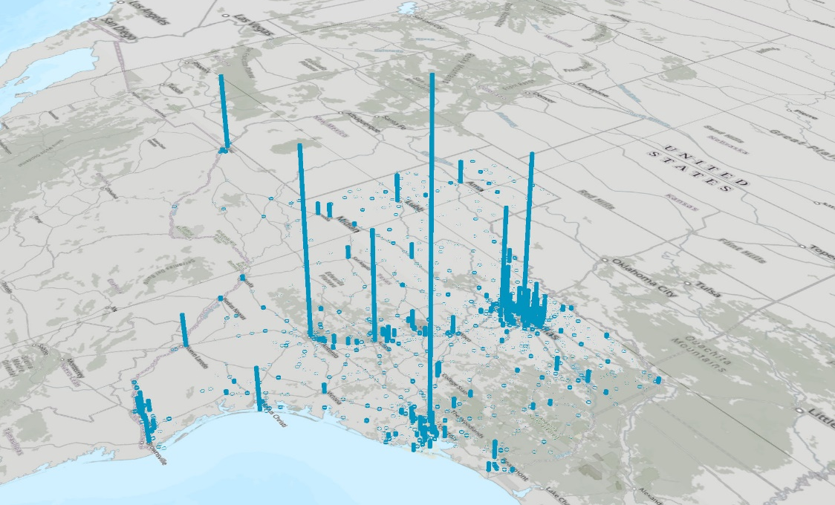
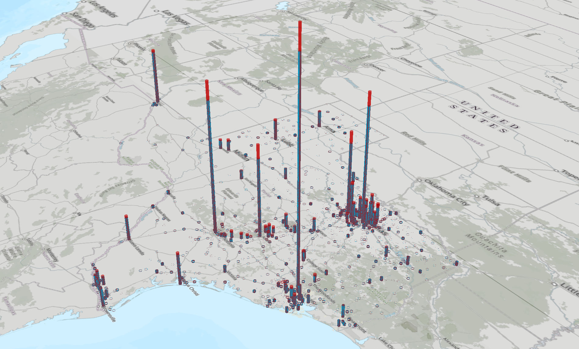

Population estimates, places, Texas, 2010 and 2017
Source: U.S. Census Bureau, 2017 Vintage Population Estimates

Slide 16
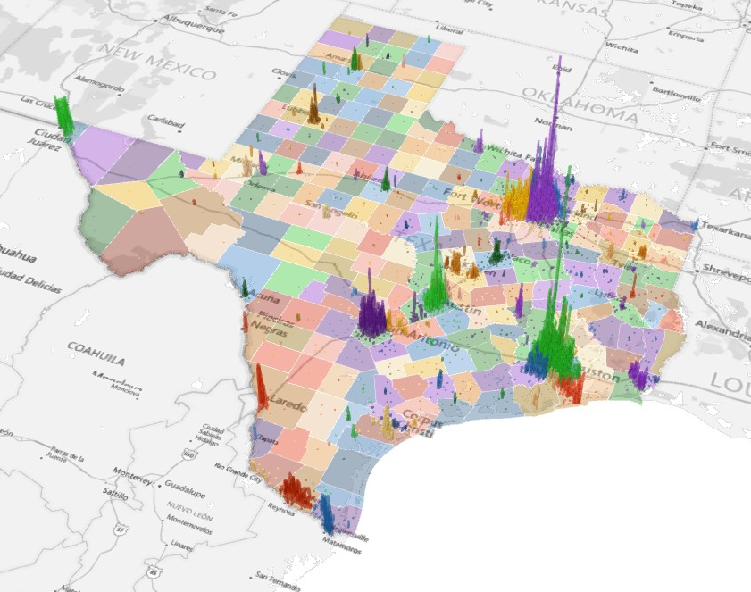
Population Density for Census Tracts, Texas, 2016
Source: U.S. Census Bureau, American Community Survey, 2012-2016 5-Year Sample

Slide 17
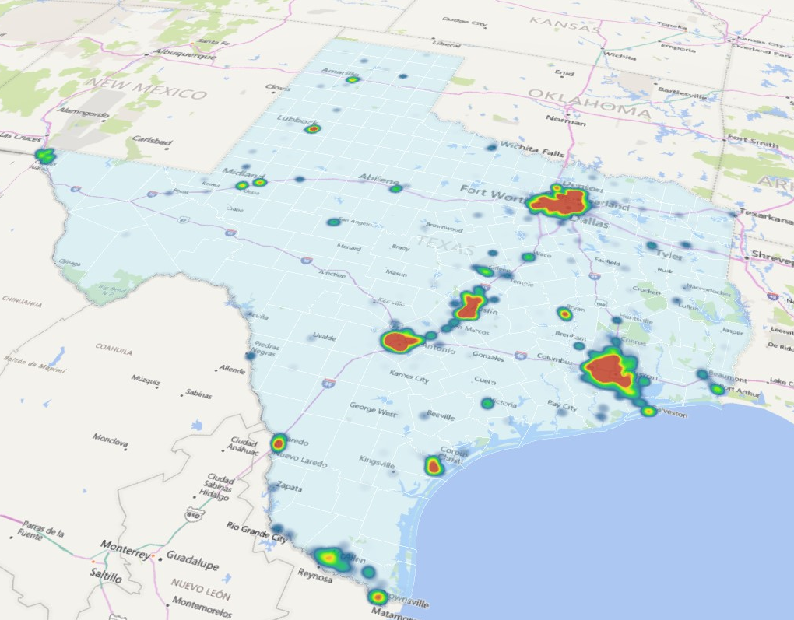
Census Tracts with an Increase in Density, Texas, 2011-2016
Sources: U.S. Census Bureau, American Community Survey, 2007-2011 and 2012-2016 5-Year Samples

Slide 18
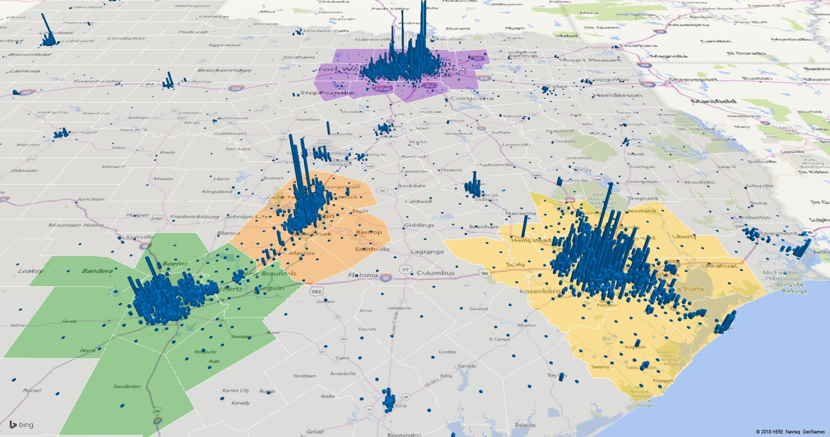
Census Tracts with an Increase in Density, Texas, 2011-2016
Sources: U.S. Census Bureau, American Community Survey, 2007-2011 and 2012-2016 5-Year Samples

Slide 19
Percent of the population that is Hispanic,
Census Tracts, Metroplex Area, Texas, 2009-2013
Source: U.S. Census Bureau, American Community Survey, 5 Year Sample 2009-2013.

Slide 20
Percent of the population that is Black/African American,
Census Tracts, Metroplex Area, Texas, 2009-2013
Source: U.S. Census Bureau, American Community Survey, 5 Year Sample 2009-2013.

Slide 21
Percent of the population that is Asian, Census Tracts, Metroplex Area, Texas, 2009-2013
Source: U.S. Census Bureau, American Community Survey, 5 Year Sample 2009-2013.

Slide 22
Percent Population 25 Years and Older with BA Degree and Above, DFW Metro Area Census Tracts, 2012-2016
Source: U.S. Census Bureau, 2016 ACS 5-Year Estimates

Slide 23
Percent Population Below Poverty Level,
DFW Metro Area Census Tracts, 2012-2016
Source: U.S. Census Bureau, 2016 ACS 5-Year Estimates

Slide 24
Percent of Housing Units Built before 1960 and after 2000, DFW Metro, 2012-2016
Source: U.S. Census Bureau, 2016 ACS 5-Year Estimates

Slide 25
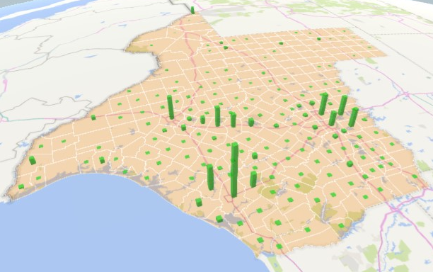
Change in Housing Units by County: 2009 to 2017
Sources: U.S. Census Bureau, American Community Survey, 2005-2009 and 2013-2017 5-Year Samples

Slide 26
Race/Ethnicity Composition, Dallas Metro Area and DFW Counties, 2017
 | Hispanic | NH White | NH Black | NH Asian | NH Two or More Races
Collin | 15.3% | 57.3% | 9.7% | 14.9% | 2.3%
Dallas | 40.2% | 29.2% | 22.5% | 6.3% | 1.4%
Delta | 7.6% | 81.0% | 6.2% | 0.7% | 2.7%
Denton | 19.4% | 59.3% | 9.8% | 8.9% | 2.1%
Ellis | 26.3% | 60.8% | 10.3% | 0.7% | 1.4%
Hunt | 16.4% | 71.7% | 7.9% | 1.4% | 1.7%
Johnson | 21.3% | 72.2% | 3.2% | 0.8% | 1.6%
Kaufman | 21.4% | 64.1% | 11.1% | 1.2% | 1.6%
Parker | 12.2% | 83.6% | 1.4% | 0.6% | 1.5%
Rockwall | 17.7% | 71.2% | 6.2% | 2.7% | 1.7%
Tarrant | 28.9% | 46.8% | 16.3% | 5.5% | 1.9%
Wise | 19.5% | 76.5% | 1.4% | 0.5% | 1.4%
Dallas-Fort Worth-Arlington Metro Area
Source: U.S. Census Bureau, 2017 Population Estimates
Source: U.S. Census Bureau, 2017 American Community Survey 1-Year Estimates

Slide 27
Numeric and Percent Change by Race/Ethnicity, 2010 to 2016
 |  | Total | NH White | NH Black | Hispanic | NH Asian | NH Other
Dallas County | NumChg | 206,845 | -20,159 | 60,442 | 120,316 | 38,678 | 7,568
 | PerChg | 8.73% | -2.56% | 11.61% | 13.28% | 32.39% | 21.62%
Tarrant County | NumChg | 207,838 | 25,809 | 58,268 | 90,228 | 23,467 | 10,066
 | PerChg | 11.49% | 2.75% | 22.10% | 18.68% | 27.88% | 25.89%
Collin County | NumChg | 157,244 | 55,202 | 24,560 | 26,855 | 43,954 | 6,673
 | PerChg | 20.10% | 11.16% | 37.71% | 23.28% | 49.78% | 35.48%
Denton County | NumChg | 143,566 | 57,762 | 22,422 | 33,964 | 24,126 | 5,292
 | PerChg | 21.67% | 13.50% | 41.23% | 28.11% | 55.17% | 33.75%
Johnson County | NumChg | 12,340 | 3,716 | 1,035 | 6,384 | 310 | 895
 | PerChg | 8.18% | 3.21% | 27.04% | 23.37% | 32.16% | 29.11%
Source: U.S. Census Bureau, 2016 Population Estimates

Slide 28
Percent distribution by race and ethnicity for 2010 and projected populations to 2030 for Dallas/Fort Worth metro area counties
 |  | NH White | NH Black | Hispanic | NH Asian | NH Other
Collin | 2010 | 63.1% | 8.3% | 14.7% | 11.2% | 2.7%
 | 2030 | 47.6% | 12.0% | 16.6% | 19.9% | 3.9%
Dallas | 2010 | 33.1% | 21.9% | 38.3% | 5.0% | 1.7%
 | 2030 | 24.3% | 23.0% | 40.9% | 9.3% | 2.5%
Delta | 2010 | 83.2% | 7.2% | 5.5% | 0.6% | 3.6%
 | 2030 | 76.5% | 9.2% | 9.2% | 0.6% | 4.6%
Denton | 2010 | 64.4% | 8.2% | 18.2% | 6.5% | 2.7%
 | 2030 | 48.3% | 14.6% | 20.9% | 12.9% | 3.3%
Ellis | 2010 | 65.5% | 8.8% | 23.5% | 0.5% | 1.7%
 | 2030 | 54.4% | 11.6% | 31.1% | 0.5% | 2.5%
Hunt | 2010 | 74.8% | 8.1% | 13.6% | 1.0% | 2.5%
 | 2030 | 62.9% | 9.2% | 20.7% | 5.0% | 2.2%
Johnson | 2010 | 76.6% | 2.5% | 18.1% | 0.6% | 2.2%
 | 2030 | 64.1% | 4.2% | 27.4% | 0.7% | 3.6%
Kaufman | 2010 | 70.0% | 10.2% | 17.0% | 0.8% | 2.0%
 | 2030 | 56.4% | 10.7% | 29.6% | 0.8% | 2.5%
Parker | 2010 | 85.3% | 1.6% | 10.6% | 0.5% | 2.0%
 | 2030 | 79.2% | 1.4% | 16.1% | 0.5% | 2.8%
Rockwall | 2010 | 74.1% | 5.6% | 15.9% | 2.4% | 2.0%
 | 2030 | 65.8% | 6.7% | 21.1% | 4.1% | 2.3%
Tarrant | 2010 | 51.8% | 14.5% | 26.7% | 4.6% | 2.4%
 | 2030 | 39.8% | 18.1% | 31.4% | 7.5% | 3.3%
Wise | 2010 | 79.7% | 1.0% | 17.1% | 0.4% | 1.8%
 | 2030 | 72.3% | 1.1% | 23.8% | 0.5% | 2.4%
Source: Texas Demographic Center, 2018 Population Projections

Slide 29
Projected Population Growth for the Total and by Race and Ethnicity in Tarrant County, Texas, 2010-2050
Source: Texas Demographic Center, 2018 Population Projections

Slide 30

Contact
  State Demographer
  Texas Demographic Center
  Office: (210) 458-6530
  Email: Lloyd.Potter@UTSA.edu
  Internet: Demographics.Texas.gov
Lloyd Potter, Ph.D.
@TexasDemography
Notes:
The Texas State Demographic Center is committed to supporting government, business, non-profit organizations and citizens with the best, most accurate, and objective information we can identify about our greatest asset, the people of Texas.

