Slide 1
Demographic Characteristics and Trends in Texas and Workforce Development
Texas Workforce Development Council
Austin, Texas
February 13, 2019

Slide 2

Growing States, 2010-2018
Rank | State | 2010 | 2017 | 2018 | Numeric growth 2017-2018 | Percent Growth 2017-2018 | Percent Growth 2010-2018
1 | Texas | 25,146,114 | 28,322,717 | 28,701,845 | 379,128 | 1.3% | 14.1%
2 | Florida | 18,804,580 | 20,976,812 | 21,299,325 | 322,513 | 1.5% | 13.3%
3 | California | 37,254,523 | 39,399,349 | 39,557,045 | 157,696 | 0.4% | 6.2%
4 | Arizona | 6,392,288 | 7,048,876 | 7,171,646 | 122,770 | 1.7% | 12.2%
5 | North Carolina | 9,535,736 | 10,270,800 | 10,383,620 | 112,820 | 1.1% | 8.9%
Source: U.S. Census Bureau. 2000 and 2010 Census Count, 2018 Population Estimates.

Slide 3
Texas added 379,128 people between July 1, 2017 and July 1, 2018.
About 1,039 people per day added to our population.
  About 524 persons per day from natural increase (more births than deaths)
  About 515 per day from net migration (288 international and 227 domestic migrants per day).
Source: U.S. Census Bureau, 2018 Population Estimates.

Slide 4

Total Estimated Population by County, Texas, 2017
87%
Source: U.S. Census Bureau, 2017 Vintage Population Estimates

Slide 5
Estimated Population Change, Texas Counties, 2010 to 2017
Source: U.S. Census Bureau, 2017 Vintage Population Estimates

Slide 6
Estimated Percent Population Change by County, Texas, 2010 to 2017
Source: U.S. Census Bureau, 2017 Vintage Population Estimates

Slide 7
Top Counties for Numeric Growth in Texas, 2016-2017
County | U.S. Rank Population Change | Population Change | Percent of Change from Natural Increase | Percent of Change from Domestic Migration | Percent of Change from International Migration
Harris* | 4 | 35,939 | 128.8% | -126.0% | 97.2%
Tarrant | 5 | 32,729 | 47.9% | 29.0% | 23.1%
Bexar | 7 | 30,831 | 47.8% | 33.4% | 18.8%
Dallas | 8 | 30,686 | 78.0% | -25.5% | 47.6%
Denton | 9 | 27,911 | 23.3% | 67.0% | 9.7%
Collin | 10 | 27,150 | 24.4% | 56.5% | 19.0%
Fort Bend | 14 | 22,870 | 29.4% | 48.1% | 22.6%
Travis | 15 | 22,116 | 47.9% | 22.1% | 30.0%
Williamson | 19 | 19,776 | 20.1% | 73.5% | 6.3%
Montgomery | 28 | 16,412 | 22.7% | 68.5% | 8.8%
Hidalgo* | 49 | 10,474 | 105.9% | -34.5% | 28.5%
* Hidalgo and Harris Counties had negative net migration (Harris -10,322 and Hidalgo -621).
Source: U.S. Census Bureau, 2017 Vintage Population Estimates

Slide 8
Top Counties for Percent Growth* in Texas, 2016-2017
County | U.S. Rank | 2015-2016 Percent Population Change | Percent of Change from Domestic Migration | Percent Change from International Migration
Comal | 2 | 5.1% | 90.7% | 1.9%
Hays | 4 | 5.0% | 81.6% | 2.8%
Kendall | 5 | 4.9% | 96.3% | 3.3%
Kaufman | 11 | 4.1% | 83.0% | 2.2%
Rains | 13 | 4.0% | 103.1% | 2.9%
Williamson | 16 | 3.7% | 73.5% | 6.3%
Rockwall | 22 | 3.6% | 81.8% | 2.4%
Parker | 26 | 3.6% | 89.7% | 1.3%
Denton | 32 | 3.5% | 67.0% | 9.7%
Guadalupe | 36 | 3.3% | 81.4% | 2.7%
Ellis | 44 | 3.1% | 78.2% | 3.0%
Llano | 45 | 3.1% | 119.8% | 0.5%
Fort Bend | 48 | 3.1% | 48.1% | 22.6%
*Among Counties with 10,000 or more population in 2017
Source: U.S. Census Bureau, 2017 Vintage Population Estimates

Slide 9

Estimated Percent of Total Net-Migrant Flow for Texas and Other States, 2016
Source: Internal Revenue Service, 2018. Migration Tables, 2015-16

Slide 10
Annual Shares of Recent Non-Citizen Immigrants to Texas by World Area of Birth, 2005-2015
Estimated number of international migrants to Texas
101,588
77,702
98,194
Sources: U.S. Census Bureau, American Community Survey, 1-Year PUMS. Population estimates 2017 vintage and 2000-2010 intercensual estimates

Slide 11
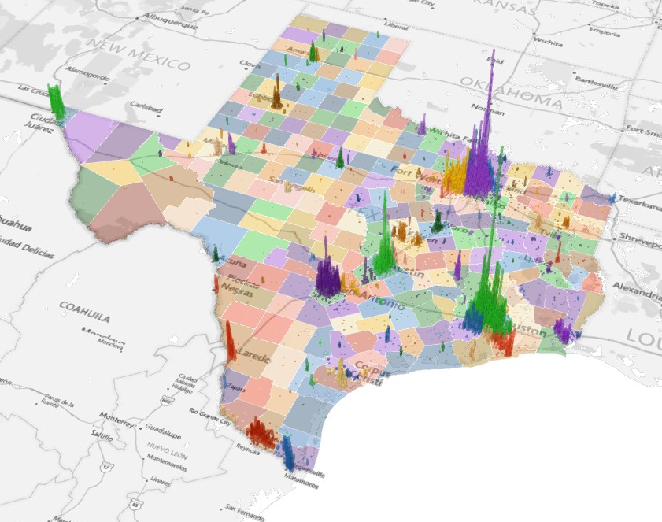
Population Density for Census Tracts, Texas, 2016
Source: U.S. Census Bureau, American Community Survey, 2012-2016 5-Year Sample

Slide 12
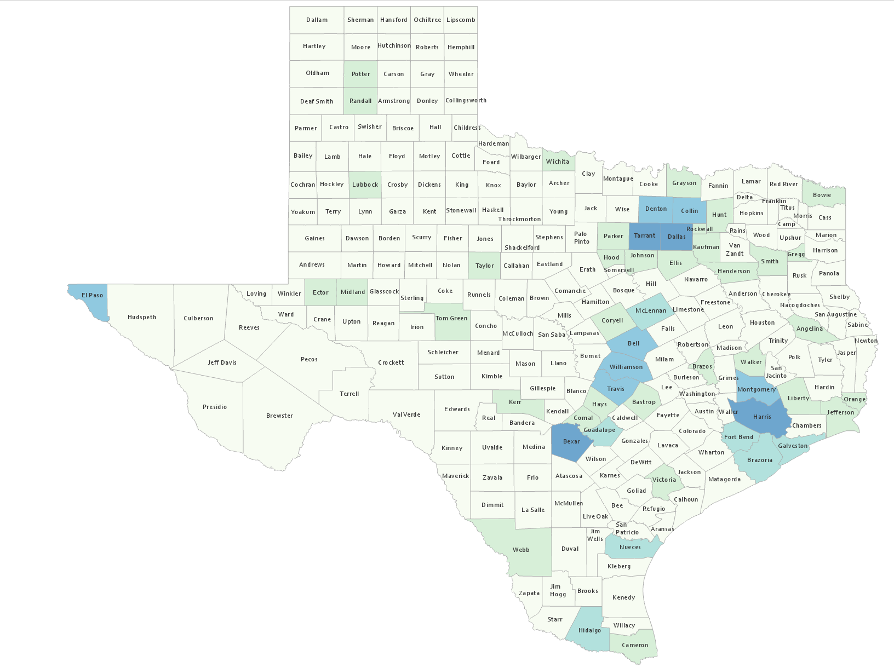
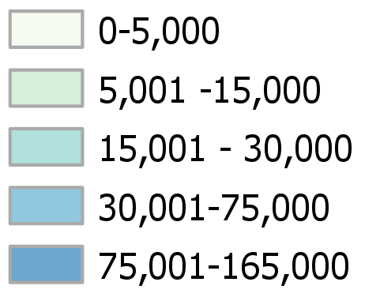
Estimated number of civilian veterans, Texas counties, 2013-2017
Source: U.S. Census Bureau, American Community Survey, 2013-2017 5-Year Sample

Slide 13
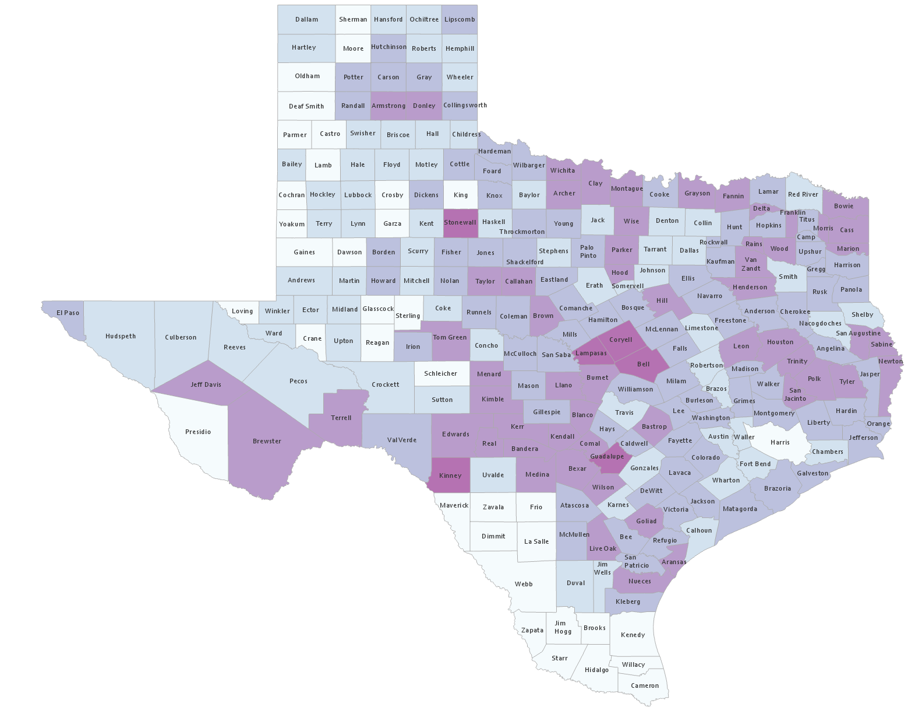
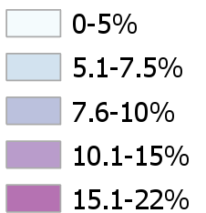
Percent of the population who are civilian veterans, Texas Counties, 2013-2017
Source: U.S. Census Bureau, American Community Survey, 2013-2017 5-Year Sample

Slide 14
Projected population by race and ethnicity, Texas, 2020-2050
Source: Texas Demographic Center 2018 Population Projections

Slide 15
Texas Projected Population Pyramid by Race/Ethnicity, 2020
Source: Texas Demographic Center 2018 Population Projections
Notes:
This population pyramid represents the age, sex, race and ethnic composition of the Texas population. Blue represents males, red females, rows are single years of age, and shades represent specified race/ethnic groups as indicated in the legend.

Slide 16
Texas Projected Population Pyramid by Race/Ethnicity, 2040
Source: Texas Demographic Center 2018 Population Projections
Notes:
This population pyramid represents the age, sex, race and ethnic composition of the Texas population. Blue represents males, red females, rows are single years of age, and shades represent specified race/ethnic groups as indicated in the legend.

Slide 17
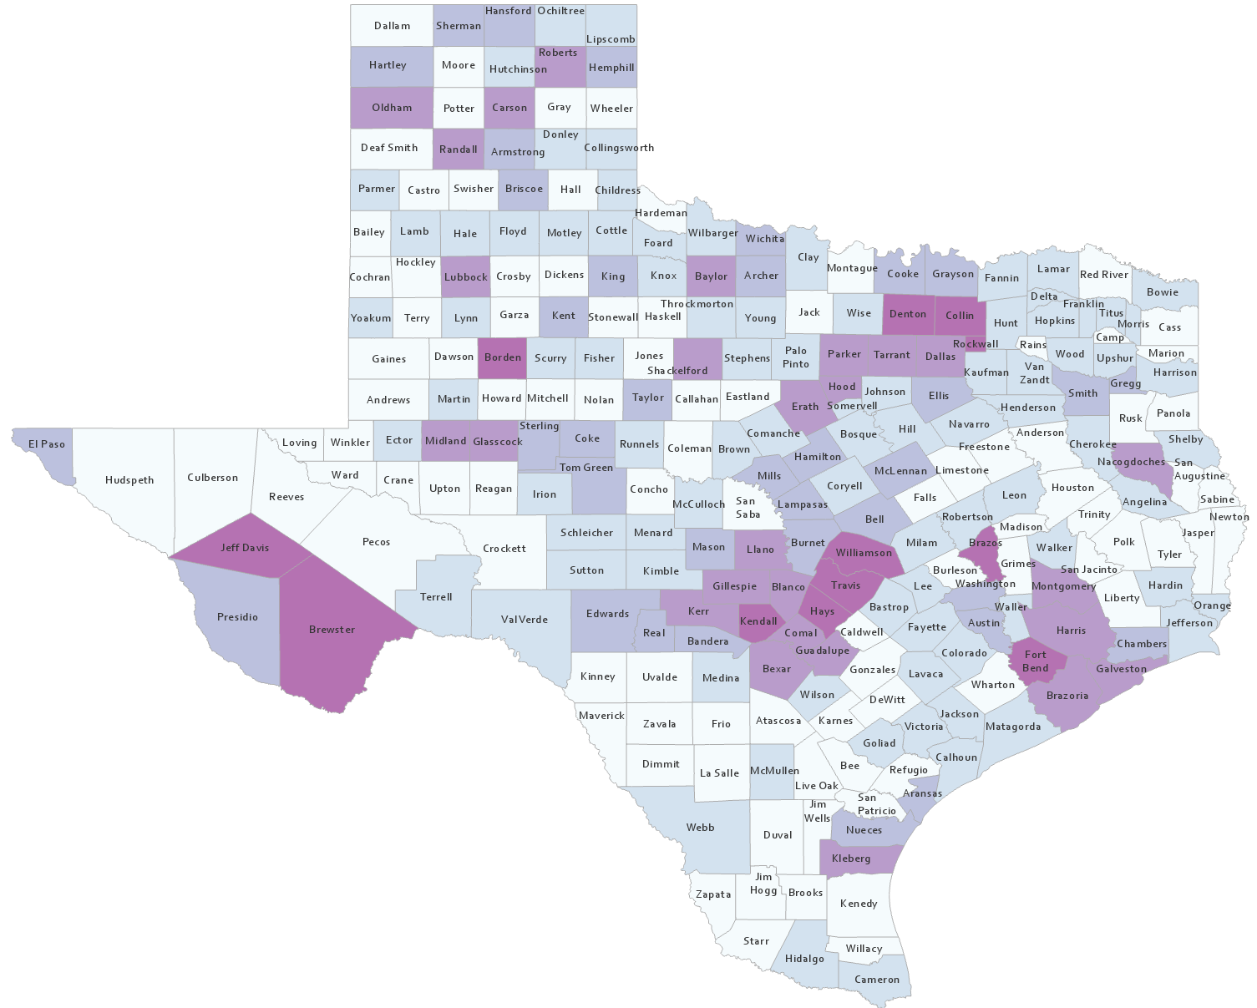
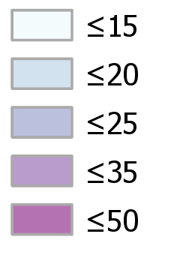
Percent of the population aged 25 years and older with a bachelor’s degree or higher, Texas counties, 2012-2016
Source: U.S. Census Bureau, American Community Survey, 2012-2016 5-Year Sample

Slide 18
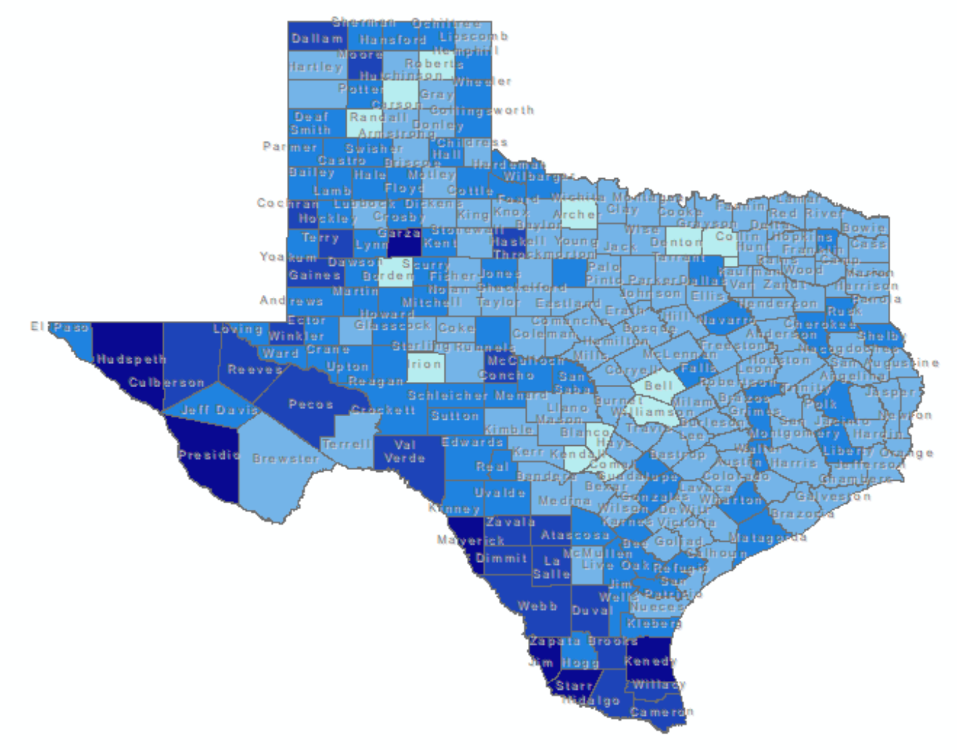
Percent of persons aged 25 years and older with less than an high school diploma, Texas counties, 2017
Source: U.S. Census Bureau, American Community Survey, 2013-2017 5-Year Sample

Slide 19
Percent of the population aged 5 years and older who do not speak English at home and speak English less than very well, Texas Counties, 2017
Source: U.S. Census Bureau, American Community Survey, 2013-2017 5-Year Sample

Slide 20
Percent distribution of educational attainment of native born and foreign born persons aged 25 years and older, Texas, 2016
About 118,868 persons are native born and are not English fluent
About 1,387,310 person are foreign born and are not English fluent
Source: U.S. Census Bureau, American Community Survey, 5-Year Sample 2012-2016

Slide 21
Percent of persons aged 25 years and older who are English fluent, native-born, and did not obtain a high school diploma, Texas, 2016
Source: U.S. Census Bureau, American Community Survey, 5-Year Sample 2012-2016

Slide 22
Percent Distribution of Educational Attainment of Persons Aged 25 Years and Older, Texas, 2008, 2011, and 2015
Source: U.S. Census Bureau, American Community Survey, 1-Year Samples, 2008-2015

Slide 23
Trends in percent distribution of educational attainment among the population aged 25 years and older, Texas, 2010-2017 and linear forecast
Source: U.S. Census Bureau, American Community Survey, 2010-2017 1-Year Samples

Slide 24
Projected Population Growth in Texas,
2010-2050
Source: Texas Demographic Center 2018 Population Projections
Notes:
According to the most recent projection (2010-2015) Texas will add 10 million new residents over the 2010 census by 2030. The bulk of these new residents will be children and from Hispanic families.

Slide 25

Contact
  State Demographer
  Texas Demographic Center
  Office: (210) 458-6530
  Email: Lloyd.Potter@UTSA.edu
  Internet: Demographics.Texas.gov
Lloyd Potter, Ph.D.
@TexasDemography
Notes:
The Texas State Demographic Center is committed to supporting government, business, non-profit organizations and citizens with the best, most accurate, and objective information we can identify about our greatest asset, the people of Texas.

Slide 26
Educational Attainment of Persons Age 25 Years and Older by Race/Ethnicity, Texas, 2015
35.9%
69.4 %
Source: U.S. Census Bureau, American Community Survey, 1-Year Sample, 2015

Slide 27
Trends in percent distribution of educational attainment among Hispanics aged 25 years and older, Texas, 2010-2017 and linear forecast
Source: U.S. Census Bureau, American Community Survey, 2010-2017 1-Year Samples

Slide 28
Trends in percent distribution of educational attainment among non-Hispanic Whites aged 25 years and older, Texas, 2010-2017 and linear forecast
Source: U.S. Census Bureau, American Community Survey, 2010-2017 1-Year Samples

Slide 29
Trends in percent distribution of educational attainment among African-Americans aged 25 years and older, Texas, 2010-2017 and linear forecast
Source: U.S. Census Bureau, American Community Survey, 2010-2017 1-Year Samples

Slide 30
Trends in percent distribution of educational attainment among Asians aged 25 years and older, Texas, 2010-2017 and linear forecast
Source: U.S. Census Bureau, American Community Survey, 2010-2017 1-Year Samples

