Slide 1


The Changing Workforce of Texas
Texas State University Career Services
May 3, 2019
@TexasDemography

Slide 2
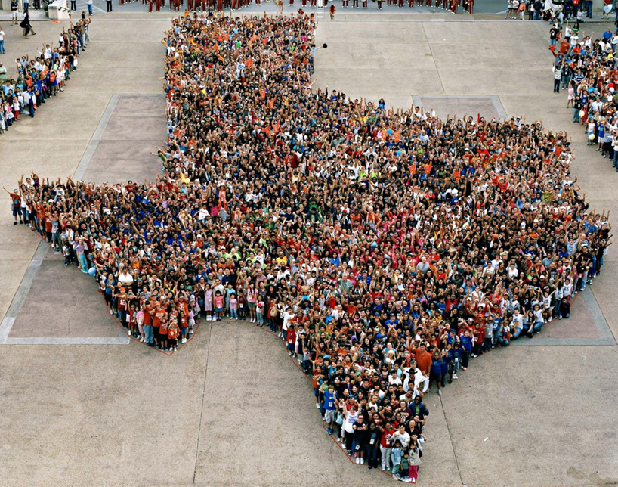
Texas is experiencing significant growth.

Slide 3
Population Growth of Select States, 2000-2018
 | 2000 Population | 2010 Population | 2018 Population | Numeric Change 2010-2018 | Percent Change 2010-2018
United States | 281,421,906 | 308,745,538 | 327,167,434 | 18,409,329 | 6%
Texas | 20,851,820 | 25,145,561 | 28,701,845 | 3,555,731 | 14%
California | 33,871,648 | 37,253,956 | 39,557,045 | 2,302,522 | 6%
Florida | 15,982,378 | 18,801,310 | 21,299,325 | 2,494,745 | 13%
Georgia | 8,186,453 | 9,687,653 | 10,519,475 | 830,766 | 9%
North Carolina | 8,049,313 | 9,535,483 | 10,383,620 | 847,884 | 9%
Washington | 5,894,121 | 6,724,540 | 7,535,591 | 811,051 | 12%
Arizona | 5,130,632 | 6,392,017 | 7,171,646 | 779,358 | 12%
Colorado | 5,029,196 | 5,029,196 | 5,695,564 | 666,248 | 13%
Source: U.S. Census Bureau. 2000 and 2010 Census Count, 2018 Population Estimates.
Notes:
Texas is the second largest state in terms of population (2nd to CA) and area (2nd to AK). In terms of number of people, Texas’ growth exceeds that of all other states between 2010 and 2018.

Slide 4
Texas added 379,128 people between July 1, 2017 and July 1, 2018.
About 1,039 people per day added to our population.
  About 524 persons per day from natural increase (more births than deaths)
  About 515 per day from net migration (288 international and 227 domestic migrants per day).
Source: U.S. Census Bureau, 2018 Population Estimates.

Slide 5
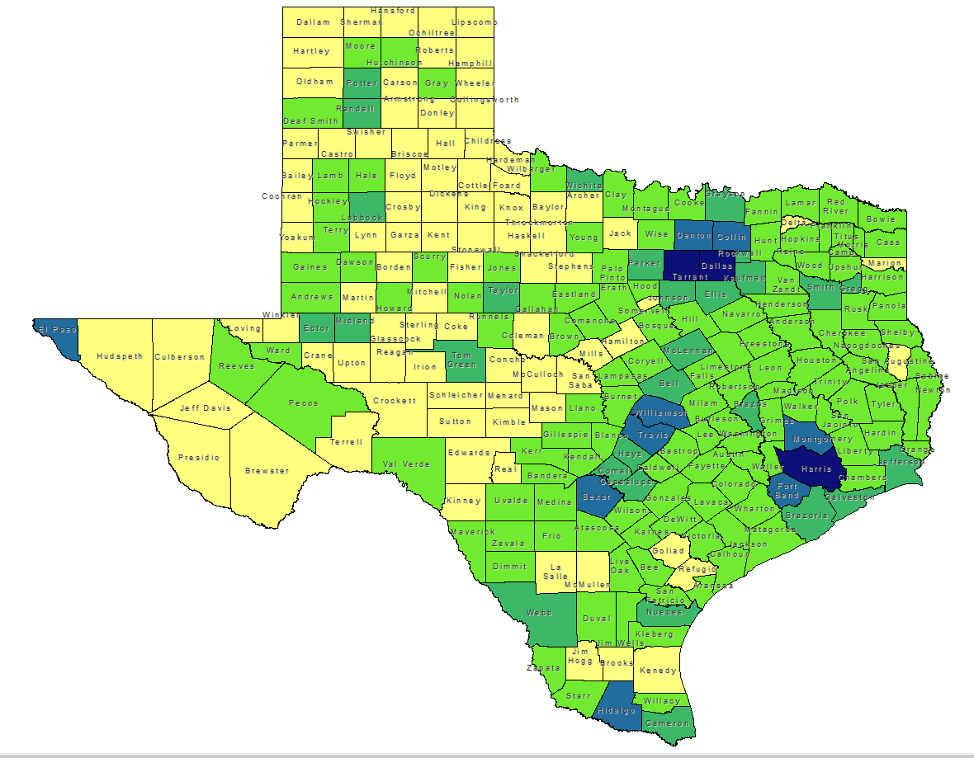

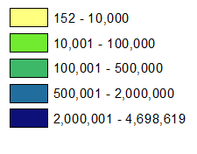
Total Estimated Population by County, Texas, 2018
Source: U.S. Census Bureau, 2018 Population Estimates
Notes:
When we look at the geographic distribution of the population of Texas over time we see continually increasing population in the counties along the I-35 corridor, the Houston area, and the lower Rio Grand Valley. Urbanized areas out west have grown but most counties in the west have experienced limited growth and some population decline. Approximately 86% of the population is along I-35 and east. This area with the 3 major metropolitan areas at the points is often described as the Texas population triangle.

Slide 6
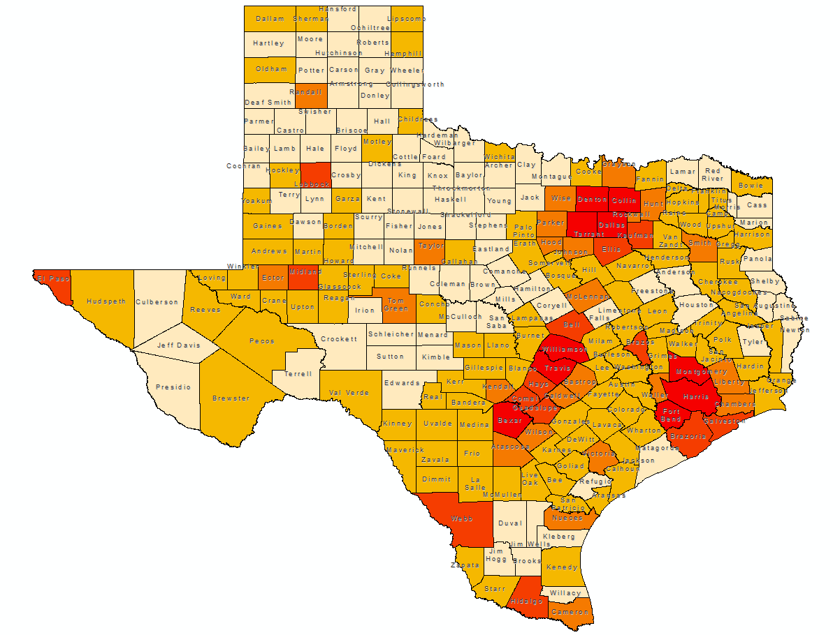
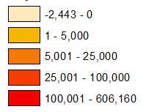
Estimated Population Change, Texas Counties,
2010 to 2018
96 counties lost population over the 8 year period.
Source: U.S. Census Bureau, 2018 Population Estimates
Notes:
Population change over the decade has been greatest in the urban and suburban population triangle counties. Counties in the lower Rio Grande Valley also had significant growth as did El Paso. Overall, 158 counties gained population while 96 (38%) lost population over the decade.

Slide 7
Top Counties for Numeric Growth in Texas, 2017-2018
County | U.S. Rank | 2018 Population Estimate | Population Change 2017-2018 | Percent of Change from Natural Increase | Percent of Change from Domestic Migration | Percent of Change from International Migration
Harris | 3 | 4,698,619 | 34,460 | 122.5% | -127.2% | 104.8%
Collin | 4 | 1,005,146 | 33,753 | 19.0% | 64.7% | 16.3%
Tarrant | 8 | 2,084,931 | 27,463 | 54.2% | 15.6% | 30.2%
Bexar | 9 | 1,986,049 | 27,208 | 51.1% | 30.1% | 18.8%
Denton | 11 | 859,064 | 23,734 | 25.9% | 63.8% | 10.3%
Fort Bend | 13 | 787,858 | 21,722 | 29.0% | 45.8% | 25.2%
Travis | 14 | 1,248,743 | 20,972 | 46.3% | 23.5% | 30.2%
Williamson | 15 | 566,719 | 20,771 | 18.4% | 75.7% | 5.9%
Montgomery | 17 | 590,925 | 18,779 | 17.4% | 73.9% | 8.6%
Dallas | 28 | 2,637,772 | 14,973 | 153.5% | -148.9% | 95.5%
Hays | 56 | 222,631 | 8,354 | 18.7% | 78.3% | 3.1%
Bell | 61 | 355,642 | 7,791 | 49.1% | 39.8% | 11.1%
Hidalgo | 65 | 865,939 | 7,616 | 131.1% | -46.7% | 15.6%
Comal | 67 | 148,373 | 7,583 | 4.9% | 93.1% | 2.0%
Brazoria | 68 | 370,200 | 7,500 | 30.9% | 59.8% | 9.3%
Midland | 72 | 172,578 | 7,192 | 24.3% | 69.3% | 6.4%
Harris, Dallas, and Hidalgo Counties had negative net migration.
Source: U.S. Census Bureau, 2018 Population Estimates

Slide 8
Top Counties for Percent Growth* in Texas, 2017-2018
County | U.S. Rank | 2018 Population Estimate | Population Change 2017-2018 | Percent Population Change 2017-2018 | Percent of Population Change from Natural Increase | Percent of Population Change from Domestic Migration | Percent of Population Change from International Migration
Comal | 3 | 148,373 | 7,583 | 5.4% | 4.9% | 93.1% | 2.0%
Kaufman | 4 | 128,622 | 5,777 | 4.7% | 13.0% | 85.8% | 1.2%
Midland | 7 | 172,578 | 7,192 | 4.3% | 24.3% | 69.3% | 6.4%
Hood | 10 | 60,537 | 2,383 | 4.1% | -2.3% | 100.0% | 2.3%
Rockwall | 13 | 100,657 | 3,780 | 3.9% | 11.8% | 84.4% | 3.8%
Hays | 14 | 222,631 | 8,354 | 3.9% | 18.7% | 78.3% | 3.1%
Williamson | 18 | 566,719 | 20,771 | 3.8% | 18.4% | 75.7% | 5.9%
Kendall | 20 | 45,641 | 1,657 | 3.8% | 0.5% | 94.9% | 4.6%
Wise | 22 | 68,305 | 2,442 | 3.7% | 6.4% | 91.9% | 1.7%
Waller | 24 | 53,126 | 1,841 | 3.6% | 18.9% | 77.7% | 3.4%
Parker | 31 | 138,371 | 4,667 | 3.5% | 9.5% | 88.3% | 2.2%
Collin | 33 | 1,005,146 | 33,753 | 3.5% | 19.0% | 64.7% | 16.3%
Rains | 34 | 12,159 | 408 | 3.5% | -5.9% | 103.2% | 2.7%
Ellis | 39 | 179,436 | 5,800 | 3.3% | 16.0% | 81.7% | 2.3%
Montgomery | 43 | 590,925 | 18,779 | 3.3% | 17.4% | 73.9% | 8.6%
Ector | 48 | 162,124 | 4,951 | 3.2% | 29.6% | 63.9% | 6.5%
*Among counties with populations of 10,000 or more in 2018.
Source: U.S. Census Bureau, 2018 Population Estimates

Slide 9
15 Fastest-Growing Large Cities and Towns between 2016 and 2017 (Populations of 50,000 or more in 2016)
Rank | City | State | Percent increase | 2017 total population
1 | Frisco | TX | 8.2 | 177,286
2 | New Braunfels | TX | 8.0 | 79,152
3 | Pflugerville | TX | 6.5 | 63,359
4 | Ankeny | IA | 6.4 | 62,416
5 | Buckeye | AZ | 5.9 | 68,453
6 | Georgetown | TX | 5.4 | 70,685
7 | Castle Rock town | CO | 5.1 | 62,276
8 | Franklin | TN | 4.9 | 78,321
9 | McKinney | TX | 4.8 | 181,330
10 | Meridian | ID | 4.7 | 99,926
11 | Flower Mound town | TX | 4.3 | 76,681
12 | Bend | OR | 4.3 | 94,520
13 | Cedar Park | TX | 4.2 | 75,704
14 | Doral | FL | 4.2 | 61,130
15 | Fort Myers | FL | 4.2 | 79,94
Source: U.S. Census Bureau, 2017 Vintage Population Estimates
Notes:
Nearly half of the top 15 fastest growing cities between 2016 and 2017 are in Texas. The fastest growing city in the country is located in the Dallas Fort Worth metro area.

Slide 10
Estimated Percent of Total Net-Migrant Flows to and From Texas and Other States, 2017
Source: U.S. Census Bureau, State to State Migration Flows, 2017

Slide 11


Domestic and Internal Migration Flows to and from the Austin Metro
Highest Sending
States:
California
Florida
New York
Colorado
Illinois
Highest Receiving
States:
California
Colorado
New York
Florida
Massachusetts
Source: U.S. Census Bureau, 2016. ACS County to County Migration Flows, 2010-2014

Slide 12
County to County Migration Flows, Travis County, 2012-2016
Travis County
 | In-Flows | Net Migration
Williamson County | 11,146 | -7,059
Harris County | 5,576 | 1,083
Bexar County | 3,824 | 510
Hays County | 3,802 | -3,148
Dallas County | 3,412 | 1,226
Tarrant County | 1,475 | -257
Bastrop County | 1,422 | -1,335
Collin County | 1,191 | 546
Caldwell County | 344 | -478
Blanco County | 34 | -12
Source: U.S. Census Bureau, American Community Survey County to County Migration Flows, 2012-2016

Slide 13

Texas continues to diversify.

Slide 14
Texas Racial and Ethnic Composition,
2000, 2010, and 2017
11
Source: U.S. Census Bureau. 2000, 2010 Decennial Census and 2017 Population Estimates
Notes:
As of the 2000 Census, about 53% of Texas’ population was non-Hispanic White, about 32% where of Hispanic descent, about 11% where non-Hispanic African American, and about 3% NH Asian, and 1% non-Hispanic Other.
In 2010, the Texas population was made up of 45% non-Hispanic Whites, 38% of Hispanic descent, 11% non-Hispanic Black or African American, 4% non-Hispanic Asian, and 2% non-Hispanic Other. In 2017, Texas continues to diversify with increases in the proportion of the population identifying as Hispanic and NH Asian and a decrease in the proportion identifying as White, NH.
Hispanics are a major driver of growth in Texas. Between 2000 and 2010, of every 10 people added to the Texas population, 6 were Hispanic. In 2010, Hispanics made up 32% of the total Texas population. Currently, Hispanics make up 39% of the total population. This represents an annual growth rate of over 2.5%, higher than the state growth rate. Over half (53.7%) of the growth add to the Texas population between 2010 and 2017 can be attributed to growth among Hispanics.

Slide 15
Race/Ethnicity Composition, Austin Metro Area and Its Counties, 2017
Austin Metro Area
 | Hispanic | NH White | NH Black | NH Asian | NH Two or More Races
Travis County | 33.9% | 49.0% | 8.0% | 6.8% | 1.9%
Williamson County | 24.5% | 59.6% | 6.4% | 6.9% | 2.1%
Hays County | 39.0% | 53.8% | 3.7% | 1.5% | 1.6%
Bastrop County | 37.8% | 52.6% | 6.8% | 0.8% | 1.4%
Caldwell County | 52.3% | 39.7% | 5.8% | 0.9% | 1.0%
Source: U.S. Census Bureau, 2017 Population Estimates
Source: U.S. Census Bureau, 2017 American Community Survey 1-Year Estimates

Slide 16
Numeric and Percent Change by Race/Ethnicity, 2010 to 2017
 | Total |  | Hispanic |  | NH White |  | NH Black |  | NH Asian |  | NH Other
 | Num Change | % Change | Num Change | % Change | Num Change | % Change | Num Change | % Change | Num Change | % Change | Num Change | % Change
Bastrop | 10,602 | 14.3% | 7,884 | 32.6% | 2,036 | 4.8% | 233 | 4.2% | 182 | 40.0% | 255 | 18.4%
Caldwell | 4,281 | 11.2% | 4,206 | 23.5% | -76 | -0.4% | -38 | -1.5% | 39 | 11.3% | 141 | 33.3%
Hays | 57,396 | 36.5% | 28,311 | 51.1% | 23,024 | 24.9% | 2,857 | 57.1% | 1,537 | 89.1% | 1,649 | 62.7%
Travis | 202,219 | 19.7% | 73,390 | 21.4% | 82,086 | 15.8% | 14,923 | 17.9% | 24,703 | 41.8% | 7,330 | 37.1%
Williamson | 125,009 | 29.6% | 36,218 | 36.9% | 56,237 | 20.8% | 9,920 | 39.8% | 17,714 | 87.3% | 4,777 | 51.5%
Austin Metro | 399,507 | 23.2% | 150,007 | 27.9% | 162,392 | 17.3% | 23,309 | 19.3% | 40,942 | 50.6% | 22,888 | 60.2%
Source: U.S. Census Bureau, 2017 Population Estimates; 2017 American Community Survey 1-Year Estimates

Slide 17
Total Fertility Rate by Race/Ethnicity, Texas, 1990-2017
Source: Centers for Disease Control and Prevention, National Center for Health Statistics, National Vital Statistics Report

Slide 18
Population Pyramid for White Non-Hispanics in Texas, 2017
Source: U.S. Census Bureau, 2017 Population Estimates
Notes:
The age distribution of the non-Hispanic white population in Texas is weighted heavily with the “baby boom” generation. Largely the result of lower fertility and less net in-migration, the non-Hispanic white population has relatively fewer young persons relative to those in the middle-age years. In 2010, at ages 37 and younger, the Hispanic population exceeds the non-Hispanic white population. In 2017, median age of NH White women is 43.5 years of age, compared to 29.3 years of age for Hispanic women.

Slide 19
Population Pyramid for Hispanics in Texas, 2017
Source: U.S. Census Bureau, 2017 Population Estimates

Slide 20
Texas Population Pyramid by Race/Ethnicity, 2017
Source: U.S. Census Bureau, 2017 Population Estimates
Notes:
This population pyramid represents the age, sex, race and ethnic composition of the Texas population. Blue represents males, red females, rows are single years of age, and shades represent specified race/ethnic groups as indicated in the legend.

Slide 21
Annual Shares of Recent Non-Citizen Immigrants to Texas by World Area of Birth, 2005-2015
Estimated number of international migrants to Texas
101,588
77,702
98,194
Source: U.S. Census Bureau, American Community Survey, 1-Year PUMS
Notes:
In 2017, it is estimated 17%, or 4.85 million, of the Texas population was foreign born.

Slide 22

Young Texans

Slide 23
Population by Age Group, Texas, 2010-2017
Source: U.S. Census Bureau, 2017 Population Estimates

Slide 24
Austin Metro Counties, Select Age Groups, 2010-2017
 | 18 to 24 Years of Age |  | 25 to 34 Years of Age
 | 2010 | 2017 | 2010 | 2017
Bastrop | 5,741 | 7,059 | 8,597 | 10,125
Caldwell | 4,412 | 4,792 | 4,647 | 5,733
Hays | 27,911 | 36,027 | 21,188 | 31,255
Travis | 130,115 | 113,033 | 192,573 | 245,766
Williamson | 31,800 | 43,310 | 63,547 | 76,207
Source: U.S. Census Bureau, 2017 Population Estimates

Slide 25
Place of Birth for Population 18 to 24 Years, Texas,
2007 and 2017
Source: U.S. Census Bureau, American Community Survey 1-Year Estimates, 2007, 2017

Slide 26
Population 18 to 24 Years by Race/Ethnicity, Texas,
2010-2017
Source: U.S. Census Bureau, 2017 Population Estimates
Notes:
Nearly half (or 46%) of Young Texans are Hispanic. Hispanics and other non-white race groups are driving growth in the 18 to 24 year-old population. The non-White population of 18 to 24 year-olds decreased between 2010 and 2017 from right under 1 million to 953 thousand.

Slide 27
Annual Numeric Change in Population 18 to 24, Texas, 2010-2017
Source: U.S. Census Bureau, 2017 Population Estimates
Notes:
Although the population of young Texans has been growing since the last Census, growth has been steadily decreasing among all race/ethnic groups, with actual declines seen among Black and non-Hispanic White 18 to 24 year olds.

Slide 28
Population 15 to 24 Years, Austin Metro Counties,
2010-2017
 |  | NH White | NH Black | NH Asian | Hispanic
Bastrop | 2010 | 4,173 | 746 | 42 | 3,873
 | 2017 | 4,160 | 750 | 69 | 5,638
Caldwell | 2010 | 2,231 | 495 | 192 | 3,399
 | 2017 | 2,032 | 447 | 196 | 3,908
Hays | 2010 | 19,618 | 1,492 | 471 | 11,974
 | 2017 | 22,334 | 2,254 | 729 | 17,954
Travis | 2010 | 72,564 | 14,119 | 11,825 | 63,713
 | 2017 | 59,244 | 14,197 | 12,034 | 65,568
Williamson | 2010 | 28,045 | 3,699 | 1,633 | 15,616
 | 2017 | 34,528 | 5,046 | 3,733 | 22,185
Source: U.S. Census Bureau, 2017 Population Estimates

Slide 29
College and Graduate Enrollment, Texas, 2007-2017
Source: U.S. Census Bureau, American Community Survey 1-Year Estimates, 2007-2017

Slide 30
College and Graduate Enrollment by Race/Ethnicity, Texas, 2008-2017
Source: U.S. Census Bureau, American Community Survey 1-Year Estimates, 2008-2017

Slide 31
Select Social Characteristics of Young Texans, 2017
1.85 million Texans are enrolled in college or graduate school.
  20.7% of undergrads live below the poverty level.
  14.6% of graduate students live below the poverty level.
  20.9% of 19 to 25 year-olds enrolled in school have no insurance.
 | Total | Male | Female
Population 18 to 24 | 2,790,087 | 1,441,775 | 1,348,312
Enrolled in college or graduate school | 37.9% | 34.1% | 41.9%
Enrolled in public school | 85.5% | 86.3% | 84.7%
Enrolled in private school | 14.5% | 13.7% | 15.3%
Percent below Poverty | 50.0% | 43.3% | 56.8%
Percent without Health Insurance* | 29.3% | 30.7% | 27.8%
Source: U.S. Census Bureau, 2017 American Community Survey 1-Year Estimates
Notes:
Over one-third of 18 to 24 year-olds are enrolled college or graduate school. Enrollment is higher among women of this age group. A large majority of young Texans enrolled in college or graduate school are enrolled in a public college or university. Of those, enrolled in private schools, there is a larger share who are women compared to men.
One in two 18 to 24 year-olds in Texas live below the poverty level, with young women more likely to live below poverty level.
18 to 24 year-old Texans have the highest uninsured rate of all other age groups, with young men being more likely to be uninsured.

Slide 32

Texas economic indicators

Slide 33
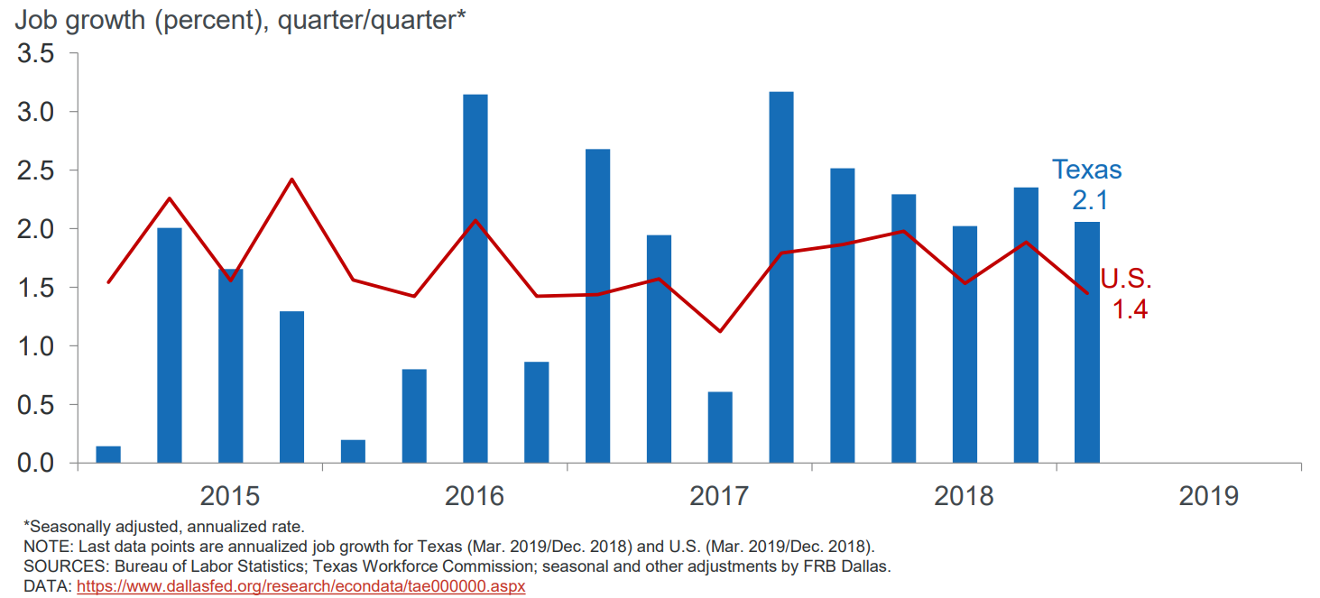
U.S. and Texas Job Growth, 2015-2019

Slide 34
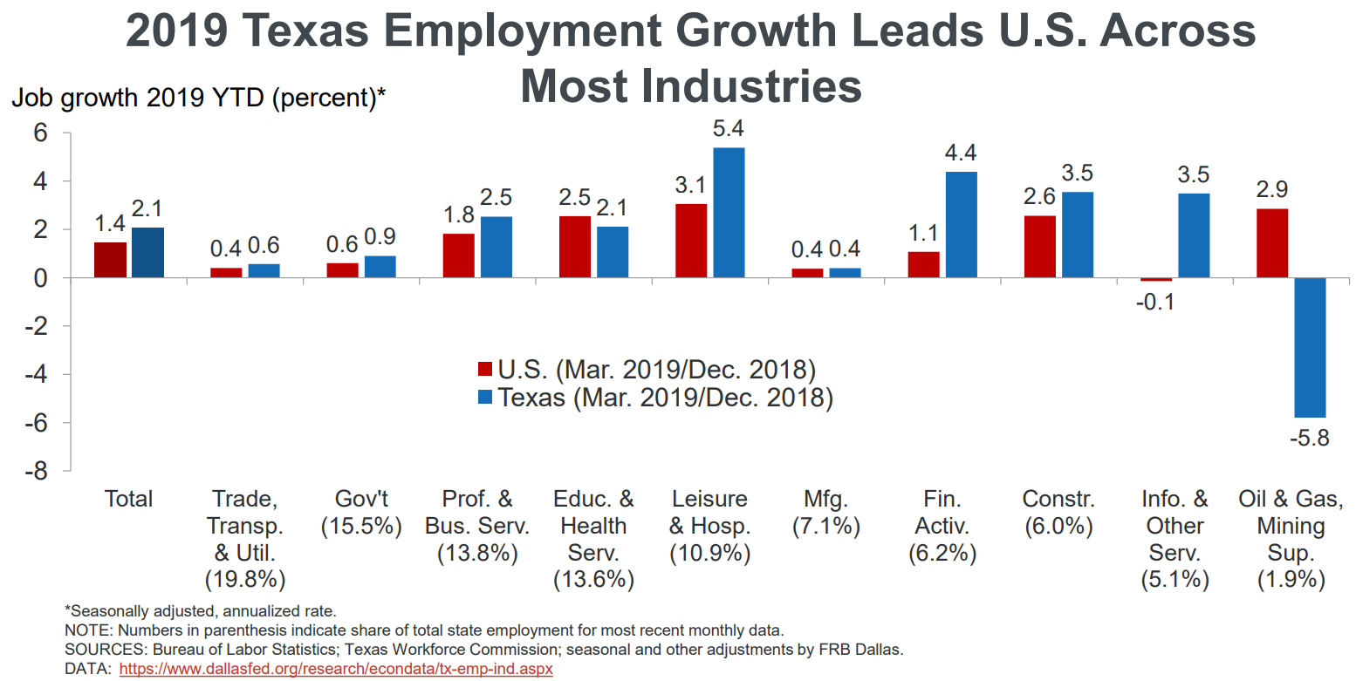

Slide 35
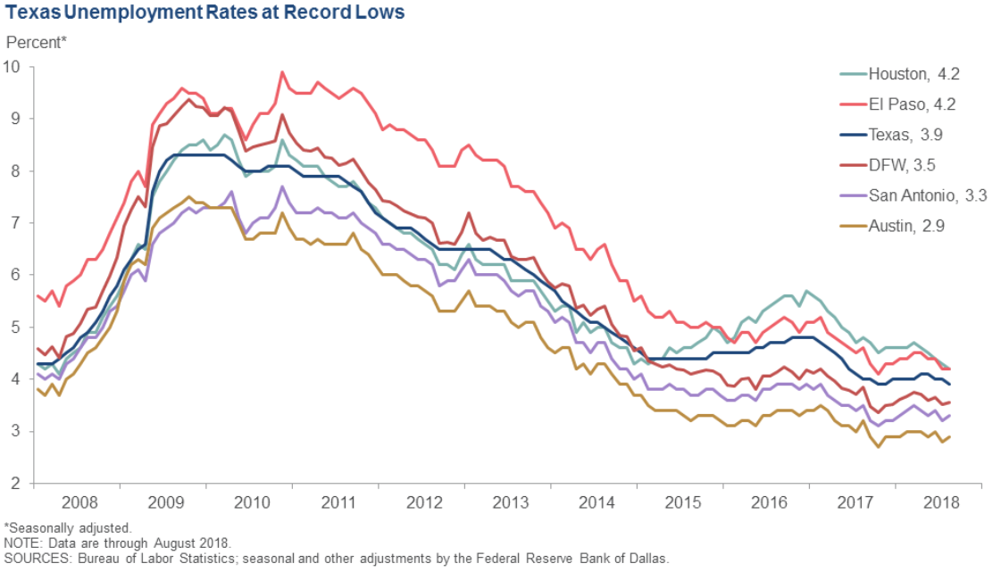

Slide 36
Economic Indicators, Texas and U.S., 2017
 | Median Household Income | Change, 2016-2017
Texas | $59,206 | +
Asian | $84,100 | +
NH White | $72,361 | +
Hispanic | $46,855 | +
Black | $45,092 | +
Unemployment rate
  Texas = 5.1%
  U.S. = 5.3%
Median Household Income
  Texas = $59,206
  U.S. = $60,336
Median Family Income
  Texas = $70,136
  U.S. = $73,891
Poverty rate
  Texas = 14.7%
  U.S. = 13.4%
Source: U.S. Census Bureau, 2017 American Community Survey 1-Year Estimates

Slide 37
Housing Affordability in Select Texas Metros,
2007-2017
Notes: Data are through fourth quarter 2017. The Housing Opportunity Index represents the share of homes sold in a given area that
Would have been affordable to a family earning the local median income.
Source: National Association of Home Builders/Wells Fargo.
Notes:
Housing affordability—the share of homes sold that were affordable to a median-income family in the area—has fallen in most major Texas metros. Additionally, apartment demand and occupancy rates generally remain high.

Slide 38
Percent Population 25 Years Plus with HS Degree and Above, Austin Metro, Census Tracts, 2017
Source: U.S. Census Bureau, American Community Survey, 5-Year Sample, 2013-2017

Slide 39
Percent Population 25 years plus with a Bachelor’s Degree and Above, Austin Metro, Census Tracts, 2017
Source: U.S. Census Bureau, American Community Survey, 5-Year Sample, 2013-2017

Slide 40
Percent of Below Poverty, Austin Metro, Census Tracts, 2017
Source: U.S. Census Bureau, American Community Survey 2017 5-Year Estimates

Slide 41
Median Household Income, Austin Metro, Census Tracts, 2017
Source: U.S. Census Bureau, American Community Survey 2017 5-Year Estimates

Slide 42
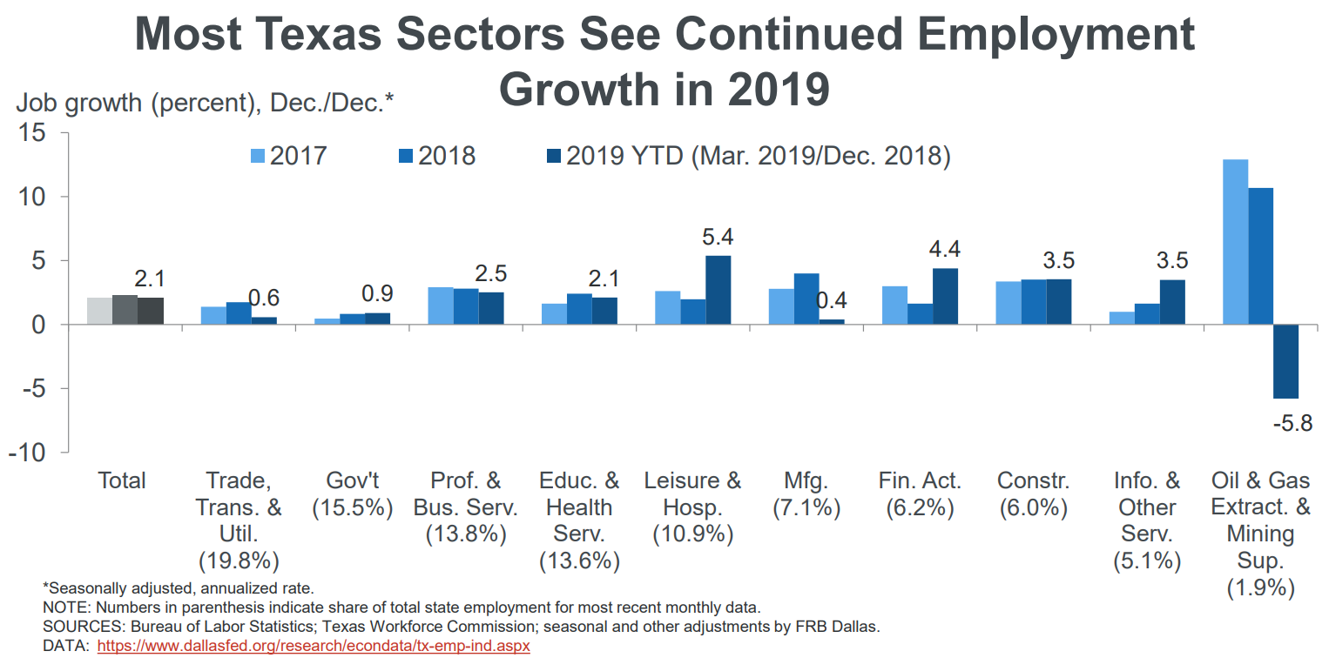
Notes:
The Service Industry makes up the bulk of the Texas economy, accounting for over 60% of private-sector activity in Texas.
Source: Federal Reserve Bank of Dallas

Slide 43

Population Projections

Slide 44
Projected Population, 2010-2050, Texas
Source: Texas Demographic Center, 2014 and 2018 Population Projections

Slide 45
Projected Population by Race and Ethnicity,
Texas 2010-2050
Source: Texas Demographic Center 2018 Population Projections
Notes:
Population projections by race and ethnicity suggest that Latino’s are and will increasingly be the largest race/ethnic group. The number and percent who are non-Hispanic white are likely to decline. Non-Hispanic other are largely of Asian descent and they appear to be increasing rapidly, although the base number is small.

Slide 46
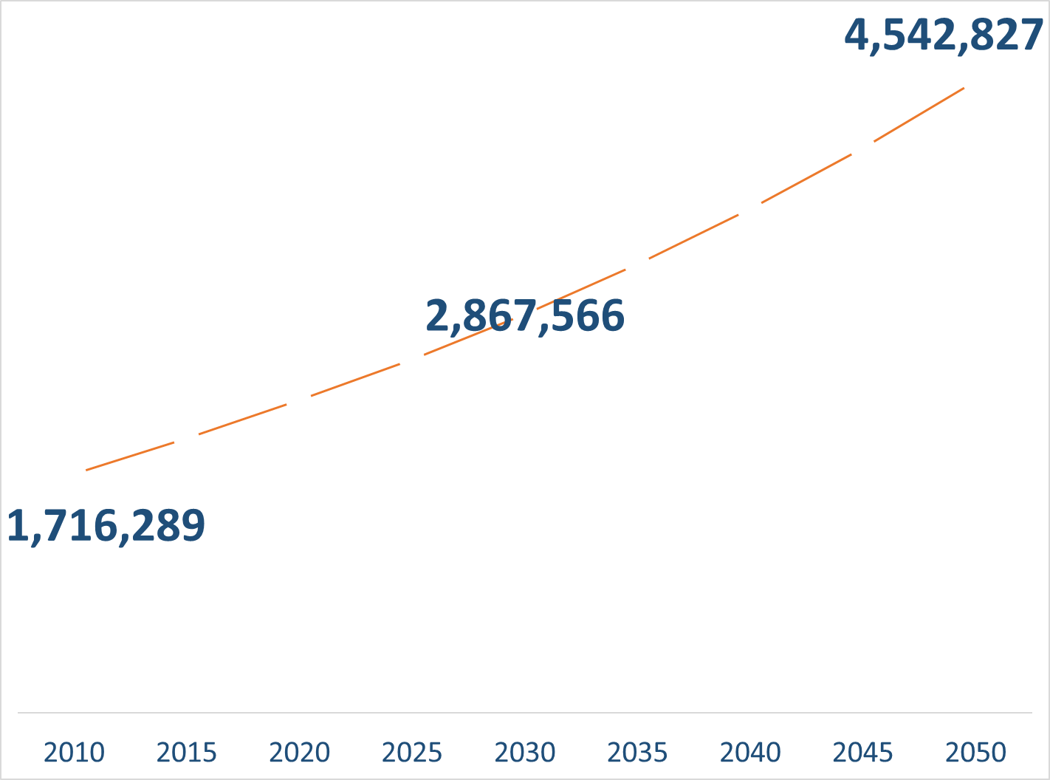
Population Projections, Austin-Round Rock Metro Area, 2010-2050
Source: Texas Demographic Center, 2018 Population Projections

Slide 47
Population Projections by Race/Ethnicity,
Austin Metro Area, 2010-2050
Source: Texas Demographic Center, 2018 Population Projections

Slide 48

JOIN US!

Slide 49



Lila Valencia, Ph.D.
(512) 936-3542
Lila.Valencia@utsa.edu
demographics.texas.gov
@TexasDemography

Slide 50
Texas Hard to Count Populations
An estimated 7 million, or nearly 25%, of Texans live in hard to count neighborhoods.
People of Color
  Texas has the second largest number of Hispanics and African Americans and third largest number of Asian populations of all states in the U.S.
Children under 5
  An estimated 5 percent, or about 2.2 million, of kids under the age of 5 were not counted in the 2010 Census, including about 75,000 Texas children.
Renters
  Over 1 in 3 Texas households are renter occupied.
Larger Households
  Approximately 5% of Texas households are considered crowded households, where more than 1 person per room is living in the household.
Notes:
Census research has shown some populations historically have been, or are at risk of being, missed in the census at disproportionately higher rates.

Slide 51
Texas Hard to Count Populations
Single-Parent Households
  An estimated 1.2 million Texas households are single-parent households, and all of these households are households with children under 18 years of age.
Immigrants
  An estimated 4.85 million foreign born reside in Texas.
Low Income Populations
  Over 1 in 3 Texas households are renter occupied.
People with Limited English Proficiency
  Approximately 8% of Texas households are limited English speaking households, with 85% of these households speaking Spanish, 9% speaking an Asian or Pacific Islander language, 4% speaking Indo-European languages, and 2% speaking other languages.
People living in Multi-Family Housing
  Nearly 1 in 4 Texas housing units are in buildings with 2 or more units and 15% of Texas housing units are in buildings with 10 or more units.
Notes:
Census research has shown some populations historically have been, or are at risk of being, missed in the census at disproportionately higher rates.

