Slide 1


Demographic Trends, Characteristics, and Projections for Texas and the Central Texas Region
Associated Builders and Contractors
Central Texas Chapter
August 28, 2019
@TexasDemography

Slide 2
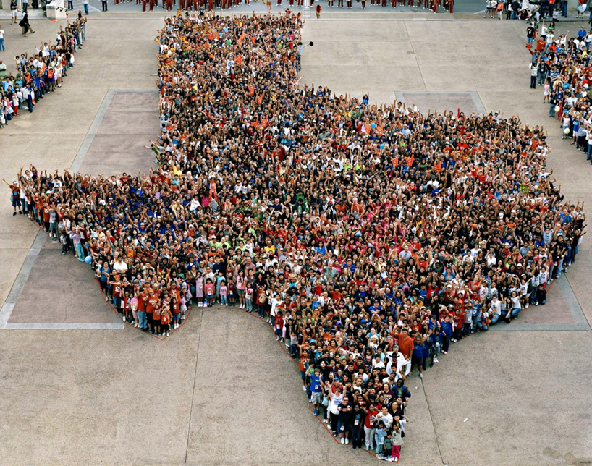
Texas is experiencing significant growth.

Slide 3
Population Growth of Select States, 2000-2018
 | 2000 Population | 2010 Population | 2018 Population | Numeric Change 2010-2018 | Percent Change 2010-2018
United States | 281,421,906 | 308,745,538 | 327,167,434 | 18,409,329 | 6%
Texas | 20,851,820 | 25,145,561 | 28,701,845 | 3,555,731 | 14%
California | 33,871,648 | 37,253,956 | 39,557,045 | 2,302,522 | 6%
Florida | 15,982,378 | 18,801,310 | 21,299,325 | 2,494,745 | 13%
Georgia | 8,186,453 | 9,687,653 | 10,519,475 | 830,766 | 9%
North Carolina | 8,049,313 | 9,535,483 | 10,383,620 | 847,884 | 9%
Washington | 5,894,121 | 6,724,540 | 7,535,591 | 811,051 | 12%
Arizona | 5,130,632 | 6,392,017 | 7,171,646 | 779,358 | 12%
Colorado | 5,029,196 | 5,029,196 | 5,695,564 | 666,248 | 13%
Source: U.S. Census Bureau. 2000 and 2010 Census Count, 2018 Population Estimates.
Notes:
Texas is the second largest state in terms of population (2nd to CA) and area (2nd to AK). In terms of number of people, Texas’ growth exceeds that of all other states between 2010 and 2018. Texas added 379,128 people between July 1, 2017 and July 1, 2018.
About 1,039 people per day added to our population.
About 524 persons per day from natural increase (more births than deaths)
About 515 per day from net migration (288 international and 227 domestic migrants per day).

Slide 4

Total Estimated Population by County, Texas, 2018
Source: U.S. Census Bureau, 2018 Population Estimates
Notes:
When we look at the geographic distribution of the population of Texas over time we see continually increasing population in the counties along the I-35 corridor, the Houston area, and the lower Rio Grand Valley. Urbanized areas out west have grown but most counties in the west have experienced limited growth and some population decline. Approximately 86% of the population is along I-35 and east. This area with the 3 major metropolitan areas at the points is often described as the Texas population triangle.

Slide 5
Estimated Population Change, Texas Counties,
2010 to 2018
96 counties lost population over the 8 year period.
Source: U.S. Census Bureau, 2018 Population Estimates
Notes:
Population change over the decade has been greatest in the urban and suburban population triangle counties. Counties in the lower Rio Grande Valley also had significant growth as did El Paso. Overall, 158 counties gained population while 96 (38%) lost population over the decade.

Slide 6
Estimated Percent Change of the Total Population by County, Texas, 2010 to 2018
Source: U.S. Census Bureau, 2018 Population Estimates
Notes:
Percent change is an indicator of the speed of population change void of information about the volume of population change. Percent change in the population over the past few years has been greatest in the suburban population triangle counties, notably among counties between San Antonio and Austin. In the early part of the decade, counties in the Eagle Ford Shale area (south east of San Antonio) had been growing quickly. This is less so the case today. The Cline Shale area (Midland and Odessa area) continues to grow and in some cases even growing faster than the State.

Slide 7
Components of Population Change
by Percent in Texas, 1950-2010
Source: U.S. Census Bureau, Population Estimates
Notes:
It is important to understand a couple of very basic element of population change to think about how growing population may impact our state infrastructure and demand for services. Population changes from two factors, one is natural increase which is simply births minus deaths over time. Essentially population added from natural increase are babies who are usually added to an already existing household. They won’t be attending school for at least the next 4 years and they won’t be driving their own vehicle on our roads for another 16 years. So the effect of population growth from natural increase on our state infrastructure is both lightening, from people dying, and somewhat lagged, until babies start attending school and driving on our roads.
The second way population changes is from net-migration, which is simply in-minus out migrants. In Texas, the balance has been for us to have more in than out migrants. Migrants, are usually adults who are looking for a place to live, adding a vehicle to the road, and for those with children enrolling in our schools. Essentially, migrants make a more immediate demand for goods and services and instantly contribute to adding stress to our state’s infrastructure.
When we look at population change in Texas, from 1950 to present we can see that before 1970, most of our growth was from natural increase. Starting in the 1970s a much larger percent of our growth is attributed to net migration and this continues to today where nearly half of our population change is from migration.

Slide 8
Estimates of Percent Components of Population Change, Texas, 2011-2018
Source: U.S. Census Bureau, 2018 Vintage population estimates
Notes:
Natural increase has been in the range of half of population change since the last Census in Texas. Thus Texas is growing quickly and substantially from having more births than deaths over time. In recent years the number and percent of new Texans from other states has declined and the number and percent of international migrants has increased.

Slide 9
Top Counties for Numeric Growth in Texas, 2017-2018
County | U.S. Rank | 2018 Population Estimate | Population Change 2017-2018 | Percent of Change from Natural Increase | Percent of Change from Domestic Migration | Percent of Change from International Migration
Harris | 3 | 4,698,619 | 34,460 | 122.5% | -127.2% | 104.8%
Collin | 4 | 1,005,146 | 33,753 | 19.0% | 64.7% | 16.3%
Tarrant | 8 | 2,084,931 | 27,463 | 54.2% | 15.6% | 30.2%
Bexar | 9 | 1,986,049 | 27,208 | 51.1% | 30.1% | 18.8%
Denton | 11 | 859,064 | 23,734 | 25.9% | 63.8% | 10.3%
Fort Bend | 13 | 787,858 | 21,722 | 29.0% | 45.8% | 25.2%
Travis | 14 | 1,248,743 | 20,972 | 46.3% | 23.5% | 30.2%
Williamson | 15 | 566,719 | 20,771 | 18.4% | 75.7% | 5.9%
Montgomery | 17 | 590,925 | 18,779 | 17.4% | 73.9% | 8.6%
Dallas | 28 | 2,637,772 | 14,973 | 153.5% | -148.9% | 95.5%
Hays | 56 | 222,631 | 8,354 | 18.7% | 78.3% | 3.1%
Bell | 61 | 355,642 | 7,791 | 49.1% | 39.8% | 11.1%
Hidalgo | 65 | 865,939 | 7,616 | 131.1% | -46.7% | 15.6%
Comal | 67 | 148,373 | 7,583 | 4.9% | 93.1% | 2.0%
Brazoria | 68 | 370,200 | 7,500 | 30.9% | 59.8% | 9.3%
Midland | 72 | 172,578 | 7,192 | 24.3% | 69.3% | 6.4%
Harris, Dallas, and Hidalgo Counties had negative net migration.
Source: U.S. Census Bureau, 2018 Population Estimates

Slide 10
Top Counties for Percent Growth* in Texas, 2017-2018
County | U.S. Rank | 2018 Population Estimate | Population Change 2017-2018 | Percent Population Change 2017-2018 | Percent of Population Change from Natural Increase | Percent of Population Change from Domestic Migration | Percent of Population Change from International Migration
Comal | 3 | 148,373 | 7,583 | 5.4% | 4.9% | 93.1% | 2.0%
Kaufman | 4 | 128,622 | 5,777 | 4.7% | 13.0% | 85.8% | 1.2%
Midland | 7 | 172,578 | 7,192 | 4.3% | 24.3% | 69.3% | 6.4%
Hood | 10 | 60,537 | 2,383 | 4.1% | -2.3% | 100.0% | 2.3%
Rockwall | 13 | 100,657 | 3,780 | 3.9% | 11.8% | 84.4% | 3.8%
Hays | 14 | 222,631 | 8,354 | 3.9% | 18.7% | 78.3% | 3.1%
Williamson | 18 | 566,719 | 20,771 | 3.8% | 18.4% | 75.7% | 5.9%
Kendall | 20 | 45,641 | 1,657 | 3.8% | 0.5% | 94.9% | 4.6%
Wise | 22 | 68,305 | 2,442 | 3.7% | 6.4% | 91.9% | 1.7%
Waller | 24 | 53,126 | 1,841 | 3.6% | 18.9% | 77.7% | 3.4%
Parker | 31 | 138,371 | 4,667 | 3.5% | 9.5% | 88.3% | 2.2%
Collin | 33 | 1,005,146 | 33,753 | 3.5% | 19.0% | 64.7% | 16.3%
Rains | 34 | 12,159 | 408 | 3.5% | -5.9% | 103.2% | 2.7%
Ellis | 39 | 179,436 | 5,800 | 3.3% | 16.0% | 81.7% | 2.3%
Montgomery | 43 | 590,925 | 18,779 | 3.3% | 17.4% | 73.9% | 8.6%
Ector | 48 | 162,124 | 4,951 | 3.2% | 29.6% | 63.9% | 6.5%
*Among counties with populations of 10,000 or more in 2018.
Source: U.S. Census Bureau, 2018 Population Estimates

Slide 11
Estimated Percent of Total Net-Migrant Flows to and From Texas and Other States, 2017
Source: U.S. Census Bureau, State to State Migration Flows, 2017

Slide 12

Texas continues to diversify.

Slide 13
Texas Racial and Ethnic Composition,
2000, 2010, and 2018
11
Source: U.S. Census Bureau. 2000, 2010 Decennial Census and 2018 Population Estimates
Notes:
As of the 2000 Census, about 53% of Texas’ population was non-Hispanic White, about 32% where of Hispanic descent, about 11% where non-Hispanic African American, and about 3% NH Asian, and 1% non-Hispanic Other.
In 2010, the Texas population was made up of 45% non-Hispanic Whites, 38% of Hispanic descent, 11% non-Hispanic Black or African American, 4% non-Hispanic Asian, and 2% non-Hispanic Other. In 2017, Texas continues to diversify with increases in the proportion of the population identifying as Hispanic and NH Asian and a decrease in the proportion identifying as White, NH.
Hispanics are a major driver of growth in Texas. Between 2000 and 2010, of every 10 people added to the Texas population, 6 were Hispanic. In 2010, Hispanics made up 32% of the total Texas population. Currently, Hispanics make up 39% of the total population. This represents an annual growth rate of over 2.5%, higher than the state growth rate. Over half (53.7%) of the growth add to the Texas population between 2010 and 2017 can be attributed to growth among Hispanics.

Slide 14
Numeric Change and Percent of Total Population Change by Race/Ethnicity, 2010-2018, Texas
Source: U.S. Census Bureau. 2010 Decennial Census and 2018 Population Estimates

Slide 15
Race/Ethnicity Composition, Austin Metro Area and Its Counties, 2017
Austin Metro Area
 | Hispanic | NH White | NH Black | NH Asian | NH Two or More Races
Travis County | 33.9% | 49.0% | 8.0% | 6.8% | 1.9%
Williamson County | 24.5% | 59.6% | 6.4% | 6.9% | 2.1%
Hays County | 39.0% | 53.8% | 3.7% | 1.5% | 1.6%
Bastrop County | 37.8% | 52.6% | 6.8% | 0.8% | 1.4%
Caldwell County | 52.3% | 39.7% | 5.8% | 0.9% | 1.0%
Source: U.S. Census Bureau, 2017 Population Estimates
Source: U.S. Census Bureau, 2017 American Community Survey 1-Year Estimates

Slide 16
Numeric and Percent Change by Race/Ethnicity, 2010 to 2017
 | Total |  | Hispanic |  | NH White |  | NH Black |  | NH Asian |  | NH Other
 | Num Change | % Change | Num Change | % Change | Num Change | % Change | Num Change | % Change | Num Change | % Change | Num Change | % Change
Bastrop | 10,602 | 14.3% | 7,884 | 32.6% | 2,036 | 4.8% | 233 | 4.2% | 182 | 40.0% | 255 | 18.4%
Caldwell | 4,281 | 11.2% | 4,206 | 23.5% | -76 | -0.4% | -38 | -1.5% | 39 | 11.3% | 141 | 33.3%
Hays | 57,396 | 36.5% | 28,311 | 51.1% | 23,024 | 24.9% | 2,857 | 57.1% | 1,537 | 89.1% | 1,649 | 62.7%
Travis | 202,219 | 19.7% | 73,390 | 21.4% | 82,086 | 15.8% | 14,923 | 17.9% | 24,703 | 41.8% | 7,330 | 37.1%
Williamson | 125,009 | 29.6% | 36,218 | 36.9% | 56,237 | 20.8% | 9,920 | 39.8% | 17,714 | 87.3% | 4,777 | 51.5%
Austin Metro | 399,507 | 23.2% | 150,007 | 27.9% | 162,392 | 17.3% | 23,309 | 19.3% | 40,942 | 50.6% | 22,888 | 60.2%
Source: U.S. Census Bureau, 2017 Population Estimates; 2017 American Community Survey 1-Year Estimates

Slide 17
Total Fertility Rate by Race/Ethnicity, Texas, 1990-2017
Source: Centers for Disease Control and Prevention, National Center for Health Statistics, National Vital Statistics Report

Slide 18
Population Pyramid for White Non-Hispanics in Texas, 2017
Source: U.S. Census Bureau, 2017 Population Estimates
Notes:
The age distribution of the non-Hispanic white population in Texas is weighted heavily with the “baby boom” generation. Largely the result of lower fertility and less net in-migration, the non-Hispanic white population has relatively fewer young persons relative to those in the middle-age years. In 2010, at ages 37 and younger, the Hispanic population exceeds the non-Hispanic white population. In 2017, median age of NH White women is 43.5 years of age, compared to 29.3 years of age for Hispanic women.

Slide 19
Population Pyramid for Hispanics in Texas, 2017
Source: U.S. Census Bureau, 2017 Population Estimates

Slide 20
Texas Population Pyramid by Race/Ethnicity, 2017
Source: U.S. Census Bureau, 2017 Population Estimates
Notes:
This population pyramid represents the age, sex, race and ethnic composition of the Texas population. Blue represents males, red females, rows are single years of age, and shades represent specified race/ethnic groups as indicated in the legend.

Slide 21
Annual Shares of Recent Non-Citizen Immigrants to Texas by World Area of Birth, 2005-2015
Estimated number of international migrants to Texas
101,588
77,702
98,194
Source: U.S. Census Bureau, American Community Survey, 1-Year PUMS
Notes:
In 2017, it is estimated 17%, or 4.85 million, of the Texas population was foreign born.

Slide 22

Texas is young, but aging.

Slide 23
Population by Age Group, Texas, 2010, 2017, 2018
 | 2010 | 2017 | 2018 | Numeric Change, 2010-2018 | Numeric Change, 2017-2018 | Percent Change, 2010-2018 | Percent Change, 2017-2018
Under 18 | 6,865,824 | 7,365,879 | 7,398,099 | 532,275 | 32,220 | 7.75% | 0.44%
18 to 24 | 2,572,969 | 2,775,029 | 2,796,079 | 223,110 | 21,050 | 8.67% | 0.76%
18 to 64 | 15,677,851 | 17,493,434 | 17,701,426 | 2,023,575 | 207,992 | 12.91% | 1.19%
65 plus | 2,601,886 | 3,463,404 | 3,602,320 | 1,000,434 | 138,916 | 38.45% | 4.01%
85 plus | 305,179 | 391,668 | 400,499 | 95,320 | 8,831 | 31.23% | 2.25%
Source: U.S. Census Bureau, 2018 Population Estimates

Slide 24
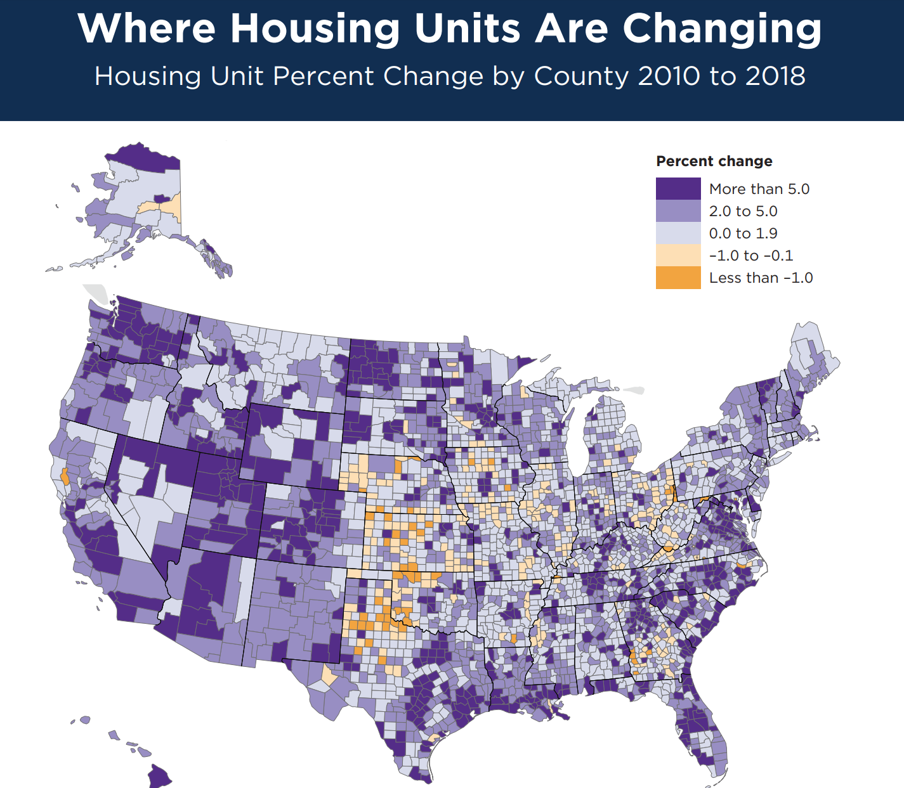
Source: U.S. Census Bureau, 2018 Population Estimates
Notes:
Texas has added over 1 million housing units since 2010, the most of any state in the country. Harris (189,542), Travis (86,563), and Dallas (84,580) counties added the greatest number of housing units between 2010 and 2018, but the fastest growth in housing units was in counties surrounding these urban core counties, such as Hays (22,585), Fort Bend (63,724), Comal (13,840), Rockwall (7,897) counties. Parts of the Rio Grande Valley and the Permian Basin also saw fast increases in housing units during this time.

Slide 25

Texas economic indicators

Slide 26
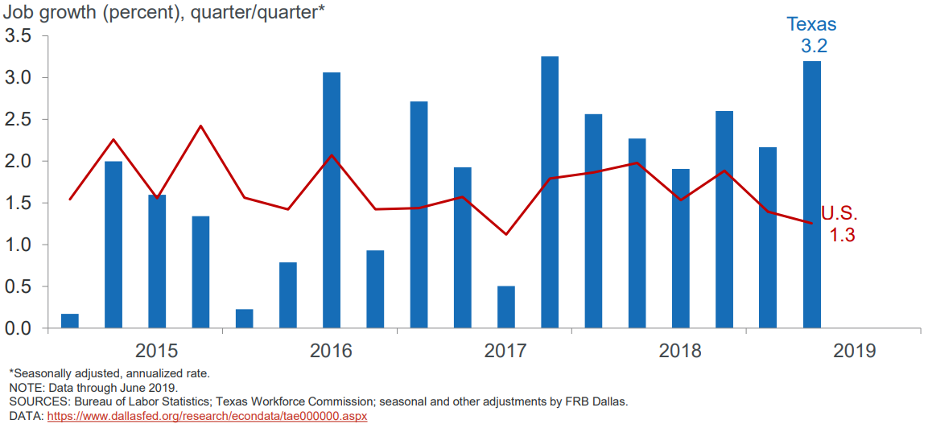
U.S. and Texas Job Growth, 2015-2019
Notes:
Texas job growth outpaced the U.S. in the first half of 2019. Texas ranks third among states in employment growth and unemployment is at a record low. DFW ranks 1st in the nation in apartment construction.

Slide 27
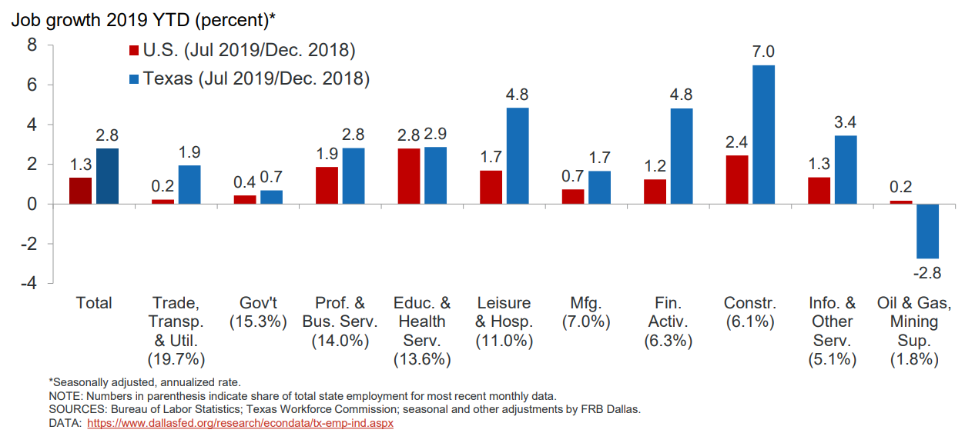
U.S. and Texas Job Growth by Industry, 2019
Notes:
Texas job growth outpaces U.S. in most sectors. As seen in building throughout the state, construction employment remains strong.

Slide 28
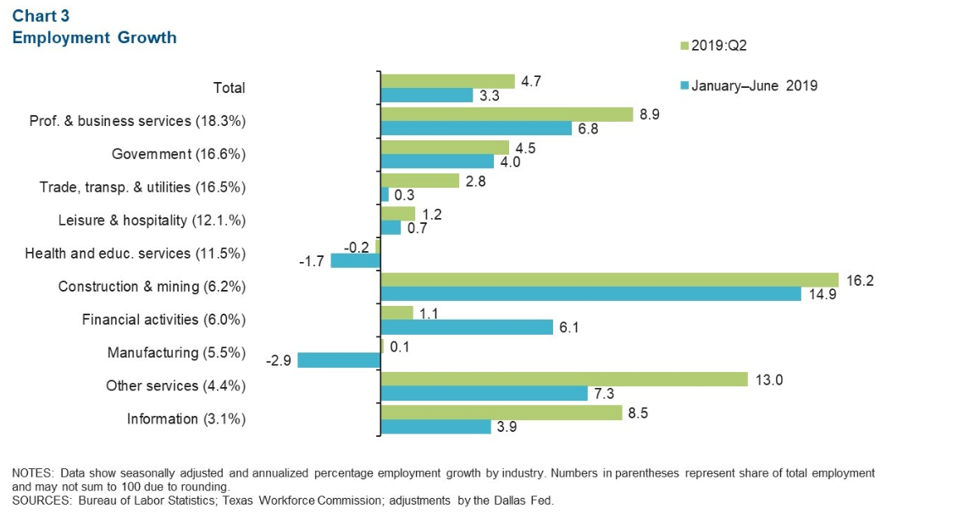
Austin Metro Area Job Growth by Industry Sector, 2019
Notes:
https://www.dallasfed.org/research/indicators/aus/2019/aus1908.aspx
Jobs related to construction and mining accelerated with a net increase of 2,500 jobs.

Slide 29
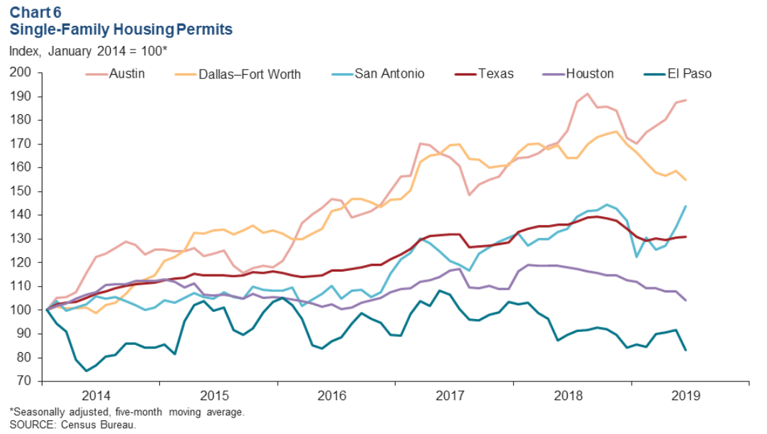
Single Family Housing Permits, Texas and Major Metros, 2019
Notes:
https://www.dallasfed.org/research/indicators/tei/2019/tei1908.aspx
Year to date, single family permits issued in all major metros except Austin are down relative to the same period last year. Year to date, multifamily permits in Texas were up 1.- percent compared to first half of last year. Multifamily permits issued in Austin and Dallas were down the first half of 2019 compared with the first half of 2018.

Slide 30
Economic Indicators, Texas and U.S., 2017
 | Median Household Income | Change, 2016-2017
Texas | $59,206 | +
Asian | $84,100 | +
NH White | $72,361 | +
Hispanic | $46,855 | +
Black | $45,092 | +
Unemployment rate
  Texas = 5.1%
  U.S. = 5.3%
Median Household Income
  Texas = $59,206
  U.S. = $60,336
Median Family Income
  Texas = $70,136
  U.S. = $73,891
Poverty rate
  Texas = 14.7%
  U.S. = 13.4%
Source: U.S. Census Bureau, 2017 American Community Survey 1-Year Estimates

Slide 31
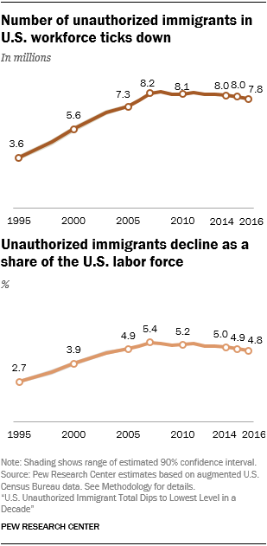
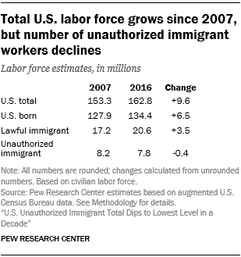
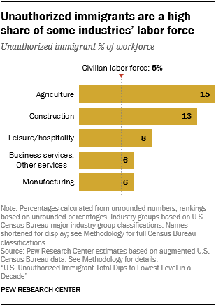
Unauthorized Immigrants in Texas
Unauthorized immigrants make up 5.7% of the total Texas population and 8.2% of the labor force, with 24% employed in construction.
Source: Pew Research Center, U.S. Unauthorized Immigrant Total Dips to Lowest Level in a Decade report; Migration Policy Institute, State Profiles
Notes:
https://www.pewresearch.org/hispanic/wp-content/uploads/sites/5/2019/03/Pew-Research-Center_2018-11-27_U-S-Unauthorized-Immigrants-Total-Dips_Updated-2019-06-25.pdf
https://www.migrationpolicy.org/data/unauthorized-immigrant-population/state/TX

Slide 32

Population Projections

Slide 33
Projected Population, 2010-2050, Texas
Source: Texas Demographic Center, 2014 and 2018 Population Projections

Slide 34
Projected Population by Race and Ethnicity,
Texas 2010-2050
Source: Texas Demographic Center 2018 Population Projections
Notes:
Population projections by race and ethnicity suggest that Latino’s are and will increasingly be the largest race/ethnic group. The number and percent who are non-Hispanic white are likely to decline. Non-Hispanic other are largely of Asian descent and they appear to be increasing rapidly, although the base number is small.

Slide 35
Projected Population Change and Percent of Total Projected Change by Race/Ethnicity, 2010-2030, Texas
Source: Texas Demographic Center 2018 Population Projections

Slide 36
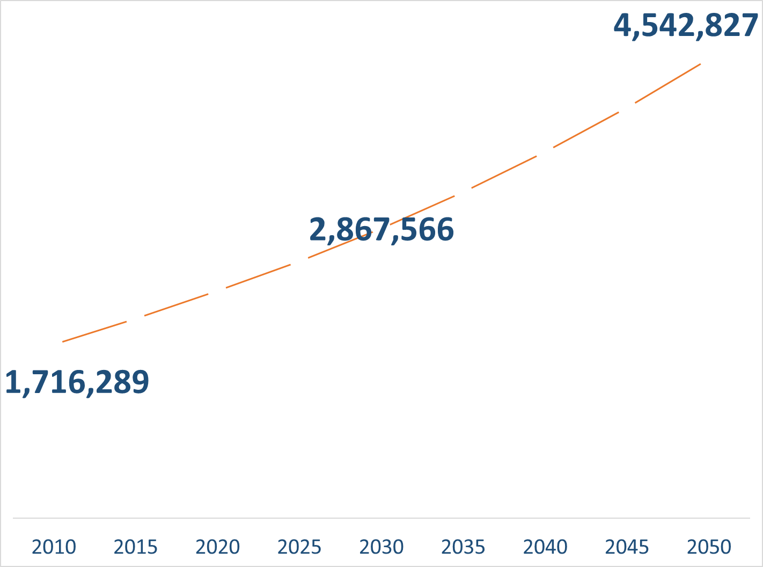
Population Projections, Austin-Round Rock Metro Area, 2010-2050
Source: Texas Demographic Center, 2018 Population Projections

Slide 37
Population Projections by Race/Ethnicity,
Austin Metro Area, 2010-2050
Source: Texas Demographic Center, 2018 Population Projections

Slide 38




Texas Counts Campaign

Slide 39



Lila Valencia, Ph.D.
(512) 936-3542
Lila.Valencia@utsa.edu
demographics.texas.gov
@TexasDemography

