Slide 1


Demographic Characteristics and Trends in Texas and Higher Education
President’s Commission on Equity at Texas A&M University at San Antonio
September 19, 2019
@TexasDemography

Slide 2
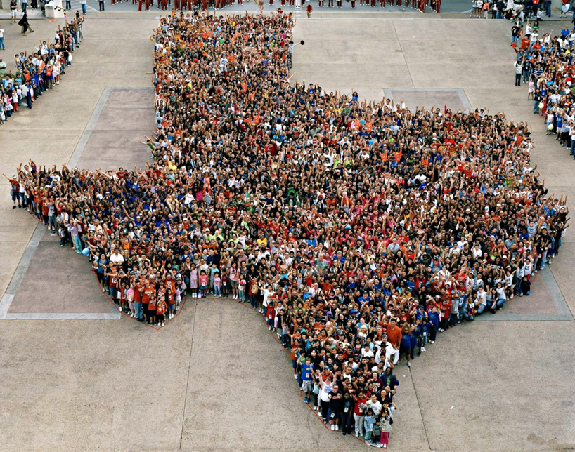
Texas is experiencing significant growth.

Slide 3
Population Growth of Select States, 2000-2018
 | 2000 Population | 2010 Population | 2018 Population | Numeric Change 2010-2018 | Percent Change 2010-2018
United States | 281,421,906 | 308,745,538 | 327,167,434 | 18,409,329 | 6%
Texas | 20,851,820 | 25,145,561 | 28,701,845 | 3,555,731 | 14%
California | 33,871,648 | 37,253,956 | 39,557,045 | 2,302,522 | 6%
Florida | 15,982,378 | 18,801,310 | 21,299,325 | 2,494,745 | 13%
Georgia | 8,186,453 | 9,687,653 | 10,519,475 | 830,766 | 9%
North Carolina | 8,049,313 | 9,535,483 | 10,383,620 | 847,884 | 9%
Washington | 5,894,121 | 6,724,540 | 7,535,591 | 811,051 | 12%
Arizona | 5,130,632 | 6,392,017 | 7,171,646 | 779,358 | 12%
Colorado | 5,029,196 | 5,029,196 | 5,695,564 | 666,248 | 13%
Source: U.S. Census Bureau. 2000 and 2010 Census Count, 2018 Population Estimates.
Notes:
Texas is the second largest state in terms of population (2nd to CA) and area (2nd to AK). In terms of number of people, Texas’ growth exceeds that of all other states between 2010 and 2018. Texas added 379,128 people between July 1, 2017 and July 1, 2018.
About 1,039 people per day added to our population.
About 524 persons per day from natural increase (more births than deaths)
About 515 per day from net migration (288 international and 227 domestic migrants per day).

Slide 4

Total Estimated Population by County, Texas, 2018
Source: U.S. Census Bureau, 2018 Population Estimates
Notes:
When we look at the geographic distribution of the population of Texas over time we see continually increasing population in the counties along the I-35 corridor, the Houston area, and the lower Rio Grand Valley. Urbanized areas out west have grown but most counties in the west have experienced limited growth and some population decline. Approximately 86% of the population is along I-35 and east. This area with the 3 major metropolitan areas at the points is often described as the Texas population triangle.

Slide 5
Estimated Population Change, Texas Counties,
2010 to 2018
96 counties lost population over the 8 year period.
Source: U.S. Census Bureau, 2018 Population Estimates
Notes:
Population change over the decade has been greatest in the urban and suburban population triangle counties. Counties in the lower Rio Grande Valley also had significant growth as did El Paso. Overall, 158 counties gained population while 96 (38%) lost population over the decade.

Slide 6
Estimated Percent Change of the Total Population by County, Texas, 2010 to 2018
Source: U.S. Census Bureau, 2018 Population Estimates
Notes:
Percent change is an indicator of the speed of population change void of information about the volume of population change. Percent change in the population over the past few years has been greatest in the suburban population triangle counties, notably among counties between San Antonio and Austin. In the early part of the decade, counties in the Eagle Ford Shale area (south east of San Antonio) had been growing quickly. This is less so the case today. The Cline Shale area (Midland and Odessa area) continues to grow and in some cases even growing faster than the State.

Slide 7
Estimates of Percent Components of Population Change, Texas, 2011-2018
Source: U.S. Census Bureau, 2018 Vintage population estimates
Notes:
Natural increase has been in the range of half of population change since the last Census in Texas. Thus Texas is growing quickly and substantially from having more births than deaths over time. In recent years, the number and percent of new Texans from other states has declined and the number and percent of international migrants has increased.

Slide 8
Estimated Percent of Total Net-Migrant Flows to and From Texas and Other States, 2017
Source: U.S. Census Bureau, State to State Migration Flows, 2017

Slide 9

Texas continues to diversify.

Slide 10
Texas Racial and Ethnic Composition,
2010 and 2018
11
Source: U.S. Census Bureau. 2018 Population Estimates
Notes:
As of the 2000 Census, about 53% of Texas’ population was non-Hispanic White, about 32% where of Hispanic descent, about 11% where non-Hispanic African American, and about 3% NH Asian, and 1% non-Hispanic Other.
In 2010, the Texas population was made up of 45% non-Hispanic Whites, 38% of Hispanic descent, 11% non-Hispanic Black or African American, 4% non-Hispanic Asian, and 2% non-Hispanic Other. In 2017, Texas continues to diversify with increases in the proportion of the population identifying as Hispanic and NH Asian and a decrease in the proportion identifying as White, NH.
Hispanics are a major driver of growth in Texas. Between 2000 and 2010, of every 10 people added to the Texas population, 6 were Hispanic. In 2010, Hispanics made up 32% of the total Texas population. Currently, Hispanics make up 39% of the total population. This represents an annual growth rate of over 2.5%, higher than the state growth rate. Over half (53.7%) of the growth add to the Texas population between 2010 and 2017 can be attributed to growth among Hispanics.

Slide 11
Race-Ethnicity Composition by Age Group, 2010 to 2018, Texas
Source: U.S. Census Bureau. 2018 Population Estimates

Slide 12
Total Fertility Rate by Race/Ethnicity, Texas, 1990-2017
Source: Centers for Disease Control and Prevention, National Center for Health Statistics, National Vital Statistics Report

Slide 13
Annual Shares of Recent Non-Citizen Immigrants to Texas by World Area of Birth, 2005-2015
Estimated number of international migrants to Texas
101,588
77,702
98,194
Source: U.S. Census Bureau, American Community Survey, 1-Year PUMS
Notes:
In 2017, it is estimated 17%, or 4.85 million, of the Texas population was foreign born.

Slide 14

Education in Texas

Slide 15
College and Graduate Enrollment, Texas, 2007-2017
Source: U.S. Census Bureau, American Community Survey 1-Year Estimates, 2007-2017

Slide 16
College and Graduate Enrollment by Race/Ethnicity, Texas, 2008-2017
Source: U.S. Census Bureau, American Community Survey 1-Year Estimates, 2008-2017

Slide 17
Percent Distribution of Educational Attainment of Persons Aged 25 Years and Older, Texas, 2007 and 2017
 | 2007 | 2017
Percent high school graduate or higher | 79.1% | 83.6% | *
Percent bachelor's degree or higher | 25.2% | 29.6% | *
Source: U.S. Census Bureau, American Community Survey, 1-Year Samples, 2007-2017. * Years significantly different p<.05
Notes:
Texas continues to make strides in educational attainment. In 2007 about half (48.5%) of Texans 25 years and older had a high school diploma or GED or even less education and the other half had some college and up to a professional degree. By 2017, closer to 60% of Texans 25 years and older now have some college, a college degree, or a professional degree. Similarly our percent of the population with at least a HS diploma has increased from 79% in 2007 to over 83% in 2017 and the percent of population with a bachelor’s degree has increased from 25% to over 29% during the same time period.

Slide 18
Educational Attainment, Texas,
2007 and 2017
Source: U.S. Census Bureau, ACS 1-Year Estimates, 2007, 2017

Slide 19
Percent of Civilian Labor Force by Occupation, Texas, 2007, 2017 and 2017-2017 Change
Source: U.S. Census Bureau, American Community Survey, 1-Year Sample, 2007, 2017

Slide 20
Educational Attainment by Race/Ethnicity,
Texas and Big Four Metro Areas, 2017
High School Degree and above
Educational attainment in the San Antonio metro is slightly higher than that of the state overall. Hispanics and Blacks in San Antonio have higher educational attainment shares relative to the state and other metros.
Bachelor’s Degree and above
Source: U.S. Census Bureau, 2017 American Community Survey 1-Year Estimates

Slide 21

Young Texans

Slide 22
Population by Age Group, Texas, 2010-2017
Source: U.S. Census Bureau, 2017 Population Estimates

Slide 23
Place of Birth for Population 18 to 24 Years, Texas,
2007 and 2017
Source: U.S. Census Bureau, American Community Survey 1-Year Estimates, 2007, 2017

Slide 24
Population 18 to 24 Years by Race/Ethnicity, Texas,
2010-2017
Source: U.S. Census Bureau, 2017 Population Estimates
Notes:
Nearly half (or 46%) of Young Texans are Hispanic. Hispanics and other non-white race groups are driving growth in the 18 to 24 year-old population. The non-White population of 18 to 24 year-olds decreased between 2010 and 2017 from right under 1 million to 953 thousand.

Slide 25
Annual Numeric Change in Population 18 to 24, Texas, 2010-2017
Source: U.S. Census Bureau, 2017 Population Estimates
Notes:
Although the population of young Texans has been growing since the last Census, growth has been steadily decreasing among all race/ethnic groups, with actual declines seen among Black and non-Hispanic White 18 to 24 year olds.

Slide 26

Population Projections

Slide 27
Projected Population, 2010-2050, Texas
Source: Texas Demographic Center, 2014 and 2018 Population Projections

Slide 28
Projected Population by Race and Ethnicity,
Texas 2010-2030
Source: Texas Demographic Center 2018 Population Projections
Notes:
Population projections by race and ethnicity suggest that Latino’s are and will increasingly be the largest race/ethnic group. The number and percent who are non-Hispanic white are likely to decline. Non-Hispanic other are largely of Asian descent and they appear to be increasing rapidly, although the base number is small.

Slide 29
Projected Population Change and Percent of Total Projected Change by Race/Ethnicity, 2010-2030, Texas
Source: Texas Demographic Center 2018 Population Projections

Slide 30
Population and Projected Population Change,
San Antonio Metro Counties, 2010-2020
County | Population 2010 | Projected Population 2020 | Numeric Change, 2010-2020 | Percent Change, 2010-2020
Atascosa | 44,911 | 51,831 | 6,920 | 15%
Bandera | 20,485 | 21,246 | 761 | 4%
Bexar | 1,714,773 | 2,093,502 | 378,729 | 22%
Comal | 108,472 | 147,330 | 38,858 | 36%
Guadalupe | 131,533 | 170,266 | 38,733 | 29%
Kendall | 33,410 | 46,278 | 12,868 | 39%
Medina | 46,006 | 50,594 | 4,588 | 10%
Wilson | 42,918 | 51,802 | 8,884 | 21%
Source: Texas Demographic Center, Population Projections, 2010-2015 Migration Scenario, Vintage 2018
Notes:
Most counties in the San Antonio Metro Area are projected to grow at a faster rate than the state (growth rate = 14% between 2010 and 2018), with the exception of Bandera and Medina County.
Bexar ranked 9th in the country among counties adding the largest numbers to their populations between 2017 and 2018. Comal ranked 67th.
Comal was 3rd fastest growing county in the country between 2017 and 2018. Kendall was the 20th fastest growing county during this time period.

Slide 31
Population Projections, Bexar, Comal, and Guadalupe Counties, 2010-2030
Source: Texas Demographic Center, 2018 Population Projections

Slide 32
Population Projections, San Antonio Metro Counties with 2010 Populations Less than 50,000
Source: Texas Demographic Center, 2018 Population Projections

Slide 33
Percent of Total Projected Population Change by Race/Ethnicity for San Antonio Metro Counties
County | Percent of Total Population Change, 2010 to 2020
 | NH White | NH Black | Hispanic | NH Asian | NH Other
Atascosa | 7.6% | 1.0% | 89.4% | 0.2% | 1.8%
Bandera | -38.6% | 2.9% | 126.4% | 1.3% | 8.0%
Bexar | 11.6% | 9.3% | 68.9% | 6.5% | 3.8%
Comal | 50.0% | 4.6% | 43.3% | 0.8% | 1.3%
Guadalupe | 25.9% | 15.9% | 53.4% | 2.1% | 2.7%
Kendall | 55.6% | 0.1% | 43.1% | 0.2% | 1.0%
Medina | -0.5% | 1.0% | 96.3% | 0.4% | 2.8%
Wilson | 41.6% | 1.0% | 55.5% | 0.2% | 1.7%
Source: Texas Demographic Center 2018 Population Projections
Notes:
The Hispanic population is projected to be the greatest contributor to the total population change for 6 of the 8 counties in the San Antonio metro area. The NH White population is projected to be the greatest contributor to total population change in Comal and Kendall county, but expected to decline in size in Bandera and Median counties.

Slide 34




Texas Counts Campaign

Slide 35

Census 2020
Every ten years, the country conducts a census to count every person in the United States.
The next count will take place April 1, 2020.
Census counts used to reapportion the U.S. House of Representatives, determining how many seats each state gets.
Census counts also used to determine the number of electoral college votes a state gets.
Census counts used by state officials to redraw congressional and state legislative boundaries to account for population shifts.

Slide 36
Q: What’s at Stake?
A: Billions of Dollars
The distribution of more than $675 billion in federal funds, grants, and support to states, counties, and communities are based on census data. This supports schools, hospitals, roads, public works, and other vital programs.
An undercount of the Texas population of just 1% could translate to a loss of $300 million per year in federal funding for the state.

Slide 37
Q: What’s at Stake?
A: Economic Development and Quality of Life
Businesses drive our fast growing economy and are the population engine of many of our communities.
These businesses use census data to understand customer needs and where to locate, creating economic opportunities for Texans.
In 2016, Texas received $59.4 billion in federal funding derived from Census data. These dollars support housing, transportation, education, health, and other services that directly improve the quality of life for all Texans.

Slide 38
Q: What’s at Stake?
A: Quality Data
The 2020 decennial census data will serve as the base for nearly all demographic and socio-economic statistics for the next 10 years.
These data are used by state agencies to allocate or determine eligibility criteria for funding.
These data are used by the TDC to produce population projections.
The quality of these data is directly linked to a complete and accurate count in 2020.

Slide 39
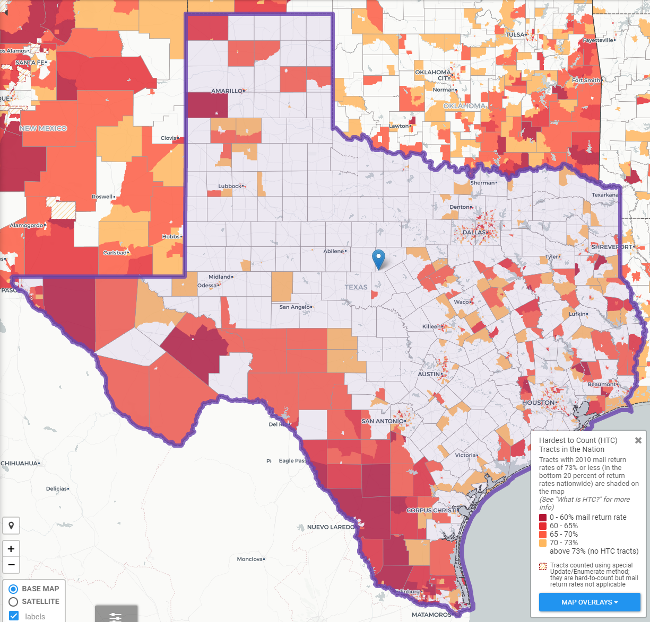


The Hard to Count (HTC) Population in Texas
Source: Center for Urban Research of the City University of New York (CUNY) Graduate Center.

Slide 40
Texas Hard to County Populations
An estimated 7 million, or nearly 25%, of Texans live in hard to count neighborhoods.
People of Color
  Texas has the second largest number of Hispanics and African Americans and third largest number of Asian populations of all states in the U.S.
Immigrants
  An estimated 4.85 million foreign born reside in Texas.
Children under 5
  An estimated 5 percent, or about 2.2 million, of kids under the age of 5 were not counted in the 2010 Census, including about 75,000 Texas children. Children who are not biologically related, Hispanic, live in complex households, live in rented housing, and who have very young parents are even more likely not to be counted.

Slide 41
Texas Hard to County Populations
Single-Parent Households
  An estimated 1.2 million Texas households are single-parent households, and all of these households are households with children under 18 years of age.
People with Limited English Proficiency
  Approximately 8% of Texas households are limited English speaking households, with 85% of these households speaking Spanish, 9% speaking an Asian or Pacific Islander language, 4% speaking Indo-European languages, and 2% speaking other languages.
People living in Multi-Family Housing
  Nearly 1 in 4 Texas housing units are in buildings with 2 or more units and 15% of Texas housing units are in buildings with 10 or more units.

Slide 42
Texas Hard to County Populations
Renters
  Over 1 in 3 Texas households are renter occupied.
Larger Households
  Approximately 5% of Texas households are considered crowded households, where more than 1 person per room is living in the household.
Low Income Populations
  Over 1 in 3 Texas households are renter occupied.

Slide 43
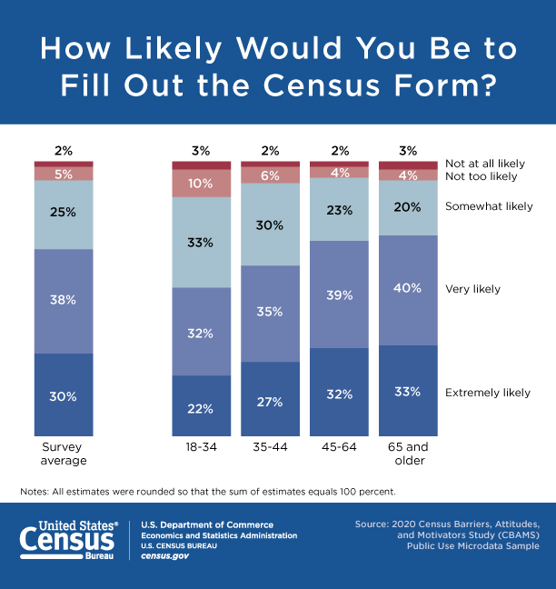

Slide 44



Lila Valencia, Ph.D.
(512) 936-3542
Lila.Valencia@utsa.edu
demographics.texas.gov
@TexasDemography

