Slide 1


Population Projections to Inform Redistricting in Texas
House Redistricting Committee
Corpus Christi, TX
November 4, 2019
@TexasDemography

Slide 2
These slides are posted on our website:
demographics.texas.gov/presentations

Slide 3
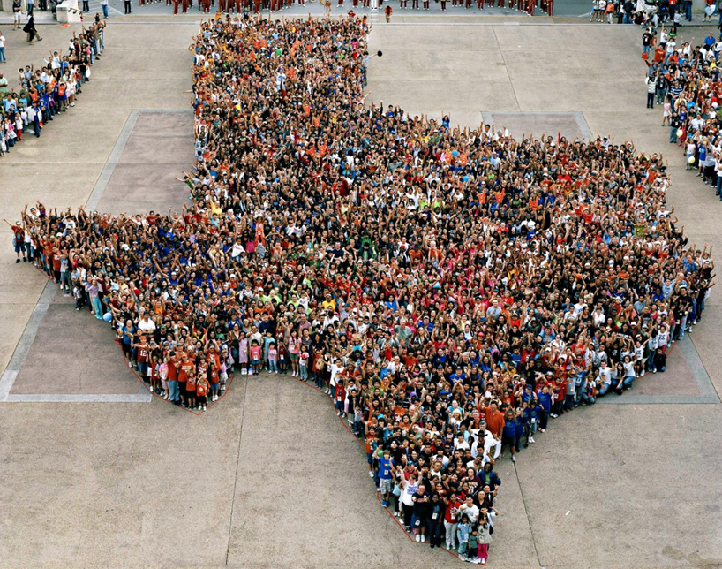
Notes:
Every ten years, the country conducts a census to count every person in the United States.
The next count will take place April 1, 2020.

Slide 4
CENSUS 2020
Every ten years, the country conducts a census to count every person in the United States.
The next count will take place April 1, 2020.
Census counts used to reapportion the U.S. House of Representatives, determining how many seats each state gets.
Census counts also used to determine the number of electoral college votes a state gets.
Census counts used by state officials to redraw congressional and state legislative boundaries to account for population shifts.

Slide 5
Population Growth and Projected Congressional Seats of Select States
 | 2010 Population | 2018 Population | Numeric Change 2010-2018 | Percent Change 2010-2018 | Projected Congressional Seats Added
United States | 308,745,538 | 327,167,434 | 18,409,329 | 6%
Texas | 25,145,561 | 28,701,845 | 3,555,731 | 14% | 3
Florida | 18,801,310 | 21,299,325 | 2,494,745 | 13% | 2
North Carolina | 9,535,483 | 10,383,620 | 847,884 | 9% | 1
Arizona | 6,392,017 | 7,171,646 | 779,358 | 12% | 1
Colorado | 5,029,196 | 5,695,564 | 666,248 | 13% | 1
Oregon | 3,831,074 | 4,190,713 | 359,638 | 9% | 1
Montana | 989,415 | 1,062,305 | 72,896 | 7% | 1
California | 37,253,956 | 39,557,045 | 2,302,522 | 6% | 0 to -1
Minnesota | 5,303,925 | 5,611,179 | 307,254 | 6% | 0 to -1
Source: U.S. Census Bureau. 2000 and 2010 Census Count, 2018 Population Estimates; Brennan Center for Justice.
Notes:
Texas is the second largest state in terms of population (2nd to CA) and area (2nd to AK). In terms of number of people, Texas’ growth exceeds that of all other states between 2010 and 2018. Texas has added over 3.5 million people between April 1, 2010 and July 1, 2018. This puts Texas on track to meet or surpass the number of people added in the last census when Texas gained 4 congressional seats. Projections from multiple sources anticipate Texas will gain 3 congressional districts after the 2020 census.

Slide 6
Linear Forecast of Census Bureau Population Estimates 2010-2018 and TDC Population Projections
Ideal House District Size = 197,384 to 197,851
Source: Texas Demographic Center 2018 Population Projections; linear forecast derived by the Texas Demographic Center from Census Bureau Population Estimates
Notes:
The Texas Demographic Center produces population projections for the state. In comparing these projections, to a linear forecast of the Census Bureau’s population estimates since 2010, we see the Texas Demographic Center is closely aligned with the Census Bureau estimates trend. TDC projections indicate Texas will grow to just under 29.7 million by 2020.

Slide 7
2010 Population and Projected 2020 Population, Texas Counties
2010
2020
Source: Texas Demographic Center, Population Projections, 2010-2015 Migration Scenario, Vintage 2018
Notes:
The population engine of the state of Texas lies in its metro areas. TDC projections indicate the areas of the state to see the greatest increases in population are located in the population triangle, anchored by the state’s major metro areas of Dallas-Fort Worth-Arlington, Houston-Sugarland-The Woodlands, San Antonio-New Braunfels, and Austin-Round Rock. Dallas County is projected to join Harris County in having a population exceeding 2.5 million in 2020. By 2020, the Collin County population is projected to exceed 1 million and Williamson and Montgomery County are projected to exceed half a million.

Slide 8
2010 Population and Projected 2020 Population,
Coastal Bend Counties
2010
2020
Source: Texas Demographic Center, Population Projections, 2010-2015 Migration Scenario, Vintage 2018
Notes:
The Coastal Bend area is projected to increase by about 58,000 between 2010 and 2020, growing from over 571,000 in 2010 to over 630,000 in 2020. The bulk of that growth is projected to be in Nueces County.

Slide 9
Projected Numeric Change,
Texas Counties and Coastal Bend Counties,
2010-2020
Source: Texas Demographic Center, Population Projections, 2010-2015 Migration Scenario, Vintage 2018
Notes:
As the metro areas of the state increase in population from 2010 to 2020, many Texas counties will see declines in their populations. Most of these counties are located in more sparsely populated parts of West Texas, East Texas, and South Texas between San Antonio and the Rio Grande Valley. 72 counties are projected to experience population decline between 2010 and 2020. Two such counties, Kleberg and Brooks, are located in the Coastal Bend. However, San Patricio and Nueces counties are projected to see steady growth and the remaining Coastal Bend Counties are also projected to continue to grow but more slowly.

Slide 10
Projected Percent Change of the Total Population,
Texas Counties and Coastal Bend Counties,
2010 to 2020
Source: U.S. Census Bureau, 2018 Population Estimates
Notes:
Percent change is an indicator of the speed of population change void of information about the volume of population change. Percent change in the population over the past few years has been greatest in the suburban population triangle counties, notably among counties between San Antonio and Austin.
Most counties in the Coastal Bend are projected to grow slower than the rate of the state (growth rate = 14% between 2010 and 2018), with the exception of Brooks and Kleberg County which are projected to decline and Aransas and Kenedy counties which are projected to grow faster than the state.

Slide 11
Population and Projected Population Change,
Coastal Bend Counties, 2010-2020
County | Population 2010 | Projected Population 2020 | Numeric Change, 2010-2020 | Percent Change, 2010-2020
Aransas | 23,158 | 27,699 | 4,541 | 19.6%
Bee | 31,861 | 34,445 | 2,584 | 8.1%
Brooks | 7,223 | 7,175 | -48 | -0.7%
Duval | 11,782 | 11,796 | 14 | 0.1%
Jim Wells | 40,838 | 42,890 | 2,052 | 5.0%
Kenedy | 416 | 476 | 60 | 14.4%
Kleberg | 32,061 | 30,987 | -1,074 | -3.3%
Live Oak | 11,531 | 12,030 | 499 | 4.3%
Nueces | 340,223 | 383,718 | 43,495 | 12.8%
Refugio | 7,383 | 7,573 | 190 | 2.6%
San Patricio | 64,804 | 71,325 | 6,521 | 10.1%
Source: Texas Demographic Center, Population Projections, 2010-2015 Migration Scenario, Vintage 2018
Notes:
Most counties in the Coastal Bend are projected to grow at about the same rate as the state (growth rate = 14% between 2010 and 2018), with the exception of Brooks, Kleberg, and Aransas County.
Brooks and Kleberg counties are projected to see population declines between 2010 and 2020, whereas Aransas is projected to grow faster than the state.

Slide 12
Projected Population, 2010-2020, Texas
Ideal House District Size = 197,851
Source: Texas Demographic Center, 2014 and 2018 Population Projections
Notes:
The Texas Demographic Center’s most recent set of projections, employing migration trends observed between 2010 and 2015, indicate Texas will have a population of 29.7 million by 2020.

Slide 13
Projected Population by Race and Ethnicity,
Texas 2010-2020
Source: Texas Demographic Center, 2018 Population Projections
Notes:
Population projections by race and ethnicity suggest that Latino’s are and will increasingly be the largest race/ethnic group. NH Black and NH Asian populations in Texas are projected to grow steadily. The non-Hispanic white population is projected to grow but at a slower pace.

Slide 14
Projected Population Change and Percent of Total Projected Change by Race/Ethnicity, 2010-2020, Texas
Source: Texas Demographic Center, 2018 Population Projections

Slide 15
Population Projections, Nueces, San Patricio, and Jim Wells Counties, 2010-2020
Source: Texas Demographic Center, 2018 Population Projections

Slide 16
Population Projections, Coastal Bend Counties with 2010 Populations less than 40,000, 2010-2020

Slide 17
Percent of Total Projected Population Change by Race/Ethnicity for Coastal Bend Counties
County | Percent of Total Population Change, 2010 to 2020
 | NH White | NH Black | Hispanic | NH Asian | NH Other
Aransas | 38.4% | 0.9% | 58.2% | 0.8% | 1.7%
Bee | -18.8% | 7.1% | 108.2% | 0.8% | 2.7%
Brooks | -120.8% | -20.8% | 262.5% | 0.0% | -20.8%
Duval | 607.1% | 28.6% | -607.1% | 0.0% | 71.4%
Jim Wells | -33.4% | 2.4% | 126.7% | 1.2% | 3.1%
Kenedy | 15.0% | 0.0% | 85.0% | 0.0% | 0.0%
Kleberg | 142.3% | -8.0% | -31.4% | 1.4% | -4.3%
Live Oak | -21.8% | 5.6% | 110.0% | 0.0% | 6.2%
Nueces | -14.6% | 3.9% | 101.0% | 6.9% | 2.8%
Refugio | -205.8% | 20.5% | 274.7% | 0.0% | 10.5%
San Patricio | -9.8% | 2.2% | 103.3% | 1.2% | 3.1%
Texas | 16.4% | 14.8% | 51.7% | 12.7% | 4.4%
Source: Texas Demographic Center 2018 Population Projections
Notes:
This table looks at the total projected population change between 2010 and 2020 and the share of the total growth contributed by each of the race/ethnicity groups. The Hispanic population is projected to be the greatest contributor to the total population change for 9 of the 11 counties in the Coastal Bend. The NH White population is projected to be the greatest contributor to total population change in 2 counties, but expected to decline in size in a number of counties.

Slide 18
Redistricting Dates
Apportionment File sent to POTUS on 12/31/2020
Redistricting Data File (Public Law 94-171 File) received by the Governor no later than April 1, 2021
PL 94-171 released to states in groups of 8 states per week, with one week prior notice
PL 94-171 File to include:
  Race,
  Race for population 18 and older,
  Race and Hispanic origin,
  Race and Hispanic origin for population 18 and older,
  Occupancy Status
  Group Quarters (GQ) Population by GQ Type
Data available at WWW.CENSUS.GOV/RDO

Slide 19



Lloyd Potter, Ph.D.
(210) 458-6530
Lloyd.Potter@utsa.edu
demographics.texas.gov
@TexasDemography

