Slide 1


Population Projections to Inform Redistricting in Texas
Texas Medical Association
Austin, TX
December 7, 2019
@TexasDemography

Slide 2
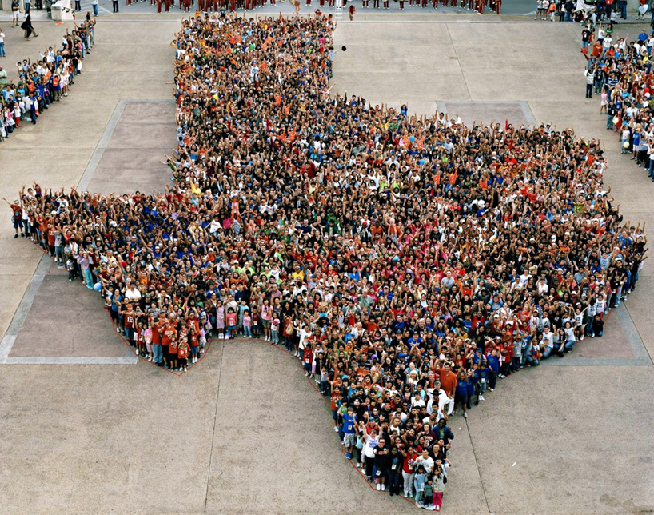
Notes:
Every ten years, the country conducts a census to count every person in the United States.
The next count will take place April 1, 2020.

Slide 3
CENSUS 2020
Every ten years, the country conducts a census to count every person in the United States.
The next count will take place April 1, 2020.
Census counts used to reapportion the U.S. House of Representatives, determining how many seats each state gets.
Census counts also used to determine the number of electoral college votes a state gets.
Census counts used by state officials to redraw congressional and state legislative boundaries to account for population shifts.

Slide 4
Population Growth and Projected Congressional Seats of Select States
 | 2010 Population | 2018 Population | Numeric Change 2010-2018 | Percent Change 2010-2018 | Projected Congressional Seats Added
United States | 308,745,538 | 327,167,434 | 18,409,329 | 6%
Texas | 25,145,561 | 28,701,845 | 3,555,731 | 14% | 3
Florida | 18,801,310 | 21,299,325 | 2,494,745 | 13% | 2
North Carolina | 9,535,483 | 10,383,620 | 847,884 | 9% | 1
Arizona | 6,392,017 | 7,171,646 | 779,358 | 12% | 1
Colorado | 5,029,196 | 5,695,564 | 666,248 | 13% | 1
Oregon | 3,831,074 | 4,190,713 | 359,638 | 9% | 1
Montana | 989,415 | 1,062,305 | 72,896 | 7% | 1
California | 37,253,956 | 39,557,045 | 2,302,522 | 6% | 0 to -1
Minnesota | 5,303,925 | 5,611,179 | 307,254 | 6% | 0 to -1
Source: U.S. Census Bureau. 2000 and 2010 Census Count, 2018 Population Estimates; Brennan Center for Justice.
Notes:
Texas is the second largest state in terms of population (2nd to CA) and area (2nd to AK). In terms of number of people, Texas’ growth exceeds that of all other states between 2010 and 2018. Texas has added over 3.5 million people between April 1, 2010 and July 1, 2018. This puts Texas on track to meet or surpass the number of people added in the last census when Texas gained 4 congressional seats. Projections from multiple sources anticipate Texas will gain 3 congressional districts after the 2020 census. Taking Texas population projections and projected congressional districts would indicate Texas congressional districts could represent between 759 and 760 thousand Texas residents (759,171 to 760,966).

Slide 5
Linear Forecast of Census Bureau Population Estimates 2010-2018 and TDC Population Projections
Ideal House District Size = 197,384 to 197,851
Ideal Senate District Size = 955,086 to 957,345
Source: Texas Demographic Center 2018 Population Projections; linear forecast derived by the Texas Demographic Center from Census Bureau Population Estimates
Notes:
The Texas Demographic Center produces population projections for the state. In comparing these projections, to a linear forecast of the Census Bureau’s population estimates since 2010, we see the Texas Demographic Center is closely aligned with the Census Bureau estimates trend. TDC projections indicate Texas will grow to just under 29.7 million by 2020.

Slide 6
Projected Percent Change of the Total Population, Texas Counties, 2010 to 2020
Source: U.S. Census Bureau, 2018 Population Estimates
Notes:
Percent change is an indicator of the speed of population change void of information about the volume of population change. Percent change in the population over the past few years has been greatest in the suburban population triangle counties, notably among counties between San Antonio and Austin. In the early part of the decade, counties in the Eagle Ford Shale area (south east of San Antonio) had been growing quickly. This is less so the case today. The Cline Shale area (Midland and Odessa area) continues to grow and in some cases even growing faster than the State.

Slide 7
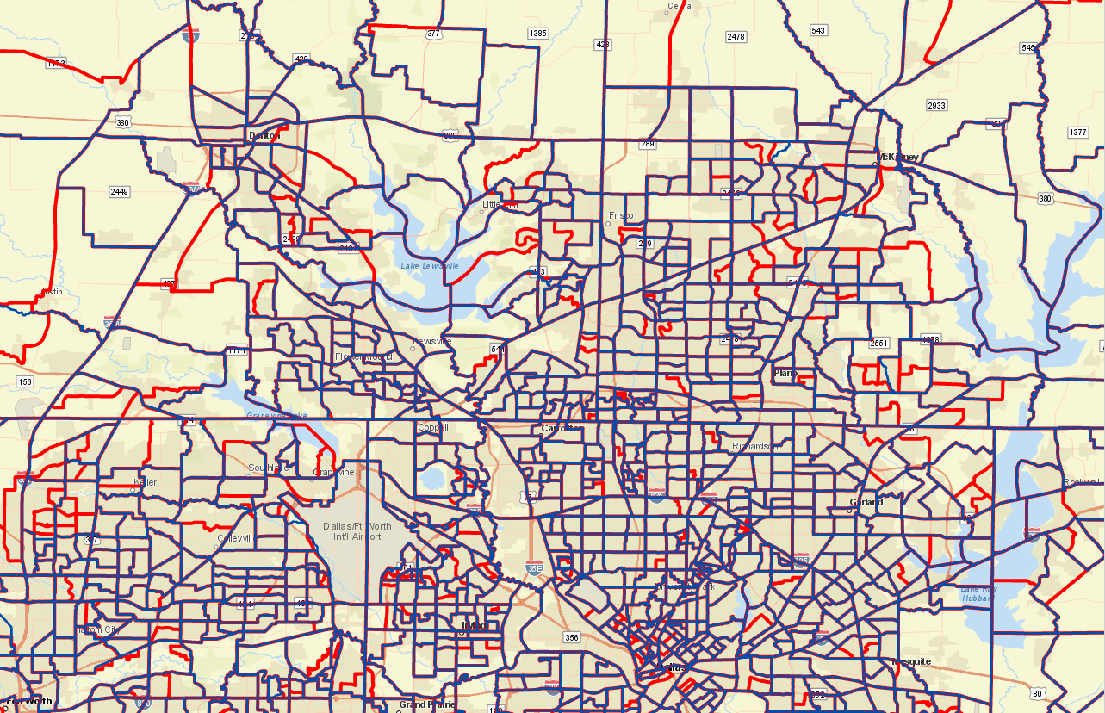
2010 Census Tracts (Blue/Purple) and Proposed Census Tract Splits (Red) for 2020, North Metroplex Area

Slide 8
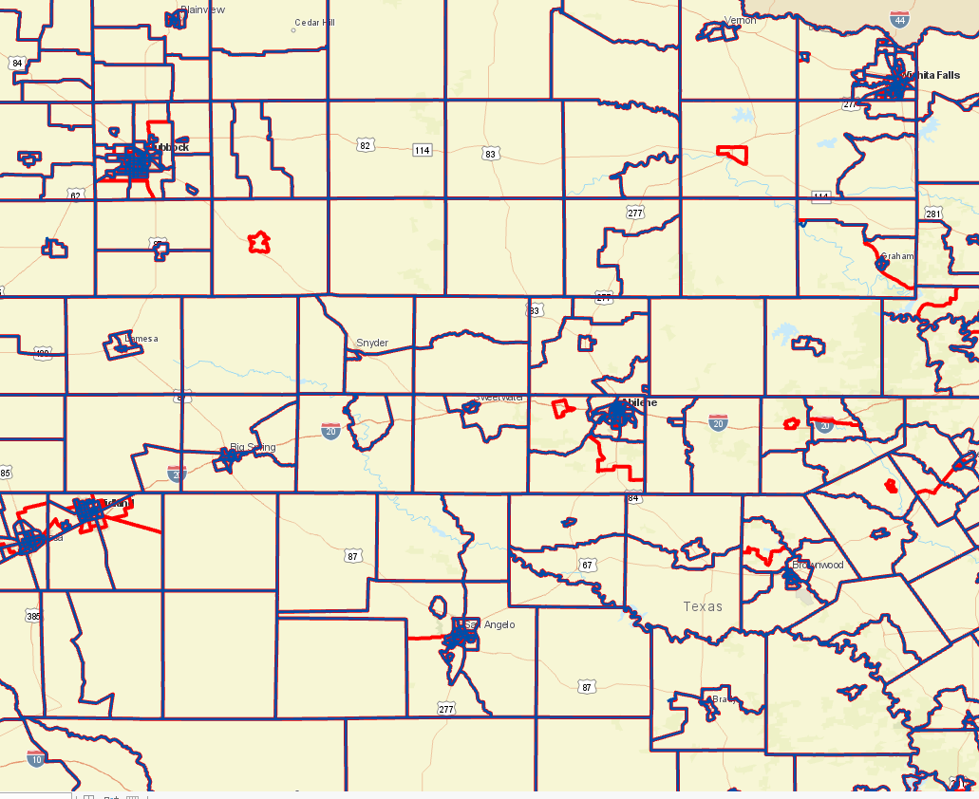
2010 Census Tracts (Blue/Purple) and Proposed Census Tract Splits (Red) for 2020, West Texas

Slide 9
Projected Population, 2010-2020, Texas
Ideal House District Size = 197,384 to 197,851
Ideal Senate District Size = 955,086 to 957,345
Source: Texas Demographic Center, 2014 and 2018 Population Projections
Notes:
The Texas Demographic Center’s most recent set of projections, employing migration trends observed between 2010 and 2015, indicate Texas will have a population of 29.7 million by 2020.

Slide 10
Projected Population by Race and Ethnicity,
Texas 2010-2020
Source: Texas Demographic Center, 2018 Population Projections
Notes:
Population projections by race and ethnicity suggest that Latino’s are and will increasingly be the largest race/ethnic group. NH Black and NH Asian populations in Texas are projected to grow steadily. The non-Hispanic white population is projected to grow but at a slower pace.

Slide 11
Projected Population Change and Percent of Total Projected Change by Race/Ethnicity, 2010-2020, Texas
Source: Texas Demographic Center, 2018 Population Projections
Notes:
Texas growth is projected to come largely from growth among non-whites.

Slide 12
Percent of Total Projected Population Change by Race/Ethnicity for Counties Adding the Greatest Numbers
County | Percent of Total Population Change, 2010 to 2020
 | NH White | NH Black | Hispanic | NH Asian | NH Other
Bexar | 11.6% | 9.3% | 68.9% | 6.5% | 3.8%
Collin | 32.8% | 16.1% | 19.8% | 26.5% | 4.7%
Dallas | -1.5% | 27.6% | 49.9% | 19.7% | 4.3%
Denton | 35.3% | 20.1% | 24.4% | 16.5% | 3.8%
Fort Bend | 24.5% | 14.9% | 27.0% | 29.6% | 4.0%
Harris | 11.1% | 19.5% | 49.2% | 15.6% | 4.6%
Montgomery | 43.7% | 7.8% | 38.8% | 6.4% | 3.3%
Tarrant | 13.1% | 26.4% | 42.5% | 12.9% | 5.1%
Travis | 36.8% | 8.8% | 39.8% | 10.3% | 4.3%
Williamson | 43.4% | 7.9% | 31.4% | 13.4% | 4.0%
Source: Texas Demographic Center 2018 Population Projections
Notes:
The Hispanic population is projected to be the greatest contributor to the total population change for at least half of the top 10 counties adding the largest numbers to their populations between 2010 and 2020. The NH White population is projected to be the greatest contributor to total population change in Collin, Denton, Montgomery, and Williamson counties. The Asian population is projected to be the greatest contributor to the total population change in Fort Bend County. The Black population is projected to contribute over 25% of the total population change in Dallas and Tarrant Counties.

Slide 13
Percent of Total Projected Population Change by Race/Ethnicity for Fastest Growing Counties
County | Percent of Total Population Change, 2010 to 2020
 | NH White | NH Black | Hispanic | NH Asian | NH Other
Andrews | 8.1% | 0.5% | 90.5% | 0.1% | 0.8%
Comal | 50.0% | 4.6% | 43.3% | 0.8% | 1.3%
Crane | 5.4% | 1.0% | 92.7% | -0.1% | 0.9%
Denton | 35.3% | 20.1% | 24.4% | 16.5% | 3.8%
Ector | -0.9% | 5.1% | 92.3% | 2.1% | 1.3%
Fort Bend | 24.5% | 14.9% | 27.0% | 29.6% | 4.0%
Hays | 44.3% | 1.5% | 47.9% | 3.1% | 3.2%
Kendall | 55.6% | 0.1% | 43.1% | 0.2% | 1.0%
Midland | 9.3% | 4.6% | 80.1% | 3.8% | 2.3%
Williamson | 43.4% | 7.9% | 31.4% | 13.4% | 4.0%
Source: Texas Demographic Center 2018 Population Projections
Notes:
The Hispanic population is projected to be the greatest contributor to the total population change for at least half of the top 10 fastest growing counties between 2010 and 2020. The NH White population is projected to be the greatest contributor to total population change in the suburban counties of Comal, Denton, Kendall, and Williamson. The Asian population is projected to be the greatest contributor to the total population change in Fort Bend County. The Black population is projected to contribute over 20% to the total population change in Denton County.

Slide 14
Redistricting Dates
Apportionment File sent to POTUS on 12/31/2020
Redistricting Data File (Public Law 94-171 File) received by the Governor no later than April 1, 2021
Starting in February 2021, PL 94-171 released to states in groups of 8 states per week, with one week prior notice
PL 94-171 File to include:
  Race,
  Race for population 18 and older,
  Race and Hispanic origin,
  Race and Hispanic origin for population 18 and older,
  Occupancy Status
  Group Quarters (GQ) Population by GQ Type
Data available at WWW.CENSUS.GOV/RDO

Slide 15



Lila Valencia, Ph.D.
(512) 936-3542
Lila.Valencia@utsa.edu
demographics.texas.gov
@TexasDemography

