Slide 1


The Changing Face of the Austin Metro Area
Center for Austin’s Future
January 12, 2020
@TexasDemography

Slide 2
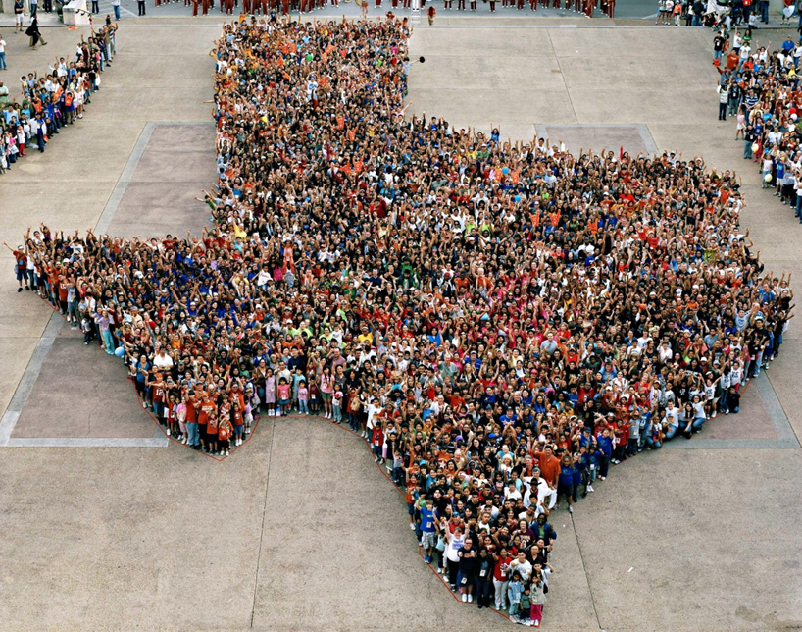
Texas is experiencing significant growth.

Slide 3
Population Growth of Select States, 2000-2019
 | 2000 Population | 2010 Population | 2019 Population | Numeric Change 2010-2019 | Percent Change 2010-2019
United States | 281,421,906 | 308,745,538 | 32,823,9523 | 19,481,418 | 6.3%
Texas | 20,851,820 | 25,145,561 | 28,995,881 | 3,849,790 | 15.3%
California | 33,871,648 | 37,253,956 | 39,512,223 | 2,257,704 | 6.1%
Florida | 15,982,378 | 18,801,310 | 21,477,737 | 2,673,173 | 14.2%
Georgia | 8,186,453 | 9,687,653 | 10,617,423 | 928,694 | 9.6%
North Carolina | 8,049,313 | 9,535,483 | 10,488,084 | 952,333 | 10.0%
Washington | 5,894,121 | 6,724,540 | 7,614,893 | 890,353 | 13.2%
Arizona | 5,130,632 | 6,392,017 | 7,278,717 | 886,429 | 13.9%
Colorado | 5,029,196 | 5,029,196 | 5,758,736 | 729,417 | 14.5%
Source: U.S. Census Bureau. 2000 and 2010 Census Count, 2019 Population Estimates.
Notes:
Texas is the second largest state in terms of population (2nd to CA) and area (2nd to AK). In terms of number of people, Texas’ growth exceeds that of all other states between 2010 and 2019.

Slide 4
Texas added 367,215 people between July 1, 2018 and July 1, 2019.
About 1,006 people per day added to our population.
  About 483 persons per day from natural increase (more births than deaths)
  About 523 per day from net migration (178 international and 345 domestic migrants per day).
Source: U.S. Census Bureau, 2018 Population Estimates.
Notes:
The Austin Metro area added about 53 thousand people during the same time period (2017 to 2018). Seventy percent (or about 37 thousand) were added through migration and the remaining 30% through natural increase. About 145 people are added to the Austin metro population every day. That’s about 100 people per day add through net migration and about 43 people per day added through natural increase.

Slide 5
Estimates of Percent Components of Population Change, Texas, 2011-2019
Source: U.S. Census Bureau, 2019 Vintage population estimates
Notes:
Natural increase has been in the range of half of population change since the last Census in Texas. Thus Texas is growing quickly and substantially from having more births than deaths over time. In the last year, the number and percent of immigrants has declined and the number and percent of domestic migrants from other states has increased.

Slide 6

Total Estimated Population by County, Texas, 2018
Source: U.S. Census Bureau, 2018 Population Estimates
Notes:
When we look at the geographic distribution of the population of Texas over time we see continually increasing population in the counties along the I-35 corridor, the Houston area, and the lower Rio Grand Valley. Urbanized areas out west have grown but most counties in the west have experienced limited growth and some population decline. Approximately 86% of the population is along I-35 and east. This area with the 3 major metropolitan areas at the points is often described as the Texas population triangle.

Slide 7
Estimated Population Change, Texas Counties,
2010 to 2018
96 counties lost population over the 8 year period.
Source: U.S. Census Bureau, 2018 Population Estimates
Notes:
Population change over the decade has been greatest in the urban and suburban population triangle counties. Counties in the lower Rio Grande Valley also had significant growth as did El Paso. Overall, 158 counties gained population while 96 (38%) lost population over the decade.

Slide 8
Estimated Percent Change of the Total Population by County, Texas, 2010 to 2018
Source: U.S. Census Bureau, 2018 Population Estimates
Notes:
Percent change is an indicator of the speed of population change void of information about the volume of population change. Percent change in the population over the past few years has been greatest in the suburban population triangle counties, notably among counties between San Antonio and Austin. In the early part of the decade, counties in the Eagle Ford Shale area (south east of San Antonio) had been growing quickly. This is less so the case today. The Cline Shale area (Midland and Odessa area) continues to grow and in some cases even growing faster than the State.

Slide 9
Largest U.S. Cities, 2018
Rank | Place | Census 2010 | 2011 | 2012 | 2013 | 2014 | 2015 | 2016 | 2017 | 2018
1 | New York , NY | 8,175,133 | 8,272,963 | 8,348,032 | 8,398,739 | 8,437,387 | 8,468,181 | 8,475,976 | 8,438,271 | 8,398,748
2 | Los Angeles , CA | 3,792,621 | 3,821,136 | 3,852,532 | 3,883,916 | 3,913,260 | 3,943,215 | 3,969,262 | 3,982,002 | 3,990,456
3 | Chicago , IL | 2,695,598 | 2,708,209 | 2,719,735 | 2,726,772 | 2,728,524 | 2,726,215 | 2,718,946 | 2,713,067 | 2,705,994
4 | Houston , TX | 2,099,451 | 2,124,143 | 2,160,086 | 2,198,280 | 2,240,982 | 2,286,630 | 2,309,752 | 2,317,445 | 2,325,502
5 | Phoenix , AZ | 1,445,632 | 1,470,052 | 1,499,839 | 1,527,336 | 1,556,552 | 1,584,927 | 1,613,581 | 1,634,984 | 1,660,272
6 | Philadelphia , PN | 1,526,006 | 1,540,322 | 1,551,797 | 1,558,371 | 1,565,604 | 1,571,258 | 1,576,390 | 1,580,221 | 1,584,138
7 | San Antonio , TX | 1,327,407 | 1,357,536 | 1,383,608 | 1,408,787 | 1,435,839 | 1,464,531 | 1,488,512 | 1,511,409 | 1,532,233
8 | San Diego , CA | 1,307,402 | 1,319,697 | 1,337,149 | 1,355,951 | 1,376,725 | 1,388,674 | 1,403,865 | 1,414,427 | 1,425,976
9 | Dallas , TX | 1,197,816 | 1,218,320 | 1,242,344 | 1,259,239 | 1,279,679 | 1,301,794 | 1,324,477 | 1,343,087 | 1,345,047
10 | San Jose , CA | 945,942 | 969,948 | 983,322 | 1,001,253 | 1,014,418 | 1,026,099 | 1,030,359 | 1,032,136 | 1,030,119
11 | Austin , TX | 790,390 | 828,694 | 854,841 | 875,463 | 901,734 | 921,545 | 939,768 | 951,750 | 964,254
12 | Jacksonville , FL | 821,784 | 829,554 | 836,997 | 842,762 | 852,560 | 865,835 | 880,495 | 891,736 | 903,889
13 | Fort Worth , TX | 741,206 | 764,034 | 781,059 | 796,175 | 815,135 | 835,950 | 856,902 | 875,456 | 895,008
14 | Columbus , OH | 787,033 | 800,522 | 812,711 | 827,824 | 841,740 | 855,012 | 866,918 | 881,763 | 892,533
15 | San Francisco , CA | 805,235 | 815,677 | 829,027 | 839,841 | 851,116 | 863,836 | 872,795 | 879,166 | 883,305
Source: U.S. Census Bureau, 2018 Vintage Population Estimates
Notes:
The City of Austin is the 11th largest U.S. city. Already larger than San Francisco, CA and soon to be larger than San Jose, CA.

Slide 10
15 Fastest-Growing Large Cities and Towns between 2017 and 2018 (Populations of 50,000 or more in 2017)
Rank | City | State | Percent increase | 2018 total population
1 | Buckeye | AZ | 8.5 | 74,370
2 | New Braunfels | TX | 7.2 | 84,612
3 | Apex | NC | 6.8 | 53,852
4 | Frisco | TX | 6.1 | 188,170
5 | Meridian | ID | 6.1 | 106,804
6 | McKinney | TX | 5.4 | 191,645
7 | Georgetown | TX | 5.2 | 74,180
8 | Rowlett | TX | 5.1 | 66,285
9 | St. Cloud | FL | 5 | 54,115
10 | Ankeny | IA | 4.6 | 65,284
11 | Dublin | CA | 4.5 | 63,445
12 | South Jordan | UT | 4.4 | 74,149
13 | Midland | TX | 4.4 | 142,344
14 | Castle Rock | CO | 4.3 | 64,827
15 | Round Rock | TX | 4.3 | 128,739
Source: U.S. Census Bureau, 2018 Vintage Population Estimates
Notes:
Nearly half of the top 15 fastest growing cities between 2017 and 2018 are in Texas. Three of the top 15 growing cities are in the Austin area.

Slide 11
Top 10 Metros in Numeric Growth,
2010 to 2018
Rank | Name | April 1, 2010 | July 1, 2017 | July 1, 2018 | Numeric Growth
1 | Dallas-Fort Worth-Arlington, TX | 6,426,222 | 7,407,944 | 7,539,711 | 1,113,489
2 | Houston-The Woodlands-Sugar Land, TX | 5,920,487 | 6,905,695 | 6,997,384 | 1,076,897
3 | Phoenix-Mesa-Scottsdale, AZ | 4,193,127 | 4,761,694 | 4,857,962 | 664,835
4 | Atlanta-Sandy Springs-Roswell, GA | 5,286,750 | 5,874,249 | 5,949,951 | 663,201
5 | Miami-Fort Lauderdale-West Palm Beach, FL | 5,566,294 | 6,149,687 | 6,198,782 | 632,488
6 | Washington-Arlington-Alexandria, DC-VA-MD-WV | 5,636,363 | 6,200,001 | 6,249,950 | 613,587
7 | Seattle-Tacoma-Bellevue, WA | 3,439,805 | 3,884,469 | 3,939,363 | 499,558
8 | Los Angeles-Long Beach-Anaheim, CA | 12,828,946 | 13,298,709 | 13,291,486 | 462,540
9 | Austin-Round Rock, TX | 1,716,321 | 2,115,230 | 2,168,316 | 451,995
10 | Orlando-Kissimmee-Sanford, FL | 2,134,402 | 2,512,917 | 2,572,962 | 438,560
Source: U.S. Census Bureau, 2018 Vintage Population Estimates
Notes:
The Austin metro area grew by nearly half a million since 2010. With a population of 2.17 million, that means 20% of the Austin metro total population growth has taken place in the last 8 years.
Usually larger metros are the ones that add the largest numbers year after year. However, Austin is rivaling the growth of larger metros in Texas and across the country. Austin metro added more population between 2010 and 2018 than the larger San Antonio metro area.

Slide 12
Top 10 Metros in Percentage Growth,
2010 to 2018
Rank | Name | April 1, 2010 | July 1, 2017 | July 1, 2018 | Percent Growth
1 | The Villages, FL | 93,420 | 124,933 | 128,754 | 37.8
2 | Myrtle Beach-Conway-North Myrtle Beach, SC-NC | 376,555 | 463,386 | 480,891 | 27.7
3 | Austin-Round Rock, TX | 1,716,321 | 2,115,230 | 2,168,316 | 26.3
4 | Midland, TX | 141,671 | 170,948 | 178,331 | 25.9
5 | St. George, UT | 138,115 | 165,859 | 171,700 | 24.3
6 | Greeley, CO | 252,847 | 305,274 | 314,305 | 24.3
7 | Cape Coral-Fort Myers, FL | 618,754 | 739,506 | 754,610 | 22.0
8 | Bend-Redmond, OR | 157,730 | 186,807 | 191,996 | 21.7
9 | Orlando-Kissimmee-Sanford, FL | 2,134,402 | 2,512,917 | 2,572,962 | 20.5
10 | Raleigh, NC | 1,130,488 | 1,334,342 | 1,362,540 | 20.5
Source: U.S. Census Bureau, 2018 Vintage Population Estimates
Notes:
Between 2010 and 2018, the Austin metro was the third fastest growing metro in the country. At this rate, Austin could surpass larger metros such as Pittsburg, Las Vegas, and Cincinnati in a few years.

Slide 13
County to County Migration Flows, Travis County, 2013-2017
 | In-Flows | Net Migration
Williamson County | 10,439 | -7,587
Harris County | 6,021 | 1,738
Asia | 4,984
Hays County | 4,084 | -3,046
Bexar County | 3,846 | 632
Dallas County | 3,447 | 1,418
Central America | 2,164
Tarrant County | 1,914 | 322
Los Angeles County, CA | 1,385 | 562
Fort Bend County | 1,242 | 267
Bastrop County | 1,228 | -1,416
El Paso County | 1,220 | 921
Bell County | 1,052 | -509
Collin County | 1,003 | 349
Maricopa County, AZ | 923 | 164
Travis County
Source: U.S. Census Bureau, American Community Survey County to County Migration Flows, 2013-2017

Slide 14

Texas continues to diversify.

Slide 15
Texas Racial and Ethnic Composition,
2010 and 2018
11
Source: U.S. Census Bureau. 2018 Population Estimates
Notes:
As of the 2000 Census, about 53% of Texas’ population was non-Hispanic White, about 32% where of Hispanic descent, about 11% where non-Hispanic African American, and about 3% NH Asian, and 1% non-Hispanic Other.
In 2010, the Texas population was made up of 45% non-Hispanic Whites, 38% of Hispanic descent, 11% non-Hispanic Black or African American, 4% non-Hispanic Asian, and 2% non-Hispanic Other. In 2017, Texas continues to diversify with increases in the proportion of the population identifying as Hispanic and NH Asian and a decrease in the proportion identifying as White, NH.
Hispanics are a major driver of growth in Texas. Between 2000 and 2010, of every 10 people added to the Texas population, 6 were Hispanic. In 2010, Hispanics made up 32% of the total Texas population. Currently, Hispanics make up 39% of the total population. This represents an annual growth rate of over 2.5%, higher than the state growth rate. Over half (53.7%) of the growth add to the Texas population between 2010 and 2017 can be attributed to growth among Hispanics.

Slide 16
Race/Ethnicity Composition, Austin Metro Area and Its Counties, 2018
Austin Metro Area
 | Hispanic | NH White | NH Black | NH Asian | NH Other
Bastrop County | 38.7% | 52.0% | 6.7% | 0.7% | 1.9%
Caldwell County | 53.0% | 39.0% | 5.7% | 0.9% | 1.4%
Hays County | 39.6% | 53.2% | 3.7% | 1.5% | 2.0%
Travis County | 33.9% | 48.8% | 8.0% | 7.0% | 2.3%
Williamson County | 24.8% | 58.6% | 6.5% | 7.5% | 2.6%
Source: U.S. Census Bureau, 2018 Population Estimates
Source: U.S. Census Bureau, 2018 American Community Survey 1-Year Estimates

Slide 17
Numeric and Percent Change by Race/Ethnicity, 2010 to 2018
 | Total |  | Hispanic |  | NH White |  | NH Black |  | NH Asian |  | NH Other
 | Num Change | % Change | Num Change | % Change | Num Change | % Change | Num Change | % Change | Num Change | % Change | Num Change | % Change
Bastrop | 12,805 | 17.3% | 9,493 | 39.2% | 2,636 | 6.2% | 239 | 4.3% | 178 | 39.1% | 259 | 18.7%
Caldwell | 5,181 | 13.6% | 5,013 | 28.0% | -39 | -0.2% | 4 | 0.2% | 40 | 11.6% | 163 | 38.4%
Hays | 65,524 | 41.7% | 32,815 | 59.2% | 26,099 | 28.3% | 3,206 | 64.0% | 1,655 | 95.9% | 1,749 | 66.6%
Travis | 224,477 | 21.9% | 80,032 | 23.3% | 90,494 | 17.4% | 16,414 | 19.7% | 28,957 | 49.0% | 8,580 | 43.4%
Williamson | 144,040 | 34.1% | 42,297 | 43.1% | 62,178 | 23.0% | 12,078 | 48.5% | 21,945 | 108.2% | 5,542 | 59.8%
Austin Metro | 451,995 | 26.3% | 169,651 | 31.5% | 181,120 | 19.3% | 28,783 | 23.9% | 46,875 | 57.9% | 25,598 | 67.3%
Source: U.S. Census Bureau, 2018 Population Estimates; 2018 American Community Survey 1-Year Estimates

Slide 18
Percent of Total Population Change Contributed by Race/Ethnicity, 2010 to 2018
 | Hispanic | NH White | NH Black | NH Asian | NH Other
Bastrop | 74% | 21% | 2% | 1% | 2%
Caldwell | 97% | -1% | 0% | 1% | 3%
Hays | 50% | 40% | 5% | 3% | 3%
Travis | 36% | 40% | 7% | 13% | 4%
Williamson | 29% | 43% | 8% | 15% | 4%
Austin Metro | 38% | 40% | 6% | 10% | 6%
Source: U.S. Census Bureau, 2018 Population Estimates; 2018 American Community Survey 1-Year Estimates

Slide 19
Percent Change by Age Group, Austin Metro Counties, 2010-2018
Source: U.S. Census Bureau, 2018 Population Estimates

Slide 20

Texas economic indicators

Slide 21
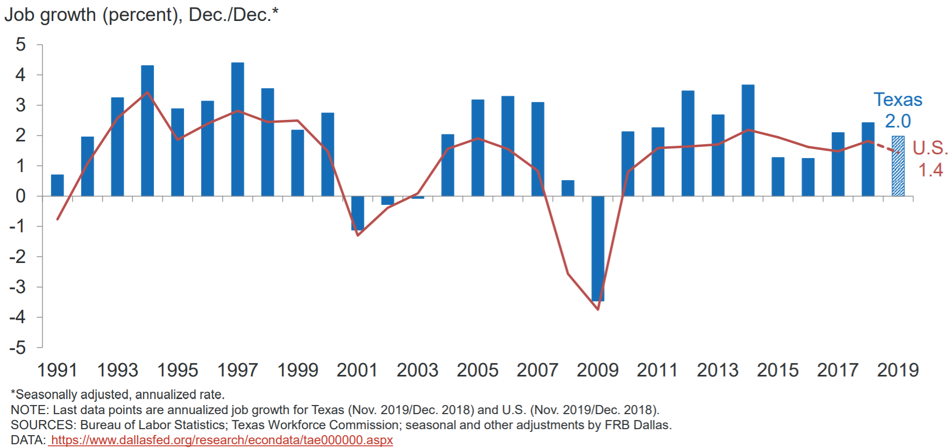
Source: Federal Reserve Bank of Dallas; https://www.dallasfed.org/-/media/Documents/research/econdata/texaseconomy.pdf

Slide 22
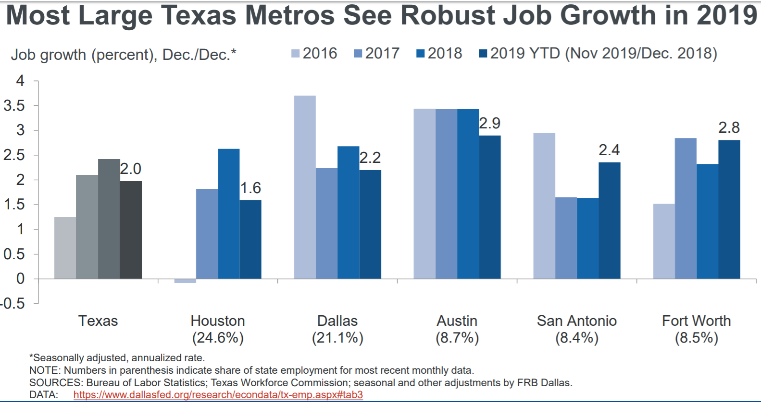
Source: Federal Reserve Bank of Dallas; https://www.dallasfed.org/-/media/Documents/research/econdata/texaseconomy.pdf

Slide 23
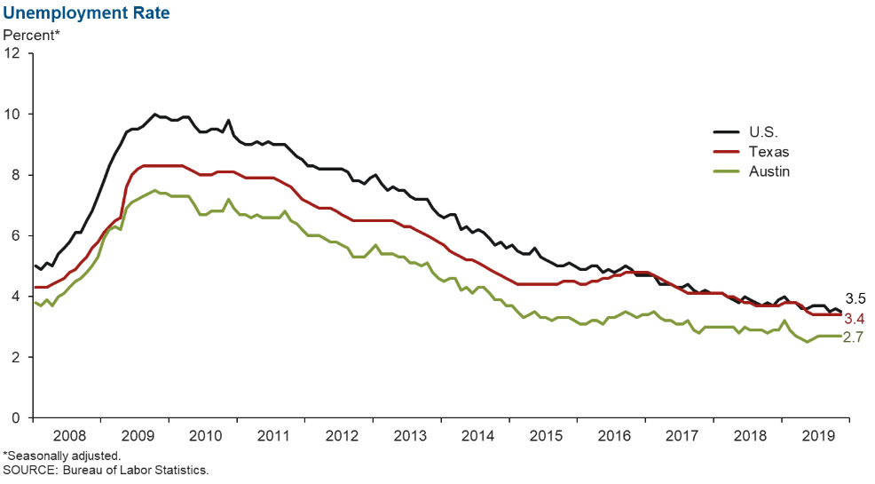
Unemployment Rate, 2008 to 2019
Source: Federal Reserve Bank of Dallas; https://www.dallasfed.org/research/indicators/aus/2020/aus2001.aspx

Slide 24
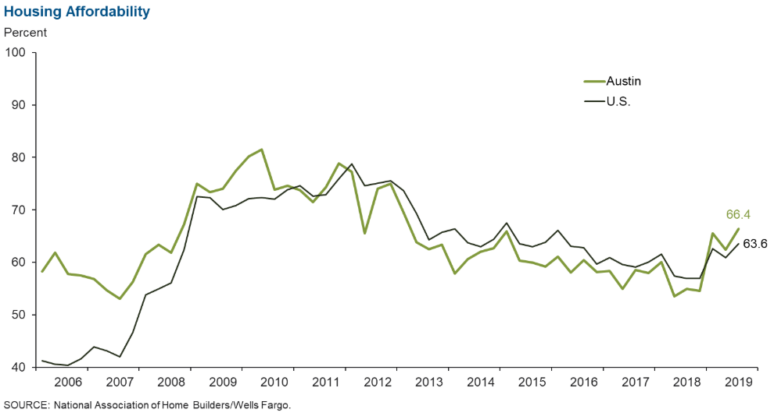
Housing Affordability in Select Texas Metros,
2006-2019
Source: Federal Reserve Bank of Dallas; https://www.dallasfed.org/research/indicators/aus/2020/aus2001.aspx
Notes:
Housing affordability—the share of homes sold that were affordable to a median-income family in the area—has fallen in most major Texas metros. Additionally, apartment demand and occupancy rates generally remain high.

Slide 25
Percent Population 25 Years Plus with HS Degree and Above, Austin Metro, Census Tracts, 2017
Source: U.S. Census Bureau, American Community Survey, 5-Year Sample, 2013-2017

Slide 26
Percent Population 25 years plus with a Bachelor’s Degree and Above, Austin Metro, Census Tracts, 2017
Source: U.S. Census Bureau, American Community Survey, 5-Year Sample, 2013-2017

Slide 27
Percent of Below Poverty, Austin Metro, Census Tracts, 2017
Source: U.S. Census Bureau, American Community Survey 2017 5-Year Estimates

Slide 28
Median Household Income, Austin Metro, Census Tracts, 2017
Source: U.S. Census Bureau, American Community Survey 2017 5-Year Estimates

Slide 29

Population Projections & the 2020 Census

Slide 30
Projected Population, 2010-2050, Texas
Source: Texas Demographic Center, 2014 and 2018 Population Projections

Slide 31
Projected Population by Race and Ethnicity,
Texas 2010-2050
Source: Texas Demographic Center 2018 Population Projections
Notes:
Population projections by race and ethnicity suggest that Latino’s are and will increasingly be the largest race/ethnic group. The number and percent who are non-Hispanic white are likely to decline. Non-Hispanic other are largely of Asian descent and they appear to be increasing rapidly, although the base number is small.

Slide 32
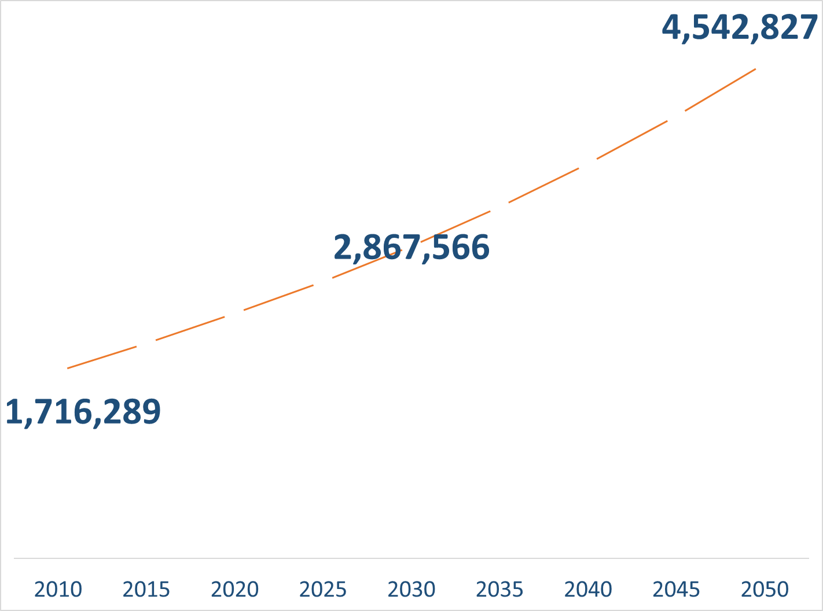
Population Projections, Austin-Round Rock Metro Area, 2010-2050
Source: Texas Demographic Center, 2018 Population Projections

Slide 33
Population Projections by Race/Ethnicity,
Austin Metro Area, 2010-2050
Source: Texas Demographic Center, 2018 Population Projections

Slide 34

2020 Census is in 79 days.

Slide 35
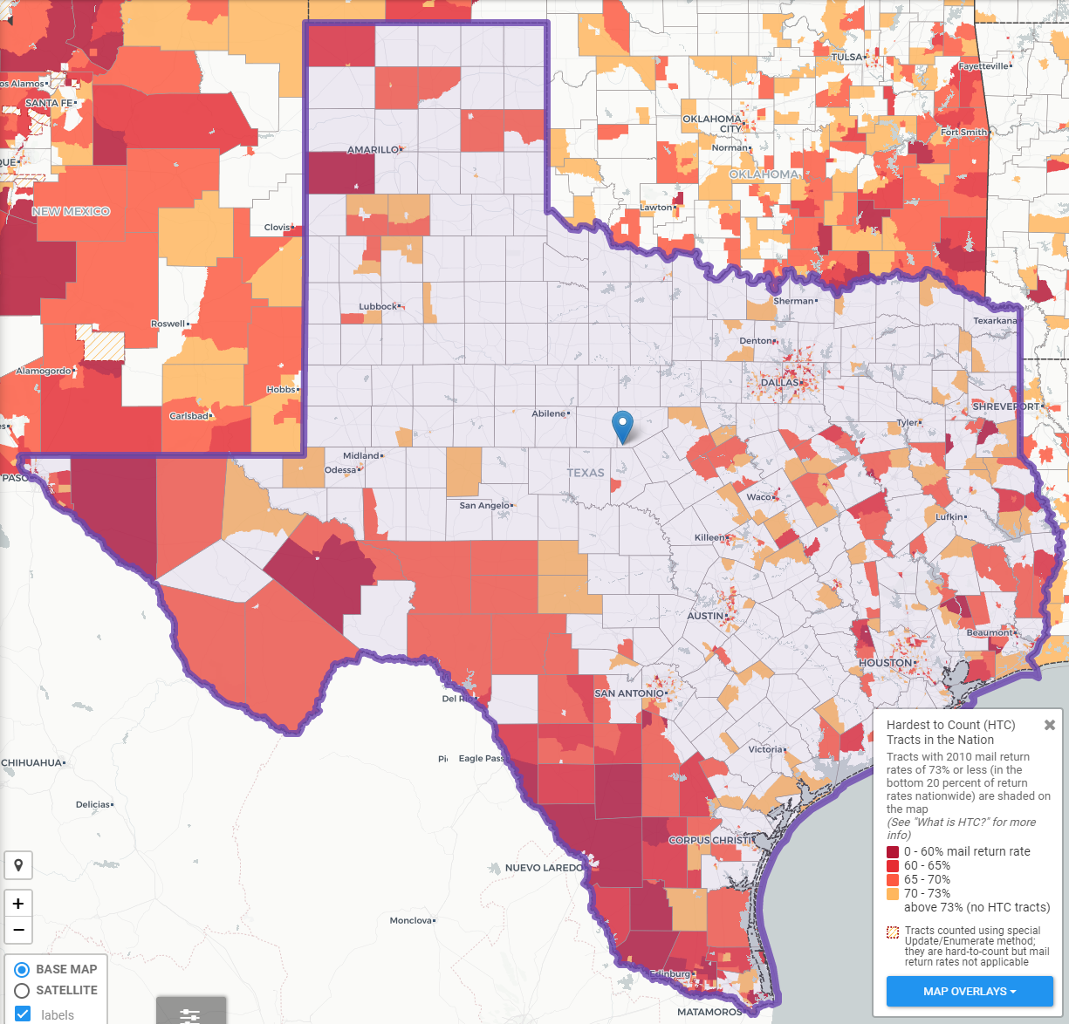
Texas Hard to Count Populations
In 2010, an estimated 240,000 Texans were undercounted in the Census.
An estimated 7 million, or nearly 25%, of Texans live in hard to count neighborhoods.
Some projections indicate up to 500,000 Texans could be undercounted in 2020.
Source: Center for Urban Research of the City University of New York (CUNY) Graduate Center.

Slide 36
Texas Hard to Count Populations
Census research has identified populations that are more difficult for the Census Bureau to count. These include:
People of Color
  Texas has the second largest number of Hispanics and African Americans and third largest number of Asian populations of all states in the U.S.
Immigrants
  An estimated 4.85 million foreign born reside in Texas.
Children under 5
  An estimated 5 percent, or about 2.2 million, of kids under the age of 5 were not counted in the 2010 Census, including about 75,000 Texas children. Children who are not biologically related, Hispanic, live in complex households, live in rented housing, and who have very young parents are even more likely not to be counted.

Slide 37
Texas Hard to Count Populations
Single-Parent Households
  An estimated 1.2 million Texas households are single-parent households, and all of these households are households with children under 18 years of age.
People with Limited English Proficiency
  Approximately 8% of Texas households are limited English speaking households, with 85% of these households speaking Spanish, 9% speaking an Asian or Pacific Islander language, 4% speaking Indo-European languages, and 2% speaking other languages.
People living in Multi-Family Housing
  Nearly 1 in 4 Texas housing units are in buildings with 2 or more units and 15% of Texas housing units are in buildings with 10 or more units.

Slide 38
Texas Hard to Count Populations
Renters
  Over 1 in 3 Texas households are renter occupied.
Larger Households
  Approximately 5% of Texas households are considered crowded households, where more than 1 person per room is living in the household.
Low Income Populations
  Over 1 in 3 Texas households are renter occupied.

Slide 39
To get involved:
Austin-Travis County Complete Count Committee
https://www.traviscountytx.gov/census2020

Slide 40



Lila Valencia, Ph.D.
(512) 936-3542
Lila.Valencia@utsa.edu
demographics.texas.gov
@TexasDemography

