Slide 1


Texas Demographic Trends & Characteristics
Texas Fiscal Officers Academy
Austin, TX
February 24, 2020
@TexasDemography

Slide 2
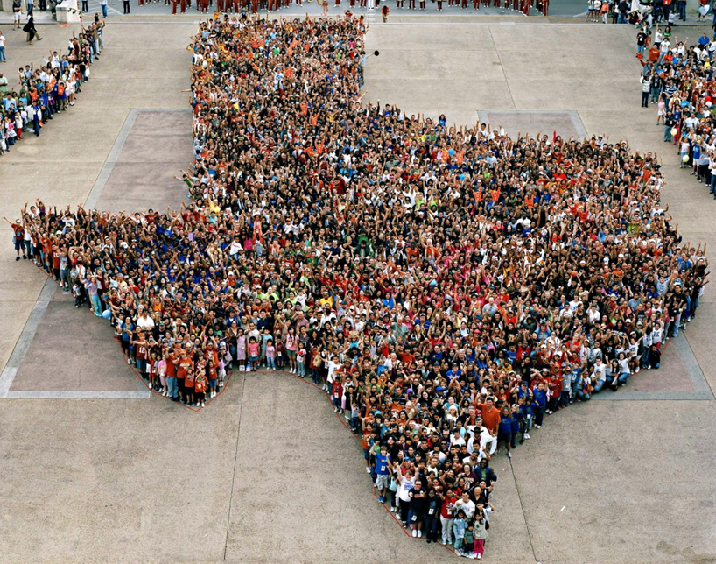
Texas is experiencing significant growth.

Slide 3
Population Growth of Select States, 2000-2019
 | 2000 Population | 2010 Population | 2019 Population | Numeric Change 2010-2019 | Percent Change 2010-2019
United States | 281,421,906 | 308,745,538 | 32,823,9523 | 19,481,418 | 6.3%
Texas | 20,851,820 | 25,145,561 | 28,995,881 | 3,849,790 | 15.3%
California | 33,871,648 | 37,253,956 | 39,512,223 | 2,257,704 | 6.1%
Florida | 15,982,378 | 18,801,310 | 21,477,737 | 2,673,173 | 14.2%
Georgia | 8,186,453 | 9,687,653 | 10,617,423 | 928,694 | 9.6%
North Carolina | 8,049,313 | 9,535,483 | 10,488,084 | 952,333 | 10.0%
Washington | 5,894,121 | 6,724,540 | 7,614,893 | 890,353 | 13.2%
Arizona | 5,130,632 | 6,392,017 | 7,278,717 | 886,429 | 13.9%
Colorado | 5,029,196 | 5,029,196 | 5,758,736 | 729,417 | 14.5%
Source: U.S. Census Bureau. 2000 and 2010 Census Count, 2019 Population Estimates.
Notes:
Texas is the second largest state in terms of population (2nd to CA) and area (2nd to AK). In terms of number of people, Texas’ growth exceeds that of all other states between 2010 and 2019.

Slide 4
Texas added 367,215 people between July 1, 2018 and July 1, 2019.
About 1,006 people per day added to our population.
  About 483 persons per day from natural increase (more births than deaths)
  About 523 per day from net migration (178 international and 345 domestic migrants per day).
Source: U.S. Census Bureau, 2018 Population Estimates.
Notes:
The DFW metro area added 131,767 between 2017 and 2018, or about 361 people added per day. 149 from natural increase (or 41%), and 212 from net migration (or 59%). 126 from domestic migration and 86 from international migration.

Slide 5
Estimates of Components of Population Change, Texas, 2011-2019
Source: U.S. Census Bureau, 2019 Vintage population estimates
Notes:
Natural increase has been in the range of half of population change since the last Census in Texas. Thus Texas is growing quickly and substantially from having more births than deaths over time. In the last year, the number and percent of immigrants has declined and the number and percent of domestic migrants from other states has increased.

Slide 6

Total Estimated Population by County, Texas, 2018
Source: U.S. Census Bureau, 2018 Population Estimates
Notes:
When we look at the geographic distribution of the population of Texas over time we see continually increasing population in the counties along the I-35 corridor, the Houston area, and the lower Rio Grand Valley. Urbanized areas out west have grown but most counties in the west have experienced limited growth and some population decline. Approximately 86% of the population is along I-35 and east. This area with the 3 major metropolitan areas at the points is often described as the Texas population triangle.

Slide 7
Estimated Population Change, Texas Counties,
2010 to 2018
96 counties lost population over the 8 year period.
Source: U.S. Census Bureau, 2018 Population Estimates
Notes:
Population change over the decade has been greatest in the urban and suburban population triangle counties. Counties in the lower Rio Grande Valley also had significant growth as did El Paso. Overall, 158 counties gained population while 96 (38%) lost population over the decade.

Slide 8
Estimated Percent Change of the Total Population by County, Texas, 2010 to 2018
Source: U.S. Census Bureau, 2018 Population Estimates
Notes:
Percent change is an indicator of the speed of population change void of information about the volume of population change. Percent change in the population over the past few years has been greatest in the suburban population triangle counties, notably among counties between San Antonio and Austin. In the early part of the decade, counties in the Eagle Ford Shale area (south east of San Antonio) had been growing quickly. This is less so the case today. The Cline Shale area (Midland and Odessa area) continues to grow and in some cases even growing faster than the State.

Slide 9

Texas continues to diversify.

Slide 10
Texas Racial and Ethnic Composition,
2010 and 2018
11
Source: U.S. Census Bureau. 2018 Population Estimates
Notes:
As of the 2000 Census, about 53% of Texas’ population was non-Hispanic White, about 32% where of Hispanic descent, about 11% where non-Hispanic African American, and about 3% NH Asian, and 1% non-Hispanic Other.
In 2010, the Texas population was made up of 45% non-Hispanic Whites, 38% of Hispanic descent, 11% non-Hispanic Black or African American, 4% non-Hispanic Asian, and 2% non-Hispanic Other. In 2017, Texas continues to diversify with increases in the proportion of the population identifying as Hispanic and NH Asian and a decrease in the proportion identifying as White, NH.
Hispanics are a major driver of growth in Texas. Between 2000 and 2010, of every 10 people added to the Texas population, 6 were Hispanic. In 2010, Hispanics made up 32% of the total Texas population. Currently, Hispanics make up 39% of the total population. This represents an annual growth rate of over 2.5%, higher than the state growth rate. Over half (53.7%) of the growth add to the Texas population between 2010 and 2017 can be attributed to growth among Hispanics.

Slide 11
Total Fertility Rate by Race/Ethnicity, Texas, 1990-2017
Source: Centers for Disease Control and Prevention, National Center for Health Statistics, National Vital Statistics Report

Slide 12
Place of Birth for the Foreign Born Population, Texas, 2018
Total Foreign Born Population |  | 4,928,025
Latin America |  | 3,276,400
Mexico |  | 2,505,720
Central America | Belize, Costa Rica, El Salvador,¹ Guatemala,³ Honduras,² Nicaragua, Panama | 474,967
South America | Argentina, Bolivia, Brazil, Chile, Colombia,¹ Ecuador, Guyana, Peru, Uruguay, Venezuela² | 182,179
Caribbean | Bahamas, Barbados, Cuba,¹ Dominica, Dominican Republic, Grenada, Haiti, Jamaica, St. Vincent & the Grenadines, Trinidad and Tobago, West Indies | 113,534
Asia |  | 1,129,111
South Central Asia | Afghanistan, Bangladesh, India,¹ Iran, Kazakhstan, Nepal, Pakistan, Sri Lanka, Uzbekistan | 440,731
South Eastern Asia | Cambodia, Indonesia, Laos, Malaysia, Burma, Philippines,² Singapore, Thailand, Vietnam¹ | 357,359
Eastern Asia | China,¹ Hong Kong, Taiwan,³ Japan, Korea² | 233,578
Western Asia | Iraq,¹ Israel, Jordan, Kuwait, Lebanon,² Saudi Arabia, Syria, Yemen, Turkey,³ Armenia | 92,090
Source: U.S. Census Bureau, 2018 American Community Survey 1-Year Estimates
Notes:
Hispanics, mostly from Mexico, make up the majority of the foreign born population in Texas.

Slide 13
Annual Shares of Recent Non-Citizen Immigrants to Texas by World Area of Birth, 2005-2015
Estimated number of international migrants to Texas
101,588
77,702
98,194
Source: U.S. Census Bureau, American Community Survey, 1-Year PUMS
Notes:
Recent trends indicate the face of the Texas immigrant is changing with increasingly larger shares of recent migrants coming from Asian countries and fewer and smaller shares coming from Latin American countries.

Slide 14

Texas is young, but aging.

Slide 15
Population by Age Group, Texas, 2010, 2017, 2018
 | 2010 | 2017 | 2018 | Numeric Change, 2010-2018 | Numeric Change, 2017-2018 | Percent Change, 2010-2018 | Percent Change, 2017-2018
Under 18 | 6,865,824 | 7,365,879 | 7,398,099 | 532,275 | 32,220 | 7.75% | 0.44%
18 to 24 | 2,572,969 | 2,775,029 | 2,796,079 | 223,110 | 21,050 | 8.67% | 0.76%
18 to 64 | 15,677,851 | 17,493,434 | 17,701,426 | 2,023,575 | 207,992 | 12.91% | 1.19%
65 plus | 2,601,886 | 3,463,404 | 3,602,320 | 1,000,434 | 138,916 | 38.45% | 4.01%
85 plus | 305,179 | 391,668 | 400,499 | 95,320 | 8,831 | 31.23% | 2.25%
Source: U.S. Census Bureau, 2018 Population Estimates

Slide 16
Race-Ethnicity Composition by Age Group, 2010 to 2018, Texas

Slide 17
Annual Numeric Change in Population 18 to 24, Texas, 2010-2017
Source: U.S. Census Bureau, 2017 Population Estimates
Notes:
Although the population of young Texans has been growing since the last Census, growth has been steadily decreasing among all race/ethnic groups, with actual declines seen among Black and non-Hispanic White 18 to 24 year olds.

Slide 18

The Texas Economy and Socioeconomic Indicators

Slide 19
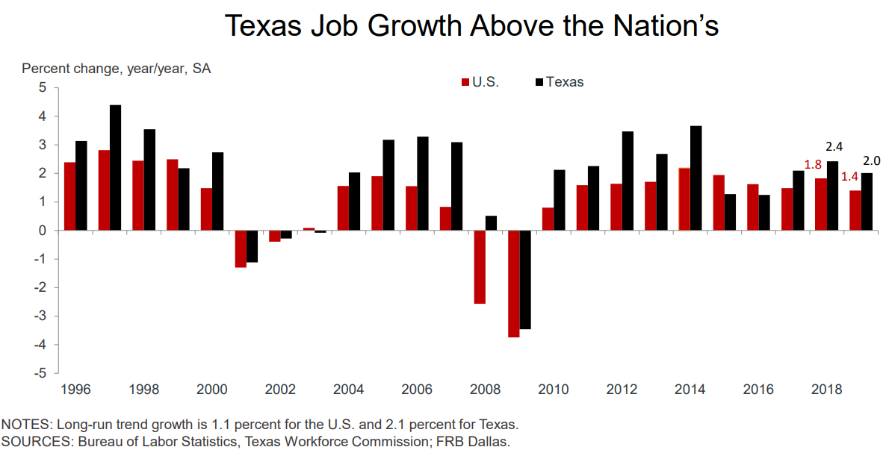
Texas Job Growth, 1996-2019
Notes:
2.0% average job growth in 2019

Slide 20
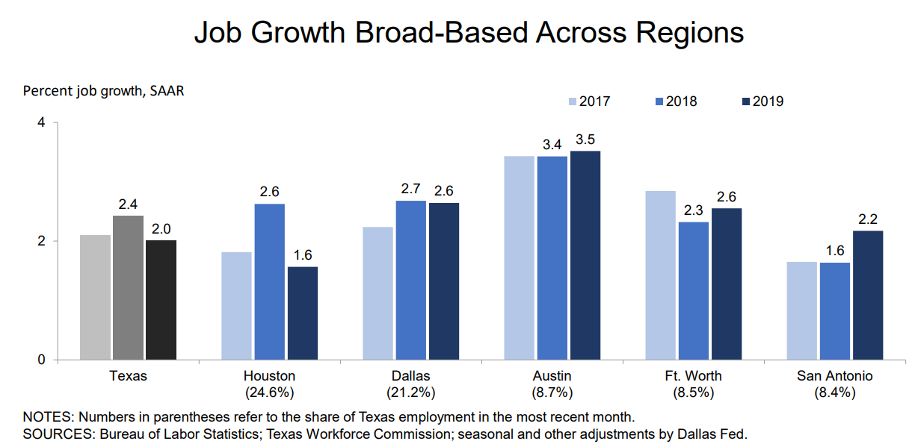

Slide 21
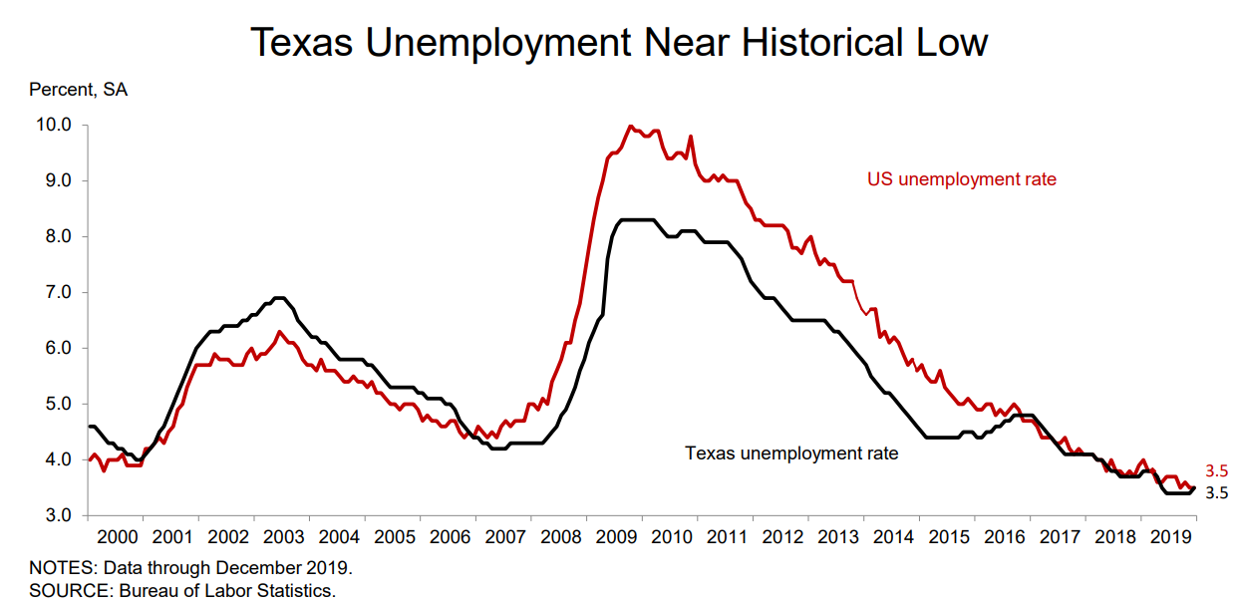

Slide 22
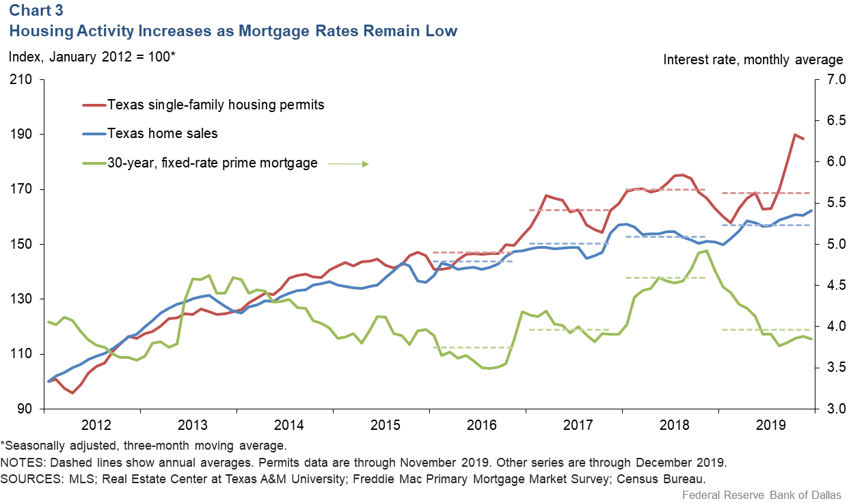
Texas Housing Activity, 2012-2019

Slide 23
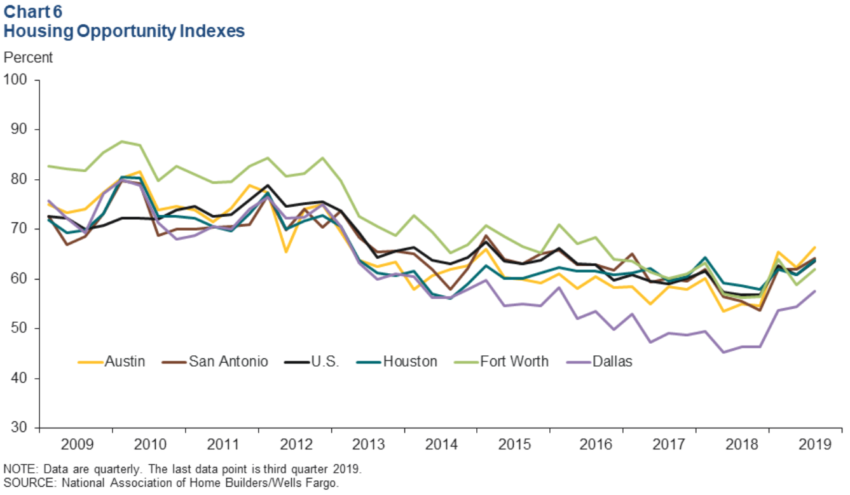
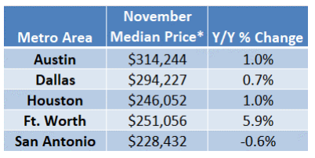
Housing Affordability in Select Texas Metros,
2009-2019
Notes:
Housing affordability—the share of homes sold that were affordable to a median-income family in the area—has fallen in most major Texas metros. Additionally, apartment demand and occupancy rates generally remain high.

Slide 24
Educational Attainment by Race/Ethnicity,
Texas and Big Four Metro Areas, 2018
High School Degree and above
Educational attainment in the DFW metro is generally higher than that of the state, with the exception of education for Hispanics. However, educational disparities by race/ethnicity are still evident.
Bachelor’s Degree and above
Source: U.S. Census Bureau, 2018 American Community Survey 1-Year Estimates

Slide 25
Median Household Income by Race/Ethnicity,
Texas and Big Four Metro Areas, 2018
Median household incomes in the DFW metro tend to be higher than the state for all race/ethnic groups, but especially for NH Whites.
Source: U.S. Census Bureau, 2018 American Community Survey 1-Year Estimates

Slide 26
Unemployment and Poverty Rates by Race/Ethnicity,
Texas and Big Four Metro Areas, 2018
The unemployment and poverty rates in the Dallas metro tend to be lower than the state rates for all race/ethnicity groups.
Poverty Rate
Unemployment Rate
Source: U.S. Census Bureau, 2018 American Community Survey 1-Year Estimates

Slide 27
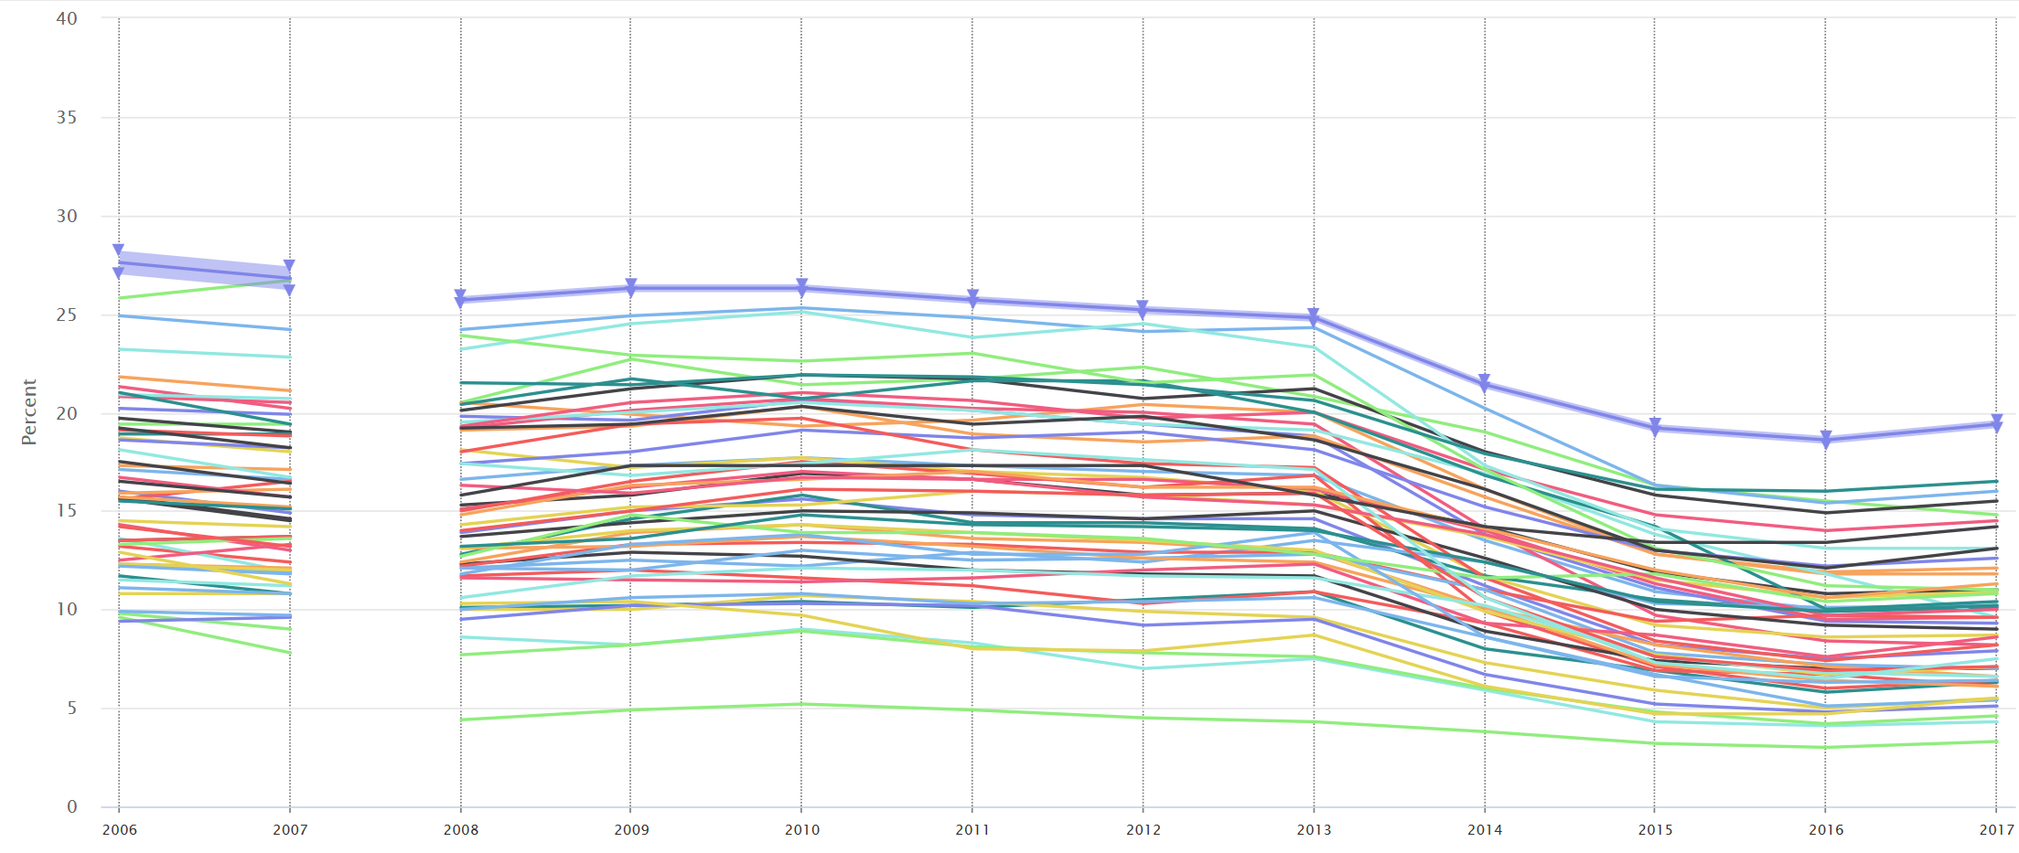
Percent Uninsured, States, 2006-2017
Texas, 2006
27.6%
Texas, 2017
19.4%
Source: U.S. Census Bureau, Small Area Health Insurance Estimates, 2006-2017
Notes:
Texas has led the country in the percent of uninsured individuals for the last ten years. In 2016, 4.4 million Texans were uninsured. This increased in 2017 to 19.4% of Texans. In 2014, Texas surpassed California in the highest number of uninsured and has topped the nation since, with a total of 4.7 million uninsured in 2017.

Slide 28

Population Projections

Slide 29
Projected Population, 2010-2050, Texas
Source: Texas Demographic Center, 2014 and 2018 Population Projections

Slide 30
Projected Population by Race and Ethnicity,
Texas 2010-2030
Source: Texas Demographic Center 2018 Population Projections
Notes:
Population projections by race and ethnicity suggest that Latino’s are and will increasingly be the largest race/ethnic group. The number and percent who are non-Hispanic white are likely to decline. Non-Hispanic other are largely of Asian descent and they appear to be increasing rapidly, although the base number is small.

Slide 31
Projected Population Change and Percent of Total Projected Change by Race/Ethnicity, 2010-2030, Texas
Source: Texas Demographic Center 2018 Population Projections

Slide 32

2020 Census is in 37 days.

Slide 33
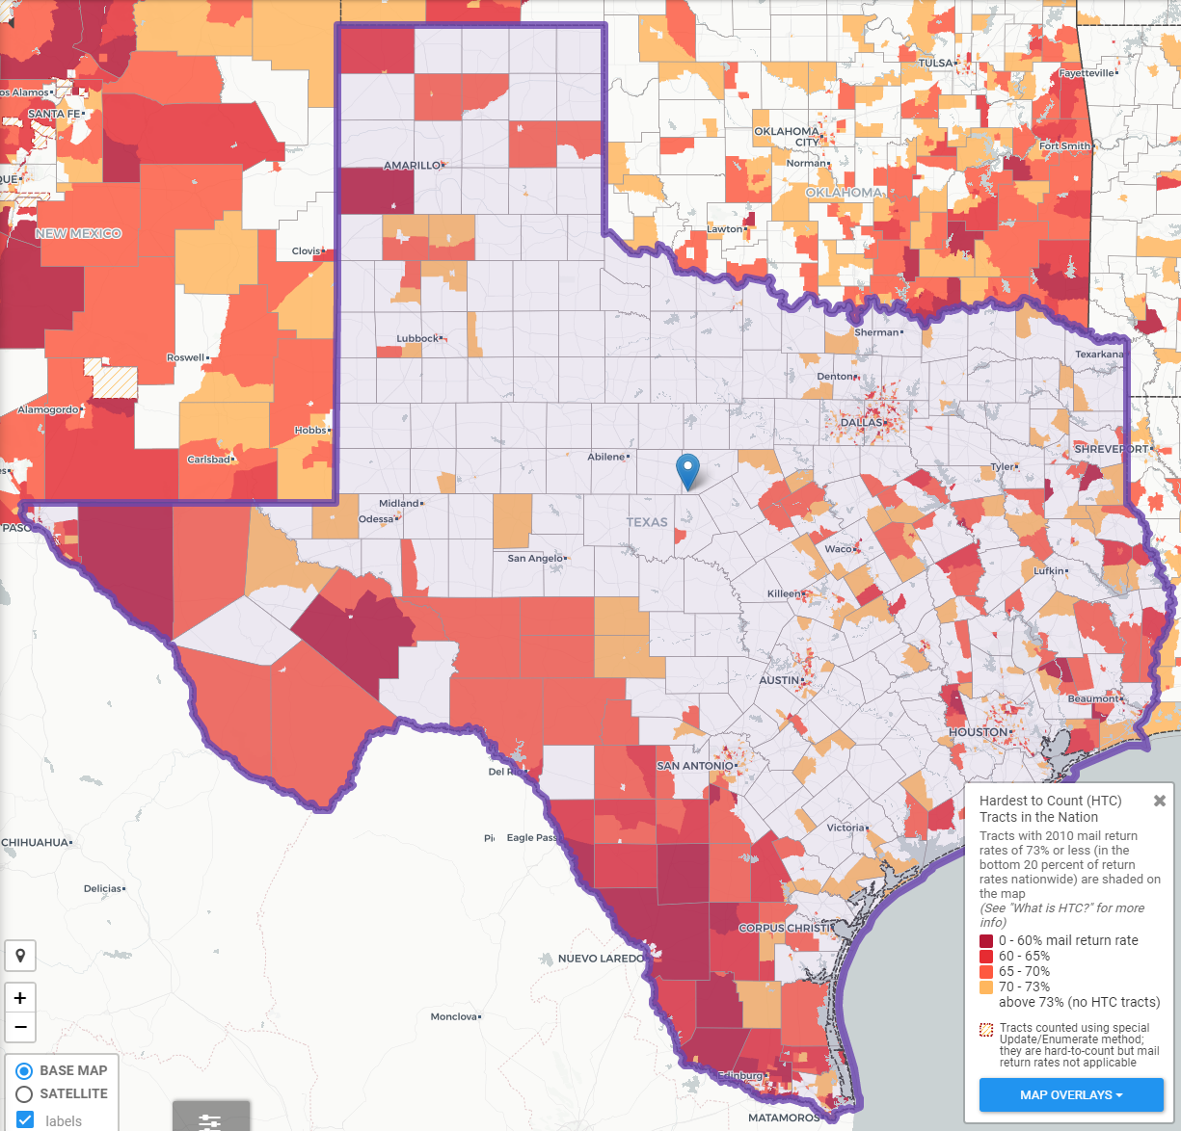
Texas Hard to Count Populations
In 2010, an estimated 240,000 Texans were undercounted in the Census.
An estimated 7 million, or nearly 25%, of Texans live in hard to count neighborhoods.
Some projections indicate up to 500,000 Texans could be undercounted in 2020.
Source: Center for Urban Research of the City University of New York (CUNY) Graduate Center.

Slide 34



Lila Valencia, Ph.D.
(210) 458-6530
Lila.Valencia@utsa.edu
demographics.texas.gov
@TexasDemography

