Slide 1


The Aging Population in Texas:
Trends, Characteristics, and Projections
Texas Assisted Living Association and LeadingAge Texas
Austin, TX
February 27, 2020
@TexasDemography

Slide 2
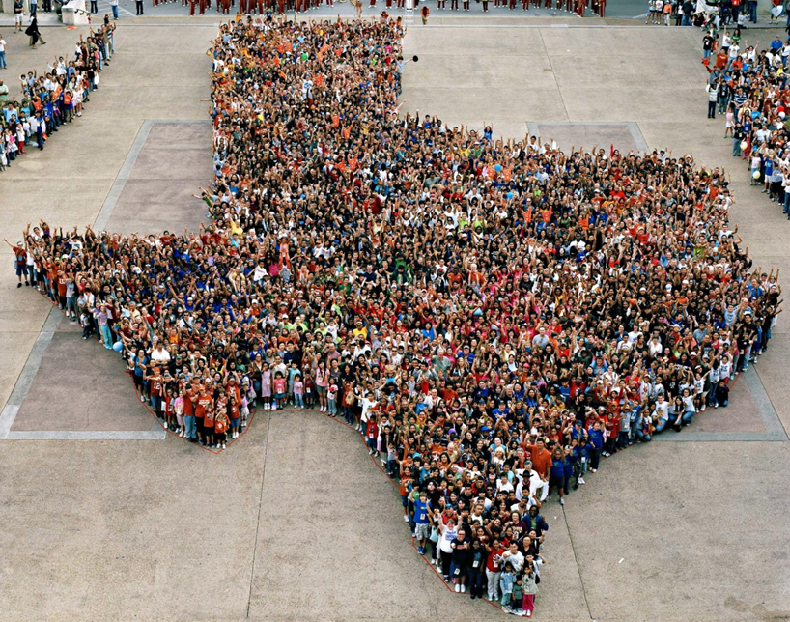

Slide 3
Population Growth of Select States, 2000-2019
 | 2000 Population | 2010 Population | 2019 Population | Numeric Change 2010-2019 | Percent Change 2010-2019
United States | 281,421,906 | 308,745,538 | 32,823,9523 | 19,481,418 | 6.3%
Texas | 20,851,820 | 25,145,561 | 28,995,881 | 3,849,790 | 15.3%
California | 33,871,648 | 37,253,956 | 39,512,223 | 2,257,704 | 6.1%
Florida | 15,982,378 | 18,801,310 | 21,477,737 | 2,673,173 | 14.2%
Georgia | 8,186,453 | 9,687,653 | 10,617,423 | 928,694 | 9.6%
North Carolina | 8,049,313 | 9,535,483 | 10,488,084 | 952,333 | 10.0%
Washington | 5,894,121 | 6,724,540 | 7,614,893 | 890,353 | 13.2%
Arizona | 5,130,632 | 6,392,017 | 7,278,717 | 886,429 | 13.9%
Colorado | 5,029,196 | 5,029,196 | 5,758,736 | 729,417 | 14.5%
Source: U.S. Census Bureau. 2000 and 2010 Census Count, 2019 Population Estimates.
Notes:
Texas is the second largest state in terms of population (2nd to CA) and area (2nd to AK). In terms of number of people, Texas’ growth exceeds that of all other states between 2010 and 2019.

Slide 4
Texas added 367,215 people between July 1, 2018 and July 1, 2019.
About 1,006 people per day added to our population.
  About 483 persons per day from natural increase (more births than deaths)
  About 523 per day from net migration (178 international and 345 domestic migrants per day).
Source: U.S. Census Bureau, 2018 Population Estimates.
Notes:
The DFW metro area added 131,767 between 2017 and 2018, or about 361 people added per day. 149 from natural increase (or 41%), and 212 from net migration (or 59%). 126 from domestic migration and 86 from international migration.

Slide 5
Estimates of Components of Population Change, Texas, 2011-2019
Source: U.S. Census Bureau, 2019 Vintage population estimates
Notes:
Natural increase has been in the range of half of population change since the last Census in Texas. Thus Texas is growing quickly and substantially from having more births than deaths over time. In the last year, the number and percent of immigrants has declined and the number and percent of domestic migrants from other states has increased.

Slide 6

Total Estimated Population by County, Texas, 2018
Source: U.S. Census Bureau, 2018 Population Estimates
Notes:
When we look at the geographic distribution of the population of Texas over time we see continually increasing population in the counties along the I-35 corridor, the Houston area, and the lower Rio Grand Valley. Urbanized areas out west have grown but most counties in the west have experienced limited growth and some population decline. Approximately 86% of the population is along I-35 and east. This area with the 3 major metropolitan areas at the points is often described as the Texas population triangle.

Slide 7
Estimated Population Change, Texas Counties,
2010 to 2018
96 counties lost population over the 8 year period.
Source: U.S. Census Bureau, 2018 Population Estimates
Notes:
Population change over the decade has been greatest in the urban and suburban population triangle counties. Counties in the lower Rio Grande Valley also had significant growth as did El Paso. Overall, 158 counties gained population while 96 (38%) lost population over the decade.

Slide 8
Estimated Percent Change of the Total Population by County, Texas, 2010 to 2018
Source: U.S. Census Bureau, 2018 Population Estimates
Notes:
Percent change is an indicator of the speed of population change void of information about the volume of population change. Percent change in the population over the past few years has been greatest in the suburban population triangle counties, notably among counties between San Antonio and Austin. In the early part of the decade, counties in the Eagle Ford Shale area (south east of San Antonio) had been growing quickly. This is less so the case today. The Cline Shale area (Midland and Odessa area) continues to grow and in some cases even growing faster than the State.

Slide 9

As Texas grows, it becomes older and increasingly diverse.

Slide 10
Texas Racial and Ethnic Composition,
2010 and 2018
11
Source: U.S. Census Bureau. 2018 Population Estimates
Notes:
As of the 2000 Census, about 53% of Texas’ population was non-Hispanic White, about 32% where of Hispanic descent, about 11% where non-Hispanic African American, and about 3% NH Asian, and 1% non-Hispanic Other.
In 2010, the Texas population was made up of 45% non-Hispanic Whites, 38% of Hispanic descent, 11% non-Hispanic Black or African American, 4% non-Hispanic Asian, and 2% non-Hispanic Other. In 2017, Texas continues to diversify with increases in the proportion of the population identifying as Hispanic and NH Asian and a decrease in the proportion identifying as White, NH.
Hispanics are a major driver of growth in Texas. Between 2000 and 2010, of every 10 people added to the Texas population, 6 were Hispanic. In 2010, Hispanics made up 32% of the total Texas population. Currently, Hispanics make up 39% of the total population. This represents an annual growth rate of over 2.5%, higher than the state growth rate. Over half (53.7%) of the growth add to the Texas population between 2010 and 2017 can be attributed to growth among Hispanics.

Slide 11
Race-Ethnicity Composition by Age Group, 2010 to 2018, Texas
Source: U.S. Census Bureau. 2018 Population Estimates
Notes:
Texas added over 3.55 million people between 2010 and 2018. However, growth is not evenly distributed across age and race/ethnicity groups. This chart shows that between 2010 and 2018, the 65 plus age category had the greatest increase (slightly more than one million) and grew at the fastest rate compared to the younger age groups. During this same period, all race/ethnicity groups saw increases in every age group, except for NH Whites. Specifically, NH Whites experienced population declines in the under 18 years and 45-64 years age groups, but had the most significant growth in the 65 years plus age group.

Slide 12

Texas is young, but aging.

Slide 13
Population by Age Group, Texas, 2010, 2017, 2018
 | 2010 | 2017 | 2018 | Numeric Change, 2010-2018 | Numeric Change, 2017-2018 | Percent Change, 2010-2018 | Percent Change, 2017-2018
Under 18 | 6,865,824 | 7,365,879 | 7,398,099 | 532,275 | 32,220 | 7.75% | 0.44%
18 to 64 | 15,677,851 | 17,493,434 | 17,701,426 | 2,023,575 | 207,992 | 12.91% | 1.19%
18 to 24 | 2,572,969 | 2,775,029 | 2,796,079 | 223,110 | 21,050 | 8.67% | 0.76%
65 plus | 2,601,886 | 3,463,404 | 3,602,320 | 1,000,434 | 138,916 | 38.45% | 4.01%
85 plus | 305,179 | 391,668 | 400,499 | 95,320 | 8,831 | 31.23% | 2.25%
Source: U.S. Census Bureau, 2018 Population Estimates
Notes:
The elder population is growing faster in Texas than in the nation. It is also the fastest growing age group in Texas.

Slide 14
Trends in Aging by County, 2010 to 2018
Source: U.S. Census Bureau, 2010 Census Data; Texas Demographic Center, 2018 Population Estimates
Notes:
This map represents the change in median age between 2010 and 2018 by county, accounting for population size. The counties in shades of yellow and orange had higher median ages than the state in 2010. The 86 counties depicted in red experienced increases in median age, or aged, but 31 counties depicted in yellow experienced decreases in their median age, or got younger, during this time period. The counties in shades of green were younger than the state in 2010. Only 6 counties, depicted in dark green, became younger during this time period. And 31 of these initially young counties aged during this time.
Geographically, major metropolitan cities such as Houston, Dallas, Fort Worth, San Antonio, Austin, and El Paso as well as the southern border regions had younger populations than the state in 2010, but still got older between 2010 and 2018. Several young counties neighboring oil fields in West Texas experienced reverse population aging (i.e., declines in the median age) likely due to the influx of young working age migrants. Similarly, a few counties in the Panhandle region and South Texas region that were older than the state in 2010 saw reverse population aging as well. These areas of the state also experienced an influx of young migrants employed in meat-packing plants in the region. The remaining counties were older than the state in 2010 and continued to age throughout this time period.

Slide 15
Select Demographic and Social Characteristics for Population 65 years plus, Texas, 2018
 | Total Population | Population 65 and up
Sex
Female | 50.4% | 55.4%
Male | 49.6% | 44.6%
Race/Ethnicity
White, NH | 41.4% | 62.6%
Black or African American | 12.3% | 9.2%
Hispanic | 39.6% | 23.1%
Asian | 5.0% | 4.0%
Marital Status
Married | 48.2% | 56.3%
Divorced or Separated | 12.9% | 15.8%
Widowed | 5.1% | 23.5%
Never married | 33.9% | 4.4%
Source: U.S. Census Bureau, 2018 American Community Survey 1-Year Estimates

Slide 16
Select Demographic and Social Characteristics for Population 65 years plus, Texas, 2018
 | Total Population | Population 65 and up
Living alone | 25.5% | 38.8%
Living with grandchild(ren) | 4.7% | 7.1%
Responsible for grandchild(ren) | 1.6% | 1.7%
With a disability | 11.4% | 36.4%
Percent below poverty level | 14.9% | 11.1%
Veteran | 6.8% | 16.9%
Source: U.S. Census Bureau, 2018 American Community Survey 1-Year Estimates

Slide 17
Select Demographic and Social Characteristics for Population 65 years plus, Texas, 2018
 | Total Population | Population 65 and up
Educational Attainment | Total | Total
HS and above | 84.0% | 80.0%
BA and above | 30.3% | 27.4%
Labor Force Participation Rate | 64.5% | 28.2%
Employed | 61.2% | 19.6%
Computer and Internet Access
No computer | 4.1% | 14.7%
Computer with broadband | 88.1% | 89.3%
Computer without internet | 7.7% | 8.9%
Source: U.S. Census Bureau, 2018 American Community Survey 1-Year Estimates

Slide 18

Population Projections

Slide 19
Projected Population, 2010-2050, Texas
Source: Texas Demographic Center, 2014 and 2018 Population Projections

Slide 20
Projected Population by Race and Ethnicity,
Texas 2010-2030
Source: Texas Demographic Center 2018 Population Projections
Notes:
Population projections by race and ethnicity suggest that Latino’s are and will increasingly be the largest race/ethnic group. The number and percent who are non-Hispanic white are likely to decline. Non-Hispanic other are largely of Asian descent and they appear to be increasing rapidly, although the base number is small.

Slide 21
Projected Population Change and Percent of Total Projected Change by Race/Ethnicity, 2010-2030, Texas
Source: Texas Demographic Center 2018 Population Projections

Slide 22
Projected Population by Age Group, Texas, 2010-2050
Source: Texas Demographic Center 2018 Population Projections
Notes:
The 65 plus age group is projected to grow by nearly 3 million by 2030 and will grow faster than other age groups. In 2010, the 65 plus age group made up just over 10% of the total state population. By 2030, the 65 plus age group will make up nearly 16% of the total state population.

Slide 23
Projected Population 65 years plus by Race/Ethnicity, Texas, 2010-2030
 | Total Population | NH White | NH Black | Hispanic | NH Asian | NH Other
2010 Population | 2,601,886 | 1,760,065 | 218,374 | 532,921 | 65,301 | 25,225
Share of 65 plus, 2010 |  | 68% | 8% | 20% | 3% | 1%
2030 Projected Population | 5,576,489 | 3,056,774 | 596,958 | 1,556,927 | 288,819 | 77,011
Share of 65 plus, 2030 |  | 55% | 11% | 28% | 5% | 1%
Numeric Change, 2010-2030 | 2,974,603 | 1,296,709 | 378,584 | 1,024,006 | 223,518 | 51,786
Percent Change, 2010-2030 | 114.3% | 73.7% | 173.4% | 192.1% | 342.3% | 205.3%
Source: Texas Demographic Center 2018 Population Projections

Slide 24

2020 Census is in 35 days.

Slide 25
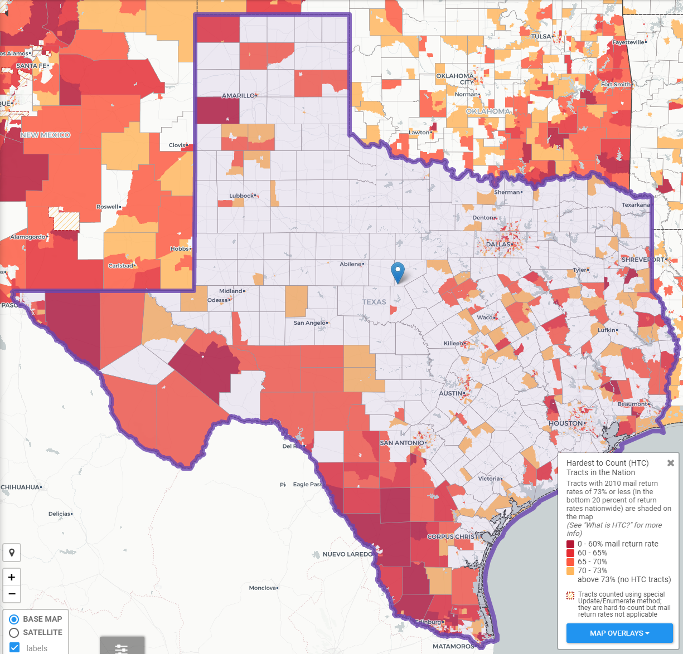
Texas Hard to Count Populations
In 2010, an estimated 240,000 Texans were undercounted in the Census.
An estimated 7 million, or nearly 25%, of Texans live in hard to count neighborhoods.
Some projections indicate up to 500,000 Texans could be undercounted in 2020.
Source: Center for Urban Research of the City University of New York (CUNY) Graduate Center.

Slide 26



Lila Valencia, Ph.D.
(210) 458-6530
Lila.Valencia@utsa.edu
demographics.texas.gov
@TexasDemography

