Slide 1
The 2020 Census in Texas: What to Expect and How to Get Faith Communities Involved
Episcopal Health Foundation InCommon
February 29, 2020
@TexasDemography

Slide 2
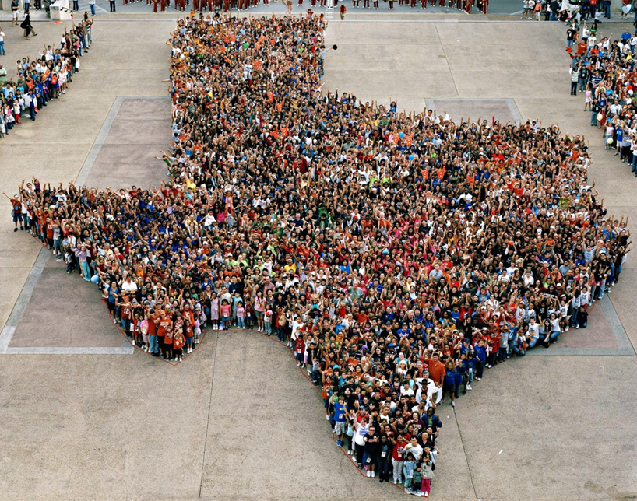
Census Day is 31 days away.

Slide 3
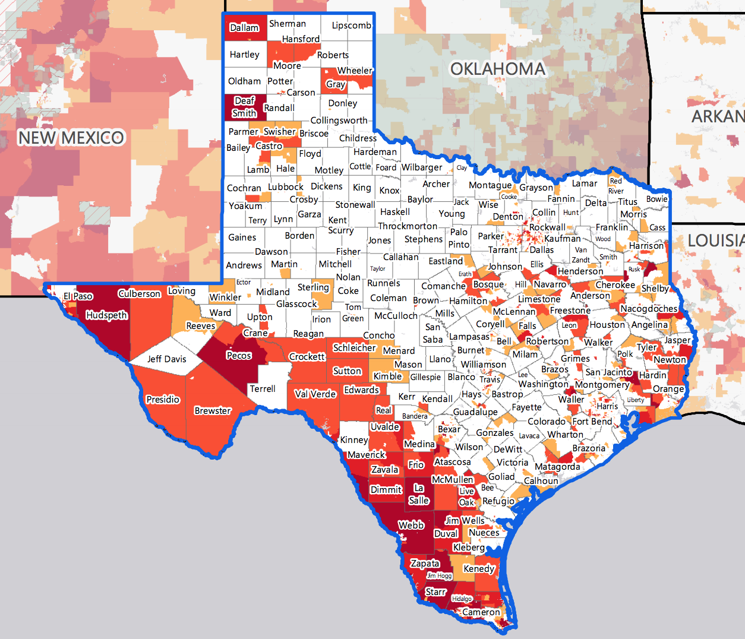
Texas Hard to Count Populations
In 2010, an estimated 240,000 Texans were undercounted in the Census.
An estimated 7 million, or nearly 25%, of Texans live in hard to count neighborhoods.
Some projections indicate up to 500,000 Texans could be undercounted in 2020.
Source: Center for Urban Research of the City University of New York (CUNY) Graduate Center.
Notes:
It has never been easy to count a place as diverse and large as Texas. Our population growth has continued to add to some of the very hard to count populations historically missed from Census surveys. So we face a significant challenge today.

Slide 4
Texas Hard to Count Populations
Census research has identified populations that are more difficult for the Census Bureau to count. These include:
People of Color
Texas has the second largest number of Hispanics and African Americans and third largest number of Asian populations of all states in the U.S.
Immigrants
An estimated 4.85 million foreign born reside in Texas.
Children under 5
An estimated 5 percent, or about 2.2 million, of kids under the age of 5 were not counted in the 2010 Census, including about 75,000 Texas children. Children who are not biologically related, Hispanic, live in complex households, live in rented housing, and who have very young parents are even more likely not to be counted.

Slide 5
Texas Hard to Count Populations
Single-Parent Households
An estimated 1.2 million Texas households are single-parent households, and all of these households are households with children under 18 years of age.
People with Limited English Proficiency
Approximately 8% of Texas households are limited English speaking households, with 85% of these households speaking Spanish, 9% speaking an Asian or Pacific Islander language, 4% speaking Indo-European languages, and 2% speaking other languages.
People living in Multi-Family Housing
Nearly 1 in 4 Texas housing units are in buildings with 2 or more units and 15% of Texas housing units are in buildings with 10 or more units.

Slide 6
Texas Hard to Count Populations
Renters
Over 1 in 3 Texas households are renter occupied.
Larger Households
Approximately 5% of Texas households are considered crowded households, where more than 1 person per room is living in the household.
Low Income Populations
Approximately 16% (or 4.2 million) of the Texas population lives below the poverty level.

Slide 7
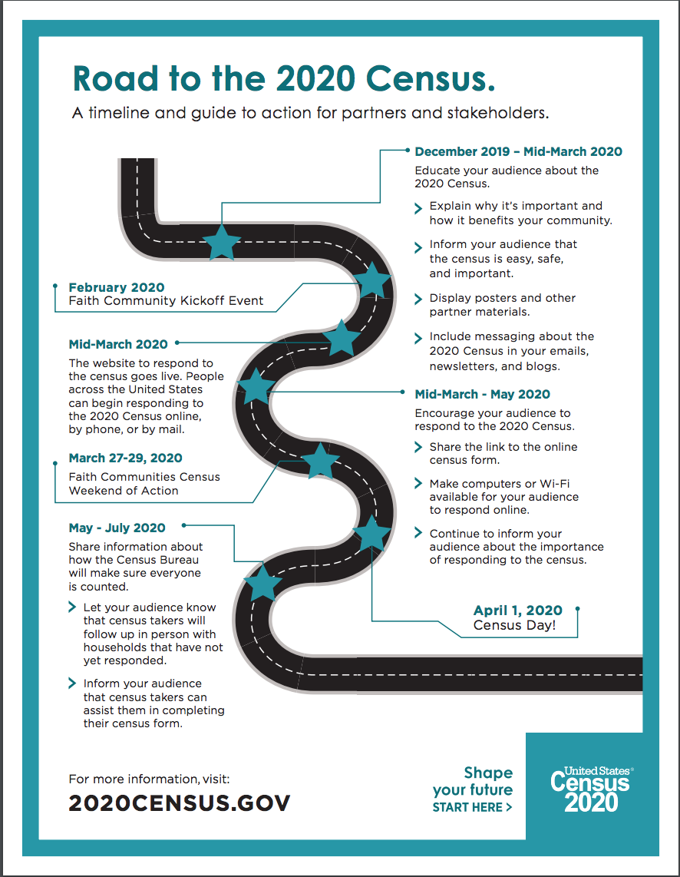
Census Messaging
Awareness
January 14-March 12
Motivation
March 13-May 12
Reminder
May 13-June 28
Notes:
Awareness: Getting out into the community and making sure people understand why it is important to take the Census. This is a great opportunity to dispel myths and allay fears.

Slide 8
Census Messaging:
Building Awareness
Educate your audience about the 2020 Census.
Explain why it’s important and how it benefits your community.
Inform your audience that the census is easy, safe, and important.
Display posters and other materials.
Include messaging about the 2020 Census in your emails, social media, blogs, and newsletters.
Awareness
January 14-March 12
Motivation
March 13-May 12
Reminder
May 13-June 28
Notes:
Awareness: Getting out into the community and making sure people understand why it is important to take the Census. This is a great opportunity to dispel myths and allay fears.

Slide 9
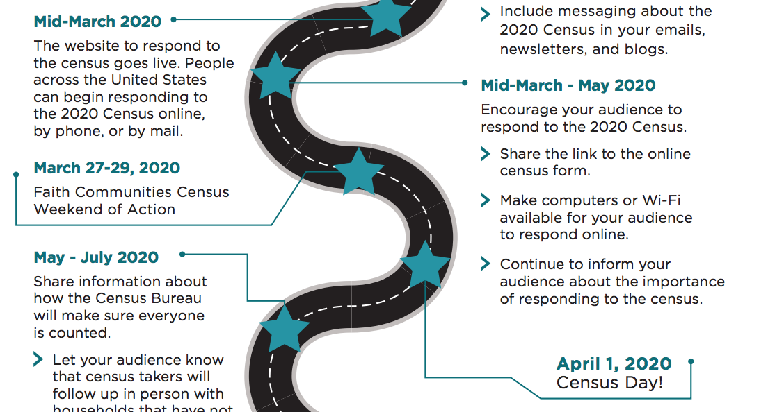
Census Messaging:
Motivation
Notes:
The message will shift from awareness to activation as households are invited to fill out the Census.
Education will still be important, but now there is also a call to action.

Slide 10
Census Messaging:
Motivation
Faith Communities Census Weekend of Action
March 27-29, 2020
Share information during the Faith Communities Census Weekend of Action
Census Day 2020
April 1, 2020
Host an event at your place of worship or coordinate with other local efforts.
Notes:
The message will shift from awareness to activation as households are invited to fill out the Census.
Education will still be important, but now there is also a call to action.

Slide 11
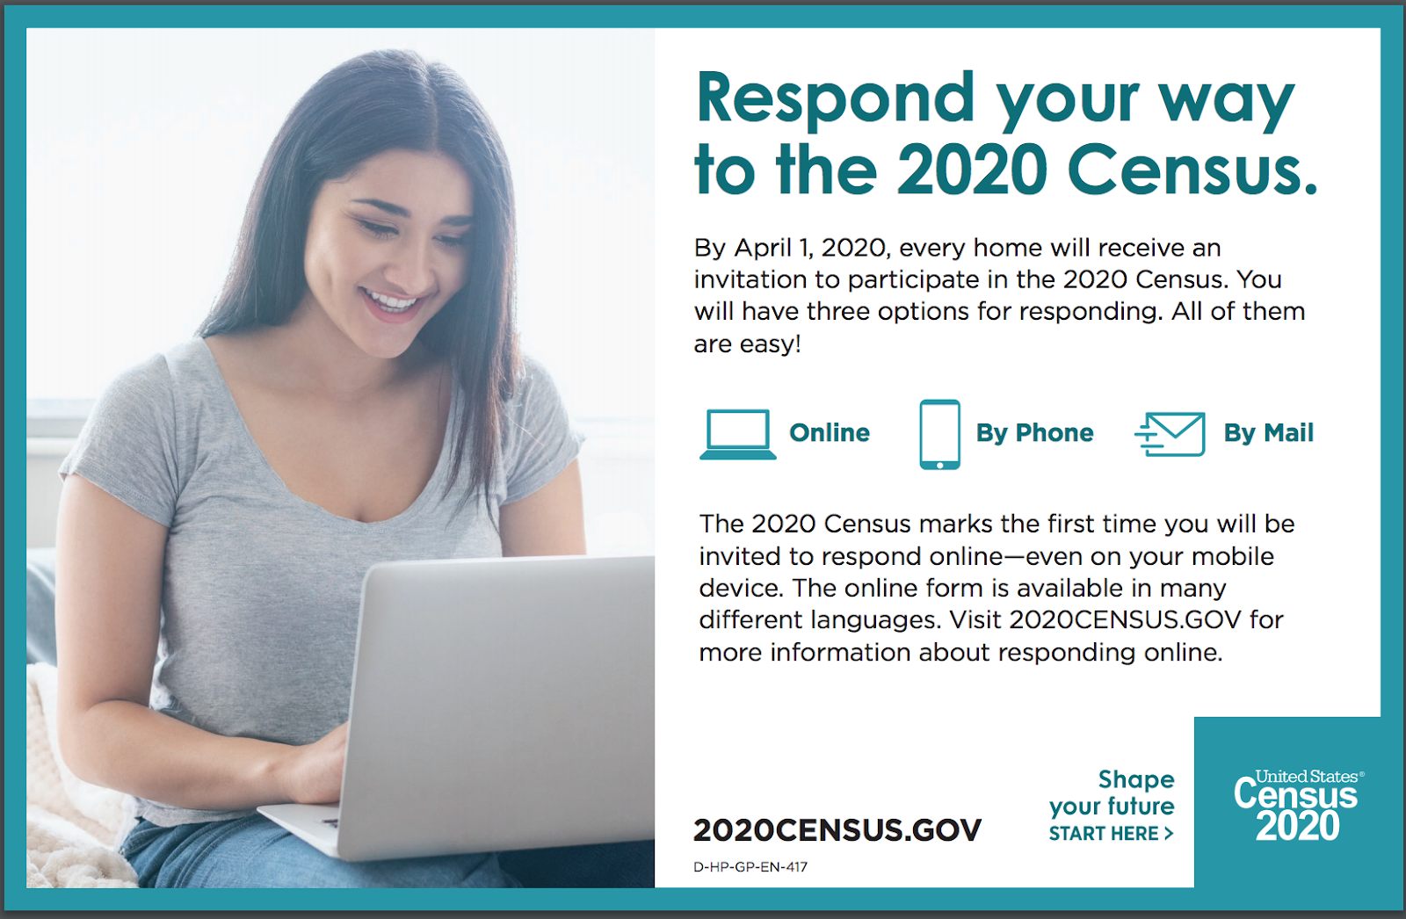
Notes:
https://2020census.gov/content/dam/2020census/materials/partners/2019-11/Half_Page_Handout_Ways_to_Respond.pdf

Slide 12
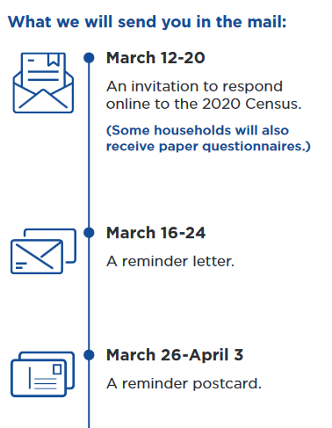
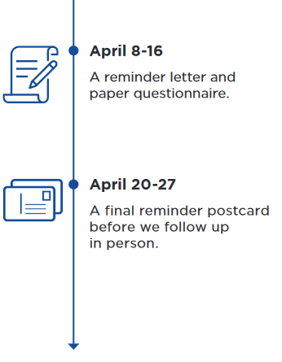
2020 Census Timeline
Notes:
https://2020census.gov/content/dam/2020census/materials/partners/2019-10/Fact_Sheet_About_How_Census_Invites_Everyone.pdf

Slide 13
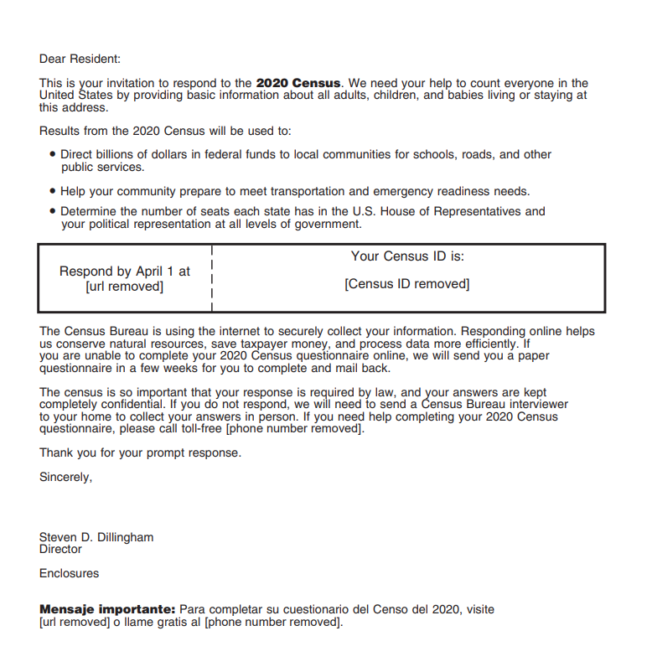
The Sample Invitation:
Notes:
https://2020census.gov/content/dam/2020census/materials/partners/2019-12/2020-informational-invitation-letter.pdf

Slide 14
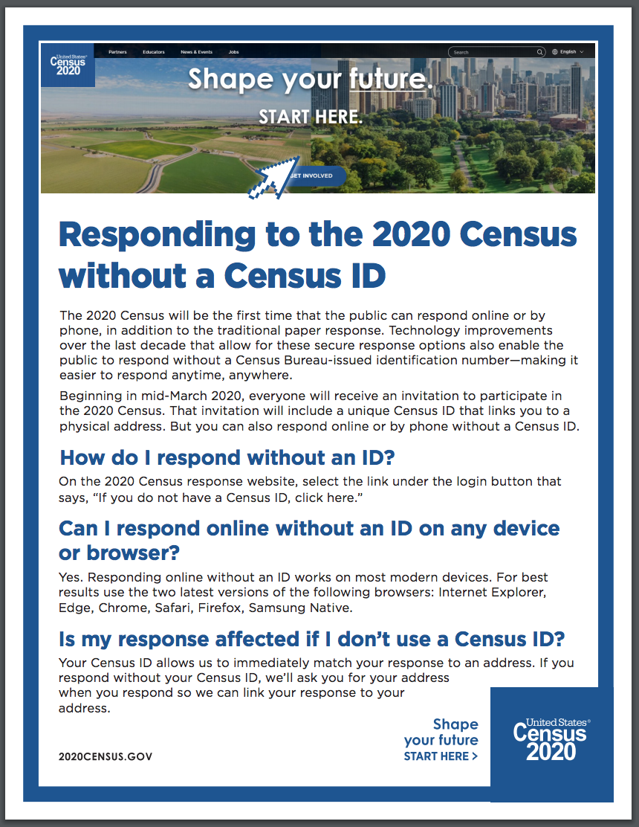
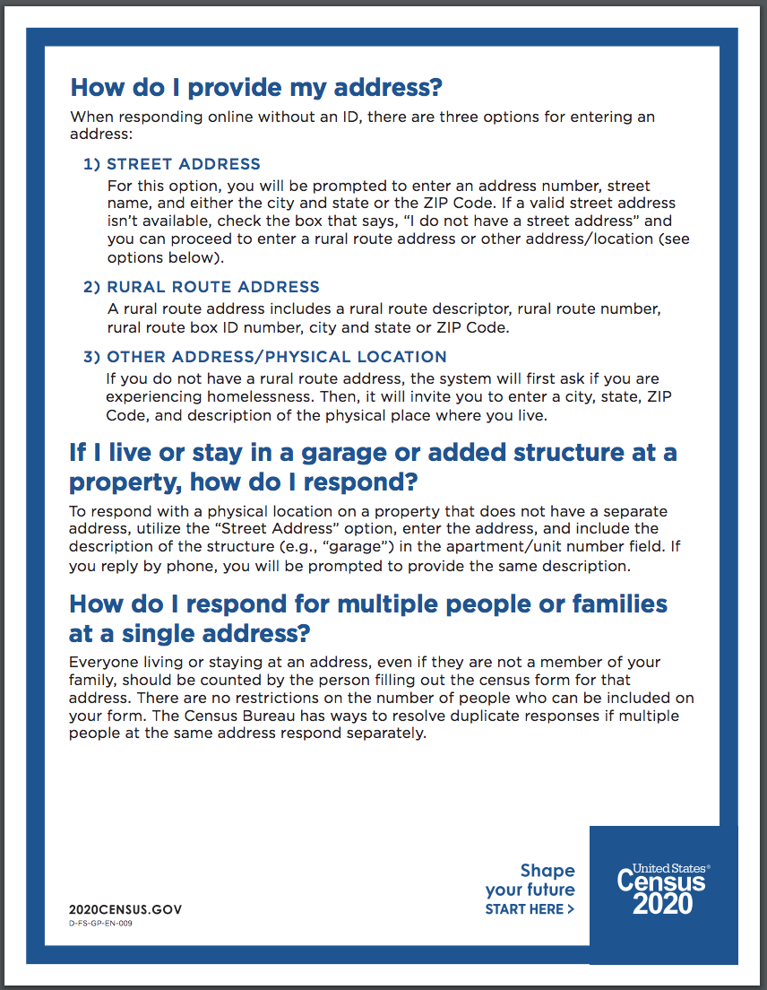
Notes:
https://2020census.gov/content/dam/2020census/materials/partners/2020-01/Responding_Without_Census_ID_FAQ.pdf

Slide 15
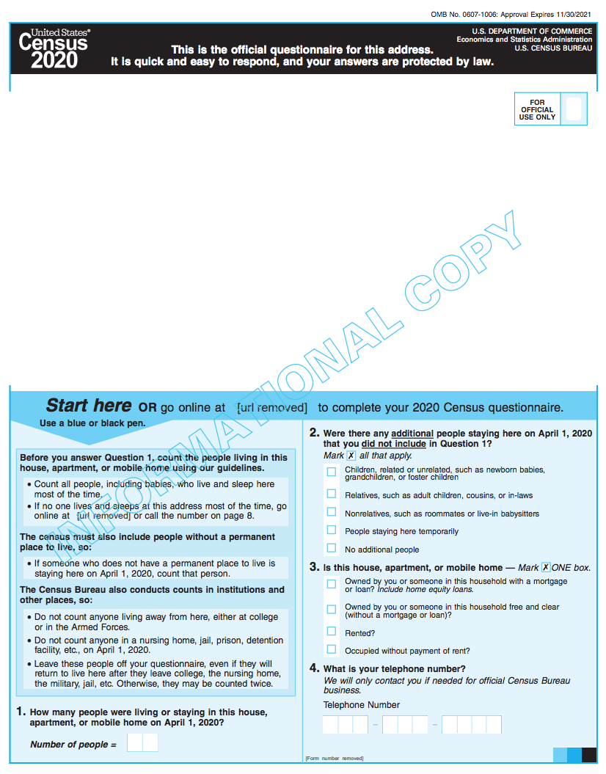
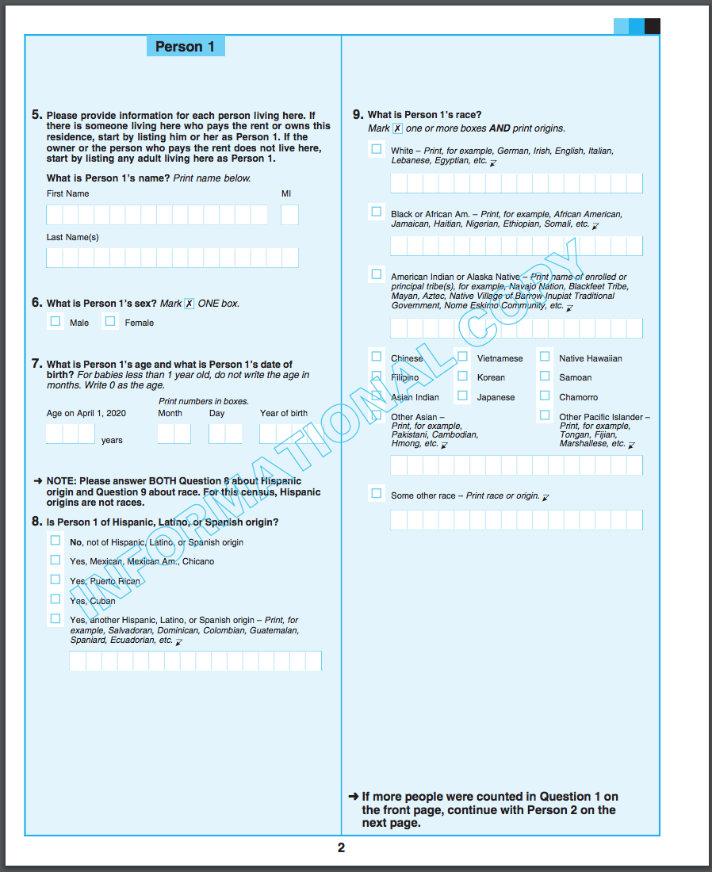
Who to count!
Sex
Age
Hispanic
Race
Notes:
https://2020census.gov/content/dam/2020census/materials/partners/2019-08/2020-informational-questionnaire.pdf

Slide 16
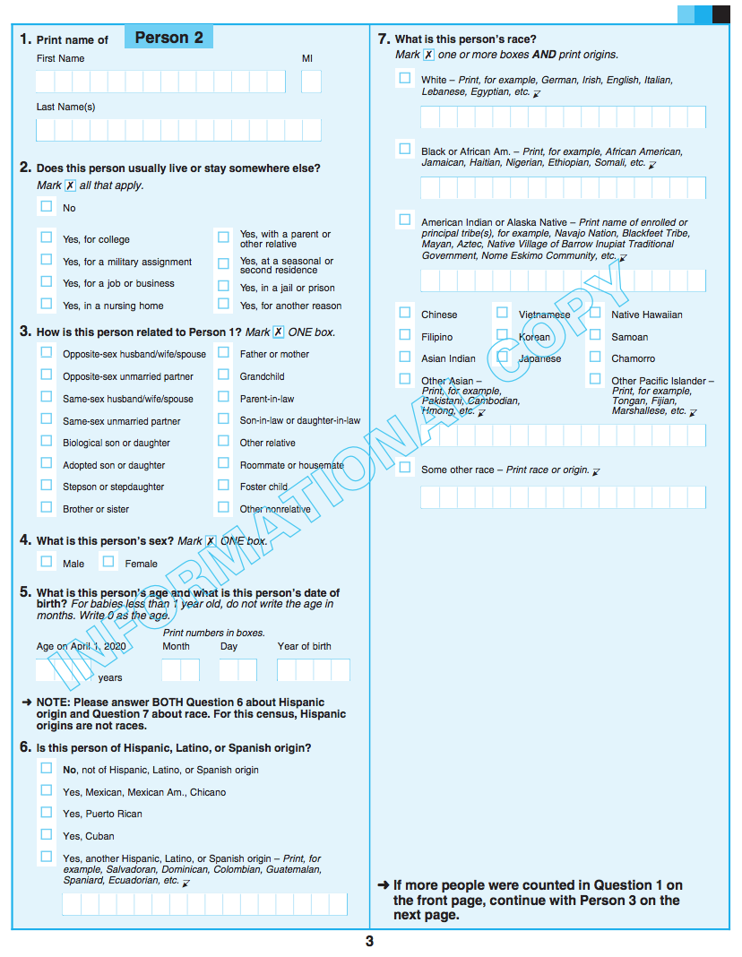
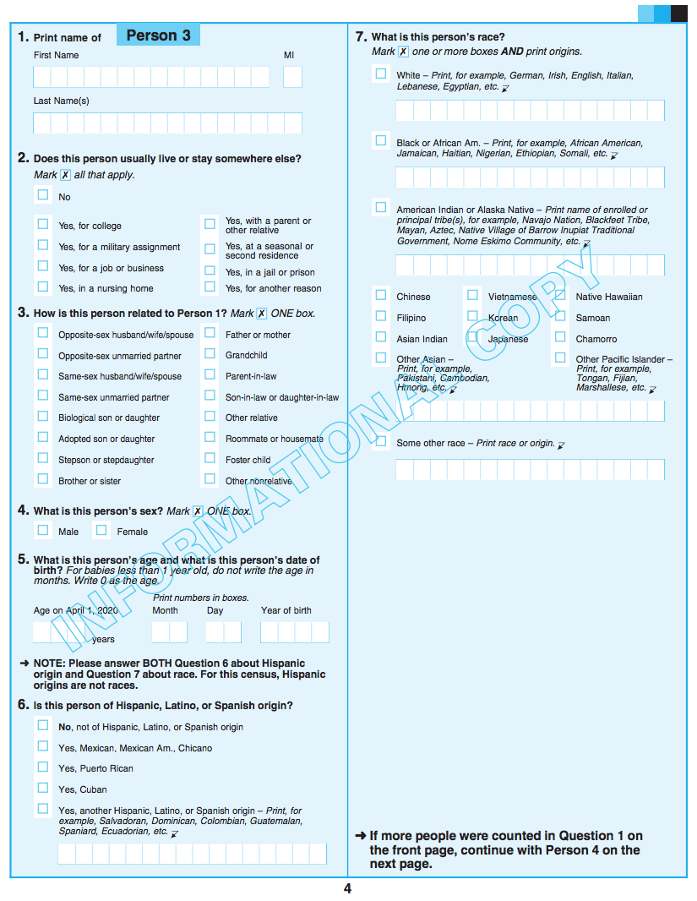

Slide 17
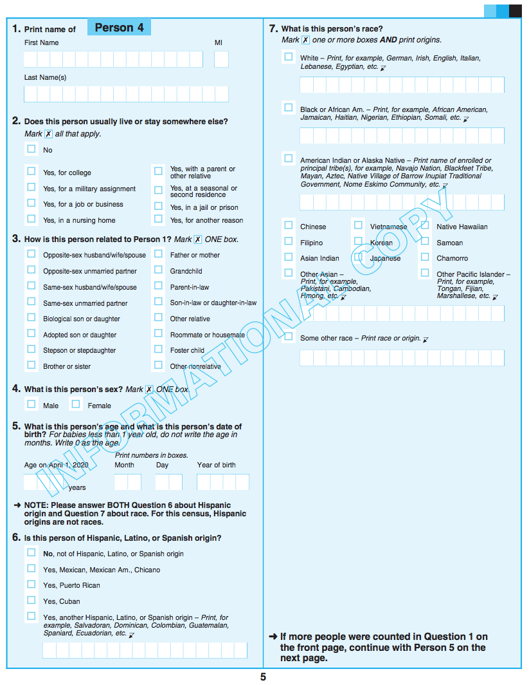
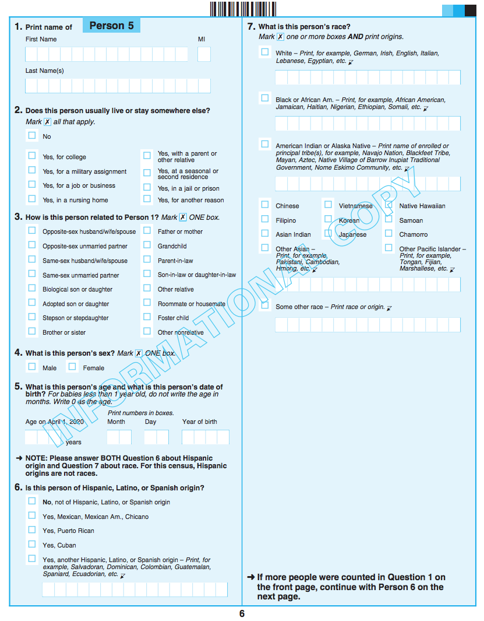

Slide 18
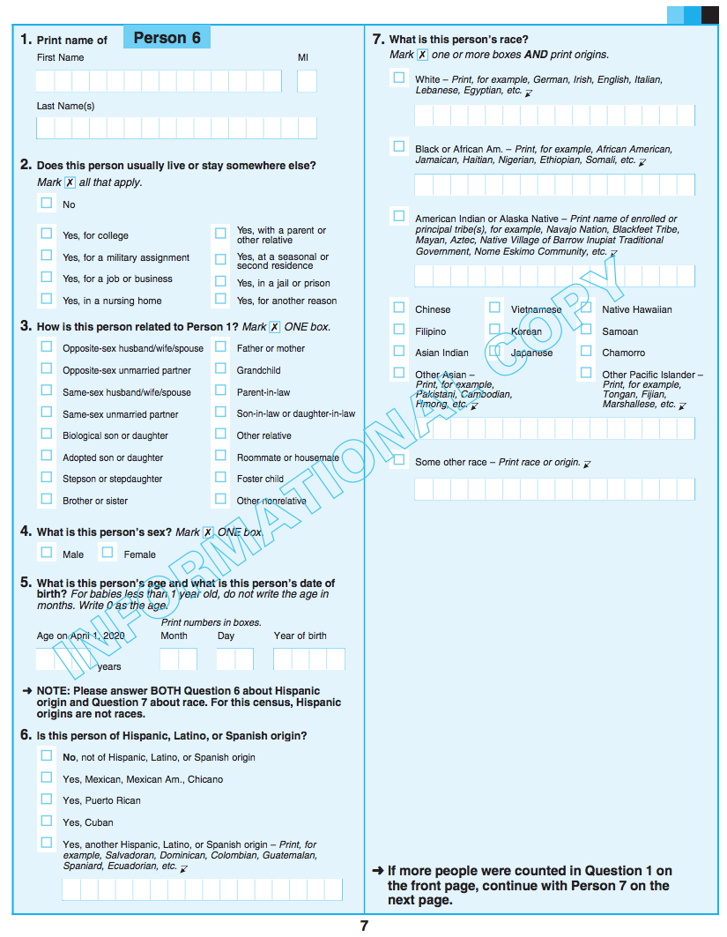
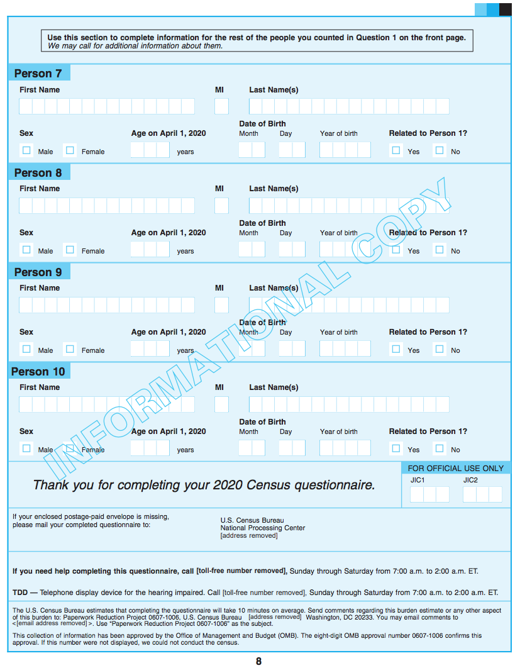

Slide 19
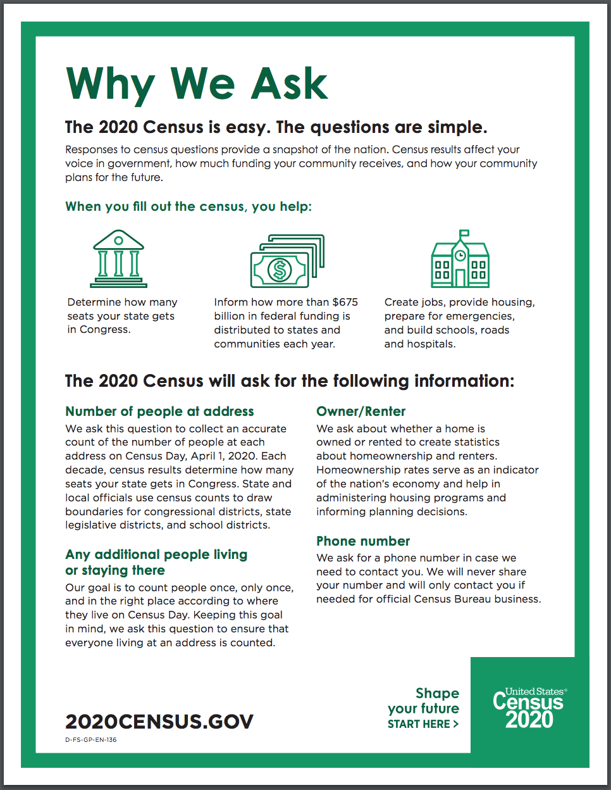
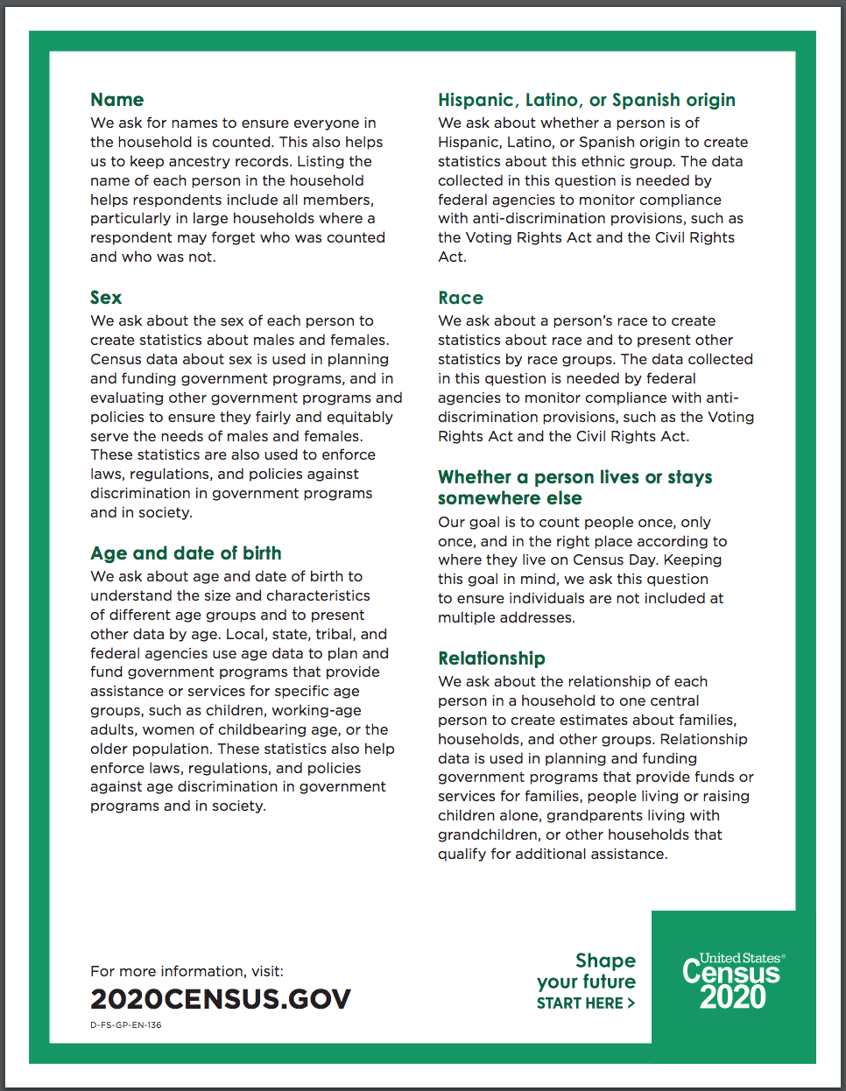
Notes:
https://2020census.gov/content/dam/2020census/materials/partners/2019-10/Handout_About_Why_We_Ask_Each_2020Census_Question.pdf

Slide 20
Census Messaging:
Reminder
Target outreach to households who have not responded to the Census.
Starting March 20, 2020, the Census Bureau will provide a map with response rates, updated daily to let you know of areas with low response.
This can help inform outreach strategies to reach communities yet to participate.
The Census Bureau will be looking for partners to host Mobile Questionnaire Assistance sites in areas with anticipated and actual low response rates.
Notes:
The message will shift from awareness to activation as households are invited to fill out the Census.
Education will still be important, but now there is also a call to action.

Slide 21
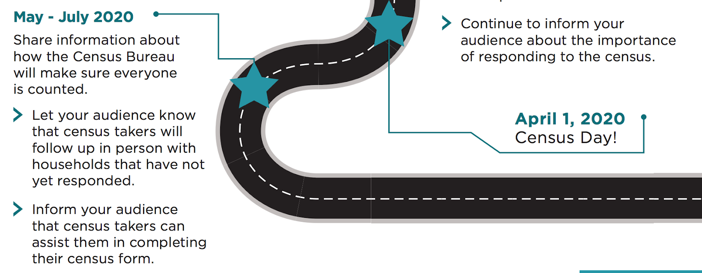
Census Messaging:
Reminder
Notes:
The message will shift from awareness to activation as households are invited to fill out the Census.
Education will still be important, but now there is also a call to action.

Slide 22
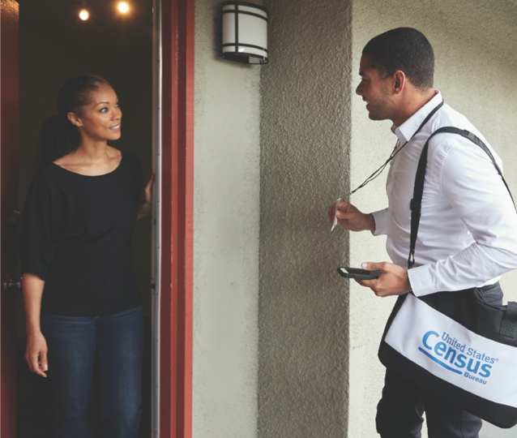
Census Messaging:
Reminder
How can I identify a census enumerator?
Photo ID badge with U.S. Dept. of Commerce watermark
May also carry a Census Bureau branded bag and other equipment with Census logo
A phone number will be made available to verify their employment.
Notes:
The message will shift from awareness to activation as households are invited to fill out the Census.
Education will still be important, but now there is also a call to action.

Slide 23
Faith Messaging:
Motivating Black Communities to Participate in the Census - Color of Change | Click Here for the Recording Click Here for the Slides
Census 2020: Research and Messaging - NALEO (Hispanic/Latinx Communities) | Click Here for the Recording Click Here for the Slides
AAPI Messaging Research on the 2020 Census - Asian Americans Advancing Justice | Click Here for the Recording Click Here for the Slides
2020 Census Barriers, Attitudes, and Motivators Study (CBAMS) Survey and Focus Groups - Census Bureau (General) | Click Here for the Recording Click Here for the Slides
2020 Census: Arab American Research and Messaging - American-Arab Anti-Discrimination Committee and Arab American Institute | Click Here for the Recording Click Here for the Slides

Slide 24
Notes:
Juntos Contamos Initiative
Rev. Carlos Alsina
Director
512-567-2918
cralsina@gmail.com

Slide 25
TexasCounts.org
Faith-Based Communities Sub-Committee

Slide 26
Lila Valencia, Ph.D.
(512) 936-3542
Lila.Valencia@utsa.edu
demographics.texas.gov
@TexasDemography

