Slide 1

Demographic Trends, Characteristics, and Population Projections for Texas
Presented to
American Society of Civil Engineers Austin Chapter
October 9, 2020

Slide 2

Texas is experiencing significant growth.

Slide 3
Population Growth of Select States, 2000-2019
 | 2000 Population | 2010 Population | 2019 Population | Numeric Change 2010-2019 | Percent Change 2010-2019
United States | 281,421,906 | 308,745,538 | 32,823,9523 | 19,481,418 | 6.3%
Texas | 20,851,820 | 25,145,561 | 28,995,881 | 3,849,790 | 15.3%
California | 33,871,648 | 37,253,956 | 39,512,223 | 2,257,704 | 6.1%
Florida | 15,982,378 | 18,801,310 | 21,477,737 | 2,673,173 | 14.2%
Georgia | 8,186,453 | 9,687,653 | 10,617,423 | 928,694 | 9.6%
North Carolina | 8,049,313 | 9,535,483 | 10,488,084 | 952,333 | 10.0%
Washington | 5,894,121 | 6,724,540 | 7,614,893 | 890,353 | 13.2%
Arizona | 5,130,632 | 6,392,017 | 7,278,717 | 886,429 | 13.9%
Colorado | 5,029,196 | 5,029,196 | 5,758,736 | 729,417 | 14.5%
Source: U.S. Census Bureau, 2000 and 2010 Decennial Census; 2019 Vintage population estimates

Slide 4
Largest U.S. Cities, 2019
Rank | Place | Census 2010 | 2011 | 2012 | 2013 | 2014 | 2015 | 2016 | 2017 | 2018 | 2019
1 | New York, NY | 8,175,133 | 8,272,948 | 8,346,693 | 8,396,091 | 8,433,806 | 8,463,049 | 8,469,153 | 8,437,478 | 8,390,081 | 8,336,817
2 | Los Angeles, CA | 3,792,621 | 3,820,876 | 3,851,202 | 3,881,622 | 3,909,901 | 3,938,568 | 3,963,226 | 3,975,788 | 3,977,596 | 3,979,576
3 | Chicago, IL | 2,695,598 | 2,708,114 | 2,719,141 | 2,725,731 | 2,727,066 | 2,724,344 | 2,716,723 | 2,711,069 | 2,701,423 | 2,693,976
4 | Houston, TX | 2,099,451 | 2,126,032 | 2,161,593 | 2,199,391 | 2,241,826 | 2,286,908 | 2,309,544 | 2,316,750 | 2,318,573 | 2,320,268
5 | Phoenix, AZ | 1,445,632 | 1,469,796 | 1,499,274 | 1,526,491 | 1,555,445 | 1,583,690 | 1,612,199 | 1,633,560 | 1,654,675 | 1,680,992
6 | Philadelphia, PA | 1,526,006 | 1,540,466 | 1,551,824 | 1,558,313 | 1,565,460 | 1,571,065 | 1,576,051 | 1,580,601 | 1,583,592 | 1,584,064
7 | San Antonio, TX | 1,327,407 | 1,357,120 | 1,383,075 | 1,408,339 | 1,435,456 | 1,464,043 | 1,487,843 | 1,511,154 | 1,530,016 | 1,547,253
8 | San Diego, CA | 1,307,402 | 1,319,592 | 1,336,776 | 1,355,320 | 1,375,831 | 1,387,323 | 1,402,089 | 1,412,621 | 1,421,917 | 1,423,851
9 | Dallas, TX | 1,197,816 | 1,218,282 | 1,242,115 | 1,258,835 | 1,279,098 | 1,301,329 | 1,323,916 | 1,342,479 | 1,341,802 | 1,343,573
10 | San Jose, CA | 945,942 | 970,369 | 983,530 | 1,001,279 | 1,014,273 | 1,025,980 | 1,030,242 | 1,032,335 | 1,028,020 | 1,021,795
11 | Austin, TX | 790,390 | 828,459 | 854,482 | 875,003 | 901,170 | 921,114 | 939,447 | 951,553 | 962,469 | 978,908
12 | Jacksonville, FL | 821,784 | 829,609 | 837,013 | 842,735 | 852,494 | 865,836 | 880,520 | 892,025 | 902,437 | 911,507
13 | Fort Worth, TX | 741,206 | 764,142 | 781,046 | 796,073 | 815,057 | 835,356 | 856,177 | 874,809 | 893,216 | 909,585
14 | Columbus, OH | 787,033 | 800,607 | 812,740 | 827,797 | 841,673 | 854,950 | 866,894 | 881,694 | 890,869 | 898,553
15 | Charlotte, NC | 731,424 | 754,829 | 773,264 | 792,047 | 807,400 | 825,668 | 843,117 | 860,002 | 872,514 | 885,708
Source: U.S. Census Bureau, 2019 Vintage Population Estimates
Notes:
Five of the 15 largest cities in the country are in Texas.

Slide 5
Top 15 Metros in Numeric Growth, 2010-2019
Rank | Name | April 1, 2010 | July 1, 2018 | July 1, 2019 | Numeric Change | Percent Change
1 | .Dallas-Fort Worth-Arlington, TX | 6,366,537 | 7,455,756 | 7,573,136 | 1,206,599 | 19.0
2 | .Houston-The Woodlands-Sugar Land, TX | 5,920,487 | 4,849,209 | 7,066,141 | 1,145,654 | 19.4
3 | .Phoenix-Mesa-Chandler, AZ | 4,193,129 | 4,849,209 | 4,948,203 | 755,074 | 18.0
4 | .Atlanta-Sandy Springs-Alpharetta, GA | 5,286,718 | 6,976,147 | 6,020,364 | 733,646 | 13.9
5 | .Washington-Arlington-Alexandria, DC-VA-MD-WV | 5,649,688 | 5,945,303 | 6,280,487 | 630,799 | 11.2
6 | .Miami-Fort Lauderdale-Pompano Beach, FL | 5,566,274 | 6,143,837 | 6,166,488 | 600,214 | 10.8
7 | .Seattle-Tacoma-Bellevue, WA | 3,439,808 | 3,935,179 | 3,979,845 | 540,037 | 15.7
8 | .Austin-Round Rock-Georgetown, TX | 1,716,323 | 2,165,497 | 2,227,083 | 510,760 | 29.8
9 | .Orlando-Kissimmee-Sanford, FL | 2,134,399 | 2,574,838 | 2,608,147 | 473,748 | 22.2
10 | .Riverside-San Bernardino-Ontario, CA | 4,224,948 | 4,612,542 | 4,650,631 | 425,683 | 10.1
11 | .Denver-Aurora-Lakewood, CO | 2,543,608 | 2,931,665 | 2,967,239 | 423,631 | 16.7
12 | .Tampa-St. Petersburg-Clearwater, FL | 2,783,485 | 3,154,649 | 3,194,831 | 411,346 | 14.8
13 | .San Antonio-New Braunfels, TX | 2,142,520 | 2,512,379 | 2,550,960 | 408,440 | 19.1
14 | .San Francisco-Oakland-Berkeley, CA | 4,335,593 | 4,726,314 | 4,731,803 | 396,210 | 9.1
15 | .Charlotte-Concord-Gastonia, NC-SC | 2,243,963 | 2,592,950 | 2,636,883 | 392,920 | 17.5
Source: U.S. Census Bureau, 2019 Vintage Population Estimates
Notes:
Four of the top 15 metros in numeric growth are Texas metros, including the 1st and 2nd ranking metros.

Slide 6
15 Fastest Growing Large Cities and Towns between 2018-2019
Rank | Geographic Area | Population Estimate |  | Change, 2018 to 2019
 |  | July 1, 2018 | July 1, 2019 | Number | Percent
1 | Leander, TX | 55,924 | 62,608 | 6,684 | 12.0
2 | Apex, NC | 53,859 | 59,300 | 5,441 | 10.1
3 | Chico, CA | 94,342 | 103,301 | 8,959 | 9.5
4 | Doral, FL | 60,762 | 65,741 | 4,979 | 8.2
5 | Bentonville, AR | 51,103 | 54,909 | 3,806 | 7.4
6 | Meridian, ID | 106,464 | 114,161 | 7,697 | 7.2
7 | Georgetown, TX | 74,275 | 79,604 | 5,329 | 7.2
8 | Buckeye, AZ | 74,339 | 79,620 | 5,281 | 7.1
9 | New Braunfels, TX | 84,495 | 90,209 | 5,714 | 6.8
10 | Redmond, WA | 67,436 | 71,929 | 4,493 | 6.7
11 | Frisco, TX | 188,452 | 200,490 | 12,038 | 6.4
12 | Fort Myers, FL | 82,229 | 87,103 | 4,874 | 5.9
13 | Lehi, UT | 65,958 | 69,724 | 3,766 | 5.7
14 | Castle Rock, CO | 65,000 | 68,484 | 3,484 | 5.4
15 | Milpitas, CA | 80,208 | 84,196 | 3,988 | 5.0
Source: U.S. Census Bureau, 2019 Vintage Population Estimates; Note: among places with populations of 50,000 or more in 2018
Notes:
Nearly a third of the 15 fastest growing cities in the country are Texas cities.

Slide 7
Components of Population Change, 2010-2019
Source: U.S. Census Bureau, 2019 Vintage population estimates

Slide 8
Estimated Percent of Total Net-Migrant Flows to and from Texas and Top Sending and Receiving States, 2018
Source: U.S. Census Bureau, State to State Migration Flows, 2018

Slide 9
Estimated County-to-County Migration Flows, Travis County, 2013-2017
 | In-Flows | Net Migration
Williamson County | 10,439 | -7,587
Harris County | 6,021 | 1,738
Asia | 4,984
Hays County | 4,084 | -3,046
Bexar County | 3,846 | 632
Dallas County | 3,447 | 1,418
Central America | 2,164
Tarrant County | 1,914 | 322
Los Angeles County, CA | 1,385 | 562
Fort Bend County | 1,242 | 267
Bastrop County | 1,228 | -1,416
El Paso County | 1,220 | 921
Bell County | 1,052 | -509
Collin County | 1,003 | 349
Maricopa County, AZ | 923 | 164
Source: U.S. Census Bureau, American Community Survey County to County Migration Flows, 2013-2017

Slide 10
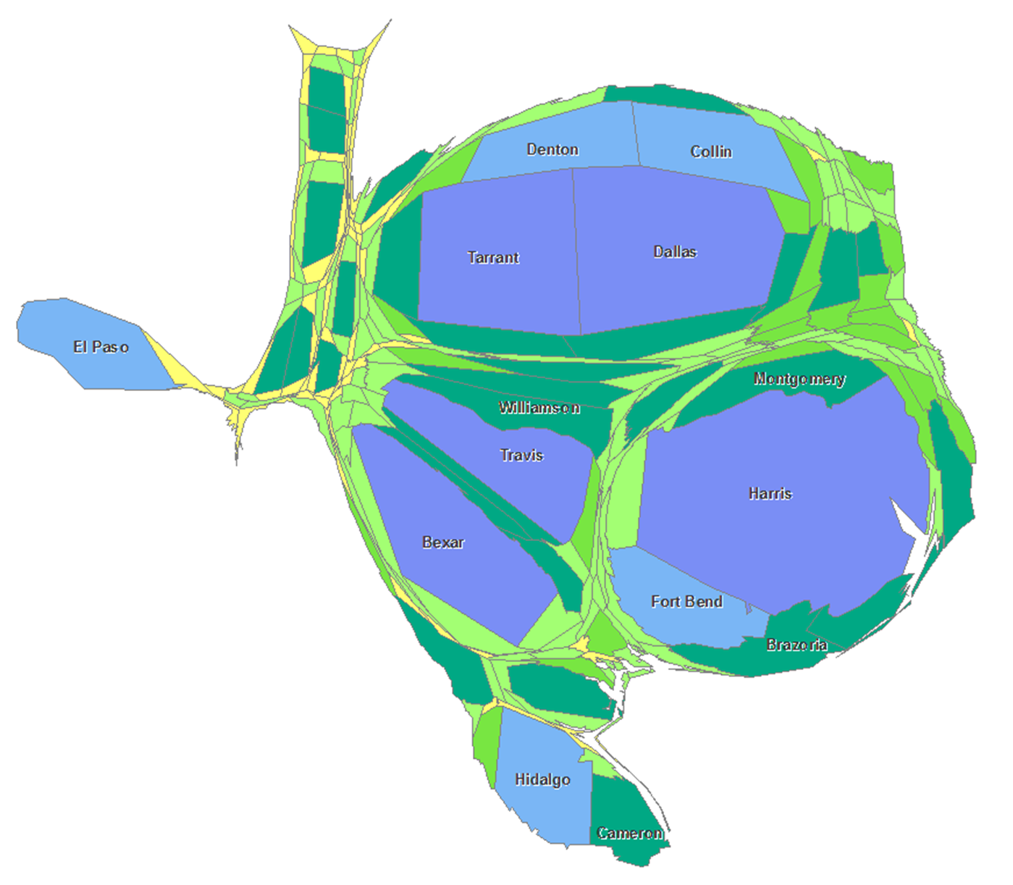
10,000 or less
10,001 - 50,000
50,001 - 100,000
100,001 - 500,000
500,001 - 1,000,000
1,000,001 - 6,000,000 plus
Population growth is not evenly distributed across the state.
Notes:
A cartogram of Texas distorted to represent population size.

Slide 11

Total Estimated Population by County, Texas, 2019
Source: U.S. Census Bureau, 2019 Population Estimates

Slide 12
Estimated Numeric Change, Texas Counties, 2010-2019
104 counties lost population over the 9 year period.
Source: U.S. Census Bureau, 2019 Population Estimates

Slide 13
Estimated Percent Change, Texas Counties, 2010-2019
Source: U.S. Census Bureau, 2019 Population Estimates

Slide 14

As Texas grows, it ages and continues to diversify.

Slide 15
Race/Ethnic Composition, Texas, 2010-2019
86.4% of growth has been from minority groups.
Source: U.S. Census Bureau. 2019 Population Estimates

Slide 16
Race/Ethnicity Composition, Central Texas Counties, 2010-2019
Race/Ethnicity Composition, 2019
 | Total | NH White | NH Black | NH Asian | NH Other | Hispanic
Bastrop | 88,723 | 51.1% | 6.6% | 0.7% | 1.9% | 39.7%
Blanco | 11,931 | 76.5% | 1.1% | 0.9% | 1.9% | 19.7%
Caldwell | 43,664 | 38.2% | 5.7% | 0.9% | 1.4% | 53.8%
Hays | 230,191 | 52.5% | 3.9% | 1.5% | 2.0% | 40.1%
Travis | 1,273,954 | 48.9% | 8.0% | 7.2% | 2.3% | 33.6%
Williamson | 590,551 | 58.0% | 6.7% | 7.8% | 2.7% | 24.8%
Percent Change by Race/Ethnicity, 2010 to 2019
 | Total | NH White | NH Black | NH Asian | NH Other | Hispanic
Bastrop | 19.6% | 6.5% | 4.4% | 41.1% | 24.4% | 45.5%
Blanco | 13.7% | 9.3% | 108.1% | 114.3% | 76.4% | 23.0%
Caldwell | 14.7% | -1.2% | 0.2% | 13.3% | 43.2% | 31.1%
Hays | 46.5% | 30.8% | 78.6% | 105.0% | 75.4% | 66.6%
Travis | 24.4% | 19.8% | 22.7% | 55.3% | 47.1% | 25.0%
Williamson | 39.7% | 26.8% | 58.0% | 127.2% | 72.1% | 49.5%
Source: U.S. Census Bureau. 2019 Population Estimates

Slide 17
Race/Ethnicity Composition, Counties in Central Texas, 2010-2019
Share of Contribution to Total Population Change between 2010 and 2019 by Race/Ethnicity
 | Total | NH White | NH Black | NH Asian | NH Other | Hispanic
Bastrop | 14552 | 19.1% | 1.7% | 1.3% | 2.3% | 75.6%
Blanco | 1434 | 54.0% | 4.7% | 3.9% | 6.8% | 30.6%
Caldwell | 5598 | -3.6% | 0.1% | 0.8% | 3.3% | 99.4%
Hays | 73084 | 39.0% | 5.4% | 2.5% | 2.7% | 50.5%
Travis | 249688 | 41.3% | 7.6% | 13.1% | 3.7% | 34.4%
Williamson | 167872 | 43.1% | 8.6% | 15.4% | 4.0% | 28.9%
Source: U.S. Census Bureau. 2019 Population Estimates

Slide 18
Race/Ethnic Composition by Age Group, Texas, 2010-2019
Source: U.S. Census Bureau. 2019 Population Estimates

Slide 19

A complete 2020 Census count is critical to Texas.

Slide 20
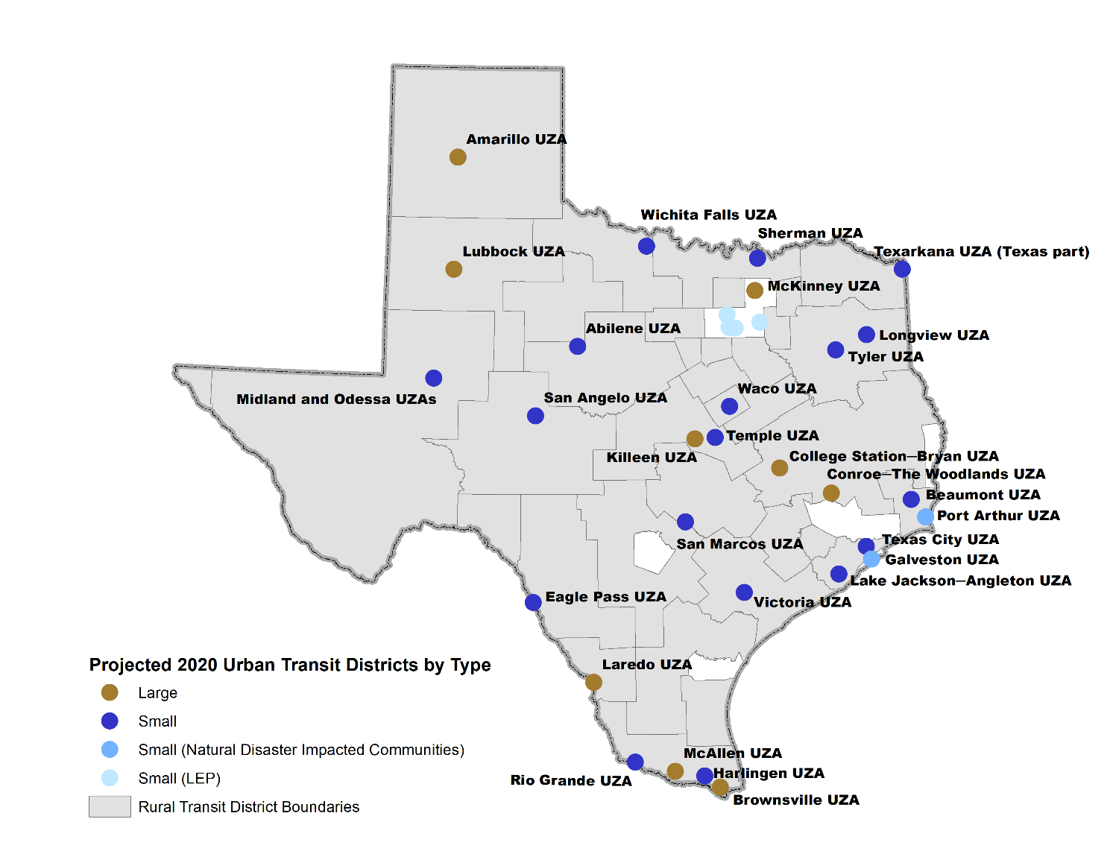
Projected 2020 Urban Transit District by Type
Indicates change in UZA classification
Source: Texas A&M Transportation Institute and Texas Demographic Center, Census 2020 Impacts on Texas Transit

Slide 21
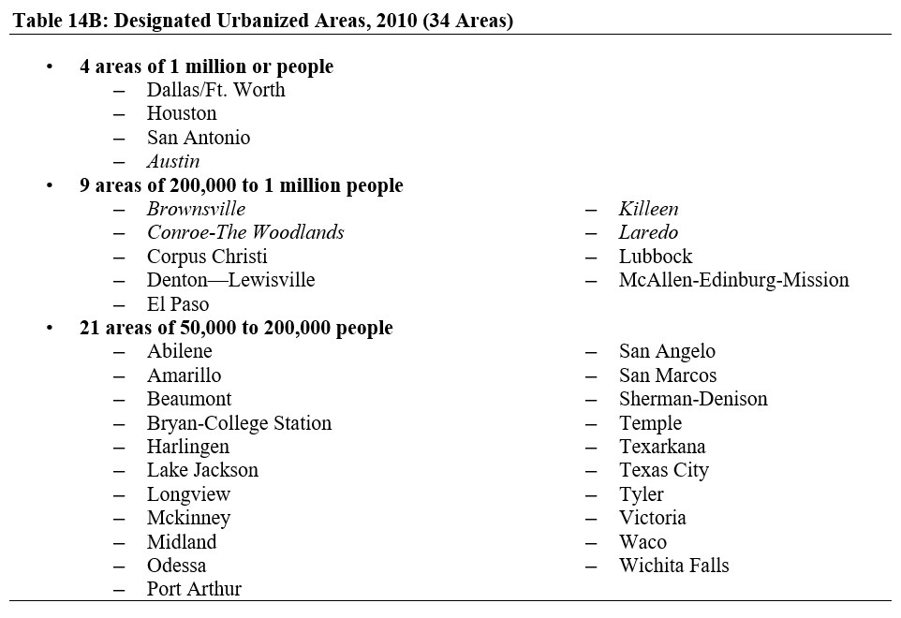
Projected Change in Texas Urbanized Areas, 2010
Note: New or merged urbanized areas in italics.
Source: Texas A&M Transportation Institute and Texas Demographic Center, Census 2020 Impacts on Texas Transit

Slide 22
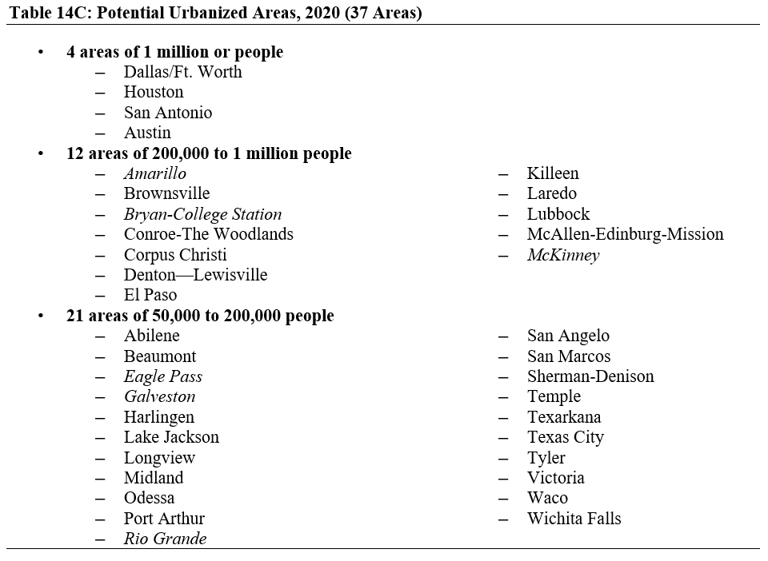
Projected Change in Texas Urbanized Areas, 2020
Note: New or merged urbanized areas in italics.
Source: Texas A&M Transportation Institute and Texas Demographic Center, Census 2020 Impacts on Texas Transit

Slide 23
Census Derived Funding in Texas, FY2017
Program | FY2017 Funding
Medicare | $ 50,065,391,000
Medicaid | $ 21,078,511,000
Other programs | $ 11,665,742,000
Supplemental Nutrition Assistance Program | $ 5,805,152,000
Highway Planning and Construction | $ 2,172,810,000
National School Lunch Program | $ 1,433,344,000
Title I Grants to Local Education Agencies | $ 1,415,074,000
State Children's Health Insurance Program | $ 1,382,120,000
Special Education Grants | $ 1,037,782,000
Head Start | $ 626,118,000
School Breakfast Program | $ 558,932,000
Supplemental Nutrition Program for Women, Infants, and Children | $ 501,349,000
Child and Adult Care Food Program | $ 367,326,000
Federal Transit Formula Grants | $ 299,620,000
Child Care and Development Block Grant | $ 292,750,000
Vocational Rehabilitation Grants to the States | $ 278,589,000
Health Care Centers | $ 252,786,000
Child Care Mandatory and Matching Funds | $ 224,538,000
Title IV-E Foster Care | $ 207,520,000
Supporting Effective Instruction State Grants | $ 169,159,000
Source: Reamer, Andrew; George Washington Institute of Public Policy, Counting for Dollars

Slide 24
Census Derived Funding in Texas, FY2017
Program | FY2017 Funding
Community Development Block Grants/Entitlement Grants | $ 156,133,000
Crime Victim Assistance | $ 155,567,000
Public Housing Capital Fund | $ 145,820,000
Block Grants for the Prevention and Treatment of Substance Abuse | $ 144,710,000
Adoption Assistance | $ 143,120,000
Unemployment Insurance Administration | $ 134,772,000
Social Services Block Grant | $ 134,505,000
Low Income Home Energy Assistance | $ 118,304,000
Career and Technical Education - Basic Grants to States | $ 93,666,000
Public Housing Operating Fund | $ 73,562,000
Home Investment Partnerships Program | $ 63,974,000
State Community Development Block Grant | $ 59,551,000
WIOA Youth Activities | $ 58,290,000
WIOA Adult Activities | $ 55,508,000
Employment Service/Wagner-Peyser Funded Activities | $ 50,422,000
WIOA Dislocated Worker Formula Grants | $ 49,097,000
Community Services Block Grant | $ 33,936,000
Special Programs for the Aging, Title III, Part C, Nutrition Services | $ 28,861,000
Federal Transit - Capital Investment Grants | $ 28,160,000
Cooperative Extension Service | $ 22,443,000
Homeland Security Grant Program | $ 21,481,000

Slide 25
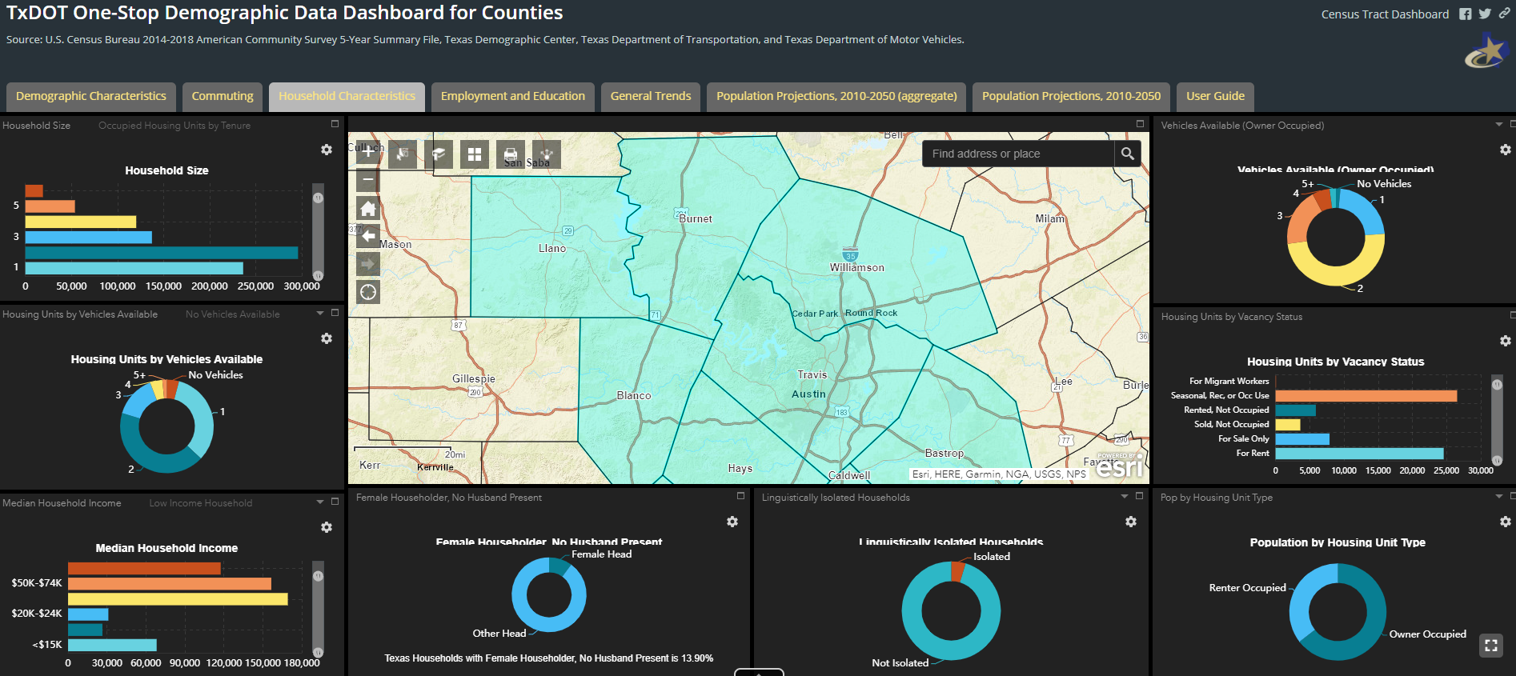
Texas Demographic Center Data Resource
TxDOT One Stop
  https://idserportal.utsa.edu/txdot/onestop/Default.aspx
  Including special projections: Household, Household income distribution/median income, Families in poverty, Vehicle Ownership, Labor force, Disability

Slide 26

Population Projections

Slide 27
Projected Population, Texas, 2010-2030
Source: Texas Demographic Center, 2014 and 2018 Population Projections

Slide 28
Population Projections by Race/Ethnicity, Texas, 2010-2030
Source: Texas Demographic Center, 2018 Vintage Population Projections, 2010-2015 Migration Scenario

Slide 29
Projected Population Change and Percent of Total Change by Race/Ethnicity, Texas, 2010-2030
Source: Texas Demographic Center 2018 Population Projections

Slide 30
Population Projections, Austin Metro Counties, 2010-2030
Source: Texas Demographic Center 2018 Population Projections

Slide 31
Population Projections by Race/Ethnicity, Austin Metro Area, 2010-2030
Source: Texas Demographic Center 2018 Population Projections

Slide 32




Lila Valencia, Ph.D.
(512) 936-3542
Lila.Valencia@utsa.edu
demographics.texas.gov
@TexasDemography

