Slide 1


October 20
Power In Numbers:
El Poder en Numeros

Slide 2

Check In
Please let us know you are attending
Add QR Code image here
With your phone’s camera,
focus on QR Code and click the link
that pops up at the top!
Link: https://amigos10-20-20powerinnumberscheckin.surveyanalytics.com

Slide 3

Presented by Lila Valencia, Ph.D.
Dr. Lila Valencia is a senior demographer at the Texas Demographic Center where she oversees product development for the Center and serves as the lead liaison to the U.S. Census Bureau’s State Data Center Network. She has over 10 years experience working as an applied demographer in a number of settings. Her current work focus involves understanding and communicating demographic trends in Texas. Lila is an engaging speaker with over 100 speaking engagements, including keynotes and legislative testimony. She holds a Ph.D. in Applied Demography from the University of Texas at San Antonio, a Masters from the College of William & Mary in Virginia, and Bachelors degree from the University of Texas at Austin.
Dr. Lila Valencia
Check In Here:

Slide 4

Power in Numbers: El Poder en Números
Texas Demographic Trends, Population Projections, and the 2020 Census
Presented to
Liberty Mutual Resource Group
October 20, 2020

Slide 5

Texas is the second largest state in area, population.

Slide 6
Population Growth of Select States, 2000-2019
 | 2000 Population | 2010 Population | 2019 Population | Numeric Change 2010-2019 | Percent Change 2010-2019
United States | 281,421,906 | 308,745,538 | 32,823,9523 | 19,481,418 | 6.3%
Texas | 20,851,820 | 25,145,561 | 28,995,881 | 3,849,790 | 15.3%
California | 33,871,648 | 37,253,956 | 39,512,223 | 2,257,704 | 6.1%
Florida | 15,982,378 | 18,801,310 | 21,477,737 | 2,673,173 | 14.2%
Georgia | 8,186,453 | 9,687,653 | 10,617,423 | 928,694 | 9.6%
North Carolina | 8,049,313 | 9,535,483 | 10,488,084 | 952,333 | 10.0%
Washington | 5,894,121 | 6,724,540 | 7,614,893 | 890,353 | 13.2%
Arizona | 5,130,632 | 6,392,017 | 7,278,717 | 886,429 | 13.9%
Colorado | 5,029,196 | 5,029,196 | 5,758,736 | 729,417 | 14.5%
Source: U.S. Census Bureau, 2000 and 2010 Decennial Census; 2019 Vintage population estimates

Slide 7
Components of Population Change, 2010-2019
Source: U.S. Census Bureau, 2019 Vintage population estimates

Slide 8

Total Estimated Population by County, Texas, 2019
Source: U.S. Census Bureau, 2019 Population Estimates

Slide 9
Estimated Numeric Change, Texas Counties, 2010-2019
104 counties lost population over the 9 year period.
Source: U.S. Census Bureau, 2019 Population Estimates

Slide 10
Largest U.S. Cities, 2019
Rank | Place | Census 2010 | 2011 | 2012 | 2013 | 2014 | 2015 | 2016 | 2017 | 2018 | 2019
1 | New York, NY | 8,175,133 | 8,272,948 | 8,346,693 | 8,396,091 | 8,433,806 | 8,463,049 | 8,469,153 | 8,437,478 | 8,390,081 | 8,336,817
2 | Los Angeles, CA | 3,792,621 | 3,820,876 | 3,851,202 | 3,881,622 | 3,909,901 | 3,938,568 | 3,963,226 | 3,975,788 | 3,977,596 | 3,979,576
3 | Chicago, IL | 2,695,598 | 2,708,114 | 2,719,141 | 2,725,731 | 2,727,066 | 2,724,344 | 2,716,723 | 2,711,069 | 2,701,423 | 2,693,976
4 | Houston, TX | 2,099,451 | 2,126,032 | 2,161,593 | 2,199,391 | 2,241,826 | 2,286,908 | 2,309,544 | 2,316,750 | 2,318,573 | 2,320,268
5 | Phoenix, AZ | 1,445,632 | 1,469,796 | 1,499,274 | 1,526,491 | 1,555,445 | 1,583,690 | 1,612,199 | 1,633,560 | 1,654,675 | 1,680,992
6 | Philadelphia, PA | 1,526,006 | 1,540,466 | 1,551,824 | 1,558,313 | 1,565,460 | 1,571,065 | 1,576,051 | 1,580,601 | 1,583,592 | 1,584,064
7 | San Antonio, TX | 1,327,407 | 1,357,120 | 1,383,075 | 1,408,339 | 1,435,456 | 1,464,043 | 1,487,843 | 1,511,154 | 1,530,016 | 1,547,253
8 | San Diego, CA | 1,307,402 | 1,319,592 | 1,336,776 | 1,355,320 | 1,375,831 | 1,387,323 | 1,402,089 | 1,412,621 | 1,421,917 | 1,423,851
9 | Dallas, TX | 1,197,816 | 1,218,282 | 1,242,115 | 1,258,835 | 1,279,098 | 1,301,329 | 1,323,916 | 1,342,479 | 1,341,802 | 1,343,573
10 | San Jose, CA | 945,942 | 970,369 | 983,530 | 1,001,279 | 1,014,273 | 1,025,980 | 1,030,242 | 1,032,335 | 1,028,020 | 1,021,795
11 | Austin, TX | 790,390 | 828,459 | 854,482 | 875,003 | 901,170 | 921,114 | 939,447 | 951,553 | 962,469 | 978,908
12 | Jacksonville, FL | 821,784 | 829,609 | 837,013 | 842,735 | 852,494 | 865,836 | 880,520 | 892,025 | 902,437 | 911,507
13 | Fort Worth, TX | 741,206 | 764,142 | 781,046 | 796,073 | 815,057 | 835,356 | 856,177 | 874,809 | 893,216 | 909,585
14 | Columbus, OH | 787,033 | 800,607 | 812,740 | 827,797 | 841,673 | 854,950 | 866,894 | 881,694 | 890,869 | 898,553
15 | Charlotte, NC | 731,424 | 754,829 | 773,264 | 792,047 | 807,400 | 825,668 | 843,117 | 860,002 | 872,514 | 885,708
Source: U.S. Census Bureau, 2019 Vintage Population Estimates
Notes:
Five of the 15 largest cities in the country are in Texas.

Slide 11
Top 15 Metros in Numeric Growth, 2010-2019
Rank | Name | April 1, 2010 | July 1, 2018 | July 1, 2019 | Numeric Change | Percent Change
1 | .Dallas-Fort Worth-Arlington, TX | 6,366,537 | 7,455,756 | 7,573,136 | 1,206,599 | 19.0
2 | .Houston-The Woodlands-Sugar Land, TX | 5,920,487 | 4,849,209 | 7,066,141 | 1,145,654 | 19.4
3 | .Phoenix-Mesa-Chandler, AZ | 4,193,129 | 4,849,209 | 4,948,203 | 755,074 | 18.0
4 | .Atlanta-Sandy Springs-Alpharetta, GA | 5,286,718 | 6,976,147 | 6,020,364 | 733,646 | 13.9
5 | .Washington-Arlington-Alexandria, DC-VA-MD-WV | 5,649,688 | 5,945,303 | 6,280,487 | 630,799 | 11.2
6 | .Miami-Fort Lauderdale-Pompano Beach, FL | 5,566,274 | 6,143,837 | 6,166,488 | 600,214 | 10.8
7 | .Seattle-Tacoma-Bellevue, WA | 3,439,808 | 3,935,179 | 3,979,845 | 540,037 | 15.7
8 | .Austin-Round Rock-Georgetown, TX | 1,716,323 | 2,165,497 | 2,227,083 | 510,760 | 29.8
9 | .Orlando-Kissimmee-Sanford, FL | 2,134,399 | 2,574,838 | 2,608,147 | 473,748 | 22.2
10 | .Riverside-San Bernardino-Ontario, CA | 4,224,948 | 4,612,542 | 4,650,631 | 425,683 | 10.1
11 | .Denver-Aurora-Lakewood, CO | 2,543,608 | 2,931,665 | 2,967,239 | 423,631 | 16.7
12 | .Tampa-St. Petersburg-Clearwater, FL | 2,783,485 | 3,154,649 | 3,194,831 | 411,346 | 14.8
13 | .San Antonio-New Braunfels, TX | 2,142,520 | 2,512,379 | 2,550,960 | 408,440 | 19.1
14 | .San Francisco-Oakland-Berkeley, CA | 4,335,593 | 4,726,314 | 4,731,803 | 396,210 | 9.1
15 | .Charlotte-Concord-Gastonia, NC-SC | 2,243,963 | 2,592,950 | 2,636,883 | 392,920 | 17.5
Source: U.S. Census Bureau, 2019 Vintage Population Estimates
Notes:
Four of the top 15 metros in numeric growth are Texas metros, including the 1st and 2nd ranking metros.

Slide 12
15 Fastest Growing Large Cities and Towns between 2018-2019
Rank | Geographic Area | Population Estimate |  | Change, 2018 to 2019
 |  | July 1, 2018 | July 1, 2019 | Number | Percent
1 | Leander, TX | 55,924 | 62,608 | 6,684 | 12.0
2 | Apex, NC | 53,859 | 59,300 | 5,441 | 10.1
3 | Chico, CA | 94,342 | 103,301 | 8,959 | 9.5
4 | Doral, FL | 60,762 | 65,741 | 4,979 | 8.2
5 | Bentonville, AR | 51,103 | 54,909 | 3,806 | 7.4
6 | Meridian, ID | 106,464 | 114,161 | 7,697 | 7.2
7 | Georgetown, TX | 74,275 | 79,604 | 5,329 | 7.2
8 | Buckeye, AZ | 74,339 | 79,620 | 5,281 | 7.1
9 | New Braunfels, TX | 84,495 | 90,209 | 5,714 | 6.8
10 | Redmond, WA | 67,436 | 71,929 | 4,493 | 6.7
11 | Frisco, TX | 188,452 | 200,490 | 12,038 | 6.4
12 | Fort Myers, FL | 82,229 | 87,103 | 4,874 | 5.9
13 | Lehi, UT | 65,958 | 69,724 | 3,766 | 5.7
14 | Castle Rock, CO | 65,000 | 68,484 | 3,484 | 5.4
15 | Milpitas, CA | 80,208 | 84,196 | 3,988 | 5.0
Source: U.S. Census Bureau, 2019 Vintage Population Estimates; Note: among places with populations of 50,000 or more in 2018
Notes:
Nearly half of the 15 fastest growing cities in the country are Texas cities.

Slide 13
Questions?

Slide 14

As Texas grows, it ages and continues to diversify.

Slide 15
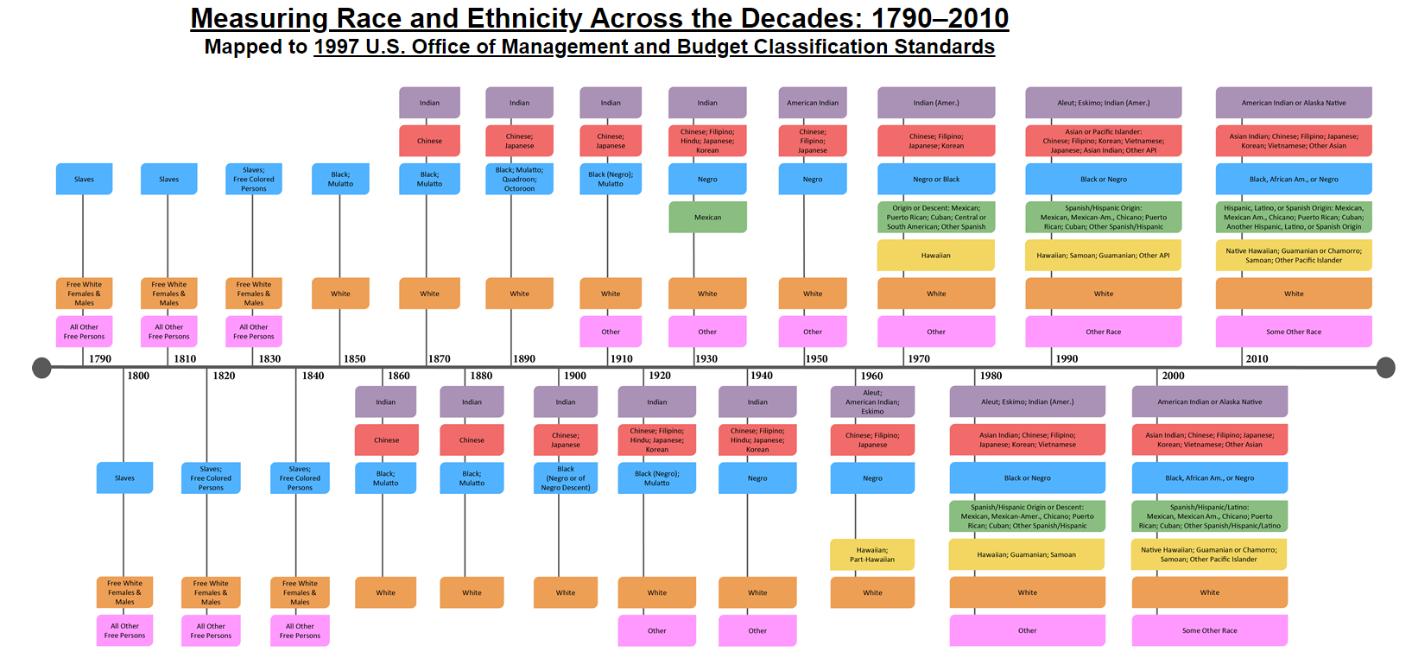
Notes:
https://www.census.gov/data-tools/demo/race/MREAD_1790_2010.html
For more than 20 years, the Office of Management and Budget has provided a common language to promote uniformity and comparability of data on race and ethnicity. The categories were developed in cooperation with Federal agencies to provide consistent data on race and ethnicity across government agencies, to enforce civil rights laws, and to monitor equal access in housing, education, employment, and other areas for populations that have historically experienced discrimination and differential treatment because of their race or ethnicity. The categories are a social-political construct and are not anthropologically or scientifically based.
The term ‘‘Hispanic or Latino’’ refers to persons who trace their origin or descent to Mexico, Puerto Rico, Cuba, Central and South America, and other Spanish cultures regardless of race.
The OMB offers a minimum of five race categories: White, Black or African American, American Indian or Alaska Native, Asian, and Native Hawaiian or Other Pacific Islander, plus Some Other Race and Two or More Races.
“White” refers to a person having origins in any of the original peoples of Europe, the Middle East, or North Africa. It includes people who indicated their race(s) as “White” or reported entries such as Irish, German, Italian, Lebanese, Arab, Moroccan, or Caucasian.

Slide 16
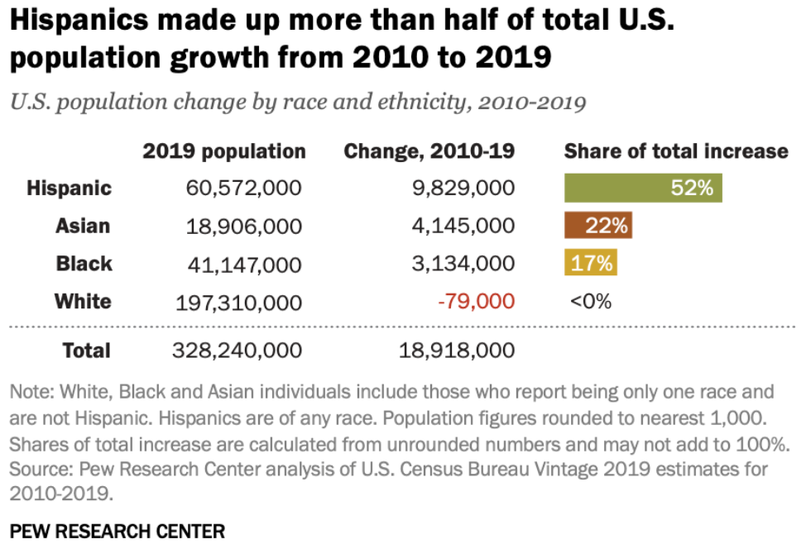
There are 60.6 million Hispanics in the U.S. in 2019, making up 18% of the U.S. population.

Slide 17
Numeric and Percent Contribution by Race/Ethnicity of Total Population Change, Texas, 2010-2019
86.4% of growth has been from minority groups.
Source: U.S. Census Bureau. 2019 Population Estimates

Slide 18
Race/Ethnicity Composition, Texas, 2019
Race/Ethnicity | 2019 Population Estimate
NH White | 11,950,774
Hispanic | 11,525,578
NH Black | 3,501,610
NH Asian | 1,457,549
NH Two or More Races | 425,866
NH American Indian & Alaska Native | 94,168
NH Native Hawaiian & Other Pacific Islander | 25,861
Source: U.S. Census Bureau. 2019 Population Estimates

Slide 19
Numeric Change in Age Group by Race/Ethnicity, Texas, 2010-2019
Source: U.S. Census Bureau. 2019 Population Estimates

Slide 20
Change in Median Age by Race/Ethnicity, U.S. and Texas, 2010-2019
 | U.S. |  |  | Texas
 | 2010 | 2019 | Diff | 2010 | 2019 | Diff
Total | 37.2 | 38.4 | 1.2 | 33.6 | 35.1 | 1.5
Hispanic | 27.3 | 29.8 | 2.5 | 27.0 | 29.2 | 2.2
NH White | 42.0 | 43.7 | 1.7 | 41.3 | 42.3 | 1.0
NH Black | 32.7 | 34.6 | 1.9 | 31.6 | 33.9 | 2.3
NH Asian | 35.4 | 37.5 | 2.1 | 33.9 | 36.4 | 2.5
Source: U.S. Census Bureau, 2010 Decennial Census, 2019 American Community Survey 1-Year Estimates

Slide 21
Hispanic Ethnicity by Nativity, Texas, 2019
 | Total Hispanics |  | Under 18 Years |  | 18 Years and Over
 | Estimate | Percent | Estimate | Percent | Estimate | Percent
Total | 11,524,842 | 100.0% | 3,660,216 | 31.8% | 7,864,626 | 68.2%
Native Born | 8,333,586 | 72.3% | 3,475,289 | 94.9% | 4,858,297 | 61.8%
Foreign Born | 3,191,256 | 27.7% | 184,927 | 5.1% | 3,006,329 | 38.2%
Naturalized U.S. Citizen | 998,073 | 31.3% | 19,232 | 10.4% | 978,841 | 32.6%
Not a U.S. Citizen | 2,193,183 | 68.7% | 165,695 | 89.6% | 2,027,488 | 67.4%
Source: U.S. Census Bureau, 2019 American Community Survey 1-Year Estimates

Slide 22
Place of Birth for the Foreign Born Population, Texas, 2018
Total Foreign Born Population |  | 4,928,025
Latin America |  | 3,276,400
Mexico |  | 2,505,720
Central America | Belize, Costa Rica, El Salvador,¹ Guatemala,³ Honduras,² Nicaragua, Panama | 474,967
South America | Argentina, Bolivia, Brazil, Chile, Colombia,¹ Ecuador, Guyana, Peru, Uruguay, Venezuela² | 182,179
Caribbean | Bahamas, Barbados, Cuba,¹ Dominica, Dominican Republic, Grenada, Haiti, Jamaica, St. Vincent & the Grenadines, Trinidad and Tobago, West Indies | 113,534
Asia |  | 1,129,111
South Central Asia | Afghanistan, Bangladesh, India,¹ Iran, Kazakhstan, Nepal, Pakistan, Sri Lanka, Uzbekistan | 440,731
South Eastern Asia | Cambodia, Indonesia, Laos, Malaysia, Burma, Philippines,² Singapore, Thailand, Vietnam¹ | 357,359
Eastern Asia | China,¹ Hong Kong, Taiwan,³ Japan, Korea² | 233,578
Western Asia | Iraq,¹ Israel, Jordan, Kuwait, Lebanon,² Saudi Arabia, Syria, Yemen, Turkey,³ Armenia | 92,090
Source: U.S. Census Bureau, 2018 American Community Survey 1-Year Estimates
Notes:
Hispanics, mostly from Mexico, make up the majority of the foreign born population in Texas.

Slide 23
Period of Entry by Area of Birth for Foreign Born Population in Texas
Source: U.S. Census Bureau, 2019 American Community Survey, 1-Year PUMS

Slide 24

Texas Socio-Economic Indicators

Slide 25
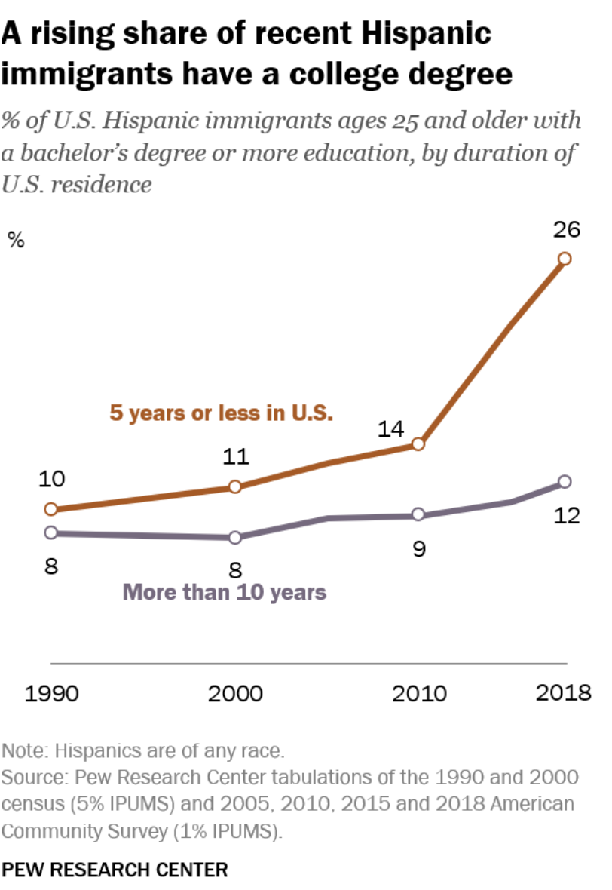
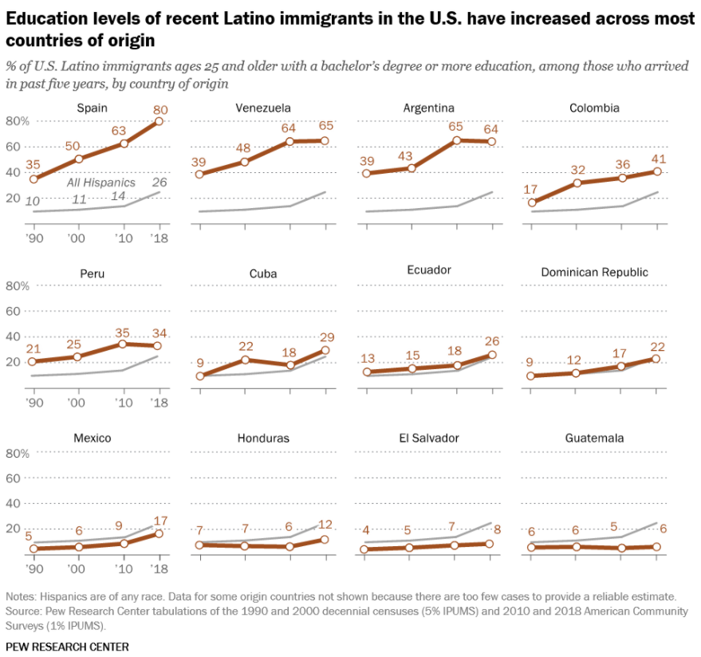

Slide 26
Population 25 and Older with High School Diploma and Above, Texas, 2015-2019
Source: U.S. Census Bureau. American Community Survey, 1-Year Estimates

Slide 27
Population 25 and Older with Bachelors Degree and Above, Texas, 2015-2019
Source: U.S. Census Bureau. American Community Survey, 1-Year Estimates

Slide 28
Median Household Income by Race/Ethnicity, Texas, 2010-2019
Source: U.S. Census Bureau. American Community Survey, 1-Year Estimates

Slide 29
Poverty and Uninsurance Rates by Race/Ethnicity, Texas, 2019
 | Texas |  | US
Population Below Poverty | Estimate | Percent | Estimate | Percent
Black or African American | 634,381 | 18.6 | 8,557,464 | 21.2
Asian | 131,705 | 9.2 | 1,761,321 | 9.6
Hispanic or Latino | 2,113,153 | 18.7 | 10,201,081 | 17.2
NH White | 933,323 | 8.0 | 17,352,095 | 9
 | Texas |  | US
Uninsured Population | Estimate | Percent | Estimate | Percent
Black or African American | 517,133 | 15 | 4,124,039 | 10.1
Asian | 161,969 | 11.3 | 1,218,462 | 6.6
Hispanic or Latino | 3,258,356 | 28.6 | 11,135,068 | 18.7
NH White | 1,240,220 | 10.6 | 12,130,924 | 6.3
Source: U.S. Census Bureau, 2019 American Community Survey, 1-Year Estimates

Slide 30
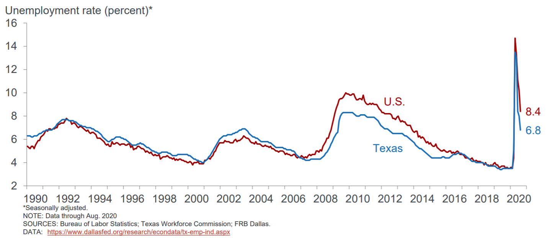
Notes:
In April 2020, 1.6 million Texans were unemployed. In August, 975,000 Texans remain unemployed.
“While the official headline unemployment rate fell to 6.8 percent in Texas in August, some groups have substantially higher unemployment rates, notably Blacks and Hispanics. In July, Dallas Fed calculations using household survey micro data indicated that the Black unemployment rate was 15.8 percent, followed by the Hispanic rate at 8.9 percent and white rate at 8.0 percent. Patterns of unemployment by race and ethnicity are similar nationally with the exception of Hispanics, whose unemployment rate in Texas is much lower than in the U.S. overall.” Federal Reserve Bank of Dallas

Slide 31

Population Projections

Slide 32
Projected Population, Texas, 2010-2030
Source: Texas Demographic Center, 2014 and 2018 Population Projections

Slide 33
Population Projections by Race/Ethnicity, Texas, 2010-2030
Source: Texas Demographic Center, 2018 Vintage Population Projections, 2010-2015 Migration Scenario

Slide 34
Projected Population Change and Percent of Total Change by Race/Ethnicity, Texas, 2010-2030
Source: Texas Demographic Center 2018 Population Projections

Slide 35
Power in Numbers: El Poder en Números
Texas is the second largest state in area and population size.
Texas has added more population than any other state since 2006.
Nearly 87% of all population growth in the last decade came from growth in non-White populations, with 53% of all growth from Hispanics alone.
Texas is home to the second largest Hispanic population
Texas is the second youngest state in the country, in large part due to growth among non-White populations which tend to be younger
Texas is projected to gain the highest number of new congressional seats following the 2020 census…unless there is a significant undercount of the population.

Slide 36
Hispanics and the American Electorate
A record 32 million Latinos are projected to be eligible to vote in 2020.
2020 is the first time Hispanics will make up the largest racial and ethnic minority in the electorate.
Texas is home to 5.6 million Latino eligible voters, making up 30% of all eligible voters in the state.
Source: Pew Research Center, Key Facts about U.S. Latinos, https://pewrsr.ch/2oH4TEC

Slide 37




Lila Valencia, Ph.D.
(512) 936-3542
Lila.Valencia@utsa.edu
demographics.texas.gov
@TexasDemography

Slide 38

Feedback Survey:
Thank you for attending!
Please share your feedback
With your phone’s camera,
focus on QR Code and click the link
that pops up at the top!
https://10-20-20powerinnumberssurvey.surveyanalytics.com
Please join/follow AMIGOS on myConnections

