Slide 1

Texas and Houston Area Demographic Characteristics and Trends
Texas City Managers' Association - Region VI
January 22, 2021

Slide 2
Population Growth of Select States, 2000-2020
 | 2010 Population | 2020 Population* | Numeric Change 2010-2020 | Percent Change 2010-2020
United States | 308,745,538 | 329,484,123 | 20,738,585 | 6.7%
Texas | 25,145,561 | 29,360,759 | 4,215,198 | 16.8%
Florida | 18,801,310 | 21,733,312 | 2,932,002 | 15.6%
California | 37,253,956 | 39,368,078 | 2,114,122 | 5.7%
North Carolina | 9,535,483 | 10,600,823 | 1,065,340 | 11.2%
Arizona | 6,392,017 | 7,421,401 | 1,029,384 | 16.1%
Georgia | 9,687,653 | 10,710,017 | 1,022,364 | 10.6%
Washington | 6,724,540 | 7,693,612 | 969,072 | 14.4%
Colorado | 5,029,196 | 5,807,719 | 778,523 | 15.5%
Source: US Census Bureau, 2010 Decennial Census; *2020 Vintage population estimates - July 1 – NOT CENSUS COUNT

Slide 3
Daily Growth and Components of Change, Texas, 2018-2019
Added 367,215 between July 1, 2018 and July 1, 2019
About 1,006 people per day
  About 483 persons per day from natural increase (more births than deaths)
  About 523 per day from net migration (178 international and 345 domestic migrants per day)
Source: US Census Bureau, 2019 Population Estimates

Slide 4
Components of Population Change, 2010-2019
Source: US Census Bureau, 2019 Vintage population estimates

Slide 5
Estimated Percent of Total Net-Migrant Flows to and From Texas and Other States, 2019
Source: US Census Bureau, 2019 ACS Migration Flows, 2019

Slide 6
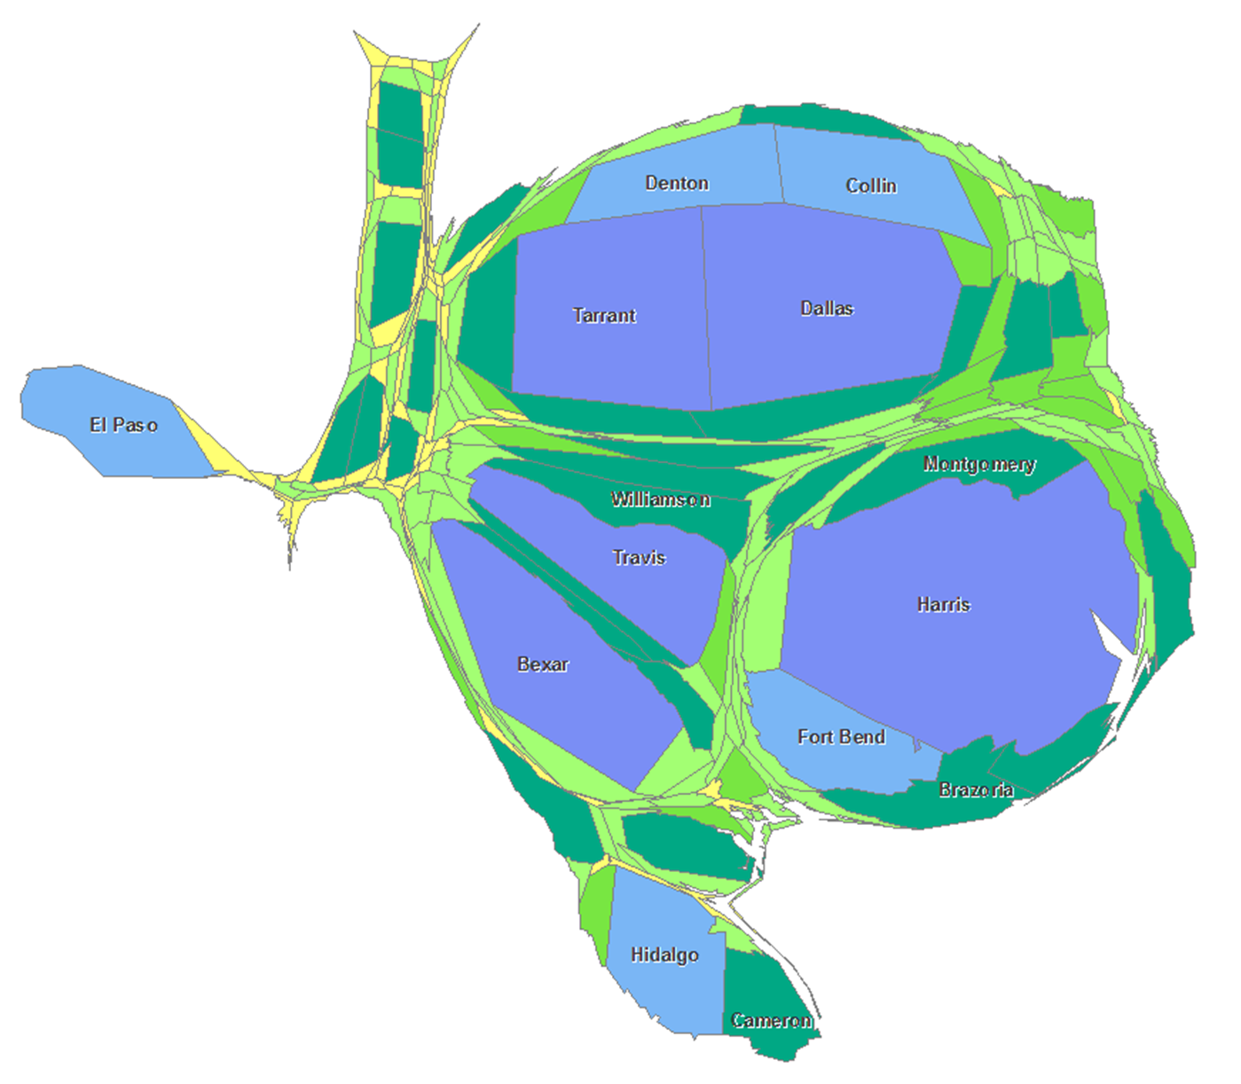
10,000 or less
10,001 - 50,000
50,001 - 100,000
100,001 - 500,000
500,001 - 1,000,000
1,000,001 - 6,000,000 plus
Population growth is not evenly distributed across the state

Slide 7

Total Estimated Population by County, Texas, 2019
Source: US Census Bureau, 2019 Population Estimates

Slide 8
Estimated Numeric Change, Texas Counties, 2010-2019
104 counties lost population over the 9 year period
Source: US Census Bureau, 2019 Population Estimates

Slide 9
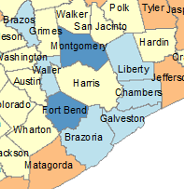
Estimated Percent Change, Texas Counties, 2010-2019
Source: US Census Bureau, 2019 Population Estimates

Slide 10
Top Counties for Numeric Growth in Texas, 2018-2019
County | US Rank | 2019 Population Estimate | Population Change 2018-2019 | Percent of Change from Natural Increase | Percent of Change from Domestic Migration | Percent of Change from International Migration
Harris | 3 | 4,713,325 | 33,280 | 116.5% | -91.5% | 74.8%
Collin | 4 | 1,034,730 | 30,423 | 20.8% | 65.6% | 13.5%
Denton | 5 | 887,207 | 28,466 | 19.8% | 74.0% | 5.8%
Travis | 6 | 1,273954 | 27,382 | 32.7% | 51.0% | 15.7%
Williamson | 9 | 590,551 | 24,088 | 15.3% | 81.0% | 3.3%
Fort Bend | 10 | 811,688 | 23,607 | 24.4% | 57.1% | 18.5%
Bexar | 11 | 2,003,554 | 22,367 | 56.0% | 33.5% | 10.5%
Tarrant | 12 | 2,102,515 | 21,069 | 65.1% | 12.1% | 23.0%
Montgomery | 16 | 607,391 | 17,621 | 18.3% | 76.2% | 5.3%
Comal | 46 | 156,209 | 8,068 | 4.3% | 94.2% | 1.1%
Kaufman | 49 | 136,154 | 7,875 | 9.4% | 90.5% | -0.1%
Bell | 53 | 362,924 | 7,527 | 48.3% | 49.8% | 1.5%
Hays | 54 | 230,191 | 7,485 | 19.9% | 76.8% | 2.8%
Hidalgo | 74 | 868,707 | 6,409 | 147.6% | -47.4% | -0.3%
Dallas | 77 | 2,635,516 | 6,166 | 345.9% | -395.5% | 149.9%
Harris, Dallas, and Hidalgo Counties had negative net migration
Source: US Census Bureau, 2018 Population Estimates

Slide 11
Top Counties for Percent Growth in Texas, 2018-2019*
County100 | US Rank | 2019 Population Estimate | Population Change 2018-2019 | Percent Population Change 2018-2019 | Percent of Population Change from Natural Increase | Percent of Population Change from Domestic Migration | Percent of Population Change from International Migration
Kaufman | 2 | 136,154 | 7,875 | 6.1% | 9.4% | 90.5% | -0.1%
Comal | 4 | 156,209 | 8,068 | 5.4% | 4.3% | 94.2% | 1.1%
Rockwall | 6 | 104,915 | 4,369 | 4.3% | 9.8% | 88.6% | 1.5%
Williamson | 9 | 590,551 | 24,088 | 4.3% | 15.3% | 81.0% | 3.3%
Kendall | 14 | 47,431 | 1,828 | 4.0% | 0.6% | 97.9% | 1.5%
Andrews | 18 | 18,705 | 694 | 3.9% | 14.0% | 84.0% | 2.0%
Chambers | 20 | 43,837 | 1,610 | 3.8% | 17.8% | 80.1% | 2.2%
Parker | 25 | 142,878 | 4,808 | 3.5% | 8.2% | 90.9% | 0.7%
Hays | 28 | 230,191 | 7,485 | 3.4% | 19.9% | 76.8% | 2.8%
Denton | 32 | 887,207 | 28,466 | 3.3% | 19.8% | 74.0% | 5.8%
Ellis | 34 | 184,826 | 5,820 | 3.3% | 16.0% | 83.2% | 0.7%
Waller | 36 | 55,246 | 1,734 | 3.2% | 20.0% | 78.4% | 1.4%
Gaines | 37 | 21,492 | 672 | 3.2% | 46.0% | 43.9% | 10.0%
Collin | 49 | 1,034,730 | 30,423 | 3.0% | 20.8% | 65.6% | 13.5%
Source: US Census Bureau, 2019 Population Estimates
*Among counties with populations of 10,000 or more in 2018

Slide 12
Largest US Cities, 2019
Rank | Place | Census 2010 | 2011 | 2012 | 2013 | 2014 | 2015 | 2016 | 2017 | 2018 | 2019
1 | New York, NY | 8,175,133 | 8,272,948 | 8,346,693 | 8,396,091 | 8,433,806 | 8,463,049 | 8,469,153 | 8,437,478 | 8,390,081 | 8,336,817
2 | Los Angeles, CA | 3,792,621 | 3,820,876 | 3,851,202 | 3,881,622 | 3,909,901 | 3,938,568 | 3,963,226 | 3,975,788 | 3,977,596 | 3,979,576
3 | Chicago, IL | 2,695,598 | 2,708,114 | 2,719,141 | 2,725,731 | 2,727,066 | 2,724,344 | 2,716,723 | 2,711,069 | 2,701,423 | 2,693,976
4 | Houston, TX | 2,099,451 | 2,126,032 | 2,161,593 | 2,199,391 | 2,241,826 | 2,286,908 | 2,309,544 | 2,316,750 | 2,318,573 | 2,320,268
5 | Phoenix, AZ | 1,445,632 | 1,469,796 | 1,499,274 | 1,526,491 | 1,555,445 | 1,583,690 | 1,612,199 | 1,633,560 | 1,654,675 | 1,680,992
6 | Philadelphia, PA | 1,526,006 | 1,540,466 | 1,551,824 | 1,558,313 | 1,565,460 | 1,571,065 | 1,576,051 | 1,580,601 | 1,583,592 | 1,584,064
7 | San Antonio, TX | 1,327,407 | 1,357,120 | 1,383,075 | 1,408,339 | 1,435,456 | 1,464,043 | 1,487,843 | 1,511,154 | 1,530,016 | 1,547,253
8 | San Diego, CA | 1,307,402 | 1,319,592 | 1,336,776 | 1,355,320 | 1,375,831 | 1,387,323 | 1,402,089 | 1,412,621 | 1,421,917 | 1,423,851
9 | Dallas, TX | 1,197,816 | 1,218,282 | 1,242,115 | 1,258,835 | 1,279,098 | 1,301,329 | 1,323,916 | 1,342,479 | 1,341,802 | 1,343,573
10 | San Jose, CA | 945,942 | 970,369 | 983,530 | 1,001,279 | 1,014,273 | 1,025,980 | 1,030,242 | 1,032,335 | 1,028,020 | 1,021,795
11 | Austin, TX | 790,390 | 828,459 | 854,482 | 875,003 | 901,170 | 921,114 | 939,447 | 951,553 | 962,469 | 978,908
12 | Jacksonville, FL | 821,784 | 829,609 | 837,013 | 842,735 | 852,494 | 865,836 | 880,520 | 892,025 | 902,437 | 911,507
13 | Fort Worth, TX | 741,206 | 764,142 | 781,046 | 796,073 | 815,057 | 835,356 | 856,177 | 874,809 | 893,216 | 909,585
14 | Columbus, OH | 787,033 | 800,607 | 812,740 | 827,797 | 841,673 | 854,950 | 866,894 | 881,694 | 890,869 | 898,553
15 | Charlotte, NC | 731,424 | 754,829 | 773,264 | 792,047 | 807,400 | 825,668 | 843,117 | 860,002 | 872,514 | 885,708
Source: US Census Bureau, 2019 Vintage Population Estimates
Notes:
Five of the 15 largest cities in the country are in Texas

Slide 13
Top 15 Metros in Numeric Growth, 2010-2019
Rank | Name | April 1, 2010 | July 1, 2018 | July 1, 2019 | Numeric Change 10-19 | Percent Change 10-19
1 | Dallas-Fort Worth-Arlington, TX | 6,366,537 | 7,455,756 | 7,573,136 | 1,206,599 | 19.0%
2 | Houston-The Woodlands-Sugar Land, TX | 5,920,487 | 4,849,209 | 7,066,141 | 1,145,654 | 19.4%
3 | Phoenix-Mesa-Chandler, AZ | 4,193,129 | 4,849,209 | 4,948,203 | 755,074 | 18.0%
4 | Atlanta-Sandy Springs-Alpharetta, GA | 5,286,718 | 6,976,147 | 6,020,364 | 733,646 | 13.9%
5 | Washington-Arlington-Alexandria, DC-VA-MD-WV | 5,649,688 | 5,945,303 | 6,280,487 | 630,799 | 11.2%
6 | Miami-Fort Lauderdale-Pompano Beach, FL | 5,566,274 | 6,143,837 | 6,166,488 | 600,214 | 10.8%
7 | Seattle-Tacoma-Bellevue, WA | 3,439,808 | 3,935,179 | 3,979,845 | 540,037 | 15.7%
8 | Austin-Round Rock-Georgetown, TX | 1,716,323 | 2,165,497 | 2,227,083 | 510,760 | 29.8%
9 | Orlando-Kissimmee-Sanford, FL | 2,134,399 | 2,574,838 | 2,608,147 | 473,748 | 22.2%
10 | Riverside-San Bernardino-Ontario, CA | 4,224,948 | 4,612,542 | 4,650,631 | 425,683 | 10.1%
11 | Denver-Aurora-Lakewood, CO | 2,543,608 | 2,931,665 | 2,967,239 | 423,631 | 16.7%
12 | Tampa-St Petersburg-Clearwater, FL | 2,783,485 | 3,154,649 | 3,194,831 | 411,346 | 14.8%
13 | San Antonio-New Braunfels, TX | 2,142,520 | 2,512,379 | 2,550,960 | 408,440 | 19.1%
14 | San Francisco-Oakland-Berkeley, CA | 4,335,593 | 4,726,314 | 4,731,803 | 396,210 | 9.1%
15 | Charlotte-Concord-Gastonia, NC-SC | 2,243,963 | 2,592,950 | 2,636,883 | 392,920 | 17.5%
Source: US Census Bureau, 2019 Vintage Population Estimates
Notes:
Four of the top 15 metros in numeric growth are Texas metros, including the 1st and 2nd ranking metros

Slide 14
15 Fastest Growing Large Cities and Towns between 2018-2019
Rank | Geographic Area | Population Estimate |  | Change, 2018 to 2019
 |  | July 1, 2018 | July 1, 2019 | Number | Percent
1 | Leander, TX | 55,924 | 62,608 | 6,684 | 12.0%
2 | Apex, NC | 53,859 | 59,300 | 5,441 | 10.1%
3 | Chico, CA | 94,342 | 103,301 | 8,959 | 9.5%
4 | Doral, FL | 60,762 | 65,741 | 4,979 | 8.2%
5 | Bentonville, AR | 51,103 | 54,909 | 3,806 | 7.4%
6 | Meridian, ID | 106,464 | 114,161 | 7,697 | 7.2%
7 | Georgetown, TX | 74,275 | 79,604 | 5,329 | 7.2%
8 | Buckeye, AZ | 74,339 | 79,620 | 5,281 | 7.1%
9 | New Braunfels, TX | 84,495 | 90,209 | 5,714 | 6.8%
10 | Redmond, WA | 67,436 | 71,929 | 4,493 | 6.7%
11 | Frisco, TX | 188,452 | 200,490 | 12,038 | 6.4%
12 | Fort Myers, FL | 82,229 | 87,103 | 4,874 | 5.9%
13 | Lehi, UT | 65,958 | 69,724 | 3,766 | 5.7%
14 | Castle Rock, CO | 65,000 | 68,484 | 3,484 | 5.4%
15 | Milpitas, CA | 80,208 | 84,196 | 3,988 | 5.0%
Source: US Census Bureau, 2019 Vintage Population Estimates; Note: among places with populations of 50,000 or more in 2018
Notes:
Nearly a third of the 15 fastest growing cities in the country are Texas cities

Slide 15
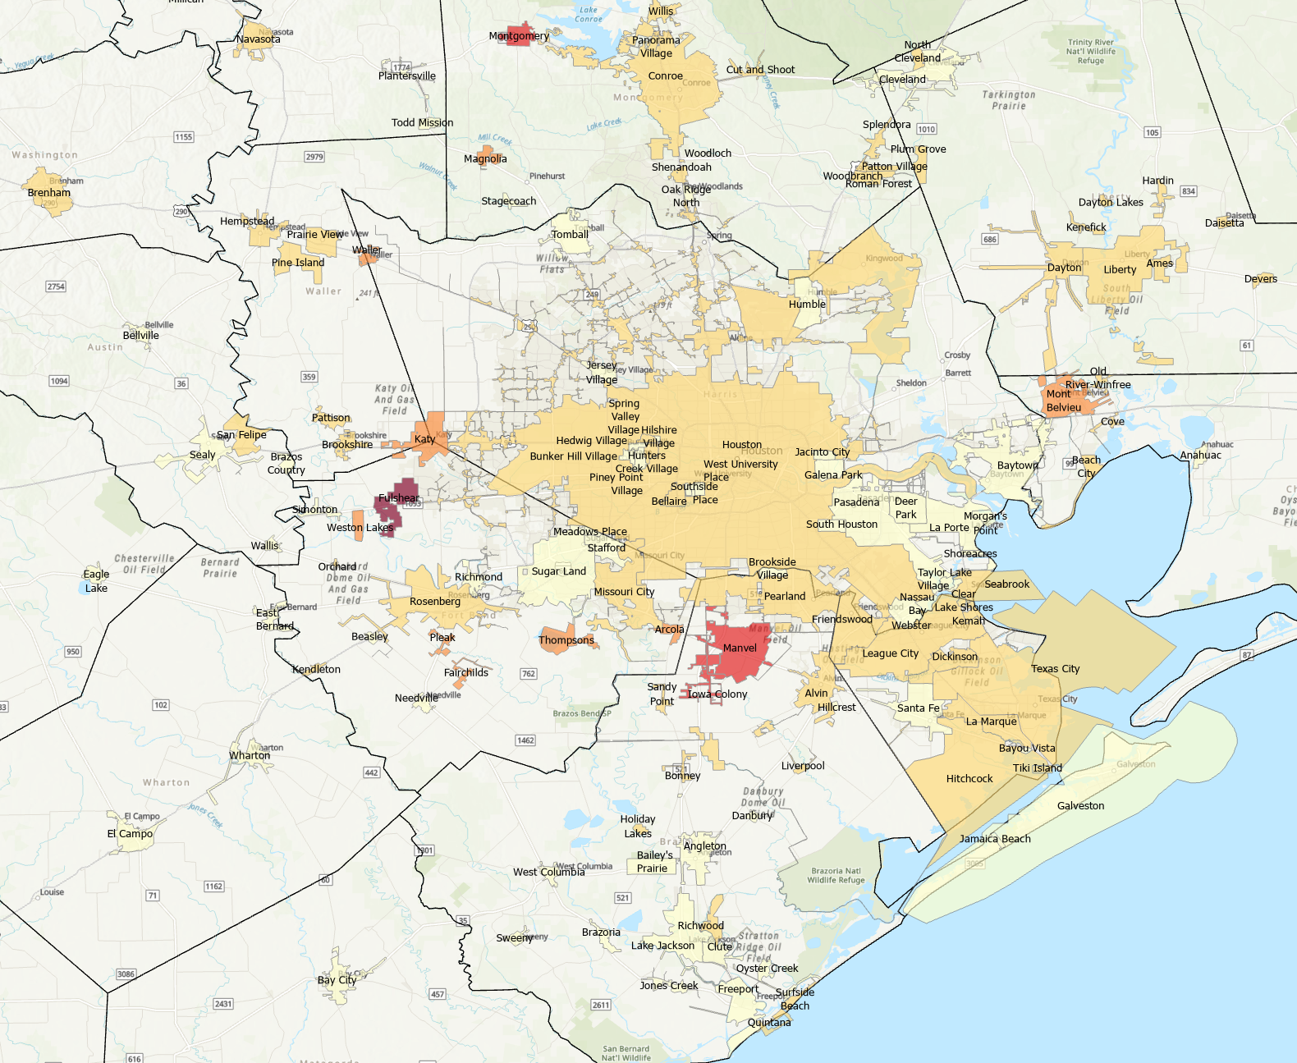
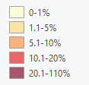
Percent population change 2010-2019, Houston area cities
Source: US Census Bureau, 2019 Vintage Population Estimates;

Slide 16
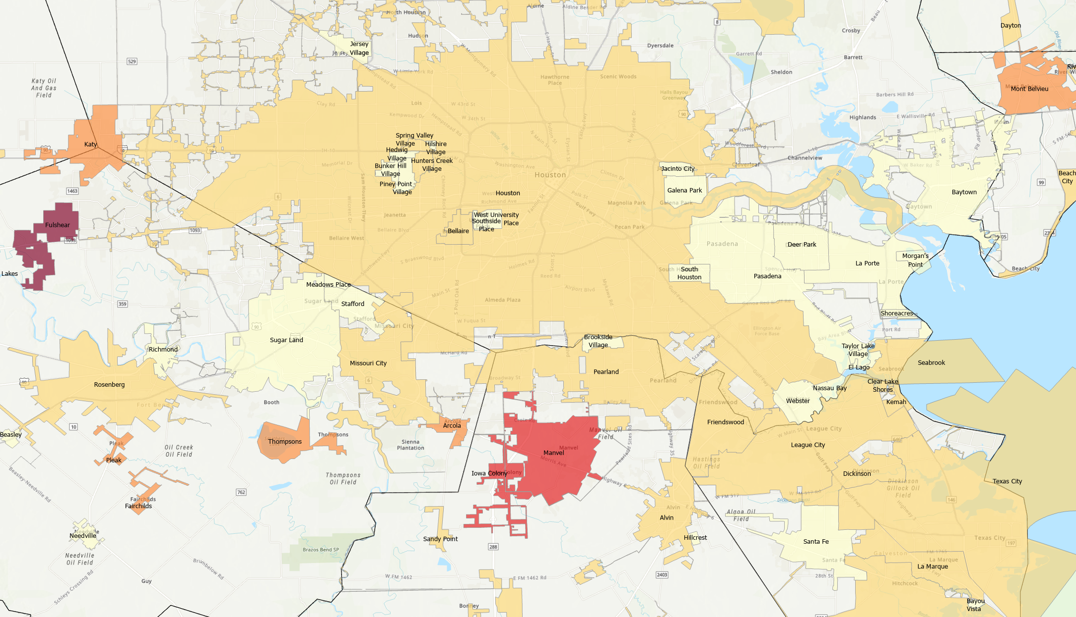
Percent population change 2010-2019, Houston area cities
Source: US Census Bureau, 2019 Vintage Population Estimates;

Slide 17
Race/Ethnic Composition, Texas, 2010-2019
86.4% of growth has been from minority groups
Source: US Census Bureau 2019 Population Estimates

Slide 18
Numeric Change in Age Group by Race/Ethnicity, Texas, 2010-2019
Source: US Census Bureau 2019 Population Estimates

Slide 19
Annual Shares of Recent Immigrants to Texas by World Area of Birth, 2005-2015
Estimated number of international migrants to Texas
101,588
77,702
98,194
Source: US Census Bureau, American Community Survey, 1-Year PUMS

Slide 20
Total Fertility Rate for Select States, 2008-2018

Slide 21
Crude Birth Rates by Race/Ethnicity, Texas, 2006-2018
Source: Centers for Disease Control and Prevention, National Center for Health Statistics, National Vital Statistics Report

Slide 22
Texas Population Pyramid, 2010 and 2018
2010 2018
Source: US Census Bureau, 2018 Population Estimates
Notes:
This population pyramid represents the age, sex, race and ethnic composition of the Texas population Blue represents males, red females, rows are single years of age, and shades represent specified race/ethnic groups as indicated in the legend

Slide 23
Texas White (non-Hispanic) and Hispanic Populations by Age, 2019
Source: Texas Demographic Center, 2018 Population Estimates
Notes:
The age distribution of the non-Hispanic white population in Texas is weighted heavily with the “baby boom” generation Largely the result of lower fertility and less net in-migration, the non-Hispanic white population has relatively fewer young persons relative to those in the middle-age years In 2010, at ages 37 and younger, the Hispanic population exceeds the non-Hispanic white population

Slide 24
Texas Population Pyramid by Race/Ethnicity, 2019
Source: US Census Bureau, 2019 Population Estimates
Notes:
This population pyramid represents the age, sex, race and ethnic composition of the Texas population Blue represents males, red females, rows are single years of age, and shades represent specified race/ethnic groups as indicated in the legend

Slide 25
Texas Population Pyramid by Race/Ethnicity, 2019
Source: US Census Bureau, 2019 Population Estimates
Notes:
This population pyramid represents the age, sex, race and ethnic composition of the Texas population Blue represents males, red females, rows are single years of age, and shades represent specified race/ethnic groups as indicated in the legend

Slide 26
Texas Population Pyramid by Race/Ethnicity, 2019
Source: US Census Bureau, 2019 Population Estimates
Notes:
This population pyramid represents the age, sex, race and ethnic composition of the Texas population Blue represents males, red females, rows are single years of age, and shades represent specified race/ethnic groups as indicated in the legend

Slide 27
Percent of population aged 25 years and older with a bachelor’s degree or higher, Census Tracts, Houston Area, 2018
Source: US Census Bureau, American Community Survey, 5-Year Sample, 2017

Slide 28
Percent of labor force in management, business, science, and arts occupations, census tracts, Houston area, 2017
Source: US Census Bureau, American Community Survey, 5-Year Sample, 2017

Slide 29
Housing Units Built Before 1960
Source: US Census Bureau, American Community Survey, 5-Year Sample, 2017

Slide 30
Housing Units Built 1960-79
Source: US Census Bureau, American Community Survey, 5-Year Sample, 2017

Slide 31
Housing Units Built 1980-89
Source: US Census Bureau, American Community Survey, 5-Year Sample, 2017

Slide 32
Housing Units Built 1990-99
Source: US Census Bureau, American Community Survey, 5-Year Sample, 2017

Slide 33
Housing Units Built 2000 and later
Source: US Census Bureau, American Community Survey, 5-Year Sample, 2017

Slide 34
Percent of the population that is non-Hispanic Black, Census Tracts, Houston Area, 2017
Source: US Census Bureau, American Community Survey, 5-Year Sample, 2017

Slide 35
Percent of the population that is Hispanic, Census Tracts, Houston Area, 2017
Source: US Census Bureau, American Community Survey, 5-Year Sample, 2017

Slide 36
Percent of the population that is Asian, Census Tracts, Houston Area, 2017
Source: US Census Bureau, American Community Survey, 5-Year Sample, 2017

Slide 37
Percent of the population that commutes driving alone, Census Tracts, Houston Area, 2017
Source: US Census Bureau, American Community Survey, 5-Year Sample, 2017

Slide 38
Percent of owner-occupied housing units valued at $500k or more, Census Tracts, Houston Area, 2017
Source: US Census Bureau, American Community Survey, 5-Year Sample, 2017

Slide 39
Percent of the population that speak English less than very well, Census Tracts, Houston Area, 2017
Source: US Census Bureau, American Community Survey, 5-Year Sample, 2017

Slide 40
Educational Attainment by Race/Ethnicity Adults Aged 25 Years and Older, Texas, 2019
Source: US Census Bureau American Community Survey, 2019 1-Year Estimates

Slide 41
Percent of Civilian Labor Force by Occupation, Texas, 2007, 2017 and 2017-2017 Change
Source: US Census Bureau, American Community Survey, 1-Year Sample, 2007, 2017

Slide 42
Percent Distribution of Educational Attainment of Persons Aged 25 Years and Older, Texas, 2008, 2011, and 2015
Source: US Census Bureau, American Community Survey, 1-Year Samples, 2008-2015

Slide 43
Percent of the Population Aged-25 Years and Older with a Bachelor’s Degree or Higher by Race/Ethnicity, Texas, 2007 and 2017
Change in percent
64%
53%
62%
38%
Source: US Census Bureau, ACS 1-Year Estimates, 2007, 2017

Slide 44
Projected Population, Texas, 2010-2030
Source: Texas Demographic Center, 2014 and 2018 Population Projections

Slide 45
Projected population for Houston area counties, 2020-2050
Source: Texas Demographic Center, 2018 Population Projections

Slide 46
Projected population for Houston area counties, 2020-2050
Source: Texas Demographic Center, 2018 Population Projections

Slide 47
Population Projections by Race/Ethnicity, Texas, 2010-2030
Source: Texas Demographic Center, 2018 Vintage Population Projections, 2010-2015 Migration Scenario

Slide 48

U.S. Response Rates to the 2020 Census
99.98% of all housing units and addresses nationwide were enumerated.
2020 Self-Response Rate of 67.0% surpassed 2010 Self-Response Rate of 66.5%.
32.9% housing units enumerated through Non-Response Follow-Up (NRFU).
24.1% of NRFU workload enumerated through proxy (landlord, neighbor, etc.).
5.6% of address nationwide (13.9% of NRFU workload) resolved using administrative records

Slide 49
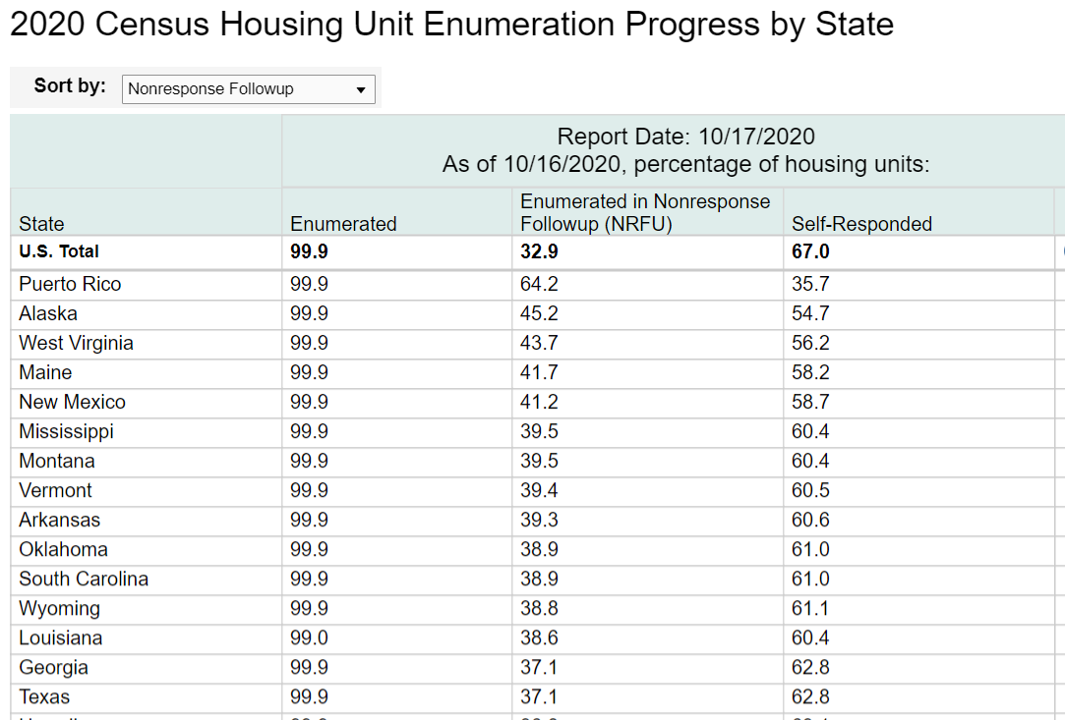
2020 Census Total Response in Texas
Total Response Rate
=
Self-Response Rate
+
NRFU Enumerated Rate
Texas Response Rate:
99.9% = 62.8% + 37.1%
Notes:
About 7.6 million Texas households self-responded.
Texas tied with GA for 38th in self-response. Texas ranked 14th in NRFU response.

Slide 50
Not all rates are created equal.
Self response rates, total response rates, enumeration rate, NRFU completion rates
What we do know:
Texas self-response rate still lags 2010 rate: 62.0% vs. 64.4%
Self-response rates vary across the state.
Enumeration does not mean count.
Self-response yields the most accurate census data.

Slide 51
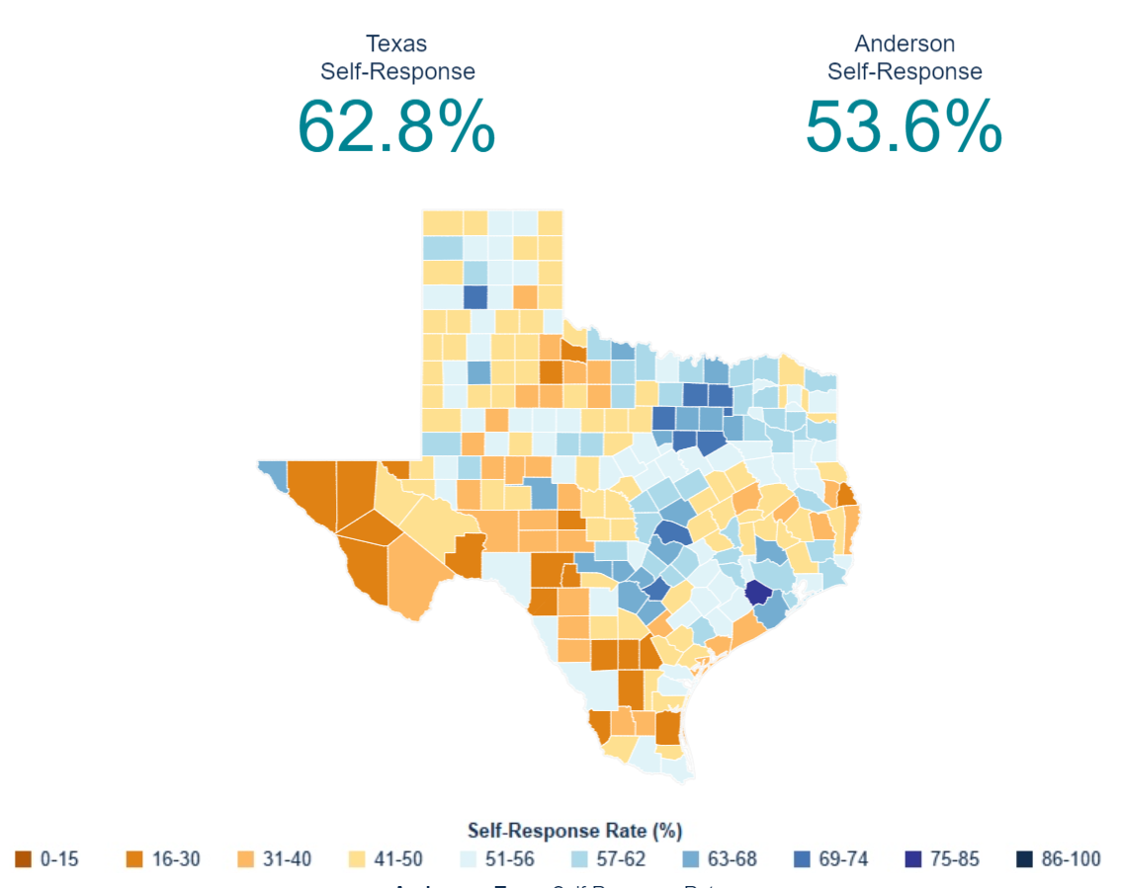
2020 Census Response Across Texas
Self-Response Rates among Texas Counties ranged from 75.8% in Fort Bend County to 18.6% in Edwards County.
29/254 (11%) Counties met or surpassed their 2010 SRR.
283/1221 (23%) Places/Cities met or surpassed their 2010 SRR.

Slide 52
TDC Analysis of Census Tracts with Self-Response Rates in Bottom 20% as of 9/28/20
Texas has 1347 census tracts with self-response rates below 50% (bottom 20% of self-response rates across all Texas census tracts)
These lower responding CTs are distributed across the state, in 231 of 254 counties. However, there are more census tracts in the lower NRFU completion ACOs, specifically Laredo, Fort Bend, Lubbock, and El Paso.
47.9% of these CTs have majority (>50%) Hispanic populations and 55.9% have a greater share of Hispanics than their state share (>40%).
5% of these CTs have majority (>50%) African American populations and 35.3% have a greater share of Blacks than their state share (>12%).
77.1% of these CTs greater shares than the Texas share of Hispanic and/or Black populations.

Slide 53
Areas of Concern
Communities of color
Under-represented groups in administrative records
Areas with low internet access
Off-campus college students
Public perception of the Census Bureau and its data

Slide 54
Redistricting Dates
Apportionment File sent to POTUS on 12/31/2020- now earliest - 3/6/2021
Redistricting Data File (Public Law 94-171 File) received by the Governor no later than April 1, 2021 now unknown
PL 94-171 released to states in groups of 8 states per week, with one week prior notice
PL 94-171 File to include:
  Race, Hispanic origin, 18 and older, occupancy status, and group quarters by type.
Data available at WWW.CENSUS.GOV/RDO

Slide 55




Lloyd Potter, PhD
(210) 458-6530
LloydPotter@UTSA.edu
Demographics.Texas.gov
@TexasDemography

