Slide 1

2020 Census Findings to Date
Presented to
South Austin Democrats
February 9, 2021

Slide 2

What is the Census?
Every ten years, the country conducts a census to count every person in the United States.
April 1, 2020 is the official Census date.
Census counts used to reapportion the U.S. House of Representatives and determine the number of electoral college votes a state gets.
Census counts used by state and local officials to redraw congressional, legislative, and local boundaries to account for population shifts.
Businesses rely on Census data for market research, locations, and economic development.
Census derived data are used to allocate over $1.5 trillion in federal funds to support healthcare, education, transportation, or other service programs.*
Census data form the foundation for nearly all demographic and socio-economic statistics, including population estimates & projections, for the next 10 years.
*Source: Reamer, Andrew; George Washington Institute of Public Policy, Counting for Dollars

Slide 3
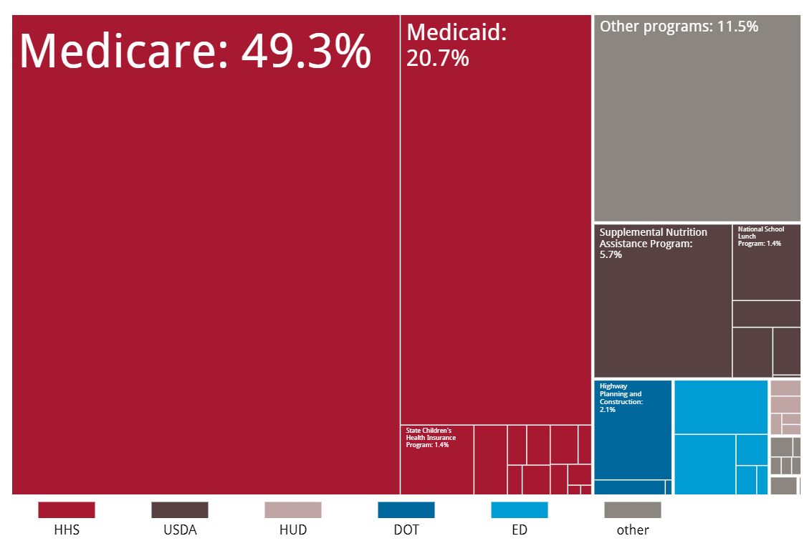
Census Derived Funding in Texas
In FY 2017, Texas received $101 billion in federal funding for programs that use Census derived data.
$50 billion for Medicare
$21 billion for Medicaid
$30 billion for other programs.
Source: Reamer, Andrew; George Washington Institute of Public Policy, Counting for Dollars

Slide 4
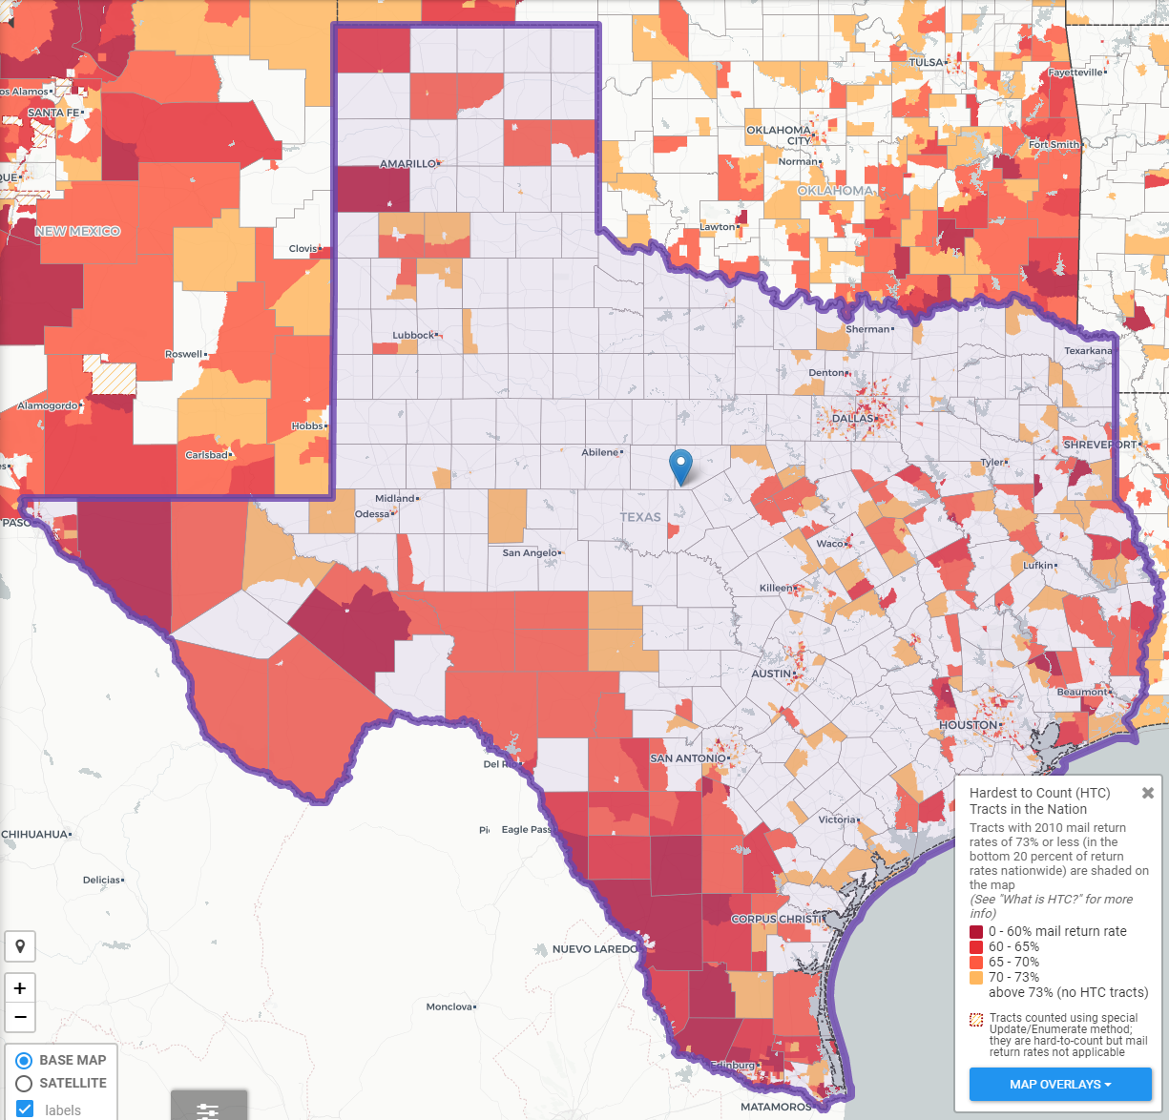
Texas Hard to Count Populations
An estimated 7 million, or nearly 25% of Texans live in HTC areas.
People of color
Children under 5 years
Populations in/near poverty
Single-parent households
Immigrants & those with limited English proficiency
Complex households: renters, multi-family, mixed status, multi-generation, larger households
Source: Center for Urban Research of the City University of New York (CUNY) Graduate Center. https://www.censushardtocountmaps2020.us
Notes:
In 2010, an estimated 240,000 Texans were undercounted in the Census.
An estimated 7 million, or nearly 25%, of Texans live in hard to count neighborhoods.
Some projections indicate more than 500,000 Texans could be undercounted in 2020.

Slide 5
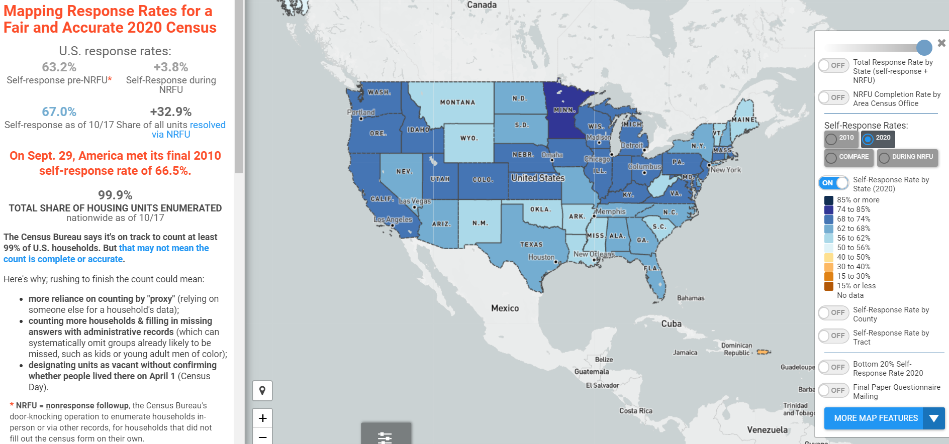
U.S. Response Rates to the 2020 Census
Total Response Rate
=
Self-Response Rate
+
NRFU Enumerated Rate
Source: Center for Urban Research of the City University of New York (CUNY) Graduate Center. https://www.censushardtocountmaps2020.us
Notes:
An estimated 99.1 million households self-responded to the 2020 Census.

Slide 6
U.S. Response Rates to the 2020 Census
99.98% of all housing units and addresses nationwide were enumerated.
2020 Self-Response Rate of 67.0% surpassed 2010 Self-Response Rate of 66.5%.
32.9% housing units enumerated through Non-Response Follow-Up (NRFU).
24.1% of NRFU workload enumerated through proxy (landlord, neighbor, etc.).
5.6% of address nationwide (13.9% of NRFU workload) resolved using administrative records

Slide 7
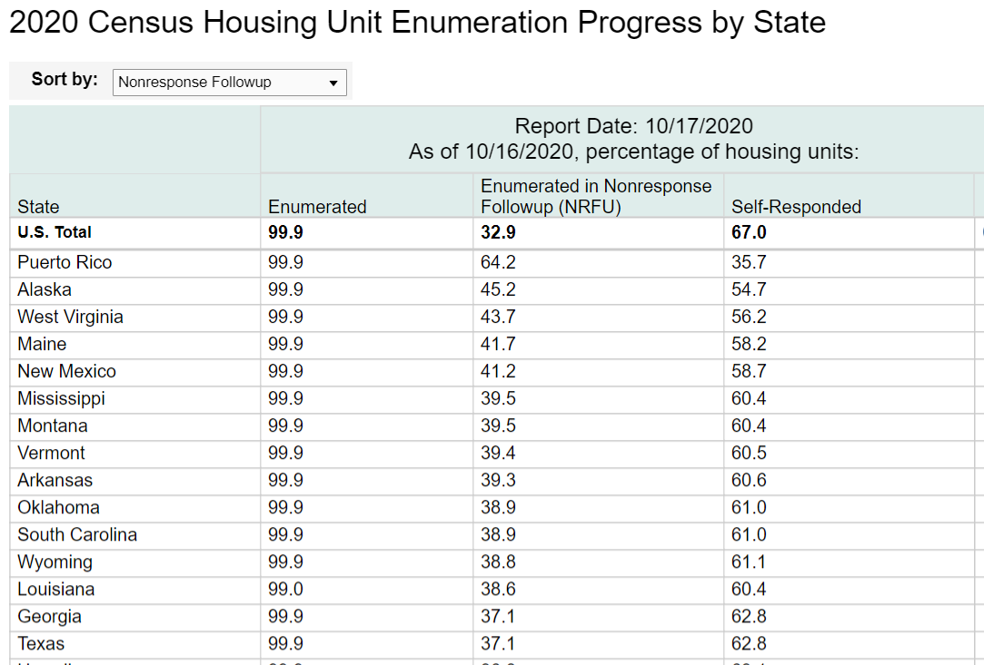
2020 Census Total Response in Texas
Total Response Rate
=
Self-Response Rate
+
NRFU Enumerated Rate
Texas Response Rate:
99.9% = 62.8% + 37.1%
Texas Ranking:
2010 = 35th
2020 = 39th
Notes:
About 7.6 million Texas households self-responded.
Texas tied with GA for 38th in self-response. Texas ranked 14th in NRFU response.

Slide 8
Not all rates are created equal.
Self response rates, total response rates, enumeration rate, NRFU completion rates
What we do know:
Texas self-response rate still lags 2010 rate: 62.0% vs. 64.4%
Self-response rates vary across the state.
Enumeration does not mean count.
Self-response yields the most accurate census data.

Slide 9
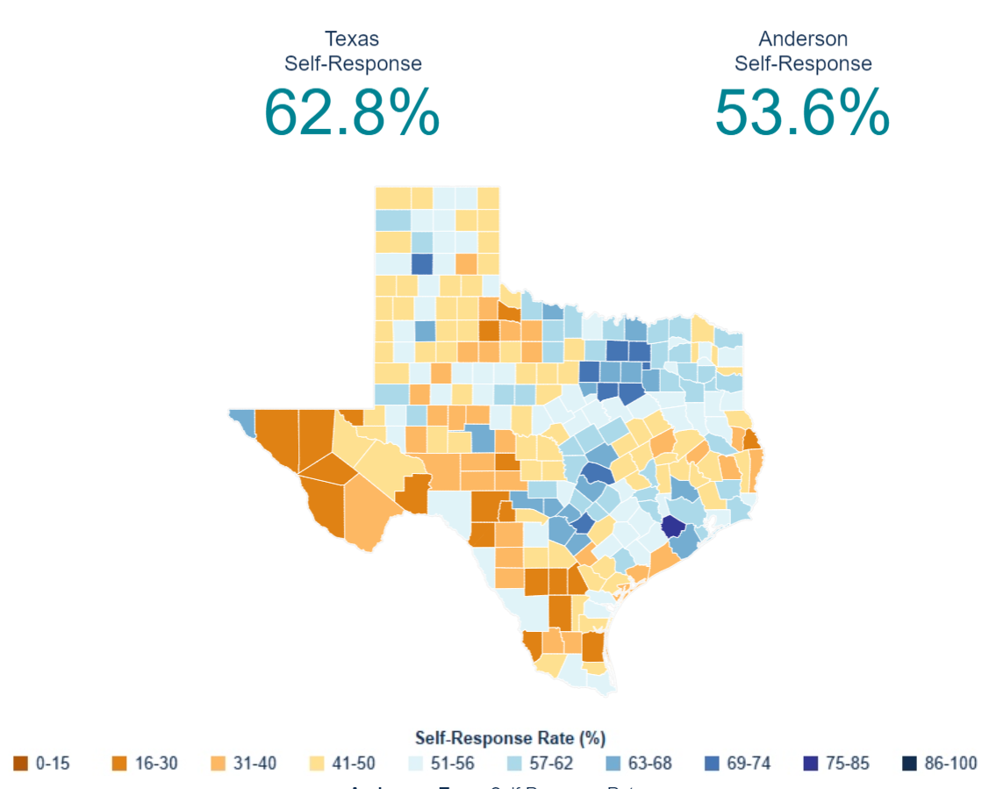
2020 Census Response Across Texas
Self-Response Rates among Texas Counties ranged from 75.8% in Fort Bend County to 18.6% in Edwards County.
29/254 (11%) Counties met or surpassed their 2010 SRR.
283/1221 (23%) Places/Cities met or surpassed their 2010 SRR.

Slide 10
TDC Analysis of Census Tracts with Self-Response Rates Less than 50%
Texas has 1,263 (18.6%) of Texas’s 6,774 census tracts with self-response rates below 50%.
These lower responding CTs are distributed across the state.
47.7% of these CTs have majority (>50%) Hispanic populations.
5.3% of these CTs have majority (>50%) African American populations.
62.0% of these CTs are either majority Hispanic or majority Black populations.

Slide 11
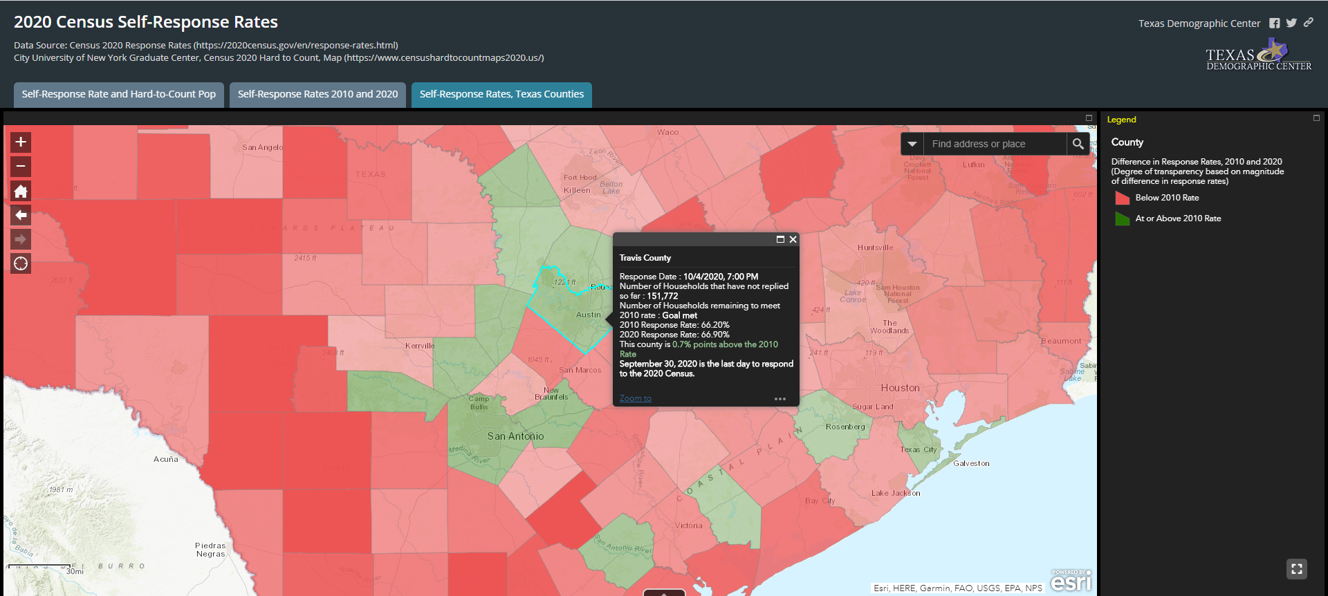
Texas Demographic Center Data and Data Products
TDC 2020 Census Resources
  Map and dashboard
  Static maps
  Redistricting resources

Slide 12
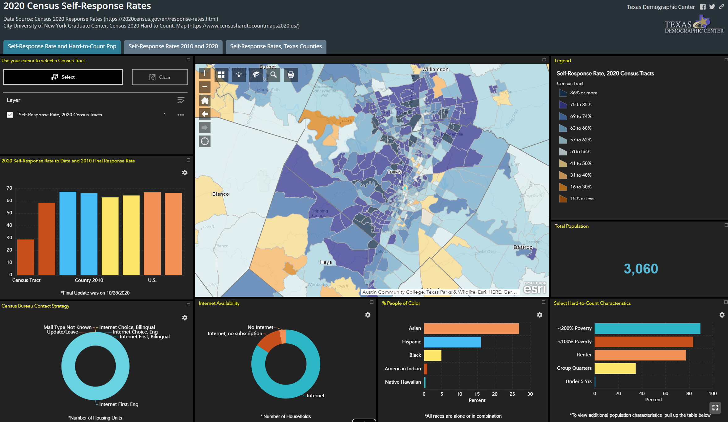

Slide 13
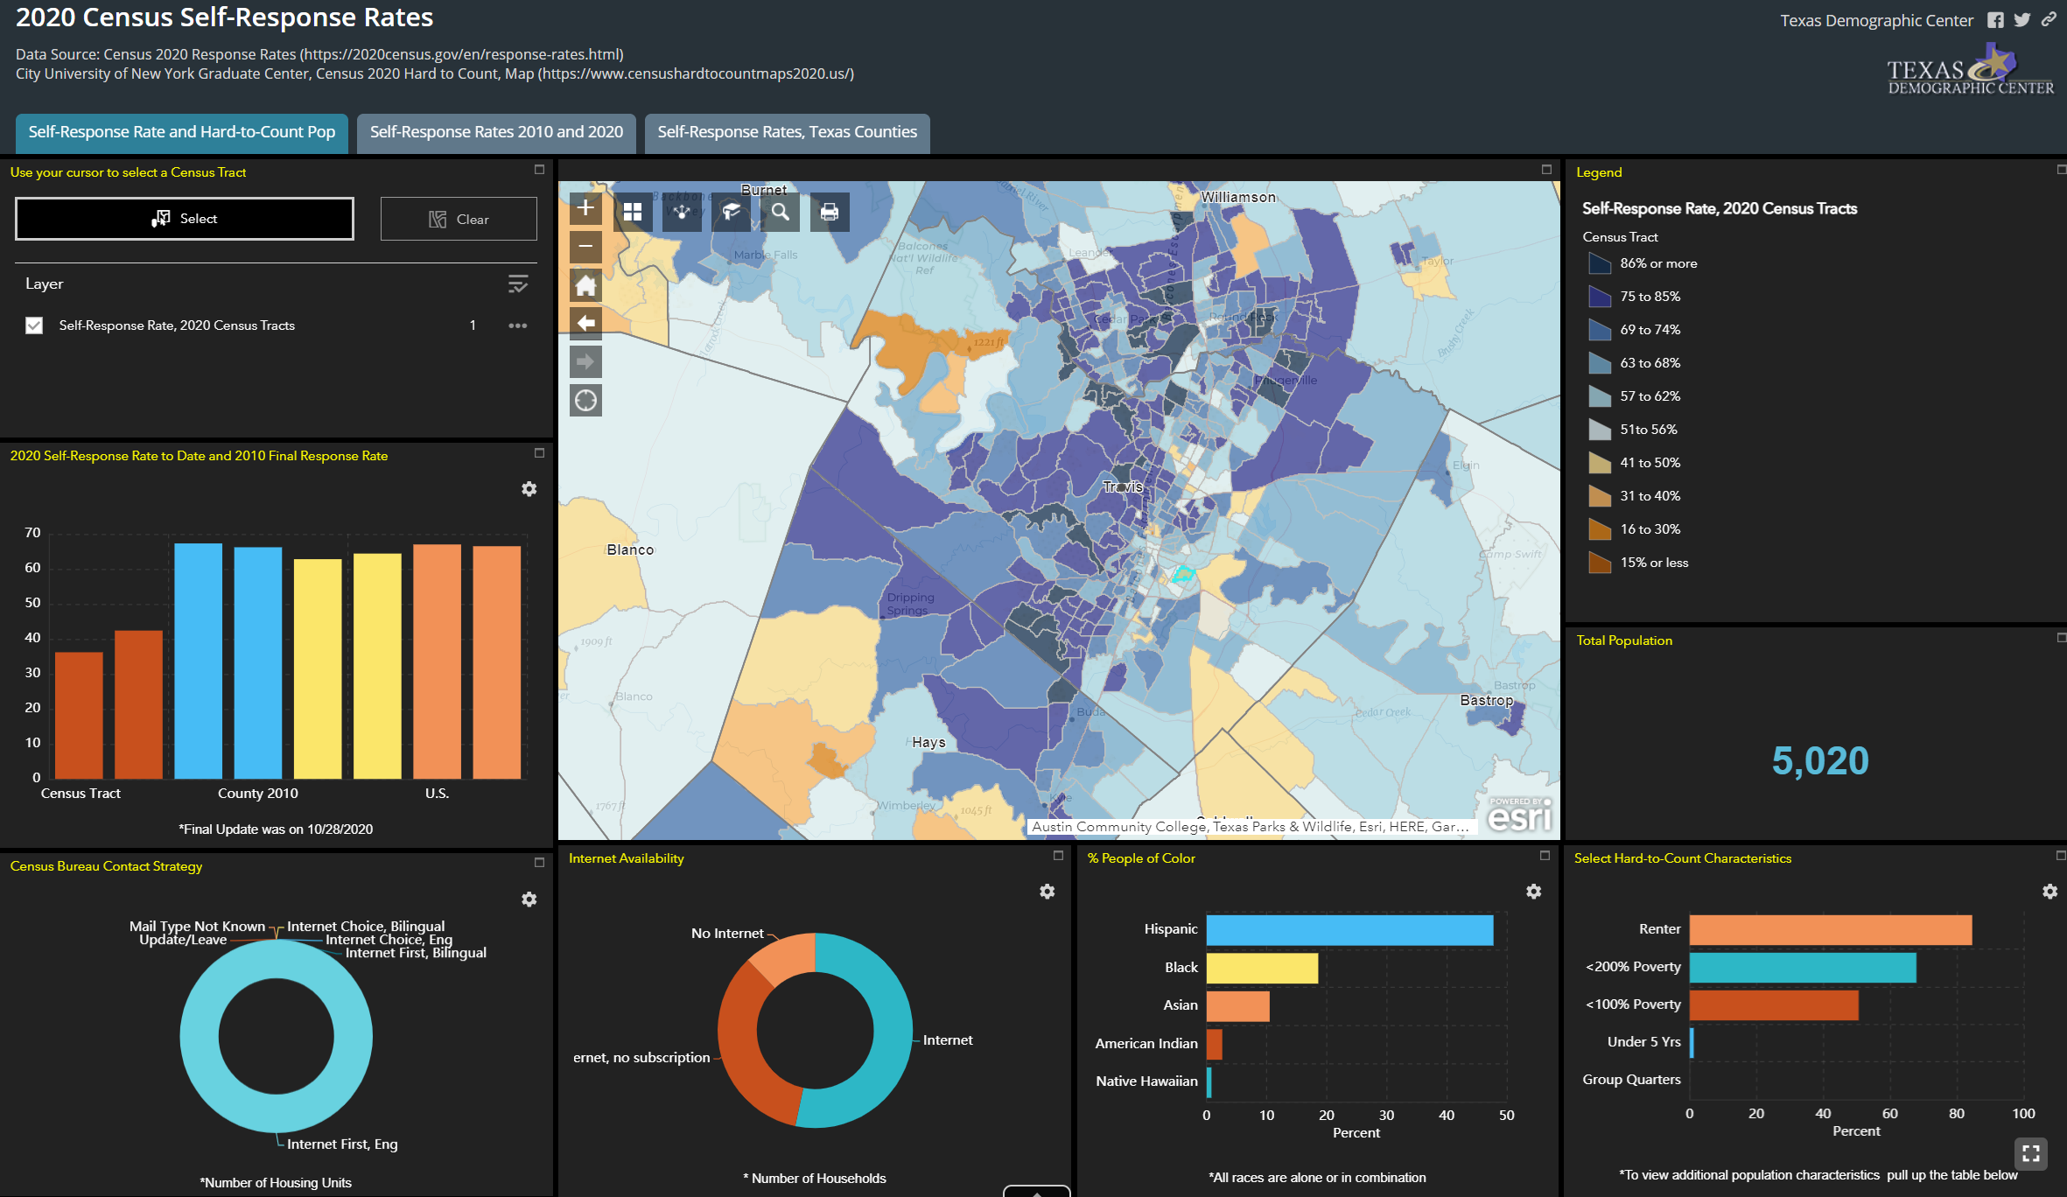

Slide 14
Areas of Concern
Communities of color
Under-represented groups in administrative records
Areas with low internet access
Off-campus college students
Public perception of the Census Bureau and its data

Slide 15
Census Bureau Data Quality Measures
The Census Bureau produces analyses to assess the accuracy of the Census. These are called Census Coverage Measures.
Demographic Analysis: produce population estimates using vital statistics, estimates of international migration and administrative records (released December 15, 2020)
Post-Enumeration Survey: interview a small sample of HHs to check accuracy of data collected on 2020 census forms (available November 2021-February 2022)
For the 1st time, Census Bureau will release data quality metrics for the nation and states along with the apportionment file. These will include information on self-response, non-response follow-up (including household interviews, proxy interviews, and administrative records enumerations). (by April 30)
Census Bureau will work with independent, external groups on evaluating the quality of the 2020 Census.
For more information: https://www.census.gov/newsroom/press-releases/2020/2020-census-quality-assessments.html

Slide 16
Boundaries impacted by Redistricting
Redistricting impacts representation and boundaries at the national, state, and local levels
  Congressional districts
  Senate districts
  House districts
  County Commissioners districts
  City Council districts
  School Board districts
*Source: Reamer, Andrew; George Washington Institute of Public Policy, Counting for Dollars

Slide 17
Important Dates:
Apportionment File sent to POTUS 12/31/2020 by April 30, 2021
Redistricting Data File (Public Law 94-171 File) received by Governors no later than 4/1/2021 July 31, 2021
  PL 94-171 released to states in groups of 8 states per week, with one week prior notice
  PL 94-171 File to include:
    Race, Ethnicity, 18 plus, Occupancy Status, Group Quarters by Type
  Data available at WWW.CENSUS.GOV/RDO
No schedule yet on other 2020 Census data products, but expected throughout 2022
Texas legislative session: January 12, 2021 to May 31, 2021
Delays in release of PL 940171 File may mean a special session
17

Slide 18
Senate Redistricting Committee Hearings
Senate Special Committee on Redistricting Community Input Virtual Meetings
  Virtual hearings commenced January 25, 2021 with 12 hearings planned
  Central Texas hearing held January 28, 2021
  Video: http://tlcsenate.granicus.com/MediaPlayer.php?clip_id=15331
  Presentation: https://senate.texas.gov/cmtes/87/c625/hearings87R/Texas-Demographic-Center-Presentation-Central-Texas-Region-1.28.21.pdf
  Austin area hearing to be held February 26, 2021 at 9AM
  Meeting registration: https://zoom.us/meeting/register/tJMlc--grjopG9VBoOxgCsFGvKShpxjFQEnf

Slide 19
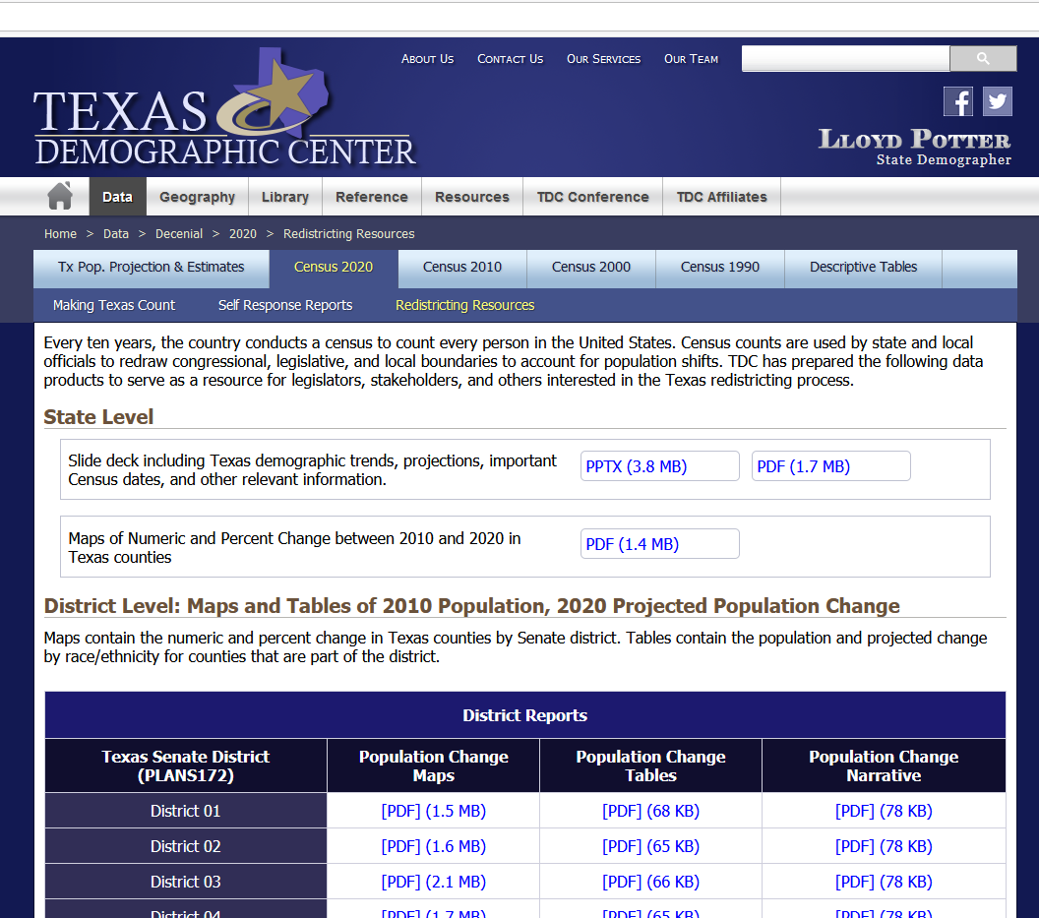
Texas Demographic Center Redistricting Resources
https://demographics.texas.gov/data/decennial/2020/RedistrictingResc

Slide 20
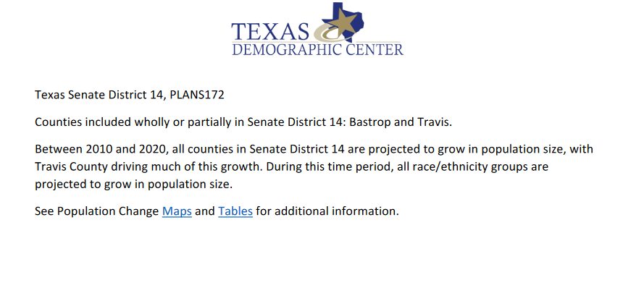
Texas Demographic Center Redistricting Resources
https://demographics.texas.gov/data/decennial/2020/RedistrictingResc

Slide 21
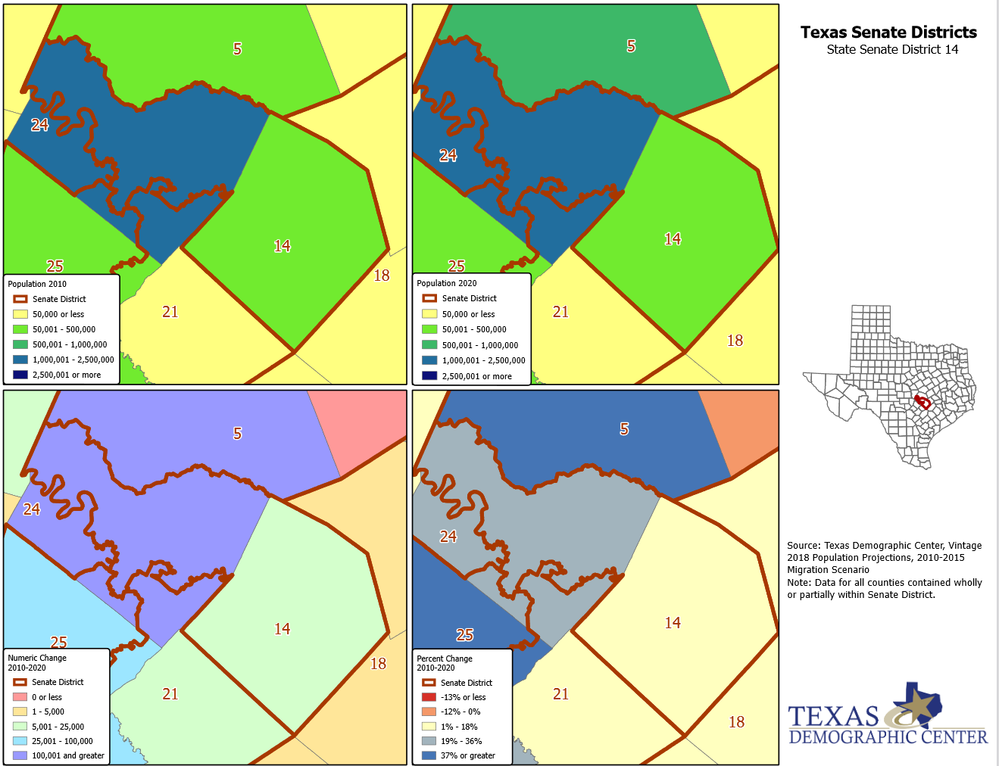
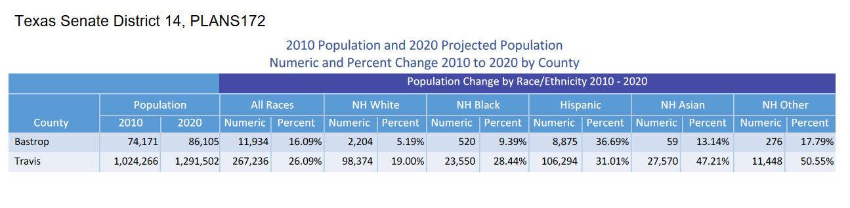
Texas Demographic Center Redistricting Resources
https://demographics.texas.gov/data/decennial/2020/RedistrictingResc

Slide 22

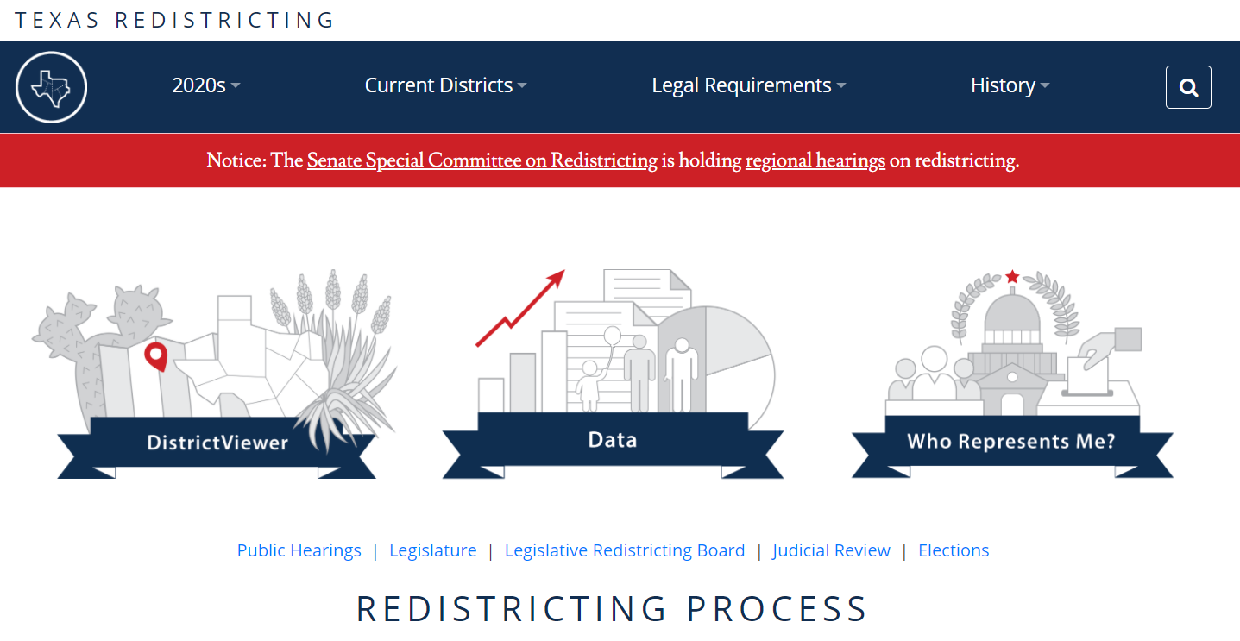
Additional Redistricting Resources
https://redistricting.capitol.texas.gov/
https://www.brennancenter.org/sites/default/files/2019-08/Report_CGR-2010-edition.pdf

Slide 23




Lila Valencia, Ph.D.
(512) 936-3542
Lila.Valencia@utsa.edu
demographics.texas.gov
@TexasDemography

