Slide 1
Census 2020 and Redistricting in Texas:
El Paso Area
Senate Redistricting Hearing
March 12, 2021
@TexasDemography

Slide 2
Census 2020
Census counts used to reapportion the U.S. House of Representatives, determining how many seats each state gets.
Census counts used by state officials to redraw congressional and state legislative boundaries to account for population shifts.
Census derived data are used to allocate over $1.5 trillion in federal funds to support healthcare, education, transportation, and other service programs.

Slide 3
Redistricting Dates
Apportionment File sent to POTUS on 12/31/2020- now by April 30, 2021
Redistricting Data File (Public Law 94-171 File) received by the Governor no later than April 1, 2021 - now by September 30, 2021
PL 94-171 released to states in groups of 8 states per week, with one week prior notice
PL 94-171 File to include:
Race, Hispanic origin, 18 and older, occupancy status, and group quarters by type.
Data available at WWW.CENSUS.GOV/RDO

Slide 4
Population Growth and Projected Congressional Seats of Select States
 | 2010 Population | 2020 Population | Numeric Change 2010-2020 | Percent Change 2010-2020 | Projected Congressional Seats Added
United States | 308,745,538 | 329,484,123 | 20,738,585 | 6.7%
Texas | 25,145,561 | 29,360,759 | 4,215,198 | 16.8% | 3
Florida | 18,801,310 | 21,733,312 | 2,932,002 | 15.6% | 2
North Carolina | 9,535,483 | 10,600,823 | 1,065,340 | 11.2% | 1
Arizona | 6,392,017 | 7,421,401 | 1,029,384 | 16.1% | 1
Colorado | 5,029,196 | 5,807,719 | 778,523 | 15.5% | 1
Oregon | 3,831,074 | 4,241,507 | 410,433 | 10.7% | 1
Montana | 989,415 | 1,080,577 | 91,162 | 9.2% | 1
California | 37,253,956 | 39,368,078 | 2,114,122 | 5.7% | -1
Minnesota | 5,303,925 | 5,657,342 | 353,417 | 6.7% | -1
Source: U.S. Census Bureau. 2010 Census Count, 2019 Population Estimates; Projected Seats- Brookings Institute.
Notes:
Texas is the second largest state in terms of population (2nd to CA) and area (2nd to AK). In terms of number of people, Texas’ growth exceeds that of all other states between 2010 and 2020. Texas has added over 4.2 million people between April 1, 2010 and July 1, 2020. This puts Texas on track to meet or surpass the number of people added in the last census when Texas gained 4 congressional seats. Projections from multiple sources anticipate Texas will gain 3 congressional districts after the 2020 census.

Slide 5
Linear Forecast of Census Bureau Population Estimates 2010-2020 and TDC Population Projections
Texas Senate District Size = 947,121 to 957,345
U.S. House Seat District Size (39 seats) = 753,840 to 760,966
Source: Texas Demographic Center 2018 Population Projections; Census Bureau 2020 Population Estimates
Notes:
The Texas Demographic Center produces population projections for the state. In comparing these projections, to the Census Bureau’s population estimates since 2010, we see the Texas Demographic Center is closely aligned with the Census Bureau estimates trend. TDC projections indicate Texas will grow to just under 29.7 million by 2020.

Slide 6
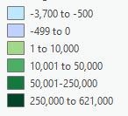
Numeric population change 2010-2019, Texas Counties with Current Texas Senate Districts
Source: U.S. Census Bureau. 2010 Census Count, 2019 Population Estimates

Slide 7
Numeric population change 2010-2019, Texas Counties with Current Texas Senate Districts
Source: U.S. Census Bureau. 2010 Census Count, 2019 Population Estimates

Slide 8
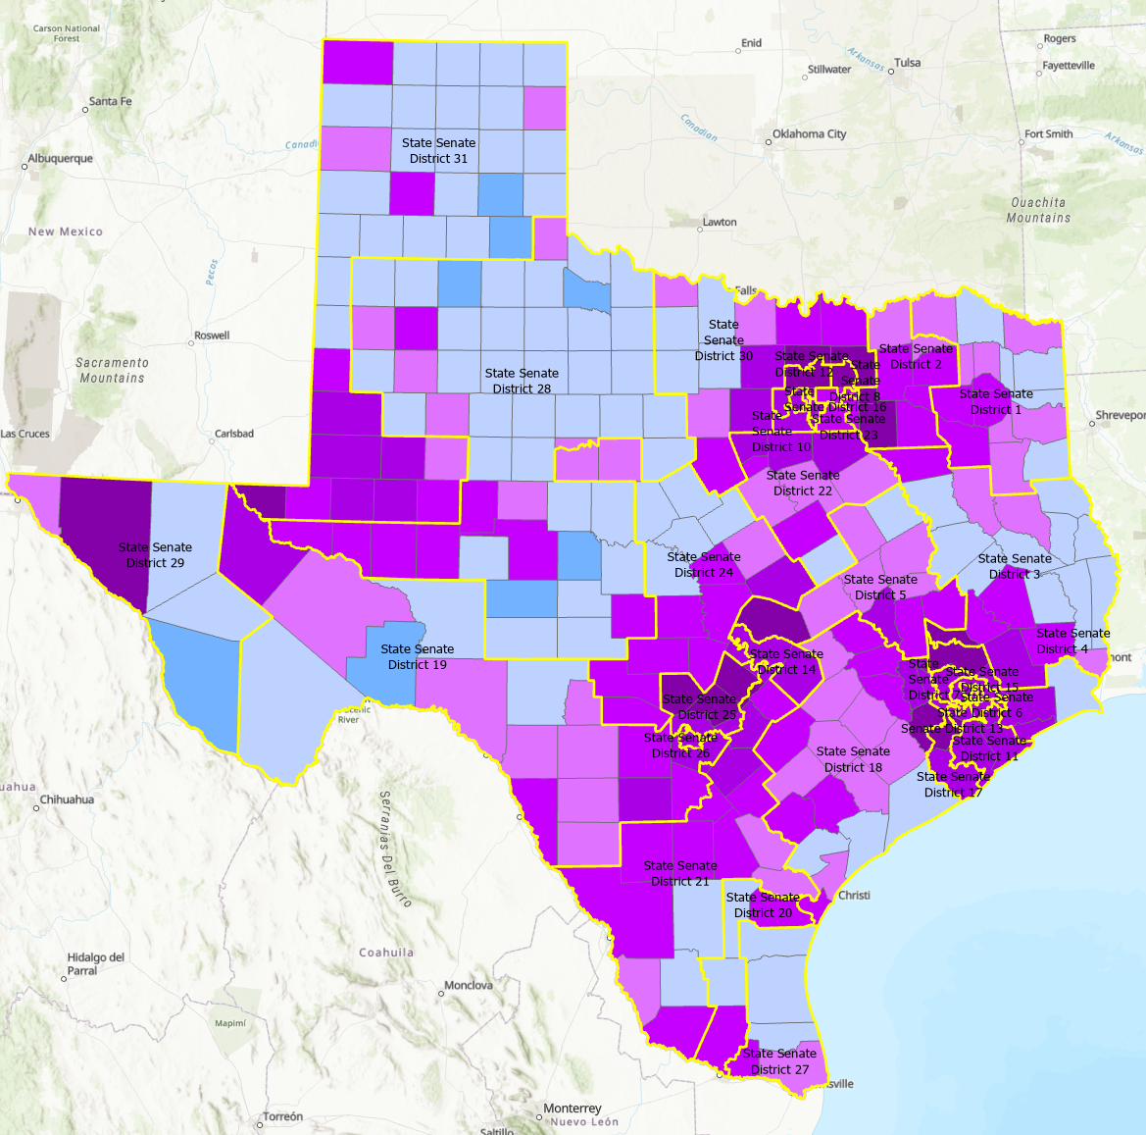
Percent population change 2010-2019, Texas Counties with Current Texas Senate Districts
Source: U.S. Census Bureau. 2010 Census Count, 2019 Population Estimates

Slide 9
Percent population change 2010-2019, Texas Counties with Current Texas Senate Districts
Source: U.S. Census Bureau. 2010 Census Count, 2019 Population Estimates

Slide 10
2010 Census Tracts (Red/Purple) and Proposed Census Tract Splits (Blue) for 2020

Slide 11
2010 Census Tracts (Red/Purple) and Proposed Census Tract Splits (Blue) for 2020

Slide 12
Projected Population by Race and Ethnicity, Texas 2010-2020
Source: Texas Demographic Center, 2018 Population Projections
Notes:
Population projections by race and ethnicity suggest that Latino’s are and will increasingly be the largest race/ethnic group. NH Black and NH Asian populations in Texas are projected to grow steadily. The non-Hispanic white population is projected to grow but at a slower pace.

Slide 13
Projected Population Change and Percent of Total Projected Change by Race/Ethnicity, 2010-2020, Texas
Source: Texas Demographic Center, 2018 Population Projections
Notes:
The bulk of the growth projected between 2010 and 2020 will come from growth among non-White populations, with only 16.4% coming from NH Whites.

Slide 14
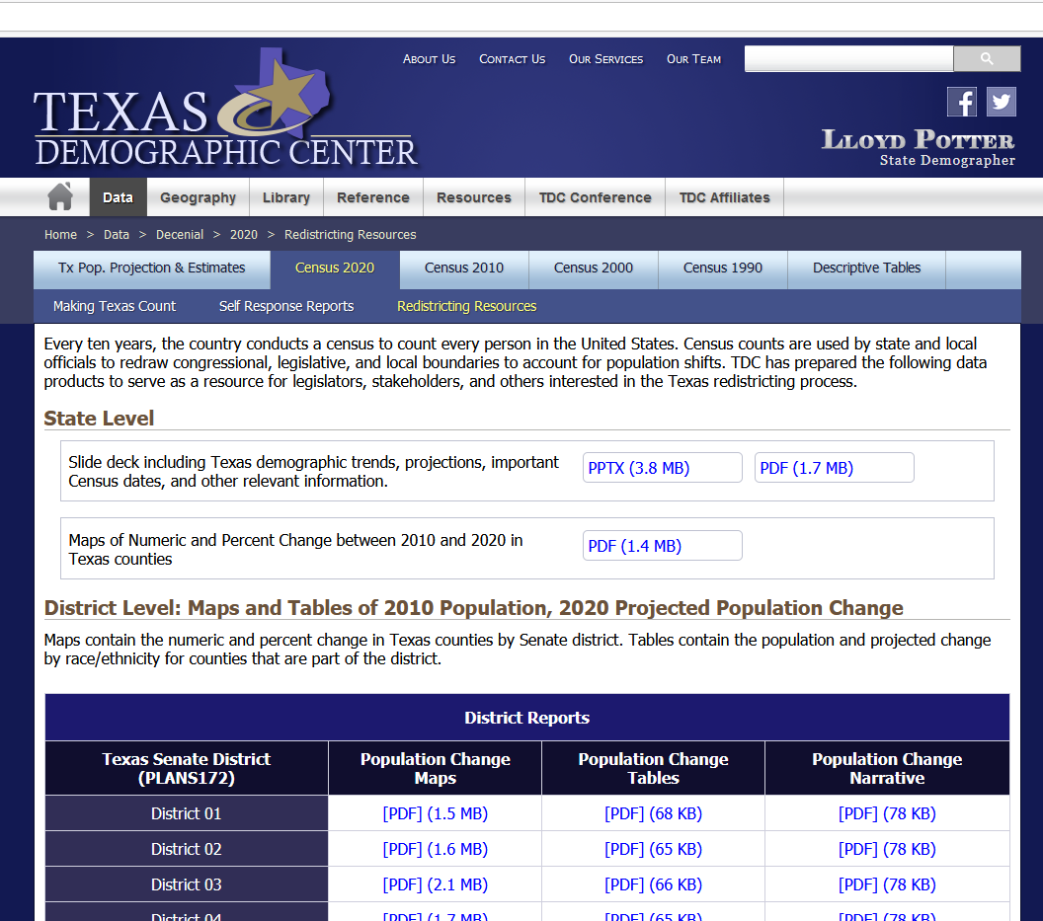
Texas Demographic Center Redistricting Resources
https://demographics.texas.gov/data/decennial/2020/RedistrictingResc

Slide 15
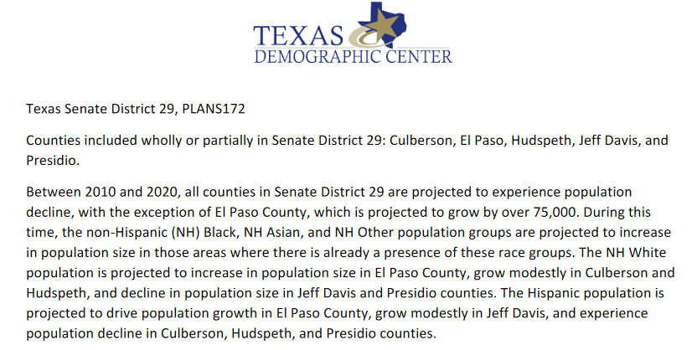
Texas Demographic Center Redistricting Resources
https://demographics.texas.gov/data/decennial/2020/RedistrictingResc

Slide 16
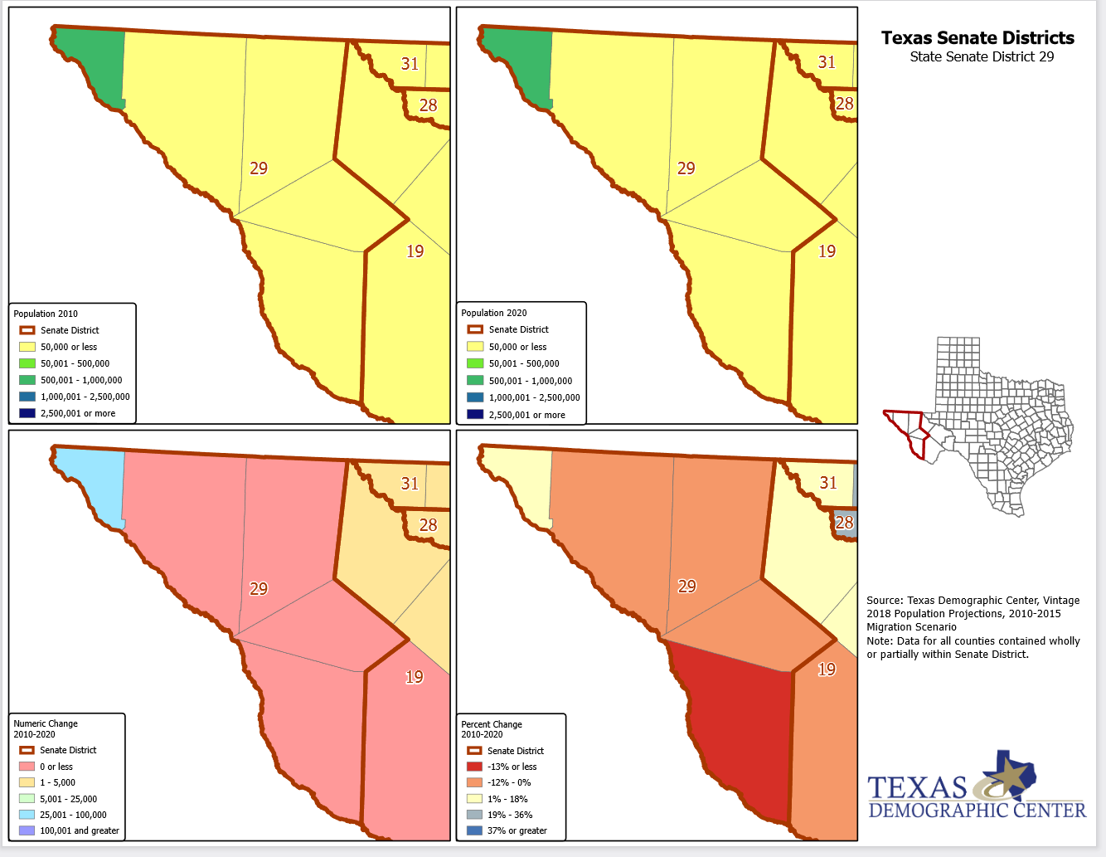
Texas Demographic Center Redistricting Resources
https://demographics.texas.gov/data/decennial/2020/RedistrictingResc

Slide 17
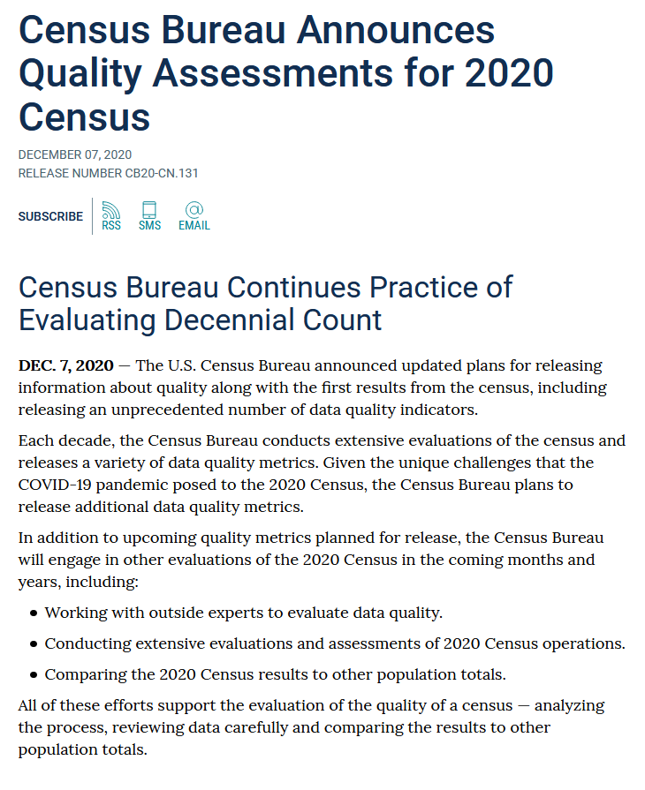
https://www.census.gov/newsroom/press-releases/2020/2020-census-quality-assessments.html

Slide 18
https://www.census.gov/programs-surveys/decennial-census/2020-census/planning-management/planning-docs/CQR-detailed-op-plan.html

Slide 19
Lloyd Potter
(210) 458-6530
Lloyd.Potter@utsa.edu
demographics.texas.gov
@TexasDemography

