Slide 1

Demographic Characteristics and Trends in Texas and the Dallas - Fort Worth Area
American Society of Civil Engineers – Dallas Branch
March 24, 2021

Slide 2
Redistricting Dates
Apportionment File sent to POTUS on 12/31/2020- now by April 30, 2021
Redistricting Data File (Public Law 94-171 File) received by the Governor no later than April 1, 2021 - now by September 30, 2021
PL 94-171 released to states in groups of 8 states per week, with one week prior notice
PL 94-171 File to include:
  Race, Hispanic origin, 18 and older, occupancy status, and group quarters by type.
Data available at WWW.CENSUS.GOV/RDO

Slide 3
Population Growth and Projected Congressional Seats of Select States
 | 2010 Population | 2020 Population | Numeric Change 2010-2020 | Percent Change 2010-2020 | Projected Congressional Seats Added
United States | 308,745,538 | 329,484,123 | 20,738,585 | 6.7%
Texas | 25,145,561 | 29,360,759 | 4,215,198 | 16.8% | 3
Florida | 18,801,310 | 21,733,312 | 2,932,002 | 15.6% | 2
North Carolina | 9,535,483 | 10,600,823 | 1,065,340 | 11.2% | 1
Arizona | 6,392,017 | 7,421,401 | 1,029,384 | 16.1% | 1
Colorado | 5,029,196 | 5,807,719 | 778,523 | 15.5% | 1
Oregon | 3,831,074 | 4,241,507 | 410,433 | 10.7% | 1
Montana | 989,415 | 1,080,577 | 91,162 | 9.2% | 1
California | 37,253,956 | 39,368,078 | 2,114,122 | 5.7% | -1
Minnesota | 5,303,925 | 5,657,342 | 353,417 | 6.7% | -1
Source: U.S. Census Bureau. 2010 Census Count, 2019 Population Estimates; Projected Seats- Brookings Institute.
Notes:
Texas is the second largest state in terms of population (2nd to CA) and area (2nd to AK). In terms of number of people, Texas’ growth exceeds that of all other states between 2010 and 2020. Texas has added over 4.2 million people between April 1, 2010 and July 1, 2020. This puts Texas on track to meet or surpass the number of people added in the last census when Texas gained 4 congressional seats. Projections from multiple sources anticipate Texas will gain 3 congressional districts after the 2020 census.

Slide 4
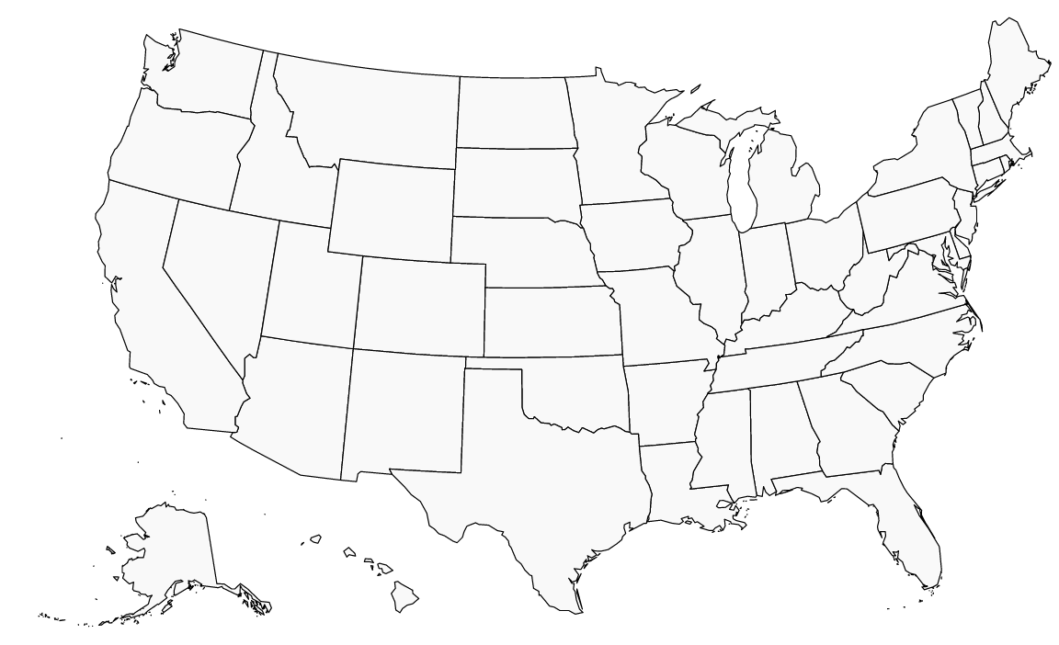
Texas makes up 8.9% of the total U.S. population in 2020
Texas accounted for 32.4% of the total growth between 2019 and 2020.
U.S. Estimated Population 2020: 329,484,123
Texas Estimated Population 2020:
29,360,759
Source: U.S. Census Bureau, 2020 Vintage population estimates
Note: These data are not from the 2020 Census, and estimates based indicators of population growth since the 2010 Census
Notes:
Texas is adding more population than any other state and growing faster than most states, with Utah growing faster than Texas between 2019 and 2020.

Slide 5

Estimated Population, Texas Counties, 2019
87% of the total Texas population is located in counties along and to the east of I-35
Total Estimated Population by County, 2019
Source: U.S. Census Bureau, 2019 Population Estimates
Notes:
When we look at the geographic distribution of the population of Texas over time we see continually increasing population in the counties along the I-35 corridor, the Houston area, and the lower Rio Grand Valley. Urbanized areas out west have grown but most counties in the west have experienced limited growth and some population decline. Approximately 86% of the population is along I-35 and east. This area with the 3 major metropolitan areas at the points is often described as the Texas population triangle.

Slide 6
Population Change, Texas Counties, 2010-2019
104 counties lost population between 2010 and 2019
Estimated Numeric Change by County, 2010-2019
Source: U.S. Census Bureau, 2019 Population Estimates
Notes:
Population change over the decade has been greatest in the urban and suburban population triangle counties. Counties in the lower Rio Grande Valley also had significant growth as did El Paso. Overall, 150 counties gained population while 104 (41%) lost population over the decade.

Slide 7
Percent Population Change, Texas Counties, 2010-2019
Suburban ring counties are among the fastest growing
Estimated Percent Change by County, 2010-2019
Source: U.S. Census Bureau, 2019 Population Estimates
Notes:
Percent change is an indicator of the speed of population change void of information about the volume of population change. Percent change in the population over the past few years has been greatest in the suburban population triangle counties, notably among counties between San Antonio and Austin. In the early part of the decade, counties in the Eagle Ford Shale area (south east of San Antonio) had been growing quickly. This is less so the case today. The Cline Shale area (Midland and Odessa area) continues to grow and in some cases even growing faster than the State.
The growth rate in the metro counties (82 counties) is 1.7 and in non-metro, or rural, counties it is .3. This means the metro county growth rate is 5.6 times that of the growth rate in non-metro, or rural, counties. At this rate, nearly 95% of the state’s population growth out to 2050 will occur in metro counties and less than 5% will occur in rural areas.

Slide 8
Texas added 367,215 people between July 1, 2018 and July 1, 2019.
About 1,006 people per day added to our population.
  About 483 persons per day from natural increase (more births than deaths)
  About 523 per day from net migration (178 international and 345 domestic migrants per day).
Source: U.S. Census Bureau, 2018 Population Estimates.
Notes:
The DFW metro area added 117,380 between 2018 and 2019, or about 322 people added per day. 139 from natural increase (or 43%), and 182 from net migration (or 57%). 127 from domestic migration and 55 from international migration.

Slide 9
Migration and natural increase contribute about equally to population growth in Texas.
Source: U.S. Census Bureau, 2019 Vintage population estimates
Notes:
Natural increase has been in the range of half of population change since the last Census in Texas. Thus Texas is growing quickly and substantially from having more births than deaths over time. In the last year, the number and percent of immigrants has declined and the number and percent of domestic migrants from other states has increased.
Between 2018-2019, Texas added about 1000 people per day. A little over half of these were added by net migration and the remainder added through natural increase.

Slide 10
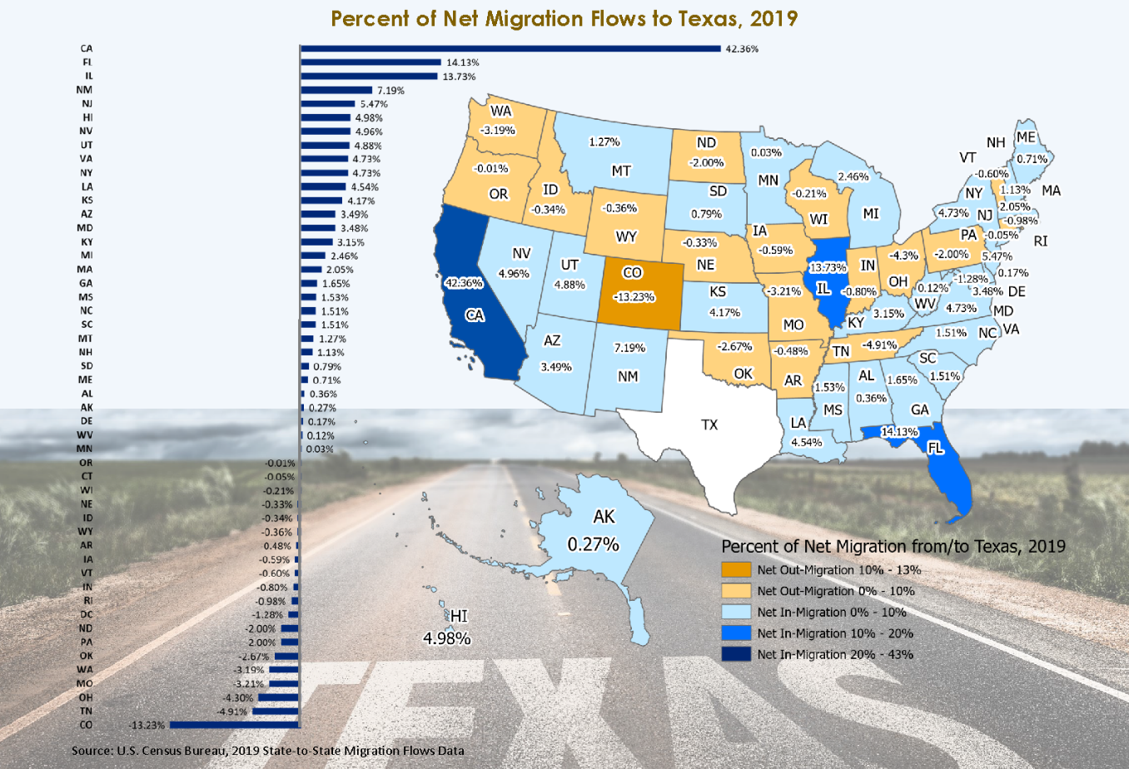
Source: U.S. Census Bureau, State to State Migration Flows, 2019; for infographic: https://demographics.texas.gov/Infographics/2020/TexasNetMigration
Notes:
CA, FL, and GA among biggest senders to Texas in 2019. CA, CO, and OK among biggest recipients of Texas movers. Receiving the largest net flow from Texas was CO, followed by TN and OH. CA sent largest share of net migrants to Texas, followed by FL and IL.

Slide 11
Top Counties for Numeric Growth in Texas, 2018-2019
County | US Rank | 2019 Population Estimate | Population Change 2018-2019 | Percent of Change from Natural Increase | Percent of Change from Domestic Migration | Percent of Change from International Migration
Harris | 3 | 4,713,325 | 33,280 | 116.5% | -91.5% | 74.8%
Collin | 4 | 1,034,730 | 30,423 | 20.8% | 65.6% | 13.5%
Denton | 5 | 887,207 | 28,466 | 19.8% | 74.0% | 5.8%
Travis | 6 | 1,273954 | 27,382 | 32.7% | 51.0% | 15.7%
Williamson | 9 | 590,551 | 24,088 | 15.3% | 81.0% | 3.3%
Fort Bend | 10 | 811,688 | 23,607 | 24.4% | 57.1% | 18.5%
Bexar | 11 | 2,003,554 | 22,367 | 56.0% | 33.5% | 10.5%
Tarrant | 12 | 2,102,515 | 21,069 | 65.1% | 12.1% | 23.0%
Montgomery | 16 | 607,391 | 17,621 | 18.3% | 76.2% | 5.3%
Comal | 46 | 156,209 | 8,068 | 4.3% | 94.2% | 1.1%
Kaufman | 49 | 136,154 | 7,875 | 9.4% | 90.5% | -0.1%
Bell | 53 | 362,924 | 7,527 | 48.3% | 49.8% | 1.5%
Hays | 54 | 230,191 | 7,485 | 19.9% | 76.8% | 2.8%
Hidalgo | 74 | 868,707 | 6,409 | 147.6% | -47.4% | -0.3%
Dallas | 77 | 2,635,516 | 6,166 | 345.9% | -395.5% | 149.9%
Harris, Dallas, and Hidalgo Counties had negative net migration
Source: US Census Bureau, 2018 Population Estimates

Slide 12
Top Counties for Percent Growth in Texas, 2018-2019*
County100 | US Rank | 2019 Population Estimate | Population Change 2018-2019 | Percent Population Change 2018-2019 | Percent of Population Change from Natural Increase | Percent of Population Change from Domestic Migration | Percent of Population Change from International Migration
Kaufman | 2 | 136,154 | 7,875 | 6.1% | 9.4% | 90.5% | -0.1%
Comal | 4 | 156,209 | 8,068 | 5.4% | 4.3% | 94.2% | 1.1%
Rockwall | 6 | 104,915 | 4,369 | 4.3% | 9.8% | 88.6% | 1.5%
Williamson | 9 | 590,551 | 24,088 | 4.3% | 15.3% | 81.0% | 3.3%
Kendall | 14 | 47,431 | 1,828 | 4.0% | 0.6% | 97.9% | 1.5%
Andrews | 18 | 18,705 | 694 | 3.9% | 14.0% | 84.0% | 2.0%
Chambers | 20 | 43,837 | 1,610 | 3.8% | 17.8% | 80.1% | 2.2%
Parker | 25 | 142,878 | 4,808 | 3.5% | 8.2% | 90.9% | 0.7%
Hays | 28 | 230,191 | 7,485 | 3.4% | 19.9% | 76.8% | 2.8%
Denton | 32 | 887,207 | 28,466 | 3.3% | 19.8% | 74.0% | 5.8%
Ellis | 34 | 184,826 | 5,820 | 3.3% | 16.0% | 83.2% | 0.7%
Waller | 36 | 55,246 | 1,734 | 3.2% | 20.0% | 78.4% | 1.4%
Gaines | 37 | 21,492 | 672 | 3.2% | 46.0% | 43.9% | 10.0%
Collin | 49 | 1,034,730 | 30,423 | 3.0% | 20.8% | 65.6% | 13.5%
Source: US Census Bureau, 2019 Population Estimates
*Among counties with populations of 10,000 or more in 2018

Slide 13
Top 15 Metros in Numeric Growth, 2010-2019
Rank | Name | April 1, 2010 | July 1, 2018 | July 1, 2019 | Numeric Change | Percent Change
1 | Dallas-Fort Worth-Arlington, TX | 6,366,537 | 7,455,756 | 7,573,136 | 1,206,599 | 19.0
2 | Houston-The Woodlands-Sugar Land, TX | 5,920,487 | 4,849,209 | 7,066,141 | 1,145,654 | 19.4
3 | Phoenix-Mesa-Chandler, AZ | 4,193,129 | 4,849,209 | 4,948,203 | 755,074 | 18.0
4 | Atlanta-Sandy Springs-Alpharetta, GA | 5,286,718 | 6,976,147 | 6,020,364 | 733,646 | 13.9
5 | Washington-Arlington-Alexandria, DC-VA-MD-WV | 5,649,688 | 5,945,303 | 6,280,487 | 630,799 | 11.2
6 | Miami-Fort Lauderdale-Pompano Beach, FL | 5,566,274 | 6,143,837 | 6,166,488 | 600,214 | 10.8
7 | Seattle-Tacoma-Bellevue, WA | 3,439,808 | 3,935,179 | 3,979,845 | 540,037 | 15.7
8 | Austin-Round Rock-Georgetown, TX | 1,716,323 | 2,165,497 | 2,227,083 | 510,760 | 29.8
9 | Orlando-Kissimmee-Sanford, FL | 2,134,399 | 2,574,838 | 2,608,147 | 473,748 | 22.2
10 | Riverside-San Bernardino-Ontario, CA | 4,224,948 | 4,612,542 | 4,650,631 | 425,683 | 10.1
11 | Denver-Aurora-Lakewood, CO | 2,543,608 | 2,931,665 | 2,967,239 | 423,631 | 16.7
12 | Tampa-St Petersburg-Clearwater, FL | 2,783,485 | 3,154,649 | 3,194,831 | 411,346 | 14.8
13 | San Antonio-New Braunfels, TX | 2,142,520 | 2,512,379 | 2,550,960 | 408,440 | 19.1
14 | San Francisco-Oakland-Berkeley, CA | 4,335,593 | 4,726,314 | 4,731,803 | 396,210 | 9.1
15 | Charlotte-Concord-Gastonia, NC-SC | 2,243,963 | 2,592,950 | 2,636,883 | 392,920 | 17.5
Source: US Census Bureau, 2019 Vintage Population Estimates
Notes:
Four of the top 15 metros in numeric growth are Texas metros, including the 1st and 2nd ranking metros

Slide 14
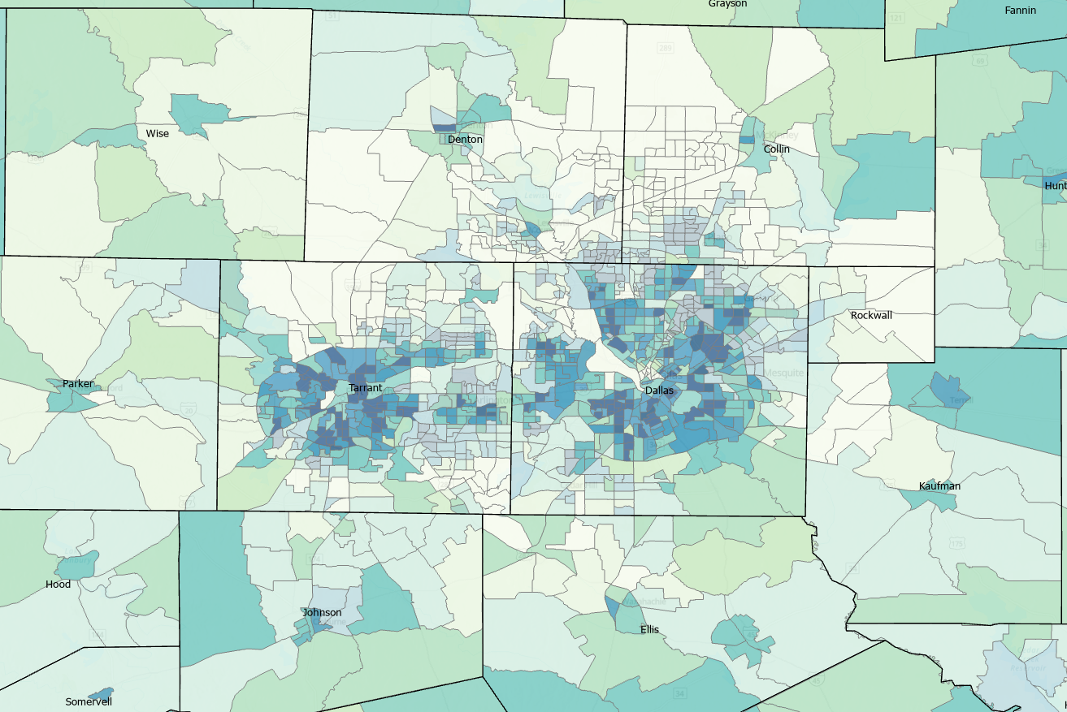
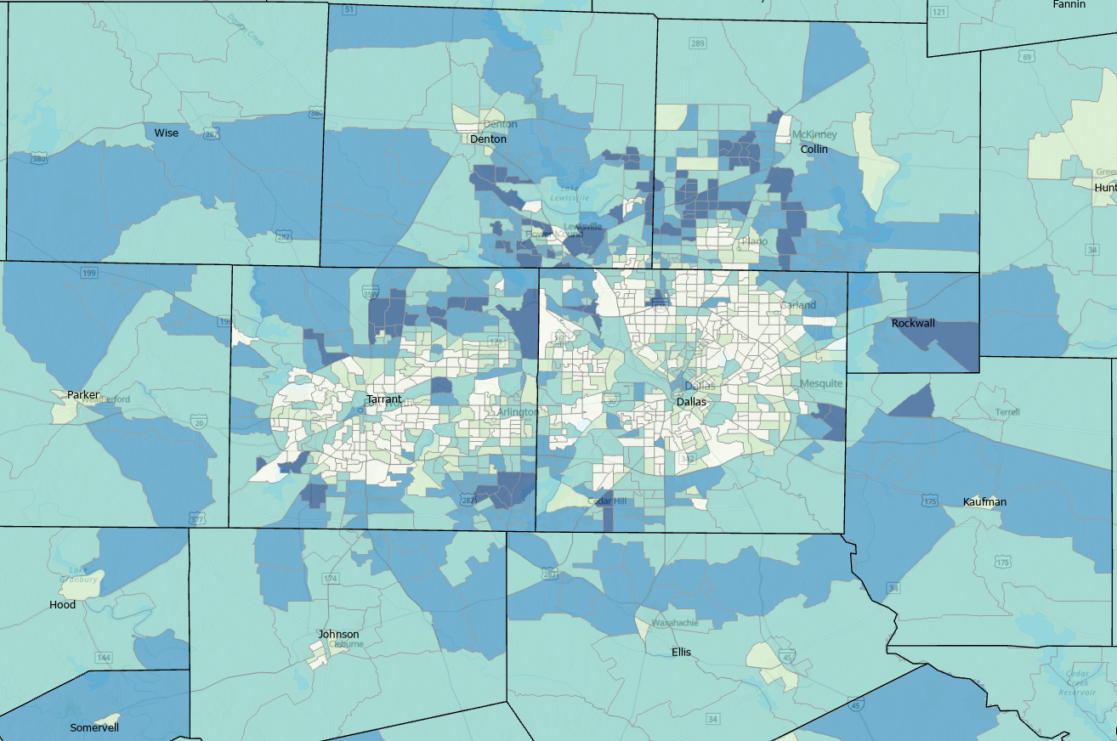

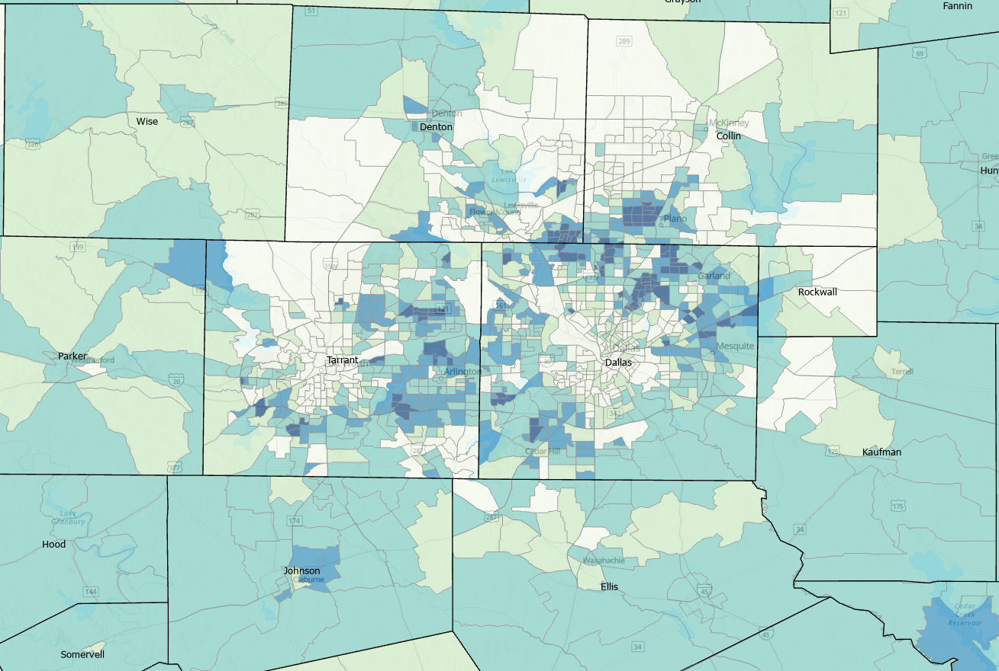
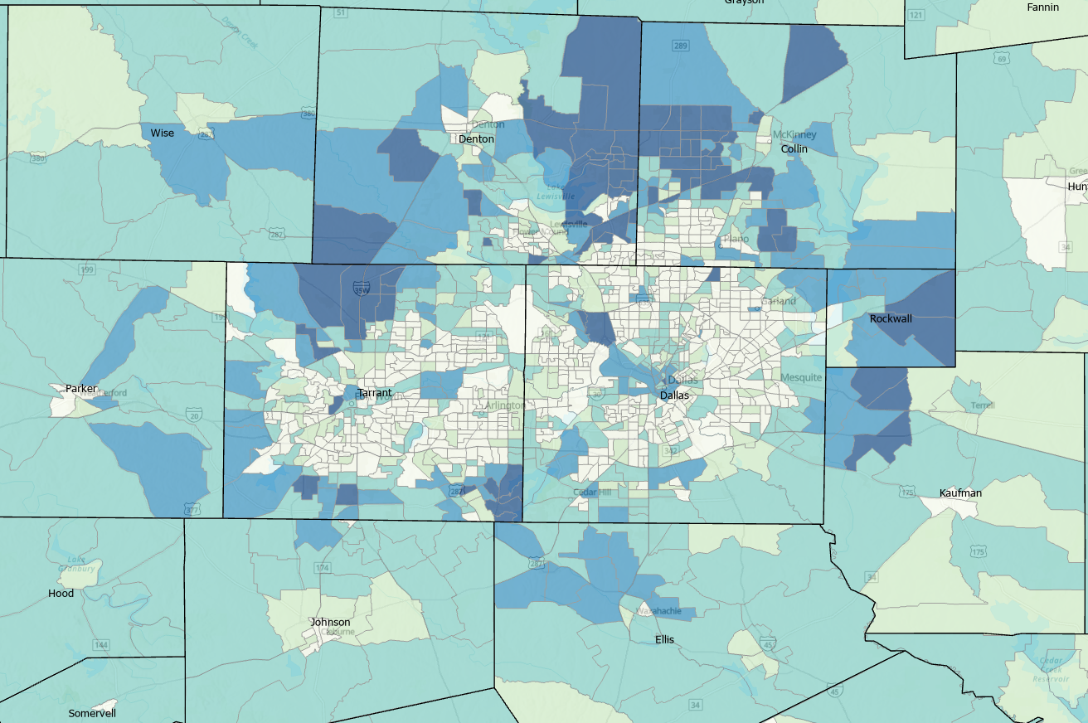
Percent of Housing Stock Built in Select Periods, Census Tracts, Texas, 2014-2019
1969 and before
1990-2009
1970-1989
2010-2019
Source: U.S. Census Bureau, American Community Survey, 5-Year Sample 2014-2019

Slide 15
Race/Ethnic Composition, Texas, 2010-2019
86.4% of growth has been from minority groups
Source: US Census Bureau 2019 Population Estimates

Slide 16
Annual Shares of Recent Immigrants to Texas by World Area of Birth, 2005-2015
Estimated number of international migrants to Texas
101,588
77,702
98,194
Source: US Census Bureau, American Community Survey, 1-Year PUMS

Slide 17
Texas Population Pyramid by Race/Ethnicity, 2019
Source: US Census Bureau, 2019 Population Estimates
Notes:
This population pyramid represents the age, sex, race and ethnic composition of the Texas population Blue represents males, red females, rows are single years of age, and shades represent specified race/ethnic groups as indicated in the legend

Slide 18
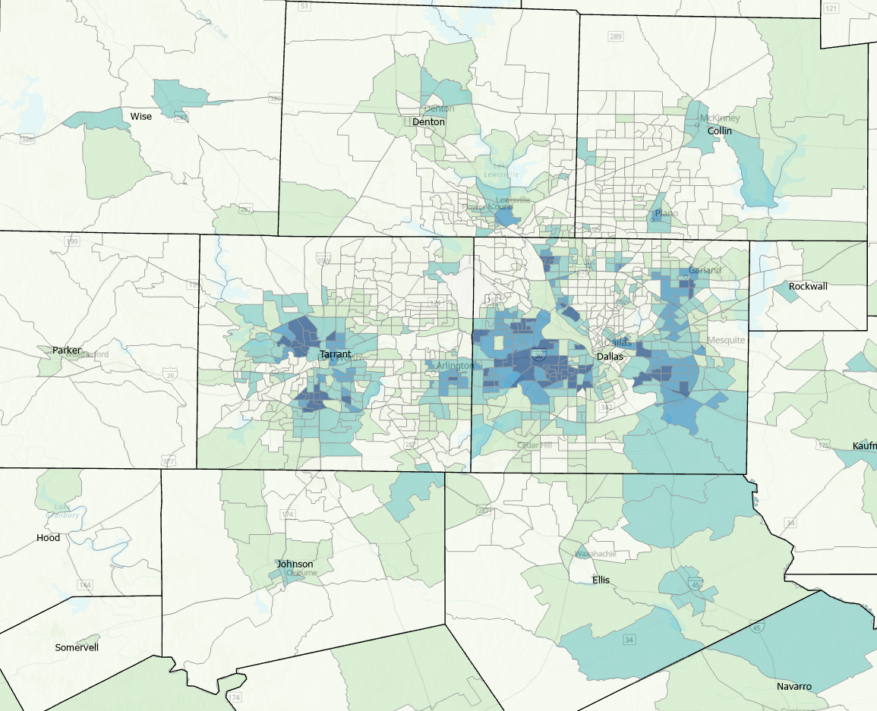

Percent of the Population that is Hispanic, Census Tracts, Texas, 2014-2019
Source: U.S. Census Bureau, American Community Survey, 5-Year Sample 2014-2019

Slide 19
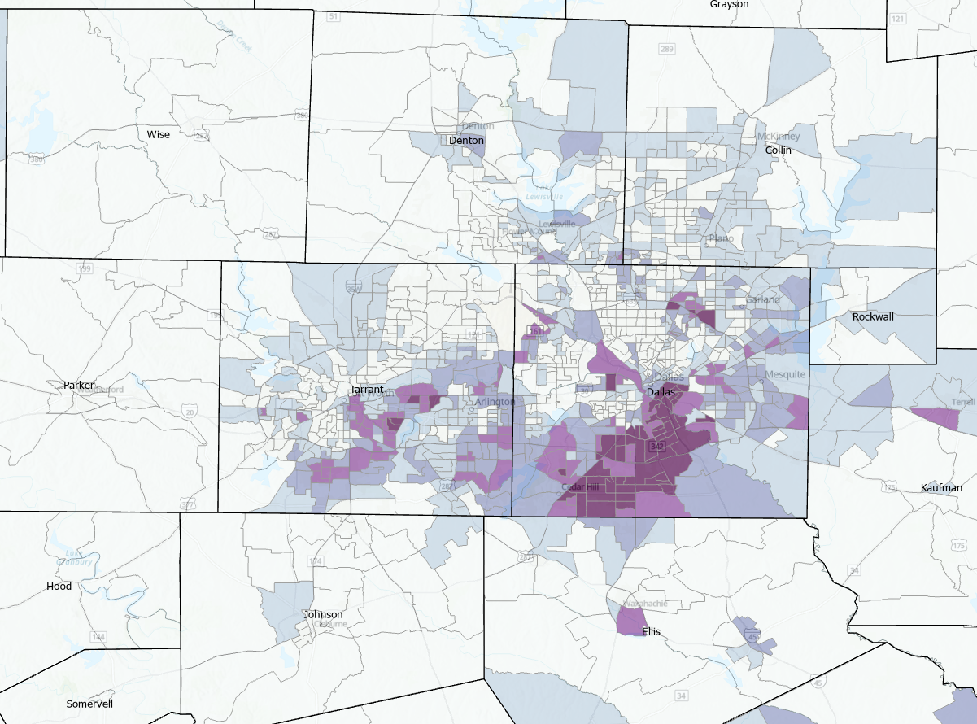

Percent of the Population that is Non-Hispanic Black, Census Tracts, Texas, 2014-2019
Source: U.S. Census Bureau, American Community Survey, 5-Year Sample 2014-2019

Slide 20
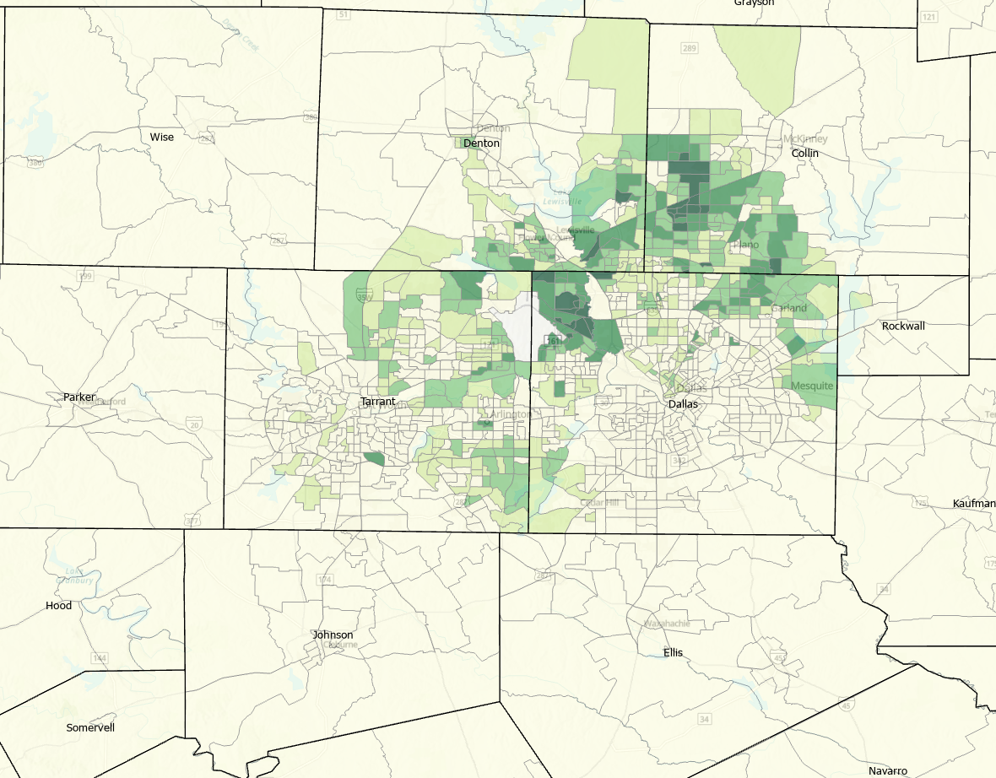

Percent of the Population that is Asian, Census Tracts, Texas, 2014-2019
Source: U.S. Census Bureau, American Community Survey, 5-Year Sample 2014-2019

Slide 21
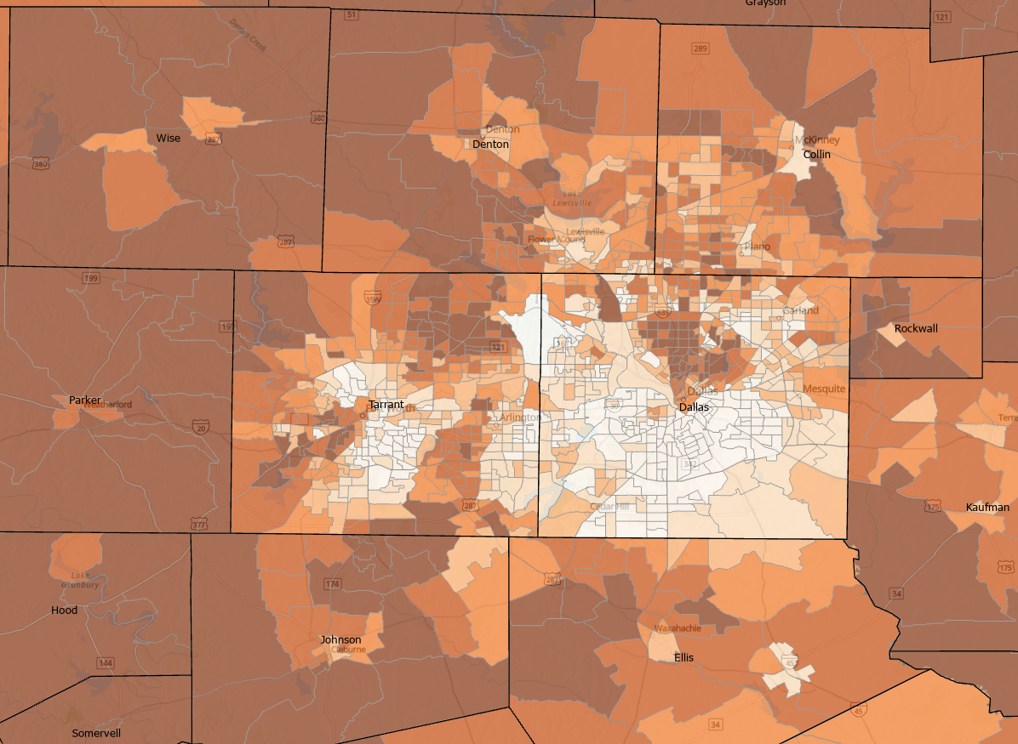
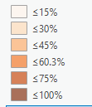
Percent of the Population that is Non-Hispanic White, Census Tracts, Texas, 2014-2019
Source: U.S. Census Bureau, American Community Survey, 5-Year Sample 2014-2019

Slide 22
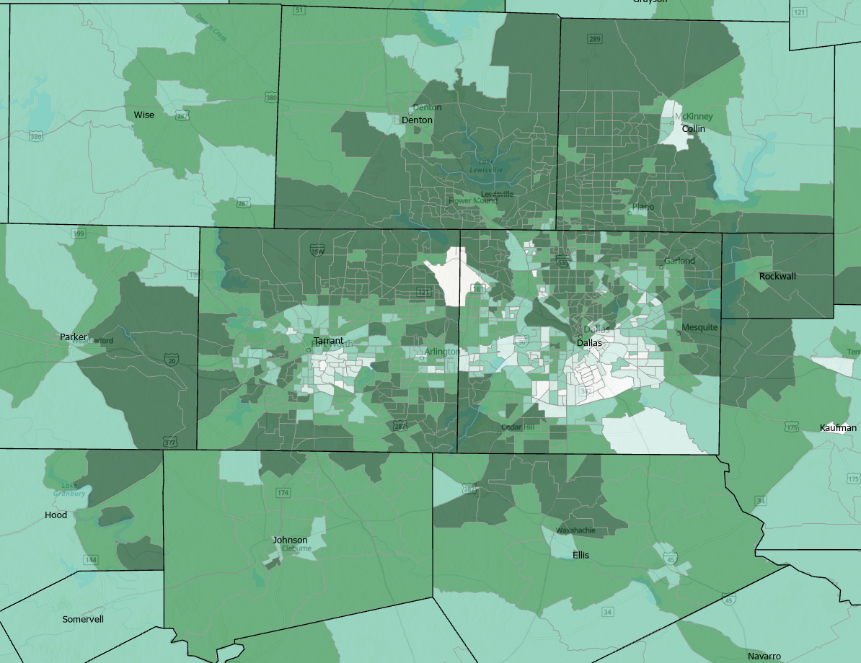

Percent of Households with Broadband Internet, Census Tracts, Texas, 2014-2019
Source: U.S. Census Bureau, American Community Survey, 5-Year Sample 2014-2019

Slide 23
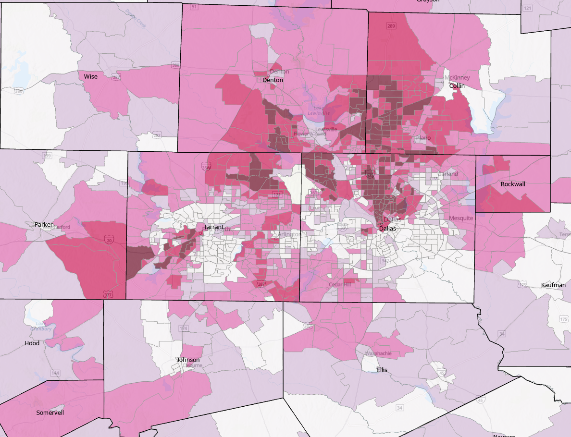

Percent of the Population that with a Bachelor’s Degree or Higher, Census Tracts, Texas, 2014-2019
Source: U.S. Census Bureau, American Community Survey, 5-Year Sample 2014-2019

Slide 24
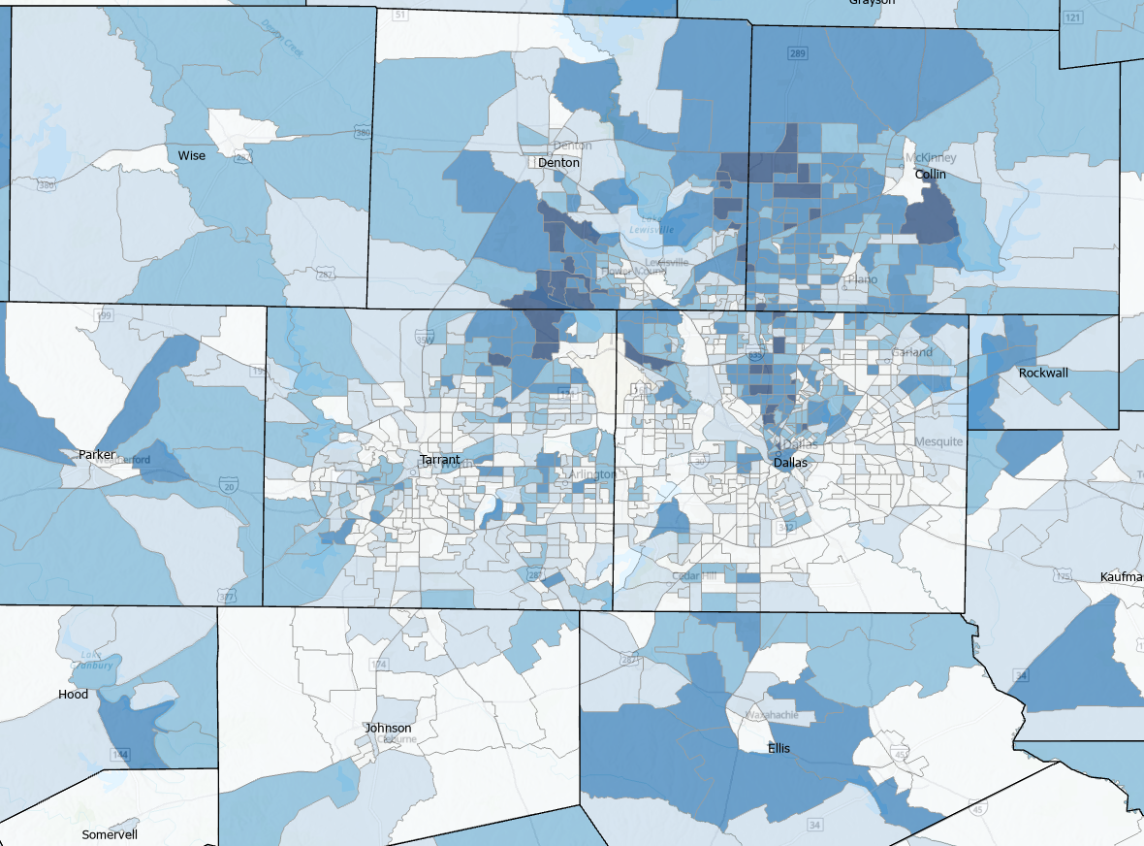
Percent of the Labor Force that Works from Home, Census Tracts, Texas, 2014-2019
Source: U.S. Census Bureau, American Community Survey, 5-Year Sample 2014-2019

Slide 25
Some adult in household substituted some or all of their typical in-person work for telework because of the coronavirus pandemic (December 9– December 21)
Source: U.S. Census Bureau Household Pulse Survey, Weeks 22

Slide 26
Some adult in household substituted some or all of their typical in-person work for telework because of the coronavirus pandemic
Source: U.S. Census Bureau Household Pulse Survey, Weeks 13-22

Slide 27
Texas Weekly Employment Estimate
Source: Federal Reserve Bank of Dallas
NOTE: Data for the weeks of December 26 and January 2 impacted by major holidays and may not be a good reflection of job changes

Slide 28
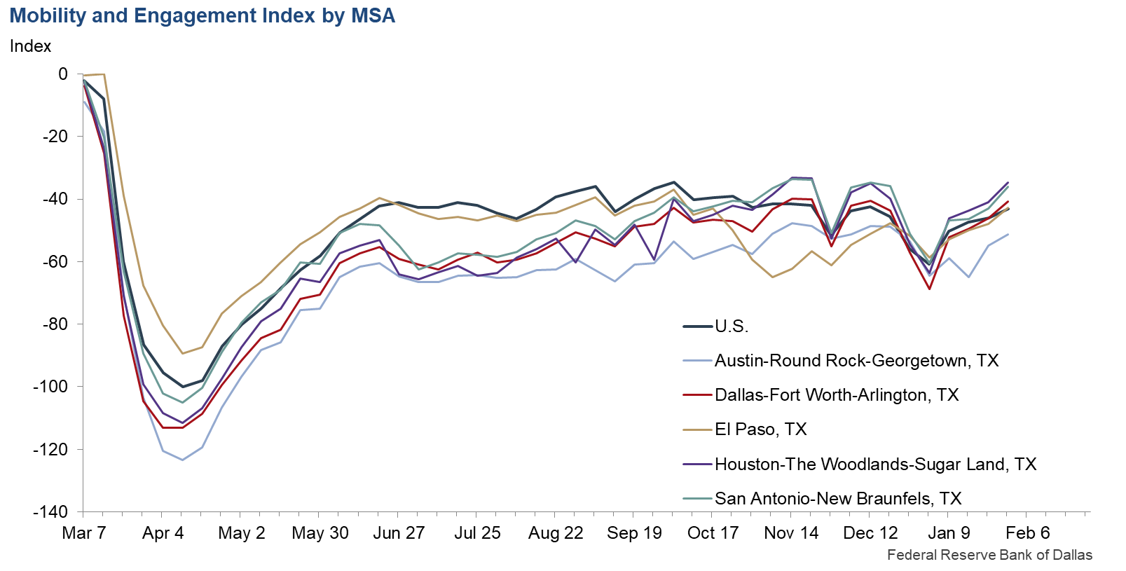
The MEI measures the deviation from normal mobility behaviors induced by COVID-19.
Notes:
The Dallas Fed Mobility and Engagement Index (MEI) summarizes the information in seven different variables based on geolocation data collected from a large sample of mobile devices to gain insight into the economic impact of the pandemic. The MEI measures the deviation from normal mobility behaviors induced by COVID-19.
The Mobility and Engagement Index is based on geolocation data collected from a large sample of mobile devices. MEI plummeted in mid-March, coinciding with a large drop in economic activity. Recently, the index has started to advance, even prior to the relaxation of stay-at-home orders. The uptick suggests economic activity may have bottomed out and could begin to improve.
Variables are:
- Fraction of devices leaving home in a day.
- Fraction of devices away from home for three to six hours at a fixed location.
- Fraction of devices away from home longer than six hours at a fixed location.
- An adjusted average of daytime hours spent at home.
- Fraction of devices taking trips longer than 16 kilometers (10 miles).
- Fraction of devices taking trips less than 2 kilometers (1.2 miles).
- Average time spent at locations far from home.

Slide 29
Projected Population, 2010-2050, Texas
Source: Texas Demographic Center, 2014 and 2018 Population Projections

Slide 30
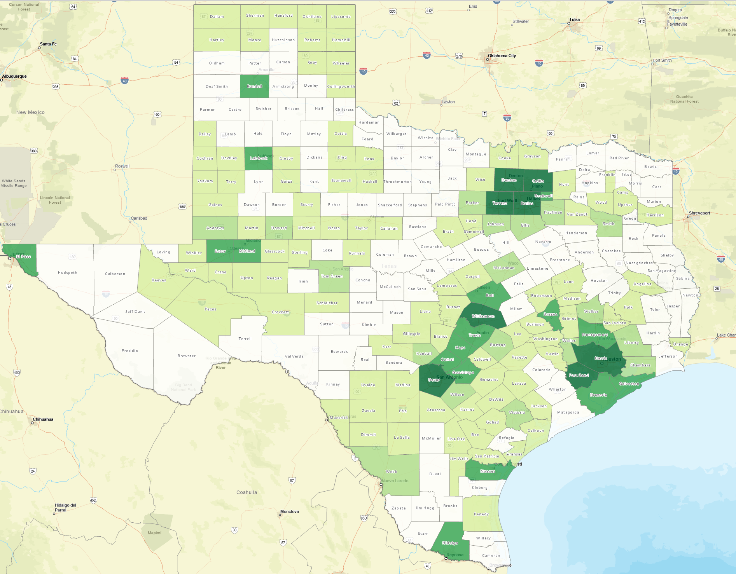
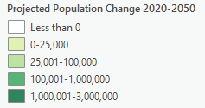
Projected Population Change, Texas Counties, 2020-2050
Source: Texas Demographic Center, 2018 Population Projections

Slide 31
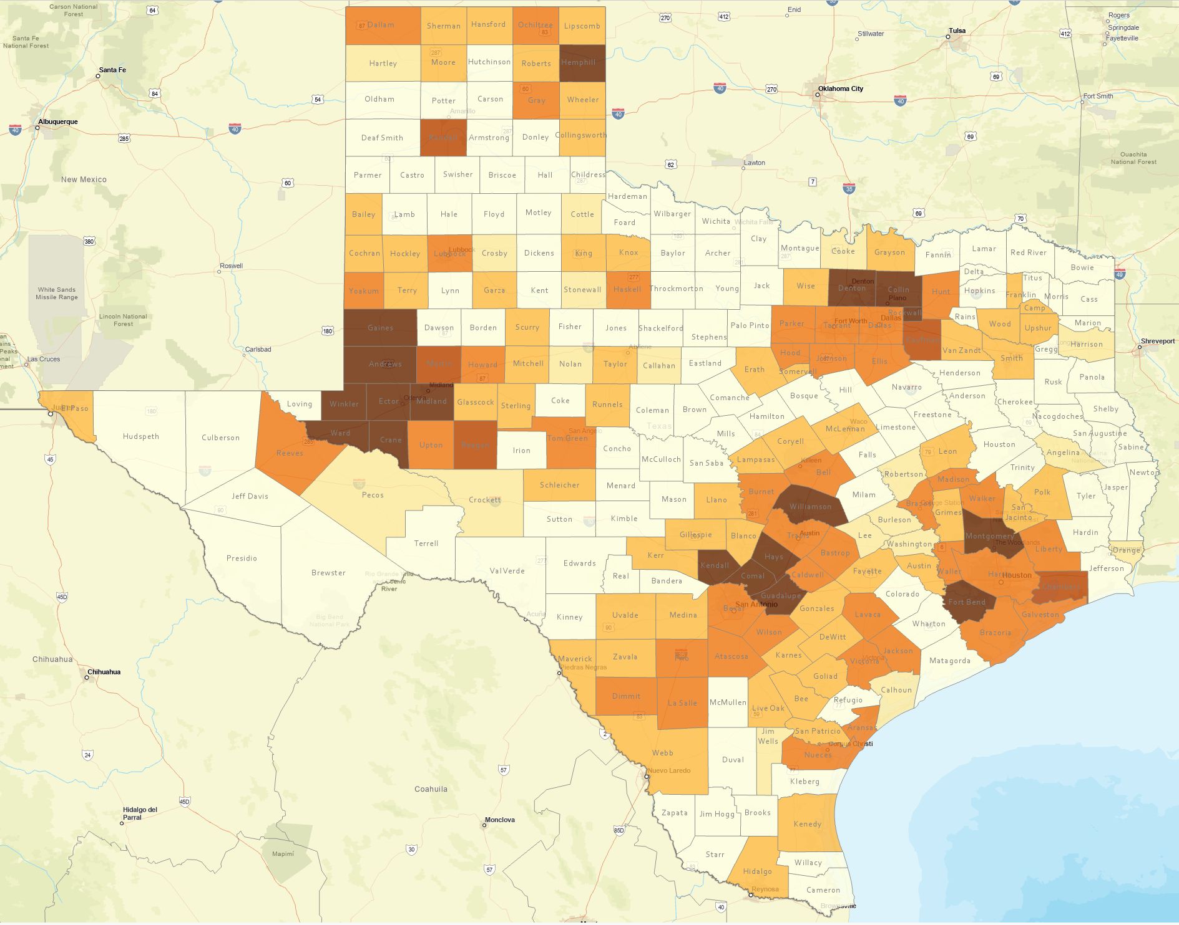
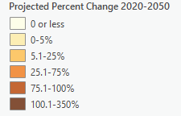
Projected Percent Population Change, Texas Counties, 2020-2050
Source: Texas Demographic Center, 2018 Population Projections

Slide 32
Population Projections, DFW Metro Largest Counties, 2010-2040
Source: Texas Demographic Center, 2018 Population Projections

Slide 33
Population Projections, DFW Metro Smaller Counties, 2010-2040
Source: Texas Demographic Center, 2018 Population Projections

Slide 34
Projected Population by Race and Ethnicity,
Texas 2010-2050
Source: Texas Demographic Center 2018 Population Projections
Notes:
Population projections by race and ethnicity suggest that Latino’s are and will increasingly be the largest race/ethnic group. The number and percent who are non-Hispanic white are likely to decline. Non-Hispanic other are largely of Asian descent and they appear to be increasing rapidly, although the base number is small.

Slide 35
Projected Population Change and Percent of Total Change by Race/Ethnicity, Texas, 2010-2030
Source: Texas Demographic Center 2018 Population Projections

Slide 36
Projected Numeric Change, DFW Metro, 2010 to 2030
Source: Texas Demographic Center, 2018 Population Projections

Slide 37




Lloyd Potter, PhD
(210) 458-6530
LloydPotter@UTSAedu
Demographics.Texas.gov
@TexasDemography

