Slide 1
Census 2020 and Redistricting in Texas:
San Antonio
Greater San Antonio Council of Texas Federation of Republican Women
May 5, 2021
@TexasDemography

Slide 2
Census 2020
Census counts used to reapportion the U.S. House of Representatives, determining how many seats each state gets.
Census counts used by state officials to redraw congressional and state legislative boundaries to account for population shifts.
Census derived data are used to allocate over $1.5 trillion in federal funds to support healthcare, education, transportation, and other service programs.

Slide 3
Redistricting Dates
Apportionment File sent to POTUS on April 26, 2021
Redistricting Data File (Public Law 94-171 File) received by the Governor no later than April 1, 2021 - now by September 30, 2021
PL 94-171 released to states in groups of 8 states per week, with one week prior notice
PL 94-171 File to include:
Race, Hispanic origin, 18 and older, occupancy status, and group quarters by type.
Data available at WWW.CENSUS.GOV/RDO

Slide 4
Population Growth and Congressional Seat Change
 | 2010 Population | 2020 Population | Numeric Change 2010-2020 | Percent Change 2010-2020 | Congressional Seat Change
United States | 308,745,538 | 331,449,281 | 22,703,743 | 7.4%
Texas | 25,145,561 | 29,145,505 | 3,999,944 | 15.90% | 2
Florida | 18,801,310 | 21,538,187 | 2,736,877 | 14.60% | 1
North Carolina | 9,535,483 | 10,439,388 | 903,905 | 9.50% | 1
Colorado | 5,029,196 | 5,773,714 | 744,518 | 14.80% | 1
Oregon | 3,831,074 | 4,237,256 | 406,182 | 10.60% | 1
Montana | 989,415 | 1,084,225 | 94,810 | 9.60% | 1
California | 37,253,956 | 39,538,223 | 2,284,267 | 6.10% | -1
New York | 19,378,102 | 20,201,249 | 823,147 | 4.20% | -1
Pennsylvania | 12,702,379 | 13,002,700 | 300,321 | 2.40% | -1
Ohio | 11,536,504 | 11,799,448 | 262,944 | 2.30% | -1
Michigan | 9,883,640 | 10,077,331 | 193,691 | 2.00% | -1
Illinois | 12,830,632 | 12,812,508 | -18,124 | -0.10% | -1
West Virginia | 1,852,994 | 1,793,716 | -59,278 | -3.20% | -1
Source: U.S. Census Bureau. 2010 and 2020 Census Count
Notes:
Texas is the second largest state in terms of population (2nd to CA) and area (2nd to AK). In terms of number of people, Texas’ growth exceeds that of all other states between 2010 and 2020. Texas has added over 4.2 million people between April 1, 2010 and July 1, 2020. This puts Texas on track to meet or surpass the number of people added in the last census when Texas gained 4 congressional seats. Projections from multiple sources anticipate Texas will gain 3 congressional districts after the 2020 census.

Slide 5
Ideal Size of Texas Senate, House, and U.S. Congressional Districts
Texas Senate District Size (31 seats) = 940,178 (811,147 in 2010)
Texas House District Size (150 seats) = 194,303 (167,637 in 2010)
U.S. House Seat District Size (38 seats) = 766,987 (698,488 in 2010 – 36 seats)
+ 3,999,944
Source: Census Bureau 2010 and 2020 Census Counts
Notes:
The Texas Demographic Center produces population projections for the state. In comparing these projections, to the Census Bureau’s population estimates since 2010, we see the Texas Demographic Center is closely aligned with the Census Bureau estimates trend. TDC projections indicate Texas will grow to just under 29.7 million by 2020.

Slide 6
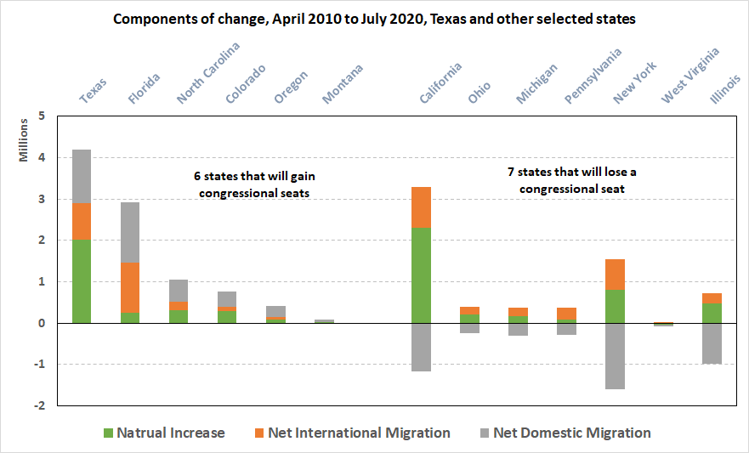
Source: U.S. Census Bureau. 2020 Vintage Population Estimates

Slide 7
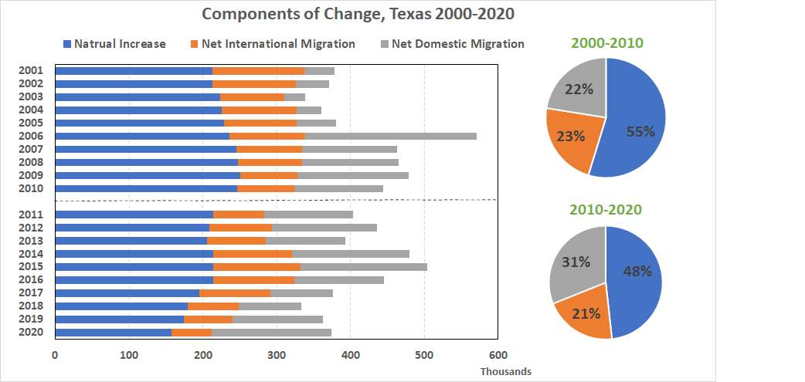
Source: U.S. Census Bureau. 2010 and 2020 Vintage Population Estimates

Slide 8
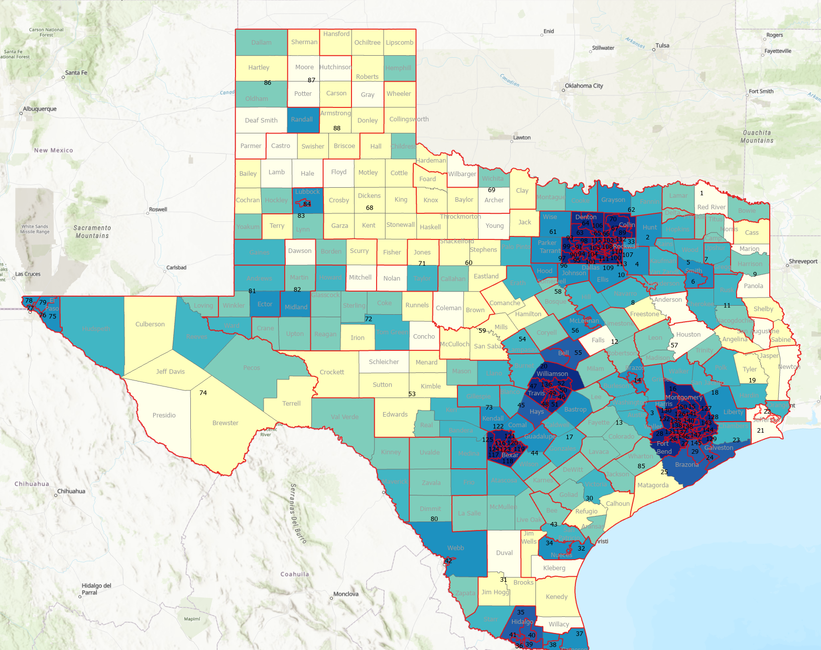
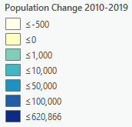
Numeric population change 2010-2019, Texas Counties with Current Texas House Districts
104 counties lost population over the 9 year period
Source: U.S. Census Bureau. 2010 Census Count, 2019 Population Estimates

Slide 9
Numeric population change 2010-2019, Texas Counties with Current Texas House Districts
104 counties lost population over the 9 year period
Source: U.S. Census Bureau. 2010 Census Count, 2019 Population Estimates

Slide 10
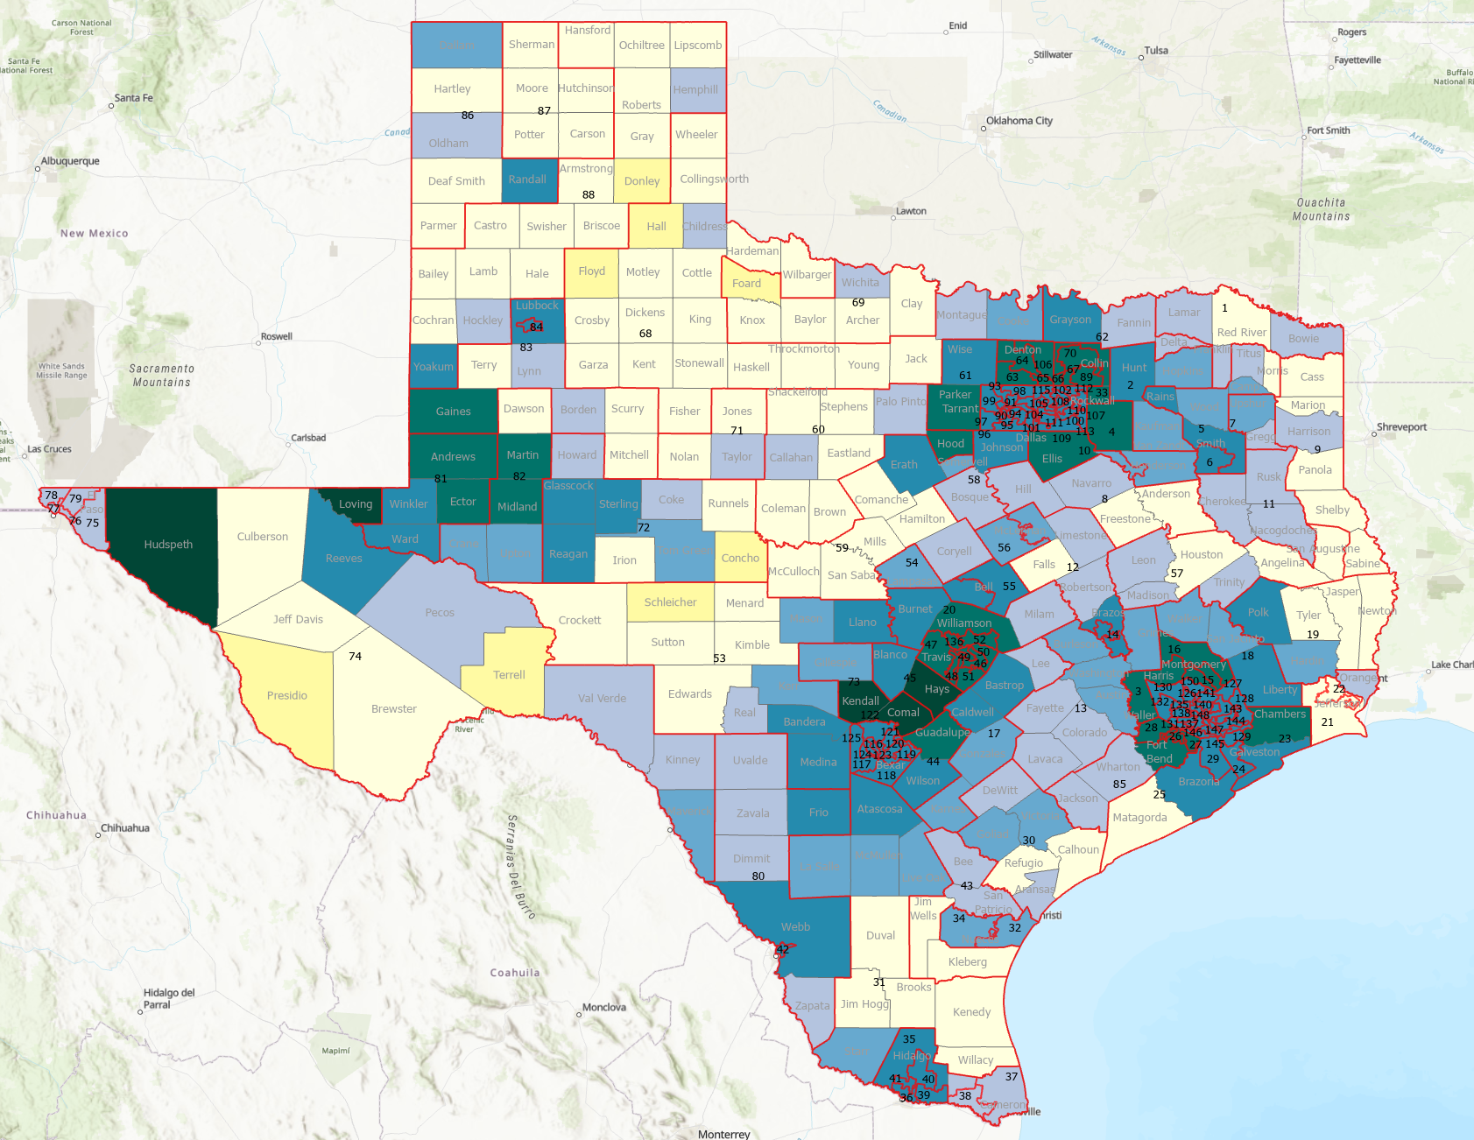
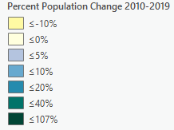
Percent population change 2010-2019, Texas Counties with Current Texas House Districts
Source: U.S. Census Bureau. 2010 Census Count, 2019 Population Estimates

Slide 11
Percent population change 2010-2019, Texas Counties with Current Texas House Districts
Source: U.S. Census Bureau. 2010 Census Count, 2019 Population Estimates

Slide 12
Top 15 Metros in Numeric Growth, 2010-2019
Rank | Name | April 1, 2010 | July 1, 2018 | July 1, 2019 | Numeric Change | Percent Change
1 | Dallas-Fort Worth-Arlington, TX | 6,366,537 | 7,455,756 | 7,573,136 | 1,206,599 | 19.0
2 | Houston-The Woodlands-Sugar Land, TX | 5,920,487 | 4,849,209 | 7,066,141 | 1,145,654 | 19.4
3 | Phoenix-Mesa-Chandler, AZ | 4,193,129 | 4,849,209 | 4,948,203 | 755,074 | 18.0
4 | Atlanta-Sandy Springs-Alpharetta, GA | 5,286,718 | 6,976,147 | 6,020,364 | 733,646 | 13.9
5 | Washington-Arlington-Alexandria, DC-VA-MD-WV | 5,649,688 | 5,945,303 | 6,280,487 | 630,799 | 11.2
6 | Miami-Fort Lauderdale-Pompano Beach, FL | 5,566,274 | 6,143,837 | 6,166,488 | 600,214 | 10.8
7 | Seattle-Tacoma-Bellevue, WA | 3,439,808 | 3,935,179 | 3,979,845 | 540,037 | 15.7
8 | Austin-Round Rock-Georgetown, TX | 1,716,323 | 2,165,497 | 2,227,083 | 510,760 | 29.8
9 | Orlando-Kissimmee-Sanford, FL | 2,134,399 | 2,574,838 | 2,608,147 | 473,748 | 22.2
10 | Riverside-San Bernardino-Ontario, CA | 4,224,948 | 4,612,542 | 4,650,631 | 425,683 | 10.1
11 | Denver-Aurora-Lakewood, CO | 2,543,608 | 2,931,665 | 2,967,239 | 423,631 | 16.7
12 | Tampa-St Petersburg-Clearwater, FL | 2,783,485 | 3,154,649 | 3,194,831 | 411,346 | 14.8
13 | San Antonio-New Braunfels, TX | 2,142,520 | 2,512,379 | 2,550,960 | 408,440 | 19.1
14 | San Francisco-Oakland-Berkeley, CA | 4,335,593 | 4,726,314 | 4,731,803 | 396,210 | 9.1
15 | Charlotte-Concord-Gastonia, NC-SC | 2,243,963 | 2,592,950 | 2,636,883 | 392,920 | 17.5
Source: US Census Bureau, 2019 Vintage Population Estimates
Notes:
Four of the top 15 metros in numeric growth are Texas metros, including the 1st and 2nd ranking metros

Slide 13
Projected Population by Race and Ethnicity, Texas 2010-2020
Source: Texas Demographic Center, 2018 Population Projections
Notes:
Population projections by race and ethnicity suggest that Latino’s are and will increasingly be the largest race/ethnic group. NH Black and NH Asian populations in Texas are projected to grow steadily. The non-Hispanic white population is projected to grow but at a slower pace.

Slide 14
Projected Population Change and Percent of Total Projected Change by Race/Ethnicity, 2010-2020, Texas
Source: Texas Demographic Center, 2018 Population Projections
Notes:
The bulk of the growth projected between 2010 and 2020 will come from growth among non-White populations, with only 16.4% coming from NH Whites.

Slide 15
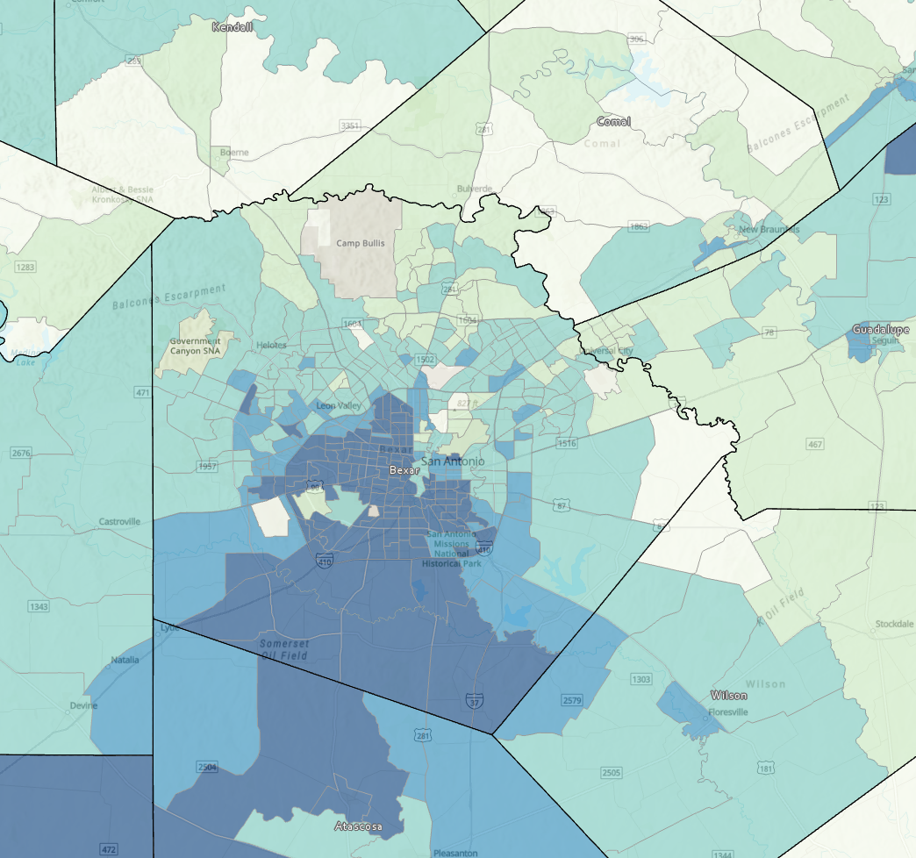
Percent of population that are Hispanic, Bexar County Census Tracts, 2015-2019
Source: US Census Bureau, American Community Survey, 5-Year Sample, 2015-2019

Slide 16
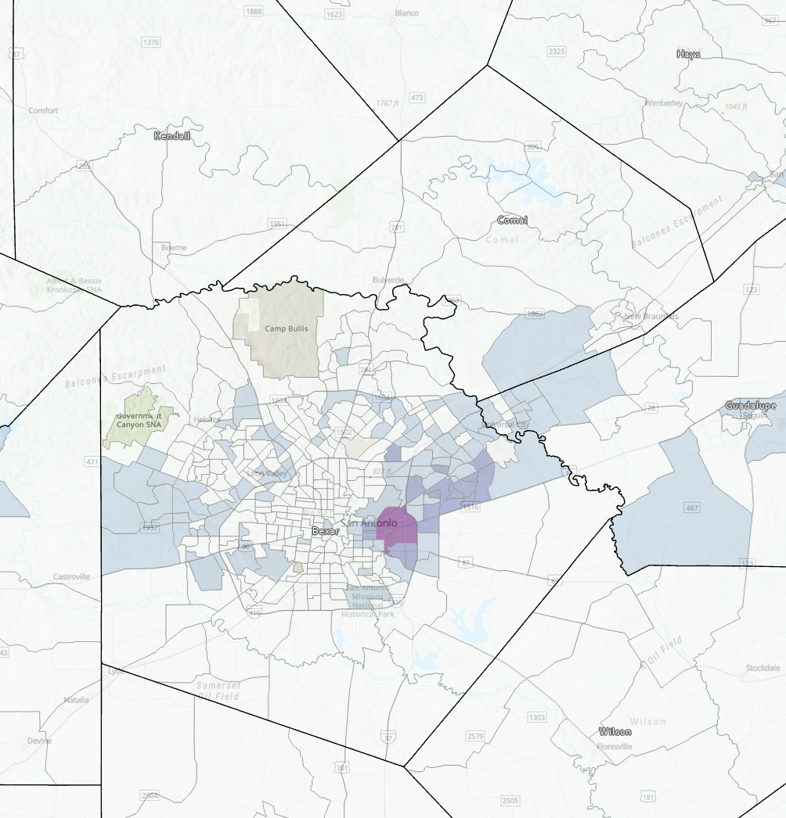
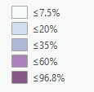
Percent of population that is non-Hispanic Black, Bexar County , Texas, Census Tracts, 2015-2019
Source: US Census Bureau, American Community Survey, 5-Year Sample, 2015-2019

Slide 17
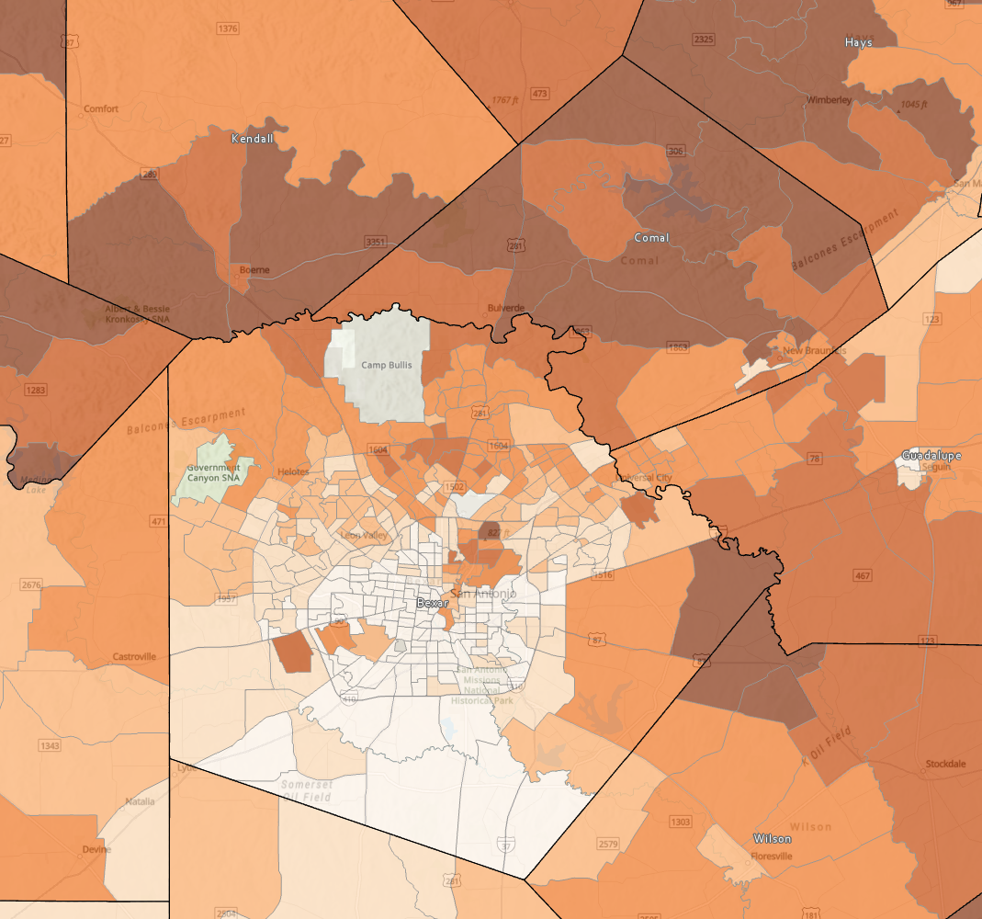
Percent of population that is non-Hispanic White, Bexar County , Texas, Census Tracts, 2015-2019
Source: US Census Bureau, American Community Survey, 5-Year Sample, 2015-2019

Slide 18
Population and Race/ethnicity, San Antonio, Bexar County, Texas, 2019
 | Texas | Bexar County | San Antonio
Population per square mile, 2010 | 96.3 | 1,383.10 | 2,879.80
Population, July 1, 2019, | 28,995,881 | 2,003,554 | 1,547,253
Population, April 1, 2010, | 25,146,091 | 1,714,781 | 1,326,161
Percent change - April 1, 2010 to July 1, 2019 | 15.30% | 16.80% | 16.70%
Source: US Census Bureau, Population Estimates, 2019
 | Texas | Bexar County | San Antonio
Race and Hispanic Origin
Black or African American alone, | 12.90% | 8.60% | 7.00%
American Indian and Alaska Native alone, percent | 1.00% | 1.20% | 0.80%
Asian alone, percent | 5.20% | 3.30% | 2.80%
Hispanic or Latino, percent | 39.70% | 60.70% | 64.20%
White alone, not Hispanic or Latino, percent | 41.20% | 27.10% | 24.70%
Source: US Census Bureau, American Community Survey, 1-Year Sample2019

Slide 19
Education and Income, San Antonio, Bexar County, Texas, 2019
Education | Texas | Bexar County | San Antonio
High school graduate or higher, percent of persons age 25 years+, 2015-2019 | 83.70% | 84.20% | 82.40%
Bachelor's degree or higher, percent of persons age 25 years+, 2015-2019 | 29.90% | 28.00% | 26.00%
Health
With a disability, under age 65 years, percent, 2015-2019 | 7.90% | 10.60% | 11.10%
Persons without health insurance, under age 65 years, percent | 20.80% | 17.80% | 18.70%
Income & Poverty | Texas | Bexar County | San Antonio
Median household income (in 2019 dollars), 2015-2019 | $61,874 | $57,157 | $52,455
Per capita income in past 12 months (in 2019 dollars), 2015-2019 | $31,277 | $27,834 | $25,894
Persons in poverty, percent | 13.60% | 15.20% | 17.80%
Source: US Census Bureau, American Community Survey, 1-Year Sample, 2019

Slide 20
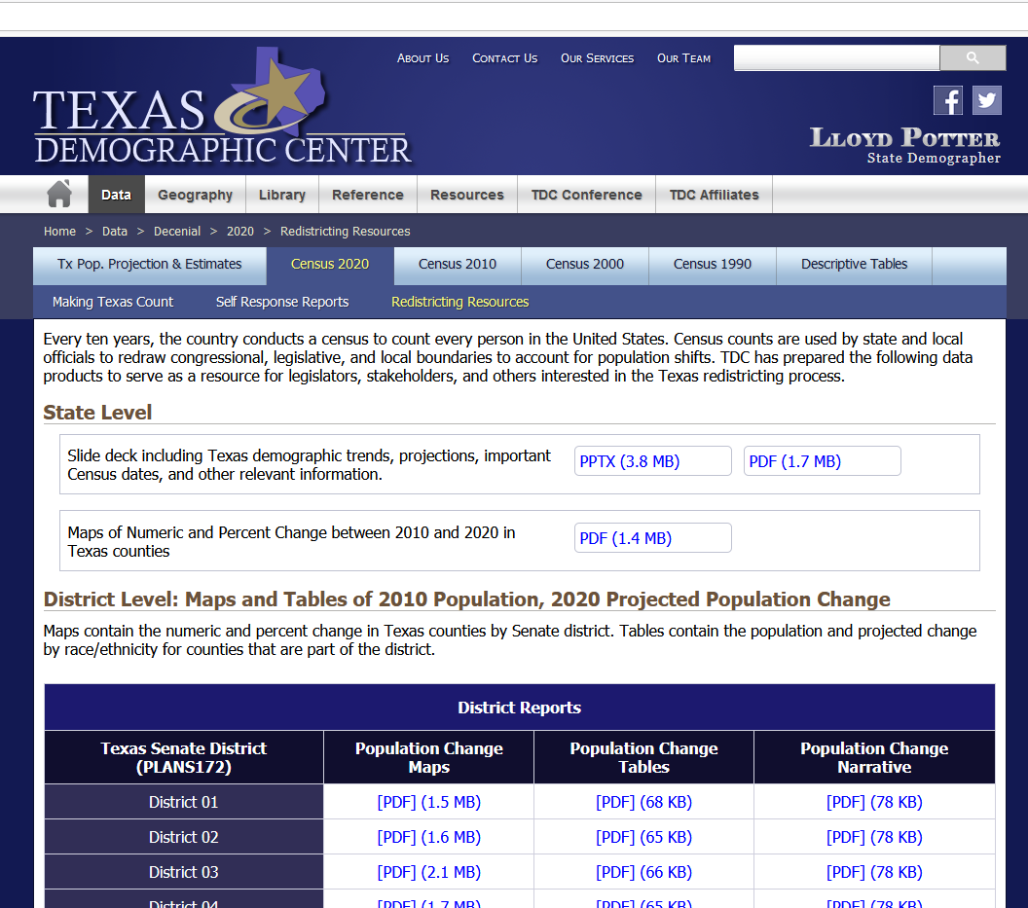
Texas Demographic Center Redistricting Resources
https://demographics.texas.gov/data/decennial/2020/RedistrictingResc

Slide 21
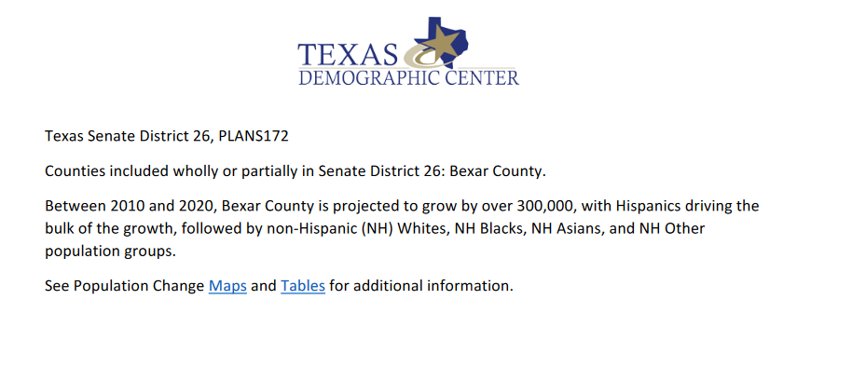
Texas Demographic Center Redistricting Resources
https://demographics.texas.gov/data/decennial/2020/RedistrictingResc
Source: Texas Demographic Center, 2018 Population Projections

Slide 22
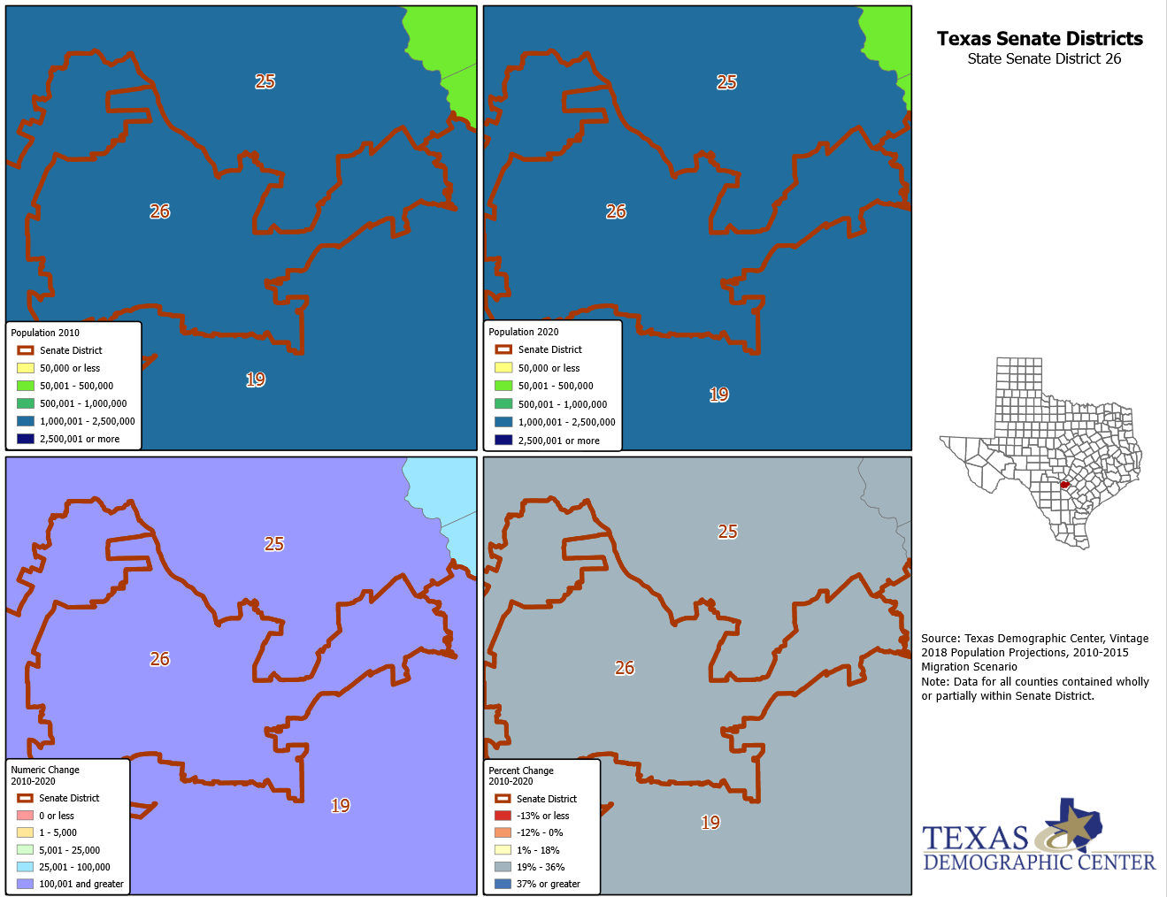
Texas Demographic Center Redistricting Resources
https://demographics.texas.gov/data/decennial/2020/RedistrictingResc
Source: Texas Demographic Center, 2018 Population Projections

Slide 23
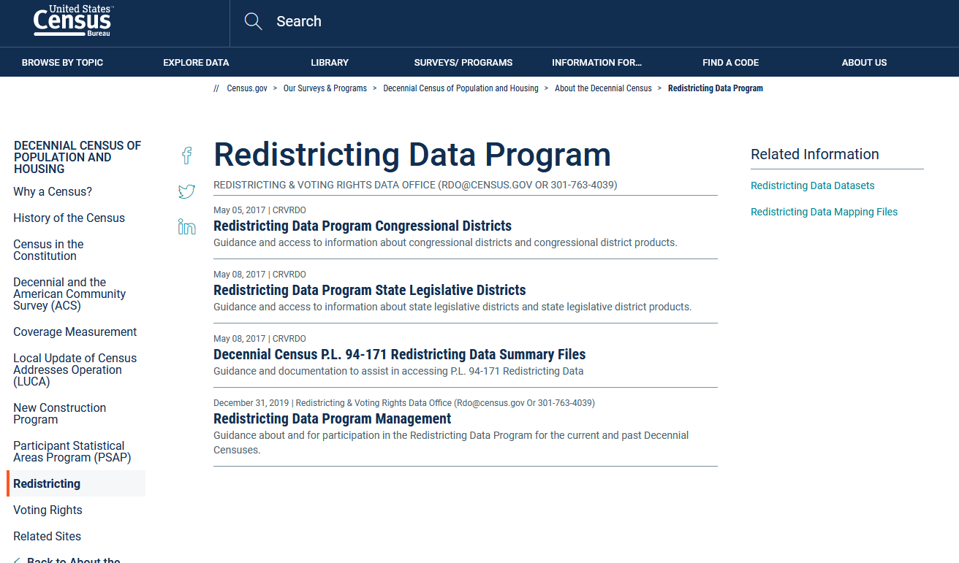
https://www.census.gov/programs-surveys/decennial-census/about/rdo.html

Slide 24
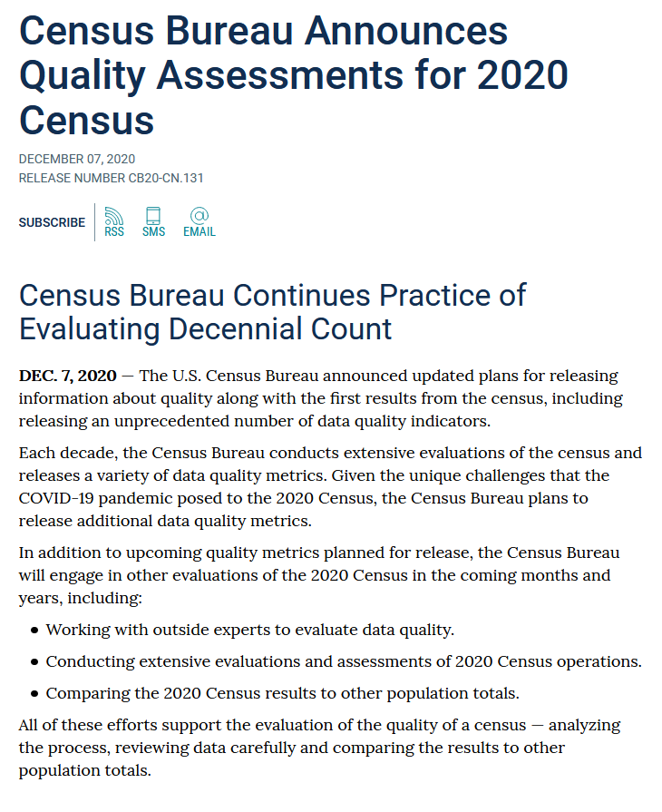
https://www.census.gov/newsroom/press-releases/2020/2020-census-quality-assessments.html

Slide 25
https://www.census.gov/programs-surveys/decennial-census/2020-census/planning-management/planning-docs/CQR-detailed-op-plan.html
Information on 2010 CQR process:
https://www.census.gov/programs-surveys/decennial-census/decade/2010/program-management/cqr.html

Slide 26
Lloyd Potter
(210) 458-6530
Lloyd.Potter@utsa.edu
demographics.texas.gov
@TexasDemography

