Slide 1
Population Change and Higher Education in Texas
President’s Cabinet and Academic Council
University of Texas at San Antonio
May 24, 2021

Slide 2
Population Growth and Congressional Seat Change
 | 2010 Population | 2020 Population | Numeric Change 2010-2020 | Percent Change 2010-2020 | Congressional Seat Change
United States | 308,745,538 | 331,449,281 | 22,703,743 | 7.4%
Texas | 25,145,561 | 29,145,505 | 3,999,944 | 15.90% | 2
Florida | 18,801,310 | 21,538,187 | 2,736,877 | 14.60% | 1
North Carolina | 9,535,483 | 10,439,388 | 903,905 | 9.50% | 1
Colorado | 5,029,196 | 5,773,714 | 744,518 | 14.80% | 1
Oregon | 3,831,074 | 4,237,256 | 406,182 | 10.60% | 1
Montana | 989,415 | 1,084,225 | 94,810 | 9.60% | 1
California | 37,253,956 | 39,538,223 | 2,284,267 | 6.10% | -1
New York | 19,378,102 | 20,201,249 | 823,147 | 4.20% | -1
Pennsylvania | 12,702,379 | 13,002,700 | 300,321 | 2.40% | -1
Ohio | 11,536,504 | 11,799,448 | 262,944 | 2.30% | -1
Michigan | 9,883,640 | 10,077,331 | 193,691 | 2.00% | -1
Illinois | 12,830,632 | 12,812,508 | -18,124 | -0.10% | -1
West Virginia | 1,852,994 | 1,793,716 | -59,278 | -3.20% | -1
Source: U.S. Census Bureau. 2010 and 2020 Census Count
Notes:
Texas is the second largest state in terms of population (2nd to CA) and area (2nd to AK). In terms of number of people, Texas’ growth exceeds that of all other states between 2010 and 2020. Texas has added over 4.2 million people between April 1, 2010 and July 1, 2020. This puts Texas on track to meet or surpass the number of people added in the last census when Texas gained 4 congressional seats. Projections from multiple sources anticipate Texas will gain 3 congressional districts after the 2020 census.

Slide 3
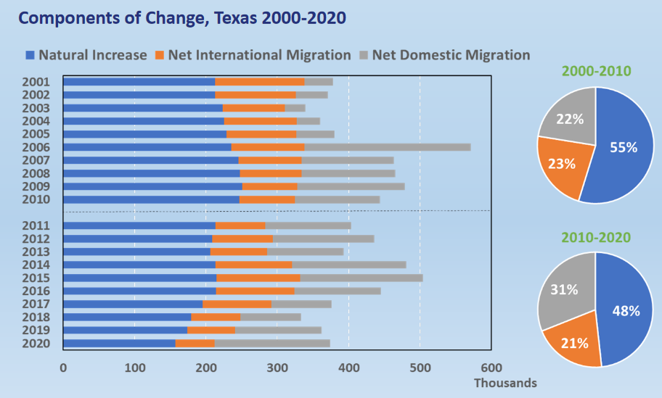
Source: U.S. Census Bureau. 2010 and 2020 Vintage Population Estimates

Slide 4
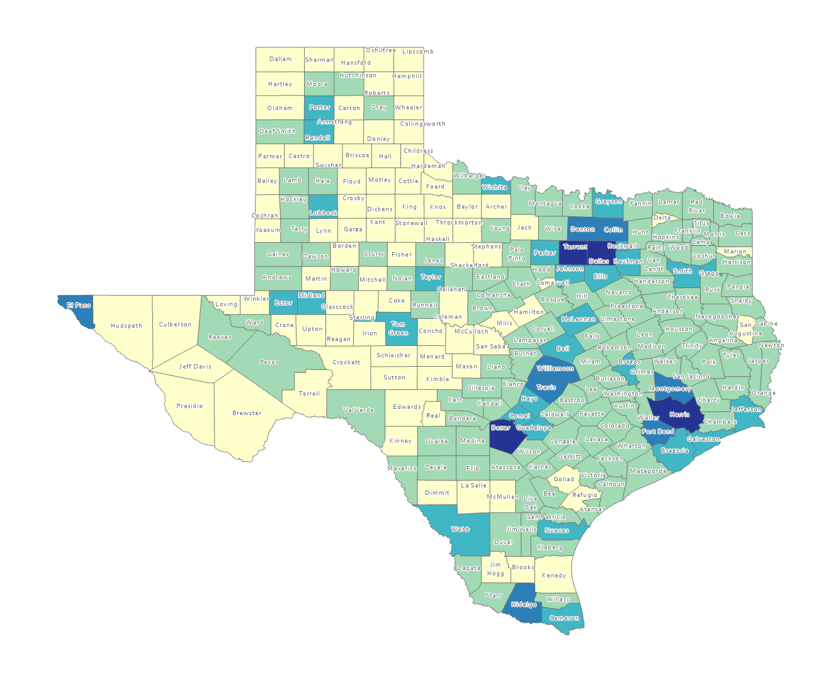
Estimated Population by County, Texas, 2020
Source: US Census Bureau, 2020 Population Estimates

Slide 5
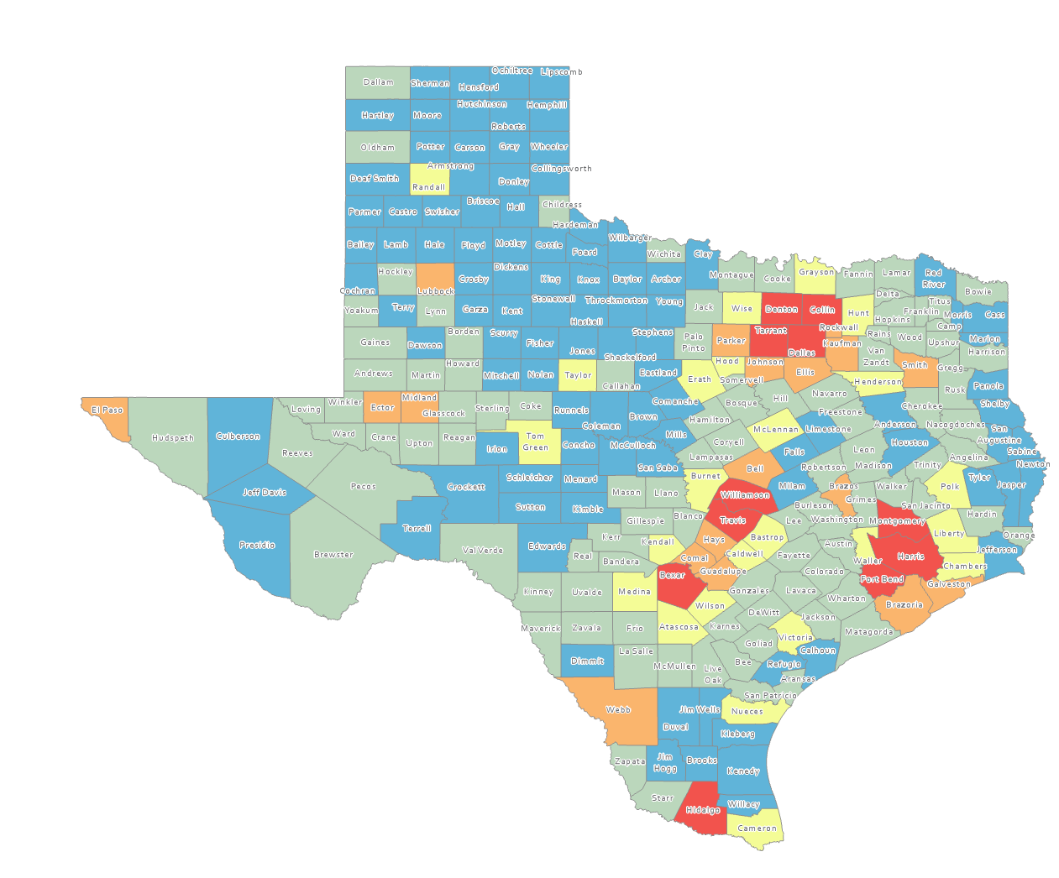
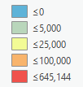
Estimated Numeric Change, Texas Counties, 2010-2020
101 counties lost population over the decade
Source: US Census Bureau, 2020 Population Estimates

Slide 6
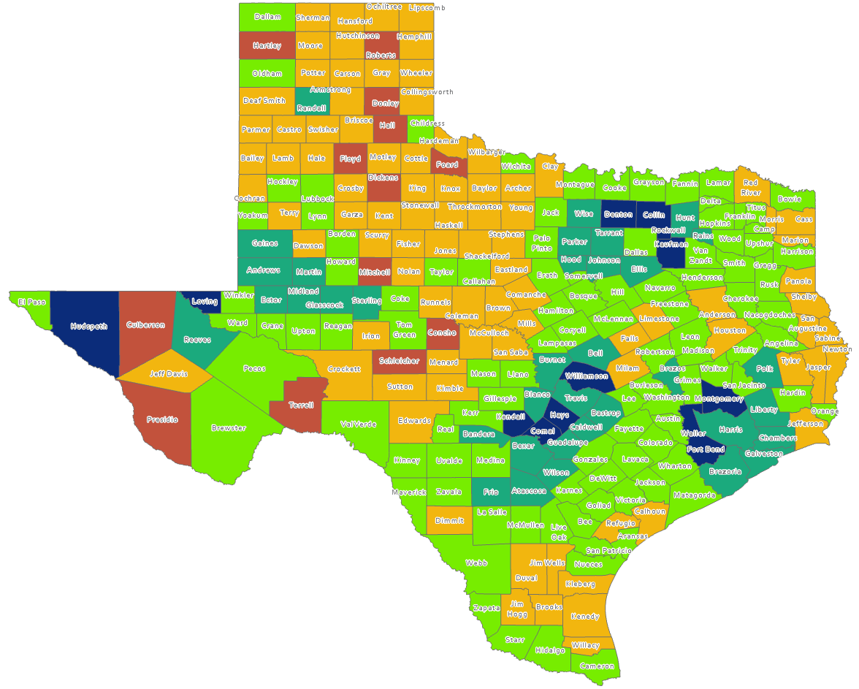
Estimated Percent Population Change, Texas Counties, 2010-2020
Suburban ring counties are among the fastest growing
Source: U.S. Census Bureau, 2020 Population Estimates

Slide 7
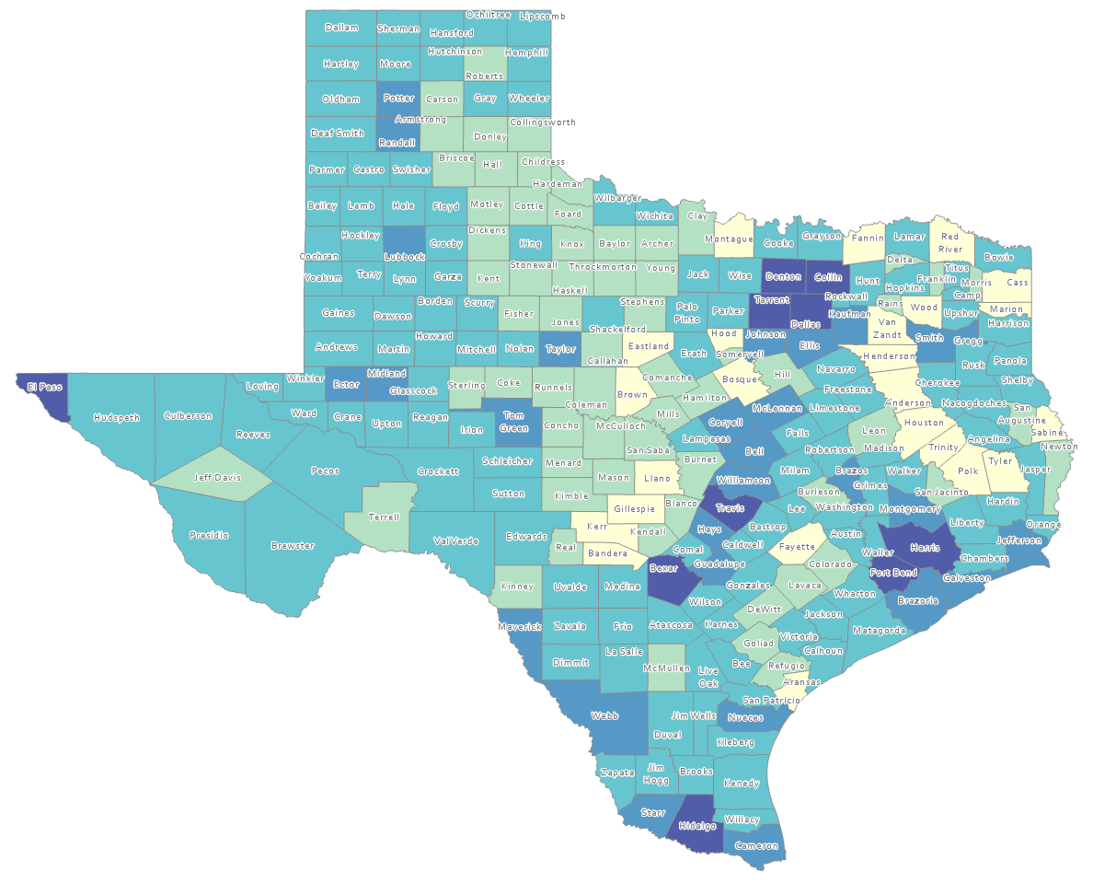
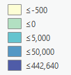
Estimated Natural Increase (Decrease), Texas Counties, 2010-2020
86 counties had natural decrease over the decade (1/3 of Texas’ counties)
Source: US Census Bureau, 2020 Population Estimates

Slide 8
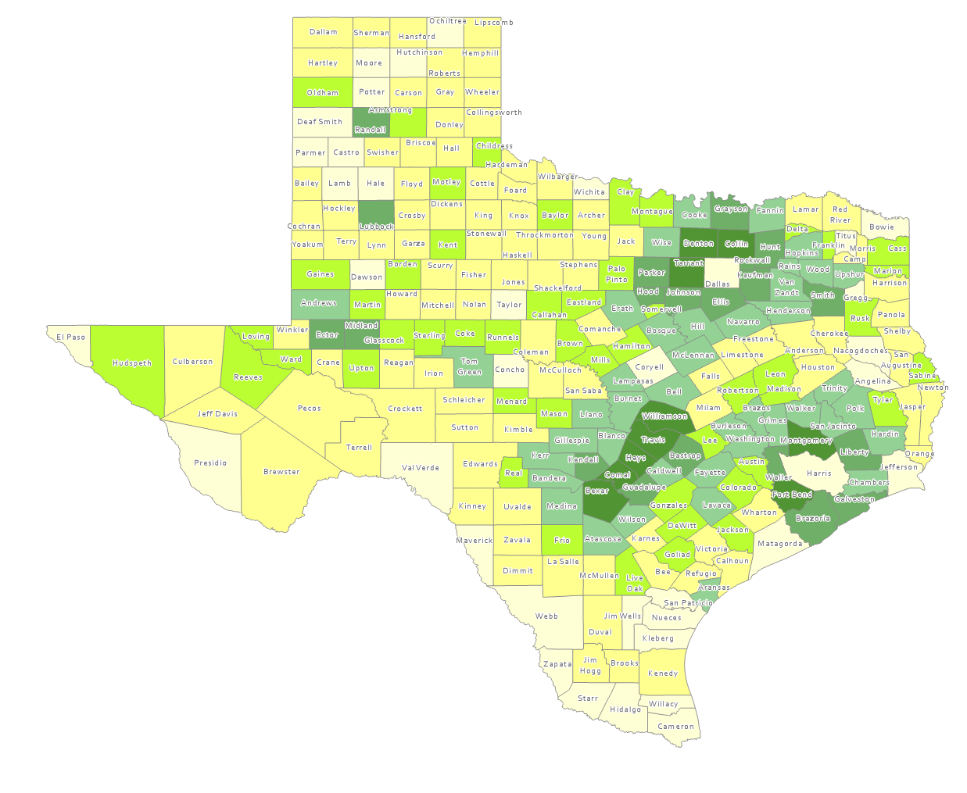
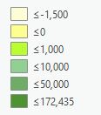
Estimated Population Change from Domestic Migration, Texas Counties, 2010-2020
More than half (134) of counties had net out domestic migration
Source: US Census Bureau, 2020 Population Estimates

Slide 9
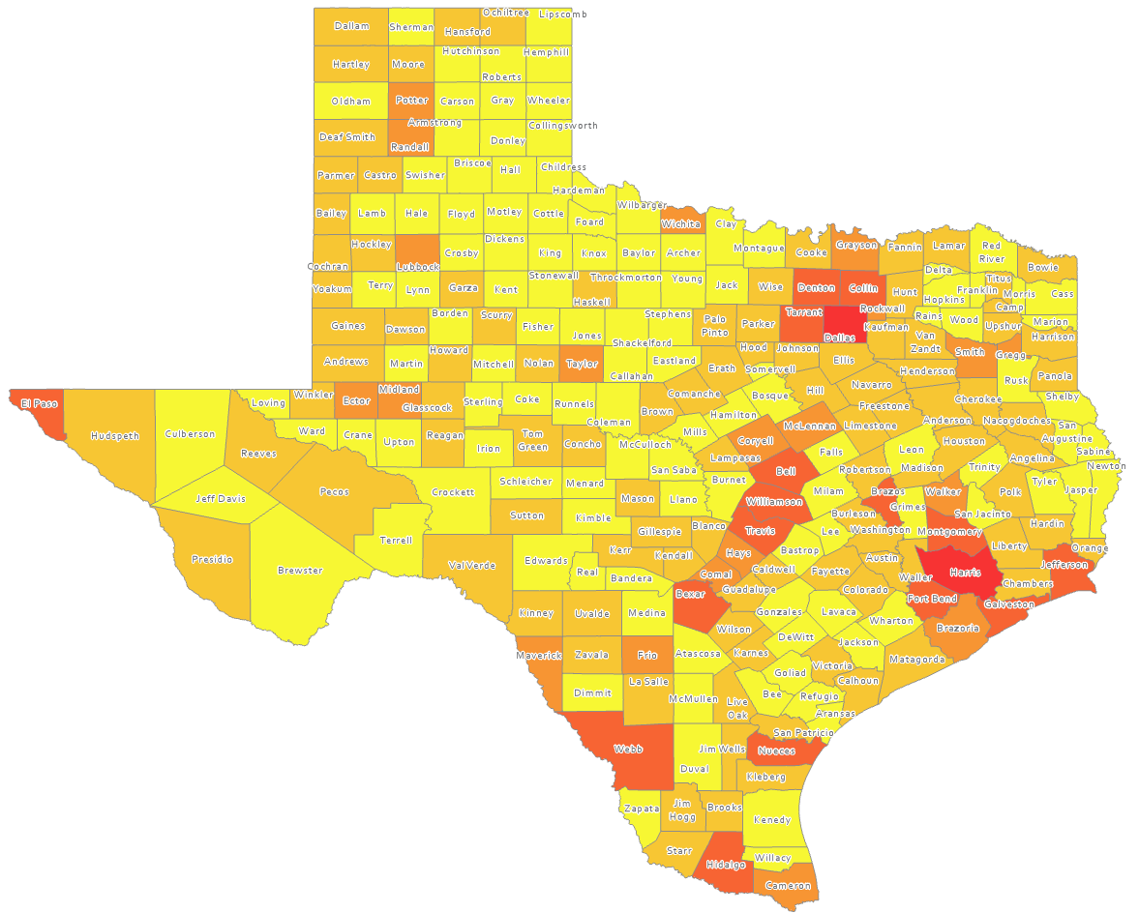
Estimated International Migrants, Texas Counties, 2010-2020
Source: US Census Bureau, 2020 Population Estimates

Slide 10
Estimated Percent of Total Net-Migrant Flows to and From Texas and Other States, 2019
Source: US Census Bureau, 2019 ACS Migration Flows, 2019

Slide 11
Race/Ethnic Composition, Texas, 2010-2019
86.4% of growth has been from minority groups
Source: US Census Bureau 2019 Population Estimates

Slide 12
Numeric Change in Age Group by Race/Ethnicity, Texas, 2010-2019
Source: US Census Bureau 2019 Population Estimates

Slide 13
Median Age and Change for Select States and the US, 2010 and 2018

Slide 14
Total Fertility Rate for Select States, 2008-2018

Slide 15
Crude Birth Rates by Race/Ethnicity, Texas, 2006-2018
Source: Centers for Disease Control and Prevention, National Center for Health Statistics, National Vital Statistics Report

Slide 16
US Population Pyramid, 2010 and 2018
2010 2018
Source: US Census Bureau, 2018 Population Estimates
Notes:
This population pyramid represents the age, sex, race and ethnic composition of the Texas population Blue represents males, red females, rows are single years of age, and shades represent specified race/ethnic groups as indicated in the legend

Slide 17
Texas Population Pyramid, 2010 and 2018
2010 2018
Source: US Census Bureau, 2018 Population Estimates
Notes:
This population pyramid represents the age, sex, race and ethnic composition of the Texas population Blue represents males, red females, rows are single years of age, and shades represent specified race/ethnic groups as indicated in the legend

Slide 18
Texas White (non-Hispanic) and Hispanic Populations by Age, 2019
Source: Texas Demographic Center, 2018 Population Estimates

Slide 19
Texas Population Pyramid by Race/Ethnicity, 2019
Source: US Census Bureau, 2019 Population Estimates
Notes:
This population pyramid represents the age, sex, race and ethnic composition of the Texas population Blue represents males, red females, rows are single years of age, and shades represent specified race/ethnic groups as indicated in the legend

Slide 20
Texas Population Pyramid by Race/Ethnicity, 2019
Source: US Census Bureau, 2019 Population Estimates
Notes:
This population pyramid represents the age, sex, race and ethnic composition of the Texas population Blue represents males, red females, rows are single years of age, and shades represent specified race/ethnic groups as indicated in the legend

Slide 21
Texas Population Pyramid by Race/Ethnicity, 2019
Source: US Census Bureau, 2019 Population Estimates
Notes:
This population pyramid represents the age, sex, race and ethnic composition of the Texas population Blue represents males, red females, rows are single years of age, and shades represent specified race/ethnic groups as indicated in the legend

Slide 22
Texas Population Pyramid by Race/Ethnicity, 2019
Source: US Census Bureau, 2019 Population Estimates
Notes:
This population pyramid represents the age, sex, race and ethnic composition of the Texas population Blue represents males, red females, rows are single years of age, and shades represent specified race/ethnic groups as indicated in the legend

Slide 23
Percent of Civilian Labor Force by Occupation, Texas, 2007, 2017 and 2017-2017 Change
Source: US Census Bureau, American Community Survey, 1-Year Sample, 2007, 2017

Slide 24
Change in Undergraduate College Enrollment by State, 2010 to 2019
Source: US Census Bureau, American Community Survey, 1-Year Sample, 2010-2019 Table B14007

Slide 25
Change in Graduate and Professional School Enrollment by State, 2010 to 2019
Source: US Census Bureau, American Community Survey, 1-Year Sample, 2010-2019 Table B14007

Slide 26
College and Graduate Enrollment, Texas, 2007-2019
Source: US Census Bureau, American Community Survey 1-Year Estimates, 2007-2019

Slide 27
College and Graduate Enrollment by Race/Ethnicity, Texas, 2008-2019
Source: US Census Bureau, American Community Survey 1-Year Estimates, 2008-2019

Slide 28
Educational Attainment of Persons Age 25 Years and Older by Race/Ethnicity, Texas, 2019
39.9%
70.1 %
Source: US Census Bureau, American Community Survey, 1-Year Sample, 2019

Slide 29
Percent of the Population Aged-25 Years and Older with a Bachelor’s Degree or Higher by Race/Ethnicity, Texas, 2007 and 2019
Change in percent
7.8%
6.1%
7.7%
5.4%
Source: US Census Bureau, ACS 1-Year Estimates, 2007, 2019

Slide 30
Lloyd Potter, Ph.D.
(210) 458-6530
TDC@UTSA.edu
Demographics.Texas.gov
@TexasDemography

