Slide 1
Census 2020 and Redistricting in Texas:
El Paso
Texas House Redistricting Hearing
July 6, 2021
@TexasDemography

Slide 2
Census 2020
Census counts used to reapportion the U.S. House of Representatives, determining how many seats each state gets.
Census counts used by state officials to redraw congressional and state legislative boundaries to account for population shifts.
Census derived data are used to allocate over $1.5 trillion in federal funds to support healthcare, education, transportation, and other service programs.

Slide 3
Redistricting Dates
Apportionment File sent to POTUS on April 26, 2021
Redistricting Data File (Public Law 94-171 File) received by the Governor no later than April 1, 2021 - now by September 30, 2021
PL 94-171 released to states in groups of 8 states per week, with one week prior notice
PL 94-171 File to include:
Race, Hispanic origin, 18 and older, occupancy status, and group quarters by type.
Data available at WWW.CENSUS.GOV/RDO

Slide 4
Population Growth and Congressional Seat Change
 | 2010 Population | 2020 Population | Numeric Change 2010-2020 | Percent Change 2010-2020 | Congressional Seat Change
United States | 308,745,538 | 331,449,281 | 22,703,743 | 7.4%
Texas | 25,145,561 | 29,145,505 | 3,999,944 | 15.90% | 2
Florida | 18,801,310 | 21,538,187 | 2,736,877 | 14.60% | 1
North Carolina | 9,535,483 | 10,439,388 | 903,905 | 9.50% | 1
Colorado | 5,029,196 | 5,773,714 | 744,518 | 14.80% | 1
Oregon | 3,831,074 | 4,237,256 | 406,182 | 10.60% | 1
Montana | 989,415 | 1,084,225 | 94,810 | 9.60% | 1
California | 37,253,956 | 39,538,223 | 2,284,267 | 6.10% | -1
New York | 19,378,102 | 20,201,249 | 823,147 | 4.20% | -1
Pennsylvania | 12,702,379 | 13,002,700 | 300,321 | 2.40% | -1
Ohio | 11,536,504 | 11,799,448 | 262,944 | 2.30% | -1
Michigan | 9,883,640 | 10,077,331 | 193,691 | 2.00% | -1
Illinois | 12,830,632 | 12,812,508 | -18,124 | -0.10% | -1
West Virginia | 1,852,994 | 1,793,716 | -59,278 | -3.20% | -1
Source: U.S. Census Bureau. 2010 and 2020 Census Count
Notes:
Texas is the second largest state in terms of population (2nd to CA) and area (2nd to AK). In terms of number of people, Texas’ growth exceeds that of all other states between 2010 and 2020. Texas has added over 4.2 million people between April 1, 2010 and July 1, 2020. This puts Texas on track to meet or surpass the number of people added in the last census when Texas gained 4 congressional seats. Projections from multiple sources anticipate Texas will gain 3 congressional districts after the 2020 census.

Slide 5
Ideal Size of Texas Senate, House, and U.S. Congressional Districts
Texas Senate District Size (31 seats) = 940,178 (811,147 in 2010)
Texas House District Size (150 seats) = 194,303 (167,637 in 2010)
U.S. House Seat District Size (38 seats) = 766,987 (698,488 in 2010 – 36 seats)
+ 3,999,944
Source: Census Bureau 2010 and 2020 Census Counts
Notes:
The Texas Demographic Center produces population projections for the state. In comparing these projections, to the Census Bureau’s population estimates since 2010, we see the Texas Demographic Center is closely aligned with the Census Bureau estimates trend. TDC projections indicate Texas will grow to just under 29.7 million by 2020.

Slide 6
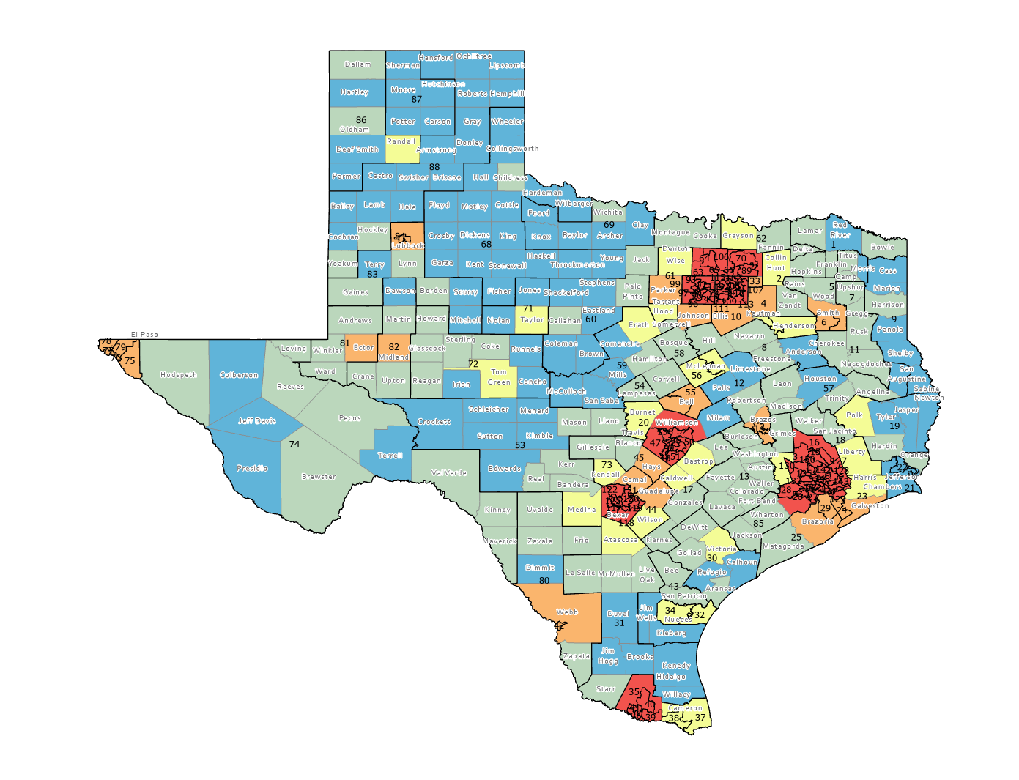
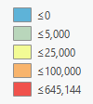
Numeric population change 2010-2020, Texas Counties with Current Texas House Districts
Source: U.S. Census Bureau. 2010 Census Count, 2020 Population Estimates

Slide 7
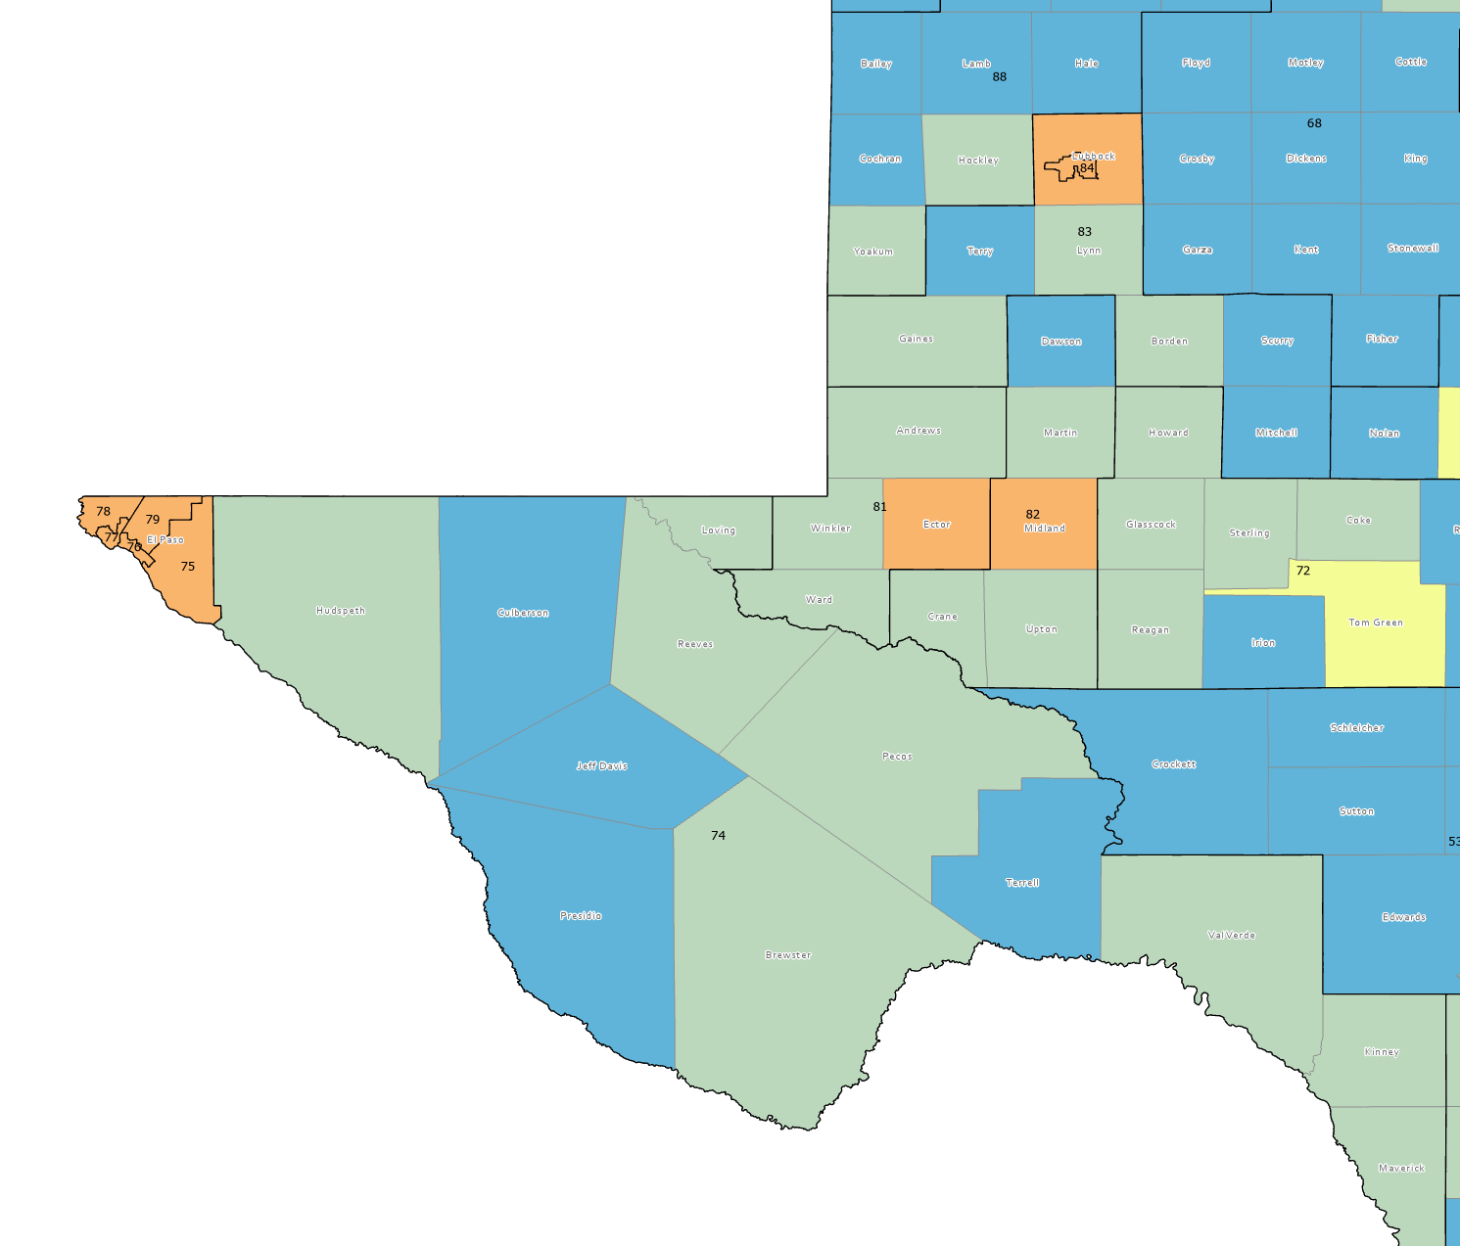
Numeric population change 2010-2020, Texas Counties with Current Texas House Districts
Source: U.S. Census Bureau. 2010 Census Count, 2020 Population Estimates

Slide 8
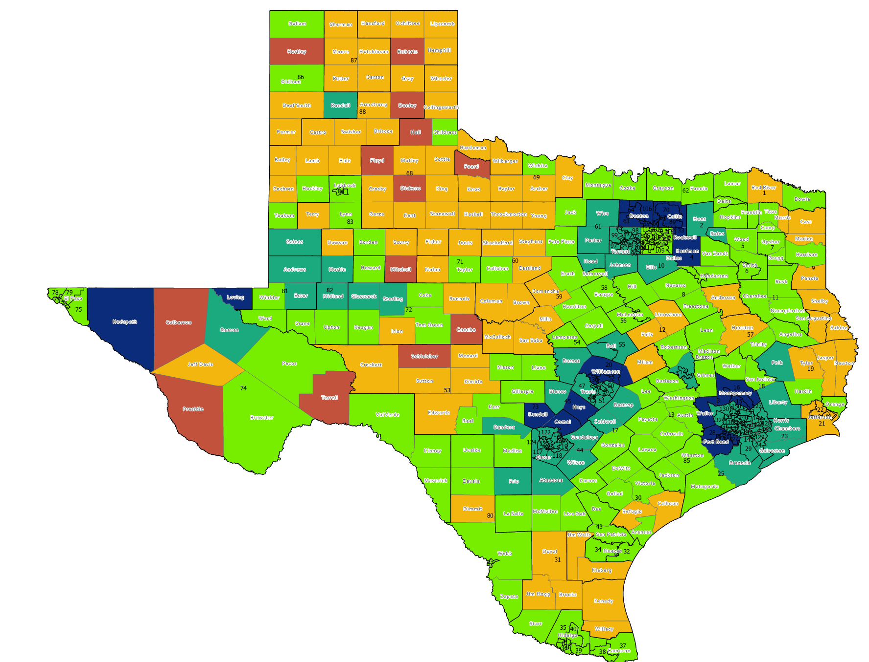
Percent population change 2010-2020, Texas Counties with Current Texas House Districts
Source: U.S. Census Bureau. 2010 Census Count, 2020 Population Estimates

Slide 9
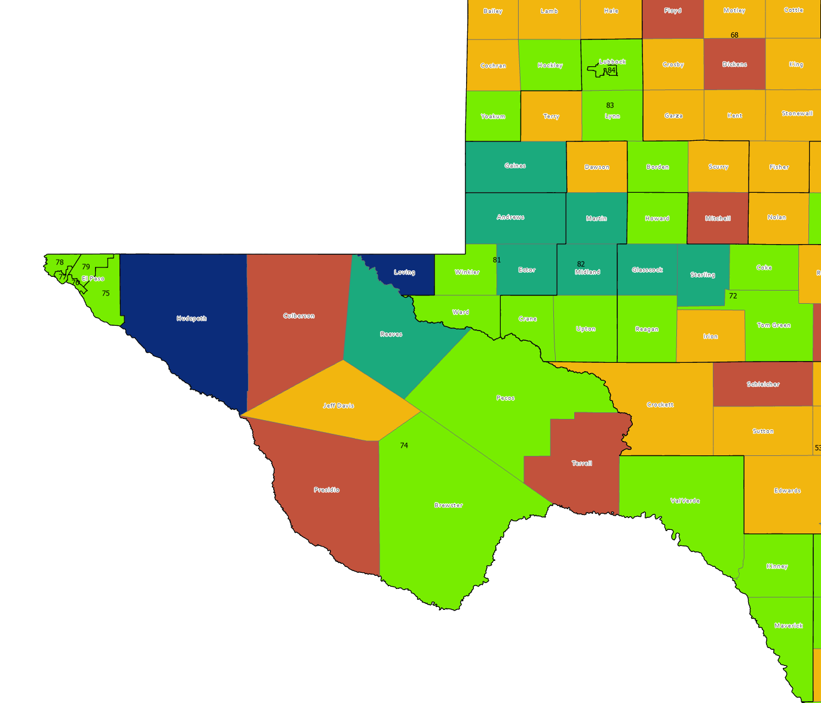
Percent population change 2010-2020, Texas Counties with Current Texas House Districts
Source: U.S. Census Bureau. 2010 Census Count, 2020 Population Estimates

Slide 10
Estimated Population by Race and Ethnicity, Texas 2010-2020
Source: U.S. Census Bureau, 2020 Evaluation Estimates

Slide 11
Estimated Population Change and Percent of Total Estimated Change by Race/Ethnicity, 2010-2020, Texas
Source: U.S. Census Bureau, 2020 Evaluation Estimates
Notes:
The bulk of the growth projected between 2010 and 2020 will come from growth among non-White populations, with only 16.4% coming from NH Whites.

Slide 12
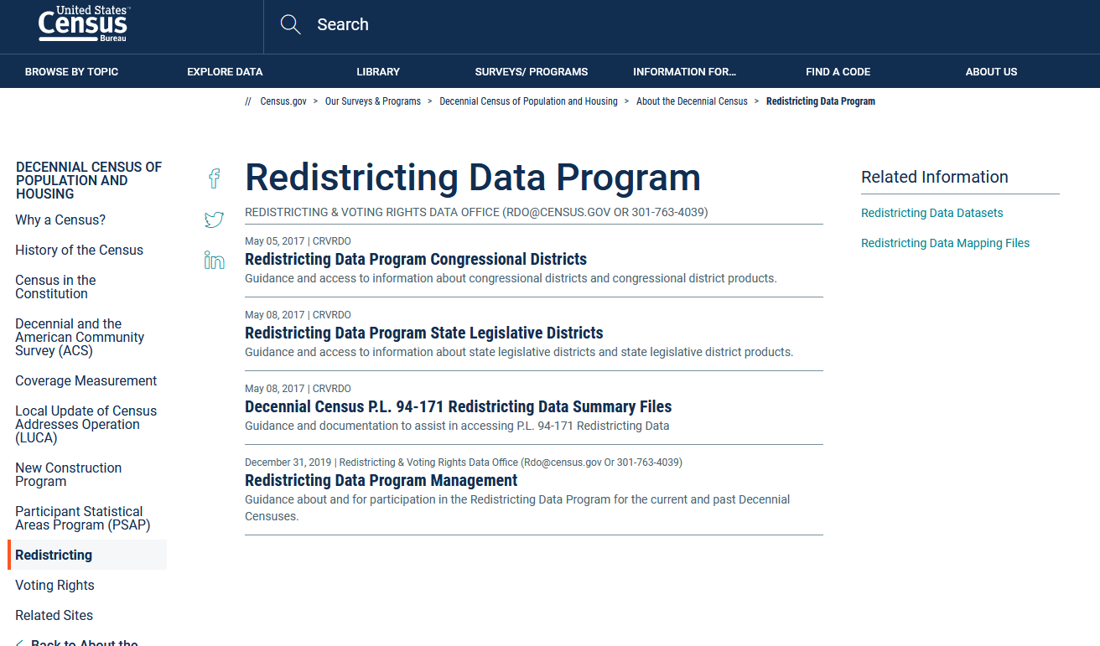
https://www.census.gov/programs-surveys/decennial-census/about/rdo.html

Slide 13
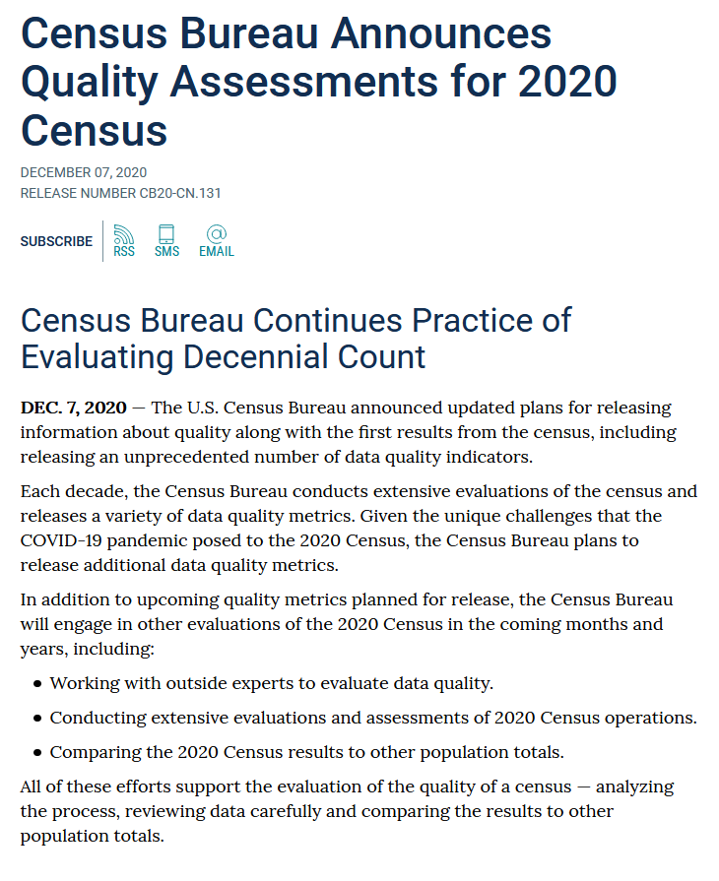
https://www.census.gov/newsroom/press-releases/2020/2020-census-quality-assessments.html

Slide 14
https://www.census.gov/programs-surveys/decennial-census/2020-census/planning-management/planning-docs/CQR-detailed-op-plan.html
Information on 2010 CQR process:
https://www.census.gov/programs-surveys/decennial-census/decade/2010/program-management/cqr.html

Slide 15
Lloyd Potter
(210) 458-6530
Lloyd.Potter@utsa.edu
demographics.texas.gov
@TexasDemography

