Slide 1
Population Change and Characteristics, Texas, Collin County, and McKinney
McKinney Chamber of Commerce
August 6, 2021

Slide 2
Population Growth and Congressional Seat Change
 | 2010 Population | 2020 Population | Numeric Change 2010-2020 | Percent Change 2010-2020 | Congressional Seat Change
United States | 308,745,538 | 331,449,281 | 22,703,743 | 7.4%
Texas | 25,145,561 | 29,145,505 | 3,999,944 | 15.9% | 2
Florida | 18,801,310 | 21,538,187 | 2,736,877 | 14.6% | 1
North Carolina | 9,535,483 | 10,439,388 | 903,905 | 9.5% | 1
Colorado | 5,029,196 | 5,773,714 | 744,518 | 14.8% | 1
Oregon | 3,831,074 | 4,237,256 | 406,182 | 10.6% | 1
Montana | 989,415 | 1,084,225 | 94,810 | 9.6% | 1
California | 37,253,956 | 39,538,223 | 2,284,267 | 6.1% | -1
New York | 19,378,102 | 20,201,249 | 823,147 | 4.2% | -1
Pennsylvania | 12,702,379 | 13,002,700 | 300,321 | 2.4% | -1
Ohio | 11,536,504 | 11,799,448 | 262,944 | 2.3% | -1
Michigan | 9,883,640 | 10,077,331 | 193,691 | 2.0% | -1
Illinois | 12,830,632 | 12,812,508 | -18,124 | -0.1% | -1
West Virginia | 1,852,994 | 1,793,716 | -59,278 | -3.2% | -1
Source: U.S. Census Bureau. 2010 and 2020 Census Count
Notes:
Texas is the second largest state in terms of population (2nd to CA) and area (2nd to AK). In terms of number of people, Texas’ growth exceeds that of all other states between 2010 and 2020. Texas has added over 4.2 million people between April 1, 2010 and July 1, 2020. This puts Texas on track to meet or surpass the number of people added in the last census when Texas gained 4 congressional seats. Projections from multiple sources anticipate Texas will gain 3 congressional districts after the 2020 census.

Slide 3
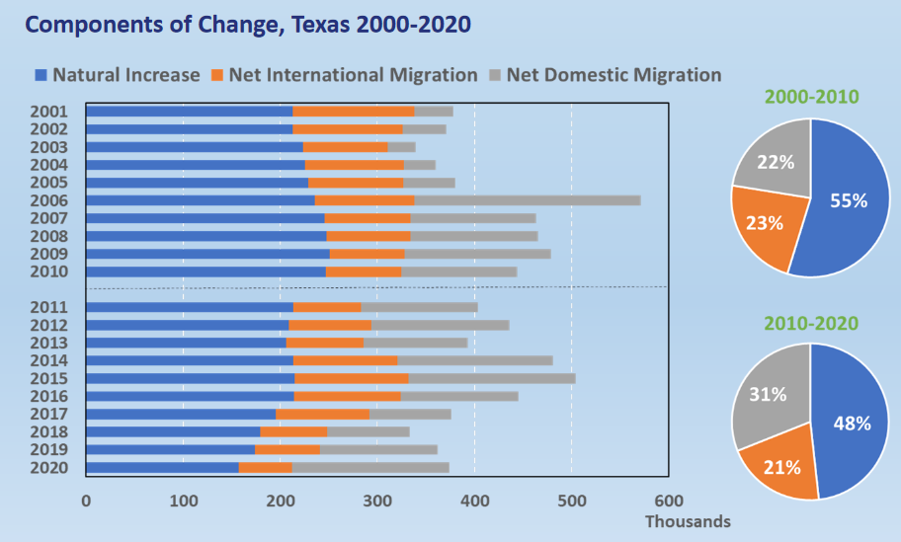
Source: U.S. Census Bureau. 2010 and 2020 Vintage Population Estimates

Slide 4
Top Counties for Numeric Growth in Texas, 2010-2020
County | US Rank | 2020 Population Estimate | Population Change 2010-2020 | Percent of Change from Natural Increase | Percent of Change from International Migration | Percent of Change from Domestic Migration
Harris | 2 | 4,738,253 | 645,144 | 68.6% | 44.1% | -12.7%
Bexar | 5 | 2,026,823 | 312,042 | 46.1% | 14.1% | 39.9%
Tarrant | 6 | 2,123,347 | 312,002 | 50.1% | 19.7% | 30.1%
Collin | 8 | 1,072,069 | 291,175 | 23.8% | 16.8% | 59.4%
Travis | 9 | 1,300,503 | 276,189 | 38.4% | 19.6% | 42.0%
Dallas | 11 | 2,635,888 | 267,732 | 88.4% | 44.2% | -32.6%
Denton | 13 | 919,324 | 257,709 | 24.8% | 8.9% | 66.3%
Fort Bend | 14 | 839,706 | 255,074 | 24.1% | 19.1% | 56.8%
Williamson | 20 | 617,855 | 195,084 | 20.4% | 5.6% | 74.0%
Montgomery | 23 | 626,351 | 170,611 | 20.4% | 7.7% | 71.9%
Source: US Census Bureau, 2020 Evaluation Population Estimates

Slide 5
Top Counties for Percent Growth in Texas, 2010-2020*
County | US Rank | 2020 Population Estimate | Population Change 2010-2020 | Percent Population Change 2010-2020 | Percent of Population Change from Natural Increase | Percent of Population Change from International Migration | Percent of Population Change from Domestic Migration
Hays | 1 | 241,365 | 84,387 | 53.7% | 16.7% | 3.6% | 79.7%
Comal | 2 | 164,812 | 56,287 | 51.9% | 5.9% | 1.8% | 92.3%
Williamson | 6 | 617,855 | 195,084 | 46.2% | 20.4% | 5.6% | 74.0%
Fort Bend | 7 | 839,706 | 255,074 | 43.6% | 24.1% | 19.1% | 56.8%
Rockwall | 11 | 109,888 | 31,490 | 40.2% | 14.9% | 3.4% | 81.7%
Denton | 13 | 919,324 | 257,709 | 38.9% | 24.8% | 8.9% | 66.3%
Kaufman | 15 | 143,198 | 39,846 | 38.6% | 17.3% | 1.4% | 81.2%
Montgomery | 16 | 626,351 | 170,611 | 37.4% | 20.4% | 7.7% | 71.9%
Collin | 17 | 1,072,069 | 291,175 | 37.2% | 23.8% | 16.8% | 59.4%
Waller | 22 | 57,452 | 14,133 | 32.7% | 22.7% | 2.9% | 74.4%
Midland | 29 | 177,863 | 40,976 | 29.9% | 42.6% | 9.0% | 48.3%
Guadalupe | 31 | 170,608 | 39,086 | 29.7% | 19.9% | 2.1% | 78.0%
Ellis | 35 | 191,760 | 42,111 | 28.1% | 21.8% | 2.1% | 76.1%
Source: US Census Bureau, 2020 Evaluation Population Estimates
*Among counties with populations of 50,000 or more in 2020

Slide 6
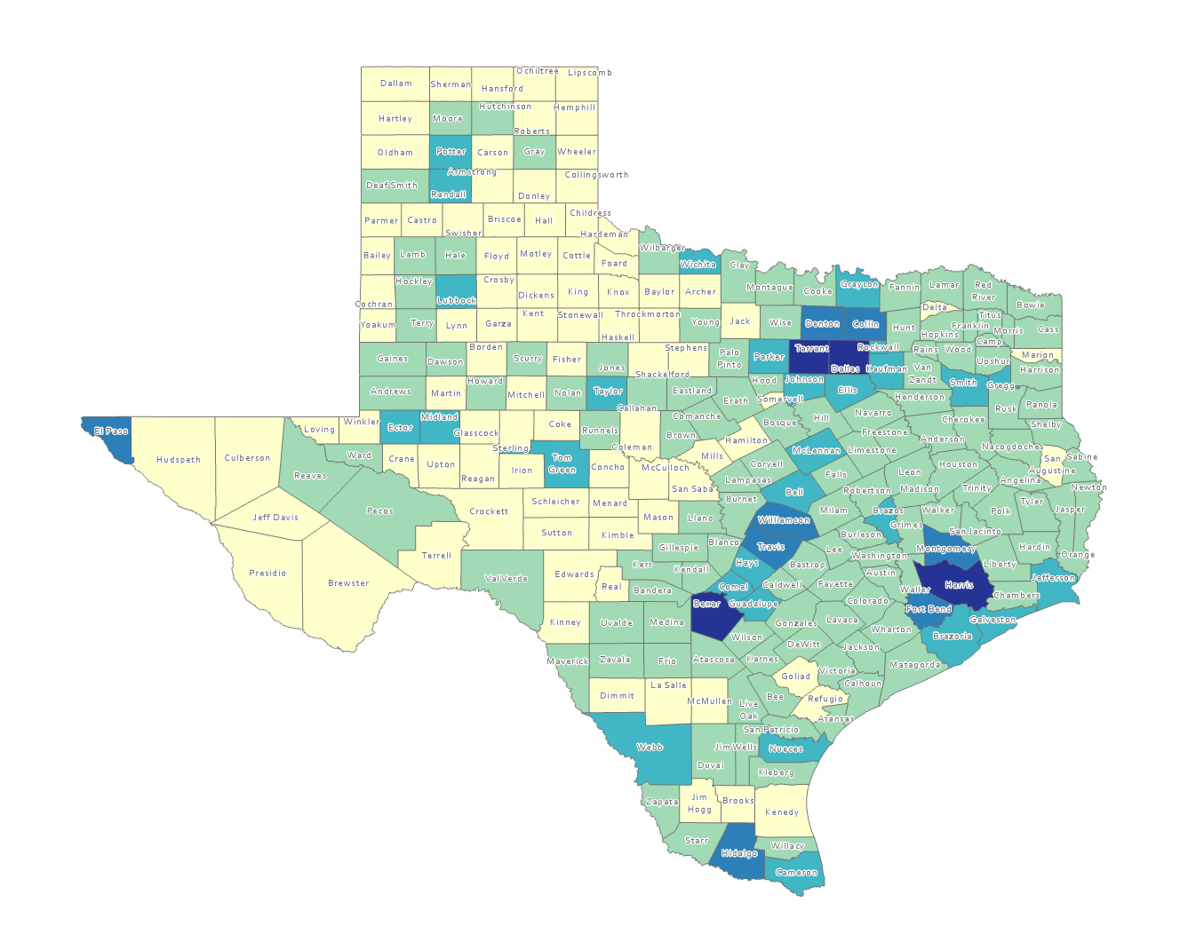
Estimated Population by County, Texas, 2020
Source: US Census Bureau, 2020 Population Estimates

Slide 7
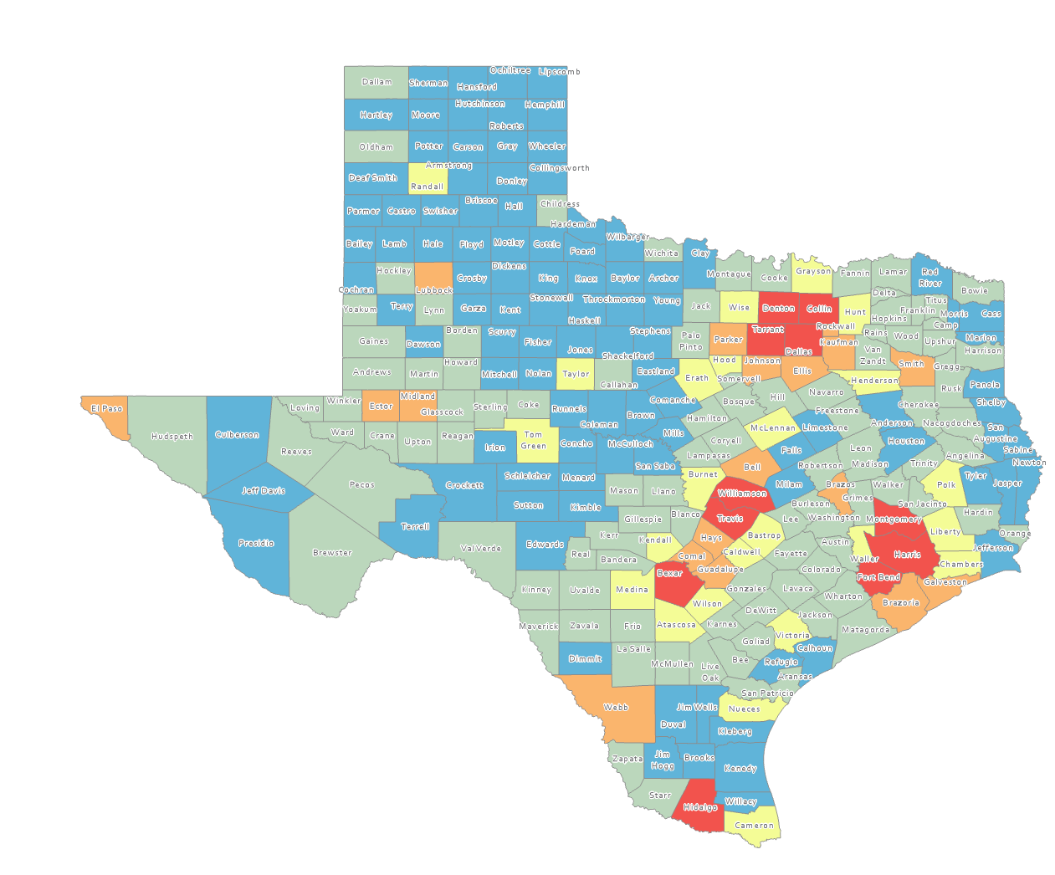
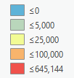
Estimated Numeric Change, Texas Counties, 2010-2020
101 counties lost population over the decade
Source: US Census Bureau, 2020 Population Estimates

Slide 8
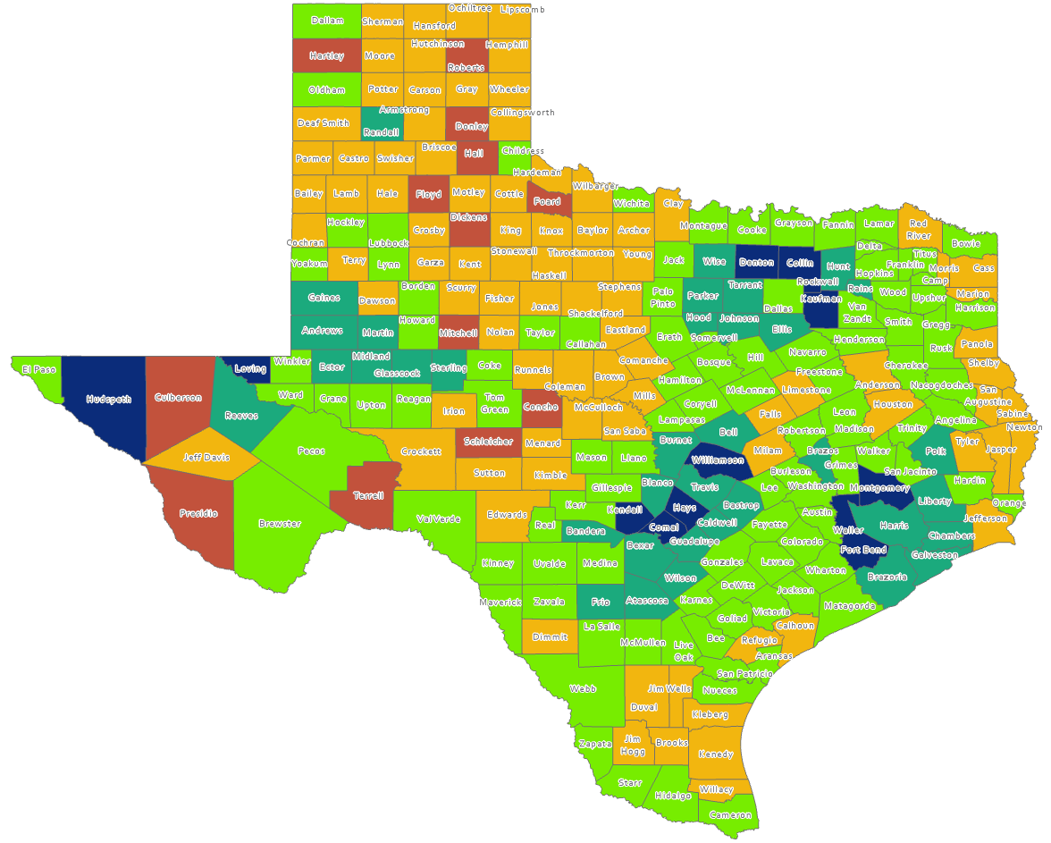
Estimated Percent Population Change, Texas Counties, 2010-2020
Suburban ring counties are among the fastest growing
Source: U.S. Census Bureau, 2020 Population Estimates

Slide 9
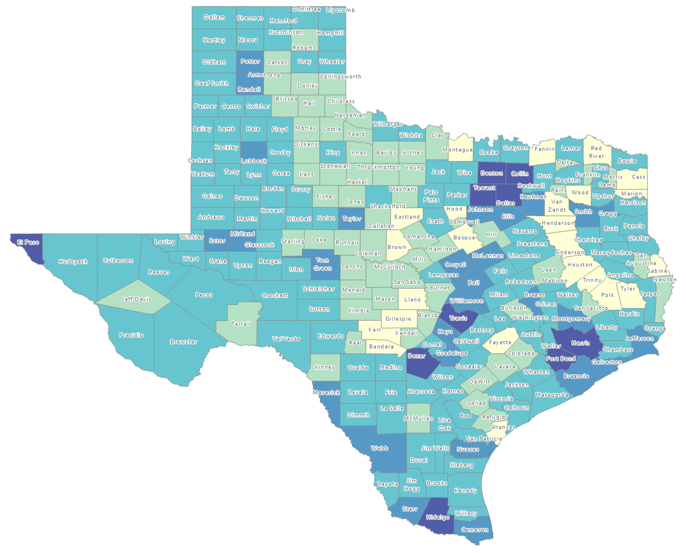
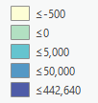
Estimated Natural Increase (Decrease), Texas Counties, 2010-2020
86 counties had natural decrease over the decade (1/3 of Texas’ counties)
Source: US Census Bureau, 2020 Population Estimates

Slide 10
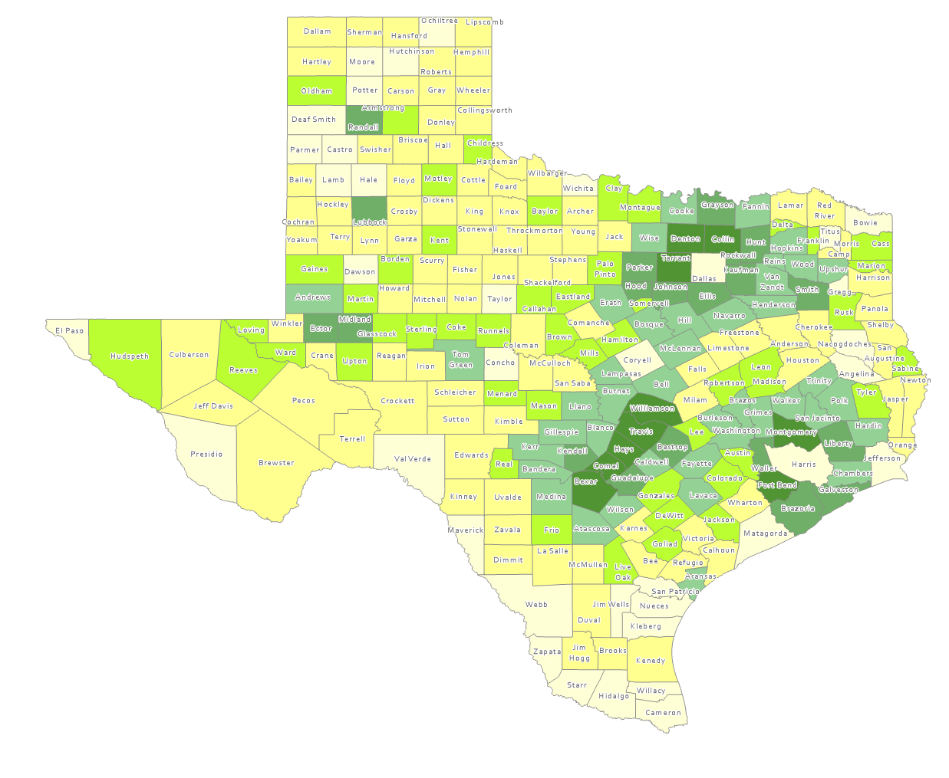
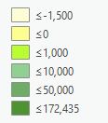
Estimated Population Change from Domestic Migration, Texas Counties, 2010-2020
More than half (134) of counties had net out domestic migration
Source: US Census Bureau, 2020 Population Estimates

Slide 11
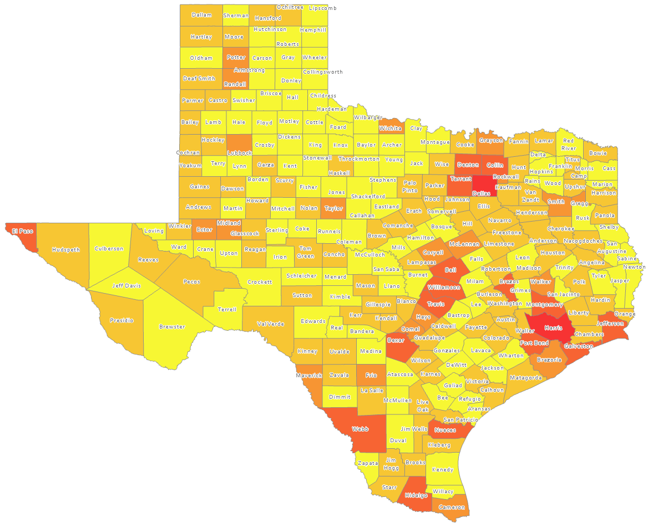
Estimated International Migrants, Texas Counties, 2010-2020
Source: US Census Bureau, 2020 Population Estimates

Slide 12
Estimated Net Domestic Migrants Between Texas and Other States, 2010-2019
Source: U.S. Census Bureau, State-to-State Migration Flows, 2010-2019

Slide 13
Race/Ethnic Composition, Texas, 2010-2019
86.4% of growth has been from minority groups
Source: US Census Bureau 2019 Population Estimates

Slide 14
Total Fertility Rate for Select States, 2008-2018

Slide 15
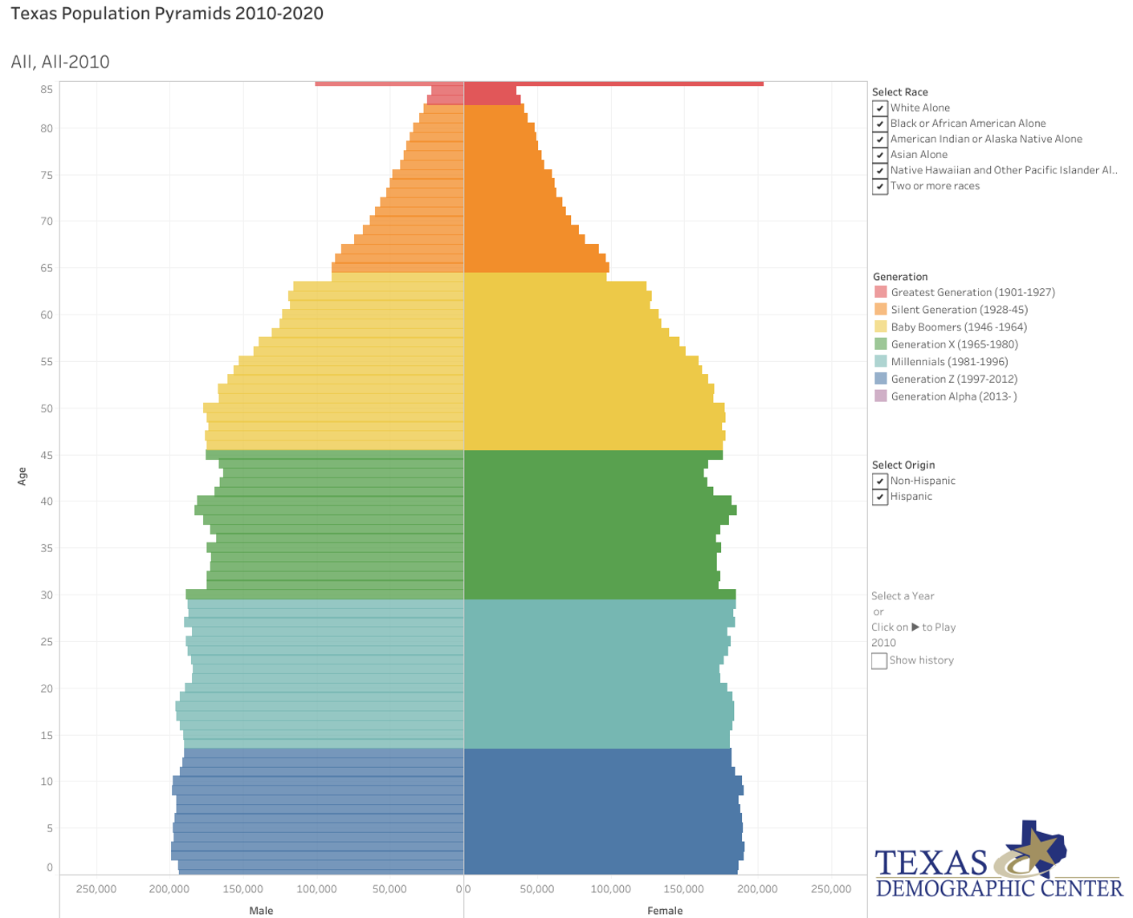
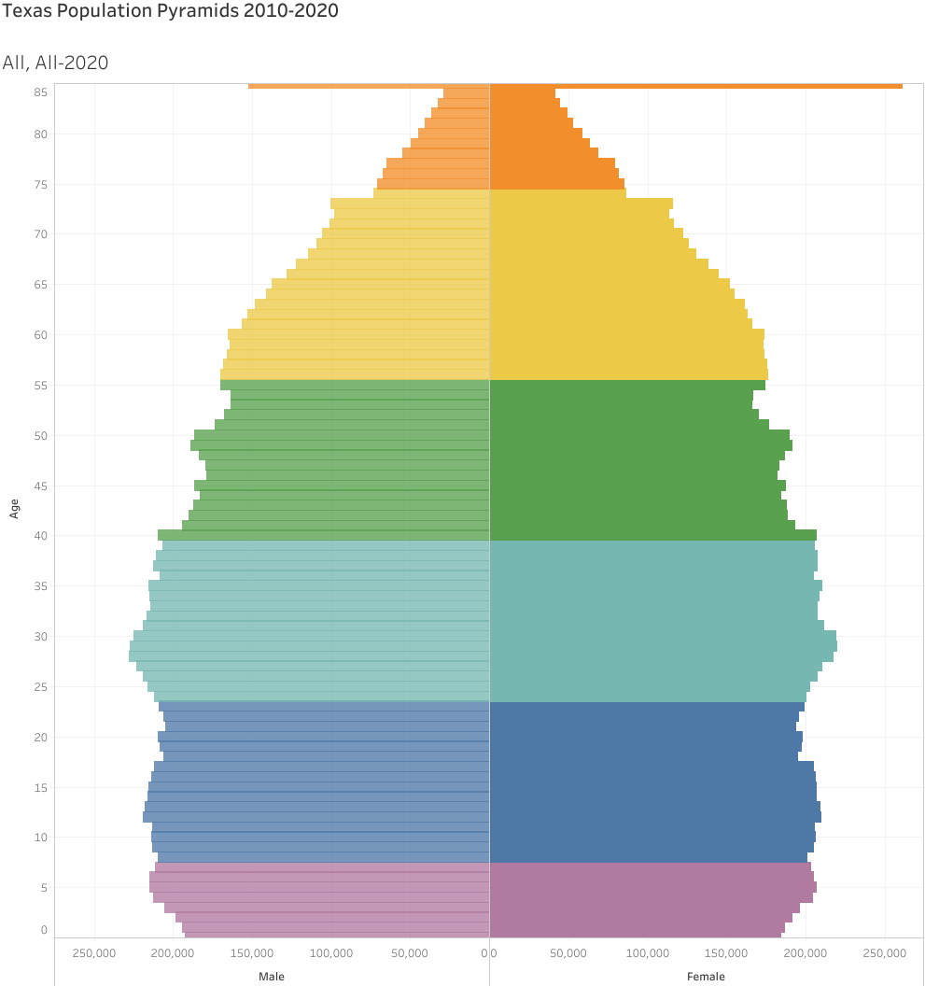
Generational Population Pyramids, Texas, 2010 and 2020
2010 2020
Source: US Census Bureau, 20209 Population Estimates

Slide 16
Texas White (non-Hispanic) and Hispanic Populations by Age, 2019
Source: Texas Demographic Center, 2018 Population Estimates

Slide 17
Texas Population Pyramid by Race/Ethnicity, 2019
Source: US Census Bureau, 2019 Population Estimates
Notes:
This population pyramid represents the age, sex, race and ethnic composition of the Texas population Blue represents males, red females, rows are single years of age, and shades represent specified race/ethnic groups as indicated in the legend

Slide 18
Texas Population Pyramid by Race/Ethnicity, 2019
Source: US Census Bureau, 2019 Population Estimates
Notes:
This population pyramid represents the age, sex, race and ethnic composition of the Texas population Blue represents males, red females, rows are single years of age, and shades represent specified race/ethnic groups as indicated in the legend

Slide 19
Texas Population Pyramid by Race/Ethnicity, 2019
Source: US Census Bureau, 2019 Population Estimates
Notes:
This population pyramid represents the age, sex, race and ethnic composition of the Texas population Blue represents males, red females, rows are single years of age, and shades represent specified race/ethnic groups as indicated in the legend

Slide 20
Texas Population Pyramid by Race/Ethnicity, 2019
Source: US Census Bureau, 2019 Population Estimates
Notes:
This population pyramid represents the age, sex, race and ethnic composition of the Texas population Blue represents males, red females, rows are single years of age, and shades represent specified race/ethnic groups as indicated in the legend

Slide 21
Percent of Civilian Labor Force by Occupation, Texas, 2007, 2017 and 2017-2017 Change
Source: US Census Bureau, American Community Survey, 1-Year Sample, 2007, 2017

Slide 22
Educational Attainment of Persons Age 25 Years and Older by Race/Ethnicity, Texas, 2019
39.9%
70.1 %
Source: US Census Bureau, American Community Survey, 1-Year Sample, 2019

Slide 23
Percent of the Population Aged-25 Years and Older with a Bachelor’s Degree or Higher by Race/Ethnicity, Texas, 2007 and 2019
Change in percent
7.8%
6.1%
7.7%
5.4%
Source: US Census Bureau, ACS 1-Year Estimates, 2007, 2019

Slide 24
Estimated population for select Collin County cities, 2010-2020
Source: US Census Bureau, 2020 Evaluation Population Estimates

Slide 25
Estimated population and linear forecasts for select Collin County cities, 2010-2020
Exponential
Forecast
Linear
Forecast
Source: US Census Bureau, 2020 Evaluation Population Estimates

Slide 26
Race/ethnic composition select Collin County cities, Collin County, and Texas, 2015-2019
 | McKinney | Allen | Frisco | Plano | Collin County | Texas
White alone, not Hispanic or Latino | 59.2% | 60.0% | 56.5% | 52.4% | 55.1% | 41.2%
Hispanic or Latino | 17.6% | 10.9% | 11.5% | 15.0% | 15.5% | 39.7%
Black or African American alone | 11.9% | 9.4% | 7.9% | 8.6% | 10.9% | 12.9%
Asian alone | 8.4% | 17.9% | 20.9% | 21.2% | 16.3% | 5.2%
Other | 3.4% | 3.3% | 3.9% | 3.4% | 3.6% | 3.2%
Source: US Census Bureau, American Community Survey, 5-Year Sample, 2015-2019

Slide 27
Social and economic characteristics for select Collin County cities, Collin County, and Texas, 2015-2019
 | McKinney | Allen | Frisco | Plano | Collin County | Texas
Foreign born persons, percent, 2015-2019 | 16.4% | 19.6% | 22.8% | 27.0% | 21.1% | 17.0%
Owner-occupied housing unit rate, 2015-2019 | 65.8% | 74.1% | 71.6% | 59.1% | 65.0% | 62.0%
Median value of owner-occupied housing units, 2015-2019 | $309,200 | $303,300 | $395,900 | $320,100 | $315,300 | $172,500
Median selected monthly owner costs -with a mortgage, 2015-2019 | $2,160 | $2,230 | $2,635 | $2,145 | $2,194 | $1,606
Median gross rent, 2015-2019 | $1,394 | $1,487 | $1,505 | $1,418 | $1,389 | $1,045
Living in same house 1 year ago, percent of persons age 1 year+, 2015-2019 | 83.4% | 86.9% | 83.4% | 88.0% | 85.1% | 84.4%
Language other than English spoken at home, percent of persons age 5 years+, 2015-2019 | 24.1% | 27.5% | 28.7% | 35.3% | 28.7% | 35.5%
Households with a broadband Internet subscription, percent, 2015-2019 | 90.0% | 96.0% | 95.9% | 93.9% | 92.8% | 81.9%
High school graduate or higher, percent of persons age 25 years+, 2015-2019 | 92.3% | 95.8% | 96.4% | 93.6% | 93.8% | 83.7%
Bachelor's degree or higher, percent of persons age 25 years+, 2015-2019 | 47.4% | 54.5% | 63.5% | 57.2% | 52.3% | 29.9%
Persons without health insurance, under age 65 years, percent | 11.3% | 7.7% | 7.0% | 12.5% | 12.5% | 20.8%

Slide 28
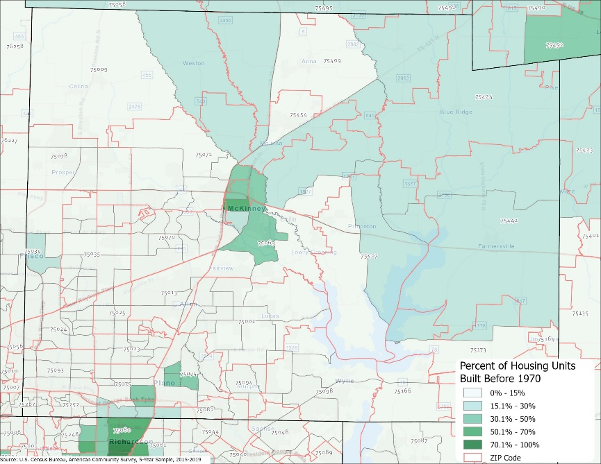
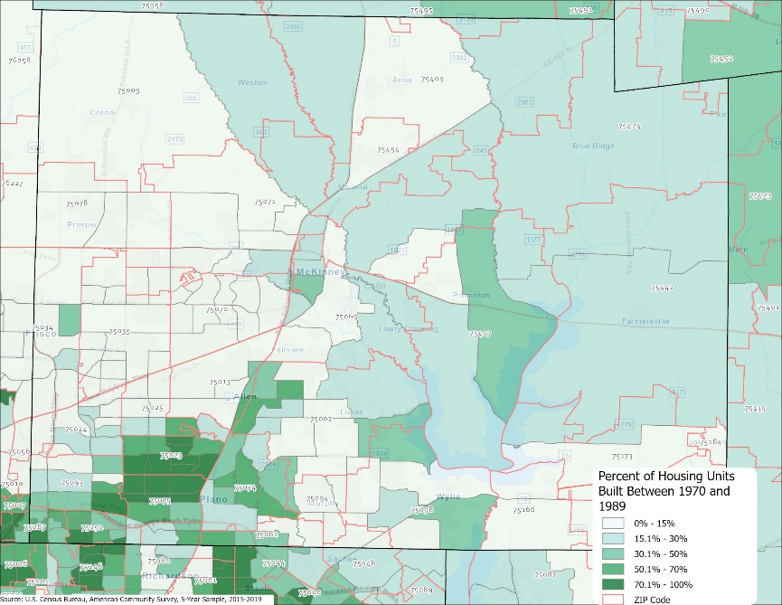
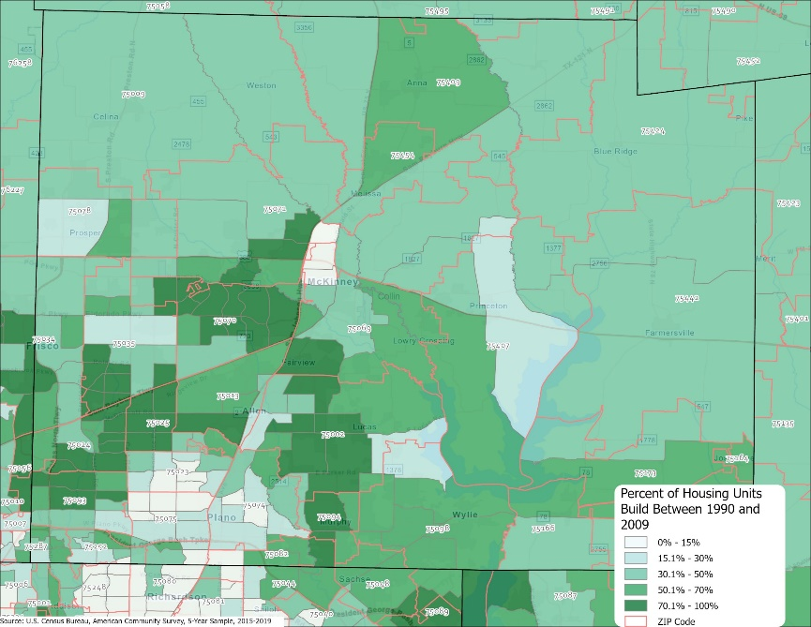
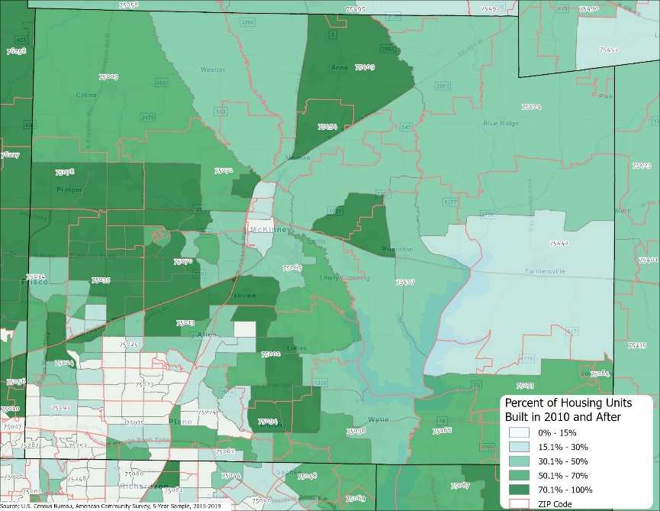
Percent of housing stock by year built Collin County census tracts, 2015-2019
Before 1970
1970-1989
1990-2009
2010 and later

Slide 29
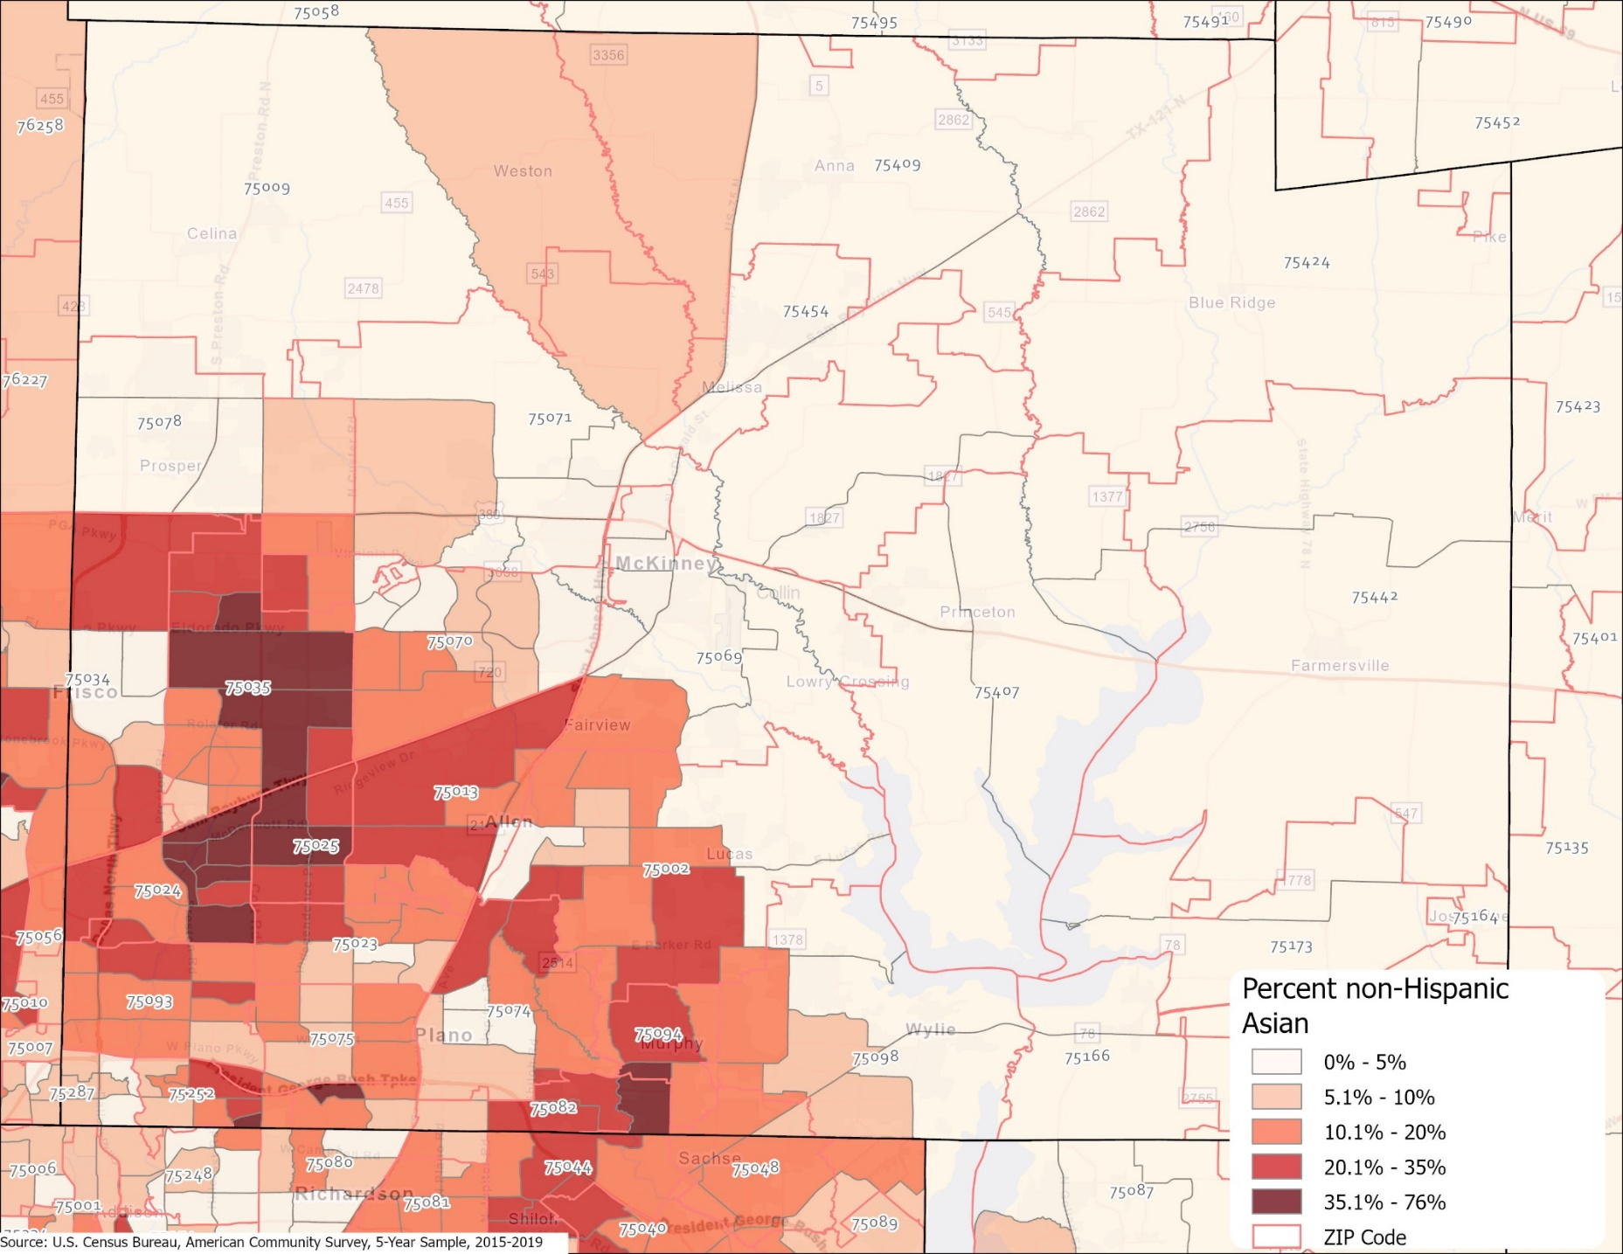
Percent non-Hispanic Asian population Collin County census tracts, 2015-2019

Slide 30
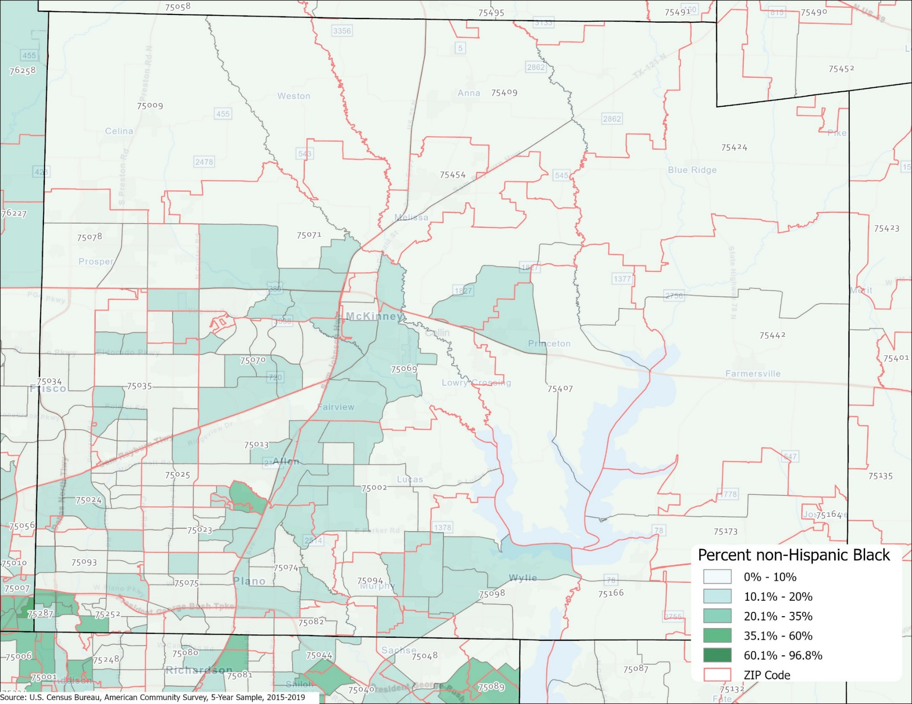
Percent non-Hispanic Black population Collin County census tracts, 2015-2019

Slide 31
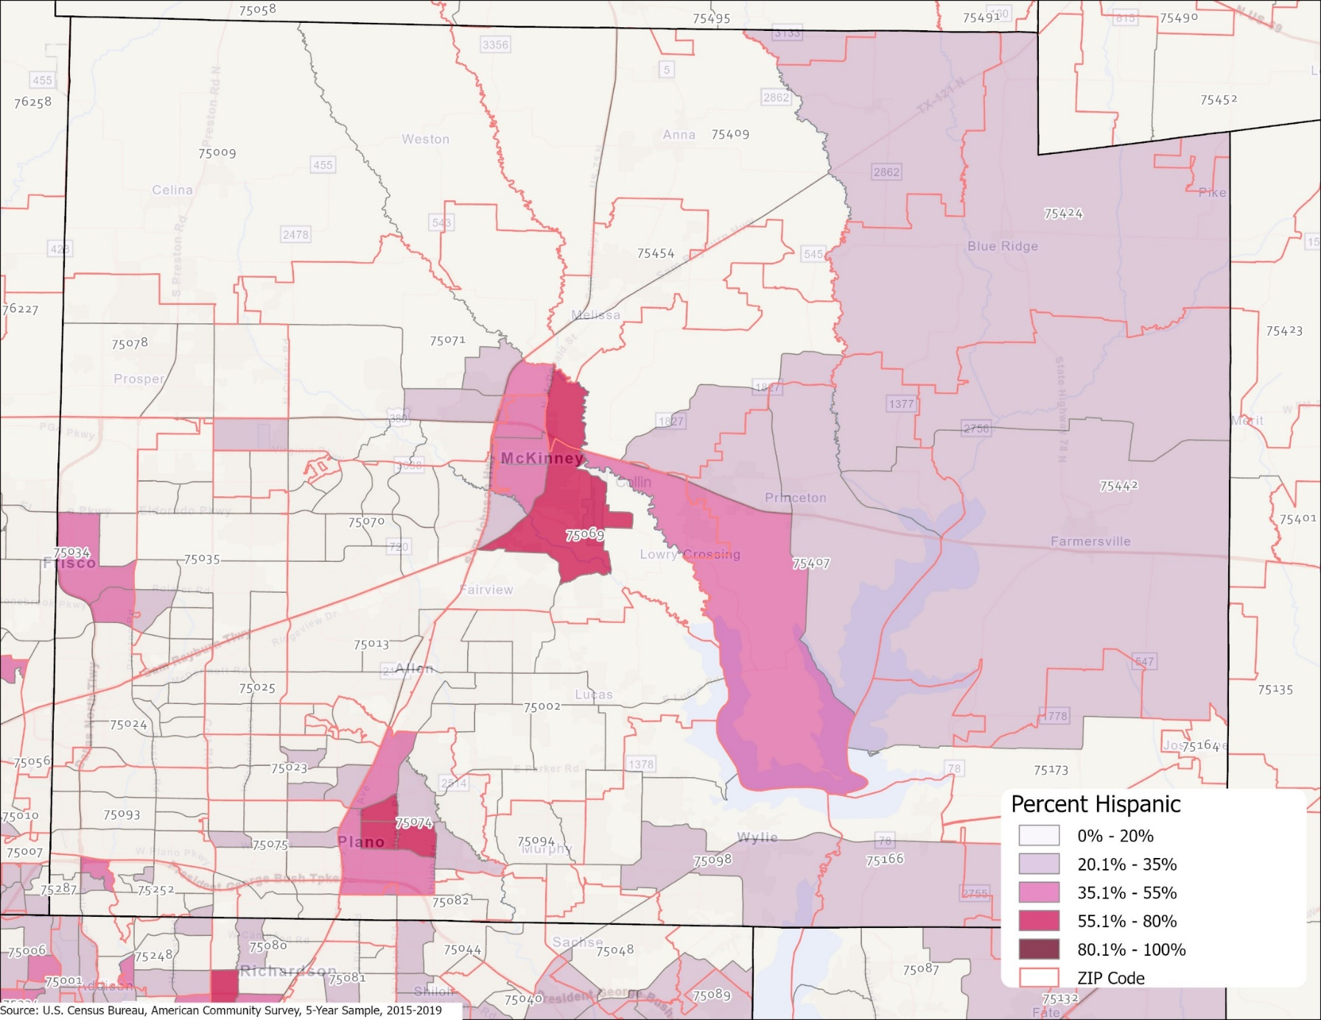
Percent population that is Hispanic, Collin County census tracts, 2015-2019

Slide 32
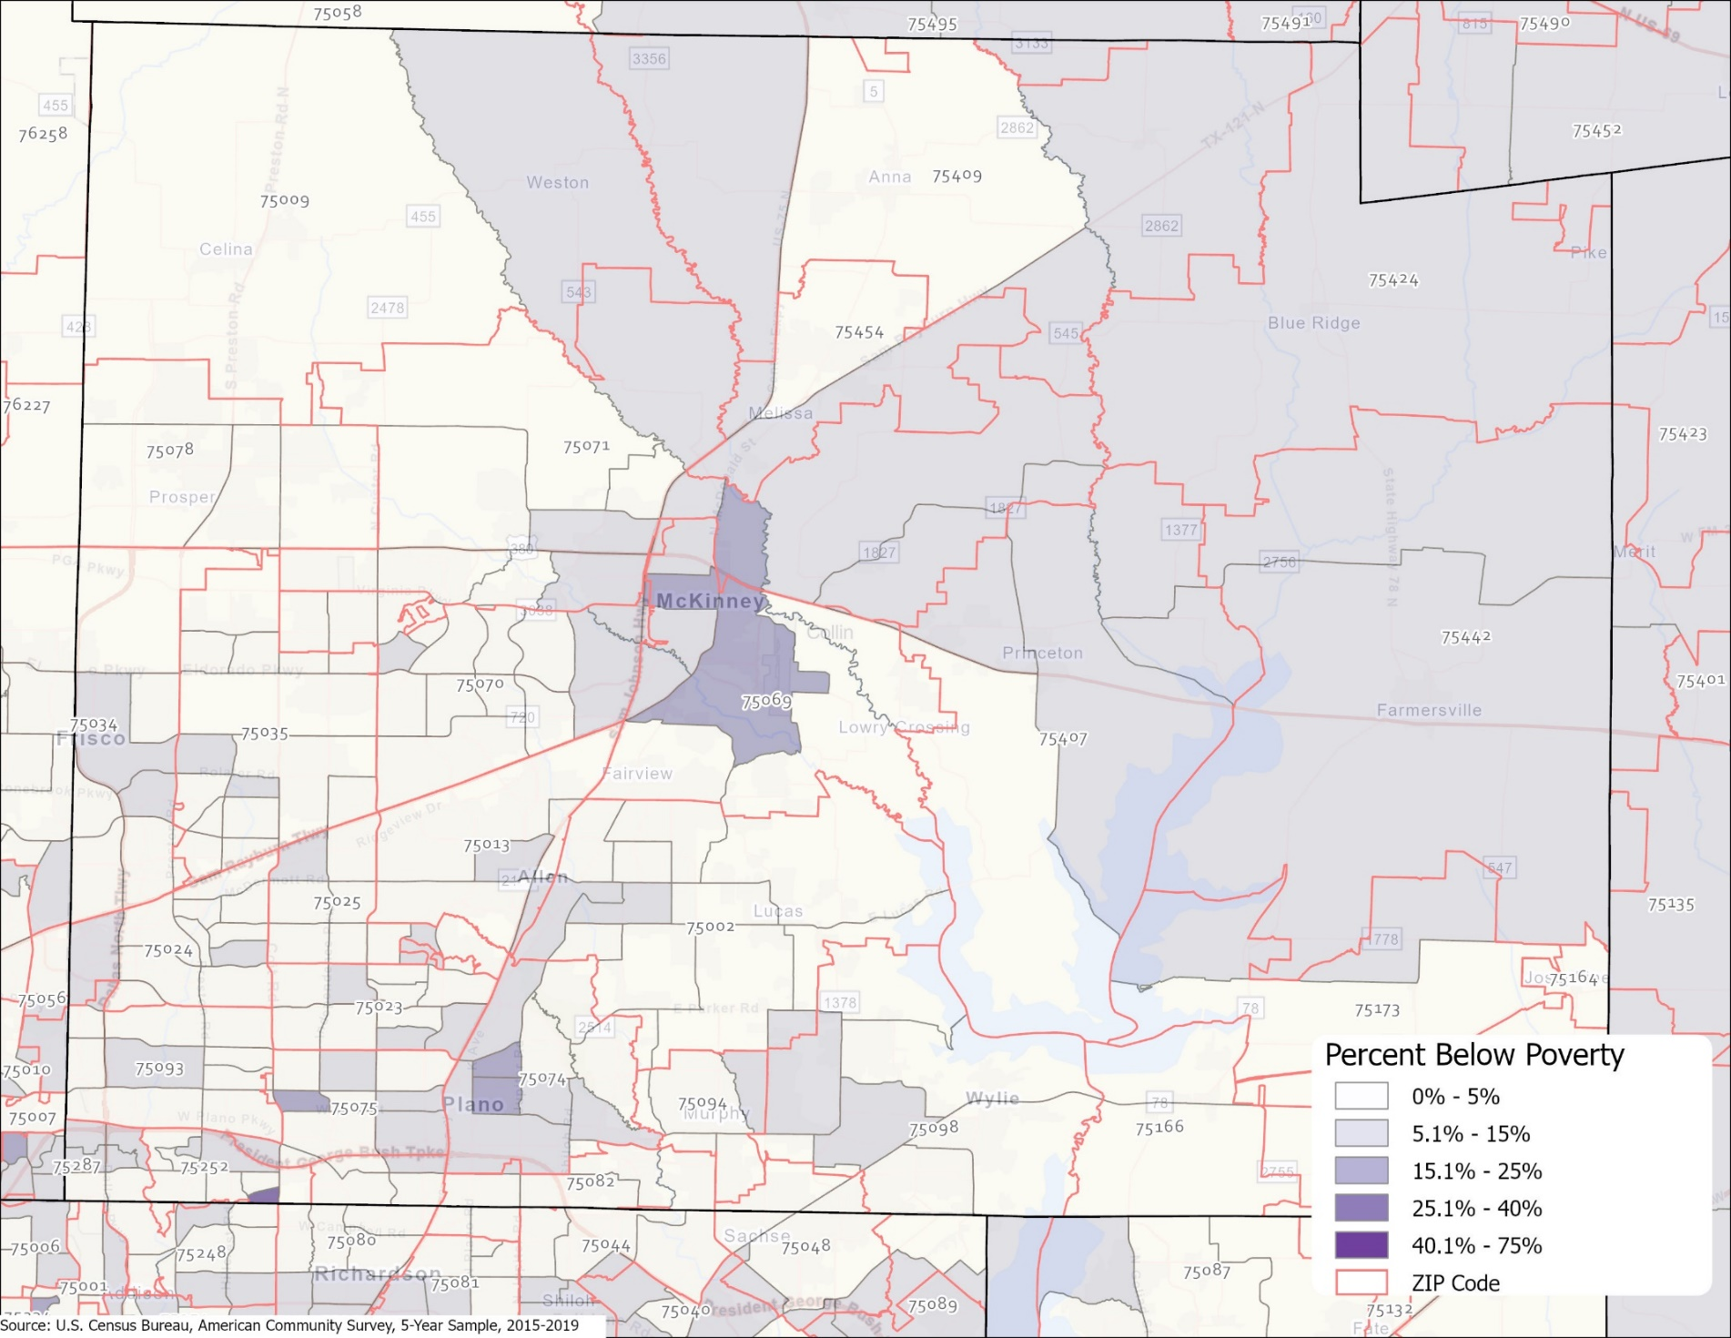
Percent of population living below poverty, Collin County census tracts, 2015-2019

Slide 33
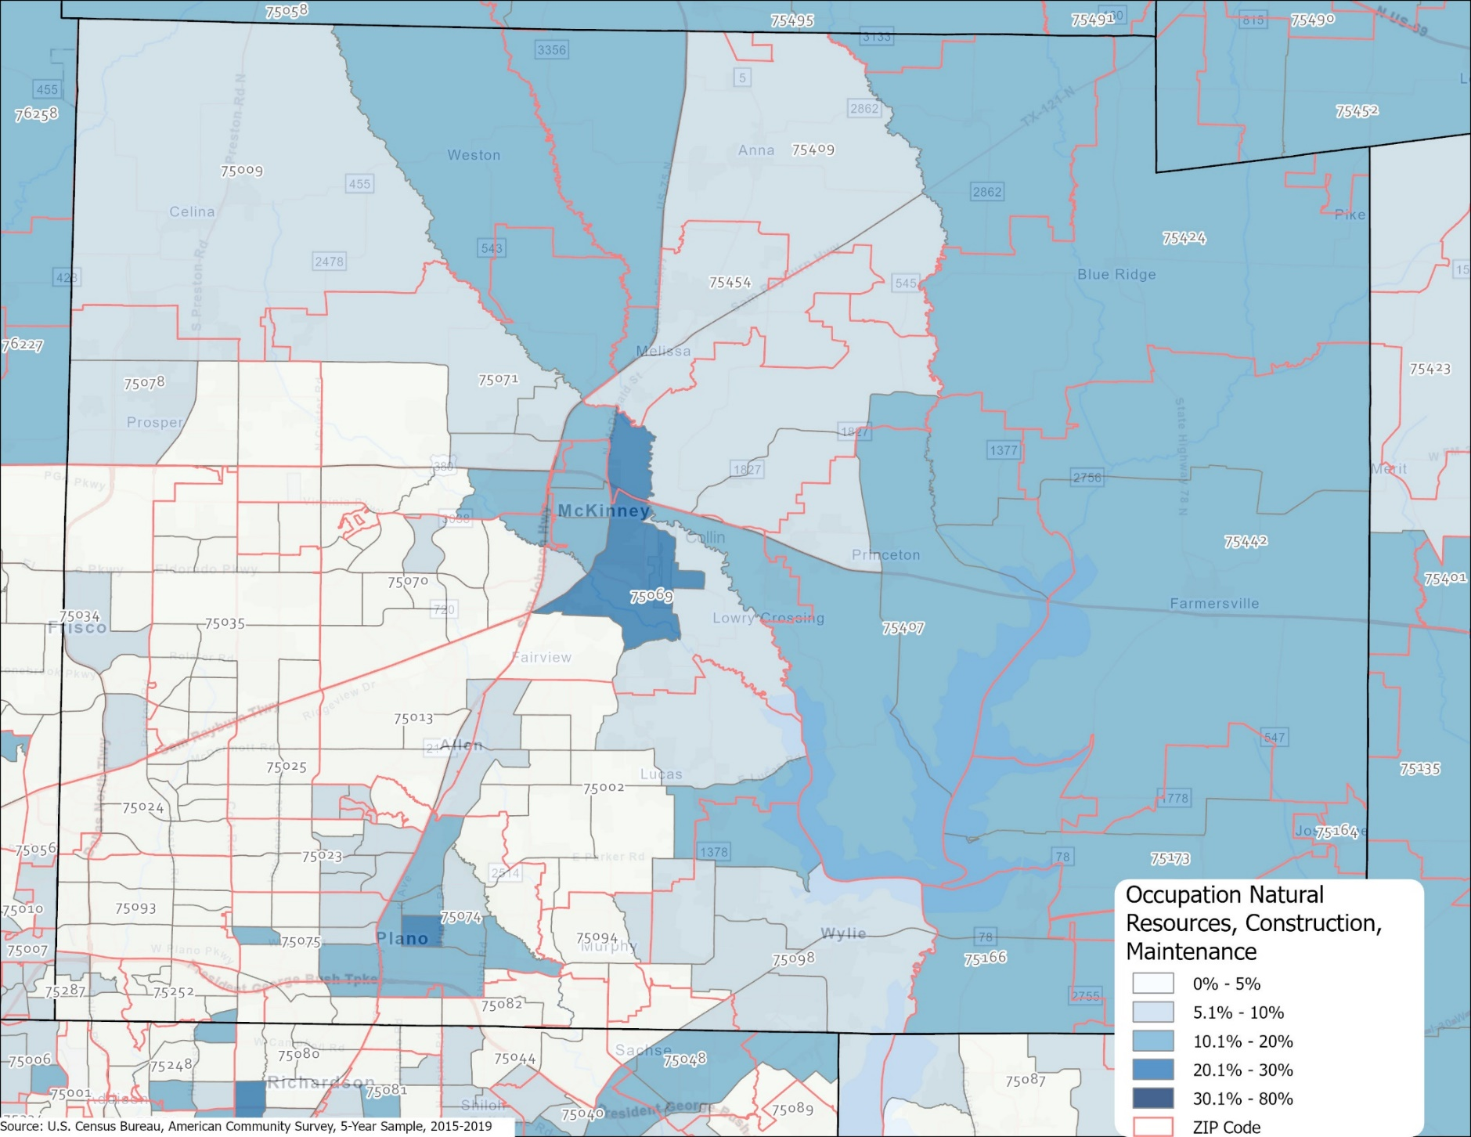
Percent of labor force working in natural resources, construction, maintenance, occupations Collin County census tracts, 2015-2019

Slide 34
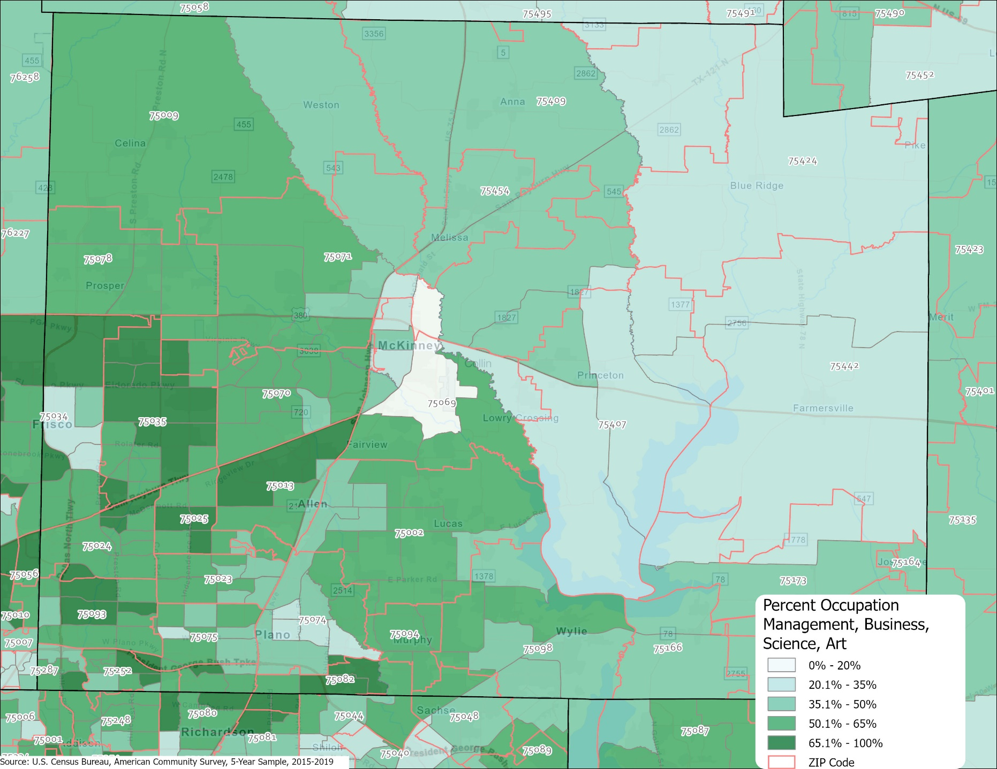
Percent of labor force working in management, business, science, art occupations, Collin County census tracts, 2015-2019

Slide 35
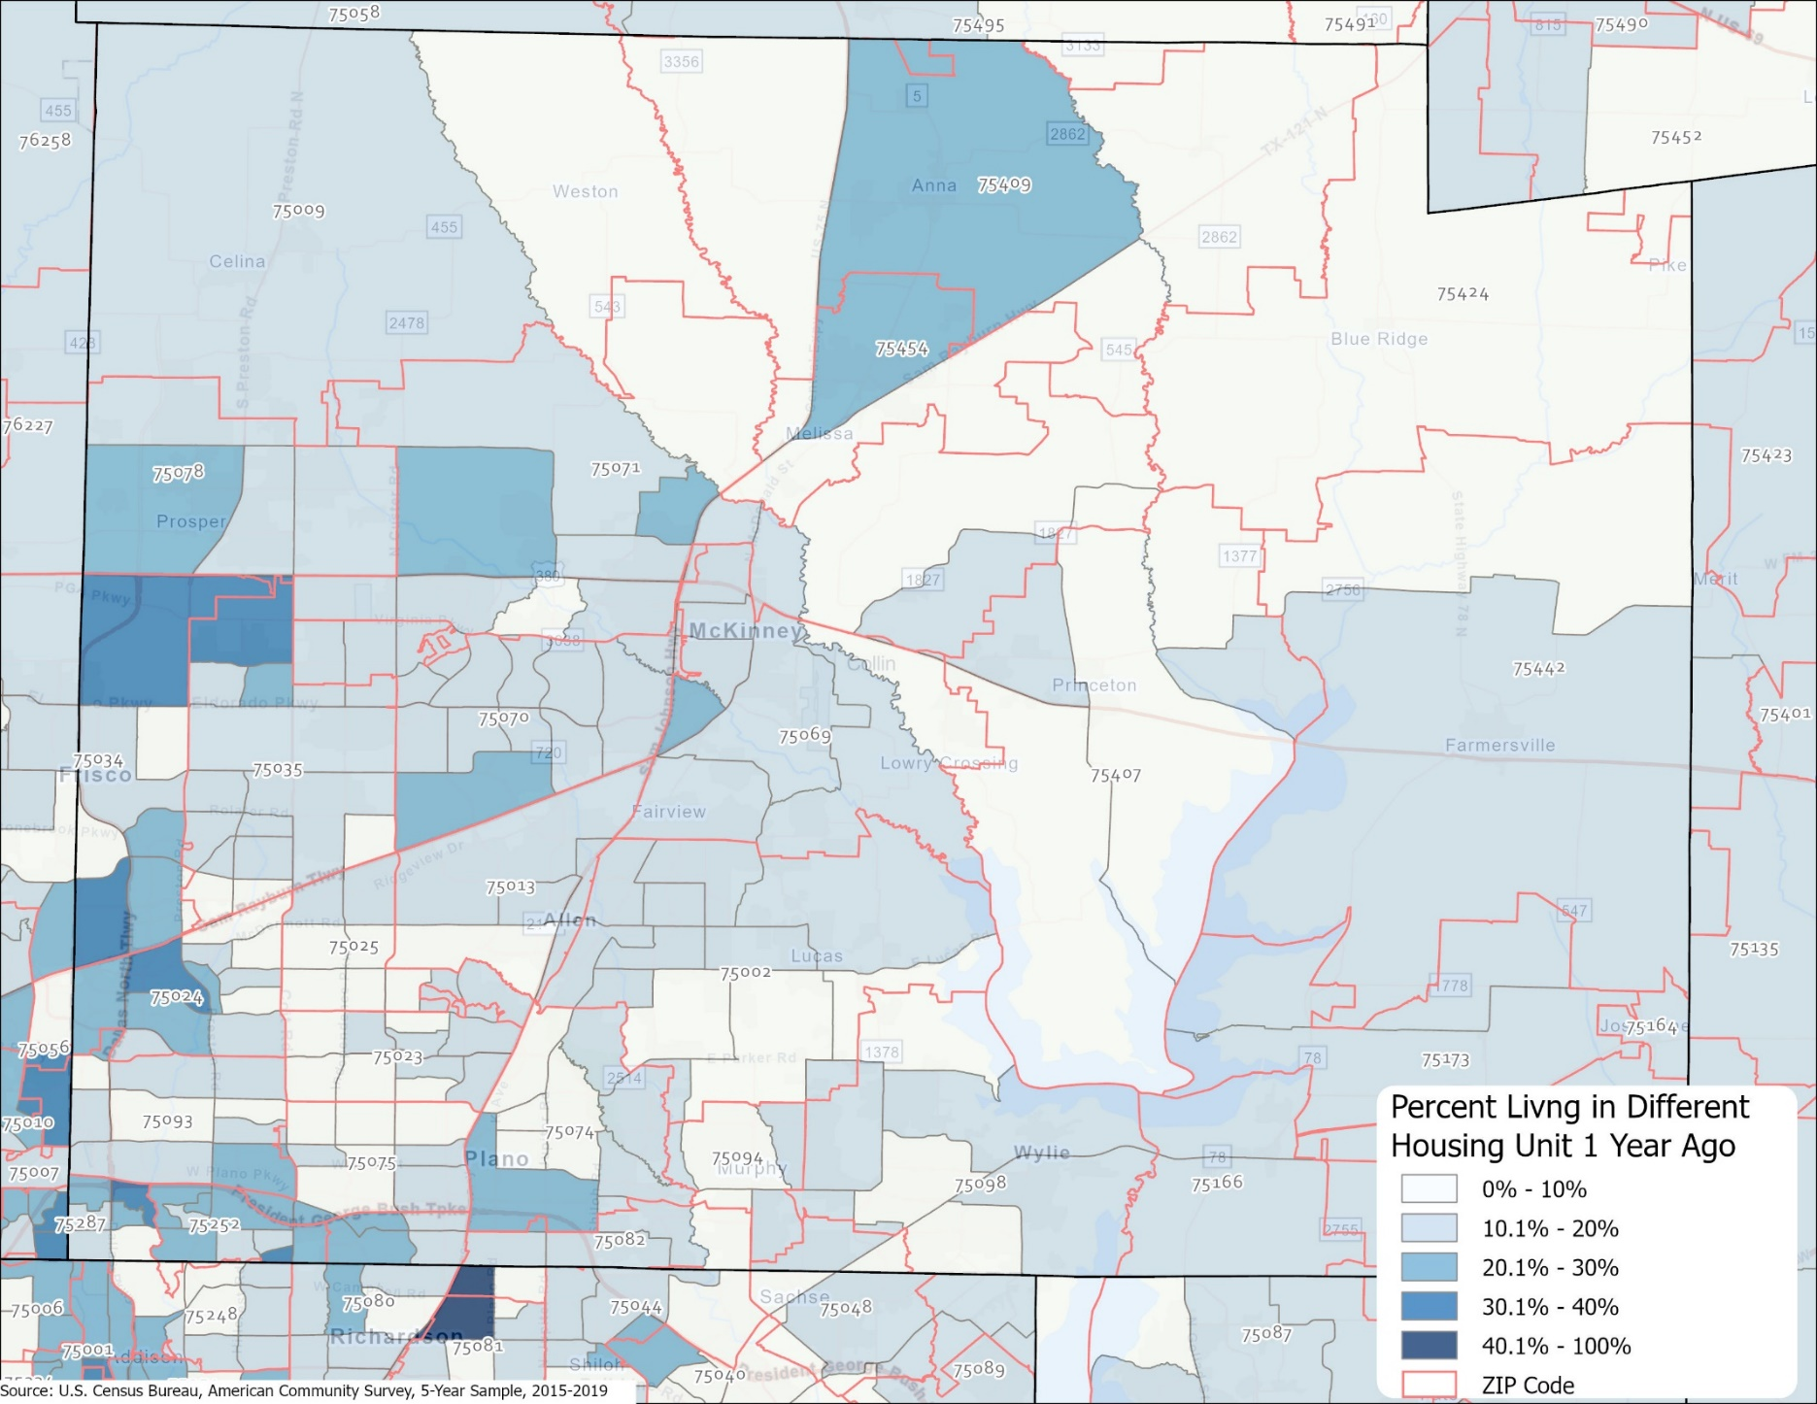
Percent lived in a different housing unit 1 year ago, Collin County census tracts, 2015-2019

Slide 36
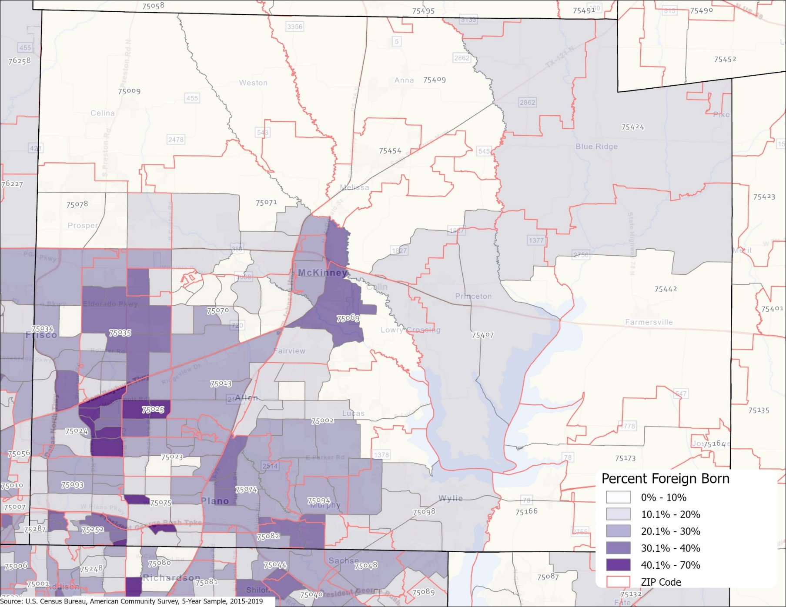
Percent population that is foreign born, Collin County census tracts, 2015-2019

Slide 37
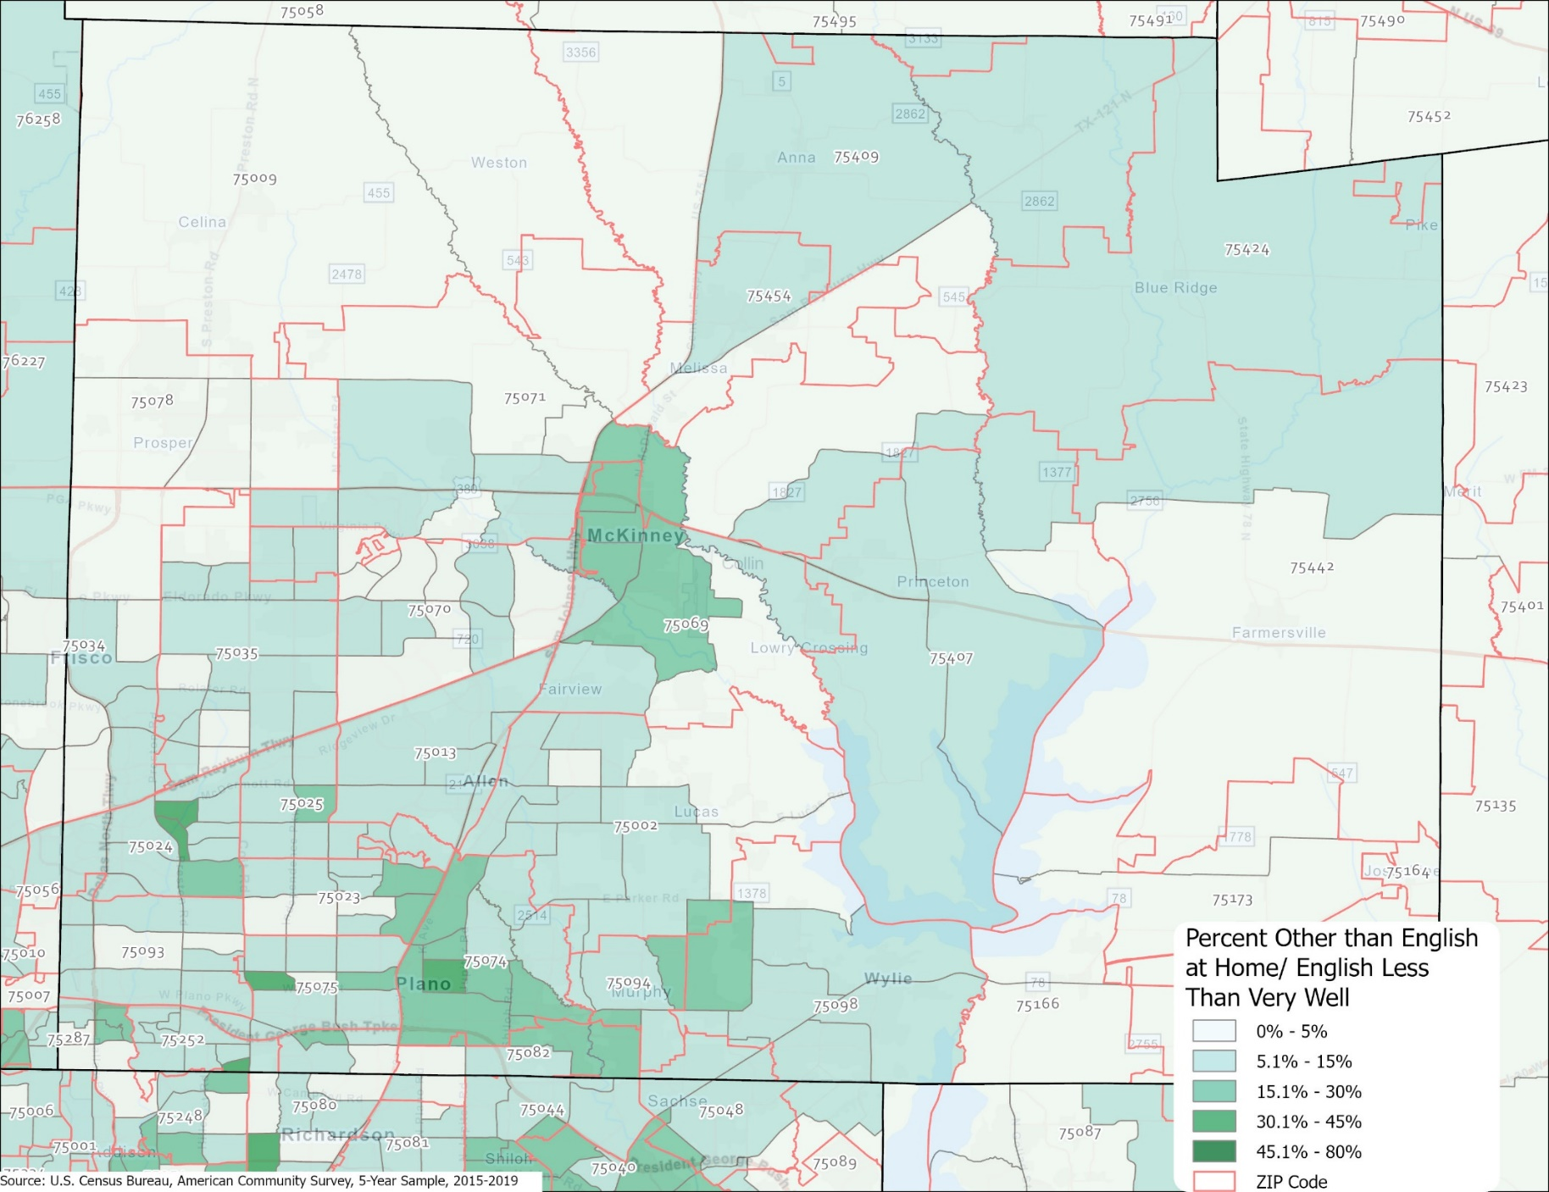
Percent of population speak language other than English and English less than very well, Collin County census tracts, 2015-2019

Slide 38
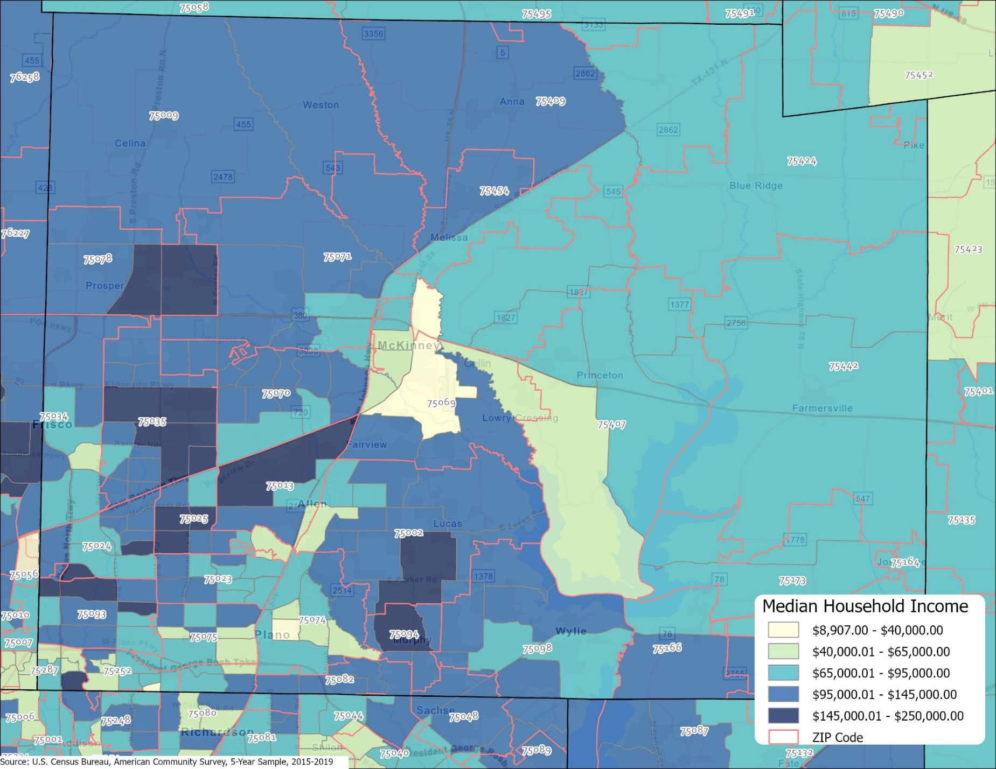
Median household income, Collin County census tracts, 2015-2019

Slide 39
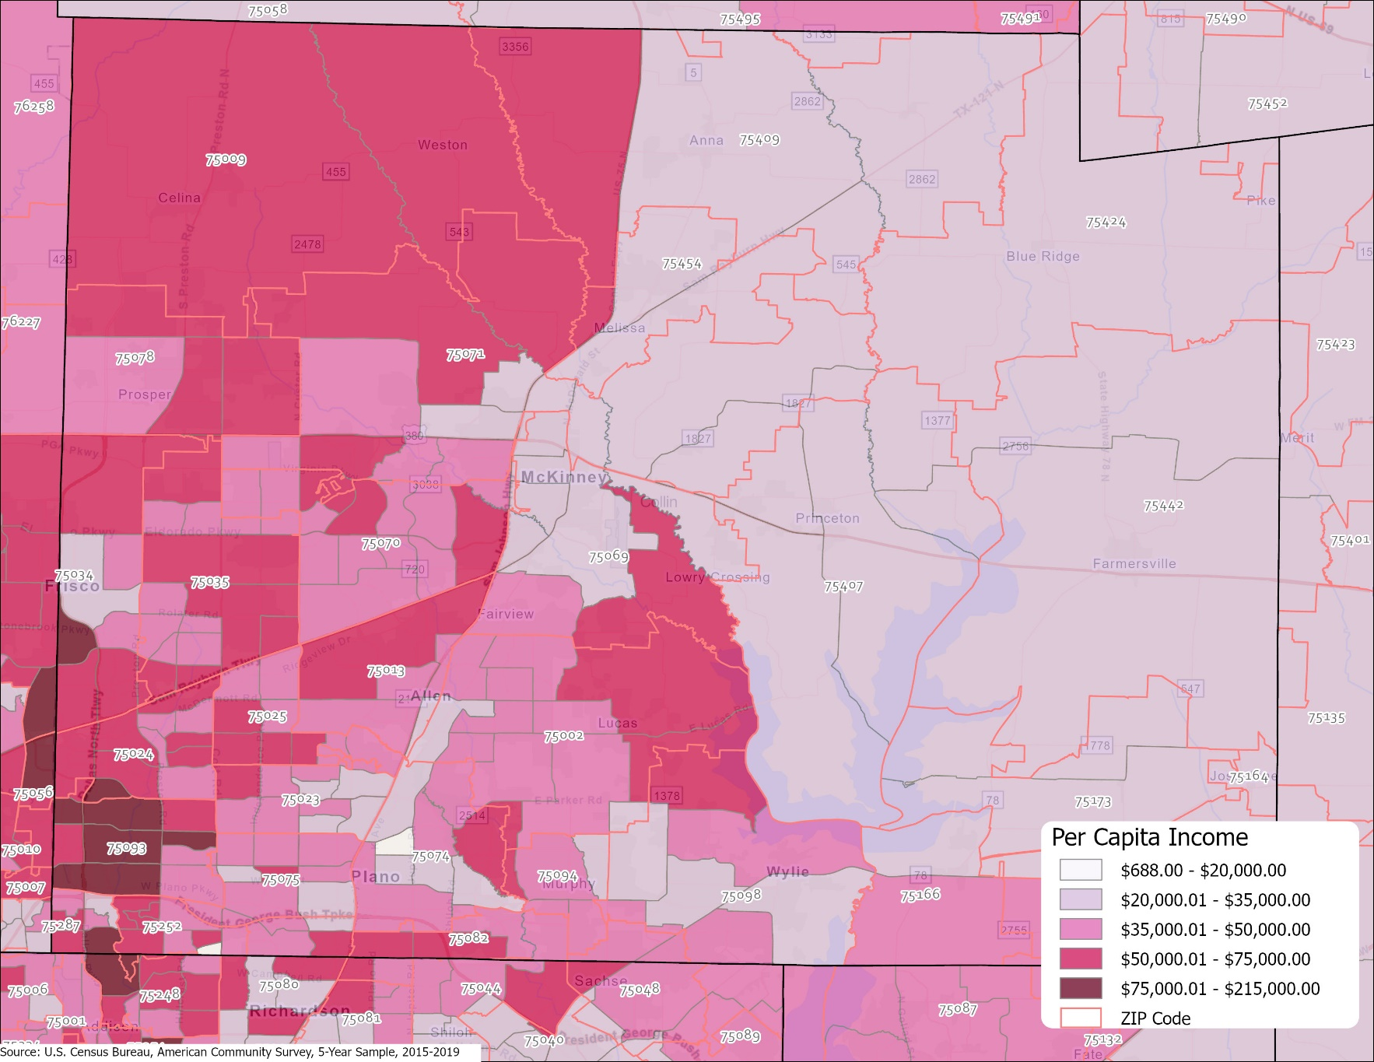
Per capita income, Collin County census tracts, 2015-2019

Slide 40
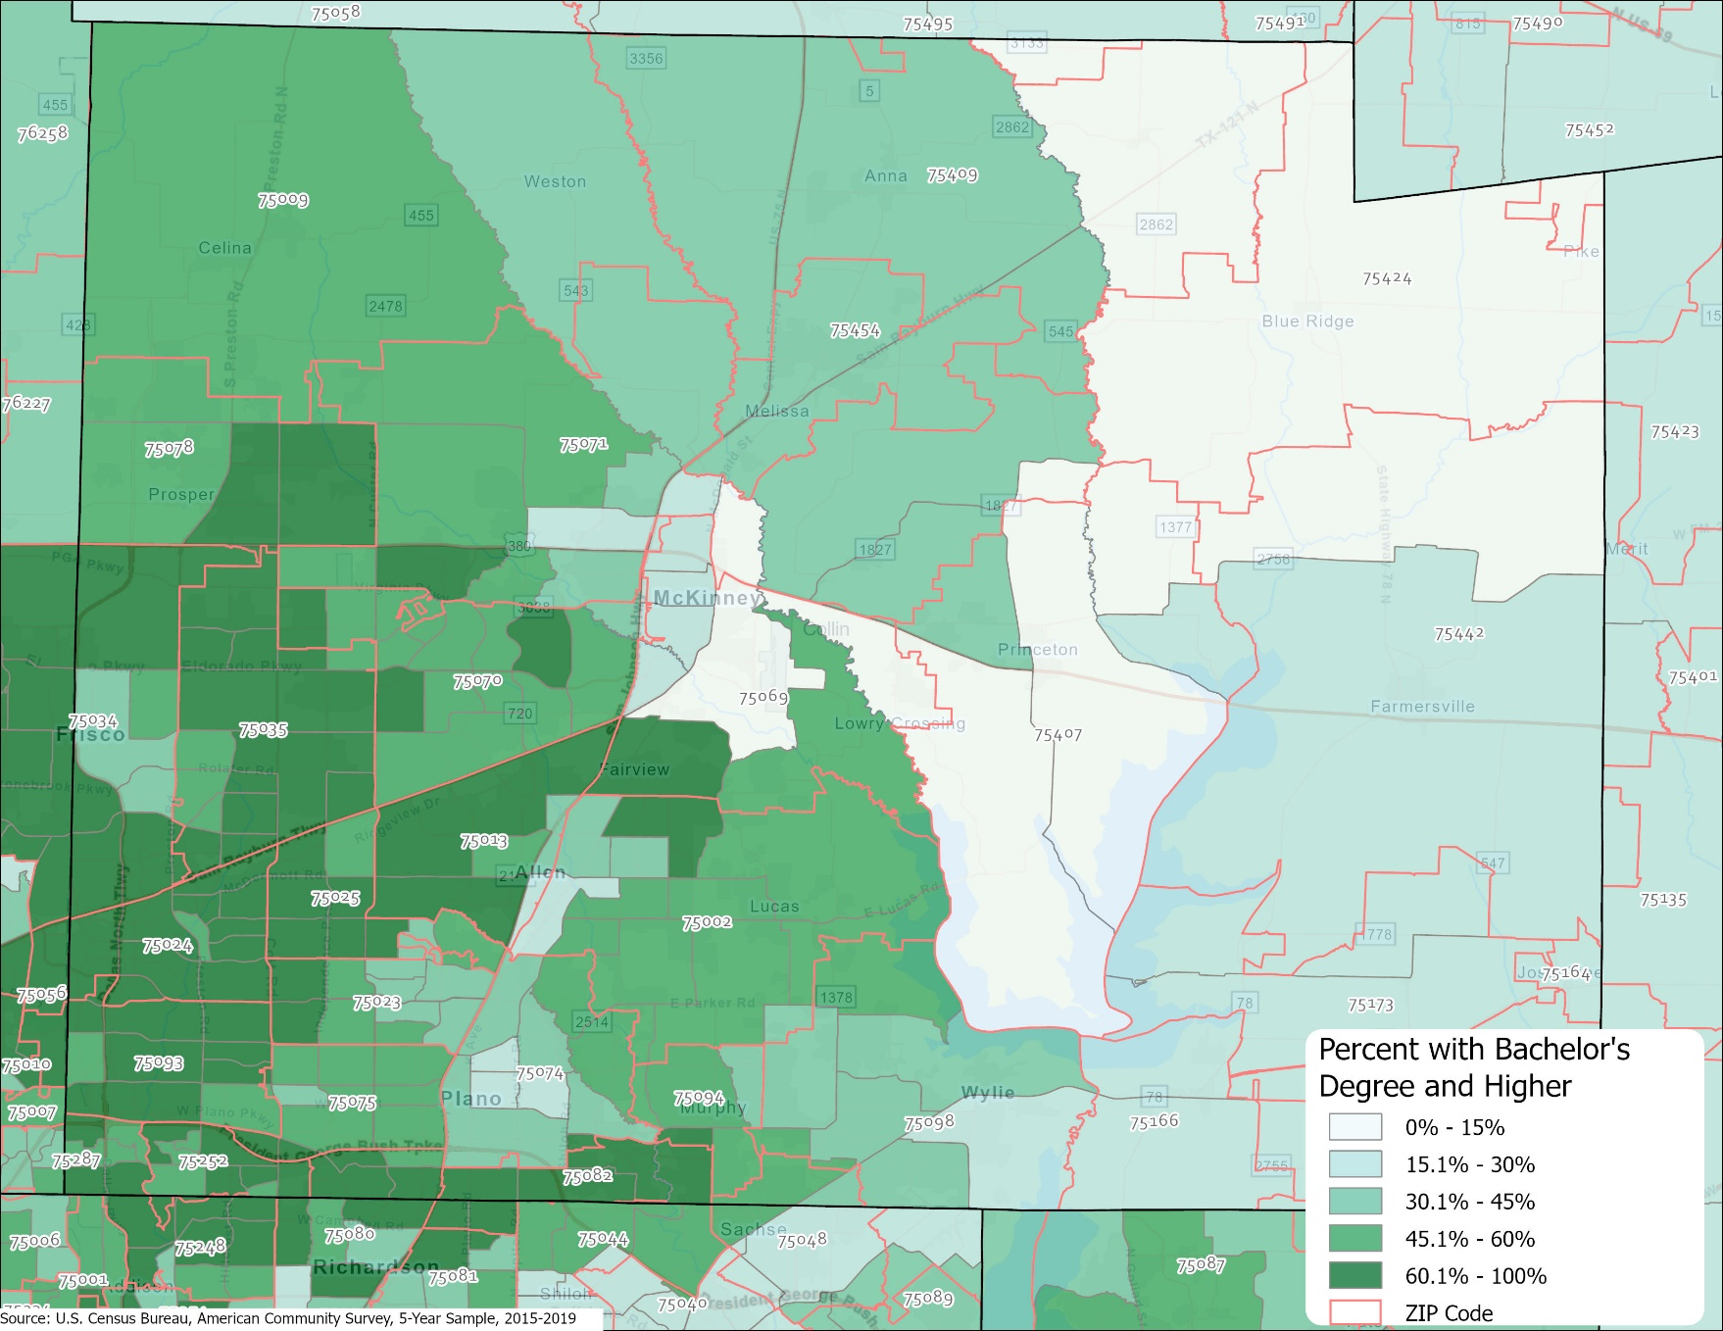
Percent of aged 25 years and older with bachelor’s degree or higher, Collin County census tracts, 2015-2019

Slide 41
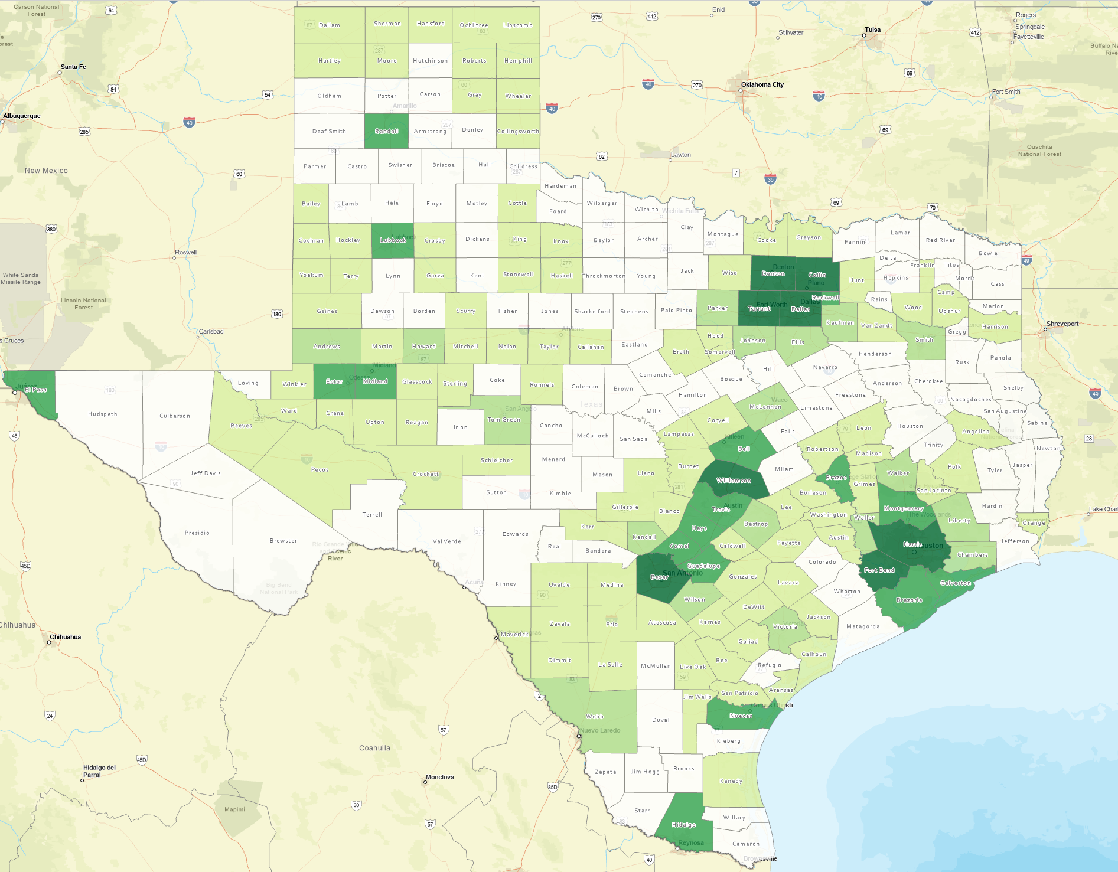
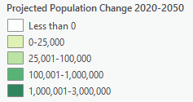
Projected Population Change, Texas Counties, 2020-2050
Source: Texas Demographic Center, 2018 Population Projections

Slide 42
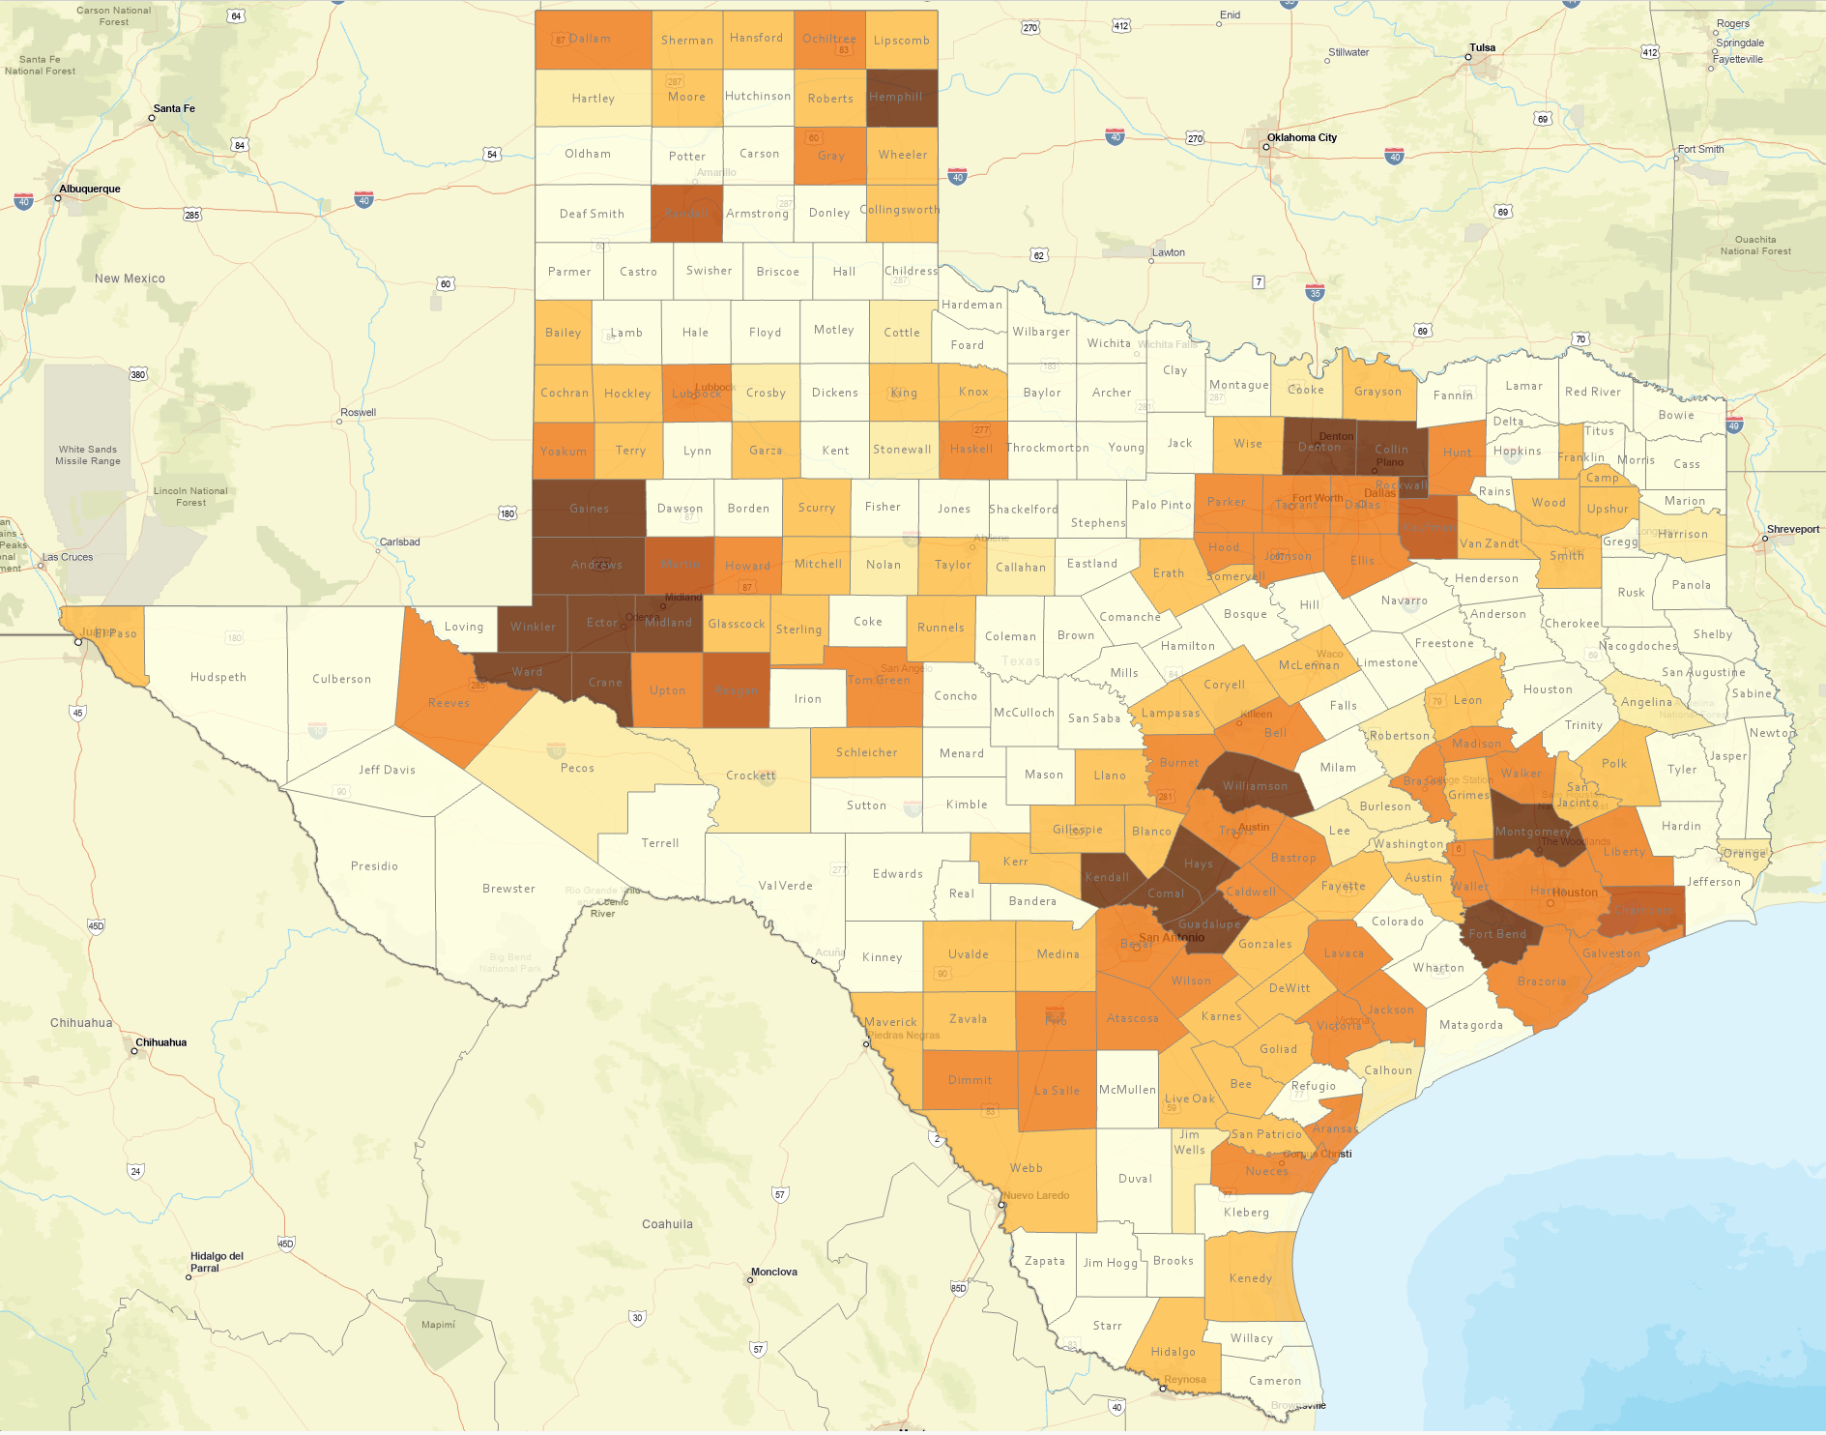
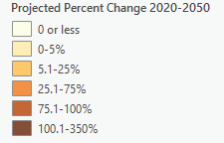
Projected Percent Population Change, Texas Counties, 2020-2050
Source: Texas Demographic Center, 2018 Population Projections

Slide 43
Population Projections, DFW Metro Largest Counties, 2010-2040
Source: Texas Demographic Center, 2018 Population Projections

Slide 44
Projected Population by Race and Ethnicity, Texas 2010-2050
Source: Texas Demographic Center 2018 Population Projections
Notes:
Population projections by race and ethnicity suggest that Latino’s are and will increasingly be the largest race/ethnic group. The number and percent who are non-Hispanic white are likely to decline. Non-Hispanic other are largely of Asian descent and they appear to be increasing rapidly, although the base number is small.

Slide 45
Projected Population Change and Percent of Total Change by Race/Ethnicity, Texas, 2010-2030
Source: Texas Demographic Center 2018 Population Projections

Slide 46
Projected Numeric Change, DFW Metro, 2010 to 2030
Source: Texas Demographic Center, 2018 Population Projections

Slide 47
Lloyd Potter, Ph.D.
(210) 458-6530
TDC@UTSA.edu
Demographics.Texas.gov
@TexasDemography

