Slide 1
Population Change and Redistricting in Texas
Mexican American Legislative Caucus
August 19, 2021

Slide 2
Redistricting Dates
Apportionment File sent to POTUS on April 26, 2021
Redistricting Data File (Public Law 94-171 File) received by the Governor September 12, 2021
PL 94-171 File to includes:
Race, Hispanic origin, 18 and older, occupancy status, and group quarters by type.
Data available at WWW.CENSUS.GOV/RDO

Slide 3
Population Growth and Congressional Seat Change
 | 2010 Population | 2020 Population | Numeric Change 2010-2020 | Percent Change 2010-2020 | Congressional Seat Change
United States | 308,745,538 | 331,449,281 | 22,703,743 | 7.4%
Texas | 25,145,561 | 29,145,505 | 3,999,944 | 15.90% | 2
Florida | 18,801,310 | 21,538,187 | 2,736,877 | 14.60% | 1
North Carolina | 9,535,483 | 10,439,388 | 903,905 | 9.50% | 1
Colorado | 5,029,196 | 5,773,714 | 744,518 | 14.80% | 1
Oregon | 3,831,074 | 4,237,256 | 406,182 | 10.60% | 1
Montana | 989,415 | 1,084,225 | 94,810 | 9.60% | 1
California | 37,253,956 | 39,538,223 | 2,284,267 | 6.10% | -1
New York | 19,378,102 | 20,201,249 | 823,147 | 4.20% | -1
Pennsylvania | 12,702,379 | 13,002,700 | 300,321 | 2.40% | -1
Ohio | 11,536,504 | 11,799,448 | 262,944 | 2.30% | -1
Michigan | 9,883,640 | 10,077,331 | 193,691 | 2.00% | -1
Illinois | 12,830,632 | 12,812,508 | -18,124 | -0.10% | -1
West Virginia | 1,852,994 | 1,793,716 | -59,278 | -3.20% | -1
Source: U.S. Census Bureau. 2010 and 2020 Census Apportionment Files
Notes:
Texas is the second largest state in terms of population (2nd to CA) and area (2nd to AK). In terms of number of people, Texas’ growth exceeds that of all other states between 2010 and 2020. Texas has added over 4.2 million people between April 1, 2010 and July 1, 2020. This puts Texas on track to meet or surpass the number of people added in the last census when Texas gained 4 congressional seats. Projections from multiple sources anticipate Texas will gain 3 congressional districts after the 2020 census.

Slide 4
Ideal Size of Texas Senate, House, and U.S. Congressional Districts
Texas Senate District Size (31 seats) = 940,178 (811,147 in 2010)
Texas House District Size (150 seats) = 194,303 (167,637 in 2010)
U.S. House Seat District Size (38 seats) = 766,987 (698,488 in 2010 – 36 seats)
+ 3,999,944
Source: Census Bureau 2010 and 2020 Census Counts
Notes:
The Texas Demographic Center produces population projections for the state. In comparing these projections, to the Census Bureau’s population estimates since 2010, we see the Texas Demographic Center is closely aligned with the Census Bureau estimates trend. TDC projections indicate Texas will grow to just under 29.7 million by 2020.

Slide 5
Population and population change for the total and race/ethnic groups, Texas, 2010-2020
Population | Total | NH White | NH Black | Hispanic | NH Asian | NH Other
2010 | 25,145,561 | 11,397,345 | 2,886,825 | 9,460,921 | 948,426 | 452,044
2020 | 29,145,505 | 11,584,597 | 3,444,712 | 11,441,717 | 1,561,518 | 1,112,961
Numeric Change | 3,999,944 | 187,252 | 557,887 | 1,980,796 | 613,092 | 660,917
Percent Change | 15.9% | 1.6% | 19.3% | 20.9% | 64.6% | 146.2%
Percent of the total population 2020 | 100% | 39.7% | 11.8% | 39.3% | 5.4% | 3.8%
Source: US Census Bureau, 2010 and 2020 Census, P.L. 94-171 Redistricting Files

Slide 6
Percent distribution of race/ethnic groups in Texas, 2010 and 2020
Source: US Census Bureau, 2010 and 2020 Census, P.L. 94-171 Redistricting Files

Slide 7
Number and percent of Texas counties that had population declines for total and for race/ethnic groups between 2010 and 2020
Total | NH White | NH Black | Hispanic | NH Asian | NH Other
143 | 198 | 158 | 63 | 49 | -
56% | 78% | 62% | 25% | 19% | 0%
Source: US Census Bureau, 2010 and 2020 Census, P.L. 94-171 Redistricting Files

Slide 8
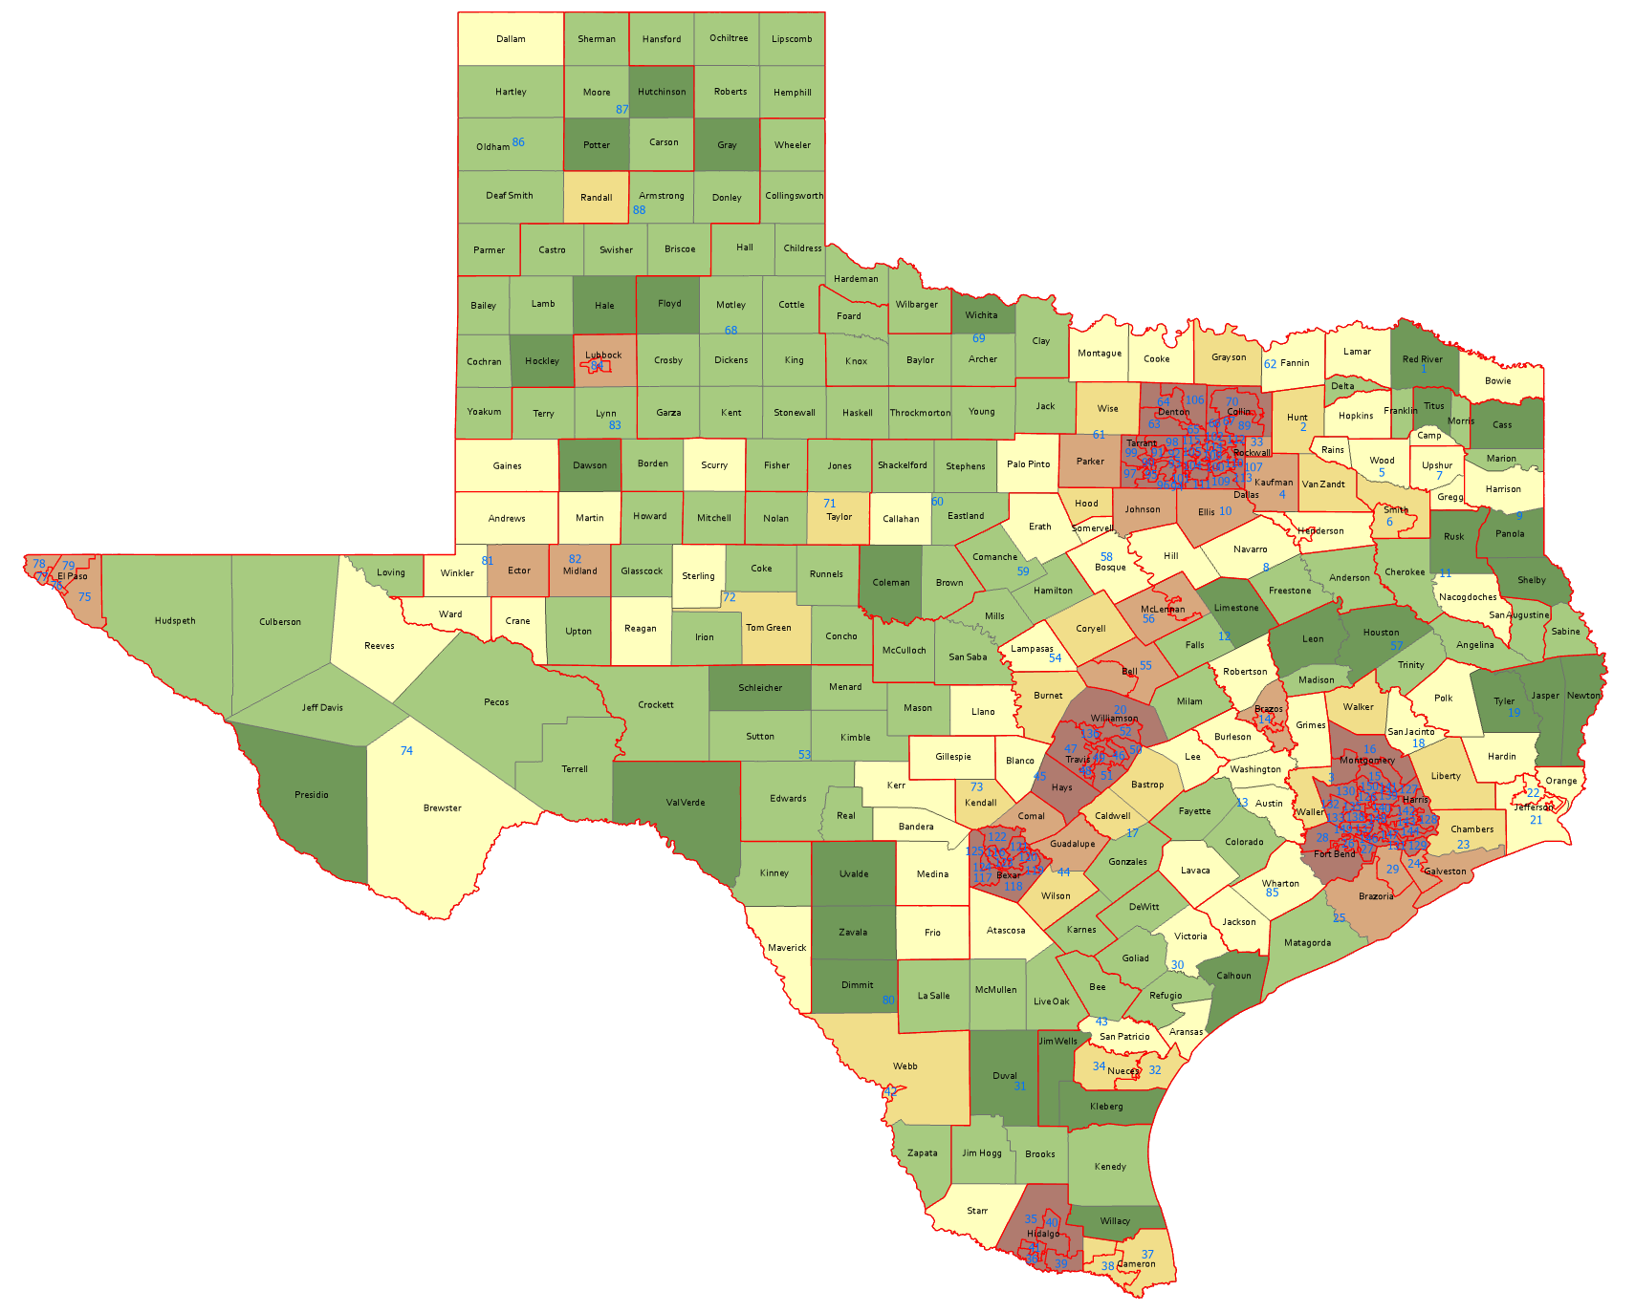
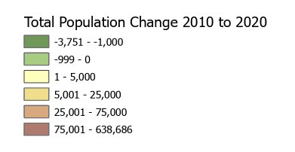
Numeric Change, Texas Counties, 2010-2020
143 counties lost population
Source: US Census Bureau, 2010 and 2020 Census, P.L. 94-171 Redistricting Files

Slide 9
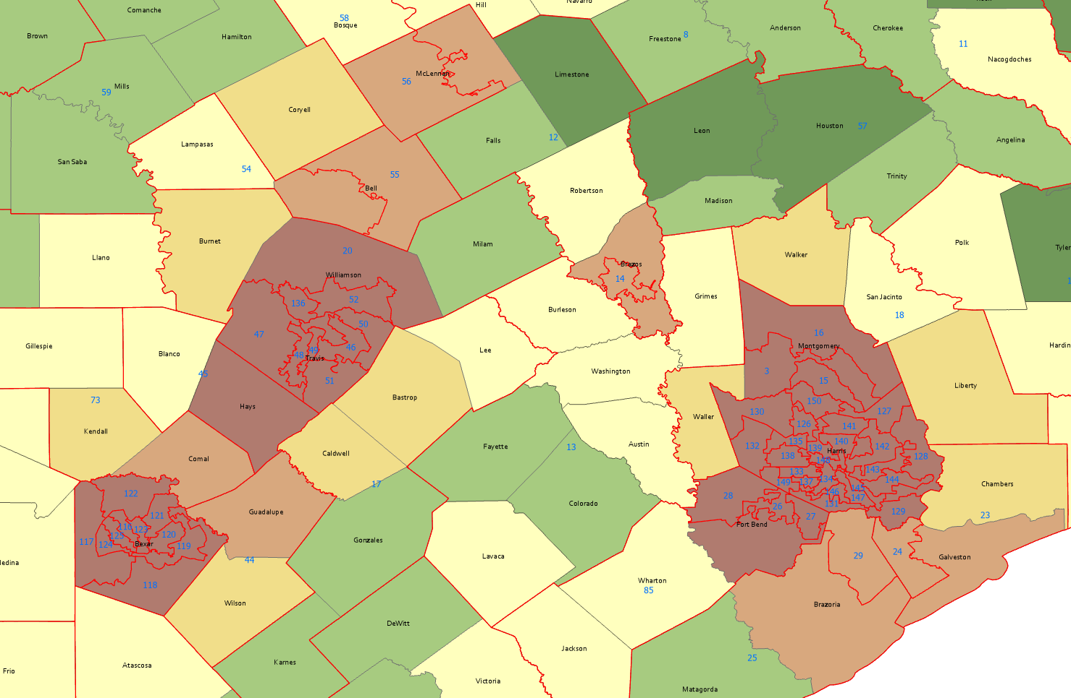
Numeric Change, Texas Counties, San Antonio, Austin, Houston, 2010-2020
Source: US Census Bureau, 2010 and 2020 Census, P.L. 94-171 Redistricting Files

Slide 10
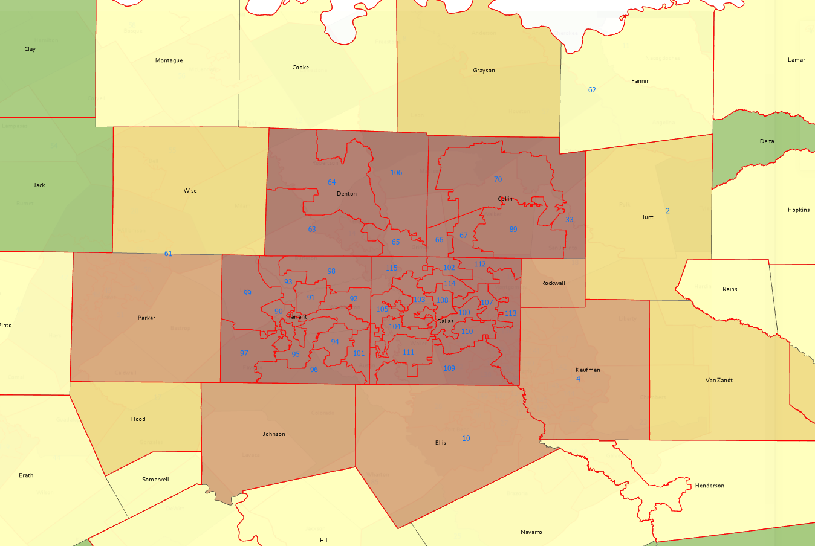
Numeric Change, Texas Counties, DFW Area 2010-2020
Source: US Census Bureau, 2010 and 2020 Census, P.L. 94-171 Redistricting Files

Slide 11
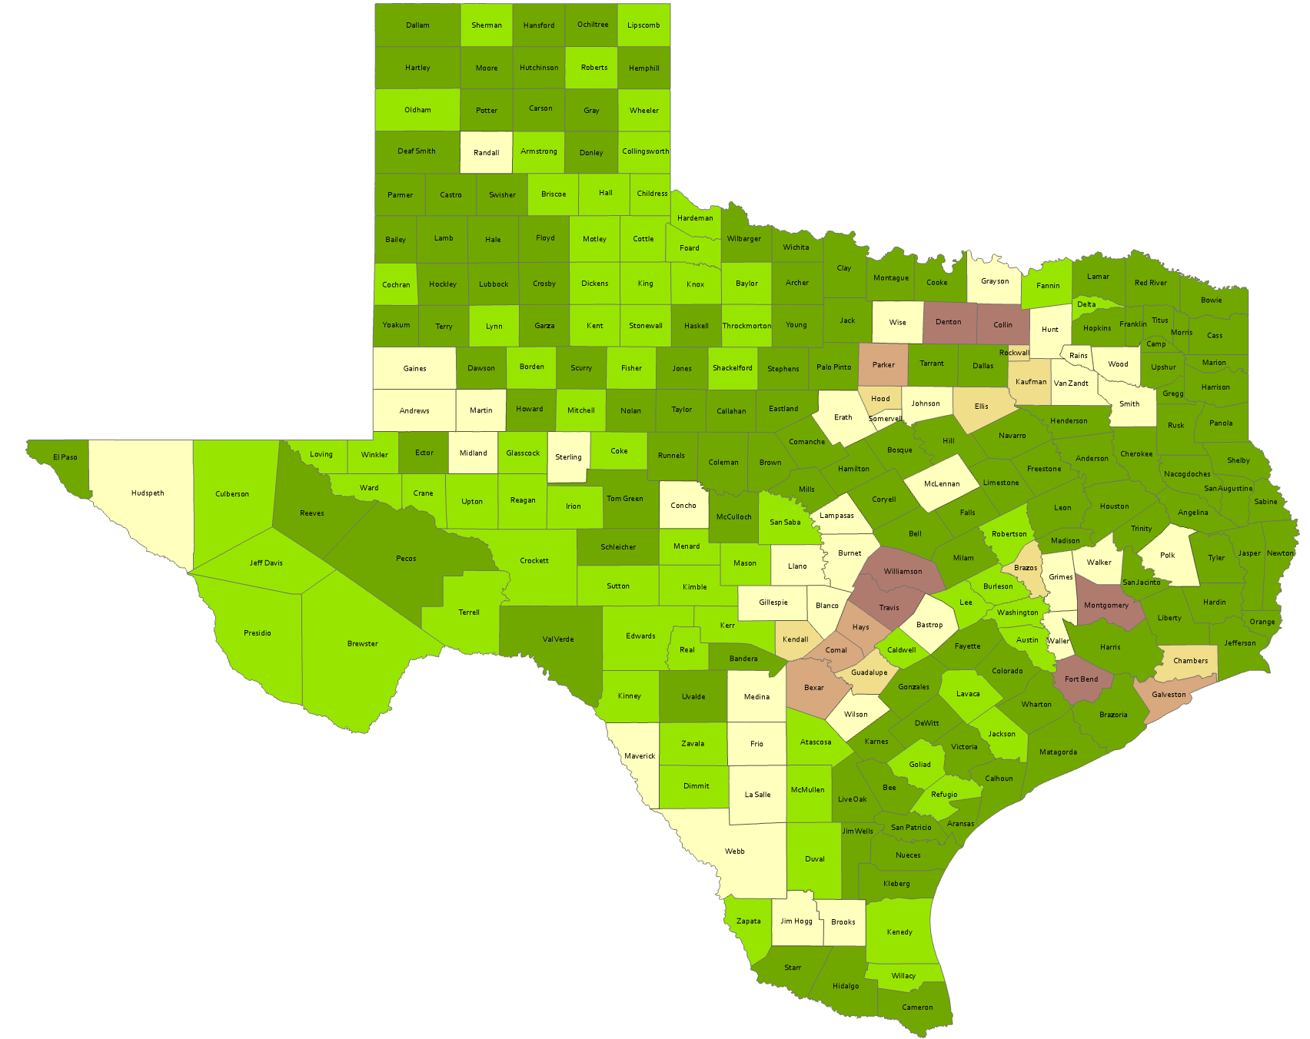
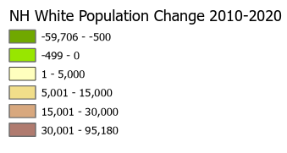
Numeric Change, Texas Counties, Non-Hispanic White, 2010-2020
198 counties lost NH white population
Source: US Census Bureau, 2010 and 2020 Census, P.L. 94-171 Redistricting Files

Slide 12
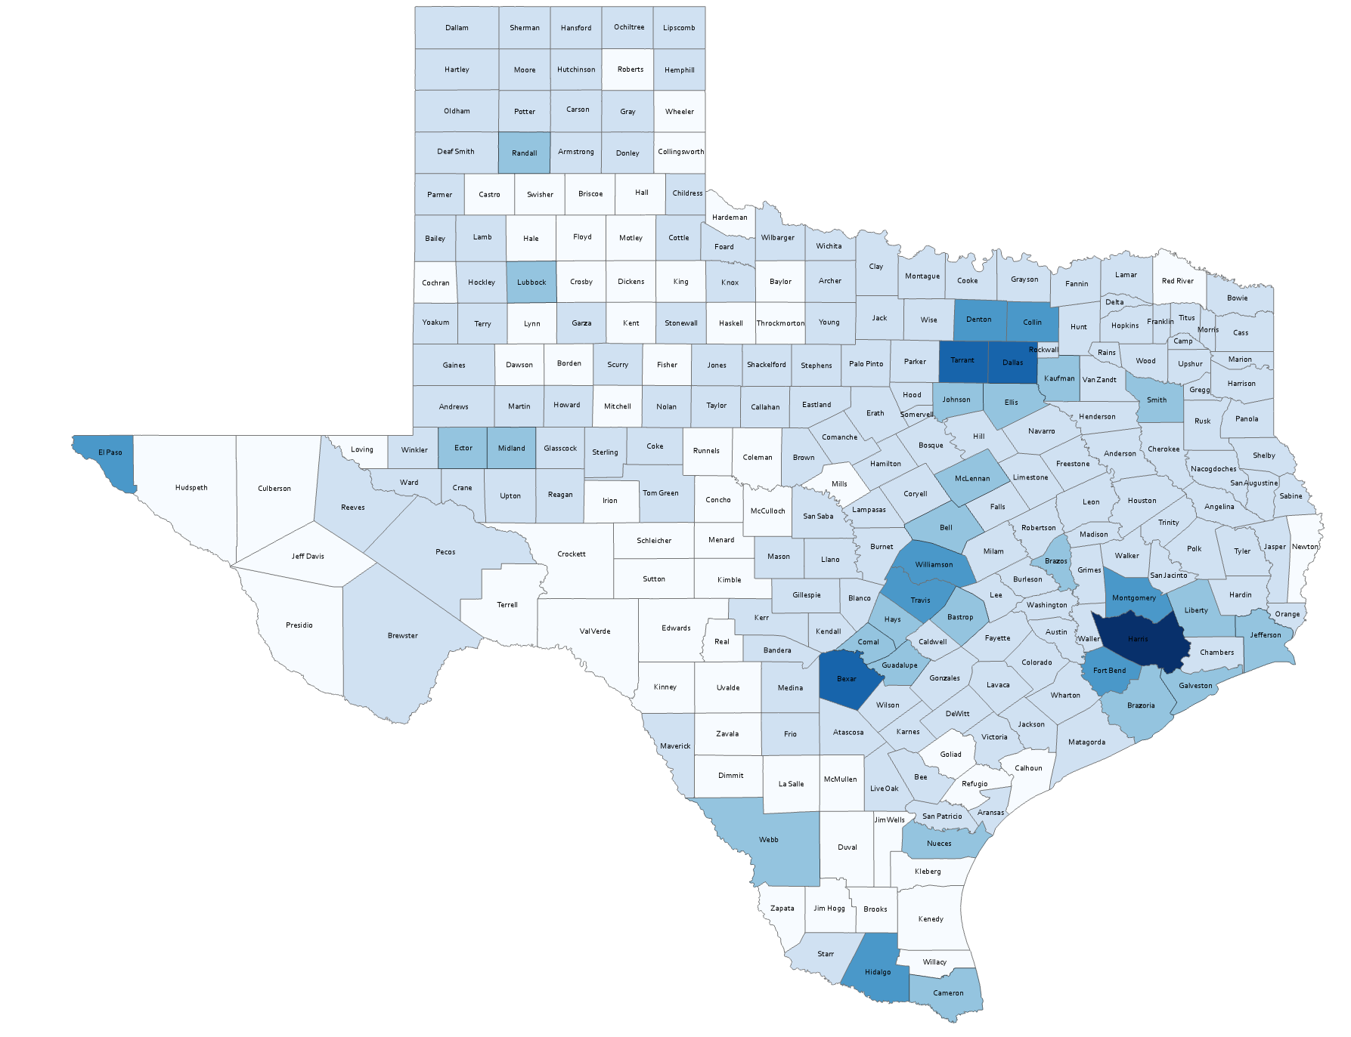
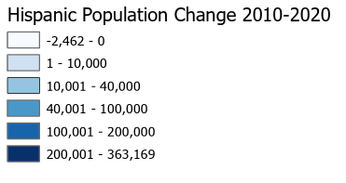
Numeric Change, Texas Counties, Hispanic, 2010-2020
63 counties lost Hispanic population
Source: US Census Bureau, 2010 and 2020 Census, P.L. 94-171 Redistricting Files

Slide 13
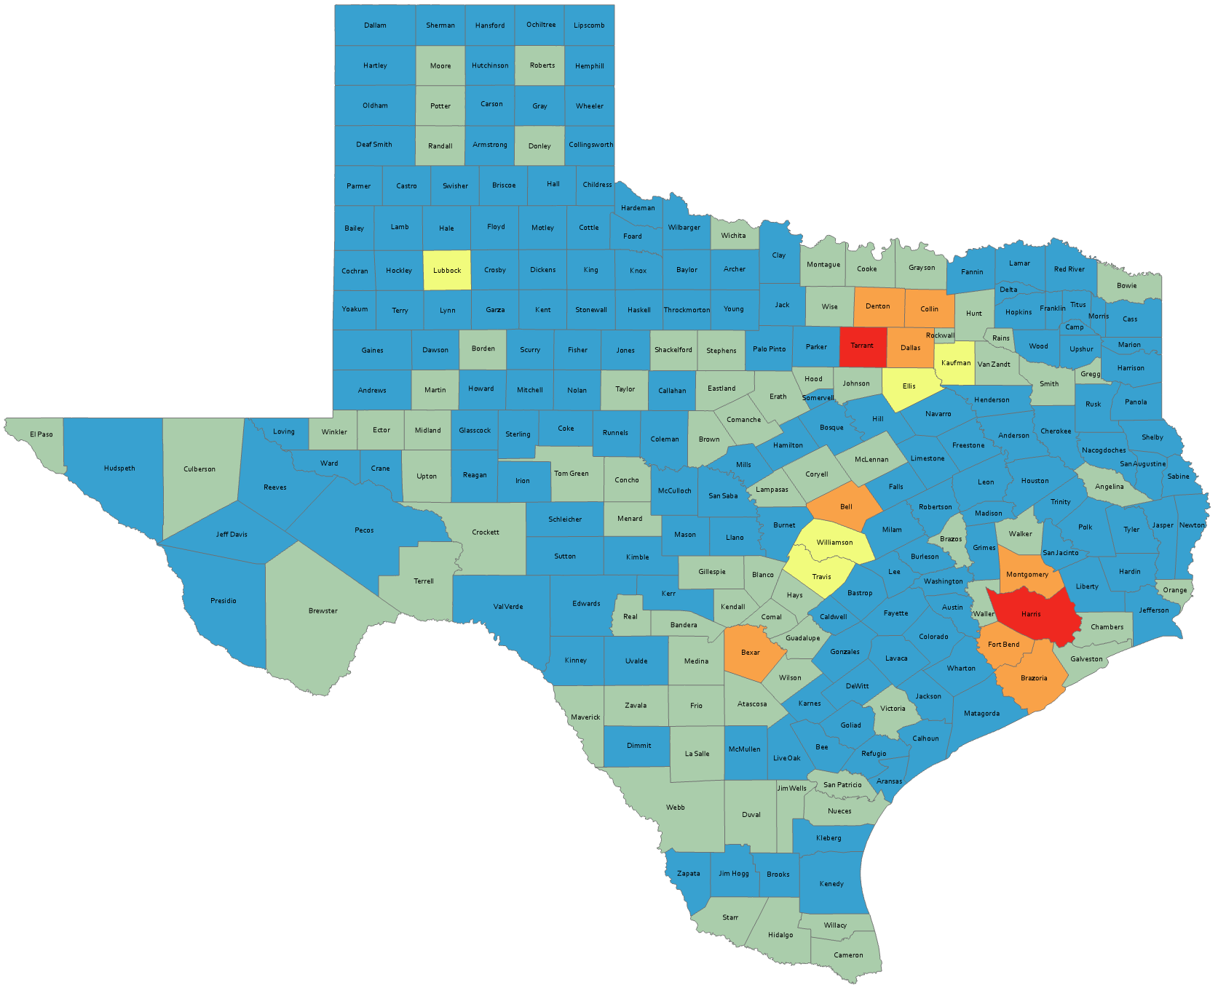
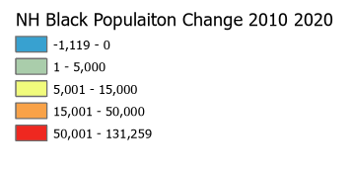
Numeric Change, Texas Counties, Non-Hispanic Black, 2010-2020
158 counties lost Black population

Slide 14
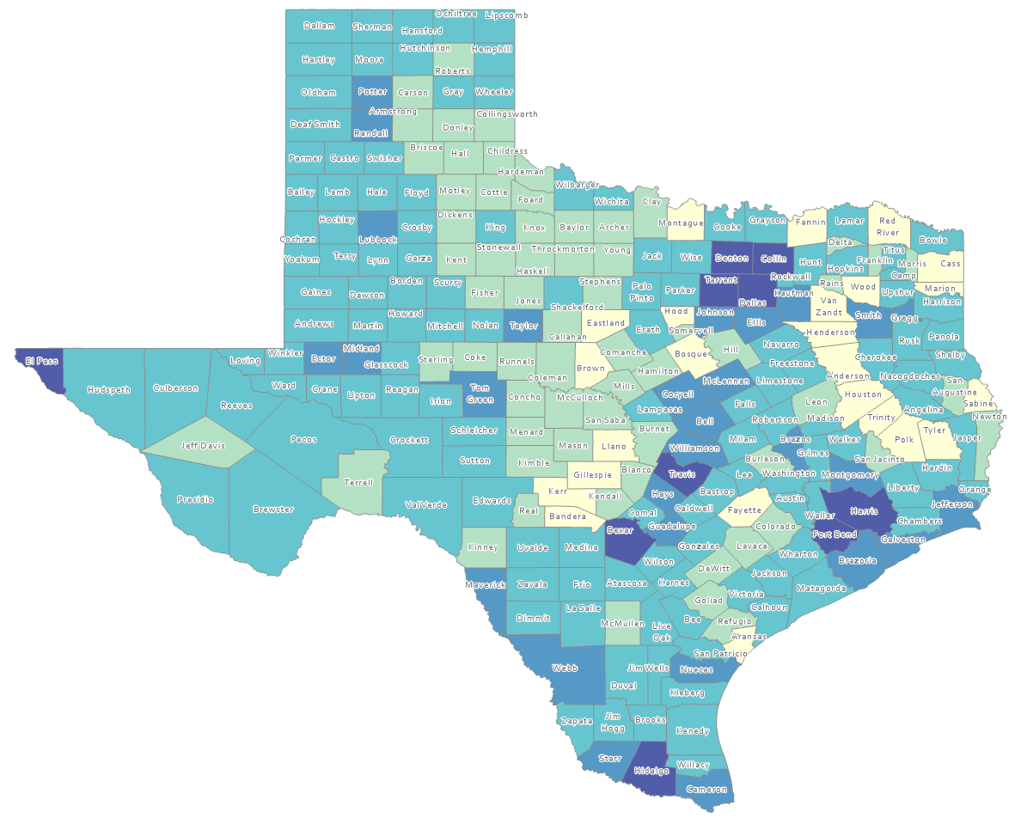
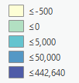
Estimated Natural Increase (Decrease), Texas Counties, 2010-2020
86 counties had natural decrease over the decade (1/3 of Texas’ counties)
Source: US Census Bureau, 2020 Population Estimates

Slide 15
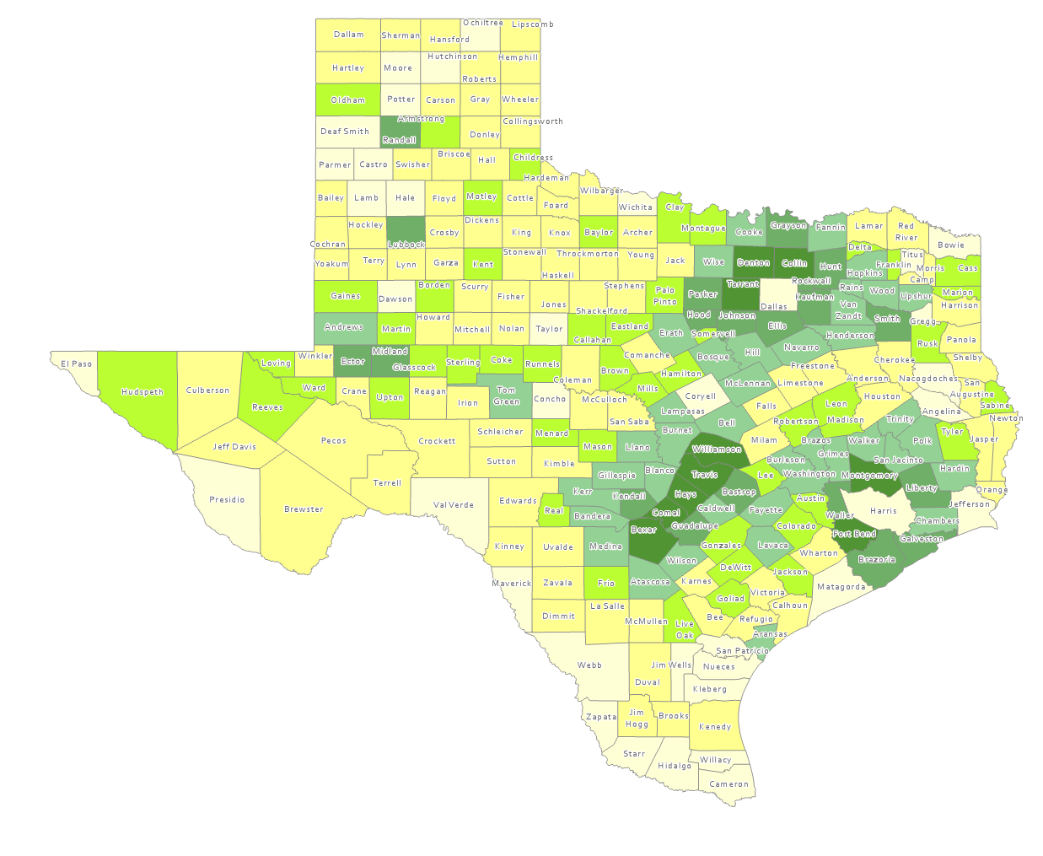
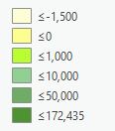
Estimated Population Change from Domestic Migration, Texas Counties, 2010-2020
More than half (134) of counties had net out domestic migration
Source: US Census Bureau, 2020 Population Estimates

Slide 16
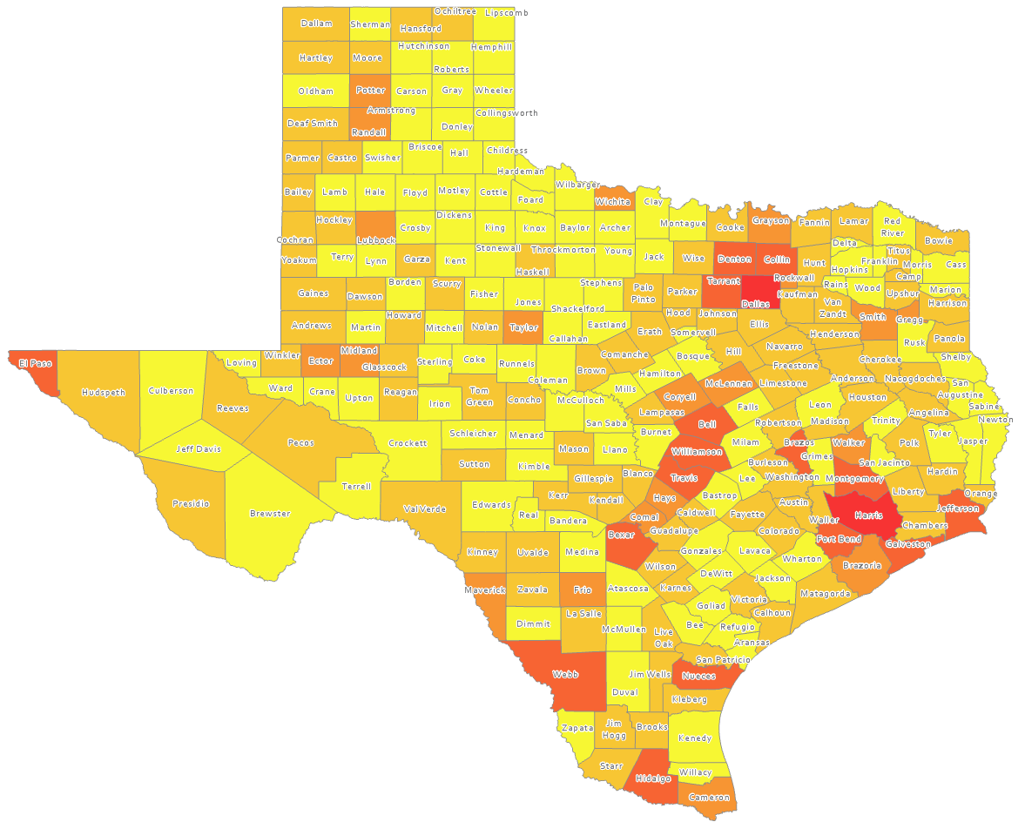
Estimated International Migrants, Texas Counties, 2010-2020
Source: US Census Bureau, 2020 Population Estimates

Slide 17
Projected Population by Race and Ethnicity, Texas 2010-2050
Source: Texas Demographic Center 2018 Population Projections
Notes:
Population projections by race and ethnicity suggest that Latino’s are and will increasingly be the largest race/ethnic group. The number and percent who are non-Hispanic white are likely to decline. Non-Hispanic other are largely of Asian descent and they appear to be increasing rapidly, although the base number is small.

Slide 18
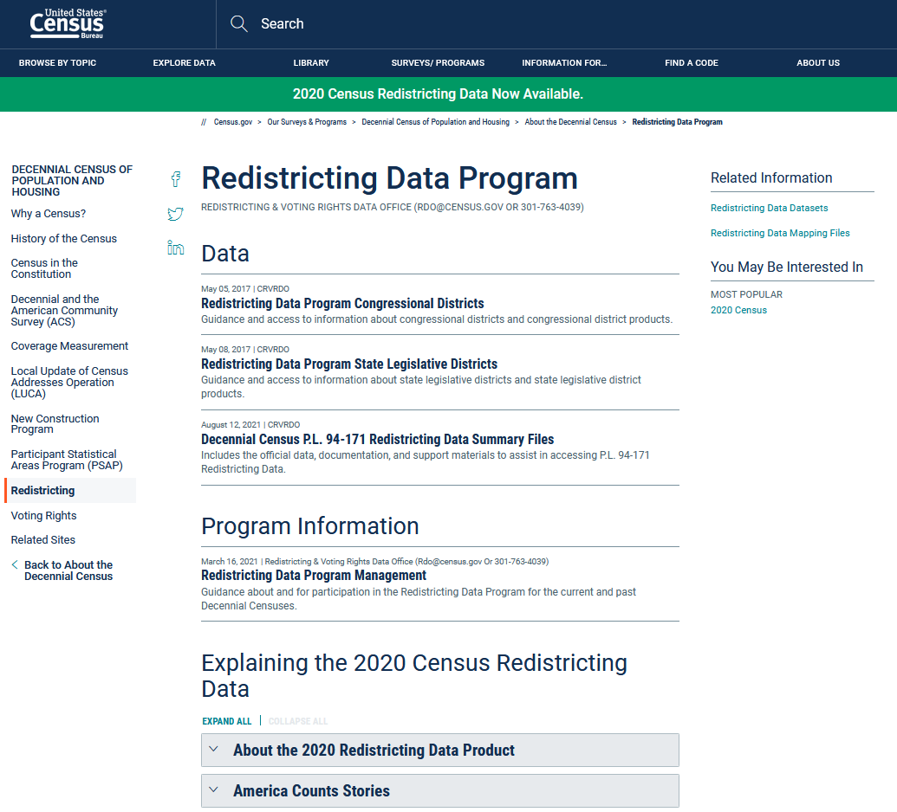
https://www.census.gov/programs-surveys/decennial-census/about/rdo.html

Slide 19
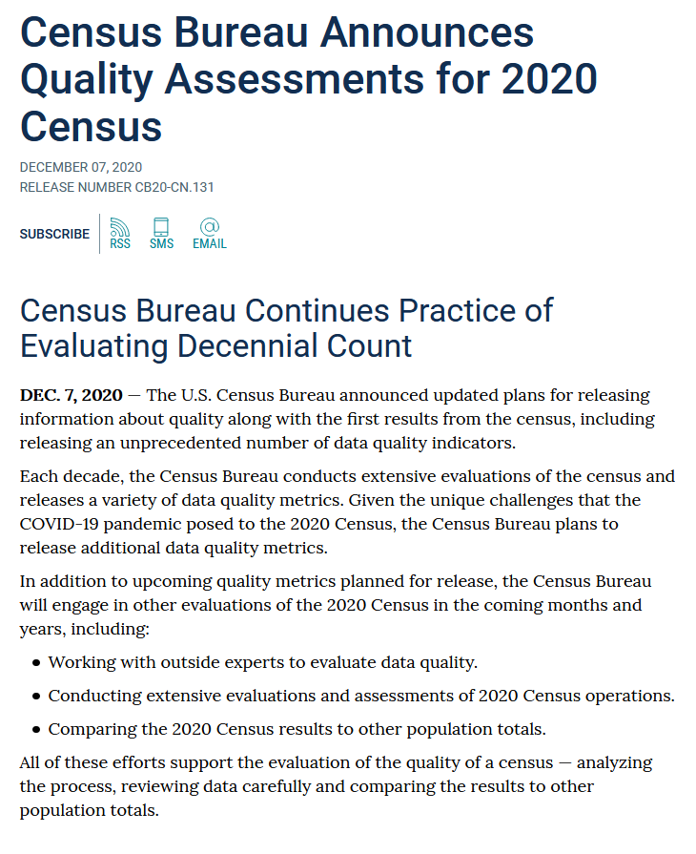
https://www.census.gov/newsroom/press-releases/2020/2020-census-quality-assessments.html

Slide 20
https://www.census.gov/programs-surveys/decennial-census/2020-census/planning-management/planning-docs/CQR-detailed-op-plan.html
Information on 2010 CQR process:
https://www.census.gov/programs-surveys/decennial-census/decade/2010/program-management/cqr.html

Slide 21
Lloyd Potter, Ph.D.
(210) 458-6530
TDC@UTSA.edu
Demographics.Texas.gov
@TexasDemography

