Slide 1
Texas and the 2020 Census, Population Change and Workforce Related Characteristics and Trends
Texas Workforce Investment Council
September 3, 2021

Slide 2
Population Growth and Congressional Seat Change
 | 2010 Population | 2020 Population | Numeric Change 2010-2020 | Percent Change 2010-2020 | Congressional Seat Change
United States | 308,745,538 | 331,449,281 | 22,703,743 | 7.4%
Texas | 25,145,561 | 29,145,505 | 3,999,944 | 15.90% | 2
Florida | 18,801,310 | 21,538,187 | 2,736,877 | 14.60% | 1
North Carolina | 9,535,483 | 10,439,388 | 903,905 | 9.50% | 1
Colorado | 5,029,196 | 5,773,714 | 744,518 | 14.80% | 1
Oregon | 3,831,074 | 4,237,256 | 406,182 | 10.60% | 1
Montana | 989,415 | 1,084,225 | 94,810 | 9.60% | 1
California | 37,253,956 | 39,538,223 | 2,284,267 | 6.10% | -1
New York | 19,378,102 | 20,201,249 | 823,147 | 4.20% | -1
Pennsylvania | 12,702,379 | 13,002,700 | 300,321 | 2.40% | -1
Ohio | 11,536,504 | 11,799,448 | 262,944 | 2.30% | -1
Michigan | 9,883,640 | 10,077,331 | 193,691 | 2.00% | -1
Illinois | 12,830,632 | 12,812,508 | -18,124 | -0.10% | -1
West Virginia | 1,852,994 | 1,793,716 | -59,278 | -3.20% | -1
Source: U.S. Census Bureau. 2010 and 2020 Census Apportionment Files
Notes:
Texas is the second largest state in terms of population (2nd to CA) and area (2nd to AK). In terms of number of people, Texas’ growth exceeds that of all other states between 2010 and 2020. Texas has added over 4.2 million people between April 1, 2010 and July 1, 2020. This puts Texas on track to meet or surpass the number of people added in the last census when Texas gained 4 congressional seats. Projections from multiple sources anticipate Texas will gain 3 congressional districts after the 2020 census.

Slide 3
Population and population change for the total and race/ethnic groups, Texas, 2010-2020
Population | Total | NH White | NH Black | Hispanic | NH Asian | NH Other
2010 | 25,145,561 | 11,397,345 | 2,886,825 | 9,460,921 | 948,426 | 452,044
2020 | 29,145,505 | 11,584,597 | 3,444,712 | 11,441,717 | 1,561,518 | 1,112,961
Numeric Change | 3,999,944 | 187,252 | 557,887 | 1,980,796 | 613,092 | 660,917
Percent Change | 15.9% | 1.6% | 19.3% | 20.9% | 64.6% | 146.2%
Percent of the total population 2020 | 100% | 39.7% | 11.8% | 39.3% | 5.4% | 3.8%
Source: US Census Bureau, 2010 and 2020 Census, P.L. 94-171 Redistricting Files

Slide 4
Percent distribution of race/ethnic groups in Texas, 2010 and 2020
Source: US Census Bureau, 2010 and 2020 Census, P.L. 94-171 Redistricting Files

Slide 5
Number and percent of Texas counties that had population declines for total and for race/ethnic groups between 2010 and 2020
Total | NH White | NH Black | Hispanic | NH Asian | NH Other
143 | 198 | 158 | 63 | 49 | -
56% | 78% | 62% | 25% | 19% | 0%
Source: US Census Bureau, 2010 and 2020 Census, P.L. 94-171 Redistricting Files

Slide 6
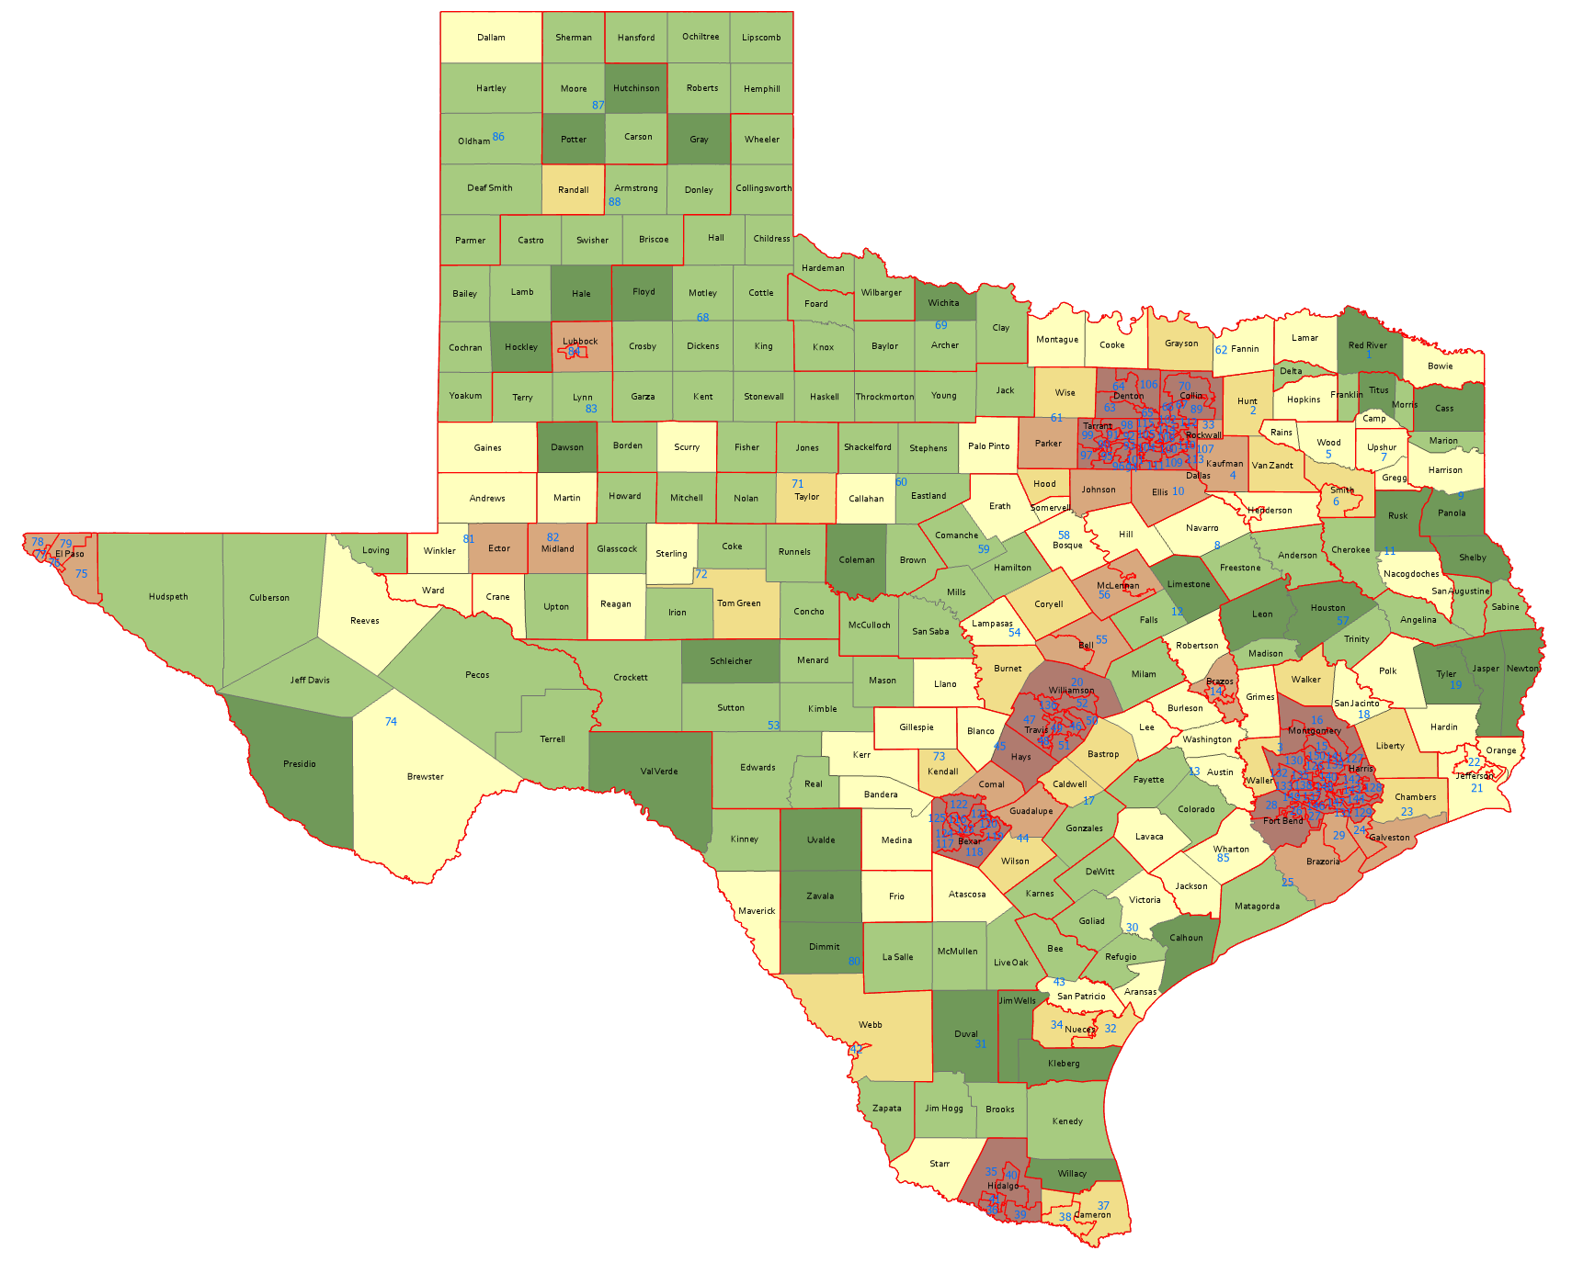
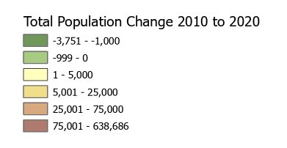
Numeric Change, Texas Counties, 2010-2020
143 counties lost population
Source: US Census Bureau, 2010 and 2020 Census, P.L. 94-171 Redistricting Files

Slide 7
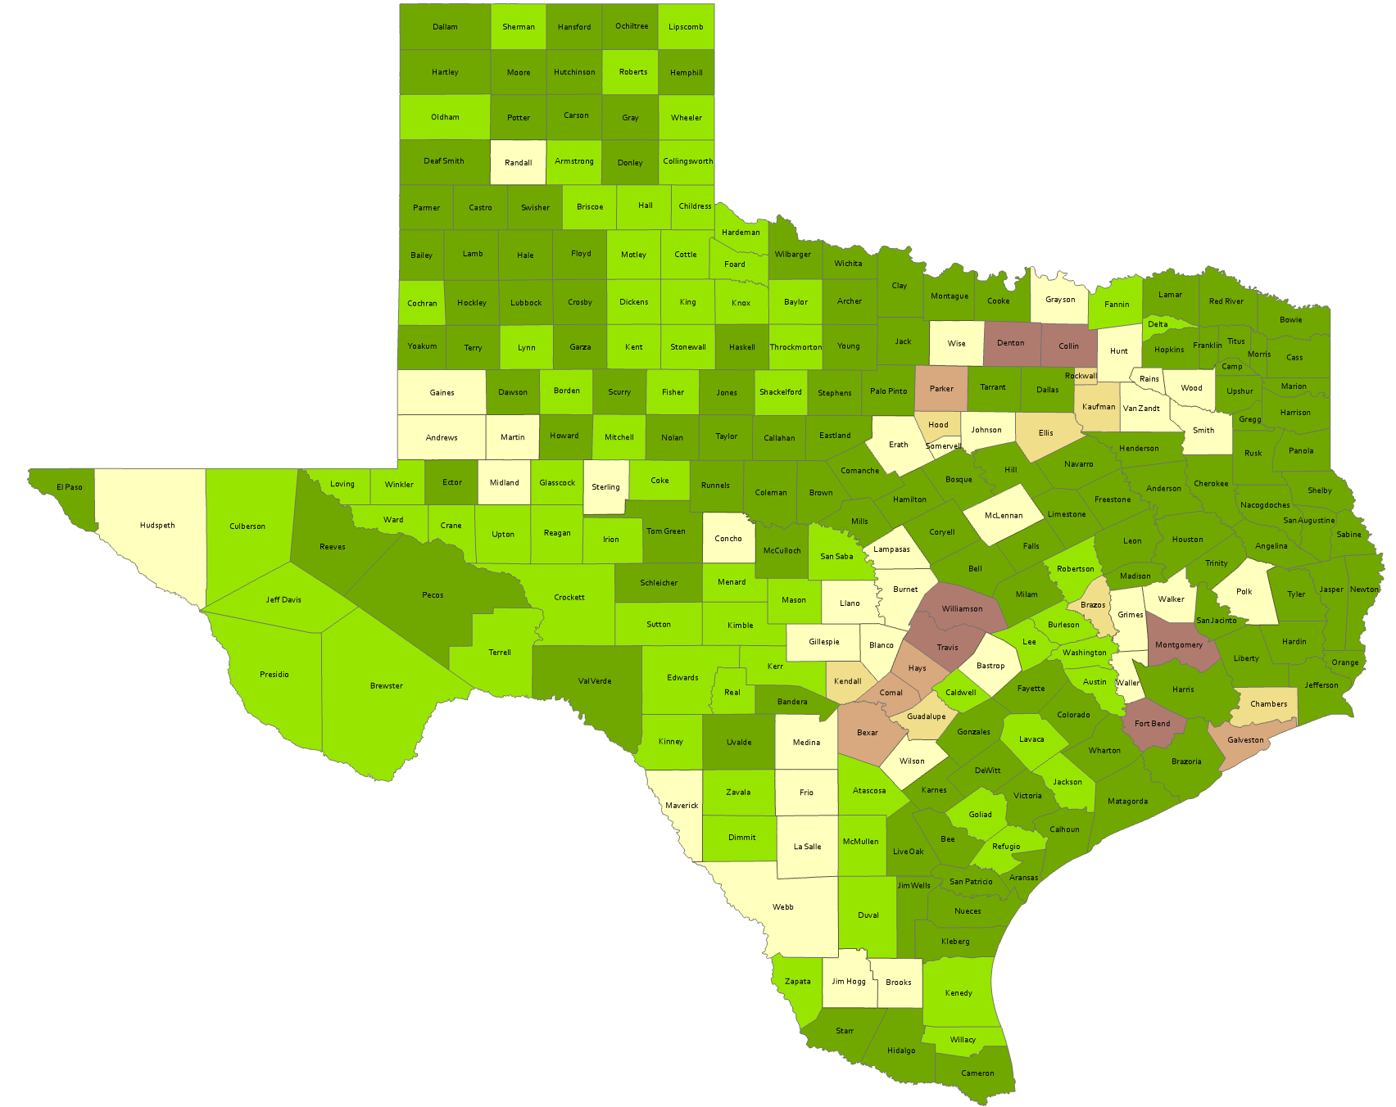
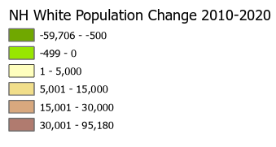
Numeric Change, Texas Counties, Non-Hispanic White, 2010-2020
198 counties lost NH white population
Source: US Census Bureau, 2010 and 2020 Census, P.L. 94-171 Redistricting Files

Slide 8
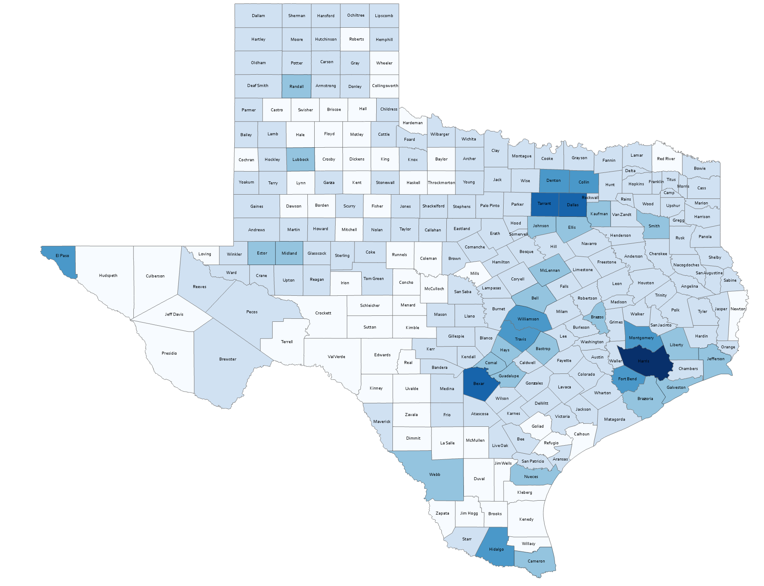
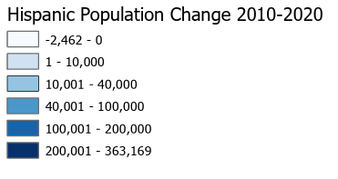
Numeric Change, Texas Counties, Hispanic, 2010-2020
63 counties lost Hispanic population
Source: US Census Bureau, 2010 and 2020 Census, P.L. 94-171 Redistricting Files

Slide 9
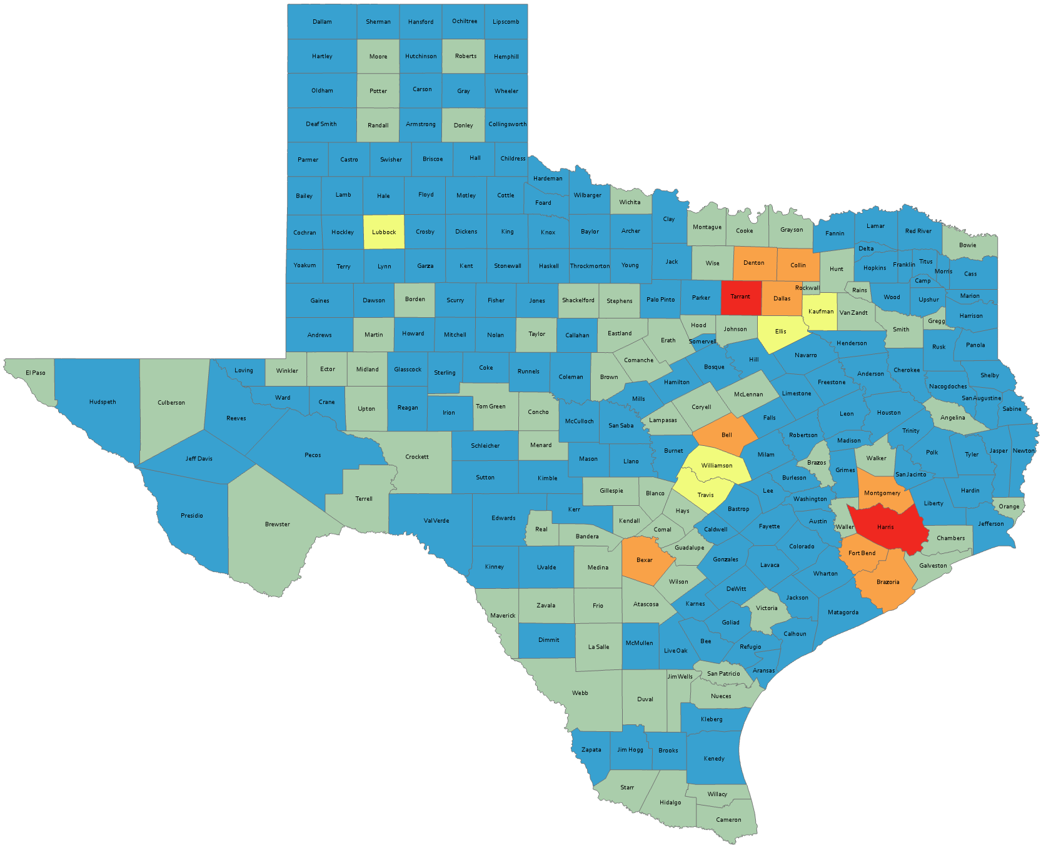
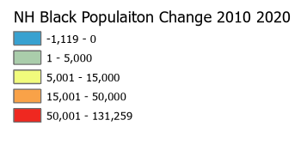
Numeric Change, Texas Counties, Non-Hispanic Black, 2010-2020
158 counties lost Black population

Slide 10
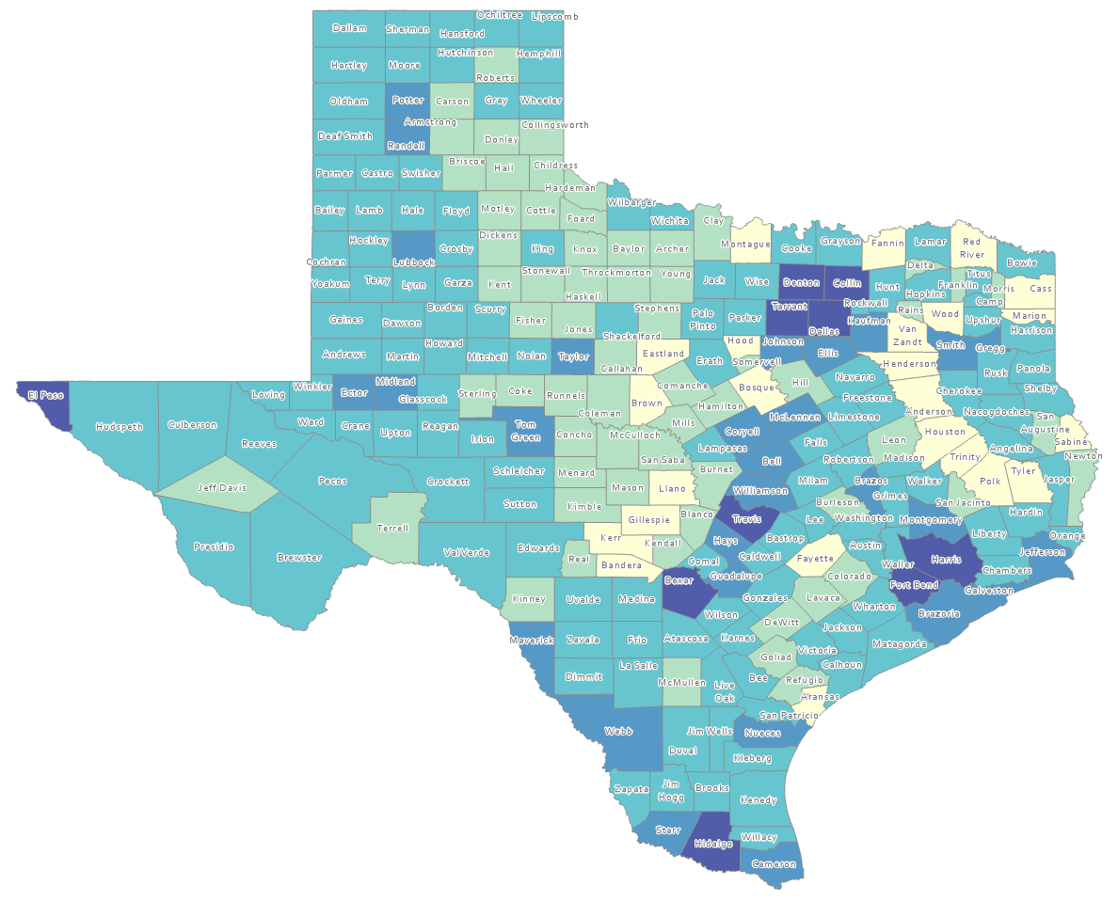
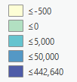
Estimated Natural Increase (Decrease), Texas Counties, 2010-2020
86 counties had natural decrease over the decade (1/3 of Texas’ counties)
Source: US Census Bureau, 2020 Population Estimates

Slide 11
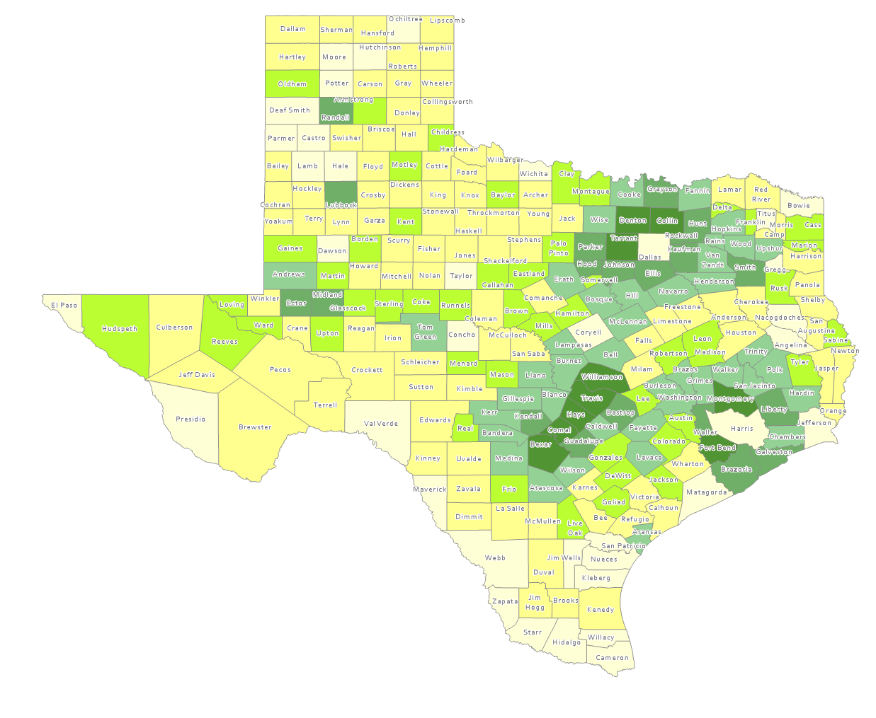
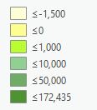
Estimated Population Change from Domestic Migration, Texas Counties, 2010-2020
More than half (134) of counties had net out domestic migration
Source: US Census Bureau, 2020 Population Estimates

Slide 12
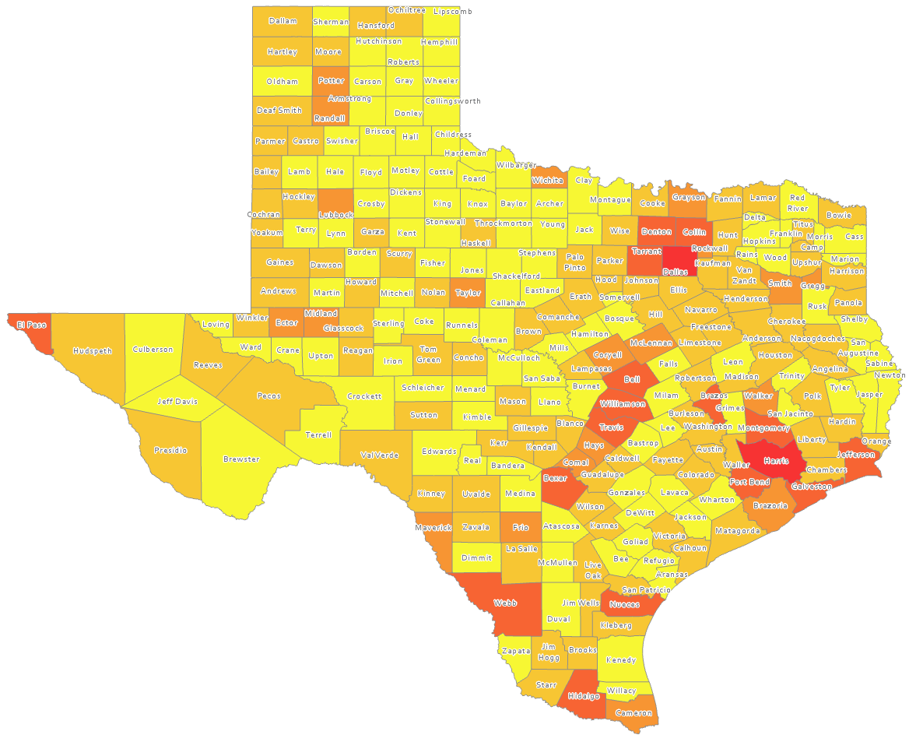
Estimated International Migrants, Texas Counties, 2010-2020
Source: US Census Bureau, 2020 Population Estimates

Slide 13
Median Age and Change for Select States and the US, 2010 and 2018

Slide 14
Total Fertility Rate for Select States, 2008-2018

Slide 15
Crude Birth Rates by Race/Ethnicity, Texas, 2006-2018
Source: Centers for Disease Control and Prevention, National Center for Health Statistics, National Vital Statistics Report

Slide 16
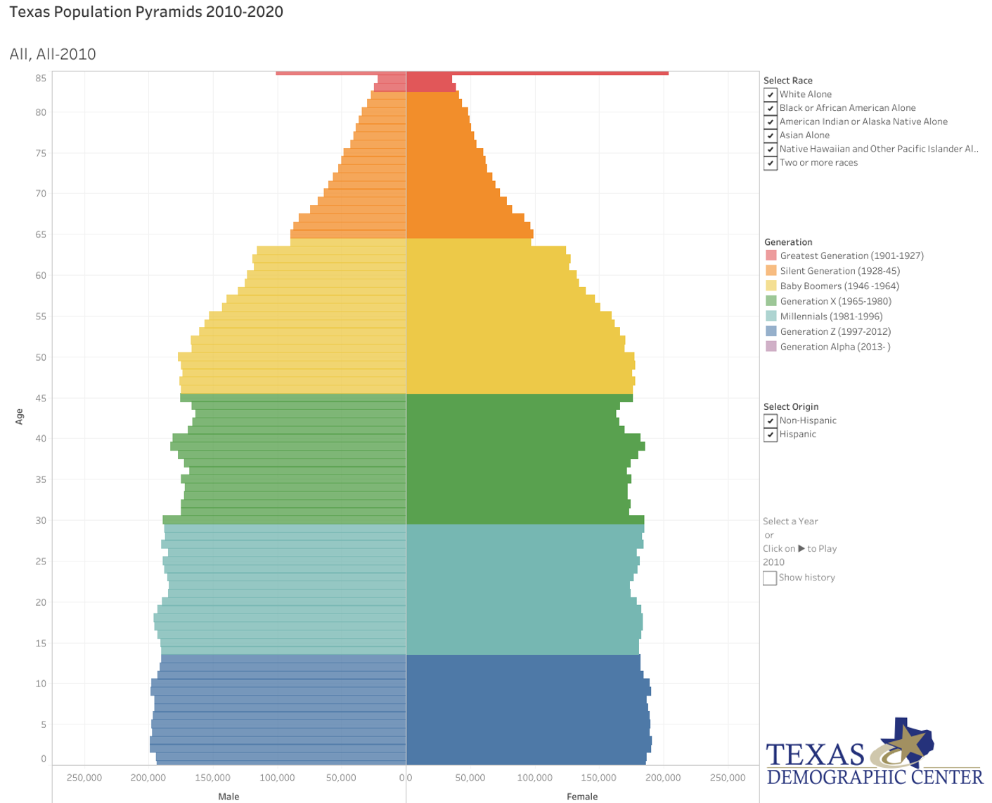
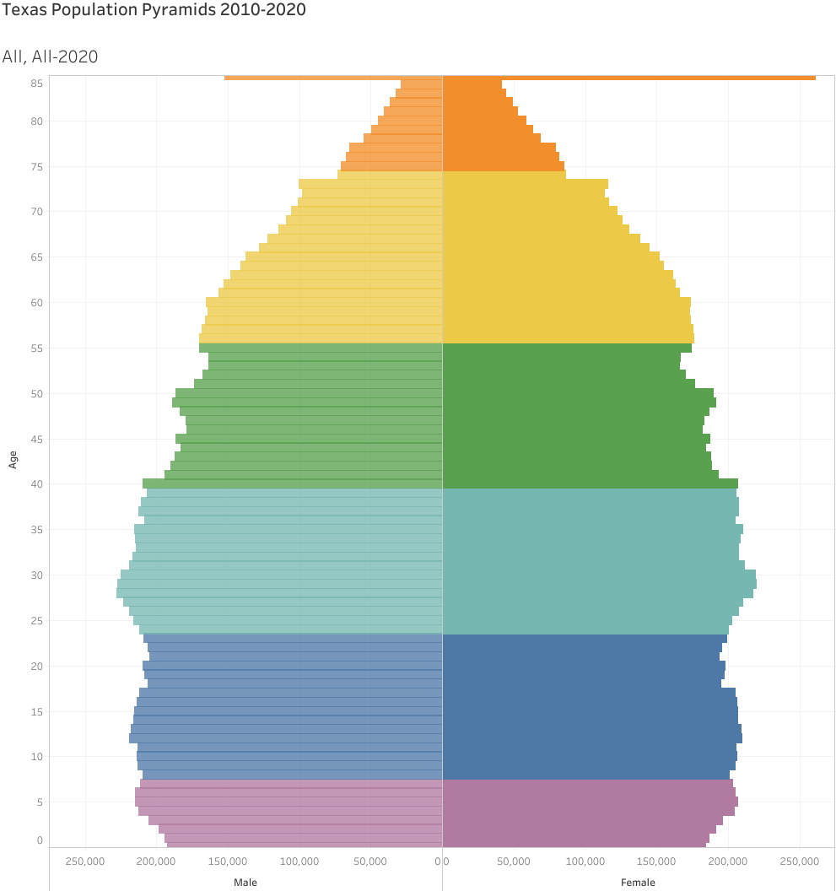
Generational Population Pyramids, Texas, 2010 and 2020

Slide 17
Texas White (non-Hispanic) and Hispanic Populations by Age, 2019
Source: Texas Demographic Center, 2018 Population Estimates

Slide 18
Texas Population Pyramid by Race/Ethnicity, 2019
Source: US Census Bureau, 2019 Population Estimates
Notes:
This population pyramid represents the age, sex, race and ethnic composition of the Texas population Blue represents males, red females, rows are single years of age, and shades represent specified race/ethnic groups as indicated in the legend

Slide 19
Texas Population Pyramid by Race/Ethnicity, 2019
Source: US Census Bureau, 2019 Population Estimates
Notes:
This population pyramid represents the age, sex, race and ethnic composition of the Texas population Blue represents males, red females, rows are single years of age, and shades represent specified race/ethnic groups as indicated in the legend

Slide 20
Texas Population Pyramid by Race/Ethnicity, 2019
Source: US Census Bureau, 2019 Population Estimates
Notes:
This population pyramid represents the age, sex, race and ethnic composition of the Texas population Blue represents males, red females, rows are single years of age, and shades represent specified race/ethnic groups as indicated in the legend

Slide 21
Texas Population Pyramid by Race/Ethnicity, 2019
Source: US Census Bureau, 2019 Population Estimates
Notes:
This population pyramid represents the age, sex, race and ethnic composition of the Texas population Blue represents males, red females, rows are single years of age, and shades represent specified race/ethnic groups as indicated in the legend

Slide 22
Percent of Civilian Labor Force by Occupation, Texas, 2007, 2017 and 2017-2017 Change
Source: US Census Bureau, American Community Survey, 1-Year Sample, 2007, 2017

Slide 23
Change in Undergraduate College Enrollment by State, 2010 to 2019
Source: US Census Bureau, American Community Survey, 1-Year Sample, 2010-2019 Table B14007

Slide 24
Change in Graduate and Professional School Enrollment by State, 2010 to 2019
Source: US Census Bureau, American Community Survey, 1-Year Sample, 2010-2019 Table B14007

Slide 25
College and Graduate Enrollment, Texas, 2007-2019
Source: US Census Bureau, American Community Survey 1-Year Estimates, 2007-2019

Slide 26
College and Graduate Enrollment by Race/Ethnicity, Texas, 2008-2019
Source: US Census Bureau, American Community Survey 1-Year Estimates, 2008-2019

Slide 27
Educational Attainment of Persons Age 25 Years and Older by Race/Ethnicity, Texas, 2019
39.9%
70.1 %
Source: US Census Bureau, American Community Survey, 1-Year Sample, 2019

Slide 28
Percent of the Population Aged-25 Years and Older with a Bachelor’s Degree or Higher by Race/Ethnicity, Texas, 2007 and 2019
Change in percent
7.8%
6.1%
7.7%
5.4%
Source: US Census Bureau, ACS 1-Year Estimates, 2007, 2019

Slide 29
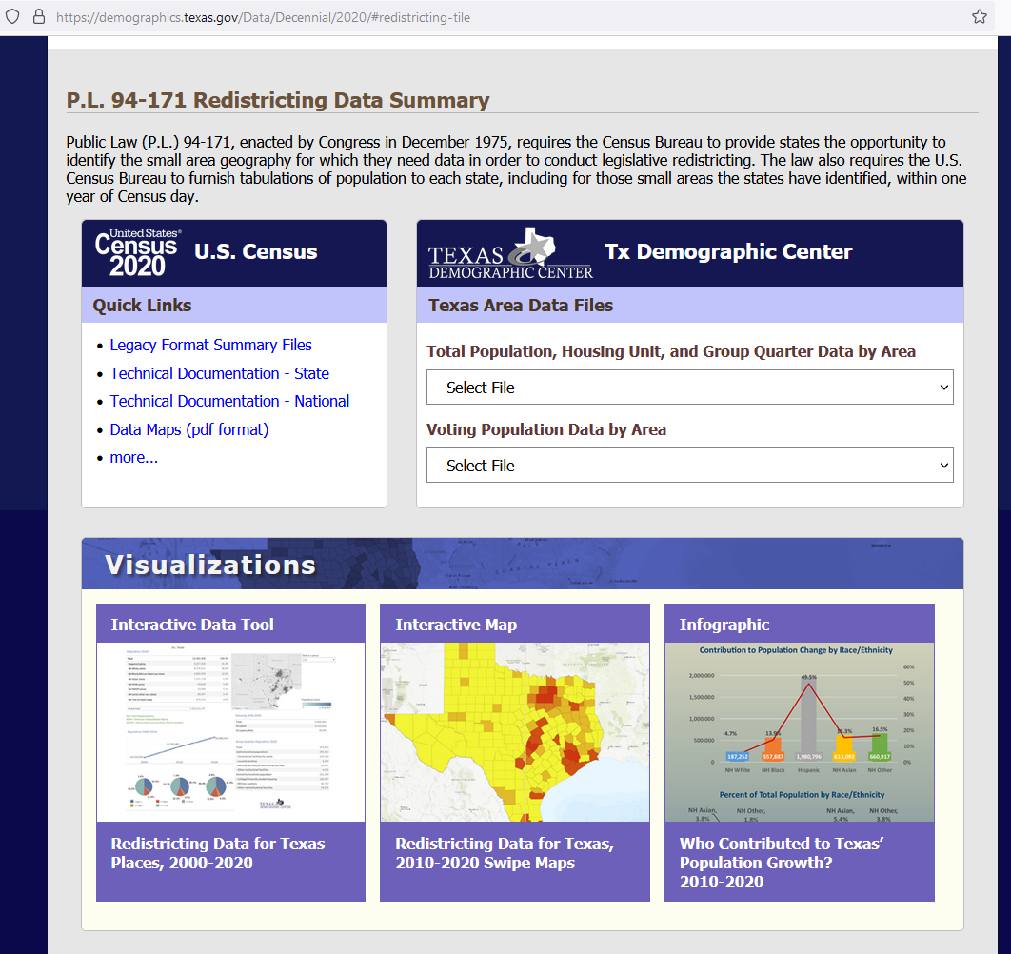
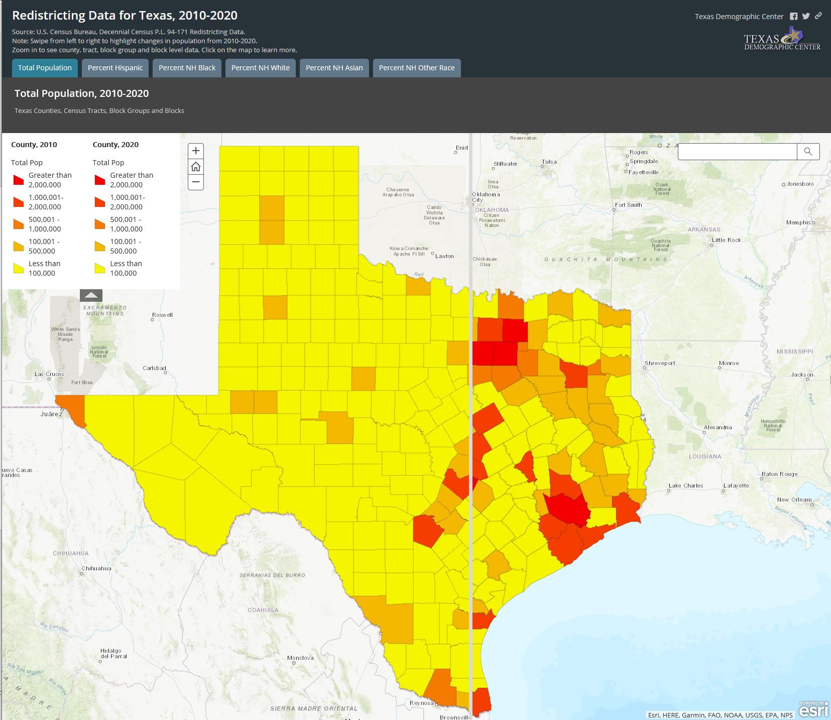
https://demographics.texas.gov/

Slide 30
Lloyd Potter, Ph.D.
(210) 458-6530
TDC@UTSA.edu
Demographics.Texas.gov
@TexasDemography

